Slide 1
Lecture 5B: C String
Content
I. Introduction: character array
II. C Strings
III. Array of Strings
IV. C‐ string Manipulation
Reference: https://www.cplusplus.com/reference/cstring/

Slide 2
I. Introduction: character array
Character array is an array with elements of the type char
Example:
Number of minutes is ranging from 0 to 59. Thus, char is sufficient to store these small values
char minutes[5] = {10,15,40,47,55}; minutes[2] = 35;
if(minutes[1] == 10)
minutes[2] = 0;
Characters which represent academic grades
char grades[]={‘F’, ‘P’, ‘C’, ‘D’};
There is no fundamental difference between arrays of char type and other types besides that you can initialize them with characters.
Character arrays are commonly used to store textual information rather than numbers.

Slide 3
II. C Strings
C String is a grouping of characters with a terminating NULL character ‘\0’
You can create Strings using a char array with a terminating NULL character ‘\0’. The latter is used to mark the end of a character string. C C-String functions rely on the NULL character to confirm the end of the string.
Initialisation during the declaration, e.g. char firstName[4] = {‘A’, ‘L’,’I’,‘\0’};
make sure you allocate enough room for the NULL character ‘\0’
The size of the char array should be at least one element higher the length of the c‐string
You can also create strings with a string literal: a grouping of characters enclosed in quotation marks, e.g. char myName[] = “ALI”;
Doing so this way automatically appends the NULL character and assigns the necessary number of elements
char
char
firstName[3] = firstName[4] =
"ALI";
"ALI”;
/* not enough */
/*OK */

Slide 4
C‐ string Input/Output
Use the format specifier %s
Example: Consider char name[31];
& is not needed for c‐strings
scanf("%s", name);
The function will store the input string into name
If the user’s input includes a white space; the white space and what come after won’t be stored in the variable name
The input string must not be longer than array_size ‐1
(30 in this example, otherwise it may cause you program crash )
To limit the input length, set the format specifier accordingly, a NULL will be added to your array :
scanf("%30s", name); /* get no more than 30 characters */
printf("%s", name);
will output the content on the screen from name on the screen until the NULL terminator (name must be a NULL terminated c‐ string!)
Notes:
Warning!
Strings are data types in some other languages e.g Visual Basic
C does not identify strings as a data type. C only sees strings as simple character arrays terminated by the NULL character
=========================
int main()
{
char countryName[20]={‘\0’};
int i=0;
printf("Enter a country name\n");
scanf("%s", countryName); → only works with one word
printf("Your country name is: %s\n", countryName); //returns first word only
You can print the string chars per char
while (countryName[i] != '\0’){
printf("%c", countryName[i]);
i++;
}

Slide 5
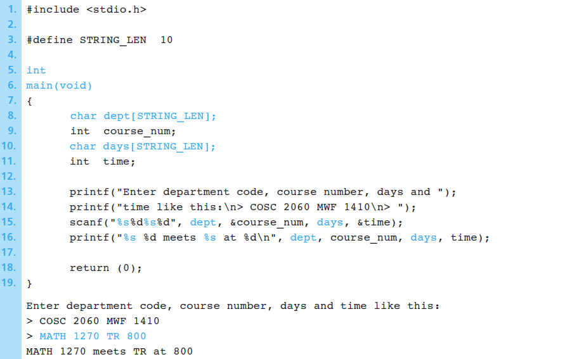
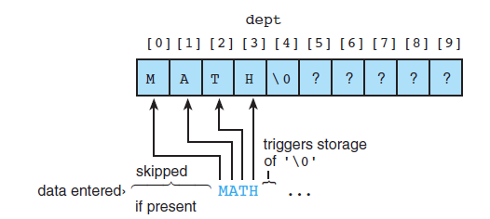
Example – String Input / Output
Write a program to ask the user to type in a string representing an academic department, an integer course code, a string abbreviations for the days of the course the meets, and an integer that gives the meeting time of the class.
White space

Slide 6
Reading Strings with white space
char *fgets(char *str, int n, FILE *stream)
The function fgets() reads a line from stdin (or a file stream) and stores it into the string (str) pointed to. It stops when either (n-1) characters are read, the newline character is read, or the end-of-file is reached, whichever comes first
# define SIZE 20
int main()
{
char countryName[SIZE];
printf("Enter a string\n");
fgets(countryName, SIZE, stdin); // works with multiple words!
printf("The string: %s\n", countryName);
return 0;
}
Notes:
n − This is the maximum number of characters to be read (including the final null-character). Usually, the length of the array passed as str is used.

Slide 7
III. Array of Strings
An array of strings is a two-dimensional array of characters in which each row is one string.
Example: Declare an array to store up to 30 names, each of which is less than 25 characters long.
#define NUM_PEOPLE 30 /*number of people*/
#define NAME_LEN 25 /*name length*/
……………….
char names [NUM_PEOPLE][NAME_LEN] ={‘\0’};
OR
char month[12][10] = {"January", "February", "March", "April", "May", "June", "July", "August","September", "October", "November", "December"};

Slide 8
Example
int main()
{
char colours [3][10] = {'\0'};
printf("Enter 3 colours separated by spaces:");
scanf("%s %s %s", colours[0], colours[1], colours[2]);
printf("you entered..:");
printf("\n%s \n%s \n%s", colours[0], colours[1], colours[2]);
}

Slide 9
IV. C‐ string Manipulation
C provides a set of standard functions for C‐ string manipulation
You need to include <string.h> header file to use these functions
These functions operate on C-strings, a char array which ends with NULL character
Function name | Description
strcat(s1, s2) | Appends s2 to s1 (also strncat)
strcmp(s1, s2) | Return 0 if (s1 is same as s2), ‐1 if (s1 < s2), 1 if (s1 > s2)
strcpy(s1, s2) | copy s2 to s1
strncpy(s1, s2, n) | copy n characters from s2 to s1 (substrings)
strlen( s1 ) | return the length of s1 up to (but not including) the null character
…. | ….

Slide 10
Strings Concatenation: strcat
char * strcat ( char * destination, const char * source );
Concatenate or append a copy of the source string to the destination string.
The size of destination should be long enough to hold the copy of source. If not, we will get the segmentation fault error.
The terminating NULL character in destination is overwritten by the first character of source, and a null-character is included at the end of the new string formed by the concatenation of both in destination.
The function returns the concatenated string
Notes:
. destination and source shall not overlap

Slide 11
Strings concatenation: strncat
char * strncat ( char * destination, const char * source, size_t num );
Appends the first num characters of source to destination, plus a terminating null-character.
If the length of the C string in source is less than num, only the content up to the terminating null-character is copied.

Slide 12
C-strings Comparison
int strcmp ( const char * str1, const char * str2 );
This function starts comparing the first character of each string using their corresponding ASCII codes. If they are equal to each other, it continues with the following pairs until the characters differ or until a terminating null-character is reached.
Examples:
The string "Air" is smaller than the string "Boat". ASCII codes: 65 105 114 0 66 111 97 116 0
The string "Air" is smaller than the string "An". ASCII codes: 65 105 114 0 65 110 0
Notes:
If two strings are not equal, strcmp() returns positive value if ASCII value of first mismatching element of first string is greater than that of second string and negative value if ASCII value of first mismatching element of first string is less than that of second string.

Slide 13
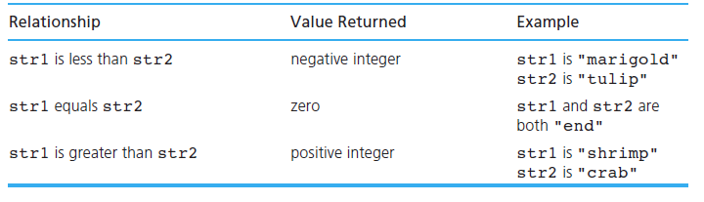
C‐ string comparison
if( strcmp(Str1, Str2)== 0 )
/* strings are equal */ else
/* strings are not equal */

Slide 14
Strings copy: strcpy
char *strcpy(char *dest, const char *src)
Copies the string source src into another string dest, including the terminating NULL character and stopping at that point.
The function returns the value of the first argument
char str1[15]= “Ali Al-Baz”
char str2[] = “Eva Rodriguez“;
printf(“String 1 says %s”, strcpy(str1,str2));
To avoid overflows, the size of the array pointed by dest shall be long enough to contain the same C string as source (including the terminating NULL character)

Slide 15
Strings copy: strncpy
char * strncpy ( char * destination, const char * source, size_t num );
Copies the first num characters of source to destination.
If the end of the source C string (which is signaled by a null-character) is found before num characters have been copied, destination is padded with zeros until a total of num characters have been written to it.
No null-character is implicitly appended at the end of destination if source is longer than num. Thus, in this case, destination shall not be considered a NULL terminated C string (reading it as such would overflow).
You can however add the NULL terminator to destination

Slide 16
Example
#include <stdio.h>
#include <string.h>
int main () {
char str1[]= "To be or not to be"; // 18 chars+NULL
char str2[40];
char str3[40];
strncpy ( str2, str1, sizeof(str2) );
strncpy ( str3, str2, 5 ); /* partial copy (only 5 chars): */
str3[5] = '\0'; /* null character manually added */
puts (str2);
puts (str3);
return 0;
}
Output:
To be or not to be
To be

Slide 17
Strings search: strstr
char * strstr ( char * str1, const char * str2 );
Locate substring str2 in str1, useful for word searches
Returns a pointer to the first occurrence of str2 in str1, or a NULL pointer if str2 is not part of str1.
The matching process does not include the terminating null-characters, but it stops there.
char str1[] = “Analysing strings for certain words and things”;
char str2[]= “ing”;
char str3[]=“xyz”;
if (strstr(str1, str2) != NULL)
printf(“str2 was found in str1”);
else
printf(“was not found”);

Slide 18
String length: strlen()
It is part of the string handling library <string.h>.
It returns the numeric length of the string up to the terminating NULL character (but does not include it)
char myName[] = “Ali”;
printf(“Your name has %d letters in it..”, strlen(myName));
Output: Your name has 3 letters in it..

Slide 19
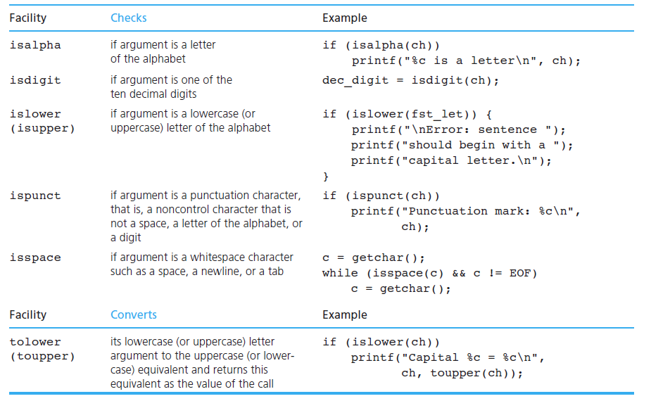
Character Analysis and Conversion
#include <ctype.h>

Slide 20
Character case: tolower(), toupper()
The two functions tolower() and toupper() apply on a single character, To use them on strings, use loop.
#include <stdio.h>
#include <ctype.h>
#include <string.h>
int main(){
char firstname[] = “ali”;
char lastname[] = “BENZ”;
convertL(lastname);
}
void convertL(char str[])
{
for (int x=0; x<strLen(str);x++)
str[x] = tolower(str[x]);
printf(“last name in lowercase is %s \n, str);
}

Slide 21
Strings to Numbers Conversion
ASCII language uses letters, digits and special characters.
We use integral and float data type to represent values in the calculations
C standard library stdlib.h provides several functions that convert strings, as char digits, to numbers
#include <stdio.h>
#include<stdlib.h>
int main(){
char str1[]="123.79";
char str2[]="55";
float x;
int y;
x=atof(str1);
y=atoi(str2);
printf("\nstr1 is %s which corresponds to the value %.2f", str1,x);
printf("\nstr2 is %s which corresponds to the value %d", str2,y);
}
Two common functions:
atof : converts string to a floating point number
atoi: converts string to an integer

Slide 22
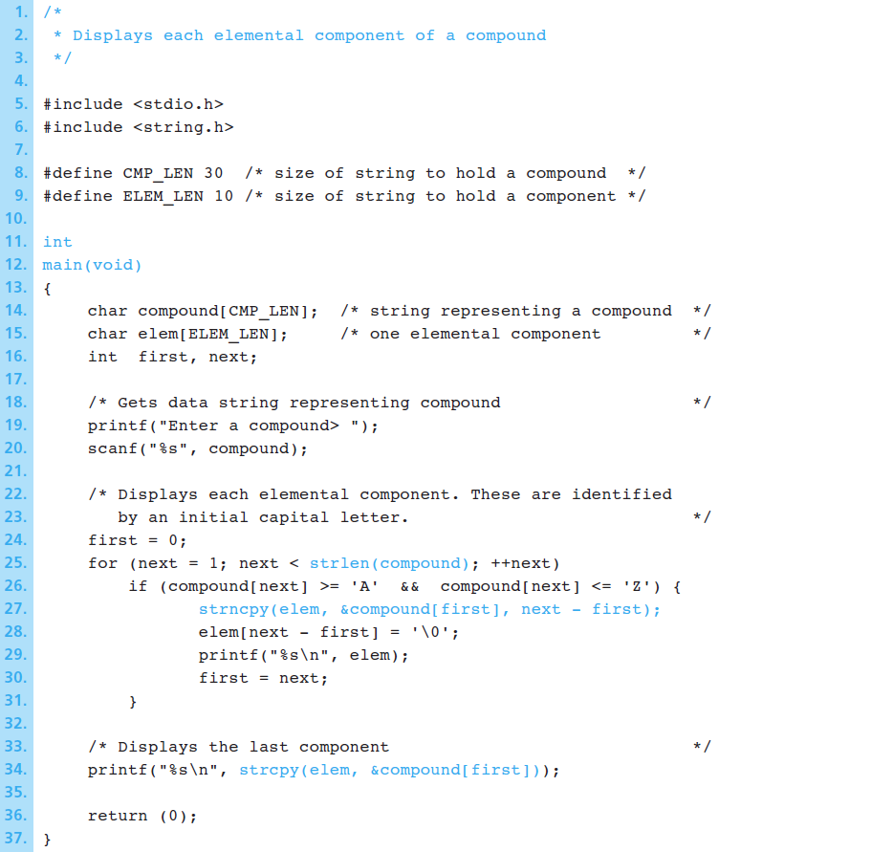
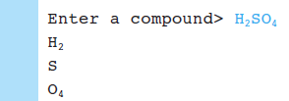
Example1: separate components into elemental components
A program to break compounds into their elemental components, assuming that each element name begins with a capital letter

Slide 23

Example 2: C String Initialisation
char str[20] = "Initial value";
Str[13] contains the character ‘\0’, the NULL character that marks the end of a string.
A blank (empty space) in a string is a valid character.
A string constant can be associated with a symbolic name using the #define directive.
#define ERR_PREFIX "*****Error - "
#define INSUFF_DATA "Insufficient Data"

