Slide 1
Lecture 7: Recursive Function
Check the Notes pages (section)

Slide 2
What is Recursion?
Recursion is a problem-solving approach, that can splits a problem into one or more simpler versions of itself
    A recursion is when one function calls ITSELF directly or indirectly
  General Structure:
  one (or more) base cases, for which the result of the function can be determined directly
  one (or more) recursive cases, for which the computation of the result is reduced to the computation of the same function on a smaller/simpler values of the input arguments
    Recursive cases must converge towards the base case(s)
Notes:
If a recursive function never reaches its base case, a stack overflow error occurs

Slide 3
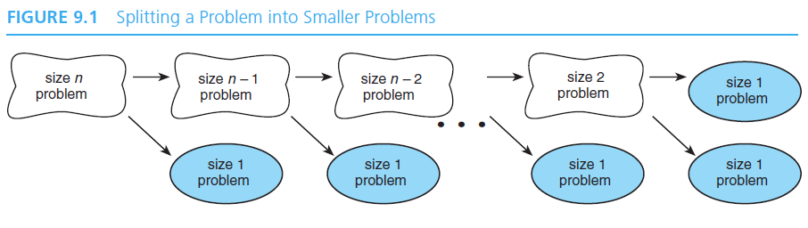
…Continued
Let’s assume that for a particular problem of size n, we can split the problem into a problem of size 1, which we can solve (a base/simple case), and a problem of size n - 1.
We can split the problem of size n - 1 into another problem of size 1 and a problem of size n - 2, which we can split further.
If we split the problem n - 1 times, we will end up with n problems of size 1, all of which we can solve.

Slide 4
Example of a Recursive Function: Factorial
The factorial : fact(n) for any positive integer n, written n!, is defined to be the product of all integers between 1 and n inclusive:
fact(n)= n!= n×(n−1) ×(n−2)×... ×2×1
fact(4)
24
  We note that: 0! = 1, 1!=1 and n! = n*(n-1)!
  hence, fact(n) = n*fact(n-1) & fact(0)=1
return 4*fact(3)
6
return 3*fact(2)
Let’s calculate fact(4) recursively:
2
return 2*fact(1)
fact(4) = 4 * fact(3)
= 4 * ( 3 * fact(2) )
= 4 * ( 3 * ( 2 * fact(1) ))
= 4 * ( 3 * ( 2 * 1*fact(0)) ))
= 4* (3 * (2 * 1* 1 ) ))=24
1
return 1*fact(0)
=1
  As always, when the function completes, control returns to the function that invoked it (which is invocation of the same function)
Notes:
Factorial can also be calculated iteratively

Slide 5
Recursive Function Coding
A recursive function has the following general form:
Function( Arguments ) {
IF the base case,
return the simple value // base case or stopping condition
ELSE
call Function with simpler version of argument (recursive expression)
}

Slide 6
Factorial Function-Iterative Implementation
fact(n)= n!= n×(n−1) ×(n−2)×... ×2×1
Use a loop to calculate factorial iteratively
// iteratively
int fact(int n) {
int product = 1;
for (int i = 2; i <= n; i++) {
product = product* i;
}
return product;
}
0! = ,; 1!=1
1. 0! = 1
2. Loop
1*2
2*3
6*4
24*5
= 2 : first iteration
= 6 : second iteration
= 24 : third iteration
= 120 : forth iteration

Slide 7
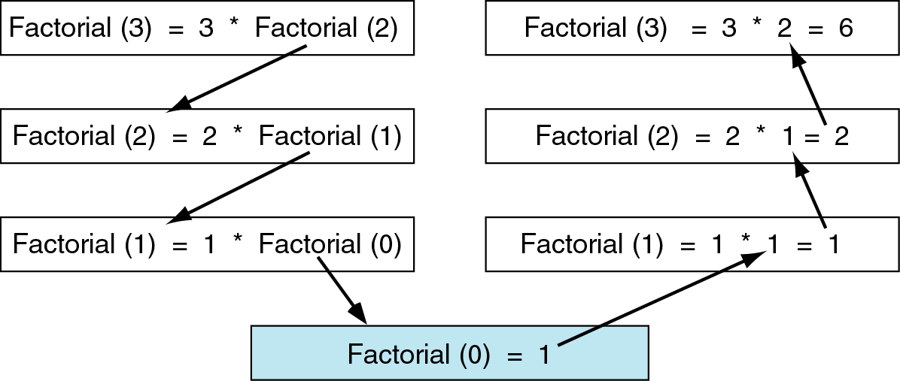

Factorial Function - Recursive Implementation
int factorial(int num)
{
if (num == 0)
return 0;
else
return ( num * factorial(num-1));
}
fact(0)=1
fact(n) = n*fact(n-1)
Base case
Recursive case

Slide 8
…Continued
fact(0)=1
fact(n) = n*fact(n-1)
Factorial(4)
4
×
Factorial(3)
3
×
Factorial(2)
2
×
Factorial(1)
84
Factorial(0) = 1

Slide 9
…Continued
Factorial(4)
4
×
Factorial(3)
3
×
Factorial(2)
2
×
Factorial(1)
Factorial(0) = 1

Slide 10
…Continued
Factorial(4)
4
×
Factorial(3)
3
×
Factorial(2)
2
×
1

Slide 11
…Continued
Factorial(4)
4
×
Factorial(3)
3
×
Factorial(2)
2
×
1

Slide 12
…Continued
Factorial(4)
4
×
Factorial(3)
3
×
2

Slide 13
…Continued
Factorial(4)
4
×
Factorial(3)
3
×
2

Slide 14
…Continued
Factorial(4)
4
×
6

Slide 15
…Continued
Factorial(4)
4
×
6

Slide 16
…Continued
24

Slide 17
Recursion vs. Iteration
Most recursive solutions have corresponding iterative solutions
  For example, fact(n) = n! can be calculated with a loop
// recursive
int fact(int n) {
if (n == 0) {
return 1;
} else {
return n * fact(n - 1);
}}
// iteratively
int fact(int n) {
int product = 1;
for (int i = 2; i <= n; i++) {
product = product* i;}
return product;
}
Condition tests for the base case of your function
Condition test for the Loop condition to determine whether to exit
5! = 5 × 4 × 3 × 2 × 1
Recursive solutions are often slower than iterative because of multiple function invocations. However, for some problems recursive solutions are often more simple and elegant than iterative solutions

Slide 18
Recursive Function Design
Determine the base case(s).
Then, determine the general (recursive) case.
Combine the base case and general case into a function.
In combining the base and general cases into a function, you must pay careful attention to the logic.
  Each call must reduce the size of the problem and move it toward the base case.
  The base case, when reached, must terminate WITHOUT a function call. It must set the return value.

Slide 19
Examples
Example1: create a function power() to compute x^{n}, where n is a positive number
  Create an iterative version of the function
Create a recursive version of the function
Compare the two solutions

Slide 20
Iterative Solution
n
x = x * x * x...* x
n times
/* Iterative solution */
double power(double
{
int i;
x, int n)
double result = x;
if (n == 0) return 1.0;
for ( i=1; i < n; i++ ) result *= x;
return result;
}

Slide 21
Recursive Solution
1. Base case
_{x}0
= 1.0
power(x, 0) = 1.0, if (n == 0)
2. General case
_{x}n _{x}n-1
= x*
power(x, n) = x * power(x, n-1)
/* Recursive solution */
double power(double x, int n)
{
if (n == 0)
return
else
return
/* base case */
1.0;
/* general case */
( x * power(x, n-1) );
}
Notes:
In general, recursive solutions are shorter and look more “elegant”.
Recursion can considerably simplify implementation of some commonly used algorithms.
If an iterative solution is more obvious and easier to understand than a recursive solution, use the iterative solution.
There is overhead associated with executing a recursive function both in terms of memory space and computer time.
A recursive function executes more slowly than its iterative counterpart
Why?
Recursive functions use nested calls that leads to intensive use of the stack memory (memory and computational overheads) and may even cause stack overflow.
Due to stack overflow your program may work on one computer and crash on another one.
There are system functions for increasing the stack size limit (not covered in CSCI291).

Slide 22
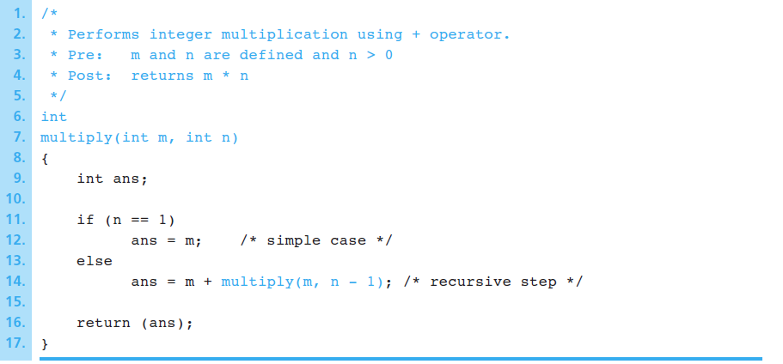
…Continue
Example 2: a recursive function multiply that returns the product of its two arguments m × n; both m and n are strictly positive
Answer:
m × n= m × (n-1) + m.
Base case
m x 1= m
If we define f(n)=m*n, then f(n)= f(n-1)+m

Slide 23
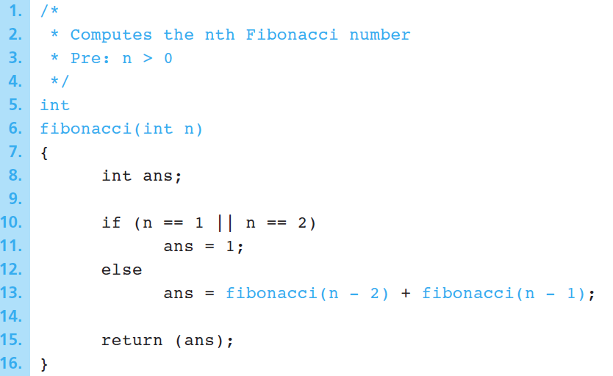
Fibonacci
Sequence is 1, 1, 2, 3, 5, 8, 13, 21, 34, ...
Fibonacci(1) is 1
Fibonacci(2) is 1
Fibonacci(n) is Fibonacci(n-2) + Fibonacci(n-1) for n > 2

Slide 24
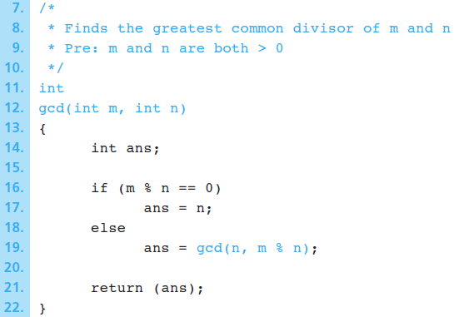
Greatest Common Divisor (gcd)
gcd( m , n ) is n if n divides m evenly
gcd( m , n ) is gcd( n , remainder of m divided by n ) otherwise

