Slide 1
CSCI291 Programming for Engineers
Dynamic Memory Allocation
Note: In the assessment, you expected to know the function malloc, calloc and memset only

Slide 2

Memory Allocation Functions
There are three functions specified by ANSI C for memory allocation:
Memory
- malloc( )
- calloc( )
- realloc( )
Heap
#include <stdlib.h>
A software application
malloc( ) calloc( ) realloc( )
Notes:
brk and sbrk are basic memory management system calls used in Unix and Unix-like operating systems to control the amount of memory allocated to the data segment of the process.^{[1]}

Slide 3
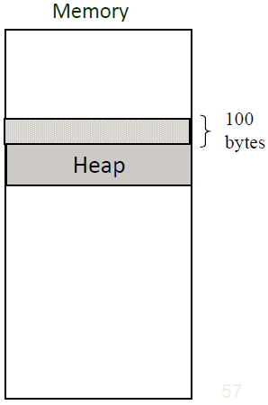
malloc( )
Allocates a specified number of bytes of memory.
void* malloc( int numOfBytes );
Example:
*ptr; malloc(100);
a memory block of 100 bytes
char
ptr =
ptr
malloc does not initialize allocated memory space.
heap
region of memory in which function malloc dynamically allocates blocks of storage.

Slide 4
Caution
malloc returns the generic type void* pointer
void* malloc( int numOfBytes );
Why void* ?
Memory allocated by malloc() can be used to store data of any type
Example:
char *ptrC;
float *ptrF;
ptrC = malloc(100); /* memory to store char type data */
ptrF = malloc(100); /* memory to store float type data */
The generic void* pointer is implicitly converted to a pointer of the type matching the lvalue when assigned

Slide 5
Type Casting
You do not have to explicitly cast the void pointer returned by malloc when you assign it to a pointer of a different type.
Example:
float *ptrF;
ptrF = malloc(100); /* usually OK */
Some compilers may require explicit casting
ptrF = (float*) malloc(100); /* explicit casting */
Explicit casting may help you to avoid bugs in your code
ptr1 = (float*) malloc(100);
You'll be warned if ptr1 has already been converted from float* to another type

Slide 6
malloc failure
Do not assume that malloc will always succeed.
When memory allocation fails, malloc returns the NULL pointer.
Example:
char *ptr;
if( (ptr = (char*)malloc(100)) == NULL )
{
printf(" Memory allocation failure");
return (-1);
}
The error recovery is application specific, but very often the program has to be terminated.

Slide 7
malloc( )
To allocate memory for a specified number of elements of any type use the sizeof() operator.
Example: Allocate memory to store 100 integers
int *ptr;
ptr = (int*)malloc( 100*sizeof(int) ); if(ptr==NULL)
{
printf(" Memory allocation
return (-1);
}
failure");
Do not specify the size of a data type explicitly as it may be different on other platforms
ptr = malloc( 100*4 ); /* bad style */

Slide 8
Caution
Do not modify the pointer returned by malloc()
Example:
float *ptr;
ptr = malloc( 100*sizeof(float) ); if(ptr==NULL)
printf( " Memory allocation failure");
ptr += 5;
may lead to memory management problems
The pointer must point to the beginning of the allocated memory space to avoid confusion of the system memory manager.

Slide 9
calloc( )
Allocates memory for a specified number of elements and initialises them to 0.
void* calloc( int numOfElem,
Example:
float *ptr;
int sizeOfElem );
ptr = (float*)calloc( 100, sizeof(float) );
if( ptr == NULL )
{ error recovery };
calloc() is more computationally expensive and as a result, it is slightly slower than malloc()

Slide 10
realloc( )
Changes the size of a previously allocated area
void* realloc( void *ptr, int newSize );
Example: Increase a dynamic array size from 100 to 2000 bytes
char *ptr;
if( (ptr = malloc(100)) == NULL )
{ error recovery }
. . . .
. . . .
If (ptr = realloc(ptr, 2000)) == NULL )
{error recovery }
The size of the originally allocated area can be increased or decreased.
Existing array values are preserved.

Slide 11
Caution
realloc will not operate correctly if you have previously modified the original pointer.
Example:
char *ptr;
if( (ptr = (char*)malloc(50) ) == NULL )
. . . . . .
ptr += 4;
. . . . .
if((ptr = (char*)realloc(ptr, 200)) == NULL )
does not point to the beginning of the allocated memory space
Debugging may be difficult as errors are usually not reported.

Slide 12
Caution
realloc will fail if new memory requirements are more than currently available.
Example:
char *ptr;
if( (ptr = (char*)malloc(500))
. . . . . .
if( (ptr = (char*)realloc(ptr,
== NULL )
2000000)) == NULL )
Side effect: The original pointer will be assigned with NULL value and the location of the original dynamic array with all data will be lost.

Slide 13

realloc( )
If there is enough room beyond the end of the originally allocated area, realloc:
extends the original area
returns the same pointer
Memory
new area
new area
If there is not enough room available at the end of the original area, realloc:
allocates a new area of the specified size
copies existing data to the new area
returns the pointer to the new area
original area
Reserved area
original area

Slide 14
free( )
The space for automatic variables declared in a function is freed when the function returns.
void sortByValue(float list[], int size )
{
int index;
Float maxVal, tempVal;
float tempArr[M_SIZE];
. .
return;
}
The memory space is freed automatically when the function executes return
You need to free dynamically allocated memory explicitly so that it can be returned to the system
void free( void *ptr);

Slide 15
free( )
You can free a dynamically allocated area any time you think it is not needed any longer.
void sortByValue(
{
int index;
float list[], int size )
float float
. .
maxVal, tempVal;
*tempArr;
. . .
you allocate memory when it is needed
if( (tempArr = malloc(size*sizeof(float))) == NULL)
. . . .
free(tempArr);
.
you free memory when it is not needed
. . . .
return;
.
}
A very simple function call, but it may cause a lot of problems if not used properly

Slide 16
Caution
Use free() function only with pointers obtained from malloc(), calloc() and realloc() functions.
void sortByValue(
{
int i;
float list[], int size )
float tempArr[M_SIZE];
. . . . .
for(i=0; i<M_SIZE; i++) tempArr[i] = 0.5*i;
/* automatic
allocation */
. . . . .
free( tempArr );
.
ERROR
tempArr was not allocated dynamically
. . . .
return
maxVal;
}
Notes:
Name of array is a pointer

Slide 17
Caution
As you call free() the pointers must point to the beginning
of the memory area allocated by malloc(),
or realloc() functions.
calloc(),
void sortByValue( float list[], int size )
{
int i;
float *tempArr;
. . . . .
if( (tempArr=calloc(size, sizeof(float))) == NULL)
. . . . .
tempArr += 4;
.
Do not modify pointers returned by malloc()
. . .
free(
tempArr );
. .
. . .
return;
WRONG
the pointer has been modified
}

Slide 18
Caution
Freeing a memory area does not change the value of the pointer. After free() it still points to the same memory area.
After free() the memory content remains the same until this memory area is allocated again.
However, you must not make any attempt to use data in the freed area
float *tempArr, tempData;
. . . . .
if( (tempArr=calloc(num, sizeof(float))) == NULL)
. . . . .
free( tempArr );
WRONG!!!
The area has already been freed
. . . .
*tempArr;
. .
tempData =
. . .

Slide 19
What does free() mean?
A function call free() tells the memory manager, that the previously allocated memory does not need to be reserved any longer.
The memory manager marks this memory area as free to be used for other purposes.
Any consecutive malloc() or calloc() call may grab that memory area.

Slide 20

Quiz
What is wrong with this code?
int j, sum=0;
char codeList[7] = {25, -12, char *listPtr;
listPtr = codeList; for(j=0; j<7; j++)
sum += listPtr[j];
free( listPtr );
24, 17, 59, 43, 1};
listPtr points to the same location as codeList that was allocated statically
You can’t free statically allocated memory

Slide 21
Dynamic Arrays
Dynamic Array allocation eliminates the most awkward aspect for conventional arrays – How big the array size
should be
#define NUM_OF_STUDENTS 50 float examMarks[NUM_OF_STUDENTS];
What if the actual number is different?
Dynamic Arrays can reserve space according to the actual requirements.
Example:
int numOfStudents; float *examMarks;
printf("Enter the number of students :"); scanf("%d", &numOfStudents);
examMarks = calloc( numOfStudents, sizeof(float) );

Slide 22
The use of Dynamic Arrays
Example: A function createFlArray that allocates memory for a specified size array and initialise elements to 0.
float *createFlArray(int size)
{
static float *array;
array = (float*)calloc( size, sizeof(float) ); return array;
}
float *priceList;
priceList = createFlArray( if( priceList == NULL ) . .
priceList[5] = 35.50;
*(priceList + 5) = 16.30;
120 );
. /* error recovery */
/* access through indexing */
/* access through a pointer */

Slide 23
Dynamic Arrays
Example: A function that concatenates two strings
char char char
firstName[] = "Peter"; secondName[] = "Norton";
*fullName;
/* function call */
fullName = addTwoStrings( firstName, secondName );
/* ----function definition---- */
char* addTwoStrings( char *firstStr, char *secondStr )
{
static char *newStr; /* a concatenated string */
newStr=malloc( strlen(firstStr) + strlen(secondStr) + 2 ); if(newStr == NULL ) return NULL; /*memory allocation error */
strcpy( | newStr, | firstStr );
strcat( | newStr, | " " );
strcat( | newStr, | secondStr );
return newStr;
}

Slide 24
Dynamic 2D Arrays
You can allocate memory for 2D Arrays using their row‐column decomposition into 1D Arrays
2D array
It’s 1D row‐column representation
2 5 7 1 6 7
1 4 2 1 6 3
4 3 1 0 4 1
rows
2 5 7 1 6 7 | 1 4 2 1 6 3 | 4 3 1 0 4 1
row 0
row 1
row 2
columns
int *matrix; matrix = calloc(
nRows*nColumns, sizeof(int) );
. . .
*(matrix
or
matrix[
. .
+ rowIndex*nColumns + colIndex)
= 35;
does the same as matrix[rowIndex][colIndex] = 35;
rowIndex*nColumns + colIndex ] = 35;
Notes:
Matrix is the address of the first element in the array

Slide 25
Dynamic 2D Arrays
Example: A function createMatrix that allocates memory for a rows x columns number of elements of type int
int *createMatrix(
{
static int *matrix;
int rows,
int cols )
A 2D array is stored in memory as a 1D array
matrix
= (int*)calloc(
rows*cols, sizeof(int) );
return
matrix;}
int *matrix1, sum = 0;
/* an example of the function call */
matrix1 = createMatrix( 20, 30 );
-1;
if( matrix1 == NULL ) return
for( i=0; i<20; i++ )
/* row index */
/* column index */
for( j=0; j<30; j++ ) sum
.
+= matrix1[i*30 + j];
. .
.
free( matrix1 );

Slide 26
Dynamic Structures
You can dynamically allocate memory to store structures
Example:
typedef struct
{ float value; int tolerance;
} resistor;
resistor *ptrRs; /* pointer to a structure */ ptrRs = malloc( sizeof(resistor) );
if( ptrRs == NULL ) { error recovery action }
. . . . . .
ptrRs->value = 33.0; /*use -> to access members of a
ptrRs->tolerance = 5;
. . . . . .
free(ptrRs);
structure*/

Slide 27
Dynamic Structures
You can dynamically allocate memory to store nested structures
Example:
typedef struct
{ float value; char tolerance;
} resistor;
typedef struct
{
int pNumber;
int quantity; resistor spec;
}part;
part *ptr; /*
pointer
to a complex structure */
ptr = malloc(
. . . . .
sizeof(part) );
.
ptr->pNumber = 3451;
₀p₃t_{/2}r₀-₁>₆spec.tolerance = 2; /* access a member of a nested struct */
Notes:
Resistor is a struct

Slide 28
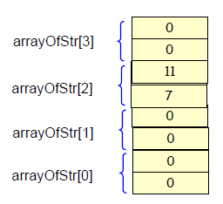
Array of Structures
Example:
typedef
{
int int
} date;
struct
day; month;
date *arrayOfStr;
arrayOfStr = calloc(
. . . .
4, sizeof(date) );
arrayOfStr[2].day = 7;
arrayOfStr[2].month = 11;
Notes:
4 elements of date struct, in total 8 elements

Slide 29



Memory Leakage
A memory leak is a dynamically allocated block of memory that has no pointers pointing to it anywhere in the program.
Since there are no pointers pointing to the blocks, the program cannot reference them and cannot free them.
void sortData(
{
char *data,
int size )
char *tempArr;
tempArr = malloc(size);
. . . .
free(tempArr);
is missing
return;
}
When the function returns, tempArr is discarded and after that the memory block cannot be freed

Slide 30
Memory Leakage
A memory leak can be created by an accidental modification of a pointer
Memory
. . . . .
char *ptr;
50 bytes
ptr = malloc(
1000*sizeof(char) );
.
50*sizeof(char) );
.
. . . . .
ptr = malloc(
1000 bytes
. . . . .
free( ptr );
return 0;
}

Slide 31
Memory Leakage
A memory leak can be created by an incorrectly used memory allocation function
. . . . .
char *ptr;
Memory
100 bytes
ptr = malloc( 100 );
. .
ptr =
. .
. . . .
realloc( ptr, 50000 );
. . . .
Proper solution
tempPtr = realloc( ptr, 50000 ); if(tempPtr != NULL)
ptr = tempPtr;

Slide 32
Memory Leakage
Writing a program that dynamically allocates memory, you are fully responsible for releasing that memory that is no longer required.
Memory leaks result in increased memory consumption and generally result in memory fragmentation.
This might slow down the performance of your program and the whole system.
Conventional debugging techniques usually prove to be ineffective for locating the source of memory leaks.
There are third‐party libraries that can trace memory leaks when you debugging a program.

Slide 33
Memory Manipulation Functions
string.h library provides a set of functions to support typical operations with memory
memcpy(void *dest, void *src, int size); Copies a block of size bytes from the source *src to the destination *dest
int memcmp(void *loc1, void *loc2, int size); Compares two blocks for a length of size bytes. If the returned value is 0, the memory content is identical
memset(void *dest, char value, int size); Sets size bytes of a memory block starting from *dest to the same value

Slide 34
memset
Example:
#include
#include
#define
<stdio.h>
<string.h>
SIZE 1024
char *buffer;
. . . .
.
buffer=malloc(SIZE);
. . . . .
memset( buffer, 0xFF,
SIZE );
. . . .
free( buffer );
. . . . .

Slide 35
memcmp
Example:
#define SIZE 1024
char *buffer1, *buffer2;
. . .
buffer1 = readData(
. . .
buffer2 = readData(
. .
malloc(SIZE); buffer1, SIZE );
. .
malloc(SIZE); buffer2, SIZE );
. . . . . .
if( memcmp( buffer1, buffer2, SIZE ) != 0 ) printf(" Content is not identical \n");

Slide 36
Summary
Dynamic memory allocation provides an efficient mechanism of utilizing computer resources.
Some data structures cannot be implemented without dynamic memory allocation.
The programming complexity of dynamically managed memory is very high.
Bugs with memory allocation and freeing are very difficult to find.

Slide 37
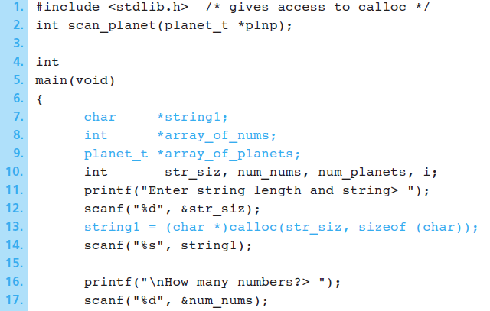
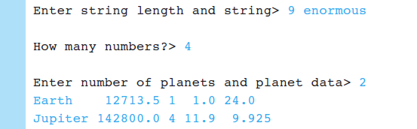
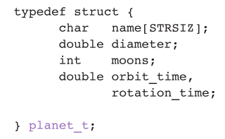
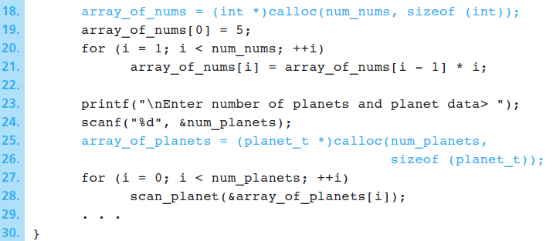
Example Allocation of Arrays with calloc

