Slide 1
Lecture 8: C Pointers
Content
I. Pointer Definition
II. Pointer Variable Definition
III. Pointer in Expressions
IV. Passing Arguments to Functions by Reference
V. Pointers and Arrays
VI. Pointers and Structures
Reference: Deitel, C How to Program (8th ed.)
Dr Obada Al-Khatib slides
Notes:
I. Pointer Definition

Slide 2
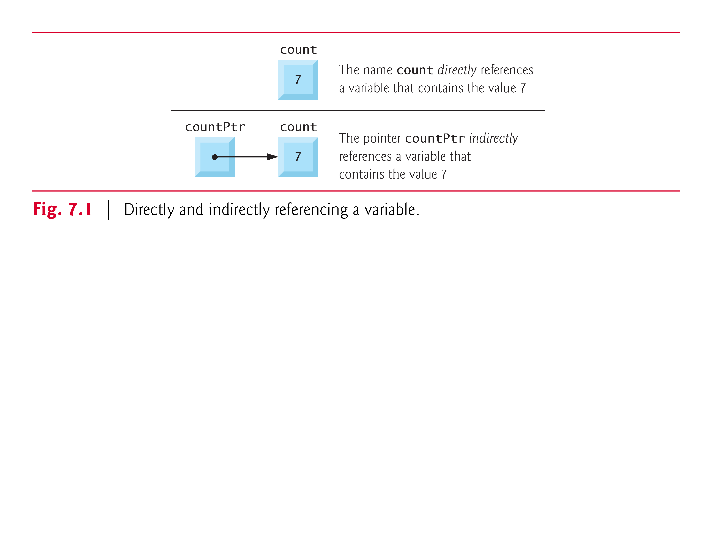
I. Pointer Definition
A Pointer is a variable whose value is a memory address.
Normally, a variable directly contains a specific value.
A pointer, on the other hand, contains an address of a variable that contains a specific value.
In this sense, a variable name directly references a value, and a pointer indirectly references a value
Referencing a value through a pointer is called indirection
or dereference
Notes:
Variables are named locations in memory, which have their memory addresses implicitly described.

Slide 3
Why it is Useful?
Pointer is one of the most powerful features of the C programming language.
Pointers enable programs to simulate pass-by-reference, to pass functions between functions, and to create and manipulate dynamic data structures, i.e., data structures that can grow and shrink at execution time, such as linked lists, queues, stacks and trees.
In this subject, we focus only on pass-by-reference.

Slide 4
II. Pointer Variable Definition
Pointers, like all variables, must be defined before they can be used.
Each pointer has a type associated with it
The definition
int *countPtr, count;
specifies that,
variable countPtr is of type int * (i.e., a pointer to an integer) and is read (right to left), “countPtr is a pointer to int” or “countPtr points to an object of type int.”
the variable count is defined to be an int, not a pointer to an int.
Notes:
To prevent the ambiguity of declaring pointer and non-pointer variables in the same declaration as shown above, declare only one variable per declaration.

Slide 5
Pointer Variable Initialization
Before being used, pointer should be assigned an address:
Pointers should be initialized when they’re defined or they can be assigned an address value afterwards.
A pointer may be initialized to NULL or an address.
A pointer with the value NULL points to nothing.
Notes:
NULL is a symbolic constant defined in the <stddef.h> header (and several other headers, such as <stdio.h>).
Initializing a pointer to 0 is equivalent to initializing a pointer to NULL, but NULL is preferred.
When 0 is assigned, it’s first converted to a pointer of the appropriate type.
The value 0 is the only integer value that can be assigned directly to a pointer variable.

Slide 6
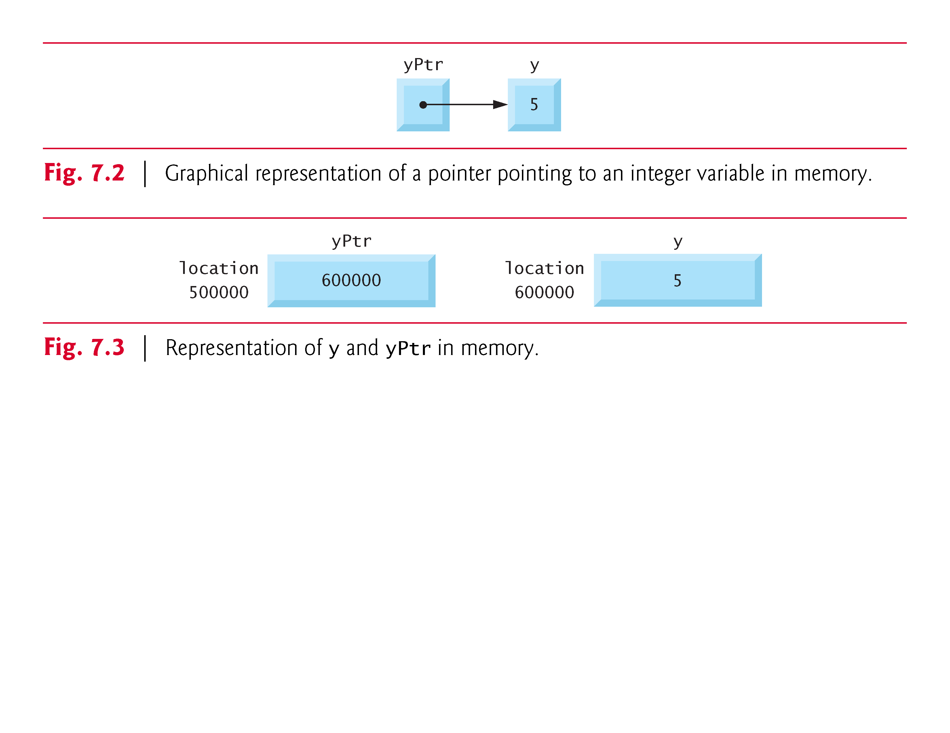
Pointer Operators : (&,*)
The &, address operator, is a unary operator that returns the address of its operand.
For example, assuming the definitions:
int y = 5; int *yPtr;
the statement
yPtr = &y;
assigns the address of the variable y to pointer variable yPtr.
Variable yPtr is then said to “point to” y.

Slide 7
…Continued
The unary * operator, commonly referred to as the indirection operator or dereferencing operator, returns the value of the object to the pointer points to.
For example, the statement
printf("%d", *yPtr);
prints the value of variable y, see last slide, namely 5.
Using * in this manner is called dereferencing a pointer.

Slide 8
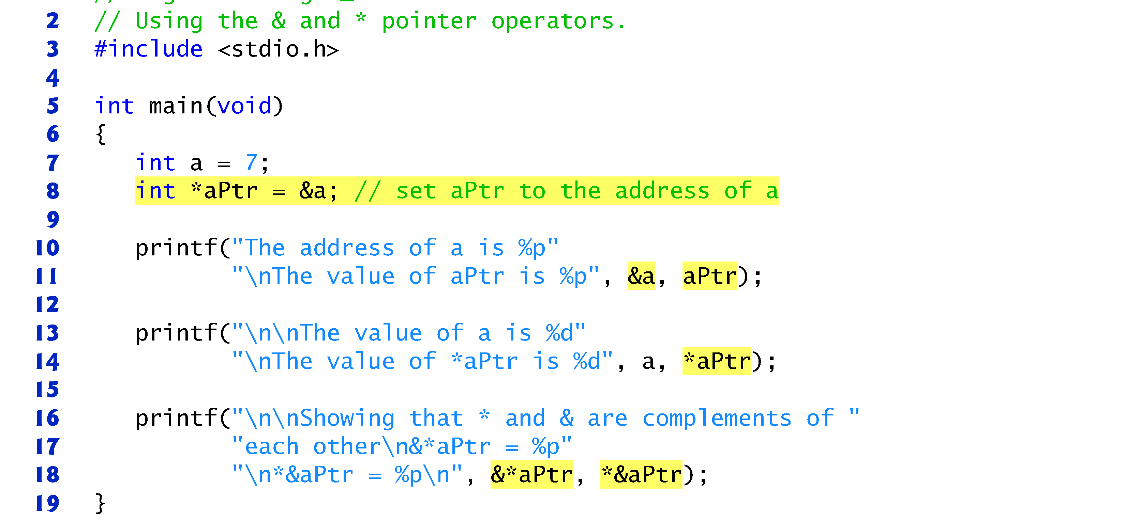
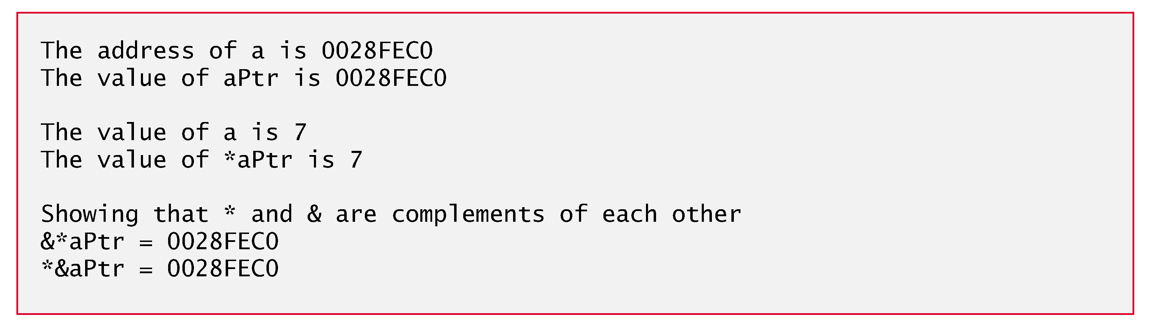
Example
specifier %p outputs the memory location as a hexadecimal integer on most platforms
the address of a and the value of aPtr are identical
The & and * operators are complements of one another—when they’re both applied consecutively to aPtr in either order, the same result is printed.

Slide 9
One Pointer with many Variables
The same pointer can point to different data variables ( one at a time ) of the same data type:
Example:
float oldPrice =45.50, newPrice=30.99;
float *ptrP;
ptrP=&oldPrice; /*obtain the address of oldPrice */
printf(“The price %f\n”, *ptrP);
ptrP=&newPrice; /*obtain the address of oldPrice */
prinftf(“The price %f\n”, *ptrP);
Display a value of type float pointed by ptrP
Output:
The price The price
= 45.50
= 30.99

Slide 10
III. Pointers in Expressions
Pointers are valid operands in arithmetic expressions, assignment expressions and comparison expressions.
A pointer can be assigned to another pointer if both have the same type.
Otherwise, you get warning which can be resolved using casting
The exception to the above rule is the pointer to void (i.e., void *), which is a generic pointer that can represent any pointer type.
All pointer types can be assigned a pointer to void, and a pointer to void can be assigned a pointer of any type.
In both cases, a cast operation is not required.
A pointer to void cannot be dereferenced.
Notes:
, pointer arithmetic is machine and compiler dependent
Consider this: The compiler knows that a pointer to int refers to 4 bytes of memory on a machine with 4-byte integers, but a pointer to void simply contains a memory location for an unknown data type—the precise number of bytes to which the pointer refers is not known by the compiler.
The compiler must know the data type to determine the number of bytes to be dereferenced for a particular pointer.

Slide 11
Arithmetic Expression
A limited set of arithmetic operations may be performed on pointers.
A pointer may be incremented (++) or decremented (--), an integer may be added to a pointer (+ or +=), an integer may be subtracted from a pointer (- or -=) and one pointer may be subtracted from another
Substraction is meaningful only when both pointers point to elements of the same array.

Slide 12
Addition with Pointers
Addition: If one of the operand is a pointer the other one must be an integer
ptr2 = ptr1++; /* CORRECT */
ptr2 = ptr1+100; /* CORRECT */
int Add = ptr1+ptr2; /* WRONG */
ptr3 = ptr1 + ptr2; /* WRONG */
The meaning of addition with pointers is different from normal arithmetic addition as the second constant addend is scaled by the pointer’s datatype number of bytes.
type *ptr;
ptr++ or ptr+=1 is actually equivalent to ptr=ptr + sizeof(type)

Slide 13

Example: Pointers to char
Since sizeof(char) is 1, the scale is 1
Address
. . . 0000000C
0000000B
0000000A
00000009
00000008
00000007
00000006
00000005
00000004
00000003
00000002
Memory Cells
00000010
00110111
00000001
00110001
00000010
00110111
00000001
00110001
00000010
00110111
00000001
00110001
Example:
char *ptr; char chVar; ptr = &chVar;
ptr++; ptr += 3; ptr--;
Initial Ptr reference

Slide 14
Example: Pointers to int
Since sizeof(int) is 4, the scale is 4
Address
. . . 0000000C
0000000B
0000000A
00000009
00000008
00000007
00000006
00000005
00000004
00000003
00000002
Memory Cells
00000010
00110111
00000001
00110001
00000010
00110111
00000001
00110001
00000010
00110111
00000001
00110001
Example:
int *ptr; int inVar;
ptr = &inVar;
ptr++; ptr += 1;
ptr--;
Initial Ptr reference

Slide 15
Pointer to short (2 bytes)
Since sizeof(short) is 2, the scale is 2
Address
. . . 0000000C
0000000B
0000000A
Memory Cells
00000010
00110111
00000001
00110001
00000010
00110111
00000001
00110001
00000010
00110111
00000001
00110001
short short ptr =
int *ptr; int inVar;
00000009
00000008
00000007
00000006
00000005
00000004
00000003
00000002
&inVar;
ptr += 3;

Slide 16
Subtraction
type *ptr;
Decrement
is actually equivalent to
ptr--; or ptr -= 1; ptr - sizeof(type)
If both operands are pointers, the result is integer
int diff = ptr1-ptr2; /* OK */
ptr3 = ptr1 - ptr2; /* WRONG */

Slide 17
Example
How to point ptr3 right in the middle between ptr1 and ptr2?
char *ptr1,*ptr2, *ptr3;
Can you do this?
ptr3 = (ptr2 +
Address
. . . 0000000C
0000000B
0000000A
00000009
00000008
00000007
00000006
00000005
00000004
00000003
00000002
Memory Cells
00000010
00110111
00000001
00110001
00000010
00110111
00000001
00110001
00000010
00110111
00000001
00110001
ptr2
ptr3
ptr1)/2;
ptr3 = ptr1 + (ptr2 - ptr1)/2;
ptr1

Slide 18
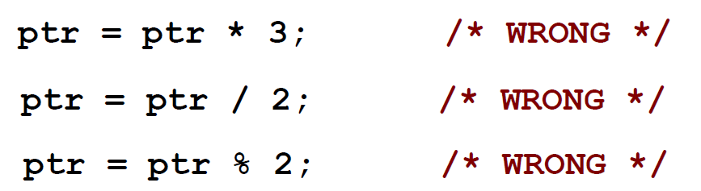
Multiplication/Division with Pointers
Multiplication and division are NOT defined for pointers
type *ptr;

Slide 19
Relational Operations with Pointers
You can use relational operators ( <, ==, >, != ) with pointers providing that both operands are pointers of the same type.
Otherwise, you get warning which can be resolved using casting
Example:
char *ptr1, *ptr2;
int *ptr3, *ptr4;
if( ptr1 <= | ptr2) { | . | . | . | } | OK
if( ptr3 != | NULL ) { | . | . | . | } | OK
while( ptr3 | < ptr4){ | . | . | . | } | OK
if( ptr1 == | ptr3 ) { | . | . | . | } | Warning
different types
while( ptr2 < 0x2400FA
) { . . . }
Warning
Cannot compare a pointer with a fixed value / constant

Slide 20
Pointers Casting
Simple data types
char int float numIn numFl
numCh = 25; numIn; numFl;
= (int)numCh + 7;
= (float)numIn/2.0;
Pointers
char *ptrCh; int *ptrIn;
ptrIn ptrCh
= (int*) ptrCh;
= (char*) ptrIn;
/* convert char* into int* */
/* convert int* into char* */
It is a valid operation, but make sure you understand what you’re doing and how this may affect your program before casting pointers

Slide 21
Quiz1: Pointer Arithmetic
What value is printed out ?
short short
int number = 5, result;
int *ptr = NULL;
ptr = &number; printf("%d", number);
*ptr = 2; printf("%d", number);
result = 10+*ptr; printf("%d", result);
result = 10/*ptr; printf("%d", result);
5
2
12
5
53
Notes:
5, 2, 12, 5

Slide 22
…Continued
How are these statements interpreted ?
*ptr++ = 10;
(*ptr)++;
*(++ptr);
++(*ptr);
See appendix for operators precedence
*ptr++ = 10; we assign 10 to the variable that is pointed to by ptr and then increase the pointer by one.
(*ptr)++; increase the value of the variable appointed to by ptr by one.
*(++ptr); This increases the physical address by 2 (short int *ptr = NULL;) and then points to that address. Doesn’t change the value of the variable appointed to by ptr.
++(*ptr); increase the value of the variable appointed to by ptr by one.

Slide 23
Quiz 2
What is wrong with this code? float voltage = 3.3; float *ptrV;
ptrV = voltage;
What is the value printed?
int number = 10;
int *ptr;
ptr = &number;
*ptr = *ptr + 2; printf("%d", number);
What is wrong with this code?
unsigned char timeSec;
char *ptr1;
ptr1 = &timeSec;
int *ptr1, float *ptr2;
ptr1 = ptr2;
ptrV = &voltage
Fine, data type of the same size
12
Warning:
two pointers of different types
Notes:
ptrV = &voltage
12

Slide 24
IV. Passing Arguments to Functions by Reference
There are two ways to pass arguments to a function—pass-by-value and pass-by-reference.
All arguments in C are passed by value.
Many functions require the capability to modify variables in the caller or to pass a pointer to a large data object to avoid the overhead of passing the object by value (which incurs the time and memory overheads of making a copy of the object).
In C, use pointers and the indirection operator(*) to simulate pass-by-reference.

Slide 25
…Continued
C Passing by reference: when calling a function with arguments that should be modified, the addresses of the arguments are passed.
This is normally accomplished by applying the address operator (&) to the variable (in the caller) whose value will be modified.
Arrays are not passed using operator & because C automatically passes the starting location in memory of the array (the name of an array is equivalent to &arrayName[0]).
When the address of a variable is passed to a function, the indirection operator (*) may be used in the function to modify the value at that location in the caller’s memory.
A function receiving an address as an argument must define a pointer parameter to receive the address.

Slide 26
Example: Pass-By-Value (1)

Slide 27
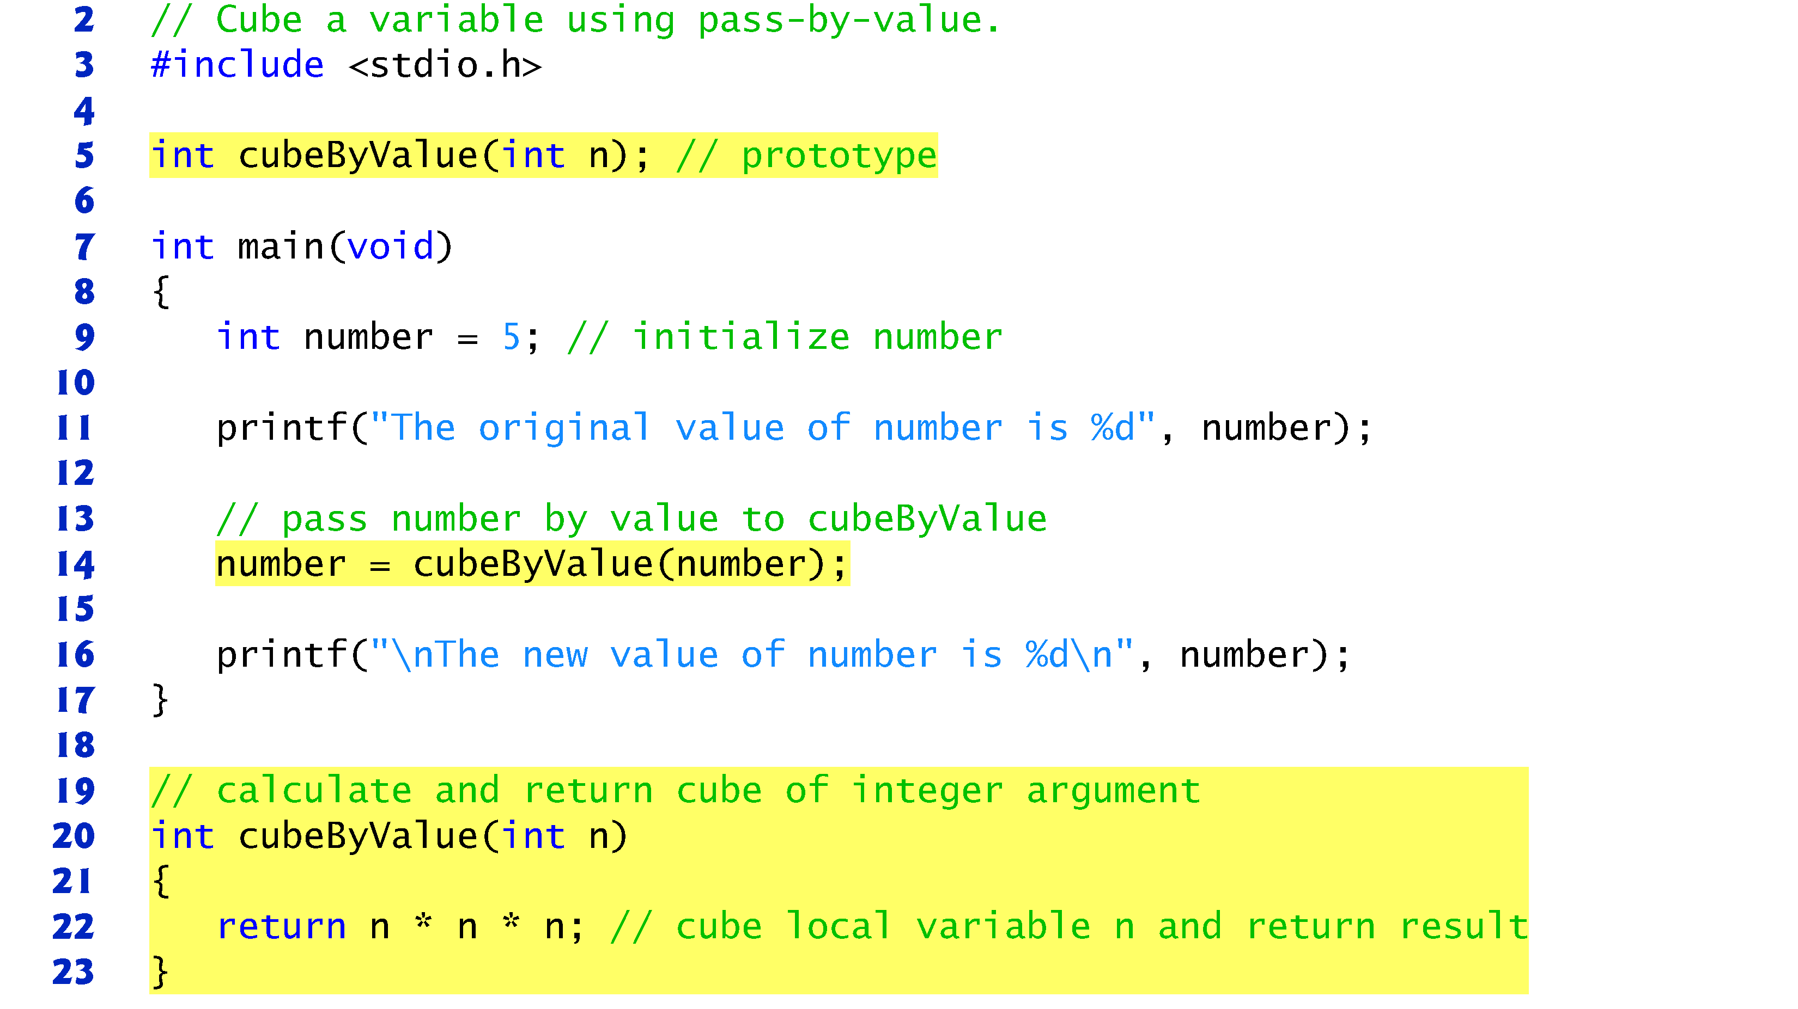
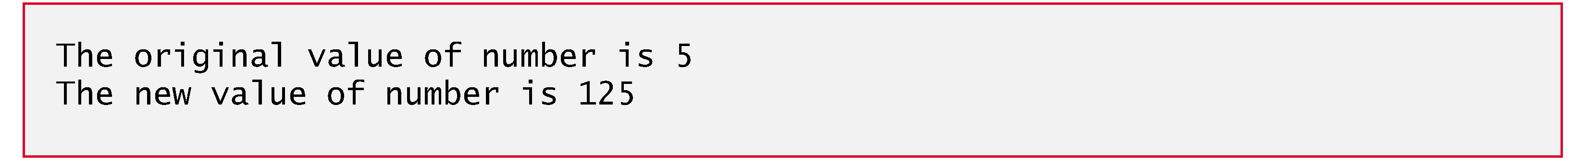
Example: Pass-By-Value (2)
The new value is assigned to number in main

Slide 28
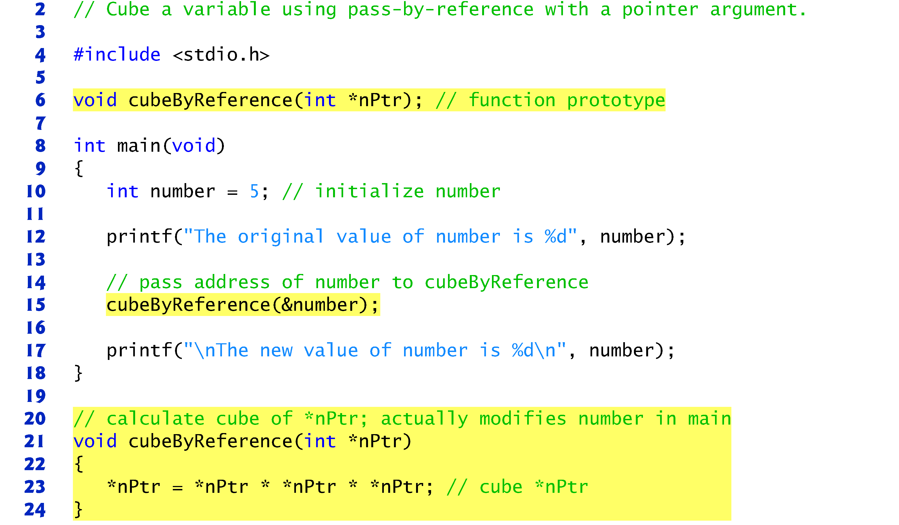
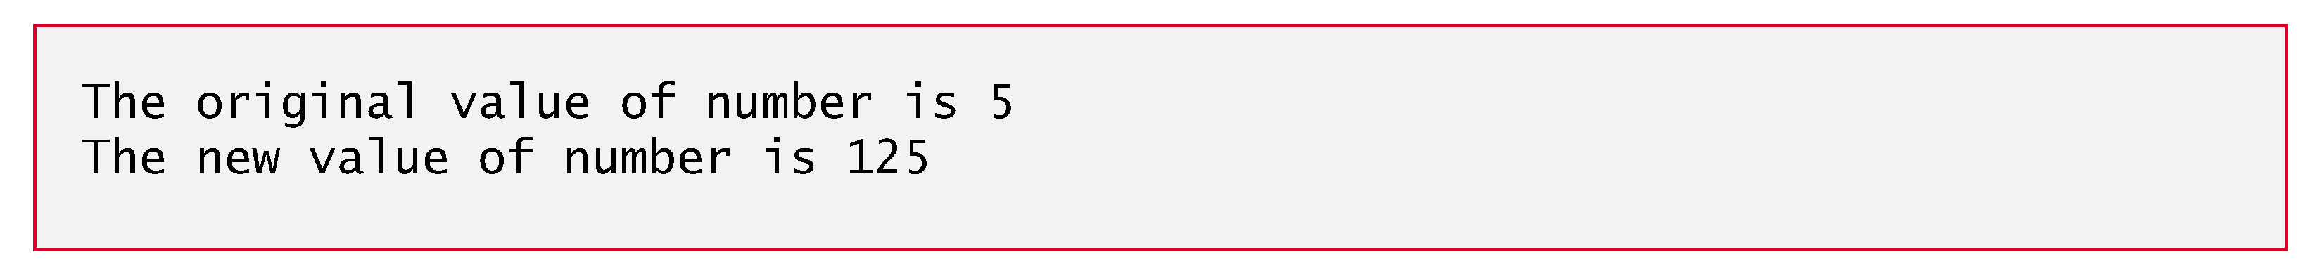
Example: Pass-By-Reference
reference—the address of number is passed
Function does not return a value.
a pointer to an int
It is the number in main

Slide 29
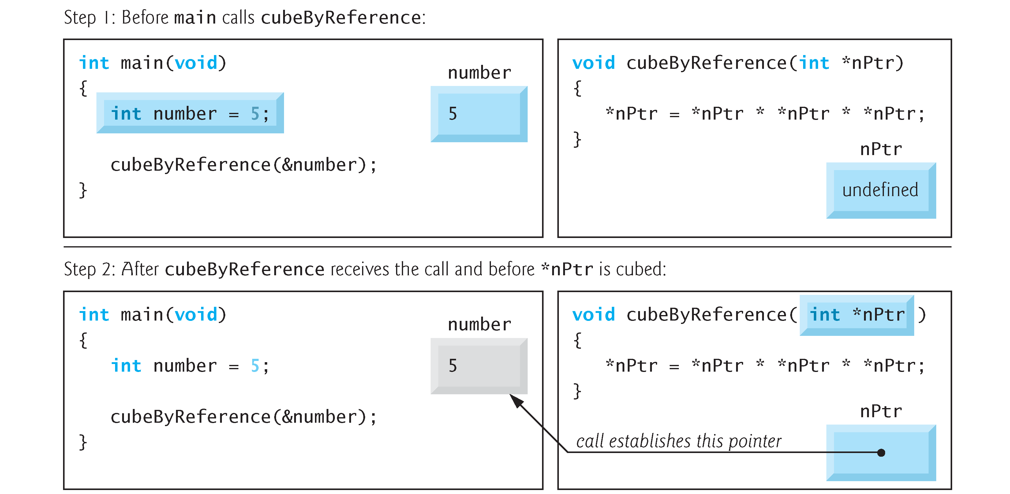
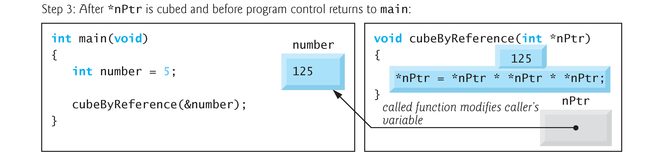

Slide 30
…Continued
A function can take pointers as parameters and also can return a value of a pointer type which is one of the function parameters list
Examples:
void order (double *smp, double *lgp);
int fwrite( void *buffer,int size, int num);
Although a function cannot return more than one value, with the use of pointers you can pass back as many values as you need
Example:
bool update(
float *price,
int *quantity, char
*code );
These three function parameters can be updated and passed back to the top level function

Slide 31
Example : Function with Output Parameters
Write a function separate, which finds the sign (signp), whole number magnitude (wholep), and fractional parts (fracp ) of its first parameter.
In function separate, only the first formal parameter, num , is an input; the other three formal parameters (signp, wholep, and fracp) are output parameters, used to carry multiple results from function separate back to the function calling it.

Slide 32
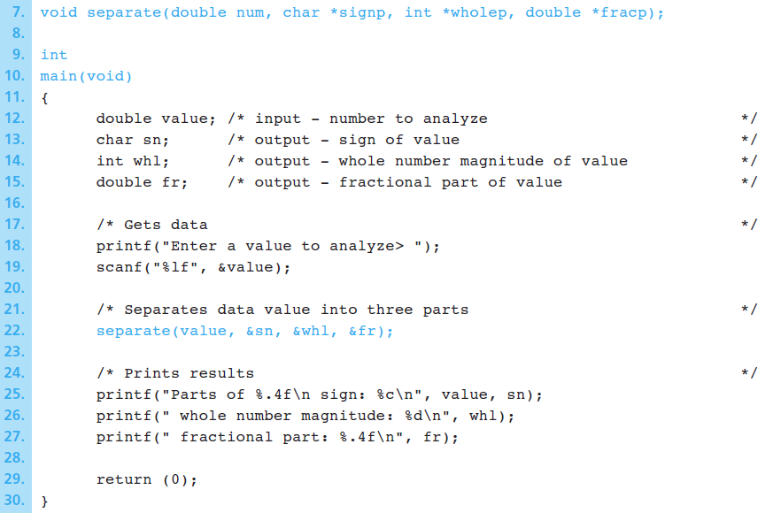
…Continued
Pointers
Pass by reference

Slide 33
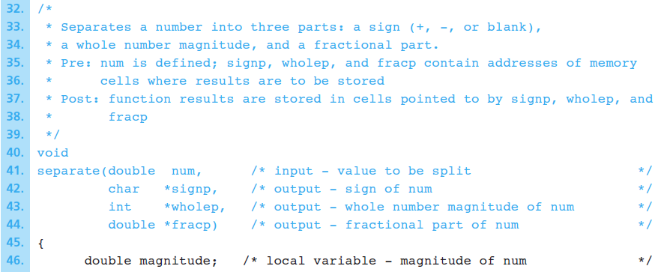
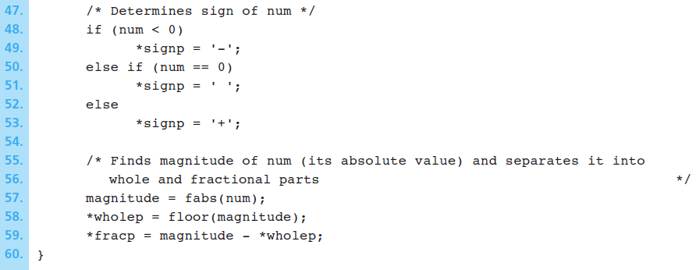
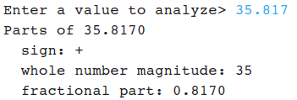
…Continued

Slide 34
Quiz 3
Show the table of values for x , y , and z that is the output displayed by the following program.
#include <stdio.h>
void sum(int a, int b, int *cp);
int
main(void)
{
int x, y, z;
x = 7; y = 2;
printf(" x y z\n\n");
sum(x, y, &z);
printf("%4d%4d%4d\n", x, y, z);
sum(y, x, &z);
printf("%4d%4d%4d\n", x, y, z);
sum(z, y, &x);
printf("%4d%4d%4d\n", x, y, z);
sum(z, z, &x);
printf("%4d%4d%4d\n", x, y, z);
sum(y, y, &y);
printf("%4d%4d%4d\n", x, y, z);
return (0);
}
void
sum(int a, int b, int *cp)
{
*cp = a + b;
}
x y z
7 2 9
7 2 9
11 2 9
18 2 9
18 4 9

Slide 35
V. Pointers and Arrays
Arrays and pointers are intimately related in C and often may be used interchangeably.
An array name can be thought of as a constant pointer.
Pointers can be used to do any operation involving array indexing.
Assume that integer array b[5] and integer pointer variable bPtr have been defined.
Because the array name (without an index) is a pointer to the first element of the array, we can set bPtr equal to the address of the first element in array b with the statement:
bPtr = b;

Slide 36
…Continued
This statement bPtr = b; is equivalent to bPtr = &b[0];
Array element b[3] can alternatively be referenced with the pointer expression *(bPtr + 3)
the pointer variable points to the array’s first element,
the offset 3 indicates which array element should be referenced,
the offset value is identical to the array index.
This notation is referred to as pointer/offset notation.
The parentheses in the expression *(bPtr + offset) are necessary because the precedence of * is higher than the precedence of +.
Without the parentheses, the above expression would add offset to the value of the expression *bPtr (b[0]).
Notes:
In general, all indexed array expressions can be written with a pointer and an offset.
In this case, pointer/offset notation was used with the name of the array as a pointer.

Slide 37
…Continued
Just as the array element can be referenced with a pointer expression, the address &b[offset] can be written with the pointer expression: bPtr + offset or b+offset
The array itself can be treated as a pointer and used in pointer arithmetic.
The expression b+offset does not change the value of b, the array name, it is still pointing to the first element.
Remember that an array name is essentially a constant pointer; it always points to the beginning of the array.
The expression: b += 3 is invalid because it attempts to modify the value of the array name with pointer arithmetic.

Slide 38
Example
To print the four elements of the integer array b, the following example uses the four methods we’ve discussed for referring to array elements:
array indexing,
offset with the array name as a pointer,
pointer indexing, and
offset with a pointer

Slide 39
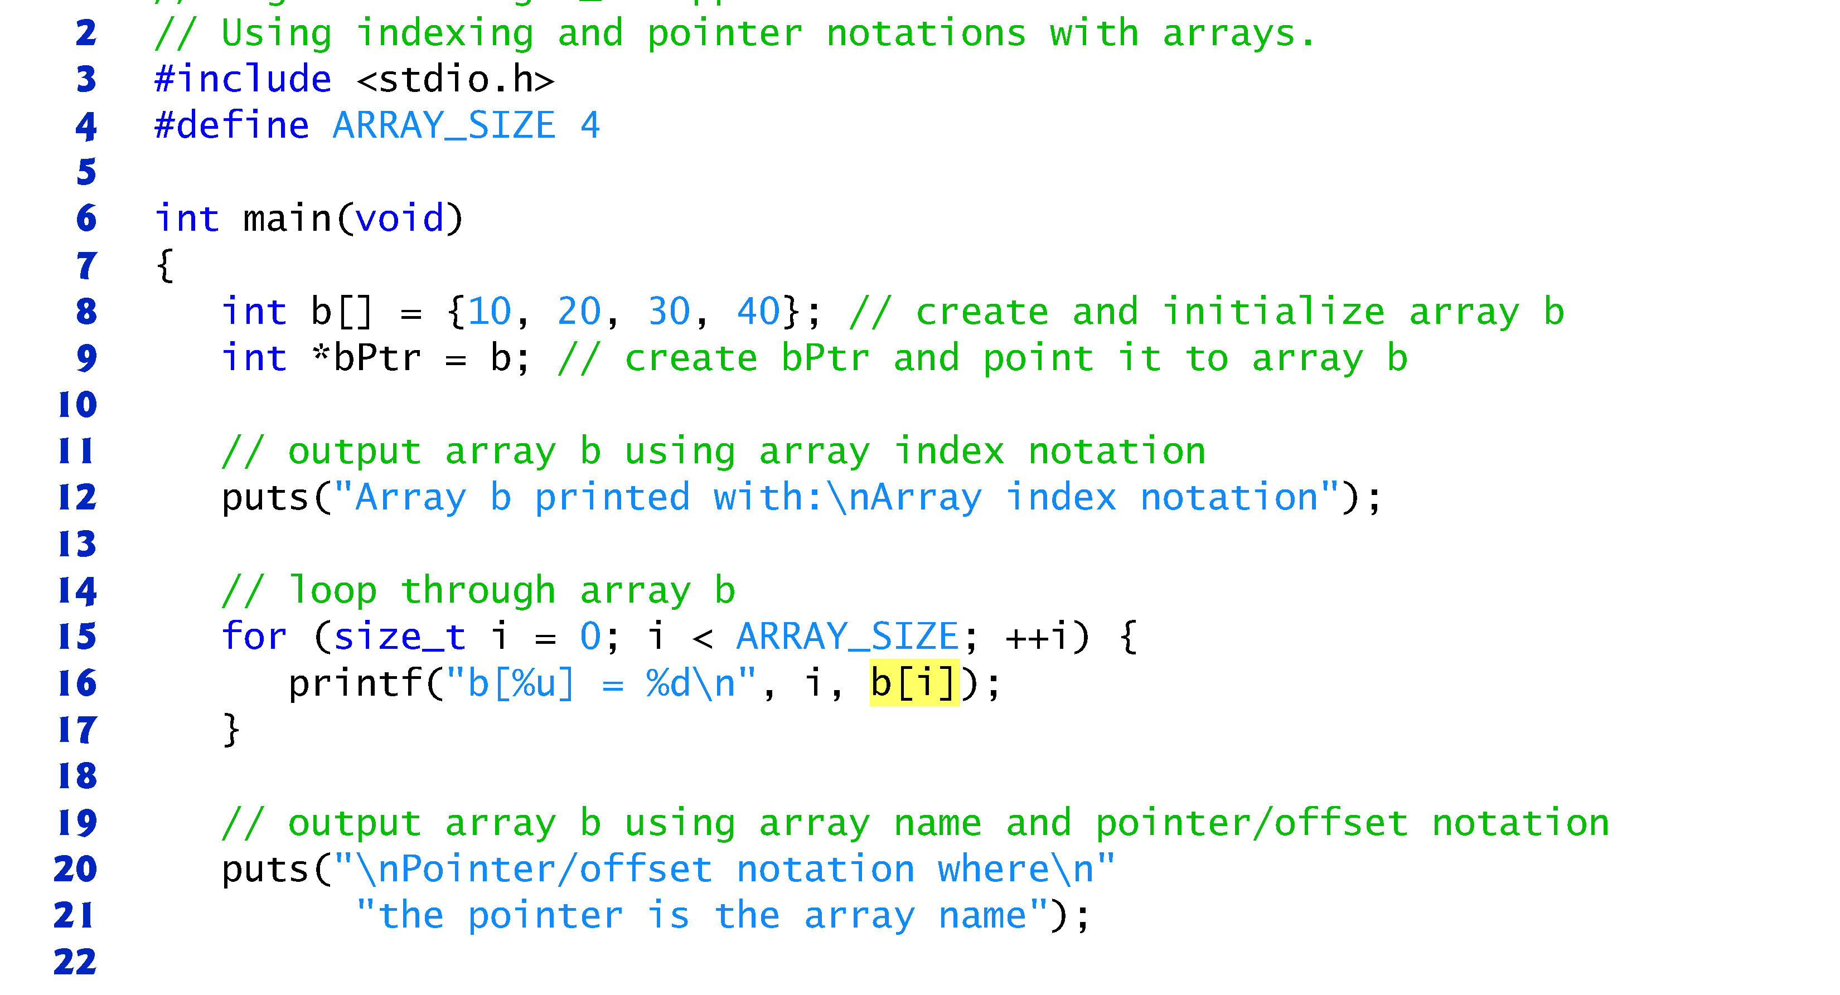
typedef int size_t;

Slide 40
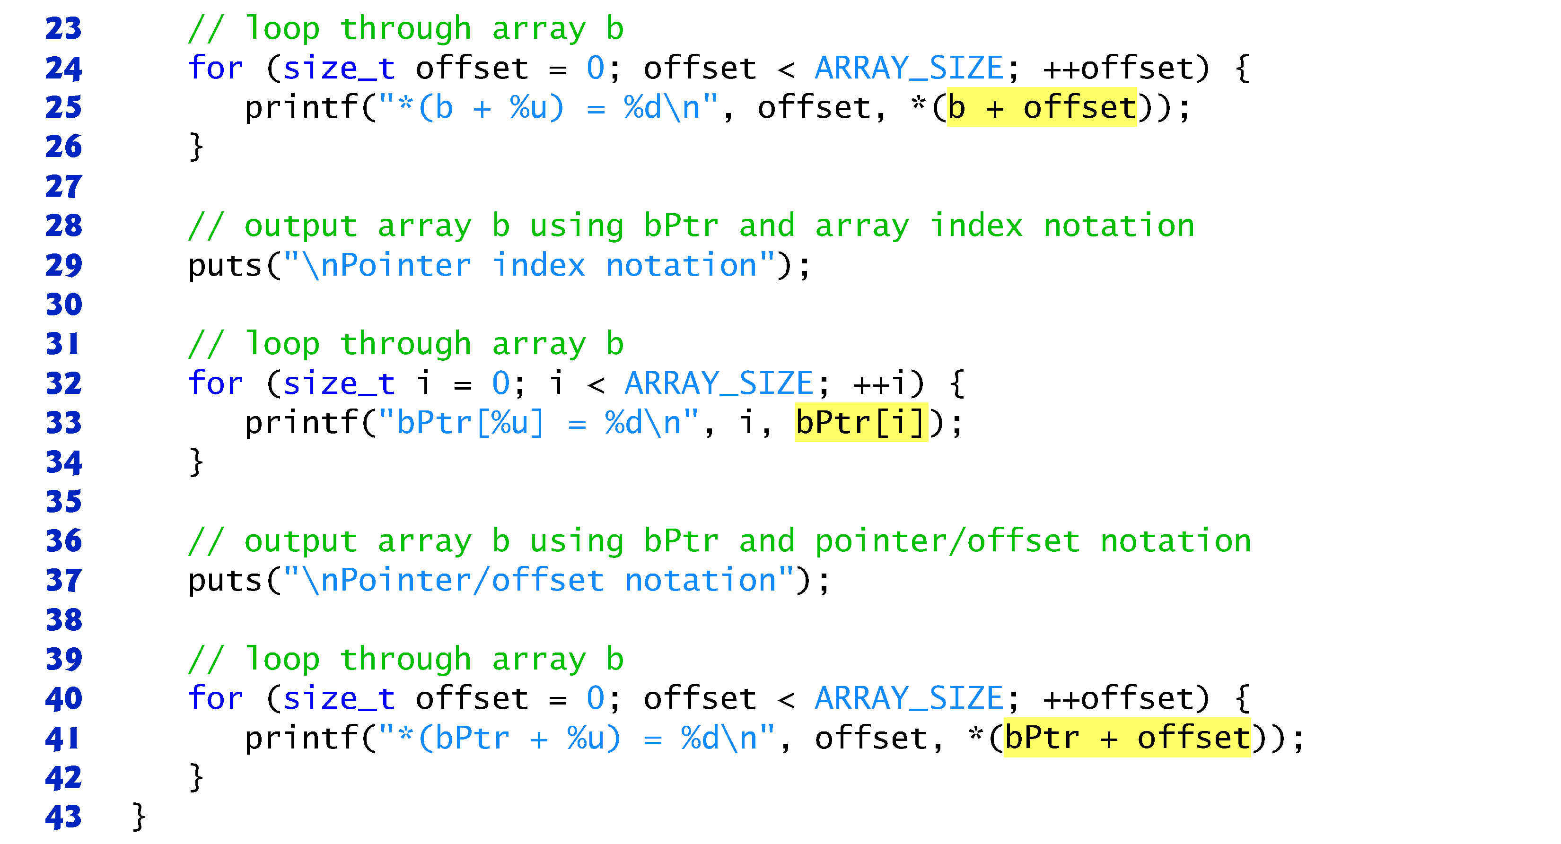

Slide 41
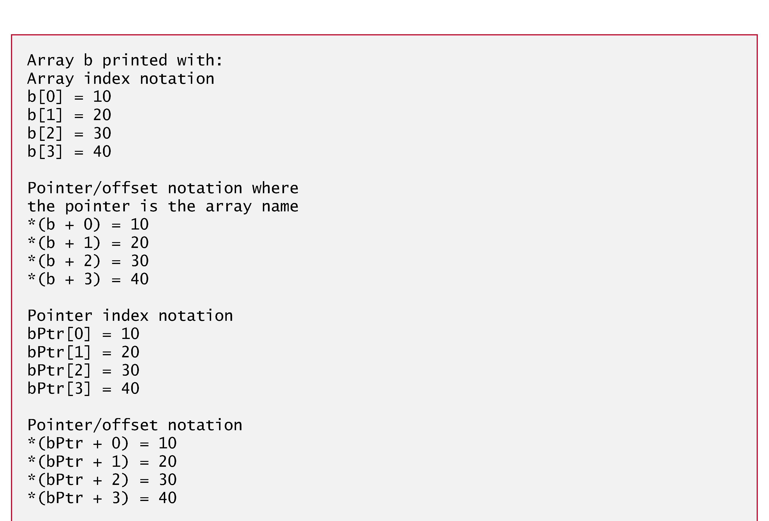

Slide 42
Arrays of Pointers
Arrays may contain pointers.
A common use of an array of pointers is to form an array of strings, referred to simply as a string array.
Each entry in the array is a string, but in C a string can be defined as a pointer to its first character.
So each entry in an array of strings is actually a pointer to the first character of a string.

Slide 43
…Continued
Consider the definition of string array suit, which might be useful in representing a deck of cards.
const char *suit[4] = {"Hearts", "Diamonds", "Clubs", "Spades"};
The suit[4] portion of the definition indicates an array of 4 elements.
The char * portion of the declaration indicates that each element of array suit is of type “pointer to char.”
Qualifier const indicates that the strings pointed to by each element pointer will not be modified.
The four values to be placed in the array are "Hearts", "Diamonds", "Clubs" and "Spades".
Each is stored in memory as a null-terminated character string that’s one character longer than the number of characters between quotes.

Slide 44
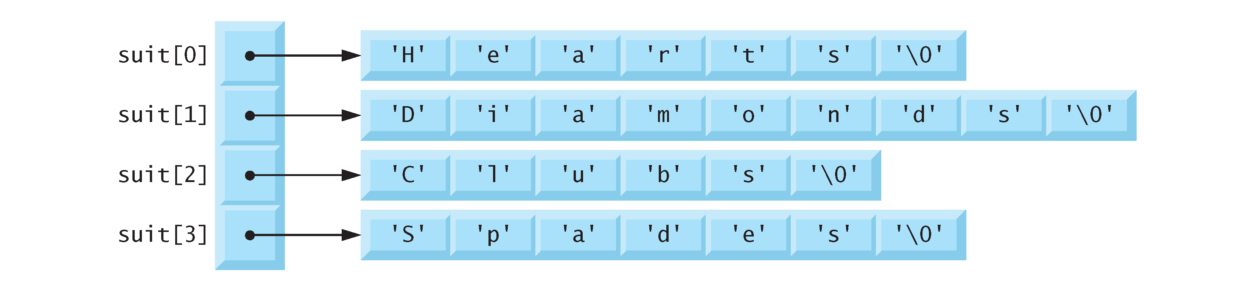
…Continued
The four strings are 7, 9, 6 and 7 characters long, respectively.
Although it appears as though these strings are being placed in the suit array, only pointers are actually stored in the array
Each pointer points to the first character of its corresponding string.
Thus, even though the suit array is fixed in size, it provides access to character strings of any length.
Notes:
The suits could have been placed in a two-dimensional array, in which each row would represent a suit and each column would represent a letter from a suit name.
Such a data structure would have to have a fixed number of columns per row, and that number would have to be as large as the largest string.
Therefore, considerable memory could be wasted when storing a large number of strings of which most were shorter than the longest string.

Slide 45
VI. Pointers and Structures
You can declare pointers to structures:
typedef struct
{
int number;
int quantity;
} part_t;
part_t *ptrPart;
Since part_t is a structured data type definition ( not a declaration ) you cannot use its pointer until a variable of the type part_t is declared
part_t bc209;
part_t * ptrPart = &bc209; /* OK */

Slide 46
…Continued
A pointer to a structured variable points to the base address of the structure
typedef struct
{
int number;
int quantity;
}part_6;
part_t *ptrPart;
part_t bc209;
ptrPart = &bc209;
Memory
00110001
00110111
00110100
00000101
00110010
00011100
01000000
00110001
00110001
00110001
quantity
number
ptrPart

Slide 47
Members Access
Once a pointer points to a structure, you can access all members of the structure
typedef struct
{
int number;
int quantity;
}part_t;
part_t *ptrPart;
part bc209;
ptrPart = &bc209; (*ptrPart).number =245603;
this is equivalent to
bc209.number = 245603;

Slide 48
…Continued
Another way to access the structure members is to use indirect membership operator ->
typedef struct
{
int number;
int quantity;
}part_t;
part_t *ptrPart; part bc209;
ptrPart = &bc209;
ptrPart->number = 245603;
this is also equivalent to
bc209.number = 245603;

Slide 49
Struct Member Access - Summary
Therefore, there are three ways of accessing members of a structured variable:
Using the variable name and the member access operator
bc209.number = 245603;
Using the indirection operator with a pointer and the member access operator
(*ptr).number = 245603;
Using a pointer followed by the indirect membership operator
ptr->number = 245603;

Slide 50
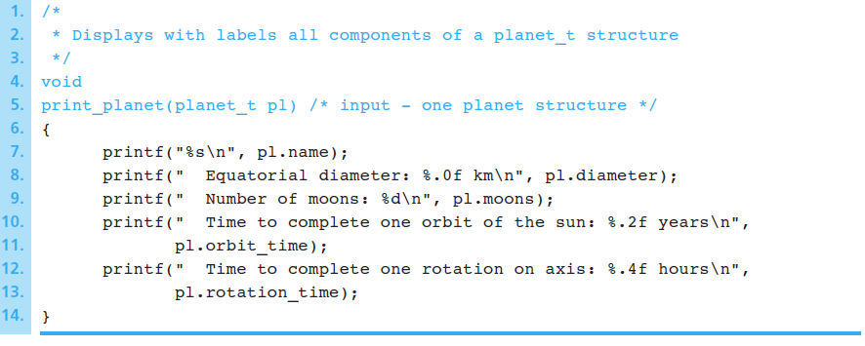
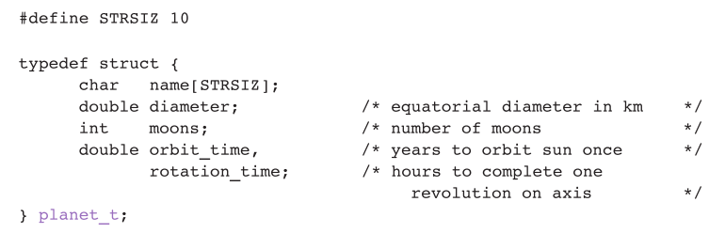
Example: Function with a Structured Input Parameters

Slide 51
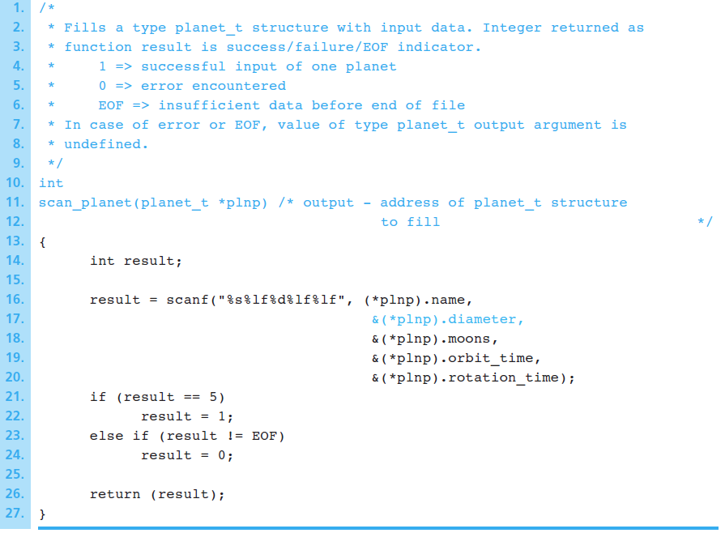
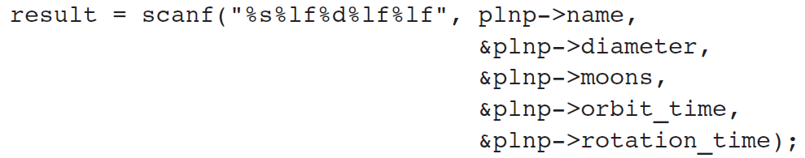
…Continued
Another way by using the -> operator

Slide 52
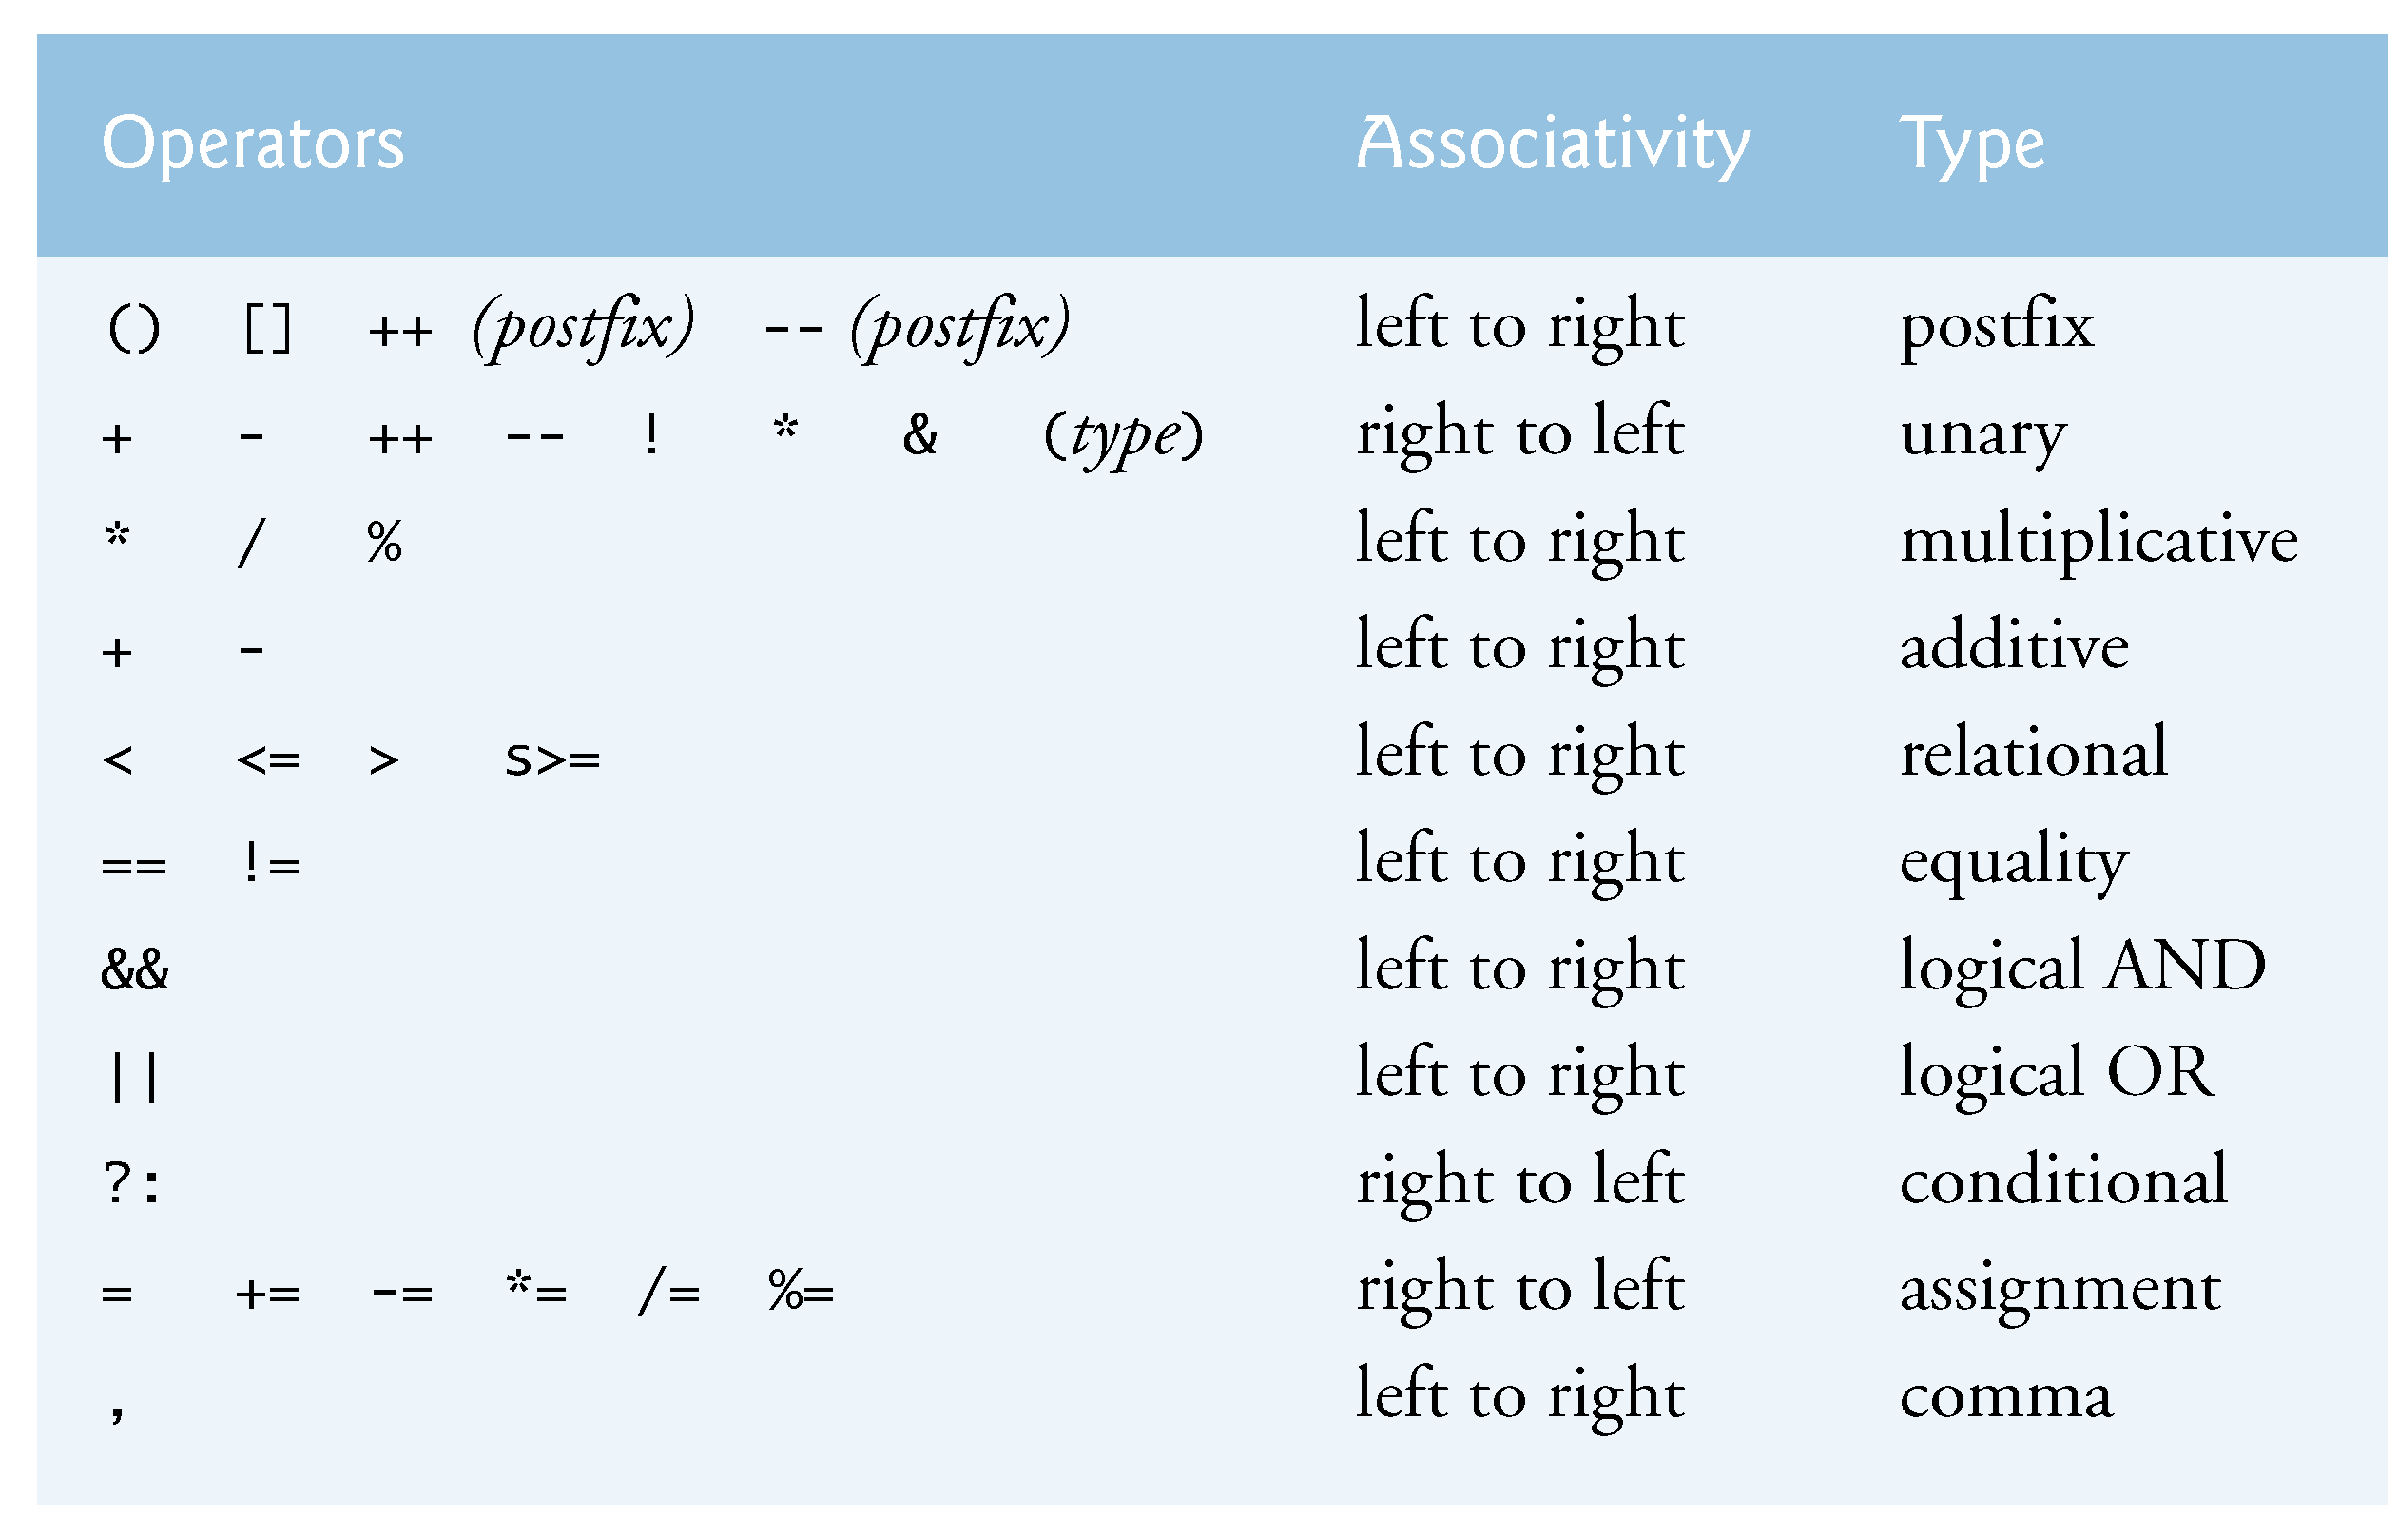
Appendix: Operators Precedence
https://en.cppreference.com/w/cpp/language/operator_precedence

