Slide 1
Lecture 9: Text & Binary Files Processing in C
Content
I. Introduction
II. Files and Streams
III. Major Steps for Processing a File IV. File Error Handling
V. Random Data Access
Appendix
Check the Notes section

Slide 2
I. Introduction
Storage of data in variables and arrays is temporary, such data is lost when a program terminates.
Files are used for permanent retention of data.
Computers store files on secondary storage devices, such as hard drives, DVDs and flash drives.
In this lecture, we explain how data files are created, updated and processed by C programs.
We consider sequential-access and random-access file processing.

Slide 3
…Continued
There are many ways how to classify files
MATLAB provides a set of built‐in functions for accessing common file formats.
load, save for MATLAB formatted data in *.mat files
csvread, csvwrite – coma delimited numbers in *.csv files
xlsread, xlswrite – Microsoft Excel spreadsheet files *.xlsx
Regardless of the file format, all files are subdivided into two major categories:
Files
Text Files
Binary Files
C provides a set of generic functions for these two categories.
Notes:
Files with a .m extension contain MATLAB code, either in the form of a script or a function. Files with a .mat extension contain MATLAB formatted data, and data can be loaded from or written to these files using the functions LOAD and SAVE
In computing, a comma-separated values (CSV) file stores tabular data (numbers and text) in plain text. Each line of the file is a data record. Each record consists of one or more fields, separated by commas. The use of the comma as a field separator is the source of the name for this file format.

Slide 4
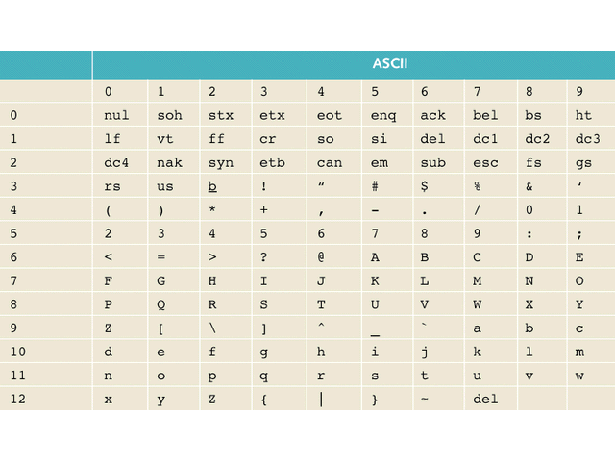
Text File Processing
A text file is a file of characters.
The basis of its internal structure is a character.
All characters (letters, digits and special characters) are stored in text files as ASCII codes.
Day ‐> 68 97 121
156 ‐> 49 53 54
38.098 ‐> 51 56 46 48 57 56
When content of a text file is displayed, all ASCII codes are interpreted as corresponding characters

Slide 5
Example
Anything wrong with this code?
----------------------------------------
char arr1[10] = { 1, 3, 5, 7, 12, 34, 11, 63, 7, 0};
int indx;
for(indx = 0; indx < 10; indx++)
printf("%c ", arr1[indx]);
----------------------------------------
The output is:
" ?
----------------------------------------
Why? . . .
The numbers are interpreted as ASCII codes, the characters they present will be printed.
5

Slide 6
…Continued
----------------------------------------
char arr1[10] = { 1, 3, 5, 7, 12, 34, 11, 63, 7, 0};
int indx;
for(indx = 0; indx < 10; indx++) printf("%d ", (int)arr1[indx]);
----------------------------------------
The output is:
1 3 5 7 12 34 11 63 7 0
----------------------------------------
char 1 is converted to int 1.
printf function converts int 1 to its ASCII 49.
A computer monitor displays 1 as the graphical symbol of 49.
6

Slide 7
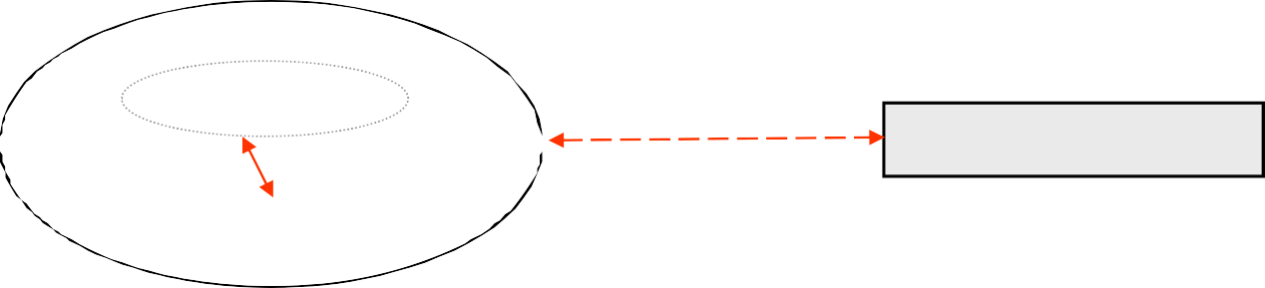
II. Files and Streams
A variable declared in a C program is a part of this program.
A file is an external collection of data that is not part of the C program.
variables
???
A Text File
C program
C must provide a linkage between the external file and the program.
The linkage is provided by File Streams

Slide 8
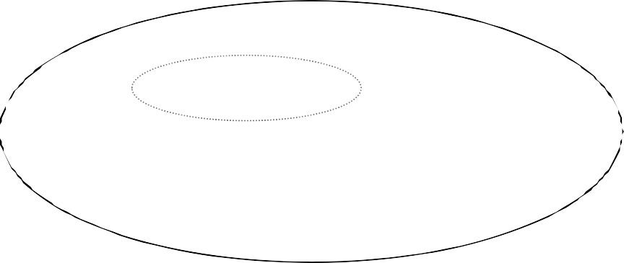
The Concept of File Stream
A File Stream is an interface/linkage between a program and a physical device.
It separates the program from the physical device by assigning each file a logical structure.
variables
A File in Disk
stream
C program
You work with a stream and the stream communicates with the actual device.

Slide 9
Text & Binary File Streams
A File Stream can be Text or Binary
physical files do not have any special marker to indicate their type (a file name or its extension does not affect the file type)
Unlike Text File Stream, A Binary File Stream does NOT perform any type conversion.
Binary code of 35.68
binary stream
text stream
A File
variables
35.68
51 53 46 54 56
A File
C program

Slide 10
III. Major Steps for Processing a File: Step1: Declare stdio.h header file
1. Include the header file stdio.h
#include <stdio.h>
The library contains a set of functions to handle file I/O through streams.
Besides defining the file stream, the stdio library also defines identifiers:
stdin –
standard input stream (per default from a keyboard)
– standard output stream (per default to the monitor)
stdout stderr
– standard error stream (per default to the monitor)
Notes:
Standard input is stream data (going into a program. The program requests data transfers by use of the read operation.
Standard output is the stream where a program writes its output data.
Standard error is another output stream typically used by programs to output error messages or diagnostics, allowing output and errors to be distinguished

Slide 11
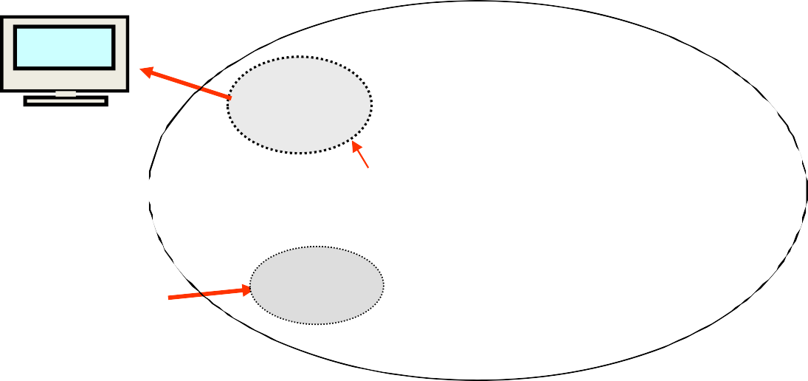




Step2: Declare the File Stream variable
2. Declare file stream variables
FILE FILE
*inFile;
*outFile;
(stdin, stdout
and stderr
are already declared )
A= 56
stdout
File
names.txt
inFile
C program
outFile
File
marks.txt
stdin

Slide 12
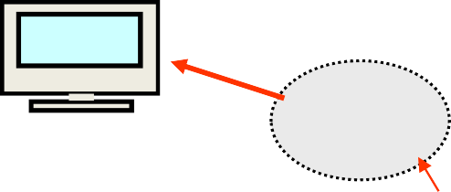

Step3: Link the file stream variable to the physical file
3. Associate the file streams with physical files: open files
3.1 TEXT file : open the file with the text flags to specify the access mode
inFile = fopen( "names.txt" , “r");
outFile = fopen( "marks.txt", "w" );
A= 56
stdout
File
names.txt
inFile
C program
outFile
File
marks.txt
stdin
Notes:
“w”: Creates an empty file for writing. If a file with the same name already exists, its content is erased and the file is considered as a new empty file.

Slide 13
Text File Opening Modes
Function fopen()
FILE* fopen(const char filename[], const char* mode);
Mode | Description | Restriction | Previous Content
r | Open file for reading | must already exist | preserved
w | Open file for writing | created if doesn't exist | erased
a | Open for writing. Output is appended at the end | created if doesn't exist | preserved
Example:Open a file for output. If it does not exist, it’ll be created. If it already exists, the existing content will be erased:
outFile = fopen("report.txt", "w");

Slide 14
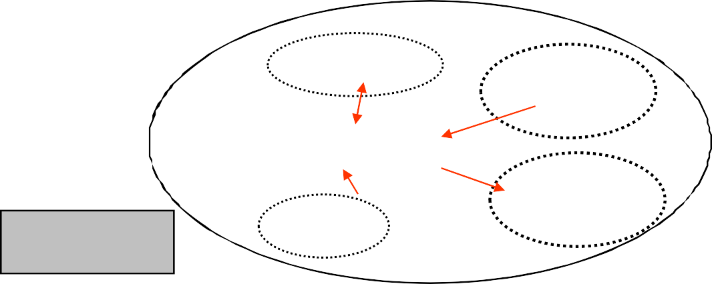
…Continued
3.2 BINARY file stream: open the Files with the binary flags
inBinFile = fopen( "names.dat", "rb" );
outBinFile = fopen( "marks.inf", "wb" );
A= 56
variables
File
names.dat
inData
stdout
C program
File
marks.inf
outData
stdin

Slide 15
Binary File Opening Modes
Function fopen
FILE* fopen(const char filename[], const char mode);
Mode | Description | Restriction | Previous Content
rb | Open file for reading | must already exist | preserved
wb | Open file for writing | created if doesn't exist | erased
ab | Open for writing. Output is appended at the end | created if doesn't exist | preserved
The same function is used for opening text and binary file streams.
Binary mode tells the I/O functions that format conversion of data and interpretation of all escape sequences ( \n, \t, …) must be suppressed.

Slide 16

Open File: Error Handling
Do NOT assume that a file stream is always successfully created
− Incorrect file name
inFile = fopen("names.txb", "r");
Violation of restrictions
FILE *inFile;
inFile = fopen("names.txt", "r");
Hardware failure
may not exist, or access may be restricted
You should always check the status of a stream after fopen :
inFile = fopen("names.txt", "r");
if( inFile == NULL) { … error recovery action … }
Notes:
NULL points to nothing

Slide 17



Step 4: Read/Write operations
4.
4.1. Text file stream: use fprintf() and fscanf() functions for file I/O operations:
fscanf(inFile, "%s",
name);
fprintf(outFile, "%f",
mark);
char name []
John
File
names.txt
inFile
C program
83.6
File
marks.txt
outFile
mark

Slide 18
…Continued
4.2. Binary file stream:
use fwrite() and fread() functions for file I/O operations
With Binary file streams, you have to perform operation per BLOCK
The fwrite()/fread() function writes/reads a given number of items, all of the same size, from/to a memory buffer into/from a binary file stream.
int fwrite( void *buffer, int sizeOfItem, | /* /* | buffer */ size of items */
int numOfItems, FILE *fp ); | /* /* | number of items */ file stream ID */
int fread ( void *buffer, int sizeOfItem, | /* /* | buffer */ size of items */
int numOfItems, FILE *fp ); | /* /* | number of items */ file stream ID */

Slide 19
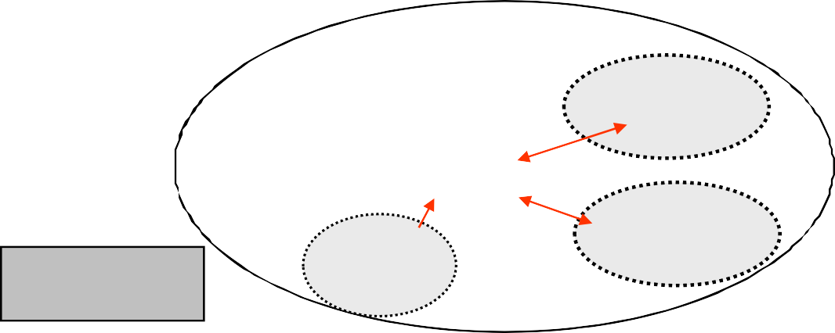
Step 5: Close the file stream
5. Disconnect from the physical files: close the files:
fclose(inFile); fclose(outFile);
Files remain in the
computer file system when they are closed
Do not accidentally close stdin or stdout
A= 56
File
names.txt
stdout
inFile
C program
File
marks.txt
outFile
stdin

Slide 20
Example1: Formatted Output in a File
In most application scenarios a text file created by a program will be printed and read by people.
Information must be presented in a readable form.
Output file streams can be formatted in the same manner as the standard output stream (easy to test and debug).
Besides data, the file may contain supplementary information such as titles, comments, version number, etc.
----------------------------------------
Date: 24/09/2006
----------------------------------------
Example: Sales report
Model: |  | FinePix S3000
Number of Items | Sold: | 3
Gross Amount: |  | 1200.00
GST Paid: |  | 120.00
Net Sale:
1080.00

Slide 21
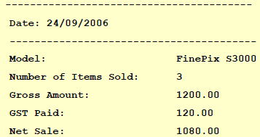
…Continued
Stp1
#include <stdio.h> int main(void)
{
int i;
Stp2
FILE | *salesReport; /* a file stream | variable | */
char | date[] = "24/09/2006"; /* a | c-string | */
char | fileName[] = "sale24_09_06.txt"; /* a | c-string | */
char | model[] = "FinePix S3000"; /* a | c-string | */
Stp3
salesReport = fopen( fileName, "w" );
if( salesReport == NULL ) /*check for file open errors*/
{
fprintf(stderr, "Error opening %s", fileName); return -1; /* terminate the program */
}
OR
printf(“Error opening %s”,fileName);

Slide 22
…Continued
/* write data to the file */ for(i=0; i<40; i++)
fprintf(saleReport, "-"); fprintf(saleReport, "\nDate: for(i=0; i<40; i++)
fprintf(saleReport, "-");
%s\n", date);
Stp4
fprintf(saleReport, | "\n%-27s%s", "Model:", model );
fprintf(saleReport, | "\n%-27s%d", "Number of items sold:",3 | );
fprintf(saleReport, | "\n%-27s%.2f", "Gross amount:", 1200.0 | );
fprintf(saleReport, | "\n%-27s%.2f", "GST Paid:", 120.0 );
fprintf(saleReport, | "\n%-27s%.2f", "Net sale:", 1080.0 );
Stp5
fclose(saleReport);
return 0;
/* close
the file
stream */
}
Notes:
- Left justified

Slide 23

File Stream as a Function Parameter
How to move file stream operations into user defined functions?
A File stream pointer can be passed to a function as a parameter
Example:
int saveReport( FILE *fp ){ /* fp is a function parameter */
…..
}
Caution: Do not declare a file stream pointer as a global variable
#include <stdio.h>
FILE *fp; Global variable. Bad style !
. . . . .
int saveReport(void)
{
fprintf(fp, "Model :" );
Notes:
fp here is not the name of the file stream (the file stream is sales report); fp is the function parameter

Slide 24
…Continued
/* A function that writes
/* returns true if OK, or
int writeHeader( FILE
{
int i, Status=0;
into a text file */
false if an error is detected */
*fp, char reportDate[] )
for(i=0; fprintf( for(i=0;
i<40; i++) fprintf( fp, "-"); fp, "\nDate: %s\n", reportDate);
i<40; i++)
fprintf( fp, "-"); "\n");
fprintf( fp,
….
return 1;
}
/* --function call-- */
status = writeHeader(
the file stream variable, see slide 20
salesReport, date );
if(status != 1) fprintf( stderr, "Error!" );

Slide 25
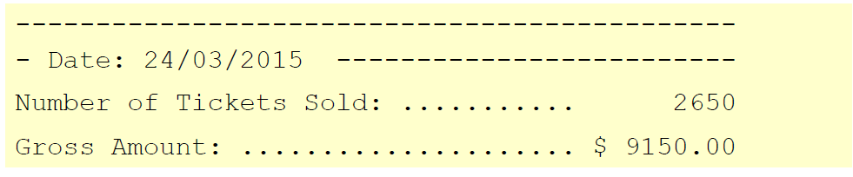
Example2: Reading a file? Know first the data format
A file can store a sequence of numbers produced by another program (results of a scientific experiment, automatic measurements...)
23.45 76.13 0.15 356.1 0.0 45.7 56.03 45.8
A file can store formatted reports that include numbers, comments, titles, separators.
You need to know the data format in order to read data correctly

Slide 26
Quiz
What may be a problem with this code?
Answer:
Return -1 is missing after fprintf along wt {}
Reading a value from the file as an integer, mark is float.
#include <stdio.h> int main(void)
{
FILE *inData; float mark;
inData = fopen("test.txt", if(inData == NULL)
"r" );
fprintf(stderr, "Error opening test.txt else
fscanf(inData, "%d", &mark);
printf(“Mark = %d”, mark); fclose(inData);
return 0;
\n”);
}

Slide 27
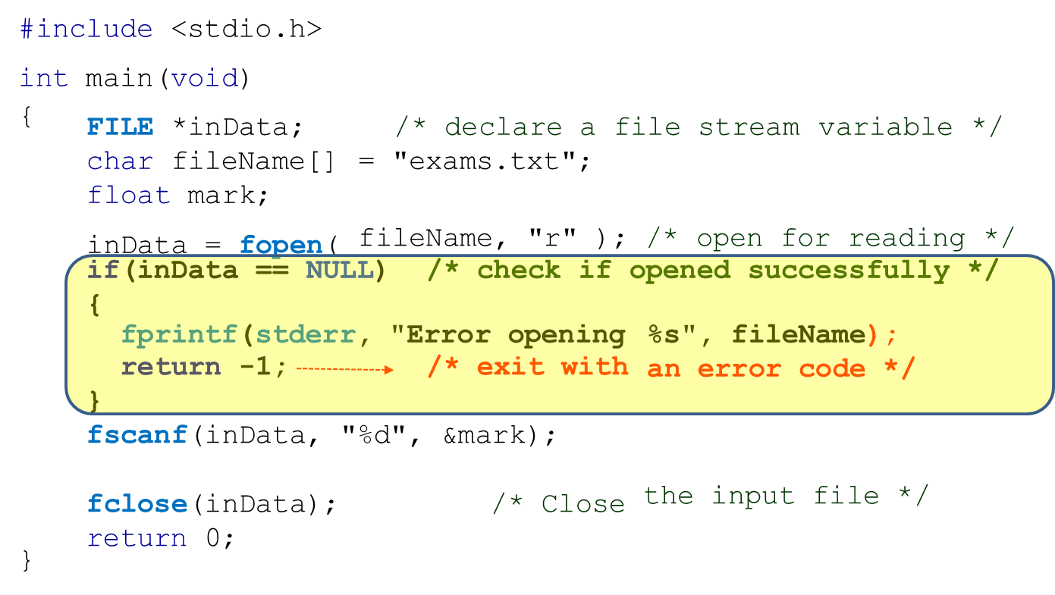
IV. File Error Handling
What if the stream output fails?
Hardware failure: data may not be physically accessed from the storage device due to its damage
You may have already closed the file stream while trying to access its content
The program may not have data to read as it hits the end of file.
The read data may be invalid (an alphabetic character instead of a digit character).
A program with superficial error handling will never be robust.
A comprehensive error checking and appropriate error recovery are essential for robust applications.
Open File: Error Handling
The remaining error source is in
Step 4
Notes:
Text File Input/Output functions also carry out data type conversion.
fprintf converts int into a sequence of ASCII codes and writes them to a file.
fscanf converts a sequence of ASCII characters into an integer number and stores it into a variable.

Slide 28
IV.1. Text File: Writing Error Handling
Exploit fprintf() return value
If successful, the fprintf() function returns number of characters written.
On failure, it returns a negative value.
stat=fprintf(saleReport, “\n%-27s%.2f”, “Net:”, 180.0);
if(stat<0){
fprintf(stderr, "File output error \n");
fclose( saleReport );
return -1;
}
Error Handling
Or Recovery
On a failure, often the return value of fprintf() is -1, which often equals the constant EOF.
“if(stat==EOF)” is often used instead of if(stat<0) after fprintf

Slide 29
Text File: Reading Error Handling
Exploit fscanf() return value:
If successful, the fscanf() function returns the number of receiving arguments successfully assigned.
If a matching failure occurs before the first receiving argument was assigned, it returns zero.
If input failure occurs before the first receiving argument was assigned, EOF is returned.
If the end of file is reached, EOF value is returned
IMPORTANT: EOF is a system indicator. There is no any EOF marker physically stored in the file to indicate the end of it.

Slide 30
Example: Calculate the average of a file data content
#include <stdio.h> int main(void)
{
float nextValue, averTemp = 0.0; int total = 0;
FILE *inFile;
inFile = fopen("may_2004.txt", "r");
if(inFile == NULL) fprintf(stderr, return -1;
}
{ /*check if the file stream "File opening error" );
has been opened */
/* read until the end-of-file */
while( fscanf(inFile, "%f", &nextValue)
{
averTemp += nextvalue; total++;
}
== 1 )
printf("The average temperature is: %f", averTemp/total); fclose( inFile );
return 0;
}
Would the loop always exit after reading all the file content?

Slide 31
…Continued
Would the loop always exit after reading all the file content? NO
What if the file had an alphabetic character instead of a digit one?
(by mistake, file corrupted, hardware failure)
24.56 25.02 24.04 G 23.15 22.47 22.13 21.84
1. while( fscanf(inFile, "%f", &nextValue) = = 1 ) averTemp += nextvalue;
When fscanf fails and returns 0, further reading from the file stream will stop.
Side effects: We would assume incorrectly that all file data has been processed.
Another Naïve solution attempt, check if I have reached the end of file
while( fscanf(inFile, "%f", &nextValue) != EOF ) averTemp += nextvalue;
Side effects: An infinite loop in the case of a wrong character

Slide 32
IV.2: Error Handling, a better solution: Error State
“stdio.h: provides two status flags and two functions to detect possible errors
Incorrect operations with a stream, set EOF or ERROR system indicators (status flags) and switch the stream to the Error State.
The flag EOF cooresponds to end of file status:
if( feof(fp) ) { Error recovery action }
The flag ERROR indicates a hardware failure:
if( ferror(fp) ) { Error recovery action }
Caution: feof() and ferror() functions themselves do not test for end‐of‐file or error . They simply return a value of the corresponding system indicator .The indicators are set by I/O attempts ( fscanf(), fread(), fprintf(), fwrite(), getc(),. . . )
Notes:
The ferror function returns nonzero if and only if the error indicator for the stream stream is set, indicating that an error has occurred on a previous operation on the stream. (tests the error indicator for the given stream.)
void perror(const char* str); The perror() function interprets the value of errno to print an error message to stderr. errno holds an integer value which determines the error condition.

Slide 33
…Continued
Slide 30 program’s Amended Error handling
/* keep reading in a buffer sequentially while while( fscanf(inFile, "%f", &nextValue)==
{
averTemp += nextvalue; total++;
}
correct */
1 )
one value is expected
/* determine the cause of fscanf failure */
/* check if all numbers have been read */ if( !feof(inFile) ) return -1;
the End‐Of‐File has not been reached
/* check if the stream read error
has occurred */
a file read error has been detected
if( ferror(inFile) ) return -2;
The while loop has to read all numbers in the file and reaches EOF. The if statements above are to check that all numbers have read by the while loop

Slide 34
Quiz
Assuming the text file content is: 1 2 3
This solution
while( !feof(inFile) )
{
fscanf(inFile, "%d",
&number);
printf("%d ", number);
}
produces the following output for some reason
1 2 3 3
What is wrong with this code?
Answer: After reading number 3, fscanf will return the value of 1. The while condition is still true. At the next loop iteration, fscanf will not find a value to read as the pointer is at the end of the file. But printf will print the last value of the variable number, which is 3. Afterwards, the loop condition is found to be false.

Slide 35
IV.3. Binary File: Write Error Handling
Reminder:
with Binary file streams, you have to perform BLOCK write operation
The fwrite function writes a given number of items, all of the same size, from a memory buffer into a Binary file stream.
int fwrite( void *buffer, int sizeOfItem, | /* /* | buffer */ size of items */
int numOfItems, FILE *fp ); | /* /* | number of items */ file stream ID */
fwrite returns a number of items actually written into the file:
If the actual number of items written is less than numOfItems, this indicates that an error has occurred.

Slide 36
Example 1
1. Declare a buffer:
#define BUFFSIZE 240
. . .
char buff[BUFSIZE];
2. Write a specified number of items into a file stream:
if(fwrite(buff, sizeof(char),BUFFSIZE,fp) != BUFSIZE)
{
/* check for ERROR condition */
if( ferror(fp) ) { . . . error recovery . . .}
}

Slide 37
Binary File: Read Error Handling
Reminder:
With Binary file streams, you have to perform BLOCK read operation
The fread function reads a given number of items, all of the same size, from the stream and places them into a memory buffer.
int fread( void *buffer, int sizeOfItem, | /* /* | buffer */ size of items */
int numOfItems, FILE *fp ); | /* /* | number of items */ file stream ID */
fread returns a number of items actually read from the file:
If the actual number of items read is less than numOfItems, check error indicators.

Slide 38
Example 2
1. Declare a buffer
#define BUFSIZE 15
. . .
char buff[BUFSIZE];
24 –1 5 17 32 28 0 11 74 27 3 –64 8 14 26
2. Read a specified number of items from a file stream
if( fread(buff, sizeof(char),BUFSIZE, fp) != BUFFSIZE )
{
/* check for EOF condition */
if( !feof(fp) ) { . . . error recovery . . . }
/* check for ERROR condition */
if( ferror(fp) ) { . . . error recovery . . .}
// may be not enough data to read
}

Slide 39
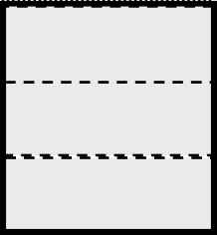
Example 3 : struct and Binary File
typedef struct
{
int productCode; int numberInStock; float price;
}product_t;
ProductCode NumberInStock Price
int int float
347051
12
145.99
. . . .
product_t record;
. . . . . .
/* a structured type variable */
/*read a record from a file stream into the struct variable*/
if (fread( &record, sizeof(product_t), 1, inFile )==1)
{
printf("The product code : printf(" Number in stock : printf(" The product price
%d\n", record.productCode);
%d\n", record.numberInStock);
: %f\n", record.price);
}
if( ferror(inData) )
{ ..Error Recovery Actions.. }
if( !feof(fp) ) { . . . error recovery . . . }

Slide 40
Example 4: Average of a Binary File Data
#define LENGTH 100
. . . . .
FILE *inData;
int buffer[LENGTH];
/* assume the file data is a multiple of 100 */
/* declare a buffer */
int counter=0, sum = 0;
inData = fopen("results.dat", "rb" );
if(inData == NULL ) { ..Error Recovery Actions.. }
/* -- read a block of data -- */
while(fread( buffer, sizeof(int), LENGTH, inData ) == LENGTH)
for(i=0; i<LENGTH; i++)
{
sum += buffer[i]; /* add all numbers */
counter++;
}
}
/* count the numbers |  | */
if( ferror(inData) ) if( !feof(inData) )
/* all file data are
{ ..Error Recovery Actions.. }
{ ..Error Recovery Actions.. } read successfully */
printf("The average value is: %f",(float)sum/counter );
fclose(inData);
/* Close the file stream */

Slide 41
Caution: Struct Memory Allocation Mismatch
Warning: If your structure memory layout does not match precisely the layout of records in a file, you will read garbage from the file into your structure.
Example: A binary file has been created on another platform that inserted a different number of slack bytes in the same structure
typedef struct
{
int productCode; int numberInStock; float price;
} product_t;
records
( in a binary file )
4589 |  | 1485 |  | 165.99 | 1520 |  | 135 |  | 234.50 | 689 |  | 4456 |  | 23.99
record
(a variable declared in your program to be used as a buffer)
1520 |  | 479 |  | 159.24
OK
mismatch
mismatch

Slide 42



Example 5: Text to Binary File
A function to convert a text file into a binary file
Part Number Component Price
Text file format
2376 | BF245 | 14.50
2378 | BF981 | 7.80
2379 | BF998 | 15.50
File conversion program
text2binary
record1
record2
. . . .

Slide 43
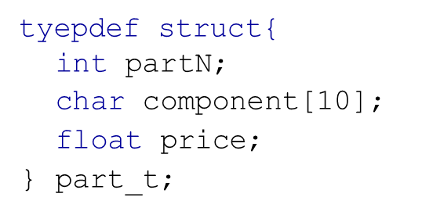
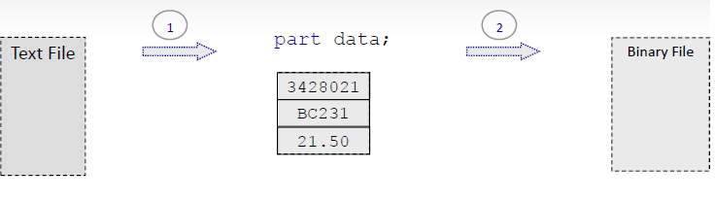
Partial Design Solution
1
fscanf( flText,
"%d%9s%f", &(data.partN),
data.component,
&(data.price) );
2
fwrite( &data, sizeof(part_t), 1, flBin );

Slide 44
…Continued
/* --define a data structure-- */ typedef struct
{
int partN;
char component[10]; float price;
} part_t;
/* part number */
/* component name */
/* retail price */
/* --- function prototype --- */
bool copyData( FILE *flText, FILE *flBin);
. . . .
/* --- status
function call --- */
= copyData( txtFileID, binFileID );
if( status == false ) { /* check for a failure */ fprintf( stderr, "Copy failed \n" );
return -1;
}

Slide 45
…Continued
/* -- function definition -- */
bool copyData( FILE *flText, FILE *flBin)
{
part_t data; /* struct variable to serve as a buffer */
while( fscanf( flText, "%d%9s%f", &(data.partN), data.component, &(data.price) ) == 3 )
{
if( fwrite( &data, sizeof(part_t), 1, flBin) != 1 )
return false; /* binary file write error */
}
if( !feof( flText) ) /*not all text file has been read*/
return false;
if (ferror(flText)||ferror(flBin) )return false;
return true; /*return true if completed without errors*/
}

Slide 46
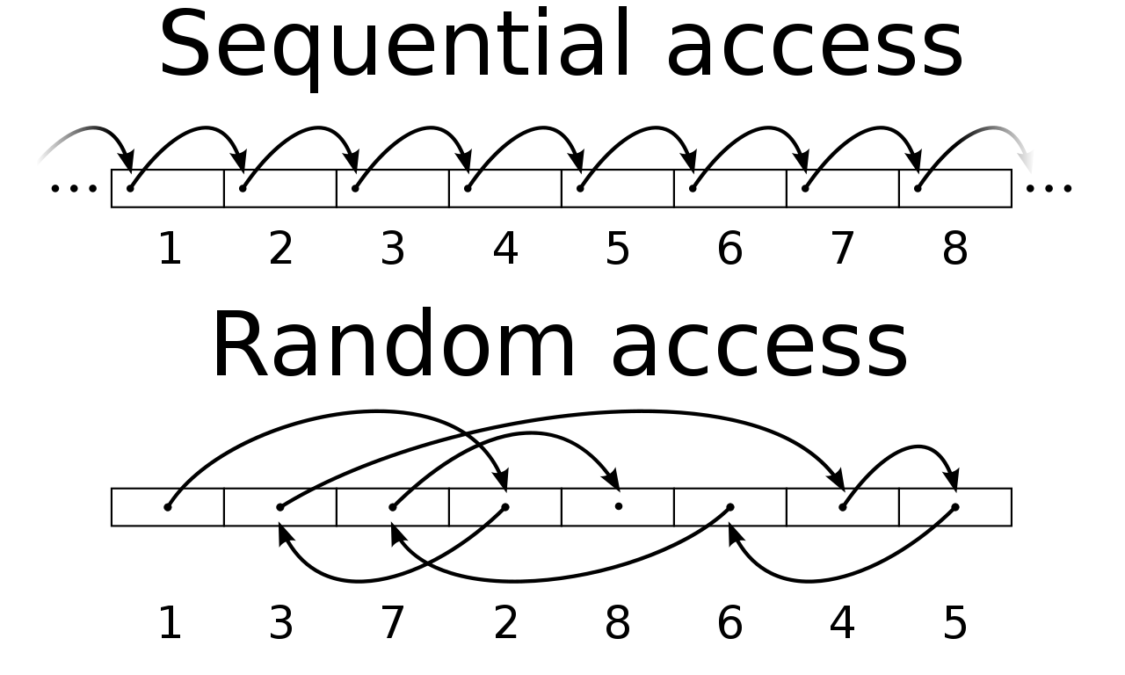
V. Random Data Access
In C, the data stored in a file can be accessed in the following ways:
Sequential Access: data is saved and accessed in sequential order
Random Access : Access any location in the file without having to access its precedent order
C supports Random Access through three functions: ftell(),fseek(), frewind()

Slide 47
File Position Indicator
Each file stream has a position indicator
The position indicator for an input stream indicates the position in the file from which data will be extracted.
34 25 77 84 59 44 58 65 43
read from here
The position indicator for an output stream indicates the position in the file where data is to be inserted.
34 25 77 84 59 44 58 65 43
write from here
− Every successful I/O operation moves the indicator automatically.

Slide 48
File Position Indicator Function: ftell()
Function ftell() returns a value of type long int that is the current file position in byte.
FILE
char long
*outBinFile;
buffer[8] = {a,b,c,d,e,f,g,h}; int filePosition;
File error handling are omitted
only to reduce the size of the code
outBinFile = fopen("results.dat", "wb");
filePosition = ftell(outBinFile); /* filePosition = 0 */ fwrite( buffer, sizeof(char), 8, outBinFile);
filePosition = ftell(outBinFile); /* filePosition = 8 */
results.dat
abcdefgh
new position

Slide 49
File Indicator Repositioning: fseek
The Function
int fseek(FILE *fp, int displacement, int origin)
is to move forward or backward the file position indicator by a number of bytes displacement relative to the origin
origin SEEK_SET SEEK_CUR SEEK_END
Meaning
O: beginning of the file
1: current position
2: end of the file
The function returns 0 if the indicator has been successfully moved, or nonzero if an error occurred.
You always need to check if repositioning has been successful.

Slide 50
…Continued
FILE *inFile;
int filePosition;
outBinFile = fopen("results.dat",
"rb");
45476575869869401158
if( fseek(inFile, 4, SEEK_SET) !=
0) { ..error ..}
45476575869869401158
if( fseek(inFile,
-3, SEEK_END) != 0) { ..error ..}
45476575869869401158

Slide 51
Caution
Positioning beyond the end‐of‐file does not cause an error. File position indicator is moved.
Subsequent reading from that position causes EOF error:
fseek(inFile, 5, SEEK_END);
5 4 1 1 3 4 7 8 9 4
Subsequent writing starts from that position.
fwrite( &buff,
sizeof(char), 3, outFile );
5 4 1 1 3 4 7 8 9 4 0 0 0 0 0 9 4 8

Slide 52
…Continued
Positioning before the file beginning does NOT move the File position indicator:
fseek(inFile, -4, SEEK_CUR);
37485987374757586868
Notes:
rewind() prototype
void rewind(FILE* stream); A call to rewind(stream) is equivalent to a call to fseek(stream, 0, SEEK_SET), except that end-of-file and error indicators are cleared.

Slide 53
Example 1: File size using ftell() and fseek()
How to obtain a total number of bytes stored in a file?
int pos, fileSize; FILE *fileP;
fileP = fopen(filename, "rb");
if(fileP == NULL ) { Error Recovery Action } fseek( fileP, 0, SEEK_END ); /*position to the End*/
pos = ftell(fileP); /* get position of the End*/
fileSize = pos; /* size = end position-0*/

Slide 54
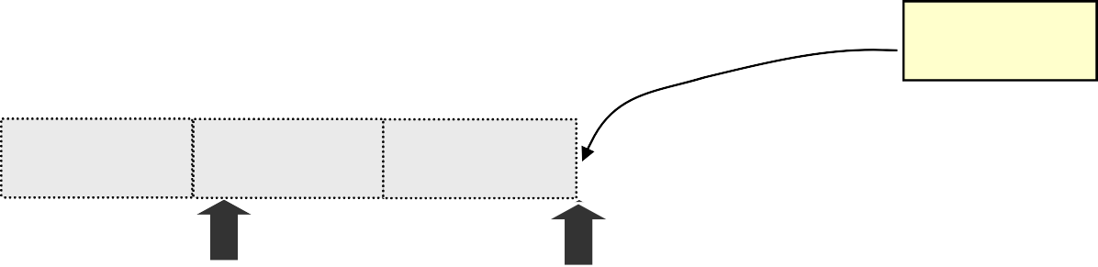
Caution
If a file stream has been opened in append mode, all positioning attempts are ignored. All output is always directed to the end‐of‐file
Example:
db = fopen( "list.dat", "ab" ); if( fseek( db, 5, SEEK_SET ) != 0 )
fprintf(stderr, " File Positioning Error \n"); if( fwrite( buff, sizeof(char), 5, db) != 5 )
printf("Write error \n");
No errors will be reported, but...
01234 56789 abcde
ABCDE

Slide 55
Example 2: Random File Reading
An automatic temperature registration system saves an average daily temperature in a file. Your program must read data from this file and calculate an average temperature for a specified week.
You need to know the file name and its path.
You need to have permission to access this file.
You need to know the file format.

Slide 56
…Continued
“2014.dat" file is in the current directory.
You have a permission to read this file.
Temperature measurements are stored in the file in binary format as a sequence of float numbers starting from a week 1.
24.5
26.7
25.1
24.2
20.6
19.0
21.5
23.8
27.5
28.2
week 1

Slide 57
…Continued
Use fseek( tmpData,
offset, SEEK_SET );
file
24.5
26.7
25.1
24.2
20.6
19.0
21.5
23.8
27.5
28.2
buffer
25.1 24.2
Then fread(
20.6
19.0
21.5
23.8
27.5
buffer, sizeof(float),
7, tmpData )

Slide 58
…Continued
FILE *tmpData;
float sum = 0.0, buffer[7]; int i, offset, weekNum,
tmpData = fopen("2014.dat", "rb" );
if(tmpData == NULL ) { ..Error Recovery Actions.. }
/* calculate the required position */
offset = (weekNum-1)*7*sizeof(float);
/* -- move indicator to the required position -- */
if( fseek( tmpData, offset, SEEK_SET ) != 0)
{ ..Error | Recovery Actions.. | }
/* -- read 7 values -- */
if(fread( buffer, sizeof(float), | 7, tmpData ) != 7)
{ ..Error | Recovery Actions.. | }
for(i=0; i<7; i++) sum += buffer[i];
/* calculate the average temperature */ printf("The average weekly temperature: %f", fclose(tmpData); /* Close the file stream
sum/7 );
*/
Appendix next…..

Slide 59
Summary: Data I/O using Text and Binary Files
Table in next slide compares the use of text and binary files for input and output of data of various types. The statements in both columns assume the following constant macros, type definition, and variable declarations.
#define STRSIZ 10
#define MAX 40
typedef struct {
char name[STRSIZ];
double diameter; /* equatorial diameter in km */
int moons; /* number of moons */
int orbit_time, /* years to orbit sun once */
rotation_time; /* hours to complete one
revolution on axis */
} planet_t;
. . .
double nums[MAX], data;
planet_t a_planet;
int i, n, status;
FILE *plan_bin_inp, *plan_bin_outp, *plan_txt_inp, *plan_txt_outp;
FILE *doub_bin_inp, *doub_bin_outp, *doub_txt_inp, *doub_txt_outp;

Slide 60
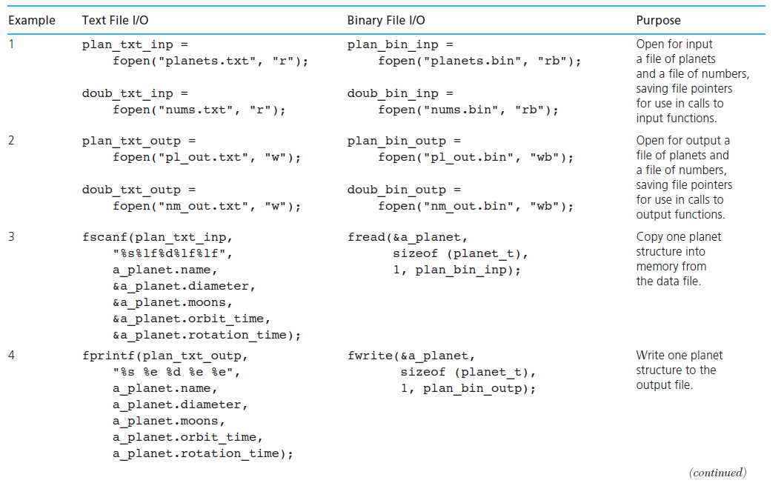
…Continued

Slide 61
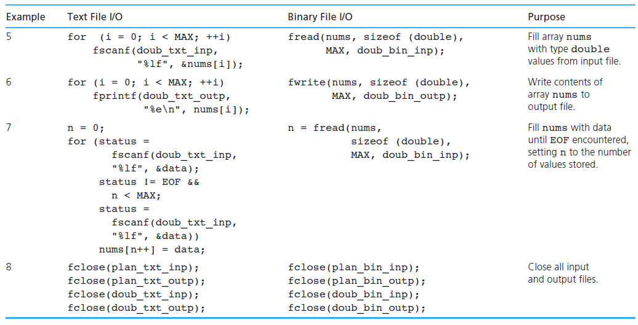
…Continued

Slide 62
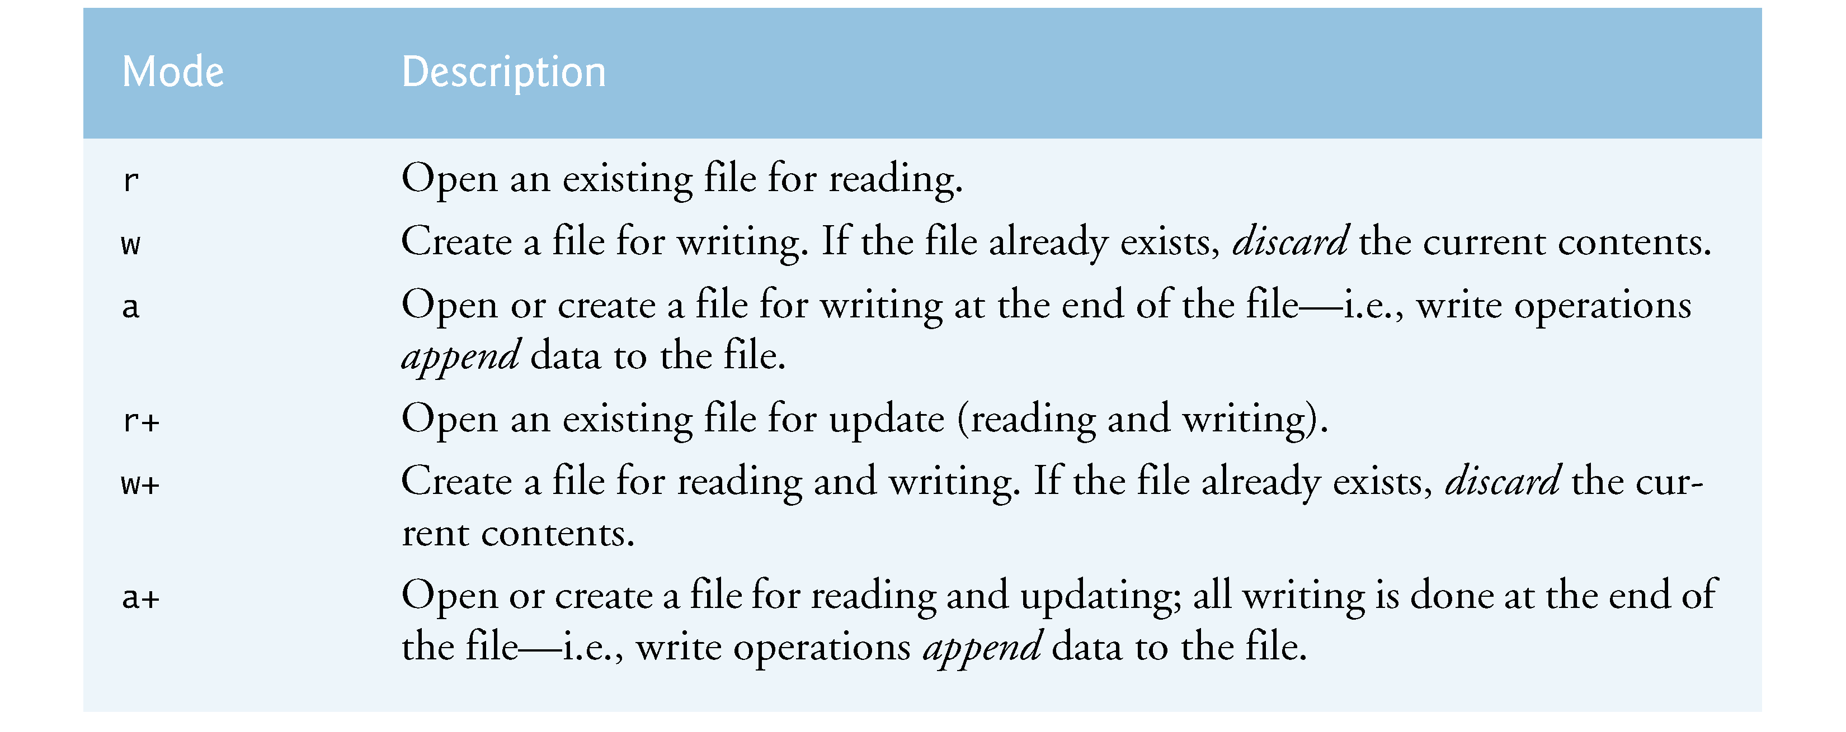
Text File Access Mode

Slide 63
Common Programming Errors
Misunderstanding of file I/O functions.
Confusing file stream pointers and file names.
Not all possible errors with file operations are anticipated.
File stream is not closed when you finish working with it.
Opening file for output using "w" mode erases the previous file content.
Attempts to read a file, which has been opened only for output.

Slide 64
Removing a File: remove()
Closing a file stream do not remove a physical file from a file system.
To remove a file use remove(file_name) function:
if( remove("tempfile.txt") == -1 )
fprintf(stderr," Error removing tempfile \n");
remove : On success, zero is returned. On error, -1 is returned
Remove fails if:
file is currently used by a program
you do not have a permission
file does not exist
Notes:
remove : On success, zero is returned. On error, -1 is returned, and errno is set appropriately.

Slide 65
Error Clearing
Once the stream is in the error state, it will stay that way.
All subsequent operations may have unpredictable behaviour no matter what they are or what is in the input.
If you intend to use a stream after a failure, you have to clear the stream by calling clearerr() function.
fscanf(inFile, “%f”, price);
If(ferror(inFile)) /* check the error indicator */
clearerr(inFile);
This will clear the two file indicators and recover the file stream from the error state. However, further reading of data may be useless.

Slide 66
fgets, fgetc,fputs, fputc functions
int fgetc(FILE* stream);: fgetc cast the character to an integer
On success, the fgetc() function returns the read character.
On failure it returns EOF. If the failure is caused due to end of file, it sets the eof indicator. If the failure is caused by other errors, it sets the error indicator
int putc(int char, FILE *stream) writes a character (an unsigned char) specified by the argument char to the specified stream and advances the position indicator for the stream. This function returns the character written as an unsigned char cast to an int or EOF on error.
On an error sets the error indicator on stream.
fgets() prototype
char* fgets(char* str,int count,FILE* stream);
The fgets() function reads a maximum of count-1 characters from the given file stream and stores them in the array pointed to by str.
The parsing continues until the end of file occurs or a newline character (\n) is found. The array str will contain the newline character too in case it is found. If no error occurs, a null character is written at the end of str
On success, the fgets() function returns str and on failure it returns null pointer.
If the failure is caused due to end of file condition, it sets the eof indicator. In this case, the contents of str are not changed.
If the failure is caused due to some other error, it sets the error indicator. In this case, the contents of str are indeterminate. They may not even be null terminated.
fputs() prototype
int fputs(const char* str, FILE* stream); The fputs() function writes all the character stored in the string str to the output file stream except the terminating null character.
On success, the fputs() function returns a non-negative value. On failure it returns EOF and sets the error indicator on stream.

Slide 67
Character Input/Output
How to read all characters from a text file including blanks, tabs and new‐lines ?
fscanf(inFile,"%c", &ch) – if performance is not an issue
fgetc() , or getc() to read one character at a time
int ch;
/* the data type must be int although ASCII codes a stored */
while( (ch = fgetc(inFile)) != EOF )
{ process a character }
fputc(), or putc() int ch = 'H'; while( fputc(ch,
functions to write one character at a time
must be a valid ASCII character
outFile) != EOF )
{ put a character into the variable }

Slide 68
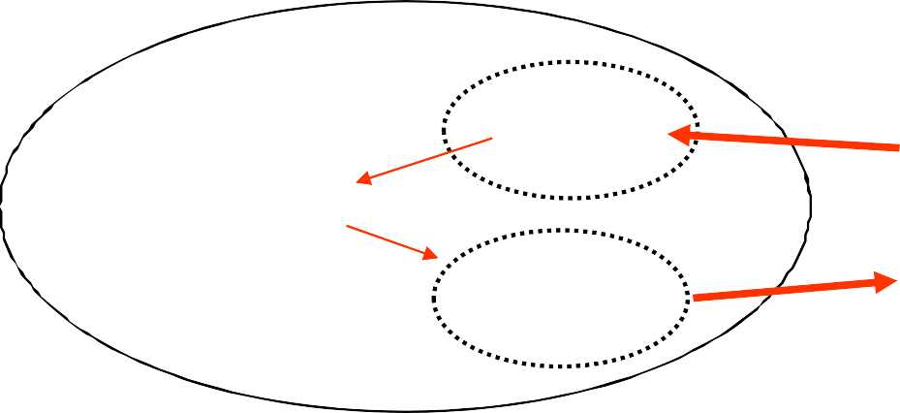
Caution
Operations when one file is associated with two streams are prone to errors.
inData
in Buffer
C program
File
results.txt
out Buffer
outData

Slide 69
Quiz
What is wrong with this code and how the bug can be fixed?
FILE *outFile; FILE *inFile; int i, ch;
outFile = fopen( "temp.txt", "w" );
. . . .
fopen( "temp.txt", "r" );
.
inFile =
. . .
for( i=0; i<LENGTH; i++ )
{
fputc( i, outFile );
ch = fgetc( inFile );
}
Answer: Read and write at the same time. First, write all characters and then read all characters. ( 2 loops)

Slide 70
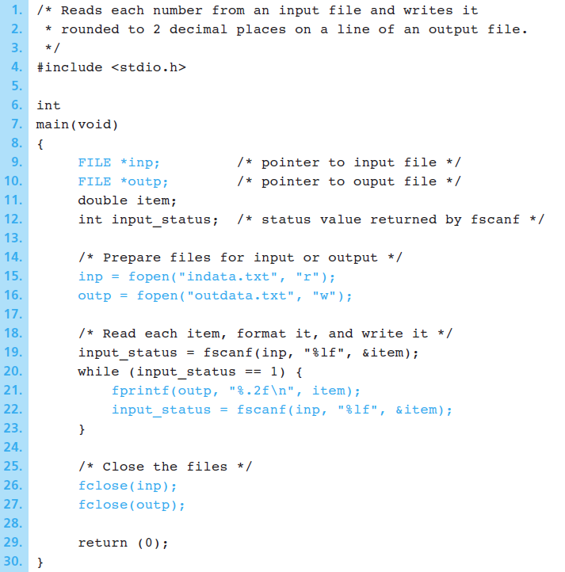
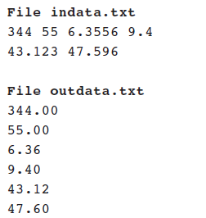
Example1: Format Text File Data in another File
A program that reads a collection of numbers from a file indata.txt and writes each number rounded to 2 decimal places on a separate line of file outdata.txt.
The error handling in this sample program is incomplete

Slide 71
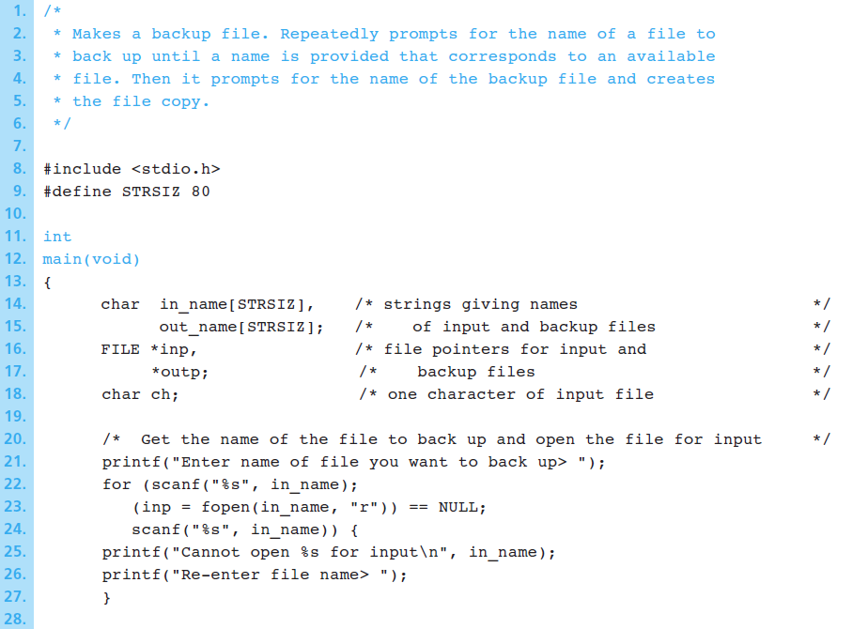
Example 2 : Backup Copy of a Text File
A program that Makes a backup file. Repeatedly prompts for the name of a file to back up until a name is provided that corresponds to an available file. Then it prompts for the name of the backup file and creates the file copy.

Slide 72
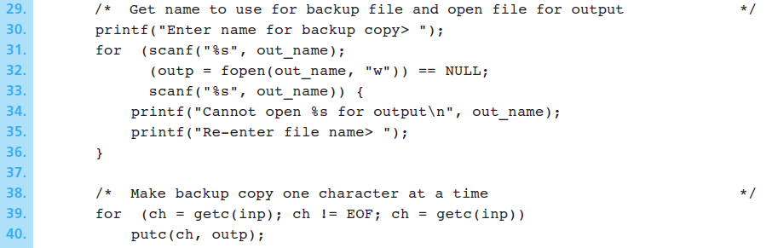
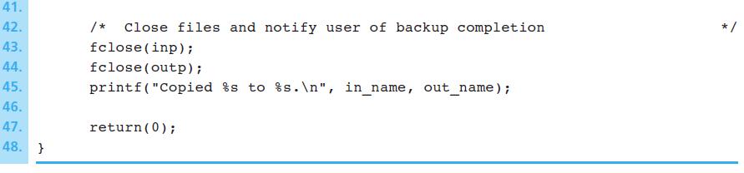
…Continued
The error handling in this sample program is incomplete

