Slide 1
Example 1 : Pass by Value
A function that should swap two values
void swap( int first,int second)
{
int temp;
temp = first;
first = second;
second = temp;
return;
}
int main(void)
{
int num1=3,
num2=9;
swap(num1,num2);
}
Actually, it does not! As copies of num1 and num2 are passed to the function, all changes of first and second have no effect on num1 and num2.

Slide 2
…Correction- Pass by Reference
Pass the addresses of the variables from the main()
void swap( int *first,int *second)
{
int temp;
temp = *first;
*first = *second;
*second = temp;
return;
}
int main(void)
{
int num1=3, num2=9;
swap(&num1,&num2);
}
*first = &num1
*second = &num2
As first and second point to num1 and num2, any changes in first and second affect num1 and num2

Slide 3
Example 2 :Program to Sort three Numbers
Write a program that gets three data values, num1, num2, and num3, and rearrange the data so that they are in increasing sequence.

Slide 4
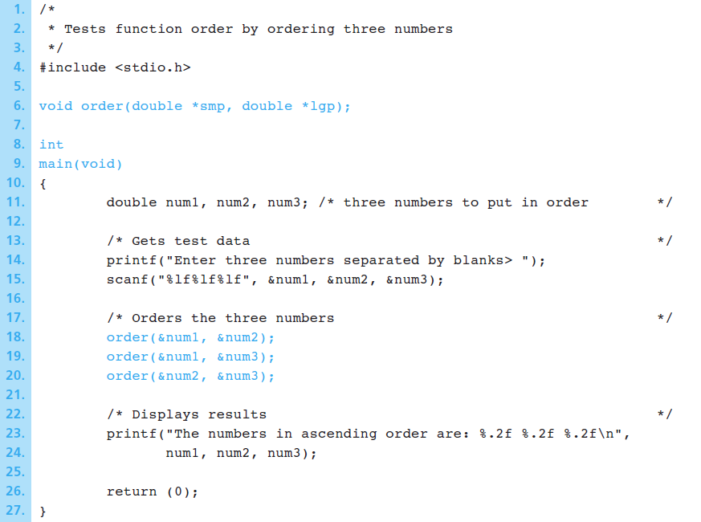
…Continued

Slide 5
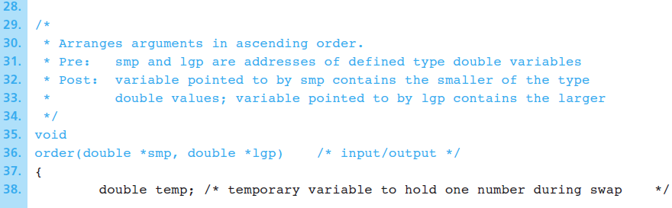
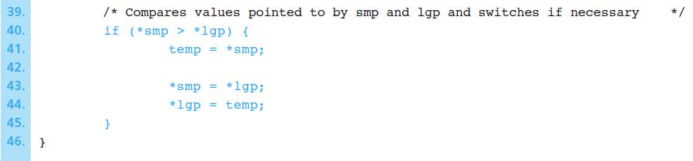
…Continued

Slide 6
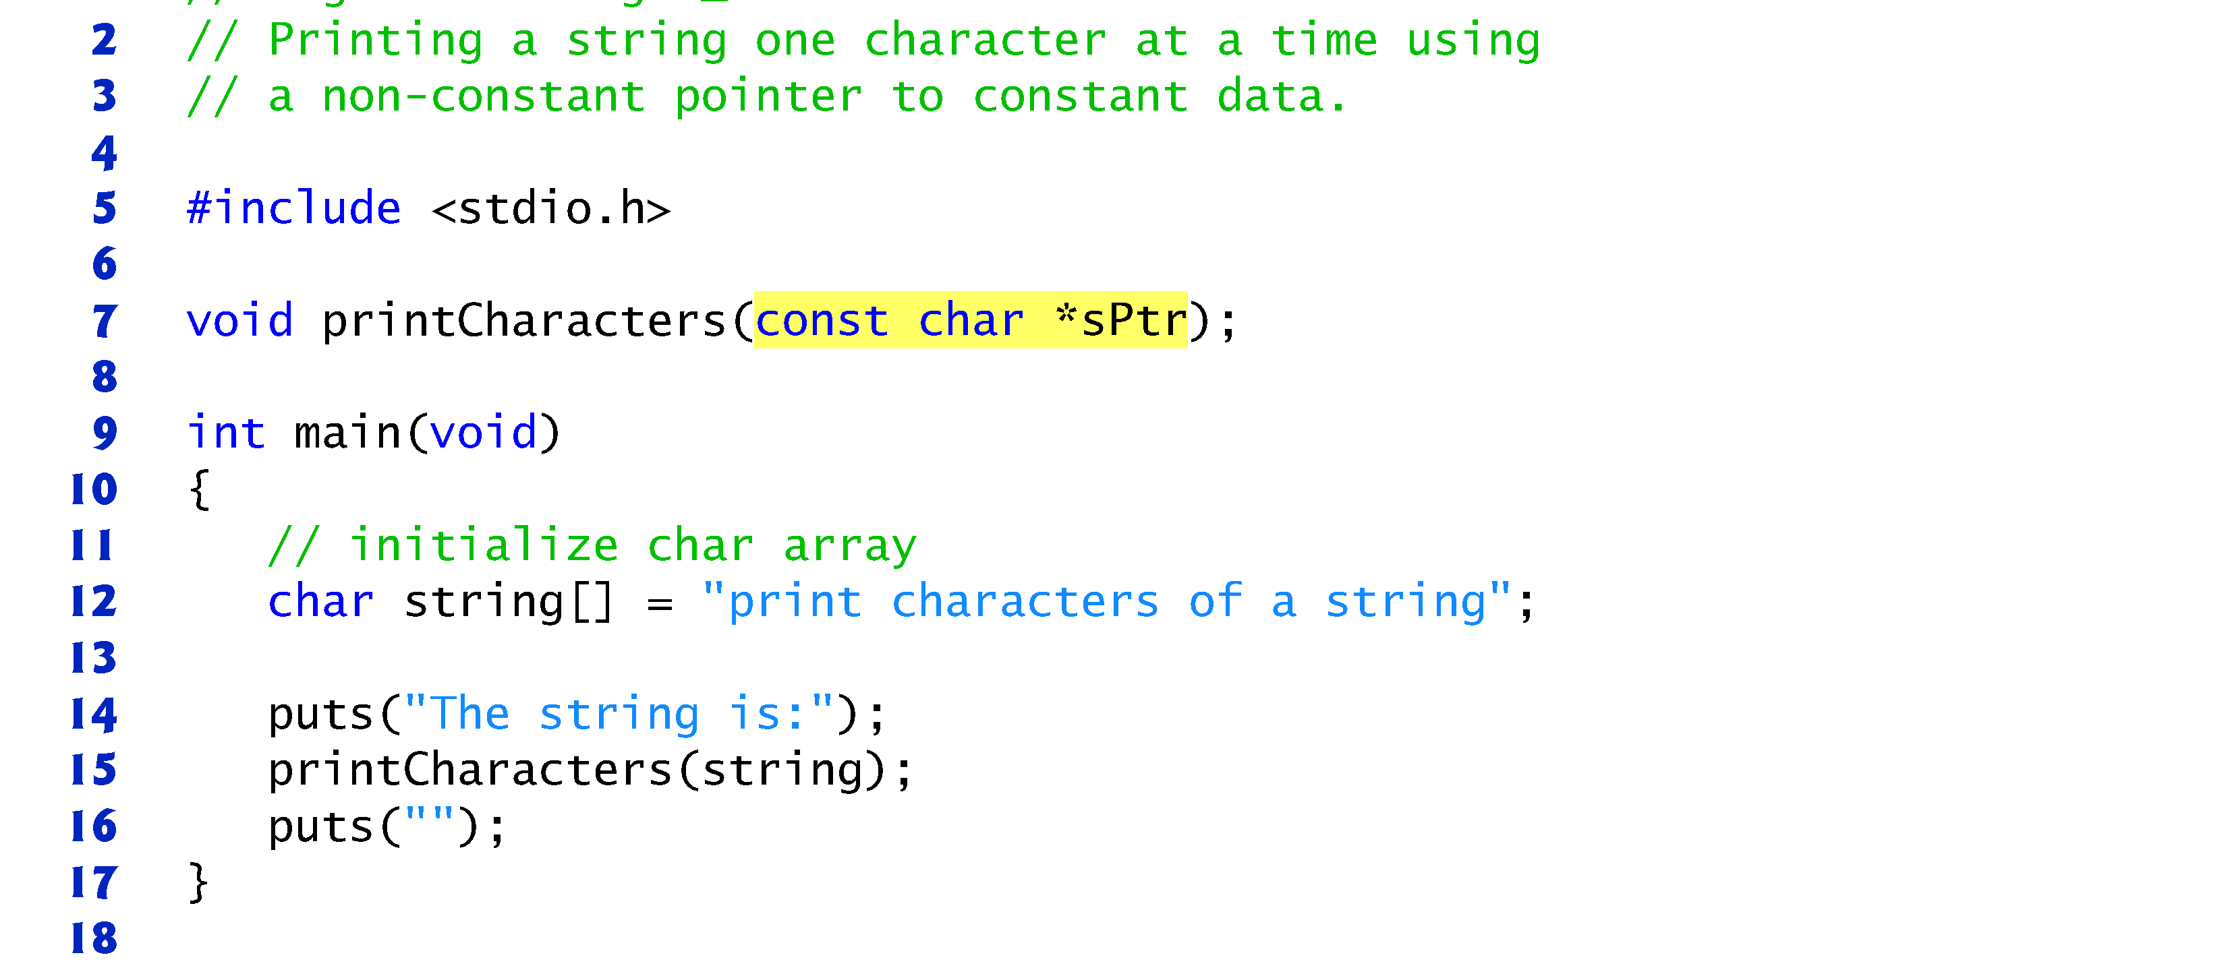
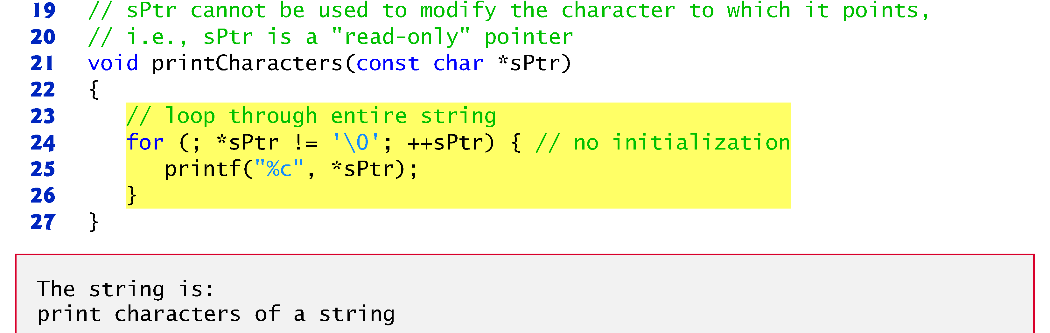
Example 3 : Printing a string
Notes:
Const tells the compiler don’t change the value of the character

Slide 7
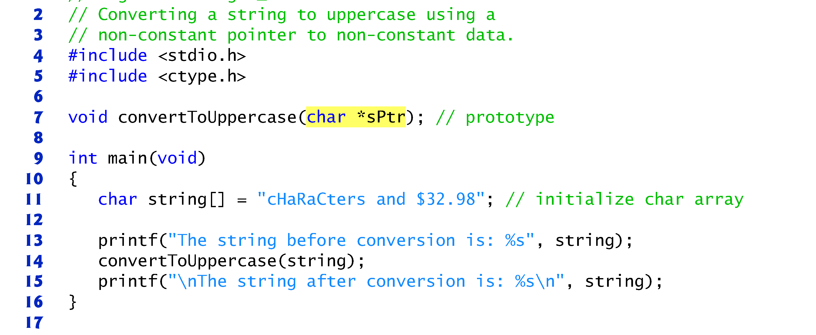
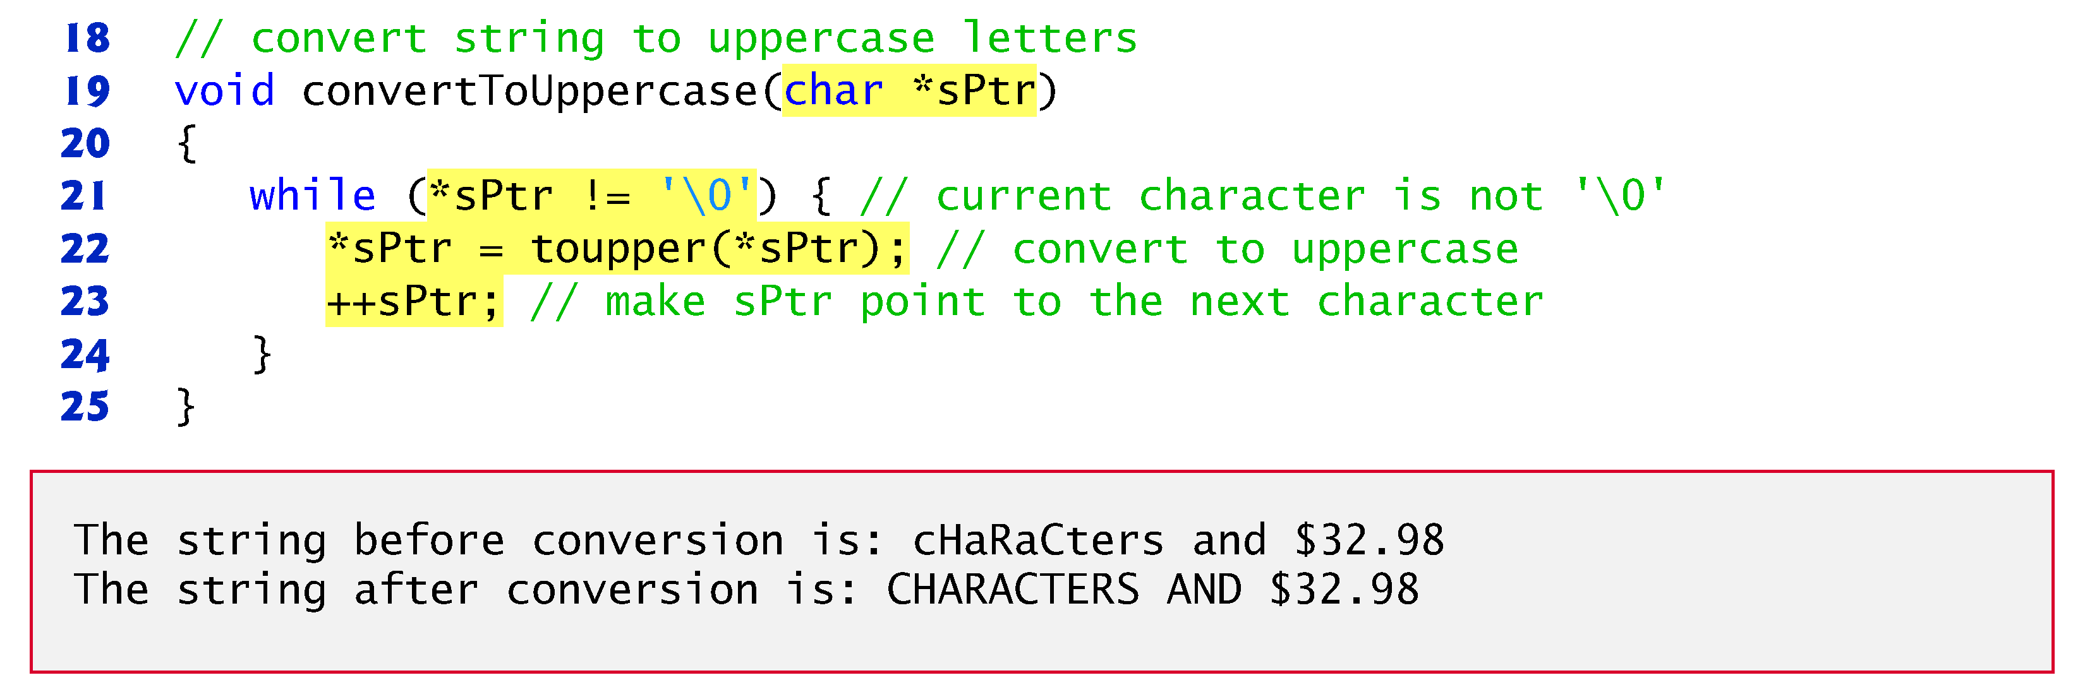
Example 4 : Converting a string case

Slide 8
Example 5 : C sizeof with pointers
float | *ptrF; | /* | can | only | point | at | float variables */
char | *ptr1; | /* | can | only | point | at | char variables */
int | *ptr2; | /* | can | only | point | at | int variables */
printf("char* | pointer requires %d bytes\n", sizeof(ptr1) | );
printf("char* | points at %d byte data", sizeof(*ptr1) );
Output:
char* pointer requires 4 bytes char* points at 1 byte data
As all pointers have a type associated with them, you cannot assign a pointer of one type to a pointer of another type.

Slide 9
Example 5: Using Array Elements as Function Arguments
The function prototype below shows one type double input parameter ( arg_1 ) and two type double * output parameters ( arg2_p and arg3_p ).
void do_it (double arg_1, double *arg2_p, double *arg3_p);
If x is declared as an array of type double elements in the calling module, the statement:
do_it(x[0], &x[1], &x[2]);
uses the first three elements of array x as actual arguments. Array element x[0] is an input argument and x[1] and x[2] are output arguments.
Notes:
21.3
21.3

