Slide 1
Expanding and Updating OSM Data with Deep Learning

Slide 2
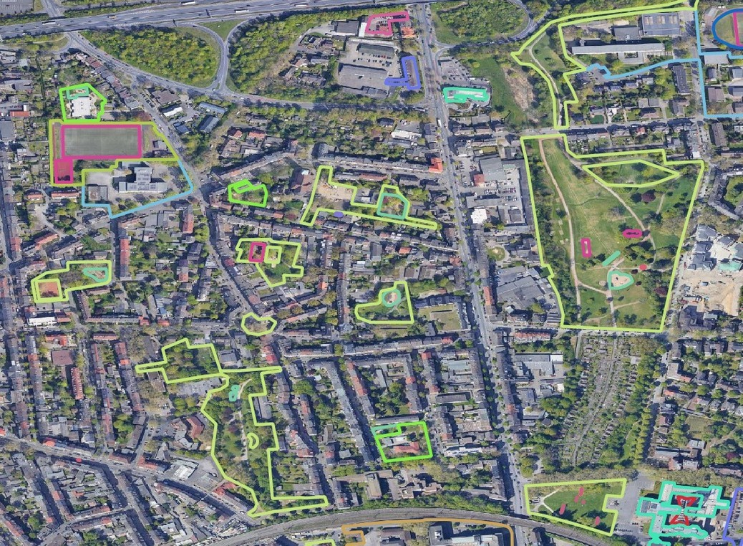
The problem
Open Street Map
OSM data is not available everywhere and it’s also not updated everywhere in a high frequency
Why not use the OSM labels for expanding the dataset to less covered areas and help the data to be updates?
●
●

Slide 3
The Framework
WebScraping
Checking labels and cleaning data Select features
Narrow detections (South America? Africa?)
Gather images from WMTS service and cut it and other pre- processing
CNN and Vision Transformer Model assessment and comparison
●
●
●
●
●
●
●

