Slide 1
Expanding and Updating OSM Data with Deep Learning

Slide 2
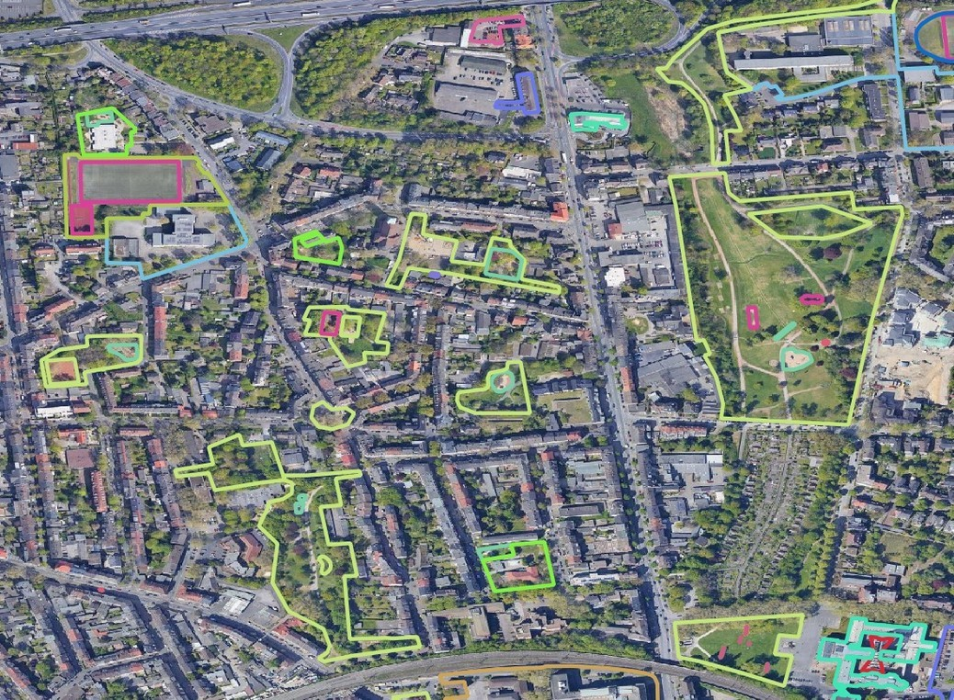
The problem
Open Street Map
OSM data is not available everywhere and it’s also not updated everywhere in a high frequency
Why not use the OSM labels for expanding the dataset to less covered areas and help the data to be updates?
●
●

Slide 3
The Framework
WebScraping
Checking labels and cleaning data Select features
Narrow detections (South America? Africa?)
Gather images from WMTS service and cut it and other pre- processing
CNN and Vision Transformer Model assessment and comparison
●
●
●
●
●
●
●

Slide 4

On Going
WebScraping
Checking labels and cleaning data Select features
Narrow detections (South America? Africa?)
●
●
●
●
to be analysed
●
Gather images from WMTS service and cut it and other pre- processing
●
CNN and Vision Transformer
Next one : COCO annotations
●
Model assessment and comparison

Slide 5
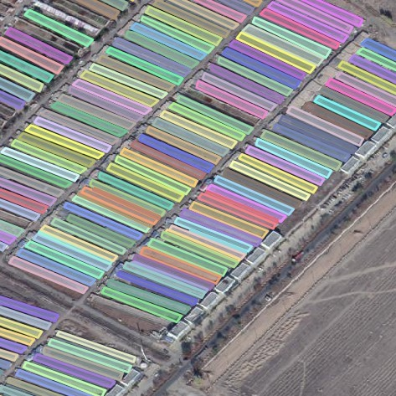
shp2coco
https://github.com/DuncanChen2018/shp2coco

Slide 6

For two weeks
COCO annotations – done
First try with CNN (Local, Palma, debugging...)
●
●

