Slide 1
Numerical Simulation of Financial
Stochastic Differential Equations
From Euler–Maruyama to Nested-Grid Verification
Group Members
Member 1: ____________________ Student ID: ____________________
Member 2: ____________________ Student ID: ____________________
Member 3: ____________________ Student ID: ____________________
Member 4: ____________________ Student ID: ____________________
Member 5: ____________________ Student ID: ____________________
Numerical Partial Differential Equations
September 2026

Slide 2
Purpose of the Presentation
Audience: students familiar with elementary probability and the explicit Euler method, without prior stochastic calculus or finance.
Discretise a stochastic differential equation on a time grid.
Use Monte Carlo averages to estimate expectations and uncertainty.
Explain the difference between Euler–Maruyama and Milstein.
Distinguish strong convergence from weak convergence.
Validate a solver when no exact solution is available.
State clearly what the numerical evidence does and does not establish.

Slide 3
The Numerical Workflow
Continuous model
dZ = a(Z)dt + b(Z)dW
Time grid
tₙ = nh
Time stepping
EM / Milstein
Repeated paths
Monte Carlo
Error analysis
strong / weak
Evidence
slopes, intervals, diagnostics
Central numerical-analysis question
A simulation is credible only when the discretisation, error reduction, statistical uncertainty, and reproducibility are explicit.

Slide 4
Connection with Numerical PDEs
For dSₜ = a(Sₜ)dt + b(Sₜ)dWₜ, define the conditional expectation
u(t,s) = E[ φ(Sₜ) | Sₜ = s ]
uₜ + a(s)uₛ + ½b(s)²uₛₛ = 0, u(T,s) = φ(s)
PDE route: discretise the derivatives on a grid in (t,s).
This coursework: discretise random paths in time and approximate the expectation by Monte Carlo.
Course connection
The central ideas remain discretisation, convergence, stable computation, and error quantification.

Slide 5
Two Models, Two Numerical Roles
Aspect | Model 1: GBM benchmark | Model 2: non-affine model
Purpose | Exact solution for verification | Realistic test without a closed form
Methods | Exact update, EM, Milstein | Log-variable Euler–Maruyama
Outputs | Strong/weak errors and moments | Nested-grid differences and nonlinear observables
Reference | Exact terminal value on the same path | A much finer numerical grid
Main issue | Path error versus expectation error | Error in the numerical reference
Strategy
Validate the implementation on an exact benchmark before using it in a model without an exact solution.

Slide 6
Structure
1. From the Euler method to stochastic time stepping
2. Model 1: verification against an exact solution
3. Model 2: nested-grid verification without an exact solution
4. Evaluation, reproducibility, and conclusions
5. Backup derivations

Slide 7
1. From the Euler Method to Stochastic Time Stepping
Time grids, Brownian increments, Monte Carlo, and convergence

Slide 8
Review: Explicit Euler for an ODE
For y′(t)=f(y), introduce tₙ=nh with h=T/N.
y(tₙ₊₁) − y(tₙ) ≈ f(yₙ)h
yₙ₊₁ = yₙ + f(yₙ)h
Key idea
Continuous evolution is replaced by many short steps. A smaller h usually improves the approximation at greater computational cost.

Slide 9
An SDE Adds a Random Increment
A scalar stochastic differential equation has two contributions:
dZₜ = a(Zₜ)dt + b(Zₜ)dWₜ
a(Zₜ)dt: drift, analogous to deterministic ODE motion.
b(Zₜ)dWₜ: diffusion, representing random fluctuations.
Brownian paths are not differentiable, so an ordinary Taylor expansion is insufficient.
One-step viewpoint
Freeze both coefficients at the left endpoint to obtain the basic stochastic Euler method.

Slide 10
Brownian Increments in the Code
The program generates independent standard normal variables Zₙ.
ΔWₙ = Wₜₙ₊₁ − Wₜₙ ~ N(0,h), ΔWₙ = √h Zₙ
E[ΔWₙ] = 0: positive and negative disturbances cancel on average.
SD(ΔWₙ) = √h: the random increment is O(√h), not O(h).
Common error
Using hZₙ suppresses the stochastic term too rapidly and changes the limiting model.

Slide 11
Euler–Maruyama
Freeze drift and diffusion over a single time step:
Zₙ₊₁ = Zₙ + a(Zₙ)h + b(Zₙ)ΔWₙ
The method is explicit and uses only the known state Zₙ.
One increment sequence produces one approximate path.
Many paths are required to estimate expectations and uncertainty.

Slide 12
Monte Carlo Estimation
For independent samples X⁽¹⁾,…,X⁽ᴹ⁾, estimate E[X] by
m̂ᴹ = (1/M) Σᵢ X⁽ⁱ⁾, SE(m̂ᴹ) ≈ sₓ/√M
95% CI: m̂ᴹ ± 1.96 sₓ/√M
Cost implication
Halving the Monte Carlo standard error requires approximately four times as many paths.

Slide 13
Two Contributions to the Total Error
A Monte Carlo time-stepping estimate contains two conceptually different errors:
Q̂ₕ,ᴹ − Q = [ E(Qₕ) − Q ] + [ Q̂ₕ,ᴹ − E(Qₕ) ]
time-discretisation bias sampling noise
Typical bias size: Chᵖ.
Typical sampling error: Cᴹ M⁻¹ᐟ².
Experimental design principle
To measure p, sampling noise must remain below the time-discretisation error over the fitted grid range.

Slide 14
Why Stochastic Taylor Expansions Need a Correction
Itô's formula is the stochastic counterpart of the chain rule:
df(Zₜ) = f′(Zₜ)dZₜ + ½ f″(Zₜ)b(Zₜ)²dt
ΔW = O(√h), so (ΔW)² = O(h).
Some second-order random terms are as large as the deterministic drift term.
Practical interpretation
Those second-order random terms cannot be discarded in a higher-accuracy pathwise method.

Slide 15
Milstein: One Additional Random Second-Order Term
For dZ=a(Z)dt+b(Z)dW, the scalar Milstein update is
Zₙ₊₁ = Zₙ + a(Zₙ)h + b(Zₙ)ΔWₙ
+ ½ b(Zₙ)b′(Zₙ)[(ΔWₙ)² − h]
The first three terms are Euler–Maruyama.
The correction has zero expectation because E[(ΔW)²]=h.
In scalar problems, the strong order typically rises from 1/2 to 1.

Slide 16
Coupling Coarse and Fine Paths
If one coarse step contains q fine steps, define
ΔWᶜₖ = Σⱼ₌₁ᑫ ΔWᶠₖ,ⱼ and ΔWᶜₖ ~ N(0,qhᶠ)
Coupled comparison: both solutions use the same Brownian path.
Independent comparison: the difference is dominated by two different random paths.
Why coupling matters
A strong error should isolate time-discretisation error rather than random-input differences.

Slide 17
Strong and Weak Errors
Strong error: are paths close?
Weak error: are statistics close?
e_strong(h) = E|Zᵀʰ − Zᵀ|
The numerical and exact terminal values must share the same Brownian path.
e_weak(h) = |E φ(Zᵀʰ) − E φ(Zᵀ)|
Only the expectation of a chosen observable is compared.
They are not interchangeable
A method may be inaccurate path by path while estimating a particular expectation accurately.

Slide 18
Reading a Convergence Order
If e(h) ≈ Chᵖ, take logarithms:
log e ≈ log C + p log h
p = 1/2: halving h multiplies the error by about 0.707.
p = 1: halving h multiplies the error by about 0.5.
The log–log fitted slope estimates p.
Caution
Interpret the slope together with its fitting range, uncertainty, and reference-solution error.

Slide 19
2. Model 1: Verification against an Exact Solution
Geometric Brownian motion as a controlled benchmark

Slide 20
Geometric Brownian Motion as a Test Equation
The benchmark model is
dSₜ = μSₜdt + σSₜdWₜ
S₀=100, μ=0.05, σ=0.30, T=1
Drift and diffusion are proportional to the current state.
The exact solution permits direct error measurement.
The exact state remains positive, providing an additional diagnostic.
Why start here?
A solver should reproduce known benchmark behaviour before it is used in a model without an exact solution.

Slide 21
Deriving the Exact GBM Solution
Apply Itô's formula to log S:
d log Sₜ = (μ − ½σ²)dt + σdWₜ
Sₜ = S₀ exp[(μ − ½σ²)t + σWₜ]
Interpretation
The term −σ²/2 follows from the stochastic chain rule; it is not an additional financial assumption.

Slide 22
Exact Moments as Distribution-Level Checks
The terminal state is lognormal, giving
E[Sᵀ] = S₀eᵘᵀ = 105.1271
Var(Sᵀ) = S₀²e²ᵘᵀ(eˢ²ᵀ−1) = 1040.7868
Exact-sampling estimate of the mean: 105.1987.
Exact-sampling estimate of the variance: 1045.0120.
Differences are consistent with Monte Carlo sampling variation.

Slide 23
Three One-Step Updates for GBM
All methods use the same ΔWₙ ~ N(0,h).
Exact: Sₙ₊₁ = Sₙ exp[(μ−½σ²)h + σΔWₙ]
EM: Sₙ₊₁ = Sₙ(1 + μh + σΔWₙ)
Milstein: Sₙ₊₁ = Sₙ[1 + μh + σΔWₙ + ½σ²((ΔWₙ)²−h)]
Fair comparison
Reusing the same increments ensures that terminal differences reflect numerical error rather than different random inputs.

Slide 24
Core GBM Implementation
h = T / N
dW = np.sqrt(h) * rng.standard_normal((M, N))
S_em = np.full(M, S0)
S_mil = np.full(M, S0)
for n in range(N):
dw = dW[:, n]
S_em *= 1.0 + mu*h + sigma*dw
S_mil *= (1.0 + mu*h + sigma*dw
+ 0.5*sigma**2*(dw**2 - h))
W_T = dW.sum(axis=1)
S_exact = S0*np.exp((mu - 0.5*sigma**2)*T + sigma*W_T)
Implementation points
The arrays advance M paths simultaneously, and the exact value uses the sum of the same increments.

Slide 25
GBM Experimental Protocol
T=1, grid sizes N=2ᵏ, and step size h=T/N.
A fixed number of paths and a recorded random seed are used.
Strong error: M⁻¹Σᵢ|Sᵀ,ᵢʰ − Sᵀ,ᵢ exact|.
Standard error is computed from the pathwise absolute differences.
Weak mean error is evaluated analytically whenever possible.
Log–log regression is applied over a stated asymptotic range.
Role of the random seed
A fixed seed does not improve accuracy. It permits exact reproduction of the pseudorandom sample.

Slide 26
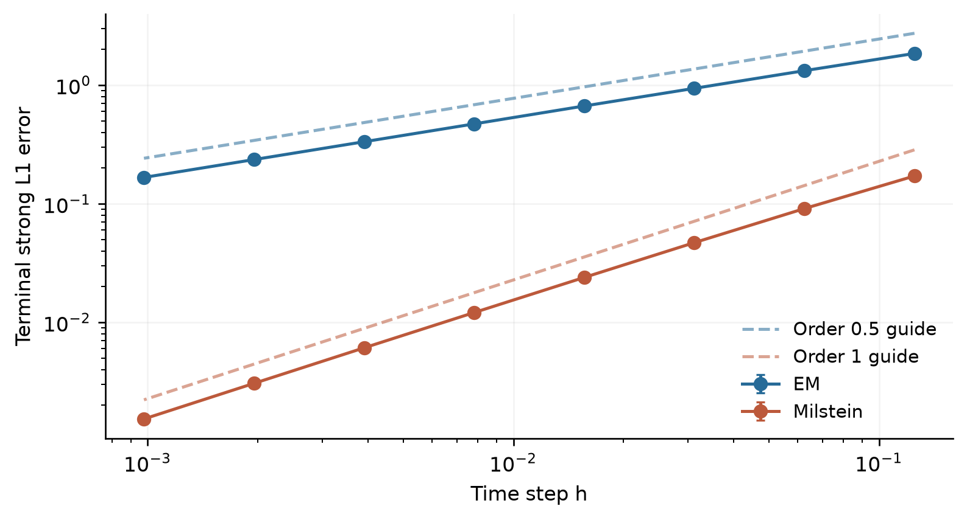
GBM Strong-Convergence Results
Fitted slopes: Euler–Maruyama 0.500; Milstein 0.991.

Slide 27
Interpreting the Strong-Error Plot
Method | N=64 | N=1024 | Reduction
Euler–Maruyama | 0.66641 | 0.16658 | about 4×
Milstein | 0.02391 | 0.00153 | about 15.6×
Conclusion
Increasing N by 16 reduces h by 16. The observed reductions agree with strong order 1/2 for EM and order 1 for Milstein.

Slide 28
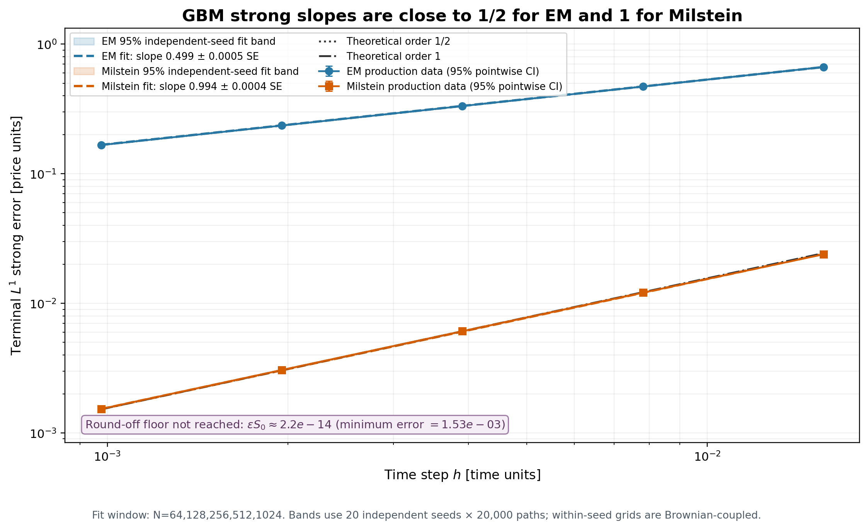
Individual Challenge: Before and After
BEFORE: error curves alone
AFTER: repeated-run error bars, theory guides, fitted slopes
Improvement
A qualitative visual claim becomes quantitative, checkable, and reproducible evidence.

Slide 29
Analytic Weak Mean Error
Euler–Maruyama satisfies E[Sₙ₊₁ | Sₙ] = Sₙ(1+μh).
E[Sᴺ EM] = S₀(1+μh)ᵀᐟʰ
|S₀(1+μh)ᵀᐟʰ − S₀eᵘᵀ| = O(h)
The Milstein correction has zero expectation.
Therefore EM and Milstein have the same terminal mean and the same weak mean bias.

Slide 30
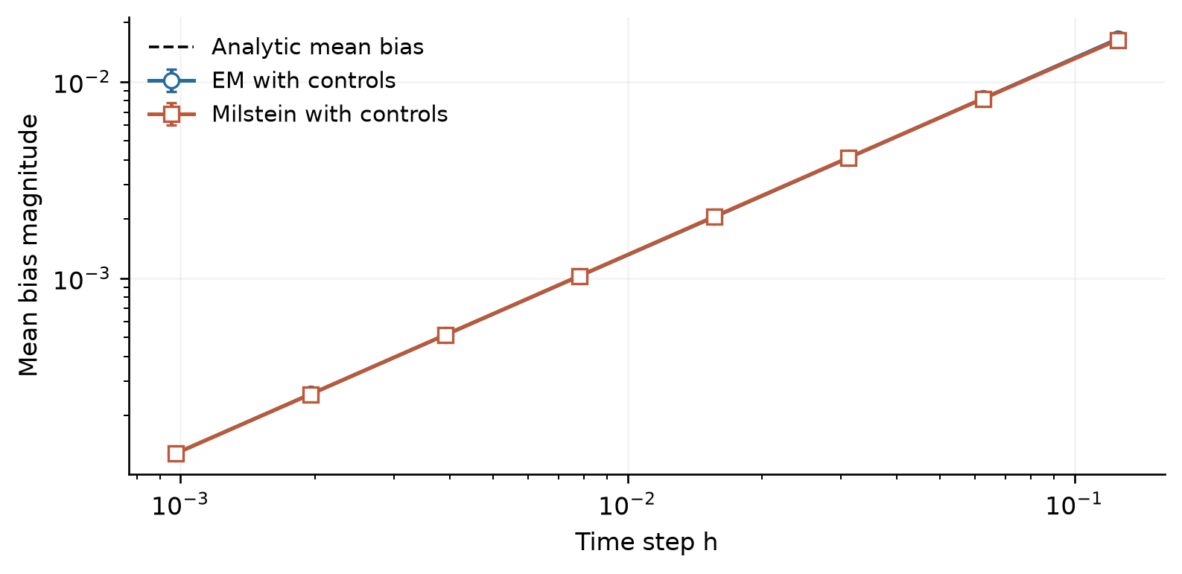
GBM Weak-Convergence Results
EM slope 0.999; Milstein slope 1.000. The curves coincide because the analytic mean bias is identical.

Slide 31
Why Better Paths Do Not Improve This Mean
Milstein improves the agreement of each numerical path with the exact path.
Its additional correction has zero expectation.
For φ(S)=S, EM and Milstein therefore have identical weak errors.
A different nonlinear observable may produce a different comparison.
Orders require an error criterion
Milstein has higher strong order in this benchmark. This does not imply higher weak order for every observable.

Slide 32
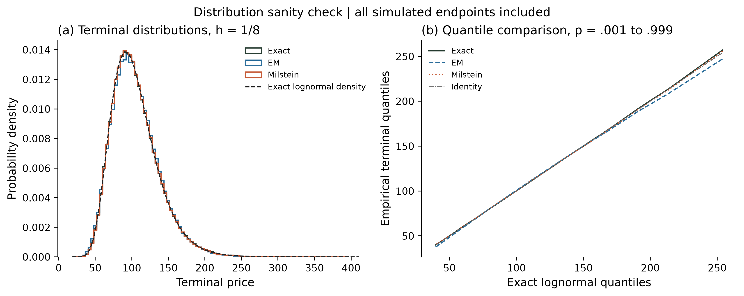
Distribution Check
The empirical distribution agrees with the exact lognormal benchmark; moments agree within sampling uncertainty.

Slide 33
Positivity Check
Terminal-value method | Negative values / paths | Empirical frequency
Exact update | 0 / 160000 | 0.000%
Euler–Maruyama | 0 / 160000 | 0.000%
Milstein | 0 / 160000 | 0.000%
Scope of the result
This is an empirical terminal-time frequency for the reported parameters and grids, not a proof of positivity preservation.

Slide 34
What the GBM Benchmark Established
Brownian increments use the correct √h scaling.
Exact and numerical values are coupled through the same path.
EM and Milstein reproduce their expected strong orders.
Both methods have first-order weak mean error for an analytic reason.
Moment, distribution, and positivity checks support the implementation.
Next step
Replace the unavailable exact solution by a controlled fine-grid numerical reference.

Slide 35
3. Model 2: Nested-Grid Verification without an Exact Solution
State-dependent volatility, correlated noise, and a numerical reference

Slide 36
A Non-Affine Model with State-Dependent Volatility
Let Sₜ=eˣᵗ and consider the coupled system
dXₜ = [μ − ½g(Yₜ)²]dt + g(Yₜ)dWₜ⁽¹⁾
dYₜ = κ(θ−Yₜ)dt + ξ√(1+Yₜ²)dWₜ⁽²⁾
g(y)=0.1 + 0.4/(1+e⁻ʸ), Corr(dW⁽¹⁾,dW⁽²⁾)=ρ
Y changes the noise amplitude of X.
The coefficient functions are non-affine.
No directly usable exact terminal solution is available.

Slide 37
Parameter Set
Parameter | Numerical role | Value
S₀, Y₀ | Initial conditions | 100, 0
μ | Mean growth component of X | 0.05
κ, θ | Mean-reversion rate and centre for Y | 2, −0.2
ξ | Noise scale in Y | 0.6
ρ | Correlation between random drivers | −0.7
T | Terminal time | 1
Minimal interpretation
Treat S as a positive state and Y as a second state controlling its instantaneous random fluctuation.

Slide 38
Generating Correlated Brownian Increments
Generate independent Z₁,Z₂ ~ N(0,1) and set
ΔW₁ = √h Z₁
ΔW₂ = √h [ρZ₁ + √(1−ρ²) Z₂]
Var(ΔW₁)=Var(ΔW₂)=h, Corr(ΔW₁,ΔW₂)=ρ
Diagnostic
Observed sample correlation: −0.699675. Target correlation: −0.7.

Slide 39
Why Discretise X = log S?
A direct Euler step for S can become negative after a large negative random increment.
Sₙ = exp(Xₙ) > 0
Update X first, then transform back to S.
Positivity is automatic whenever X remains finite.
Structure-aware discretisation
The variable transformation uses analytic structure to preserve a state constraint.

Slide 40
Synchronous Euler–Maruyama Update
Both components use the old state Yₙ:
Xₙ₊₁ = Xₙ + [μ−½g(Yₙ)²]h + g(Yₙ)ΔW₁,ₙ
Yₙ₊₁ = Yₙ + κ(θ−Yₙ)h + ξ√(1+Yₙ²)ΔW₂,ₙ
Sₙ₊₁ = exp(Xₙ₊₁)
Meaning of synchronous
Updating Y first and using the new value in the X step would implement a different numerical scheme.

Slide 41
Implementation Details
def g(y):
# stable sigmoid avoids exponential overflow
return 0.1 + 0.4 * expit(y)
for n in range(N):
y_old = y.copy()
gy = g(y_old)
x += (mu - 0.5*gy**2)*h + gy*dW1[:, n]
y += kappa*(theta - y_old)*h \
+ xi*np.sqrt(1.0 + y_old**2)*dW2[:, n]
assert np.isfinite(x).all() and np.isfinite(y).all()
s = np.exp(x)
Recorded diagnostics
Finite-state checks, increment variances, correlation, and the number of non-positive prices.

Slide 42
An Exact Structural Property of the Discrete Mean
Conditional on the current state, use E[eᵃΔᵂ] = eᵃ²ʰᐟ²:
E[Sₙ₊₁ | 𝓕ₙ] = Sₙe⁽ᵘ⁻½ᵍₙ²⁾ʰ E[eᵍₙΔᵂ]
= Sₙeᵘʰ
E[Sᴺ] = S₀eᵘᵀ for every h
Consequence for weak testing
The observable φ(S)=S has zero discretisation bias and cannot test whether the terminal distribution is correct.

Slide 43
Why Use a Call Payoff as the Nontrivial Observable?
Choose a nonlinear terminal observable
φ(S) = (S−K)⁺ = max(S−K,0), K=100
E[φ(S)] is not determined by E[S].
Equal means do not imply equal payoff expectations.
The observable detects changes in distribution shape and the upper tail.
Its kink at S=K makes a weak rate harder to resolve.
Reason for the choice
Once the linear mean is exact, a distribution-sensitive observable is required.

Slide 44
Nested Fine-Grid Reference
Construct a coarse and a fine solution from the same finest Brownian increments:
D̂ᴺ = (1/M)Σᵢ |Sᵀ,ᵢᴺ − Sᵀ,ᵢ ref|
B̂ᴺ = (1/M)Σᵢ [φ(Sᵀ,ᵢᴺ) − φ(Sᵀ,ᵢ ref)]
The first quantity is a coupled strong difference.
The second is a paired weak-observable difference.
Precise terminology
These are differences relative to a numerical reference, not known exact errors. Reference sensitivity must be checked.

Slide 45
Nested-Grid Experimental Design
Component | Setting
Coarse grids | N = 8, 16, 32, 64, 128, 256
Main reference | N_ref = 8192
Sensitivity references | 2048, 4096, 8192
Number of paths | M = 100000
Coupling | All grids aggregate the same finest increments
Strong quantity | E|Sᵀᴺ − Sᵀ ref|
Weak quantities | Mean and paired call-payoff differences
Fitting range
The strong-rate fit uses N=8,16,32,64 to reduce finite-reference curvature.

Slide 46
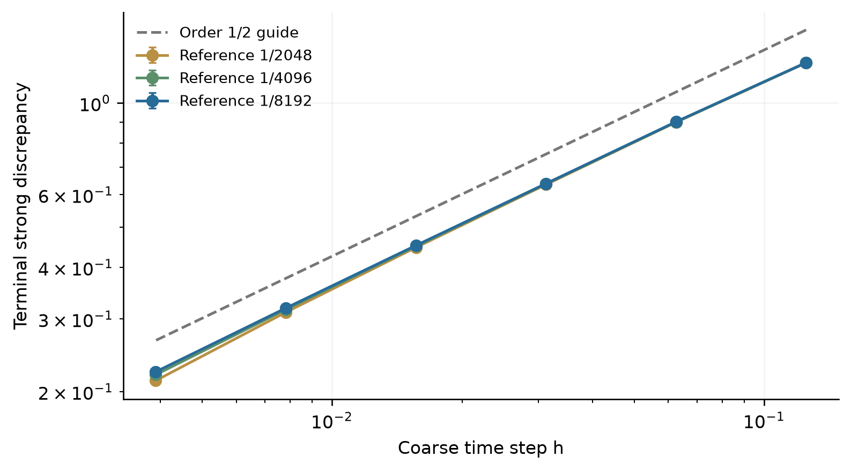
Non-Affine Strong-Difference Results
The fitted slope relative to N_ref=8192 is 0.491, consistent with EM strong order 1/2.

Slide 47
Reference-Grid Sensitivity
N_ref | Fitted slope | Interpretation
2048 | 0.496 | Coarser reference, similar slope
4096 | 0.493 | Close to the finer result
8192 | 0.491 | Main reported reference
Supported conclusion
The half-order trend is stable across these reference choices. This is numerical evidence, not an exact error bound.

Slide 48
The Reference Also Has Discretisation Error
Differences between successive reference levels are
E|S²⁰⁴⁸ − S⁴⁰⁹⁶| ≈ 0.05679
E|S⁴⁰⁹⁶ − S⁸¹⁹²| ≈ 0.04016
0.04016 / 0.05679 ≈ 0.707 ≈ 2⁻¹ᐟ²
The reference levels themselves show half-order reduction.
The 8192-step solution is not exact.
It is sufficiently fine to reveal a stable slope for N=8 to 64.

Slide 49
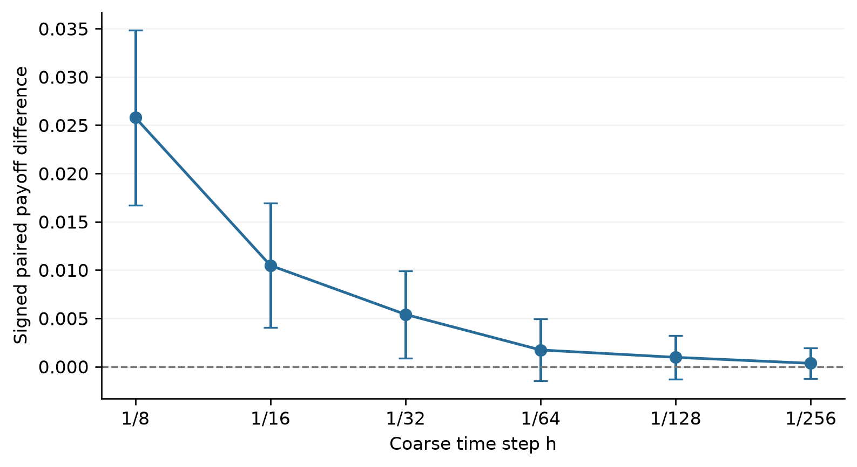
Non-Affine Weak Differences
Coarse payoff differences are resolved; fine-grid confidence intervals include zero.

Slide 50
Why No Reliable Weak Order Is Reported
For N=8,16,32, paired-payoff confidence intervals exclude zero.
For N=64,128,256, the intervals include zero.
At fine levels, the sign and magnitude are sensitive to sampling noise.
A log–log fit would mistake noise for an asymptotic law.
The kink in the payoff makes the asymptotic regime harder to resolve.
Correct interpretation
Weak differences decrease, but the sample budget is insufficient for a credible weak-order estimate. This limits the evidence; it does not show scheme failure.

Slide 51
Sample-Size Experiment
M | Paired difference | Standard error | 95% interval
10,000 | 0.009045 | 0.005149 | [−0.001048, 0.019137]
40,000 | 0.004942 | 0.002592 | [−0.000139, 0.010022]
100,000 | 0.001722 | 0.001633 | [−0.001479, 0.004923]
Interpretation
Standard error decreases approximately as M⁻¹ᐟ², but all three intervals still include zero.

Slide 52
Mean and Implementation Diagnostics
The exact discrete-mean identity predicts
E[Sᵀᴺ] = 100e⁰·⁰⁵ = 105.1271
Simulation: 105.08796, 95% CI [104.89962, 105.27629]
Payoff: 14.53804, 95% CI [14.40515, 14.67093]
Different roles
The mean checks the implementation; the nonlinear payoff probes distributional weak error.

Slide 53
Numerical Diagnostic Checklist
Diagnostic | Observation
Increment variances | Consistent with 1/8192 ≈ 1.221×10⁻⁴
Increment correlation | −0.699675; target −0.7
Finite states | All reported X, Y, and S values were finite
Positivity | S=exp(X) remained positive
Exact mean identity | The theoretical mean lies inside the empirical interval
Reference sensitivity | Three reference grids give similar strong slopes
Principle
A visually convincing convergence plot does not replace these diagnostics.

Slide 54
4. Evaluation, Reproducibility, and Conclusions
What the evidence supports and how the result can be audited

Slide 55
What the Coursework Requires
Component | Required task | Evidence reported
GBM strong | Compare EM/Milstein with theory | Slopes 0.500 and 0.991
GBM weak | Choose and explain an observable | Analytic first-order mean bias
Diagnostics | Distribution and positivity checks | Moments, histogram, frequency
Non-affine strong | Nested grids and sensitivity | Stable half-order trend
Non-affine weak | Intervals and justified conclusion | Trend visible; rate unresolved
Reproducibility | Commands, seed, environment, Git | Traceable code and outputs
Weak order
The requirement is a sound experiment and evidence-based interpretation, not a forced slope from unresolved data.

Slide 56
Code Structure Mirrors the Mathematics
Parameters: initial data, coefficients, T, grids, paths, and seed.
Random increments: finest-grid normal samples and correlation transform.
Solvers: EM, Milstein, and log-variable EM.
Coupling: aggregation of fine increments for each coarse grid.
Statistics: means, standard errors, intervals, and fitted slopes.
Outputs: tables, figures, data, and run metadata.
Practical benefit
An anomalous plot can be traced through statistic, path, increment, and parameter layers.

Slide 57
A Minimal Reproducibility Chain
Identify the Git commit
Run the recorded command
Fix the seed and record versions
Save raw output and figure data
Match the reported precision
Audit rule
If script output and the report disagree, correct the report or identify the version difference.

Slide 58
Eight Common Failure Modes
Using hZ instead of √h Z for Brownian increments.
Comparing independent paths when measuring strong error.
Confusing sample standard deviation with standard error.
Refining h without checking the Monte Carlo noise floor.
Updating Y before the synchronous X update.
Describing a finite fine-grid solution as exact.
Fitting a weak rate to differences whose intervals include zero.
Reporting a slope without the fitting range and diagnostics.

Slide 59
How to Read a Convergence Plot Critically
Is the horizontal axis h, N, or computational cost?
Is the vertical quantity an exact error or a reference difference?
Are coarse and fine solutions driven by the same random input?
Do error bars show standard deviation, standard error, or confidence intervals?
Which points are used in the slope fit, and why?
Do the finest points reach a noise or reference-error floor?
Is the conclusion stable under changes in sample size or reference grid?
Practical rule
Identify what the vertical axis measures before assessing linearity or reading a slope.

Slide 60
Main Conclusions
EM and Milstein show GBM strong orders close to 1/2 and 1.
For the terminal mean, both methods share the same first-order weak bias.
Nested-grid experiments support half-order strong convergence in the non-affine model.
The non-affine discretisation preserves the mean exactly, so a nonlinear observable is required.
The present path budget supports a decreasing weak-difference trend, but not a credible weak order.
Confidence intervals, reference sensitivity, and diagnostics are as important as fitted slopes.

Slide 61
Possible Extensions
Increase paired samples or use a control variate for payoff differences.
Balance h and M under a fixed computational budget.
Refine the reference grid and quantify its systematic contribution.
Report uncertainty in the fitted convergence slope.
Compare Monte Carlo with a finite-difference solution of the associated backward PDE.
Scope
The present coursework should first explain its existing evidence and limitations clearly before adding further machinery.

Slide 62
Thank you
Questions?
Starting from the Euler method, three additions were essential:
normal increments, repeated sampling, and quantified uncertainty.

Slide 63
5. Backup Derivations
Additional detail for questions

Slide 64
Backup: Why Is the GBM Mean Bias First Order?
Let N=T/h and expand the logarithm:
log(1+μh) = μh − ½μ²h² + O(h³)
(1+μh)ᵀᐟʰ = eᵘᵀ[1 − ½μ²Th + O(h²)]
S₀(1+μh)ᵀᐟʰ − S₀eᵘᵀ = O(h)

Slide 65
Backup: Why Pairing Reduces Noise
For two observables A and B on the same path,
Var(A−B) = Var(A) + Var(B) − 2Cov(A,B)
A shared Brownian path makes A and B strongly positively correlated.
Common path fluctuations cancel in the paired difference.
The remaining variation is mainly the discretisation difference.

Slide 66
Backup: Standard Error and Sample Size
For paired samples D₁,…,Dᴹ,
D̄ = (1/M)ΣᵢDᵢ, SE(D̄)=sᴰ/√M
M₂ ≈ M₁(ε₁/ε₂)²
Reducing the standard error by a factor of five requires approximately 25 times as many paths.

Slide 67
Backup: Terminology
Term | Meaning in this coursework
Drift | Deterministic mean change per unit time
Diffusion | Amplitude of the random fluctuation
Brownian increment | Normal variable with mean 0 and variance h
Path | A complete sequence Z₀,Z₁,…,Zᴺ
Observable | A terminal function φ(Zᵀ)
Strong convergence | Numerical and exact values approach on the same path
Weak convergence | Expectations of an observable approach
Nested grid | Coarse increments are sums of shared fine increments
Numerical reference | Fine-grid approximation used for an unknown exact solution

Slide 68
References and Project Files
Course Problem Pack, Direction 4: Financial SDEs, pp. 6–7.
D. J. Higham, “An Algorithmic Introduction to Numerical Simulation of Stochastic Differential Equations,” SIAM Review, 43(3), 2001.
P. E. Kloeden and E. Platen, Numerical Solution of Stochastic Differential Equations, Springer, 1992.
Project files
gbm.py, nonaffine.py, results/, undergraduate_revision/, and presentation/.
Editable format
All titles, body text, tables, flow diagrams, and formula text in this deck are native PowerPoint objects.

