Slide 1



Kaggle Competition:
Allstate Claims Severity
Group XBX:
Andrew, Alex, David

Slide 2
1 Introduction
Machine Learning Competition
116 Cat + 14 Cont
Continuous outcome
Goal: Create algorithms to minimize MAE

Slide 3
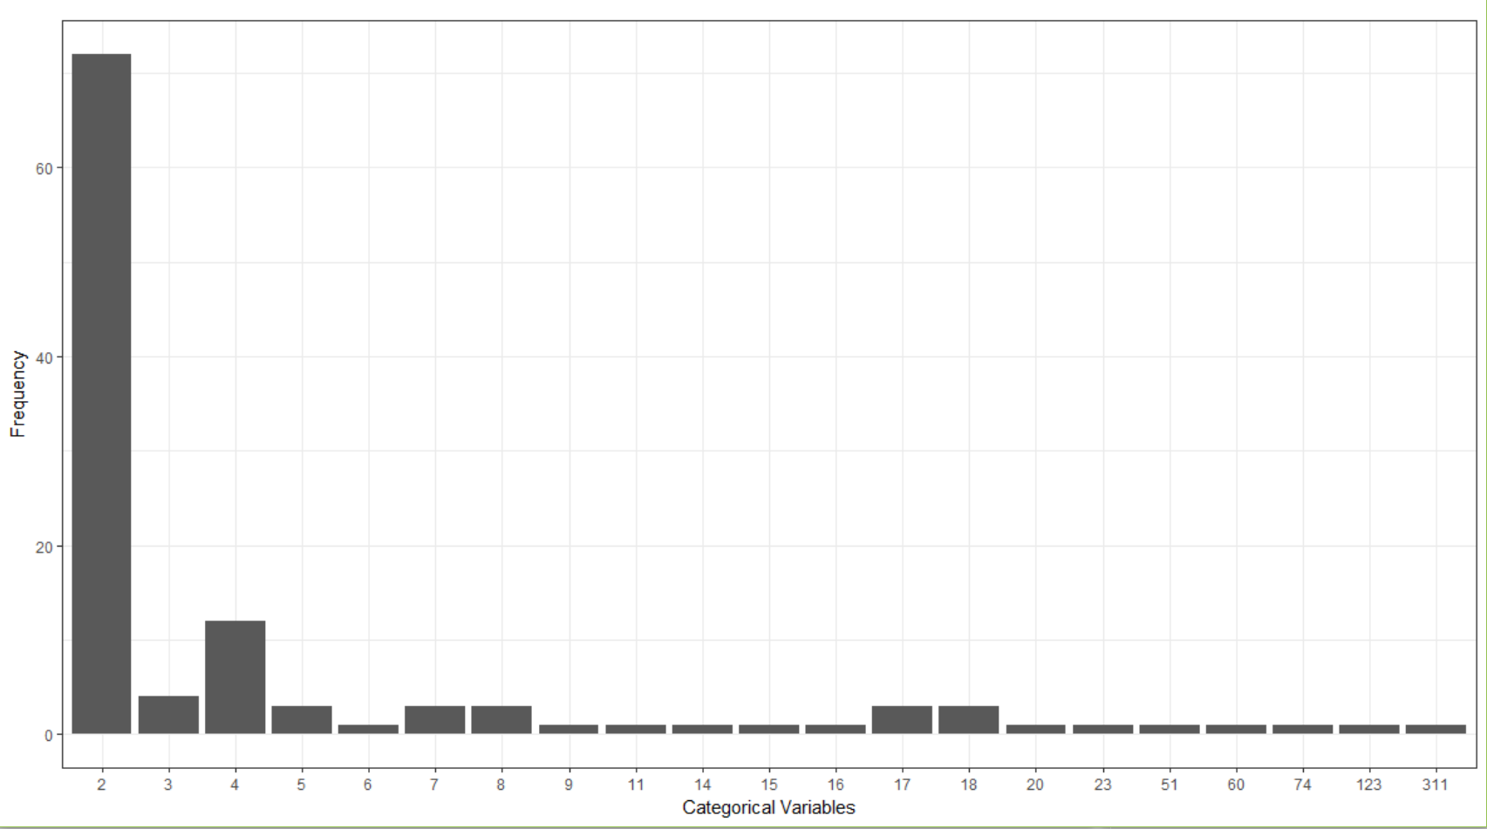
2 Variable EDA
Log Transformation on the prediction variable loss
Level of categorical variables ranges from 2 to 311, crucial for feature selection
Level | # of Categorical Vars
2 | 72
3 | 4
4 | 12
… | ..
74 | 1
123 | 1
311 | 1
Possible sigmoid transformation on continuous variables

Slide 4
3.1 Encoding 1
Multinomial
Binomial (one-hot)
Filter NZV
Idea:
Process (caret package):
Raw
Convert to design matrix
Matrix
Identify NZV
Matrix
Remove NZV
Version1
Matching train and test columns
After: 193 variables

Slide 5
3.2 Encoding 2
Combine
Re-level
To Numeric
Idea:
Combine
Compare
Re-level
Version 2
1. Convert to character
2. Row bind train and test
Find different levels between train and test
Set all unmatched levels to NA
Re-factorize
Re-Split
Process (base R):
After: 130 variables

Slide 6
3.3 Encoding 3
Feature Engineering
Encode2
Version 3
Idea:
Ref: by modkzs from Kaggle.com
Feature Selection
Combine
595 New Variables
From Xgboost and LR
Remove unbalanced Col
Consider interaction between important col
After: 725 variables

Slide 7
4 Exploratory Model Selection
Encoding Method: One Hot Encoding Unfiltered
Validation: Train-Test Split (90-10)
Machine Learning Algorithms:
LASSO Regression
Ridge Regression
CART
Random Forest
XGBoost
Neural Network

Slide 8
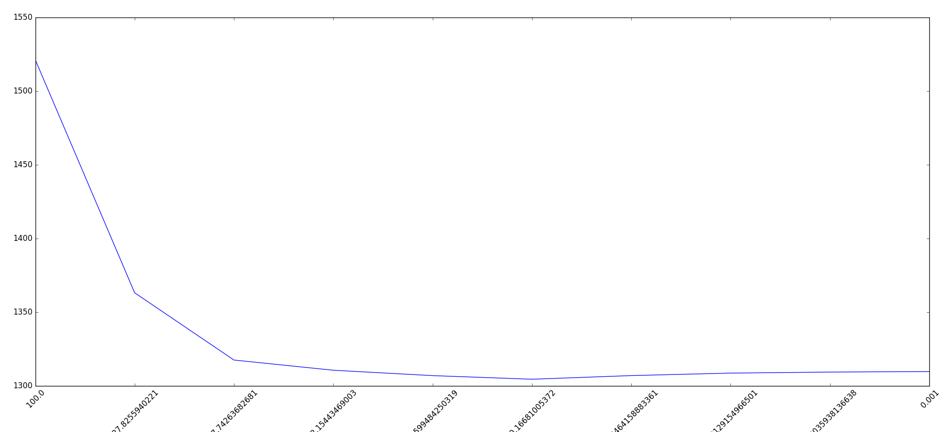
4.1 LASSO Regression
Best lambda: 0.16681005372
Mean Absolute Error: 1304.562

Slide 9
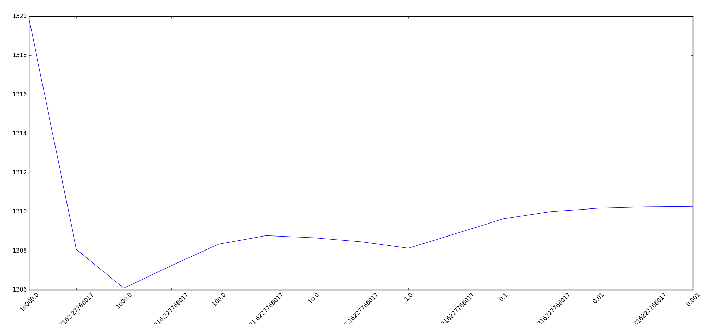
4.2 Ridge Regression
Best lambda: 1000.0
Mean Absolute Error: 1306.081

Slide 10
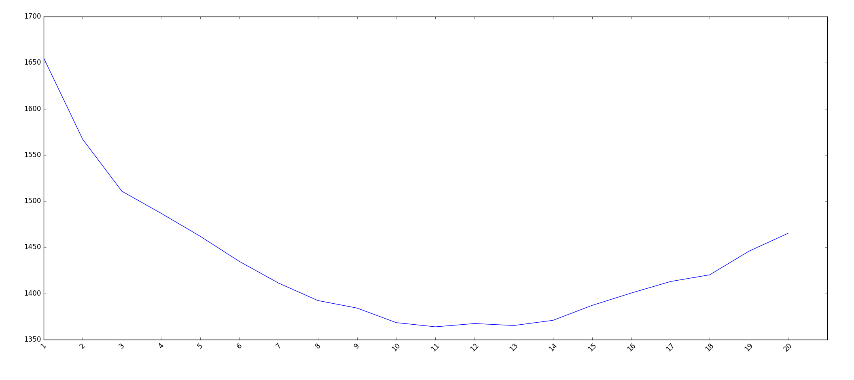
4.3 CART
Best Tree Depth: 11
Mean Absolute Error: 1363.859

Slide 11
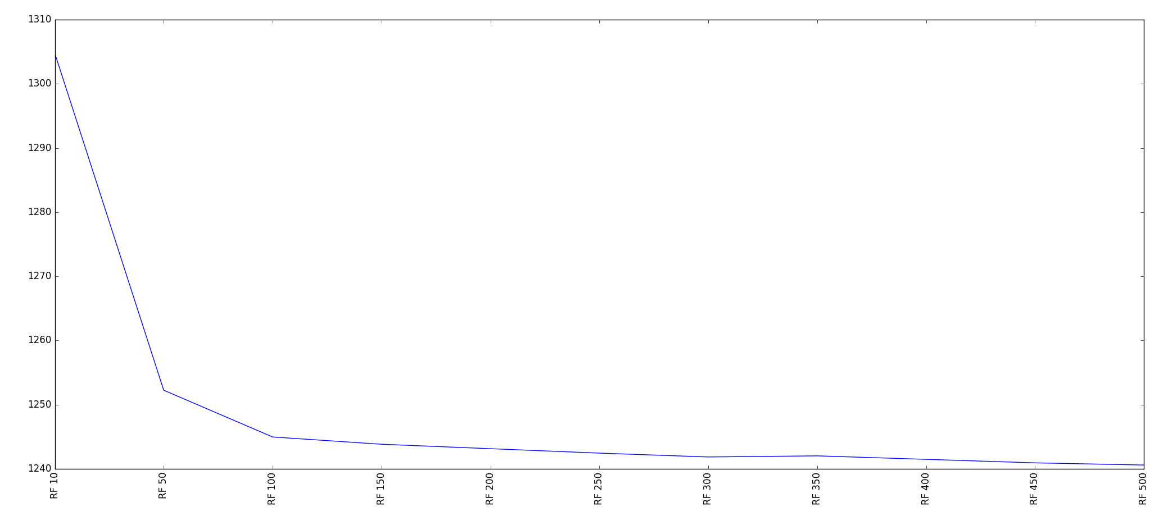
4.4 Random Forest
Number of Trees: 500
Mean Absolute Error: Approaching 1240

Slide 12
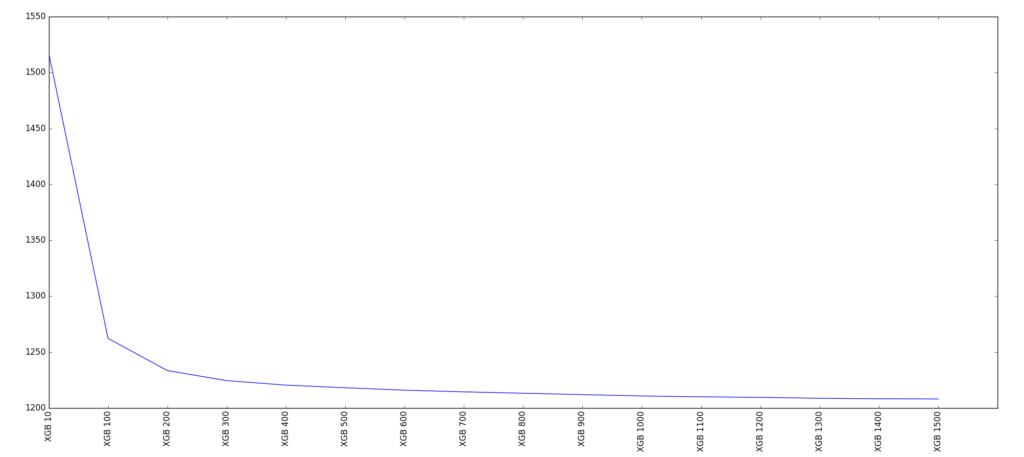
4.5 XGBoost
Number of boosted models: 1500
Mean Absolute Error: Approaching 1200

Slide 13
4.6 Exploratory Model Selection Summary
Model | Mean Absolute Error
LASSO | 1304.562
Ridge | 1306.081
CART | 1363.858
Random Forest | ~1240
XGBoost | ~1200
Neural Network | -
Best Models: Random Forest, XGBoost, Neural Network

Slide 14
4.7 Neural Network
Work Flow
Create dummy variables
Put all dummitized variables into sparse matrix
Scale numerical variables for normalization
Setting parameters of the neural net construction
Stack using 10-fold cross-validation and bagging.
Use mean absolute error to evaluate.
Key Parameters
Number of bags
Number of bags used for bagging
Number of epochs
Number of times all of the training vectors are used once to update the weights
Dropout
Notes:
Number_of_bags:
You get different predictions for each run due to the randomness introduced bydropout and initial weights. Some features may have more weight in the first run and less in th eothers. Thus, by averaging several times, the model should detect more pattern I the data and achieve a better score. The number 5 was just a trade-off between accuracy and running time.

Slide 15
Output Layer
Num. of node: 1
Hidden Layer 3
Num. of node: 50
Hidden Layer 2
Num. of node: 200
Hidden Layer 1
Input Layer
Num. of node: 400
Num. of node: 1190
Notes:
Input Layer:
- Dense:
- # of node:

Slide 16
5.1 Workflow for Stacking
Train
Test
Train
Test
Submission

Slide 17
5.1 Workflow for Stacking
Train
build
predict
Model1
Model2
Model3
Model4
Test
We get:
P1
P2
P3
P4
True

Slide 18
5.1 Workflow for Stacking
Train
Test
Build using same parameter
predict
Model1
Model2
Model3
Model4
Submission
We get:
P1
P3
but no outcome
this time
P2
P4

Slide 19
5.1 Workflow for Stacking
Stacking Model
P1
P2
P3
P4
True
Predict
Final
Prediction
P1
P2
P3
P4

Slide 20
5.2 Stacking Candidates
Neural Network
Original
Encode 1
Encode 2
Xgboost
Encode 3
Xgboost

Slide 21
5.3 Stacking Attempts
80-20 Split
GAM
Xgboost
60-40 Split
GAM
Xgboost
Regular GBM
Regular GBM
80-20 Split
Double Layer
GAM as L1, GBM as L2
GBM as L1, GBM as L2

Slide 22
5.4 Stacking Results
1114
1128
1103.82
1108
E2 Xgb
GBM
E3 Xgb
Top 6%
NN

Slide 23
6 Conclusion and Future Direction
Xgboost and Neural Network are two accurate algorithm for this dataset.
We were able to push the MAE to 1103.8 based on model stacking.
Multiple Neural Networks regarding to different encoding will be built to further climb the leaderboard.

