Slide 1
Price Prediction Stayze

Slide 2
Problem Statement
The Stayze rental company aggregates rental providers and provides service to the end customers with listings that capture variety of property parameters and the owner characteristics
The problem to solve is to predict the price of a rental property with the help of historic data as closely as possible.

Slide 3
Why solve this problem?
The rental property price of NY city properties depends on various characteristics associated with the listing on the portal and owners. The aim is to predict the average rent of the new property depending on the past data.
This will help all the stakeholders to come to a common understanding of the prices of the new listing
Understand the rent potential in different areas with different characteristics

Slide 4
Evaluation Metric
The solution will be evaluated based on a low Root Mean Square Error (RMSE)
Root mean squared error (RMSE) is the square root of the mean of the square of all of the error values.

Slide 5
Step1: Pre processing
Data Cleaning:
Deleting redundant columns[features].
Dropping duplicates.
Cleaning individual columns for data consistency.
Remove the null values and outliers from the dataset
Transform some data from date format to duration [for example last_review]

Slide 6
Step2: Data Visualization:
Plot all NeighborhoodGroups
Neighbourhoods-distribution
Room Types - distribution
Relation between neighbourgroup and Availability of Room
Map of Neighbourhood group
Map of Neighbourhood
Number of review

Slide 7
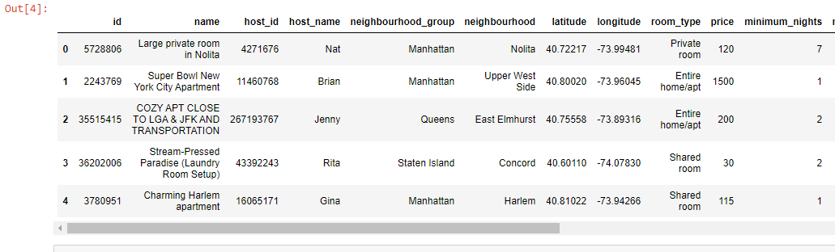
DataView
The above table combines a lot of data of rows and columns of shape (34226*16)

Slide 8
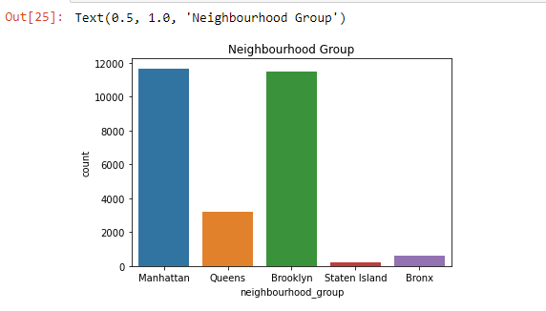
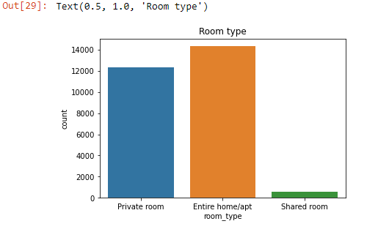
EDA
Eda-Univariate: The count of listings by neighbourhood group and room type.

Slide 9
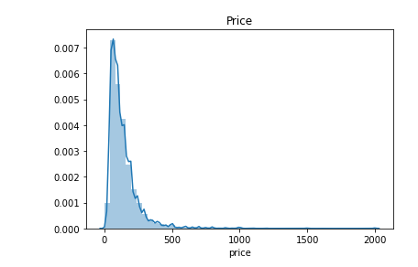
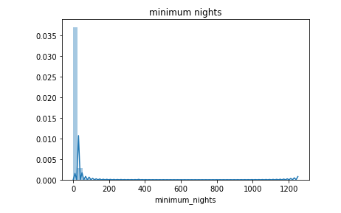
Distribution of parameters

Slide 10
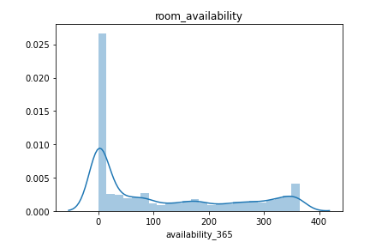
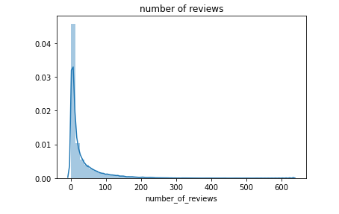
By seeing the distribution curves we can infer the data is left skewed.

Slide 11
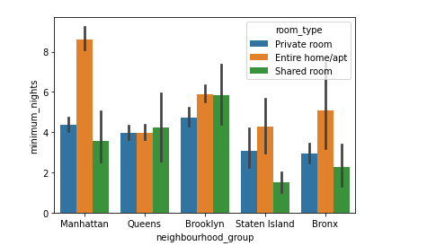
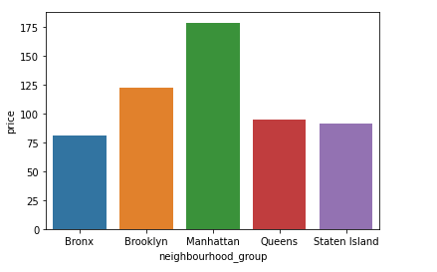
EDA-Bivariate
This analysis is to see the relationship between the two/more variables.

Slide 12
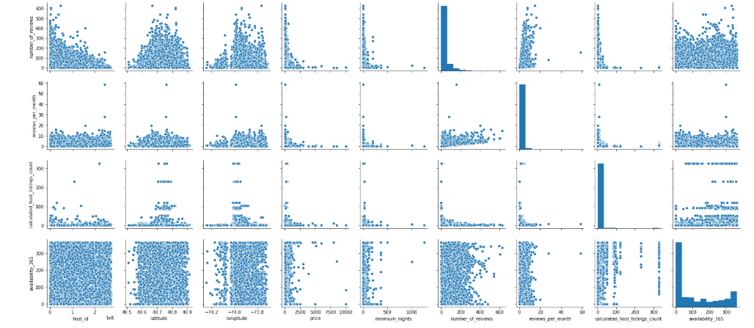
EDA-Multivariate: Multivariate methods look at two variables at a time to explore relationships.

Slide 13
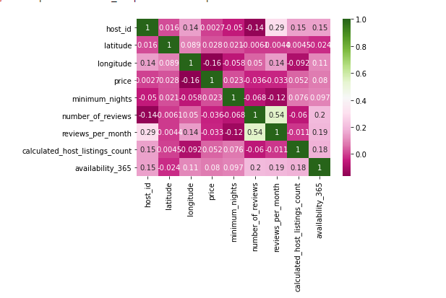
Correlation Matrix

Slide 14
EDA-Insights
Manhattan has high count of listed properties as well has prices
‘Entire home/apt’ has high demand
The prices reduce as we move away from the city center [Thus latitude, longitude values play an important part]. Refer next slide.

Slide 15
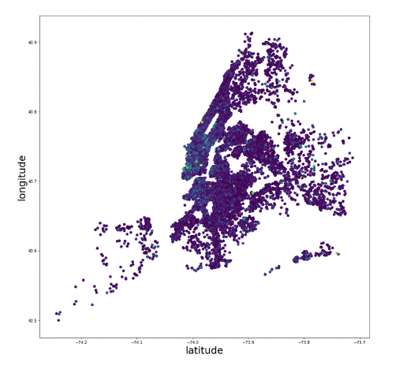
Map of City

Slide 16
EDA specific outcomes
In the plots presented earlier we find that, price is dependent on latitude, longitude, number of reviews, room type, neighbouhoodgroup and neighbourhood.
It does not depend much on the host_id and availability_365 [hence they can be dropped]

Slide 17
Step3:Analysis
Clean the data & delete the null values
Delete the outliers
Price < 30 and Price > 1000 are treated as outliers: They roughly correspond to 1 and 99 percentile values
Scalar Transformation
Two data sets created for independent analysis one each with
Label encoding
One hot encoding
Distance from City Center is created as new dependent variable [From the values of Latitude/Longitude – using haversine formula] and drop the original Latitude/Longitude values
However, as there was no value addition with that approach the same was dropped and Latitude,Longitude added back as parameters.

Slide 18
Analysis Results
One hot encoding gave better results than label encoding
No improvement by using scalar transformation.
Distance from city center variable which is derived from Latitude/Long resulted in reasonable good predictions but the RMSE score was skewed. [Refer next slide]
More investigation is required. Currently this parameter is not considered.

Slide 19
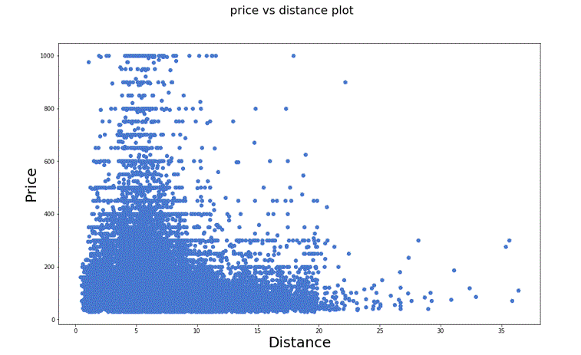
Distance from CC insight
Note: The prices were not at their maximum at the true city center, hence resulting in negative skew of predictions for lower values of price

Slide 20
Model Approaches
Linear Regression
Root Mean Square Error.
Cross validation
Ridge Regression
Alpha as hyperparameter
Random Forest Regression

Slide 21
Model Evaluation and Results
Sl.no | Model | Evaluation metric | Hyperparameter | Result Label | Onehot
1. | Linear reg | RMSE | None | 102.19 | 97.07
2. | Linear reg | RMSE | CV=10 | 99.19 | 95.14
3. | Linear reg | RMSE | CV=5 | 99.19 | Not done
4. | Ridge reg | RMSE | Alpha=0.5 | Not done | 96.99
5. |  |  | Alpha=0.3 | Not done | 97.01
6. |  |  | Alpha=0.7 | Not done | 96.97
7. | Random forest reg | RMSE | None | Not done | 95.96
8. |  |  | CV=10 | Not done | 95.14
Note : Initial results for Linear regression models with one-hot encoding were found to give better results compared to Label Encoding. Hence subsequently, only one-hot encoding was used for Ridge and Random Forest models.

Slide 22
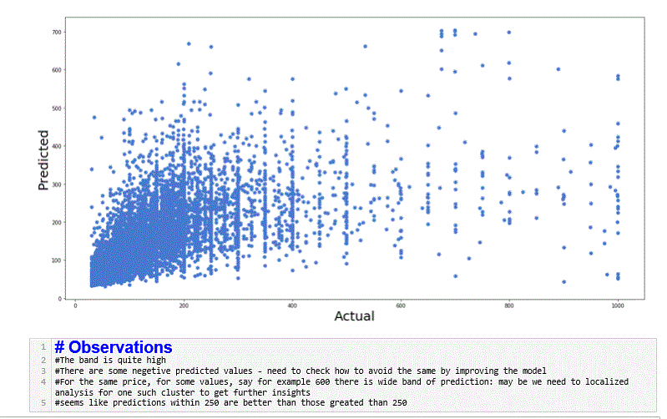
Predictions

Slide 23
Future Scope
Some basic LR and Random Forest methods are tried out. We could try with more algorithms like, XGBoost, Lasso, ElasticNet and many more.
Check with log transformation of data and the effect of same on the model performance.
Distance from city-center variable which is derived from Latitude/Longitude resulted in reasonable good predictions but the RMSE score was skewed as the values at the lower band become negative
More investigation is required as to why this could be happening. Currently this parameter is not considered.

