Slide 1
Flight Price Prediction

Slide 2
Problem Statement
The travel company aggregates airline service providers and want to offer Price Prediction service to the end customers with data of past listings that capture variety of property parameters.
The problem to solve is to predict the price of a Flight Ticket Price with the help of historic data as closely as possible.

Slide 3
Why solve this problem?
This will help all the stake-holders, mainly customers to make informed decisions when purchasing the flight tickets

Slide 4
Evaluation Metric
The solution will be evaluated based on a (-ve) Root Mean Square Error (RMSE)

Slide 5
Step1: Pre processing
Data Cleaning:
Deleting redundant columns[features].
Dropping duplicates.
Cleaning individual columns for data consistency.
Remove the null values and outliers from the dataset
Transform some data from date format to duration

Slide 6
Step2: Data Visualization:
Plots of price versus number of stops
Plots of price versus duration of flights
Plots of price versus departure times (for different source cities)
Plots of price versus seasonality characteristics like month and day_of_week

Slide 7
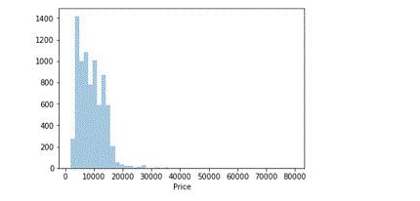
Price Variation

Slide 8
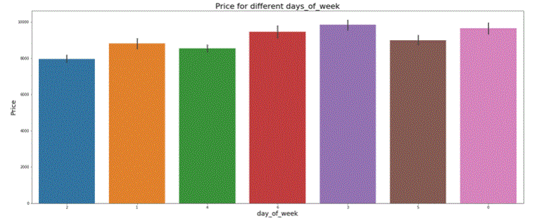
Price Variation with day_of_week

Slide 9
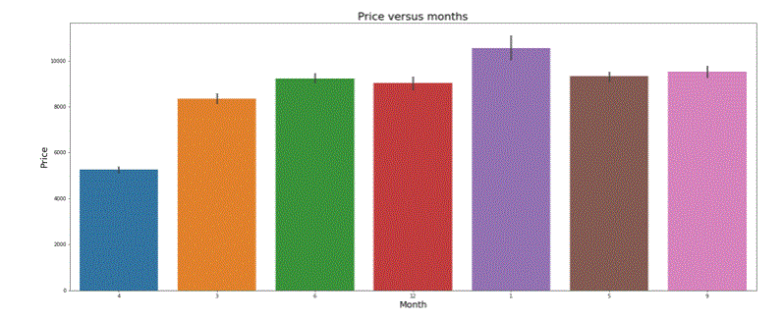
Price Variation with month

Slide 10
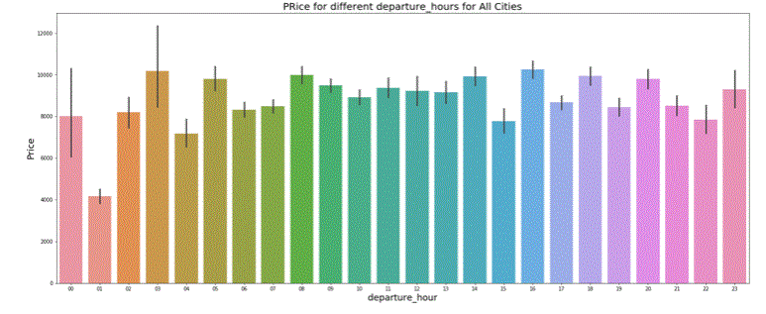
Price Variation with departure_hour

Slide 11
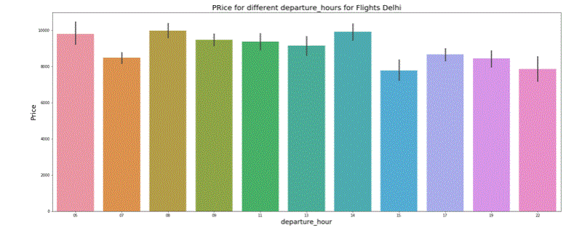
Price Variation with departure_hour(Delhi)

Slide 12
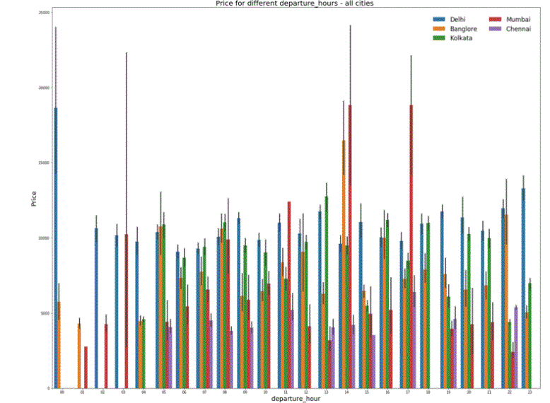
Price Variation with departure_hour all Cities(as Source)

Slide 13
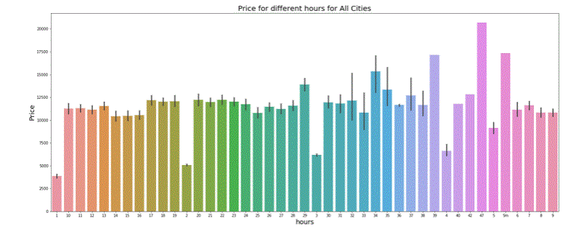
Price Variation with hour (flight-time)

Slide 14
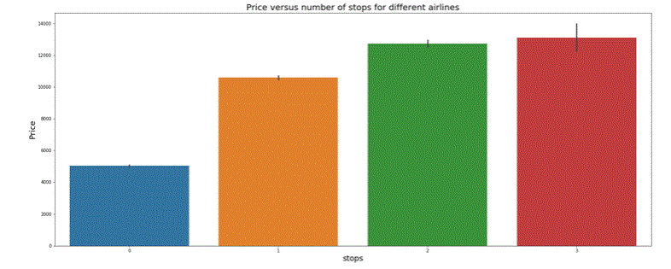
Price Variation with stops

Slide 15
EDA-Insights
The prices depend on Airline
Prices vary with number of stops
Duration also indicates this aspect
Price varies based on week_of_day
Price varies based on month of the flight
Prices in some routes are in general higher
Prices depend on departure time of flight though the variation is different for different source cities

Slide 16
Step3:Analysis
Clean the data & delete the null values
Delete the outliers
Price > 2000 are treated as outliers: They roughly correspond to 1 percentile values. This was decided by Trial and error
Two data sets created for independent analysis one each with
Label encoding
One hot encoding
Different parameters were studied for their effect

Slide 17
Analysis Results
One hot encoding gave better results than label encoding
Significant parameters were
Stops, Duration,day_of_week,Source
Slightly less significant ones
Month, Departure Time,Additional Info

Slide 18
Model Approaches
Linear Regression
Root Mean Square Error.
Cross validation
Ridge Regression
Alpha as hyperparameter
Random Forest Regression

Slide 19
Model Evaluation and Results
Sl.no | Model | Evaluation metric | Hyperparameter | Result Label | Onehot
1. | Linear regression | RMSE | None | 2901 | Not Done
2. | Linear regression | RMSE | CV=10 | 2752.3 | Note Done
3. | Linear regression | RMSE | CV=5 | 2751.3 | Not done
4. | Ridge regression | RMSE | Alpha=0.5 | Not done | 2031.5
5. |  |  | Alpha=0.3 | Not done | 2030.10
6. |  |  | Alpha=0.7 | Not done | 2031.88
7. | Randomforest reg... | RMSE | None | Not done | 1781.6
8. |  |  | CV=10 | Not done | 1749.5
9. | LGBMRegressor | RMSE | None | Not done | 1691.03
10. | CatBoostRegressor | RMSE | None | Not done | 1639.51
Note : Initial results for Linear regression models with one-hot encoding were found to give better results compared to Label Encoding. Hence subsequently, only one-hot encoding was used for models.

Slide 20
Future Scope
Some basic LR and Random Forest methods are tried out. We could try with more algorithms like, XGBoost, Lasso, ElasticNet and many more.
Check with log transformation of data and the effect of same on the model performance.
Effect of Arrival time is not considered as
Departure time is supposedly the complementary feature. Further analysis can be done on this
Other encoding methods (other than Label,One-hot encoding) can be tried

