Slide 1
Stock Portfolio Optimisation
SPO2 Group
Simin Liang, Mehak Dhingra, Jiazhe Han, Salihah Nisha, Ruchir Mandar Kajrolkar

Slide 2
Catalogue
Introduction
Data Cleaning & Wrangling
Data Analysis for Static Weights
Data Modeling for Dynamic Weights
Conclusion

Slide 3
Introduction
Given data: S&P 500
Try to find the best (optimized) portfolio - total sharpe ratio
3 scenarios: static weights (absolute)
static weights (relative)
dynamic weights

Slide 4
Background Information
Why we use S&P 500?
Market Representation
Investment Reference
Risk-adjusted returns

Slide 5


Data Cleaning & Wrangling
Loading Data & Time Index
Removing Weekends and Holidays (Get data for 252 trading days per year)
Handling and Drop NaN Values
Calculating Daily Returns - we used pct.change method
Top 75 Stocks are calculated based on Sharpe Ratio Calculation
Notes:
Loading Data & Time Index
We start by loading the data from a CSV file and converting the 'Date' column to a datetime format. We then set the 'Date' column as the index.
Handling NaN Values
Next, we handle any missing values by first forward filling and then backward filling. —> Remove any NaN that still exists due to padding. This ensures that no gaps remain in the data.
Calculating Daily Returns
We calculate the daily returns for each stock, which are the percentage changes in closing prices from one day to the next.
Statistical Analysis
We then compute the average daily return and standard deviation of daily returns for each stock.
Sharpe Ratio Calculation
The Sharpe ratio is calculated by dividing the average daily return by the standard deviation. We set the risk-free rate to 0 for simplicity.
Finally, we select the top 75 stocks with the highest Sharpe ratios and create a new DataFrame containing only the data for these stocks.

Slide 6
Data Analysis

Slide 7
Sharpe Ratio
excess_return
mean[daily_return_rate - R(0 risk)]
=
Sharpe Ratio
std_excess_return
=
Return / Risk
how can we compute sharpe ratio of a stock
how can we compute sharpe ratio of a portfolio

Slide 8
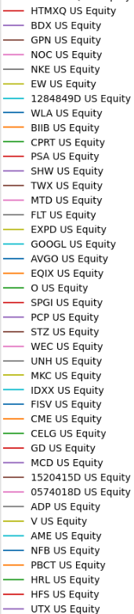
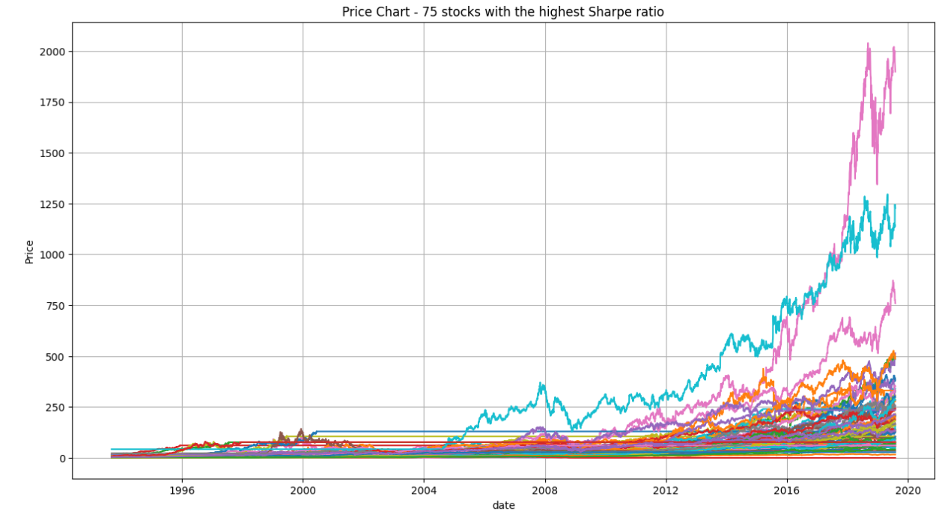
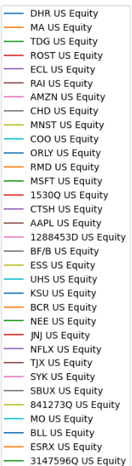
The Price of the top 75 stocks throughout the years

Slide 9
Absolute Static Weights
Where the quantity of each stock is determined at the beginning and fixed throughout the period

Slide 10
Absolute static weights (random)
Using random combinations : at 1 year intervals
Generate random investment portfolios using historical data
Calculate expected annualized return, volatility, and Sharpe ratio
Select the best portfolio based on the Sharpe ratio
Calculate the actual Sharpe ratio using current year's data
Save the results every year and display them
Notes:
Random：1 y
The goal is to generate static absolute weights and calculate the portfolio at 1year intervals using random combinations.
We start by grouping the data yearly but exclude the current year. Data processing begins from the second year to ensure we have a full year's data for analysis.
For each year, we use the previous year's data to form portfolios. We calculate daily returns and generate 1000 random portfolios by assigning random weights to each stock.
By generating a large number of random portfolios, we minimize the impact of any extreme weight combinations. Additionally, the normalization process ensures that the sum of weights is always 1, providing balanced portfolios.
For each portfolio, we calculate the expected annual return, volatility, and Sharpe ratio. The Sharpe ratio is calculated as the return divided by the volatility.
We select the portfolio with the highest Sharpe ratio as the optimal portfolio. The weights of this portfolio are used to calculate the actual Sharpe ratio for the current year using the current year's data.
We save the results for each year, including the predicted and actual Sharpe ratios, returns, and volatilities. This helps in evaluating the performance of our investment strategy over time.

Slide 11
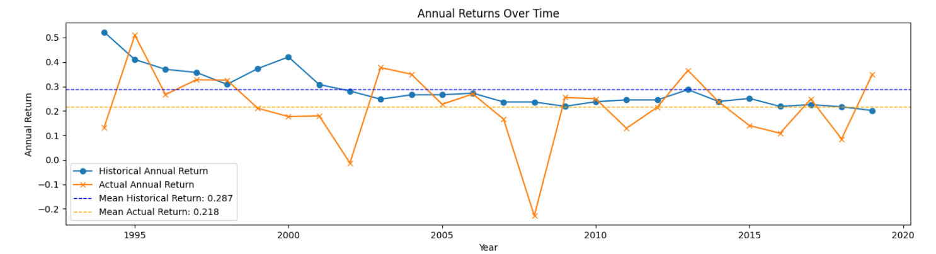
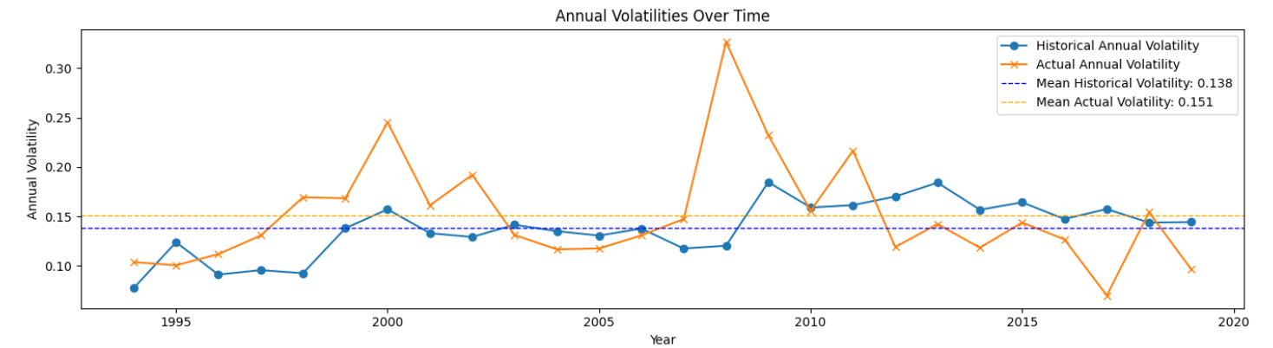
Notes:
Between 2000-2002: There was a sharp decline in both historical and actual returns. This corresponds to the dot-com bubble burst and the subsequent market crash. 2008 Financial Crisis: both historical and actual return dropped again during the global financial crisis.
2000-2002: Volatility spiked during the dot-com bubble burst. Both volatilities increased significantly during the 2008 financial crisis. Volatility is inversely proportional to the return values. If the return value is high then volatility must be low as there is minimal risk involved

Slide 12
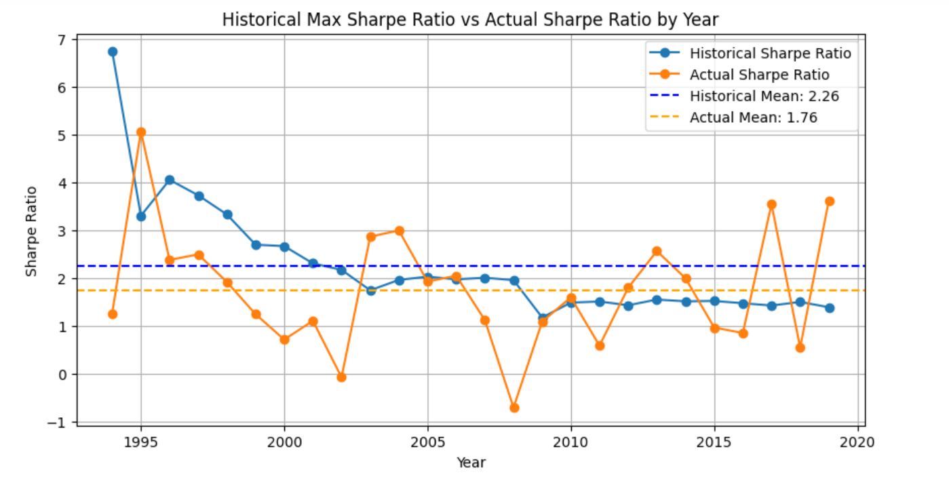

Slide 13
Absolute static weights (standard optimisation) 1 year intervals
Define Objective Function: The objective function is the negative Sharpe ratio, which should be minimized. This ratio is calculated based on portfolio return, volatility, and the risk-free rate.
Set Constraints: Ensure that the sum of portfolio weights equals 1 (fully invested portfolio)
Optimization: Use scipy.optimize.minimize with the SLSQP method to find the optimal weights that minimize the negative Sharpe ratio while satisfying the constraints.
Result Interpretation: The optimization result includes the optimal weights, the minimized value of the objective function (negative Sharpe ratio), and other information.

Slide 14
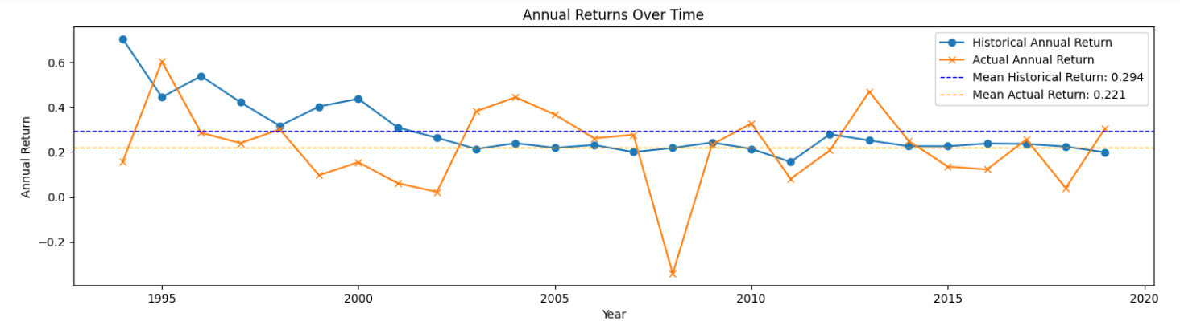
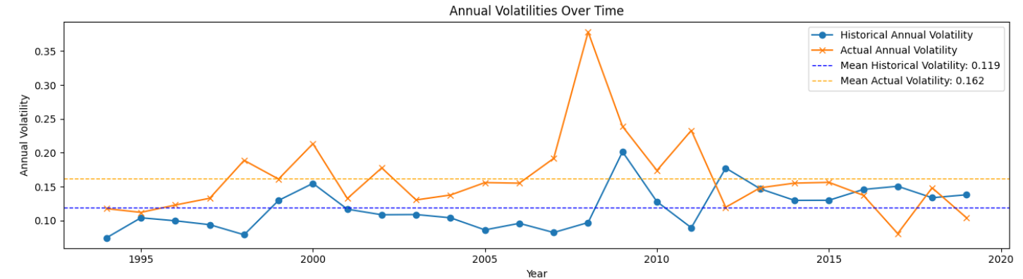
Notes:
Between 2000-2002: There was a sharp decline in both historical and actual returns. This corresponds to the dot-com bubble burst and the subsequent market crash. 2008 Financial Crisis: both historical and actual return dropped again during the global financial crisis.
2000-2002: Volatility spiked during the dot-com bubble burst. Both volatilities increased significantly during the 2008 financial crisis. Volatility is directly proportional to the return values. If the return value is high then volatility must be low as there is minimal risk involved

Slide 15
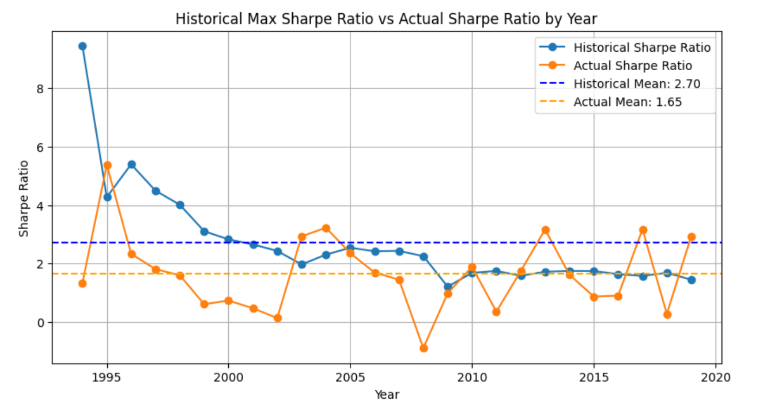

Slide 16
Results and Comparison
We found the sharpe ratio to be 1.76 for random and 1.65 for optimisation.
Despite a slightly lower Sharpe ratio (1.65), the optimisation approach with SLSQP remains preferable due to its consistency. It offers a systematic, deterministic method for finding optimal portfolio weights, particularly suited for scalability and complex optimization problems compared to random generation.

Slide 17
Relative static weights

Slide 18
Static Weight (Relative)
Random Generation
Initial investment of 100000 and monthly investment of 10000
Uses past data to form portfolios
Calculate daily returns, average returns and covariance matrix
Generate random weights and calculate expected returns, volatility and sharpe ratio
Identifies the best combination based on highest sharpe ratio
Simulate the portfolio value over the year with monthly investment and assess performance using actual returns and volatilities
Notes:
Relative Static weight is a strategy where initial asset weight is set and periodic rebalancing.

Slide 19
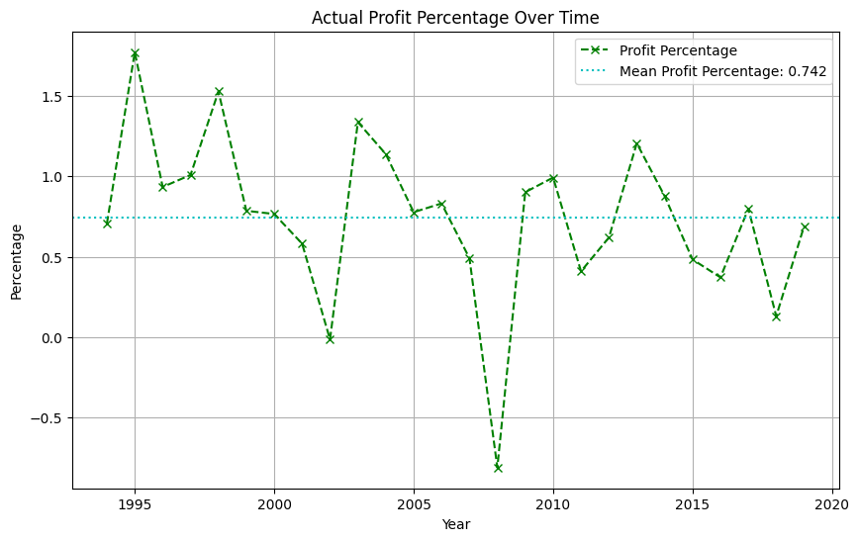
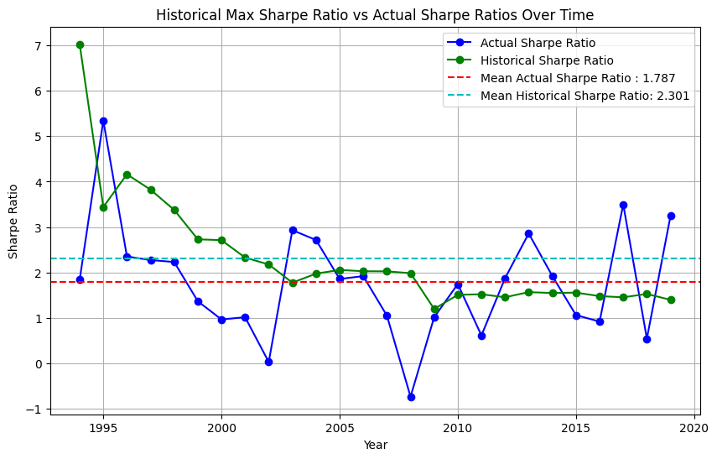
sfdfsfjsfisjfiosjj
Historical sharpe ratios were consistently higher than actual sharpe ratio
Initial values shows slight profits each year but percentages were relatively low ranging from 0.17% to 1.75%
Notes:
, profit percentage measures the profit earned from individual stocks or the portfolio relative to their revenue, indicating profitability efficiency, while return rate measures the gain or loss on the entire investment relative to the initial amount invested, indicating overall investment performance
Historical sharpe ratios were consistently higher than actual sharpe ratio, indicating over-optimistic forecasts, lower actual sharpe ratio than historical could also reflect market unpredictability
Portfolio value- final values shows slight profits each year but percentages were relatively low ranging from 0.17% to 1.75%. Modest growth of investment as the returns did not outperform the additional investments although portfolio value increased.

Slide 20
Static Weight (Relative)
Standard optimisation per year
Optimisation Method:
Same optimisation method discussed for absolute static weight Difference:monthly investment of 10000 per month
Notes:
Same optimisation method discussed for absolute static weight. neg_sharpe_ratio: Computes negative Sharpe ratio for optimization.
optimize_portfolio: Uses minimize from scipy.optimize with constraints for weight sum = 1 and bounds [0, 1].
SLSQP method

Slide 21
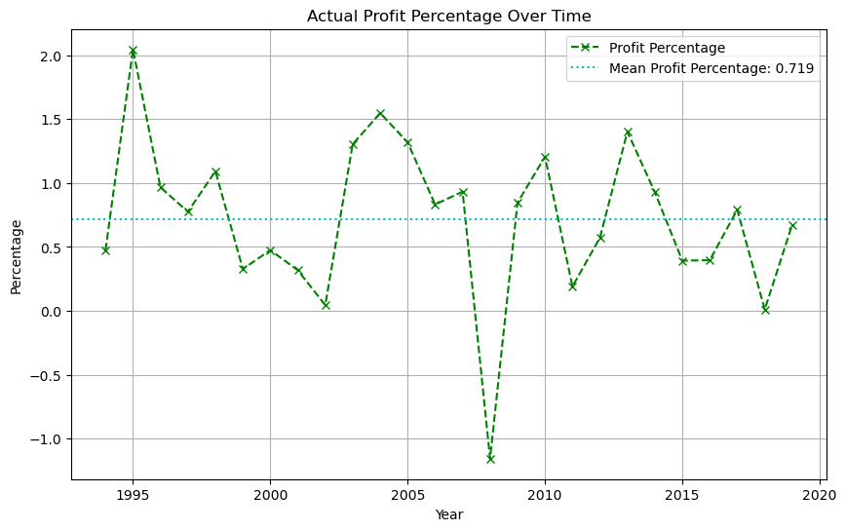
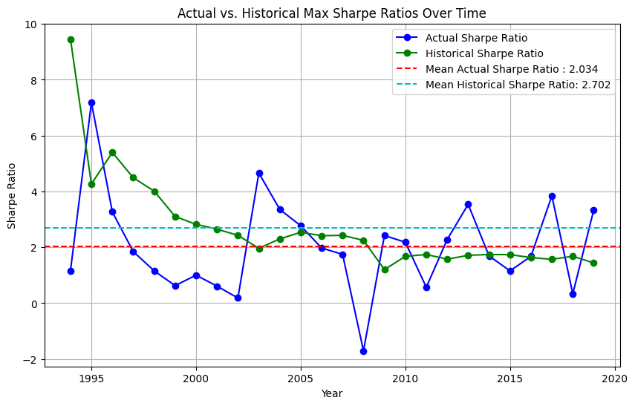
Historical max sharpe ratio are often higher than actual values
Ranged from slight gains to modest increase in final portfolio value
Profit percentage is mostly low ranging from 0.05% to 2.04% with only a few years achieving over 1%.
Notes:
Historical max sharpe ratio are often higher than actual values, indicating market will change over time and the classification strategy can’t fit the change well.
Ranged from slight gains to modest increase in final portfolio value
Profit percentage is mostly low ranging from 0.05% to 2.04% with only a few years achieving over 1%

Slide 22
Data Modeling
Equal weights
where each stock has the same relative initial value in the portfolio
Dynamic Weights
where the weights will be some function of the recent stock performances.
Simin P1

Slide 23
Breakout strategy using simple moving averages
Simple Moving Average (SMA):
Definition: The Simple Moving Average is the arithmetic mean of a specified number of closing prices over a specific time period.
Calculation: It is calculated by adding the closing prices of an asset for a number of time periods and then dividing the total by the number of time periods.
Example: For a 5-day SMA with closing prices of $10, $12, $14, $16, and $18, the SMA would be calculated as follows: ($10 + $12 + $14 + $16 + $18) / 5 = $14.
Why moving averages?
Closing Prices Reflect Final Market Sentiment: The closing price is often considered the most important price of the day, capturing the final market sentiment and investor positioning. This makes it a robust indicator for calculating moving averages.
Simplicity and Effectiveness: Moving averages are simple to calculate and interpret. They smooth out short-term fluctuations and highlight longer-term trends, making them a highly effective tool for identifying market trends and potential breakout points.
Support and Resistance Levels: Moving averages often act as dynamic support and resistance levels. During an uptrend, prices might pull back to the moving average before continuing higher, and during a downtrend, they might rise to the moving average before falling again.

Slide 24
Fundamentals Behind the Success of Breakout Strategies
Market Momentum: Breakout strategies take advantage of market momentum. When a breakout occurs, it often signals the beginning of a new trend, driven by a shift in market sentiment. This momentum can lead to extended price movements, providing opportunities for significant gains.
Support and Resistance Levels: These levels are critical in technical analysis. A breakout above resistance or below support indicates a change in the supply-demand dynamics, often leading to strong price movements as new trends emerge.
Volume Confirmation: Breakouts are typically accompanied by increased trading volume, confirming the validity of the breakout and reducing the likelihood of false signals. This volume surge indicates strong investor interest and participation, further propelling the trend.
Trend Persistence: Financial markets tend to exhibit trends due to various factors such as economic fundamentals, investor behavior, and market cycles. Breakout strategies capitalize on these trends, allowing traders to profit from sustained price movements.

Slide 25
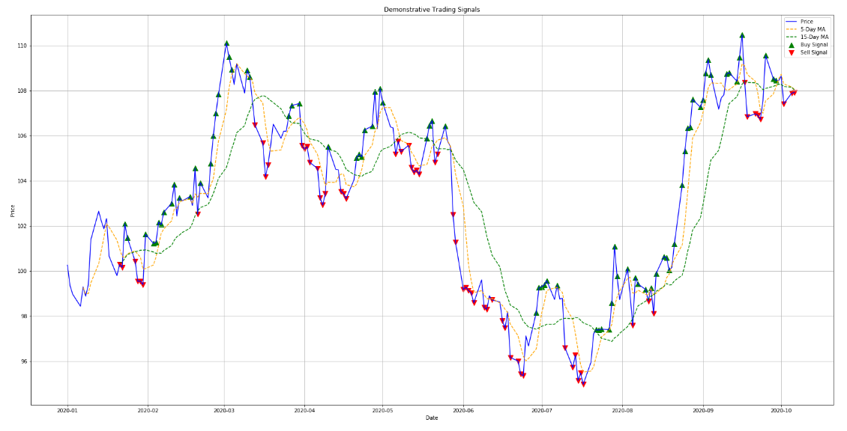

Slide 26
Methodology
Melt DataFrame: Transform the DataFrame so that ticker names are in a single column.
Calculate Returns: Calculate daily returns for each ticker.
Remove NaNs: Drop rows with NaN values
Define Windows: Set short (5-day) and long (15-day) windows for moving averages.
Calculate Moving Averages: Calculate the short and long moving averages for each ticker.
Adjusting the Timeframe to Prevent Look-Ahead Bias: the dataset is adjusted to prevent future data from influencing past decisions by shifting the data forward by one month. This adjustment helps to eliminate look-ahead bias, ensuring that moving averages and other indicators are based only on information available at the time of the trading decision.
Fill Positions: Forward fill the position values to simulate holding the position until the next signal.
Calculate Strategy Returns: Calculate the strategy returns by multiplying the position with log returns.
Group by Date: Calculate the mean returns for each date.
Cumulative Returns: Calculate the cumulative returns of the strategy.

Slide 27
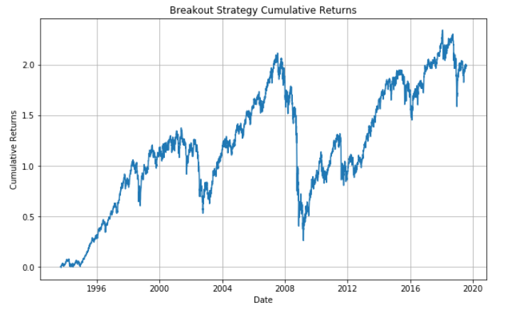
Pre-optimization results
Annualized Expected Return: 5.15%
Annualized Volatility: 14.52%
Sharpe Ratio: 0.35
What can be improved?
Losses are quite significant during times of financial crises due to false breakouts. These losses need to be limited so that cumulative gains are much higher.

Slide 28
Trends in breakout strategy results
Dot-com Bubble Burst (2000-2002)
September 11 Attacks (2001)
2002 Stock Market Downturn
Financial Crisis of 2007-2008
2018 Stock Market Correction

Slide 29
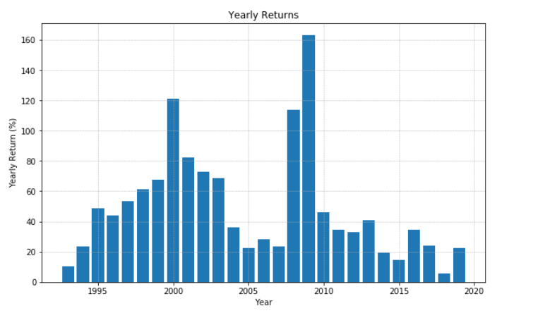
Post-optimization Methodology and results
Methodology:
To find the optimal stop-loss and take-profit levels for our breakout trading strategy, we employed an exhaustive grid search. This method involves testing a wide range of values for both stop-loss and take-profit parameters to identify the combination that maximizes the strategy's performance metrics, such as the Sharpe ratio, annualized return, or cumulative return.
Define Parameter Range:
Stop-Loss: Cap the maximum loss to a specified threshold: -3 %
Take-Profit: Cap the maximum gain to a specified threshold: +100 %
Results
Annualized Expected Return: 38.22%
Annualized Volatility: 12.15%
Sharpe Ratio: 3.14

Slide 30
Machine Learning: Support Vector Regression (SVR)
What’s SVR ?
Why use it here
Standard Optimization: Maximize the Sharpe ratio
Methods: SVR + Standard Optimization

Slide 31
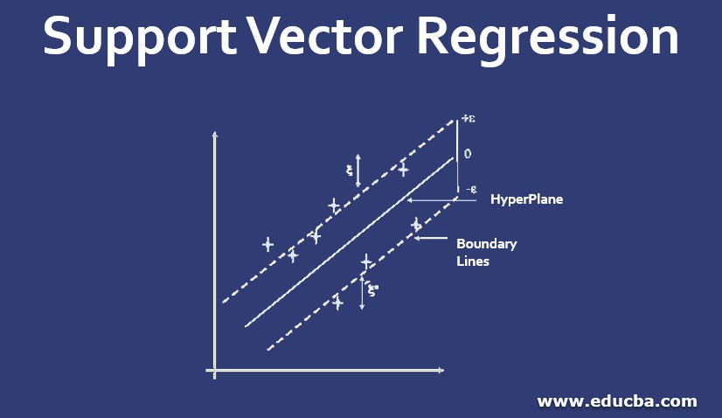
Detailed Explaination of Process
Calculate Returns and Volatility
Feature Preparation
Cross-Validation (TimeSeriesSplit)
SVR Models (Return & Volatility)
Standard Optimization
Calculate Actual Sharpe Ratio
Iterative Training and Evaluation

Slide 32
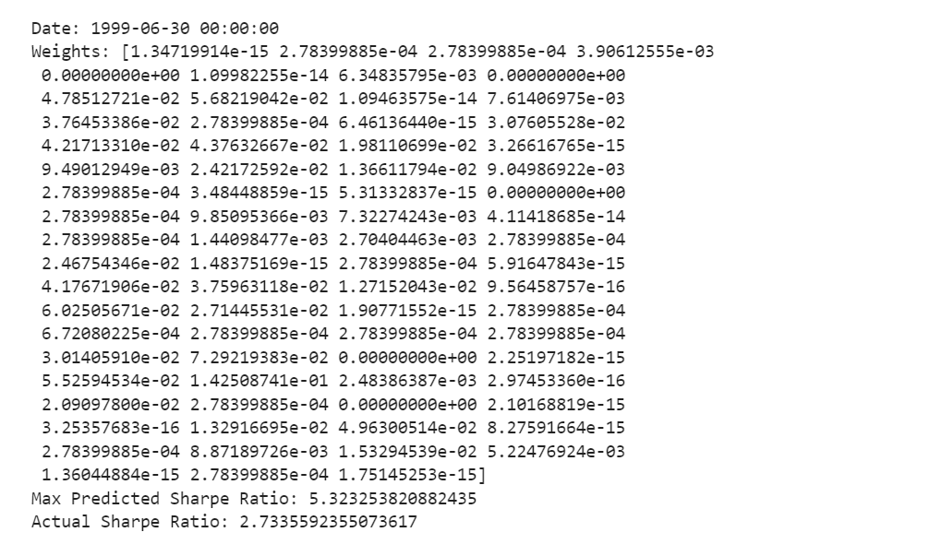

Slide 33
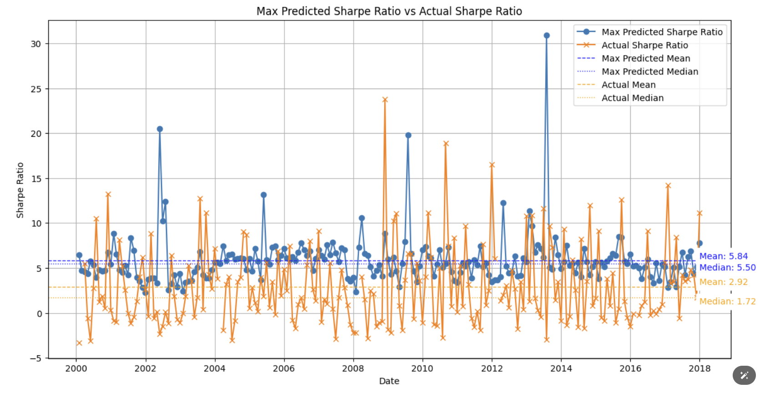
Predicted Sharpe Ratio vs Actual Sharpe Ration

Slide 34
Conclusion
Overall, using SVR for prediction for sharpe ratio is more effective compared to break out strategy and other traditional methods.
Most of traditional methods like random generation and standard optimization achieve actual Sharpe ratios close to but below 2. The SVR model, despite some differences, consistently outperforms these traditional methods, achieving an actual mean Sharpe ratio of 2.92.
Limitations
Bias in the data because of using the top 75 stocks as the original dataset
Limited dataset with just closing prices for each stock

Slide 35
Q&A

