Slide 1

Mobile Office Assistant
Mobile Office Assistant
Get your business on board !

Slide 2
Goals
Efficient & Flexible office procedures through mobile phone
  Keep business on board when traveling or away from office
  Reduce the inefficient inter-personal coordination process during office procedures
Advantages
Convenience : Integrated office business assistant
High-Expandibility : less time & money spent on following development
User Experience : Customized Function Sets

Slide 3
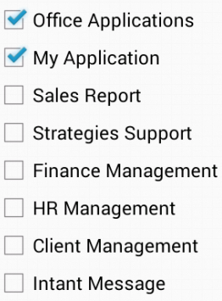
Design & implementation

Slide 4
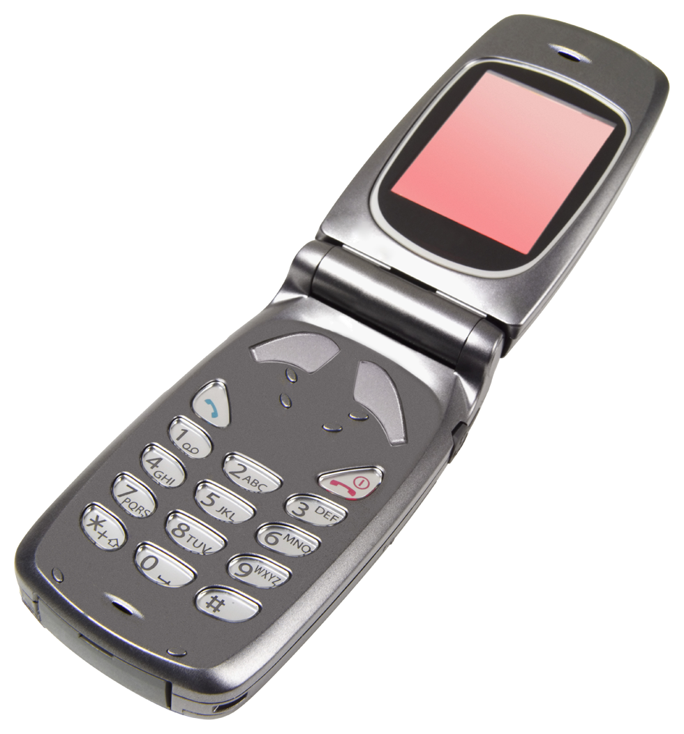

Handle application
Create application
Manager
Staff
5. Call handler to send ‘get to-handle’ request
1. Call handler to send ‘create’ request
8. Call handler to send ‘approve/disapprove’ info
7. Send ‘to-handle’ application back
Server listener
6. Call handler to get ‘to-handle’ request
2. Get request and call related handler
9. Call handler to get ‘(dis)approve’ info
3. Call ApplicationIO to process data file
10. Call ApplicationIO to set status
4. New application created
11. Application status changed

