Slide 1
EXECUTIVE ANALYTICS CAPSTONE
Customer churn: where should retention effort start?
Decision brief for a fictional subscription business
Decision requested: approve a small, measured retention pilot — not a blanket discount campaign.
Demo figures are synthetic; replace with results from the supplied CSV before submission.

Slide 2
The baseline: churn is measurable, but exposure is not guaranteed loss
Synthetic demo data • recalculate using the supplied task dataset
22.0%
78.0%
₹187,876
35.8 mo
Churn rate
Retention rate
Monthly charges linked to churn
Average tenure
Readout: use churn and retention as outcome metrics. Treat monthly charges attached to churned records as an exposure proxy, not a forecast of cash loss.

Slide 3
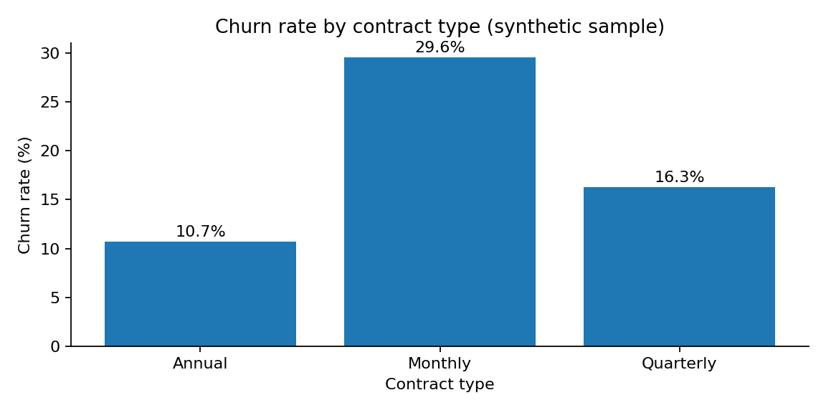
Insight 1 — contract type helps prioritise outreach
Descriptive association; it does not prove contract type causes churn
Monthly: 29.6%
Annual: 10.7%
Action: test a service check-in or voluntary save option for eligible monthly customers. Measure incremental retention against a holdout.

Slide 4
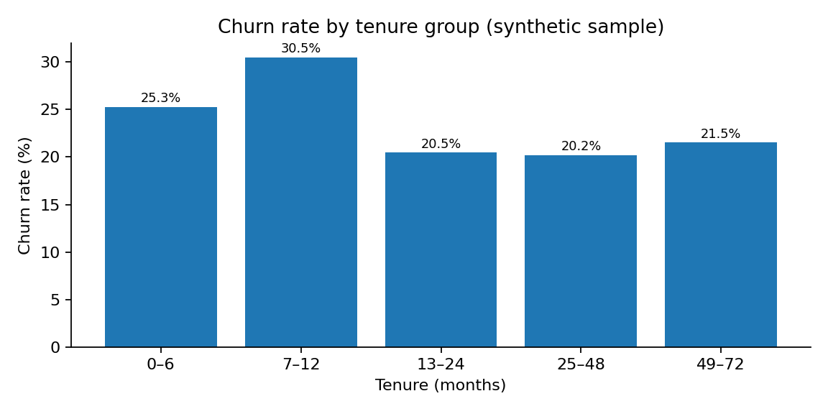
Insight 2 — early tenure is a sensible onboarding checkpoint
Use a defined cohort and retention window
Under 12 months: 27.9%
24+ months: 20.6%
Action: add day 7, 30, and 60 onboarding milestones; monitor activation and 90-day retention.

Slide 5
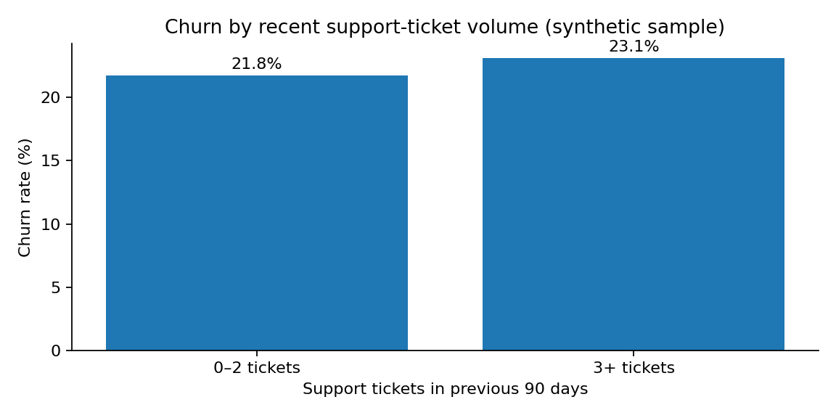
Insight 3 — repeat support contacts may flag customer friction
Support-ticket count is a signal to investigate, not proof of cause
3+ tickets: 23.1%
0–2 tickets: 21.8%
Action: offer repeat-ticket customers a single case owner and root-cause review. Track resolution time, complaints, and subsequent retention.

Slide 6
Impact scenario — plan a pilot, do not promise a result
Illustrative range based on the synthetic sample
Pilot cohort: 251 customers
Illustrative 5–10% relative preservation
Churned-customer charge exposure: ₹55,512/month
₹2,776–₹5,551/month
Assumption: intervention preserves 5–10% of exposure in the eligible cohort. This is a scenario calculation, not a churn model or causal estimate.
Actual impact = treatment vs holdout retention difference × eligible base, translated to net margin after costs.

Slide 7
Recommendation, safeguards, and limitations
RECOMMEND
DO NOT OVERSTATE
1. Run a 4–6 week pilot.
2. Prioritise early-tenure monthly and repeat-ticket customers.
3. Use a holdout group; compare 30/60/90-day retention.
4. Scale only if net impact is positive.
• Demo data is synthetic.
• Associations do not prove causation.
• Monthly charges are not lifetime value or realised loss.
• Contact cost, discounts, margins, and customer choice matter.
Next measurement: pre-register eligibility, outcome window, guardrails, and a treatment/holdout comparison.

