Slide 1
Task 4

Slide 2
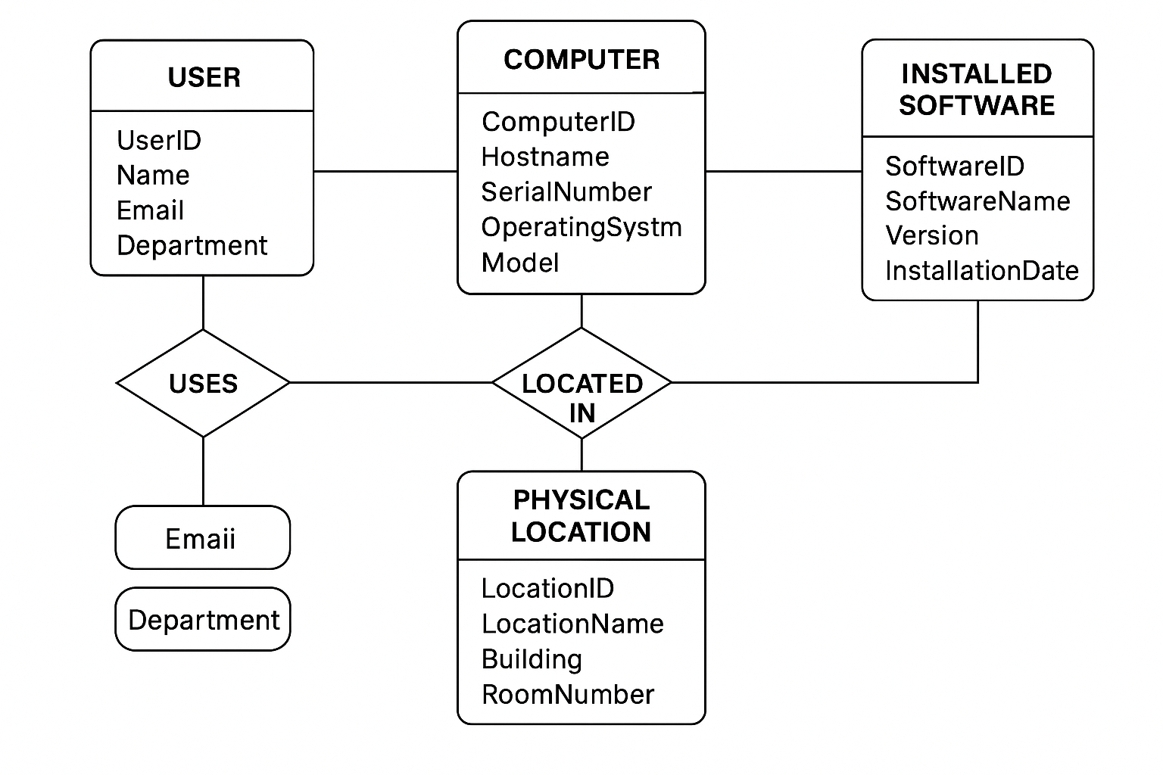
Relationships and Cardinality
1. User–Computer
Description: One user can use multiple computers. Each computer is assigned to one user.
2. Computer–Location
Description: One location can house multiple computers. Each computer is located in one location.
3. Computer–Installed Software
Description: One computer can have many software installations; one software can be installed on many computers.
User → One-to-many → Computer (One user can have multiple computers)
Computer → Many-to-one → Location (Each computer has one location)
Computer → Many-to-many → Software (Each computer can have multiple software installations)

Slide 3
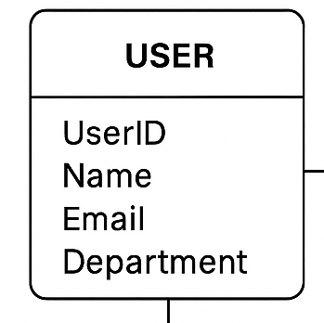
User
Attributes:
UserID (Primary Key) — Unique identifier for each user (e.g., integer or string)
Name — Full name of the user (e.g., string)
Email — Email address of the user (e.g., string)
Department — Department the user works in (e.g., string)

Slide 4
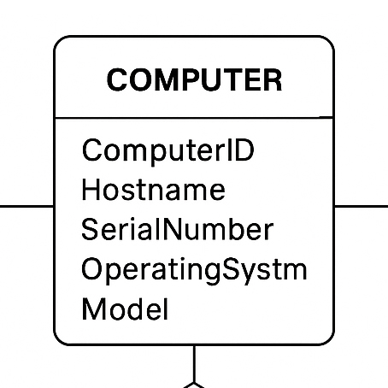
Computer
Attributes:
ComputerID (Primary Key) — Unique identifier for each computer (e.g., integer or string)
Hostname — Hostname of the computer (e.g., string)
SerialNumber — Serial number of the computer (e.g., string)
OperatingSystem — The OS the computer is running (e.g., string)
Model — The model of the computer (e.g., string)
LocationID (Foreign Key) — Refers to the physical location where the computer is stored (relates to the Location entity)

Slide 5
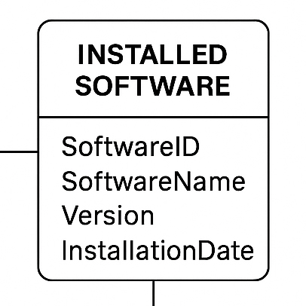
Installed Software
Attributes:
SoftwareID (Primary Key) — Unique identifier for each software installation (e.g., integer or string)
SoftwareName — Name of the installed software (e.g., string)
Version — Version of the installed software (e.g., string)
InstallationDate — Date when the software was installed (e.g., Date)
ComputerID (Foreign Key) — Refers to the computer the software is installed on (relates to the Computer entity)

Slide 6
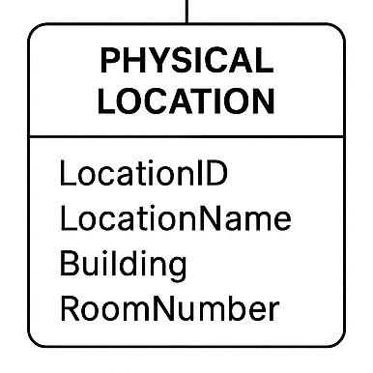
Physical Location
Attributes:
LocationID (Primary Key) — Unique identifier for each physical location (e.g., integer or string)
LocationName — Name of the physical location (e.g., string)
Building — Building name or identifier (e.g., string)
RoomNumber — Room number or identifier (e.g., string)

