Slide 1
Projects at Marut Drones
Drone autonomy, computer vision, mapping & GPS-denied navigation
Janadri Yalla Yashwanth
Software Engineer — Drone AI & Automation | Technical Interview

Slide 2
Introduction
About Me
▸ Software Engineer at Marut Drones — Drone AI & Automation team
▸ B.Tech in Computer Science (AI & ML), CGPA 8.6
▸ Work spans the full drone-software stack:
• Computer vision & ML on drone / aerial imagery
• Autonomous flight, precision landing & obstacle avoidance
• GPS-denied navigation (LiDAR, radar, SLAM) and mapping / photogrammetry
• Production backends that serve the models
Janadri Yalla Yashwanth · Marut Drones
2

Slide 3
Agenda
Projects Overview
▸ 1. UAV Log Analyzer — JIYI & Pixhawk
▸ 2. YOLO Detection Models — Custom Training
▸ 3. Building / Tree / Stockpile Detection — TIFF & Panorama
▸ 4. Measurement Tools on GeoTIFF
▸ 5. Depth Estimation — Stereo Cameras
▸ 6. Precision Landing on a Moving Platform
▸ 7. MightySLAM — Research & Hardware Requirements
▸ 8. Photogrammetry Stitching — WebODM & Pix4D
▸ 9. Path Planning & Obstacle Avoidance — Radar
▸ 10. Indoor Navigation without GPS — LiDAR
▸ 11. LingBot — 3D Environment Mapping
Janadri Yalla Yashwanth · Marut Drones
3

Slide 4
Project 1
UAV Log Analyzer — JIYI & Pixhawk
▸ Full-stack tool that ingests raw drone logs from two flight controllers, auto-detects the format, decodes, and diagnoses issues
• Dual ecosystem: Pixhawk / ArduPilot (.bin) and JIYI — including XOR-decrypting JIYI's encrypted logs
• From-scratch binary parser (50+ message types); ~30-check engine (power, IMU/vibration, GPS, EKF, compass, RC, failsafes)
• Classifies each finding PASS / WARN / FAIL and infers probable crash cause; generates a PDF report
Python · FastAPI · React · ReportLab · Docker
Format detection — header magic bytes
Pixhawk / ArduPilot → A3 95
JIYI (plain) → 00 FF
JIYI (encrypted) → 37 C8
XOR every byte with 0x37 to decrypt
37^37 = 00 · C8^37 = FF → the known JIYI marker
Open sample report — Pixhawk (ArduPilot)
Open sample report — JIYI
Janadri Yalla Yashwanth · Marut Drones
4

Slide 5
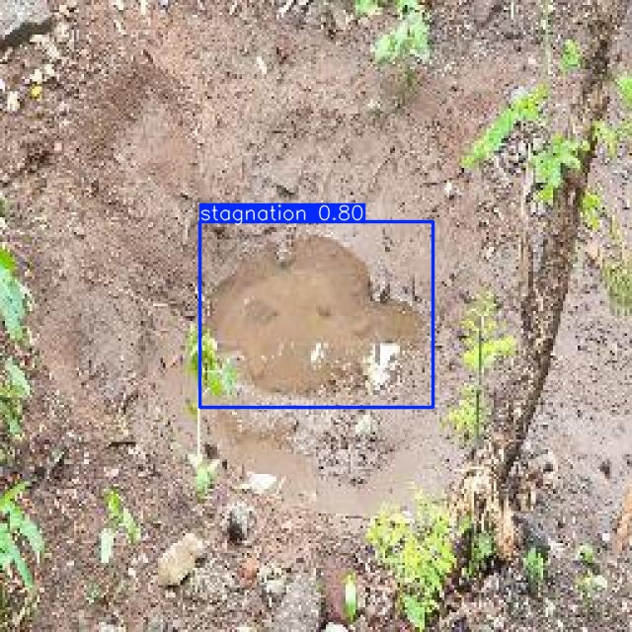
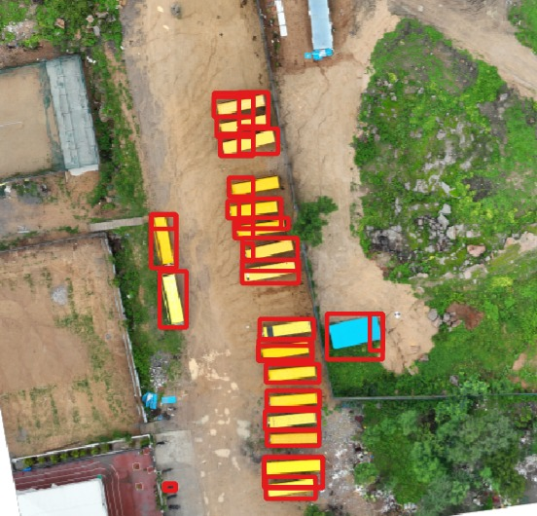
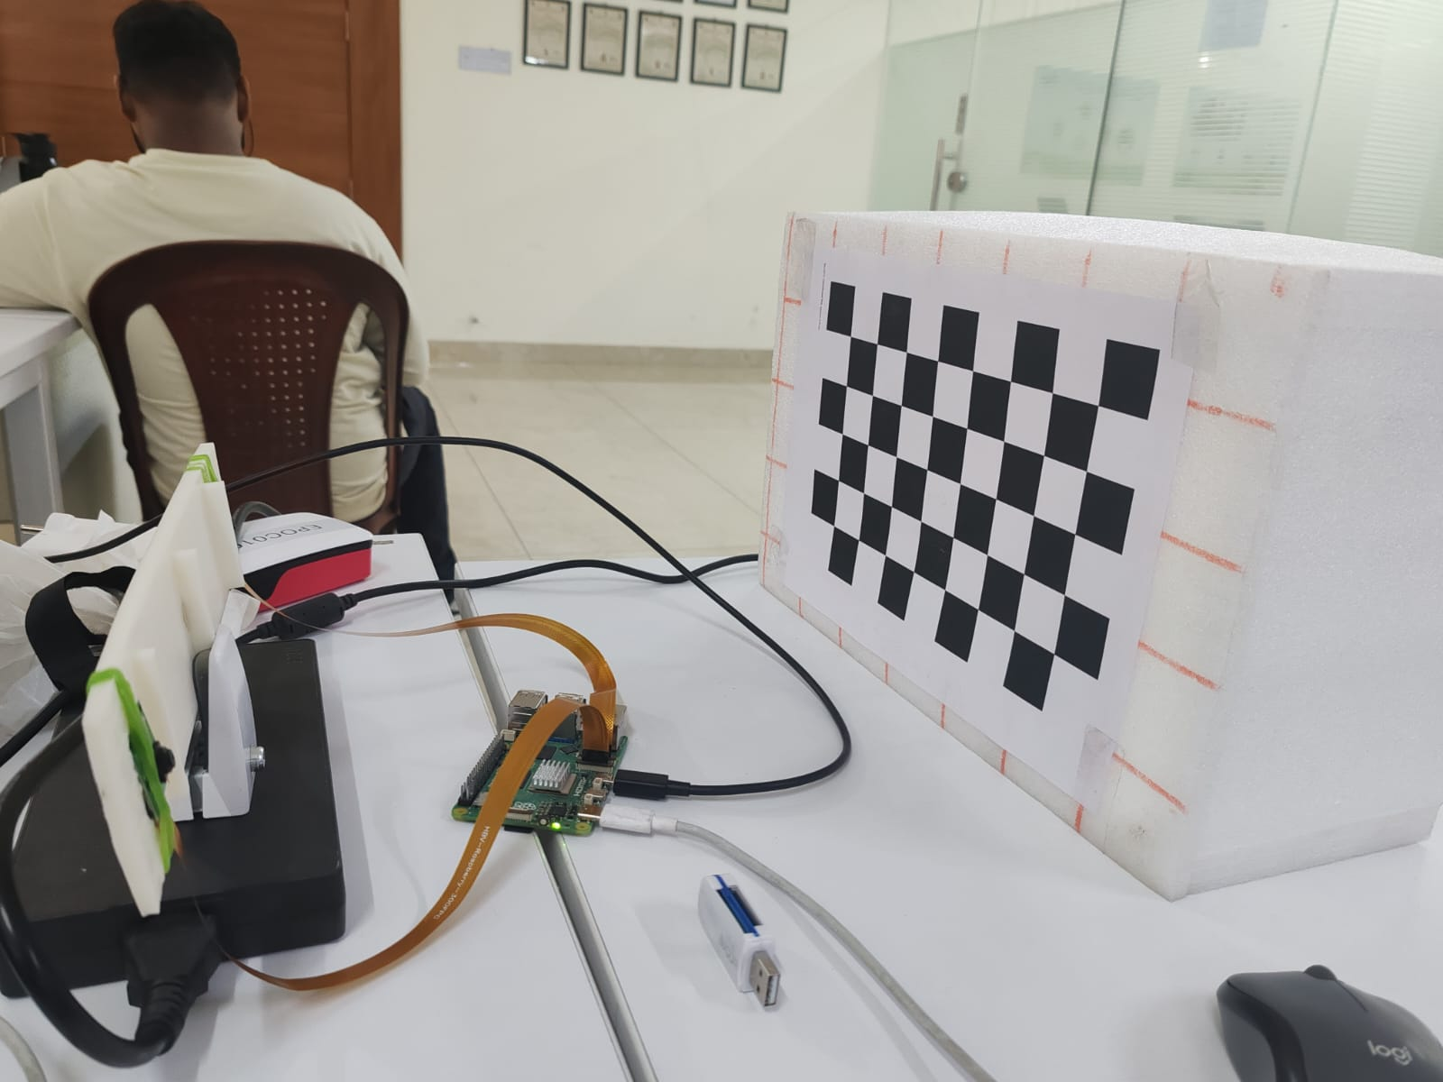
Project 2
YOLO Detection Models — Custom Training
▸ Trained custom YOLO object-detection models on self-labeled datasets for five real-world tasks:
• Water stagnation · broken fence · vehicle detection · PPE-violation detection · fire detection
• Owned the full pipeline: data collection → annotation → augmentation → training → validation & tuning
YOLO (Ultralytics) · PyTorch · OpenCV
Janadri Yalla Yashwanth · Marut Drones
5

Slide 6
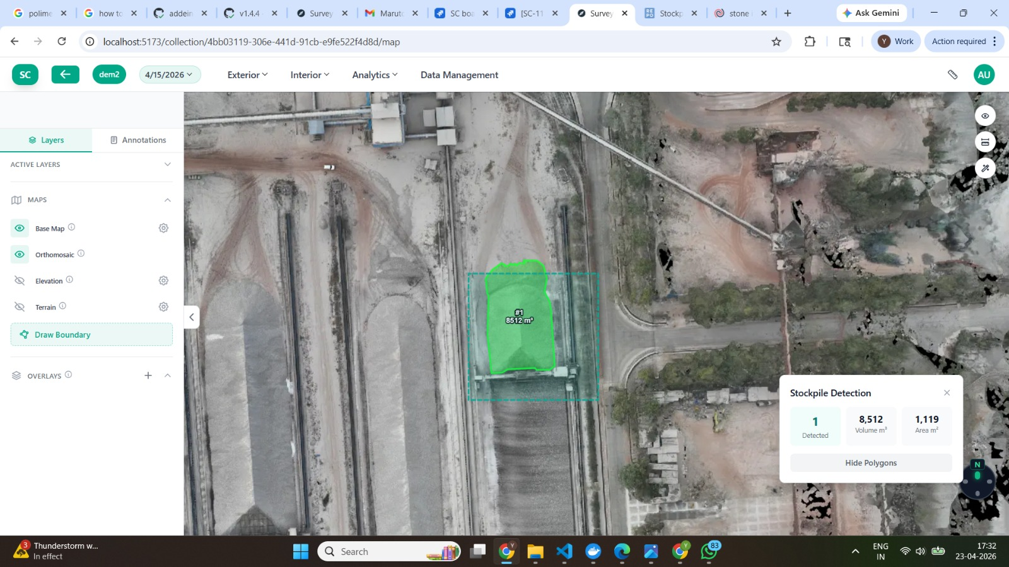
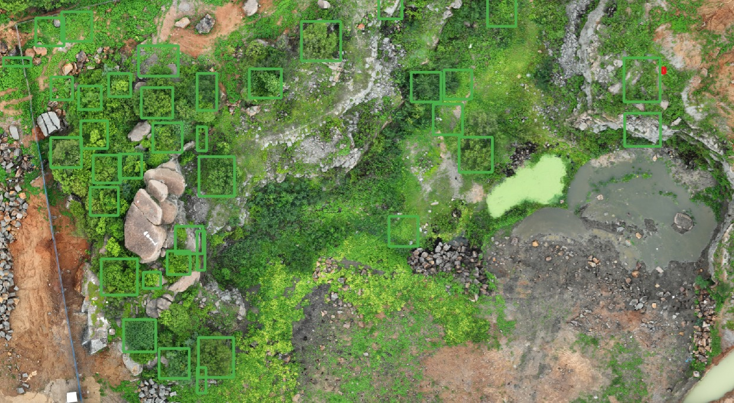
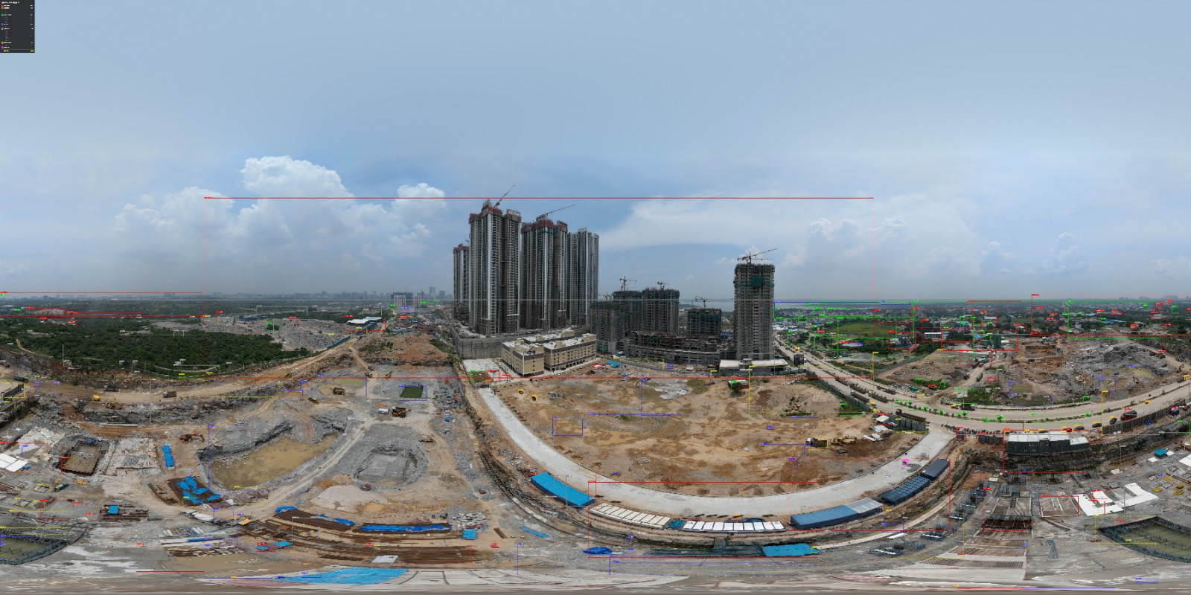
Project 3
Building / Tree / Stockpile Detection — TIFF & Panorama
▸ Detection pipelines on GeoTIFF orthomosaics and stitched panorama images
• Buildings (LangSAM / GroundingDINO), trees (DeepForest), stockpiles (SAM-2)
• DSM / DTM height filtering to remove false positives; stockpile volume (m3) + material classification
• Output: georeferenced GeoJSON with per-object area, height and volume
SAM-2 · DeepForest · GroundingDINO · rasterio / GDAL
Janadri Yalla Yashwanth · Marut Drones
6

Slide 7
Project 4
Measurement Tools on GeoTIFF
▸ Built measurement tools that operate on georeferenced TIFF orthomosaics
• Distance, area and elevation measurement using CRS-aware pixel-to-real-world conversion
• Lets surveyors take accurate real-world measurements directly on the map
Python · rasterio / GDAL · GeoTIFF
Janadri Yalla Yashwanth · Marut Drones
7

Slide 8
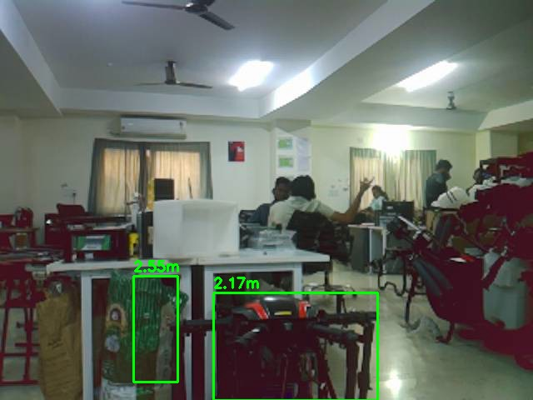
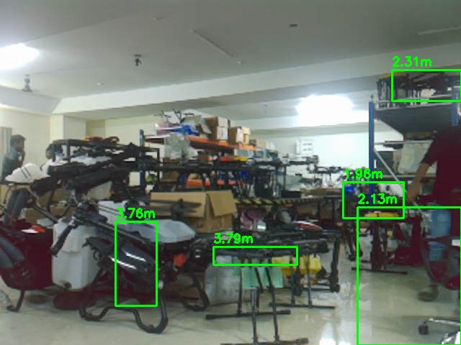
Project 5
Depth Estimation — Stereo Cameras
▸ Estimates real-world distance to objects from a calibrated stereo camera pair — outputs per-object range (e.g. 2.33 m, 2.17 m)
• Calibrated the cameras with a checkerboard target; stereo rectification → disparity map → metric depth
• Built a custom stereo camera rig running on a Raspberry Pi
• Gives the drone 3D perception / distance sensing without GPS or LiDAR
OpenCV (stereo vision) · Raspberry Pi · Python
Janadri Yalla Yashwanth · Marut Drones
8

Slide 9
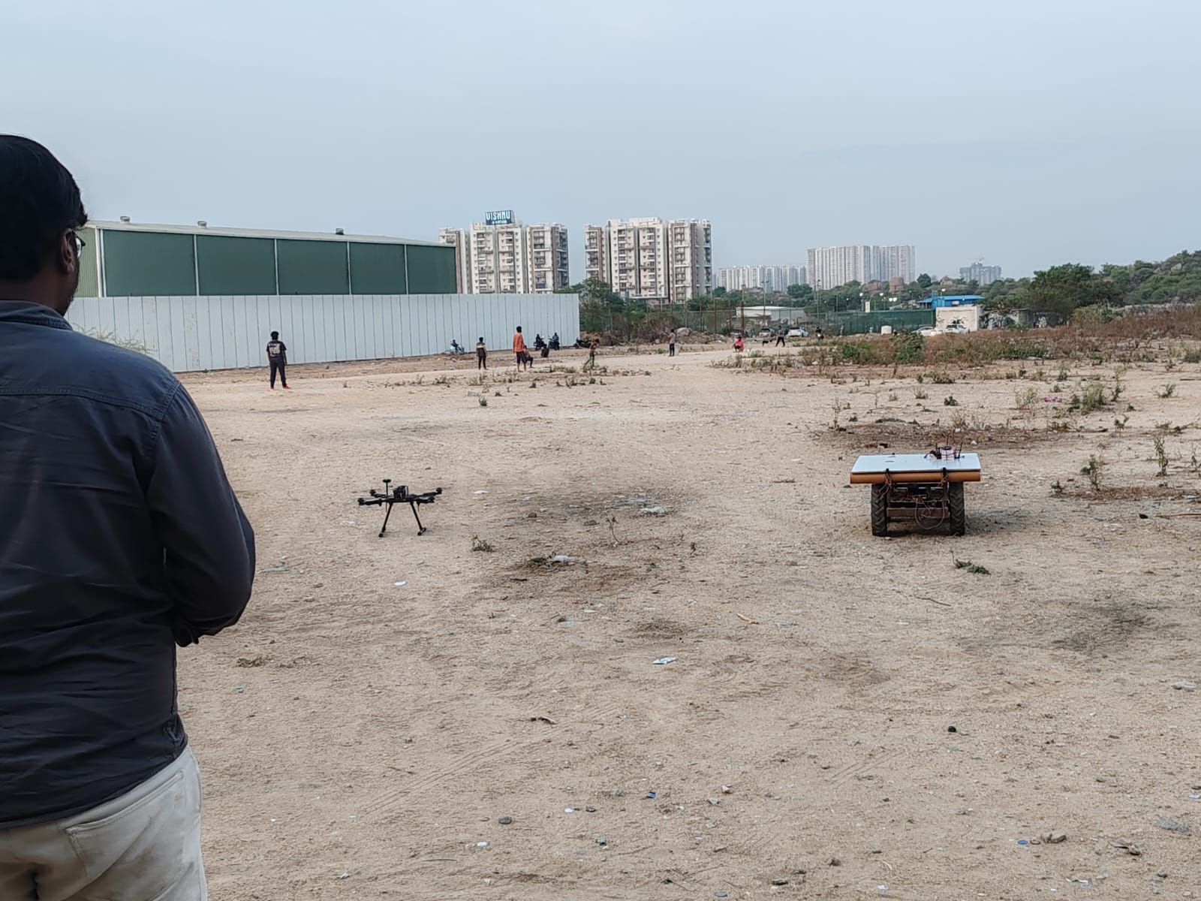
Project 6
Precision Landing on a Moving Platform
▸ Autonomous landing on an AprilTag target mounted on a moving ground rover
• Raspberry Pi companion: AprilTag (OpenCV) → LANDING_TARGET + velocity setpoints over MAVLink to the flight controller at 20 Hz
• Three-mode state machine: visual control with rover-velocity feed-forward, GPS-NAV, hover fallback; touchdown auto-disarm
• Proven ~5-10 cm accuracy on the stationary tag
ArduPilot · MAVLink · Raspberry Pi · AprilTag · OpenCV
Janadri Yalla Yashwanth · Marut Drones
9

Slide 10
Project 7
MightySLAM — Research & Hardware Requirements
▸ Researched MightySLAM for GPS-denied localization and mapping
• Evaluated the approach and its sensor / compute needs for our drone platform
• Produced a hardware-requirements report to guide deployment
SLAM · Sensor fusion (LiDAR / camera / IMU)
Janadri Yalla Yashwanth · Marut Drones
10

Slide 11
Project 8
Photogrammetry Stitching — WebODM & Pix4D
▸ Generated orthomosaics and 3D reconstructions from drone image sets
• Used WebODM (open-source) and Pix4D Mapper (commercial) pipelines
• Feeds the stitched maps used by the detection and measurement tools
WebODM · Pix4D Mapper · Photogrammetry
Janadri Yalla Yashwanth · Marut Drones
11

Slide 12
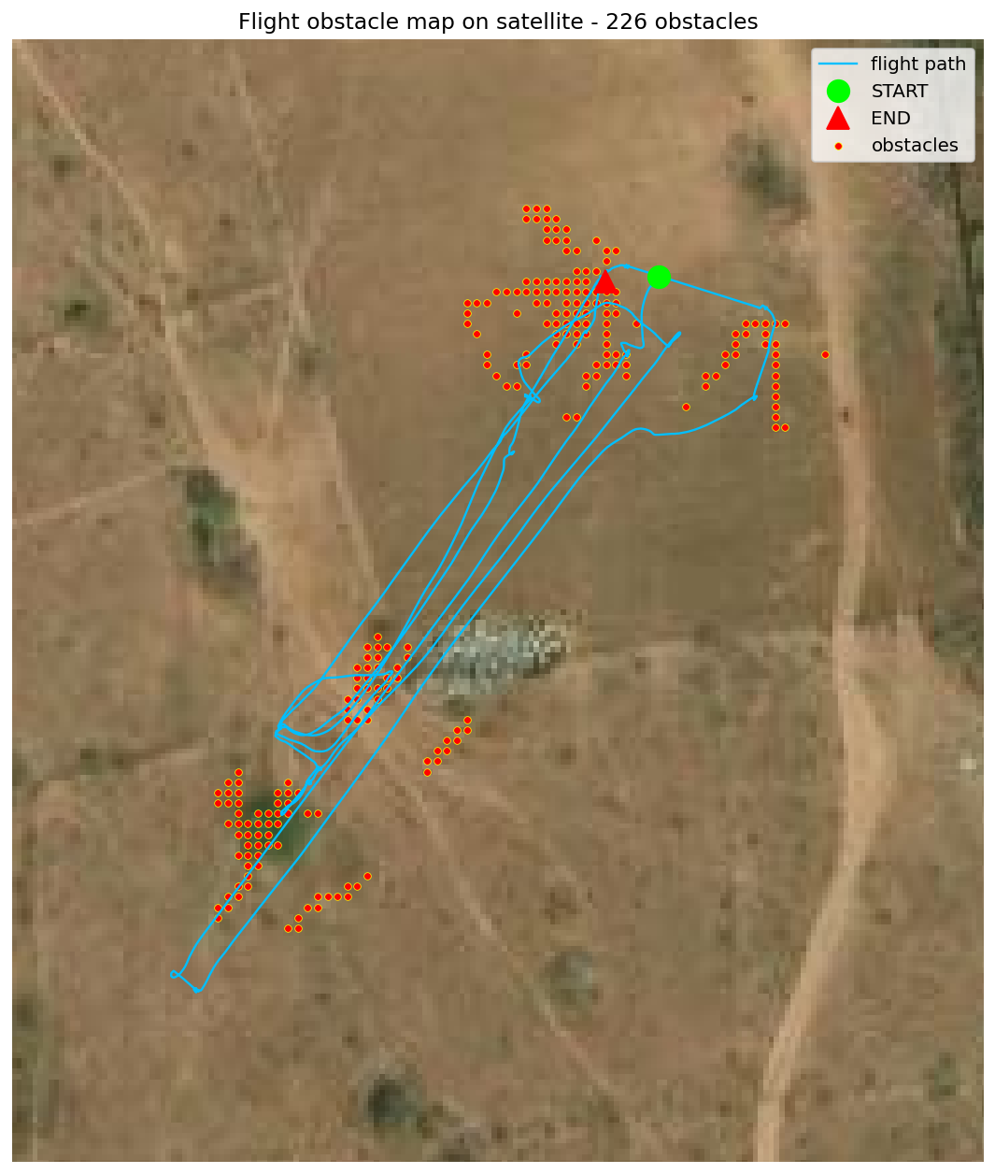
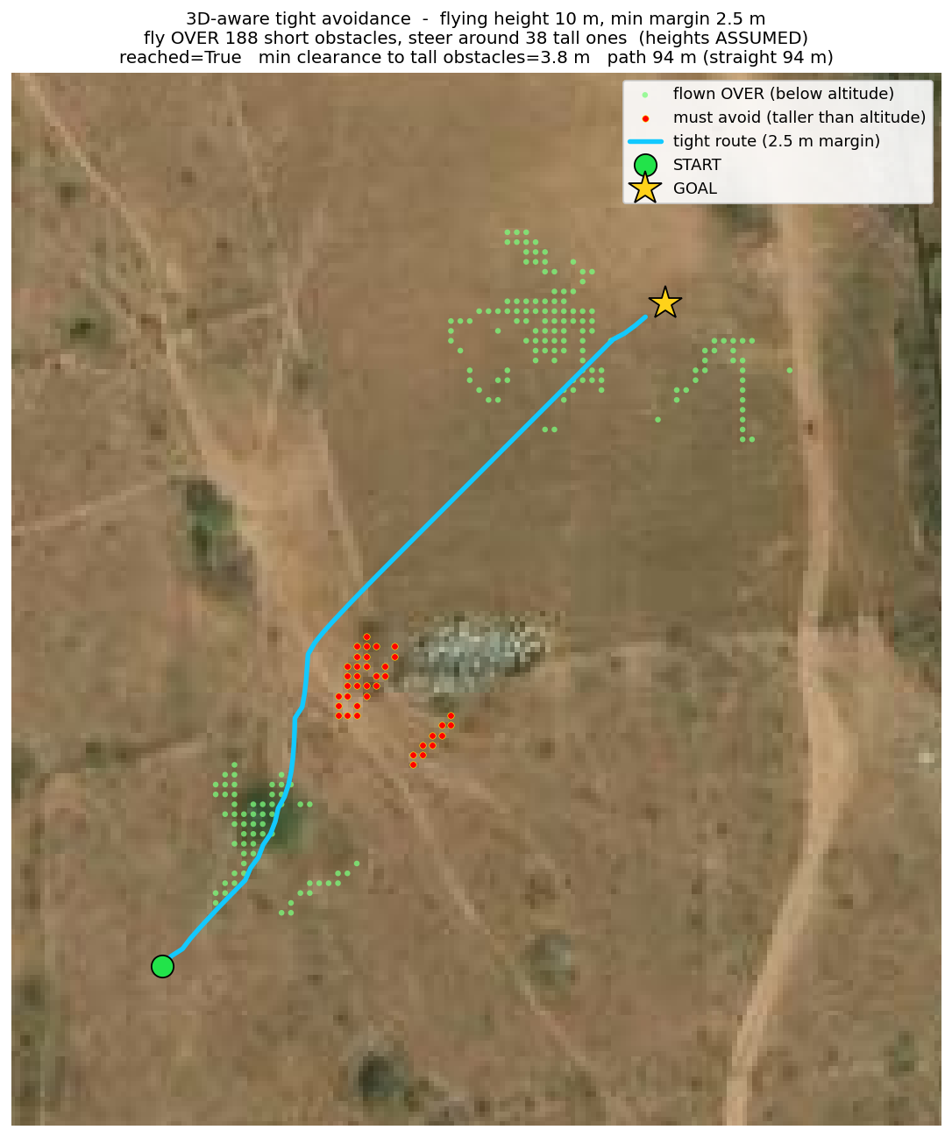
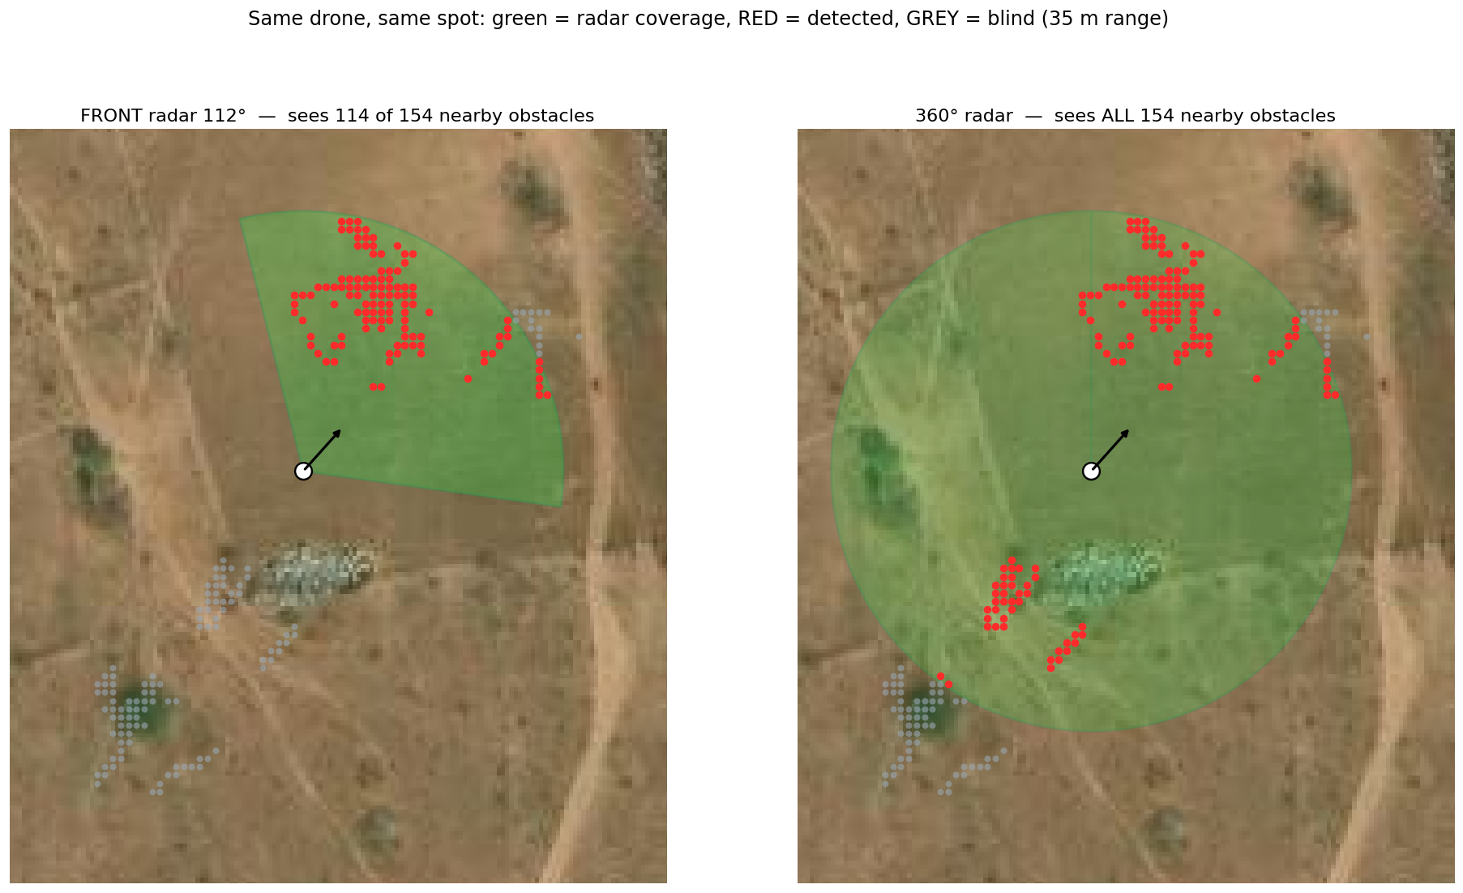
Project 9
Path Planning & Obstacle Avoidance — Radar
▸ Pre-mission path planning with radar-based obstacle avoidance, validated on real flight data (226 obstacles mapped in one flight)
• 3D-aware avoidance: fly OVER short obstacles, steer around taller ones with a safety margin (2.5 m) and ~3.8 m min clearance
• Compared sensor coverage — a 112° front radar saw 114 of 154 nearby obstacles vs a 360° radar seeing all 154; front + down radar for terrain
• Obstacles and planned routes visualized on satellite imagery
Radar (360° + front/down) · Path planning · Python · ArduPilot
Janadri Yalla Yashwanth · Marut Drones
12

Slide 13
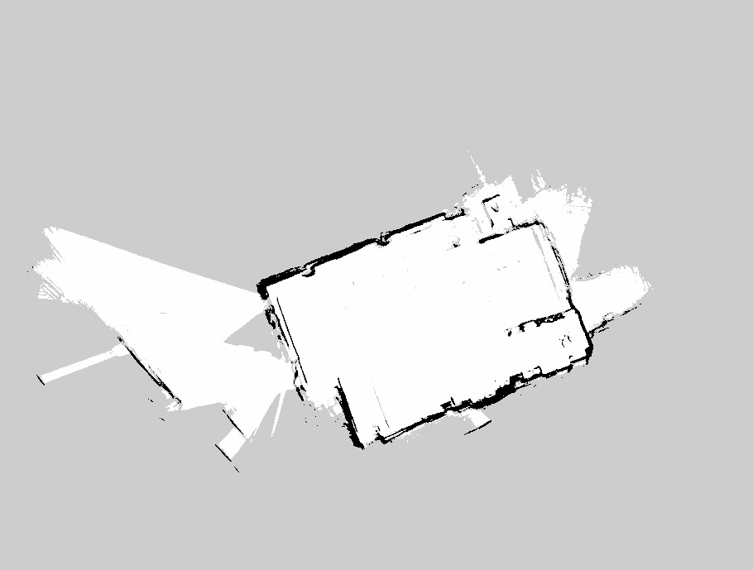
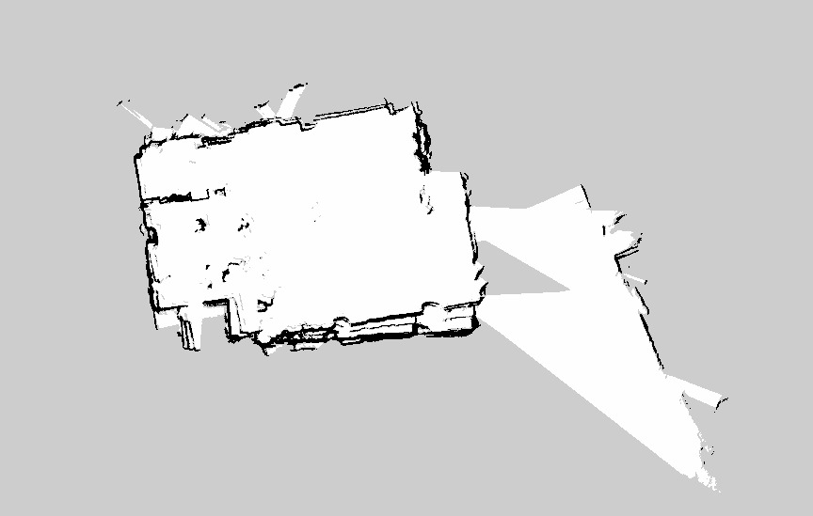
Project 10
Indoor Navigation without GPS — LiDAR
▸ Autonomous indoor navigation where GPS is unavailable, using LiDAR-based SLAM
• Built 2D occupancy-grid maps of indoor spaces in real time — walls and free space mapped as the drone moves
• Lets the drone localize and avoid obstacles indoors — key for GPS-denied / EW-resilient operations
LiDAR · 2D SLAM / occupancy mapping · Python
Janadri Yalla Yashwanth · Marut Drones
13

Slide 14
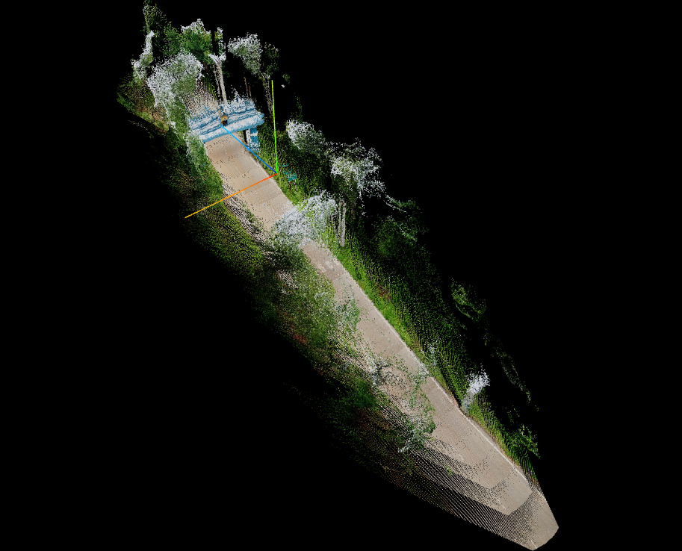
Project 11
LingBot — 3D Environment Mapping
▸ Built dense 3D point-cloud reconstructions of the environment — paths, vegetation and structures
• Turns drone / sensor data into a navigable 3D map for perception and planning
3D reconstruction · Point cloud · SLAM · Python
Janadri Yalla Yashwanth · Marut Drones
14

Slide 15
Summary
Technical Skills
▸ Languages: Python, C++, C, Java, SQL
▸ AI / Computer Vision: PyTorch, YOLO, SAM-2, DeepForest, SegFormer, OpenCV, stereo vision
▸ Drone / Autonomy: ArduPilot, MAVLink, Raspberry Pi, AprilTag, LiDAR, Radar, SLAM
▸ Mapping / Geospatial: WebODM, Pix4D, rasterio, GDAL, GeoTIFF, DSM / DTM, GeoJSON
▸ Backend: FastAPI, Celery, Redis, PostgreSQL, REST APIs
▸ DevOps: Docker, GitHub Actions, Git, Linux
Janadri Yalla Yashwanth · Marut Drones
15

Slide 16
Thank you — Questions?

