Slide 1
Standardization of Application Development Process

Slide 2
OVERVIEW

Slide 3
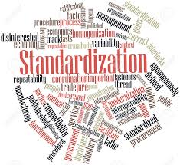
Purpose of the Group
Standardization of Development Process – AppOps & ERPOps
Discuss and come up with Recommendations
Help Teams to get more Productive
Encourage teams to develop Reusable Modules
Enabling people to come up with New Ideas for Standardization

Slide 4

Touchpoints : Meeting 1
Team Introduction
Questionnaire to gather data on Process and Technologies used by teams

Slide 5
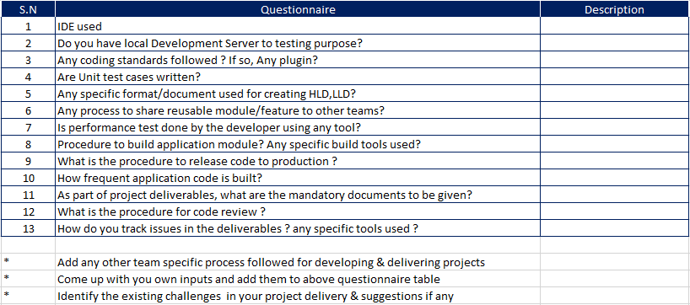
Questionnaire

Slide 6
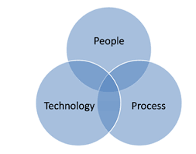
Outcome : Meeting 1
Inputs were gathered from teams of the Group Members
Discussion on the Questionnaire Answers
Understanding how Teams function
Decided to Categorize Standardization:
Process
Technology

Slide 7


Touchpoints : Meeting 2
Presentation on Existing Process in a Team by group members
Reusing codes and modules
SSO Integration for mobile apps
Sharing Micro-Services

Slide 8
Outcome : Meeting 2
Automation Tools :
Jenkins
Quality:
Java – SonarQube
Junit - Testing

Slide 9





Touchpoints : Meeting 3
Presentation on Existing Tools and Resources
Action Point - Documentation for the following:
Java
JavaScript
Maven
GitHub
Action Point – Encourage Teams to use existing resources like :
Yammer, Confluence, Rally(CA technologies), GitHub, StackOverflow, Box etc.

Slide 10
Outcome : Meeting 3
Yammer Group Creation : https://www.yammer.com/ge.com/#/threads/inGroup?type=in_group&feedId=10145238
Box Location to share files : https://ge.box.com/s/cajitgehwb3u5px14kcmfop896p70qpb
Confluence Page for documents
Stack Overflow Tag – STAND-PUG

Slide 11
Going Forward
Processes
Networking
Discuss & Recommend
Technology
Explore different Tools
Understanding Functions
Discuss & Recommend
Present a Demo

