Slide 1

Covid-19 Pandemic Case Statistics and Analysis
DATA 228: Big Data Technology and Applications
DATAGATE TEAM MEMBERS:
Deep Arvind Bambharoliya
Ha Phan
Shrey Bishnoi
Vaibhav Yalla

Slide 2
Tables of contents
Introduction
Data pipeline and Architecture
Analytical Queries
Visualization and analysis

Slide 3
Introduction
Motivation
Objectives
Datasets

Slide 4
Introduction
Motivation:
Our project will focus on collecting a large dataset of Covid19 throughout the world, using big data tool on AWS to process and store data and then using Tableau to perform visualization and analysis process.
Covid-19: deadly disease, 265.677.715 cases, 5.263.626 worldwide.
Significant impacts on society: school, business closing, jobs lost, poverty increasing.
Collecting and examining a large amount of Covid-19 data:
critical for understanding its characteristics and behavior and impacts.
collaborative efforts: from data, science, and technology: inspire insights and foster breakthroughs necessary to limit COVID-19 cases by finding the trends and inform the appropriate response, planning and allocation of resources.

Slide 5
Introduction
Objectives:
Giving a big picture about covid19 in the world in term of the total cases country by country, continent by continent, new cases daily, monthly, the numbers of people vaccinated.
Analyze the vaccination policies of different nations to examine the best possible way to help improve fatality rates.
Analyze how some policies (social distancing, face mask covering, stay-at-home restrictions) help to slow down covid cases.
Understand and capture the trends to make people assess the situation quantitatively and take necessary preventive actions.
Used by researchers, biomedical engineering, government, and NGOs to make people aware and provide the right support (vaccine, hygiene protocols, food) and common people to understand the data in a simpler format.

Slide 6
Introduction
Datasets:
Data source: Amazon Open Repository (Covid Data Lake)
Data is collected from many sources: John Hopkins University, European Centre for Disease Prevention and Control (ECDC) for a select number of European countries; and government sources for the United Kingdom, the United States, Canada, Israel, Algeria, Switzerland, Serbia, Malaysia.
Data related to confirmed cases, deaths, hospitalizations, and testing, as well as other related information such as the degree of policies, are imposed on different regions, countries, GDP, or population which are helpful for the analysis process.

Slide 7
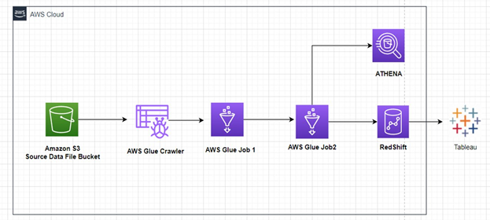
Data Pipeline and Architecture

Slide 8
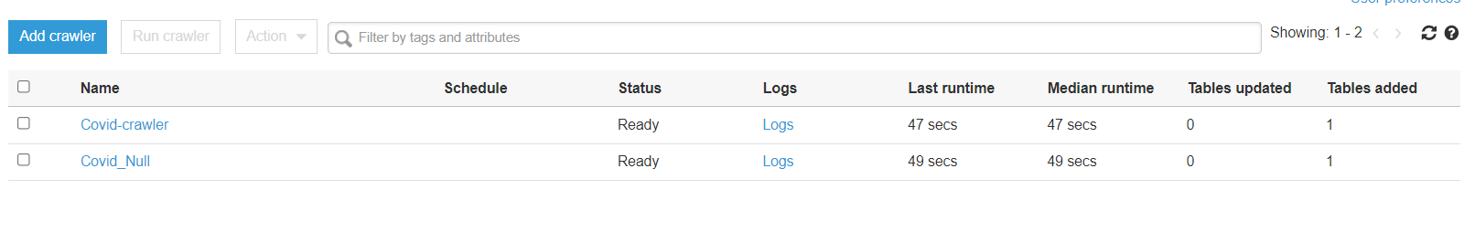
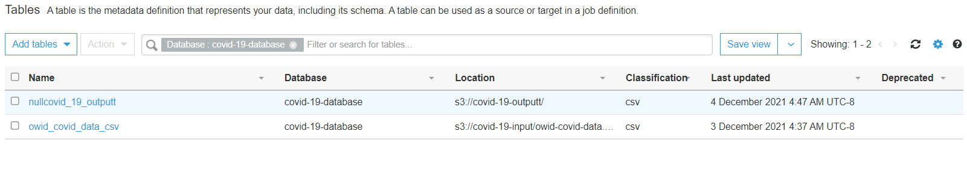
Data Pipeline and Architecture
Crawler:
Created Run on Demand Crawler.
Crawled output data is inserted in the Table in the Data Catalog.

Slide 9
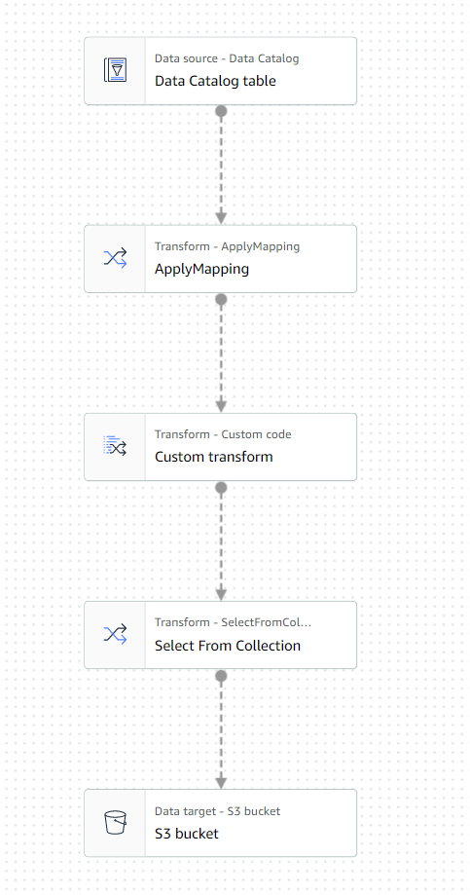
Data Pipeline and Architecture
AWS JOB 1
Source: Crawled data which is present in the Database (Data Catalog)
Apply Mapping: We can change datatypes of each column
Custom Code: Pyspark code, which helps to clean the data
Destination: The output of the job is stored in S3 and the Data Catalog

Slide 10
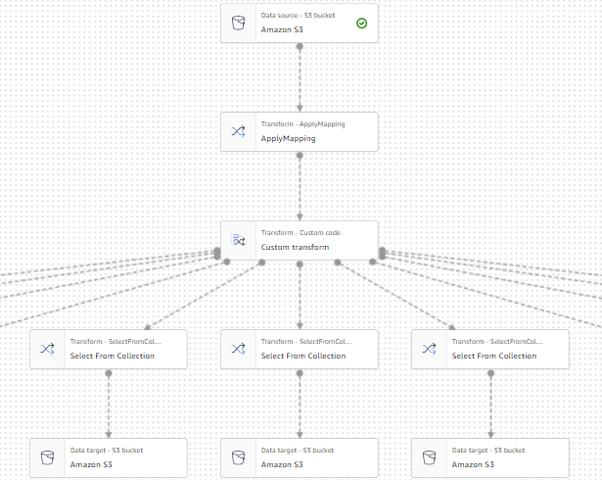
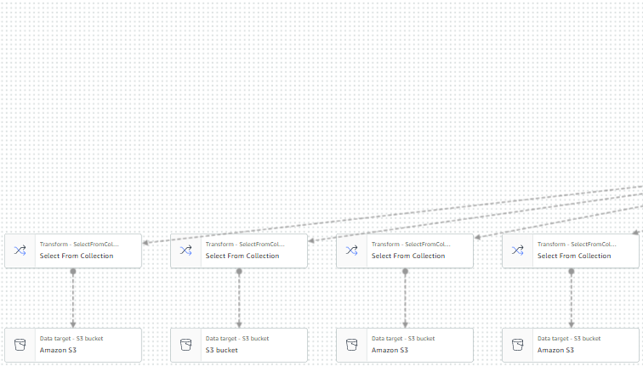
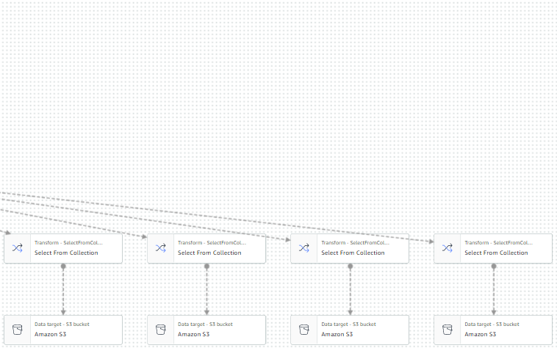
Data Pipeline and Architecture
AWS JOB 2: In this job we have divided tables and kept the output files in S3 bucket.
Source: The source file is the output file of Glue Job 1 (Cleaned data)
Custom Code: By using data frames we have divided the tables.
Destination: The destination point is a S3 bucket and Data Catalog

Slide 11
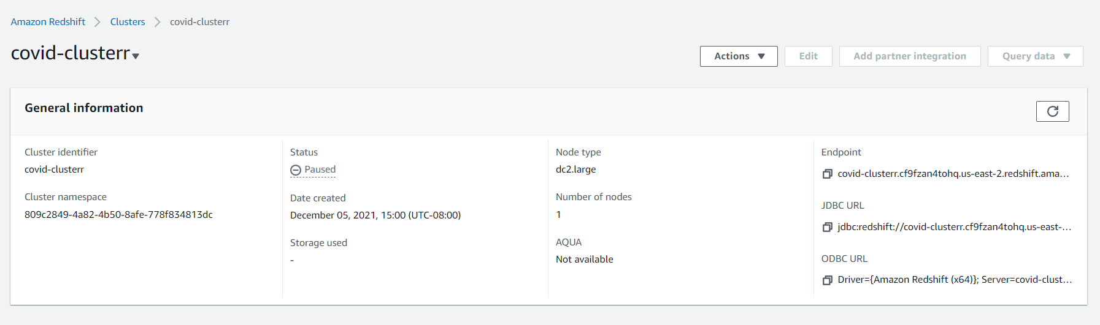
Amazon RedShift
Created a Cluster
Created new IAM Roles with S3Full Access and Glue policies
Used Query editor V2, created tables
Used copy commands to insert data

Slide 12
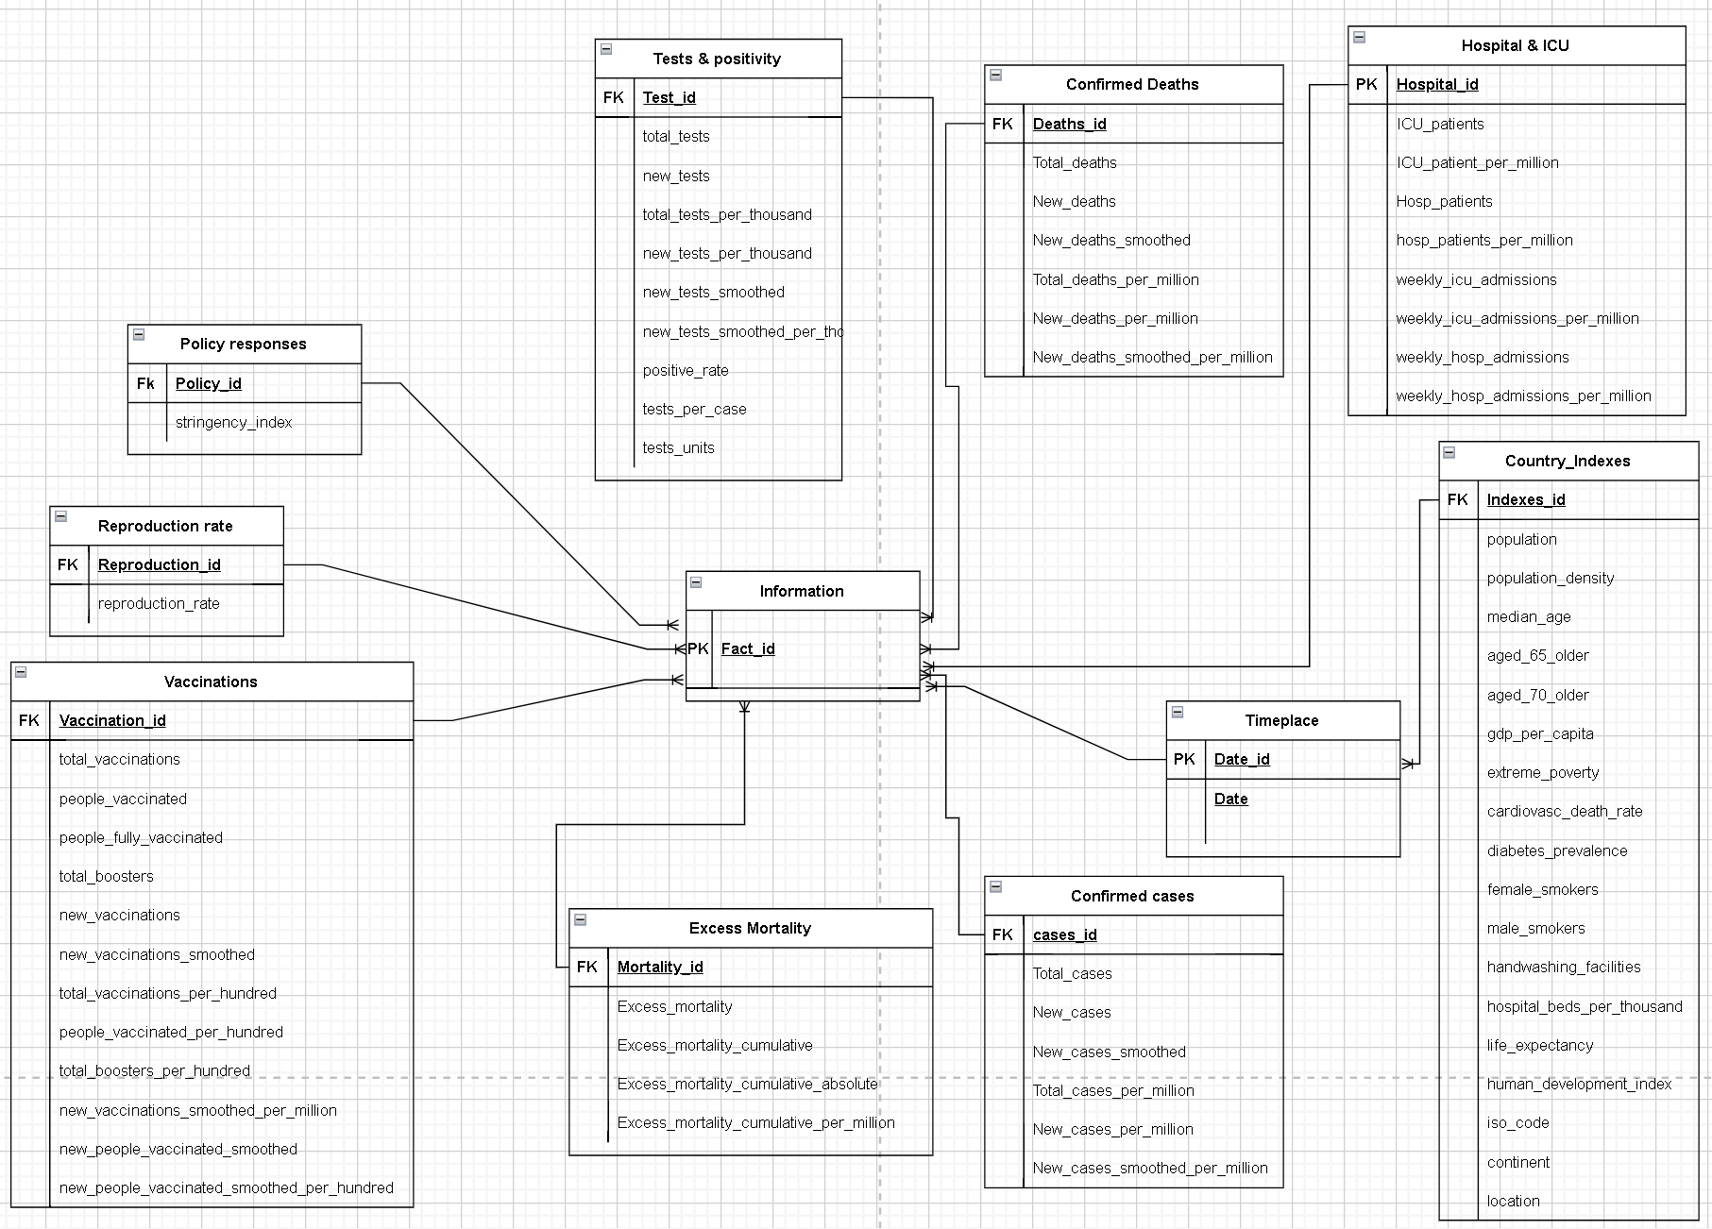
ER DIAGRAM

Slide 13
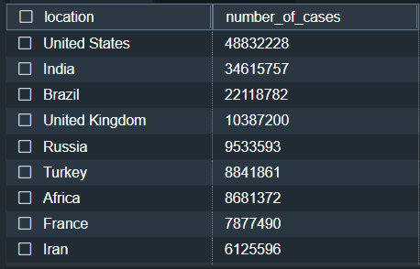
Analytical Queries
1. Top 10 places which are mostly affected by covid-19

Slide 14
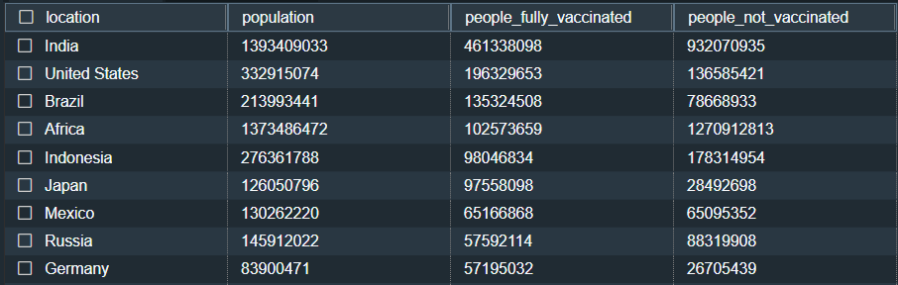
Analytical Queries
2. Number of people who are not vaccinated

Slide 15
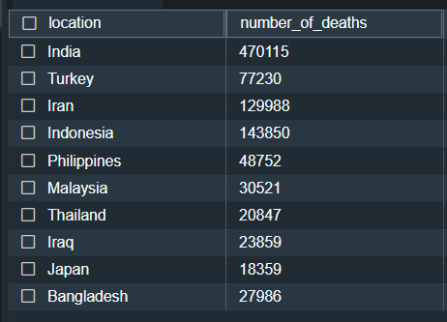
Analytical Queries
3. Number of deaths in top 10 countries in continent Asia

Slide 16
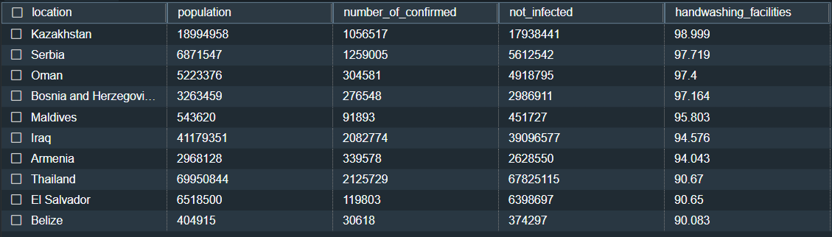
Analytical Queries
4.HOW Handwashing FACILITIES EFFECT COVID CONFIRMED CASES

Slide 17
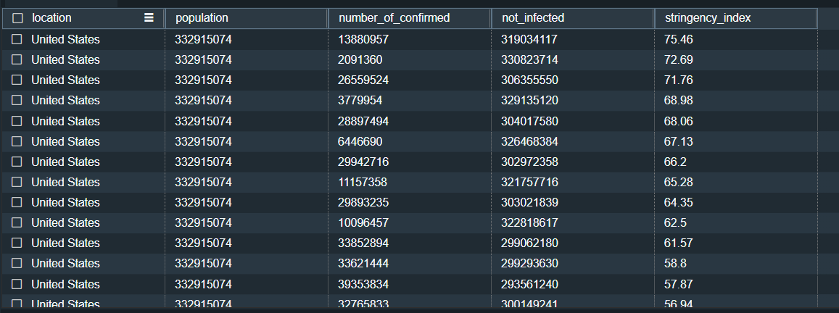
Analytical Queries
5. HOW Stringency index FACILITIES EFFECT COVID CONFIRMED CASES

Slide 18
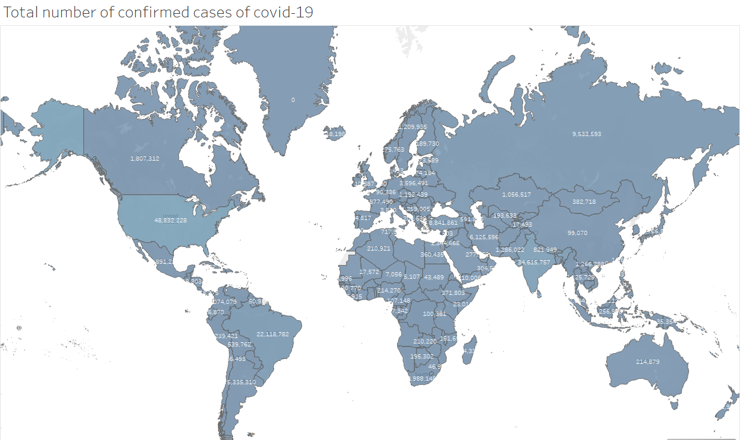
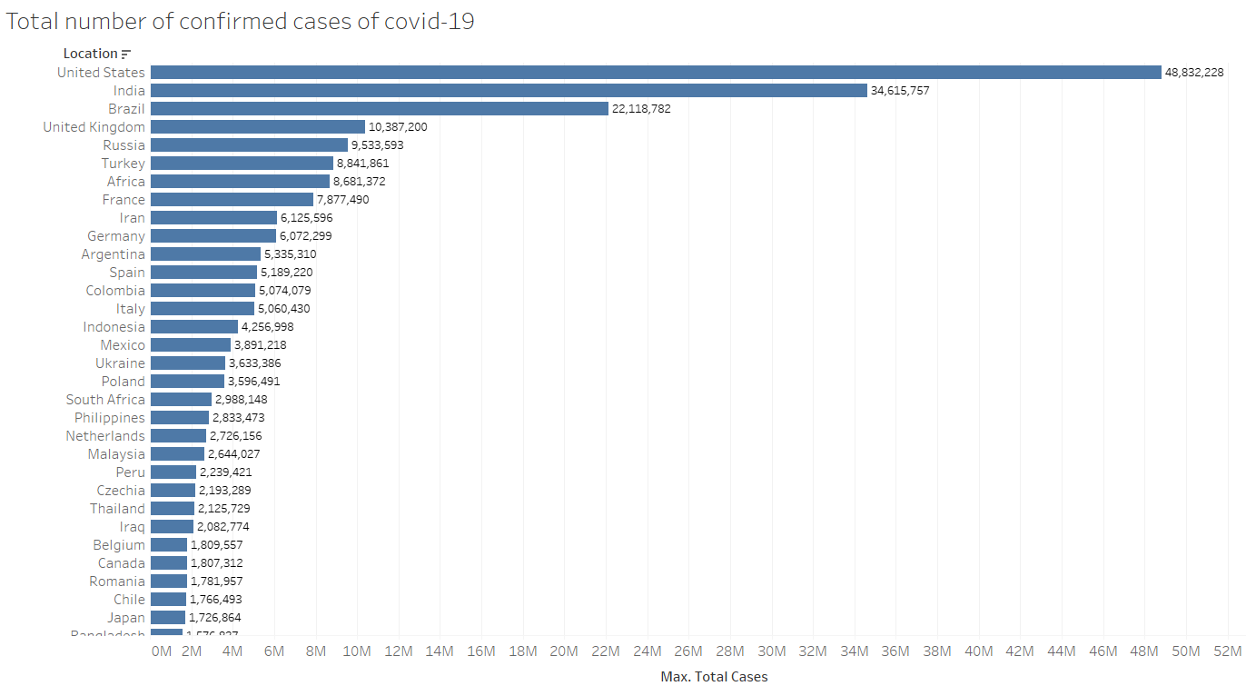
Visualization

Slide 19
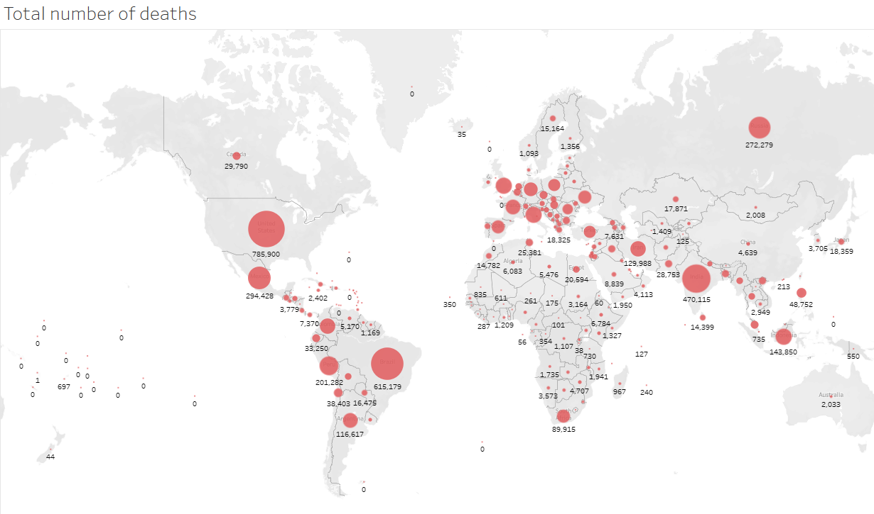
Visualization

Slide 20
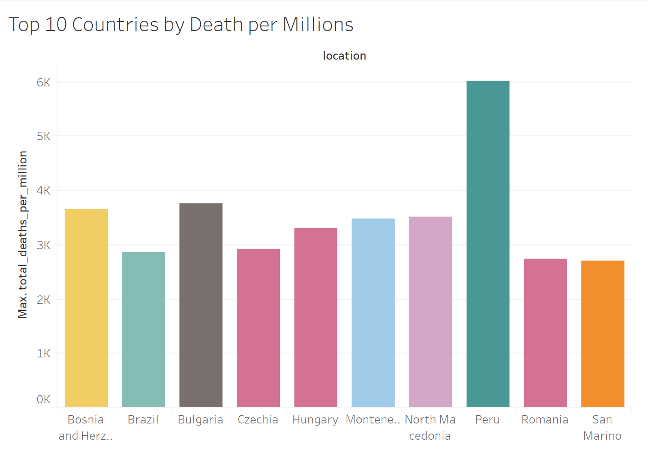

Slide 21
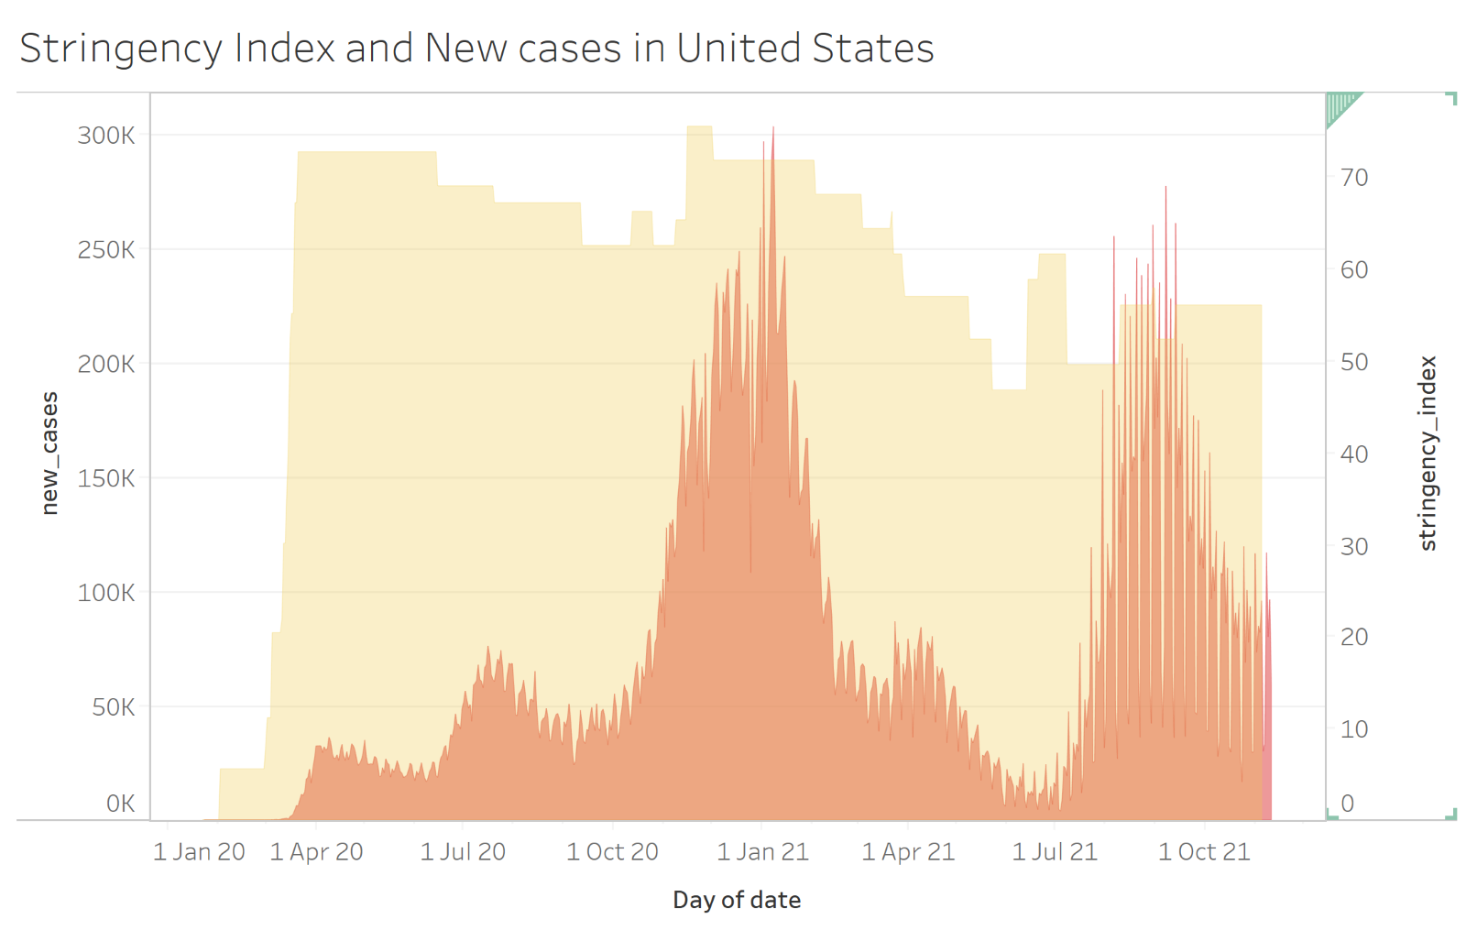

Slide 22
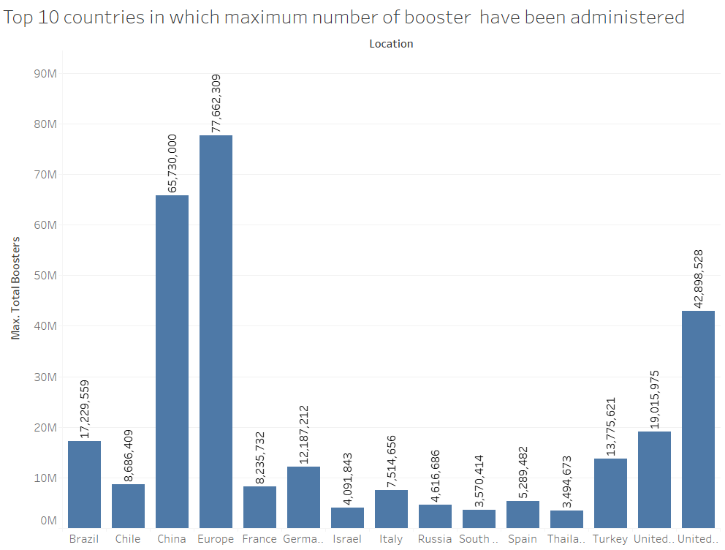
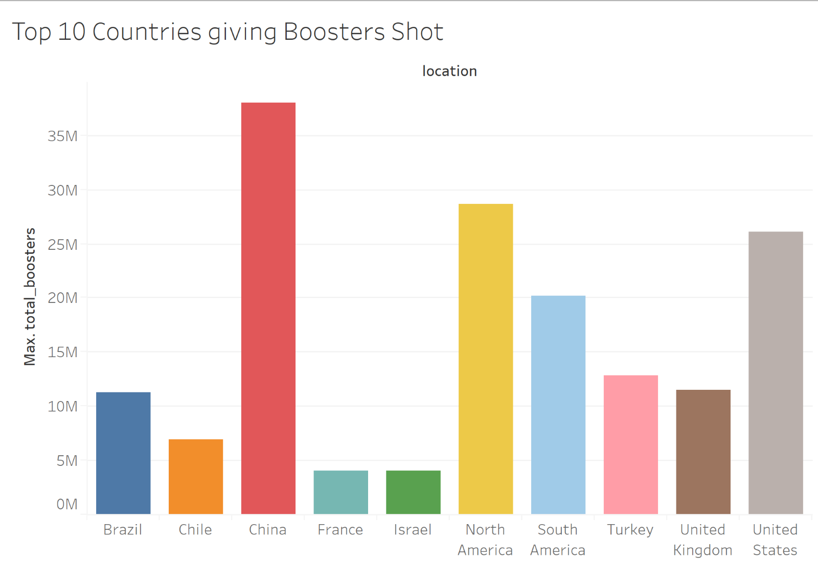

Slide 23
CONCLUSION

Slide 24
Thank You

