Slide 1
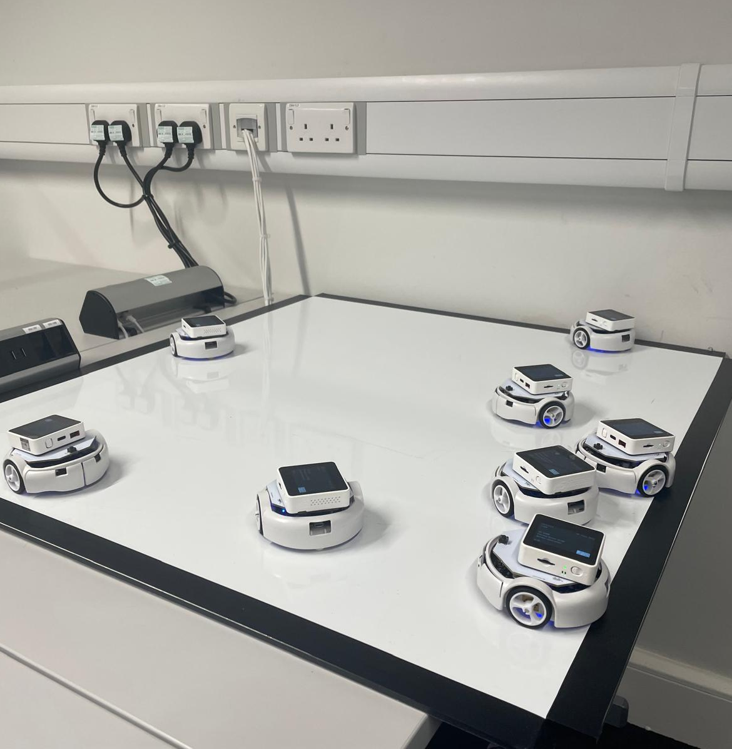
Communication policies that shape Embedded Evolution in ESP32 Collectives
Luis Yallico Ylquimiche
(SID: 2354065)
Supervisor: Dr Paul O'Dowd
MSc Robotics
25th August 2025

Slide 2
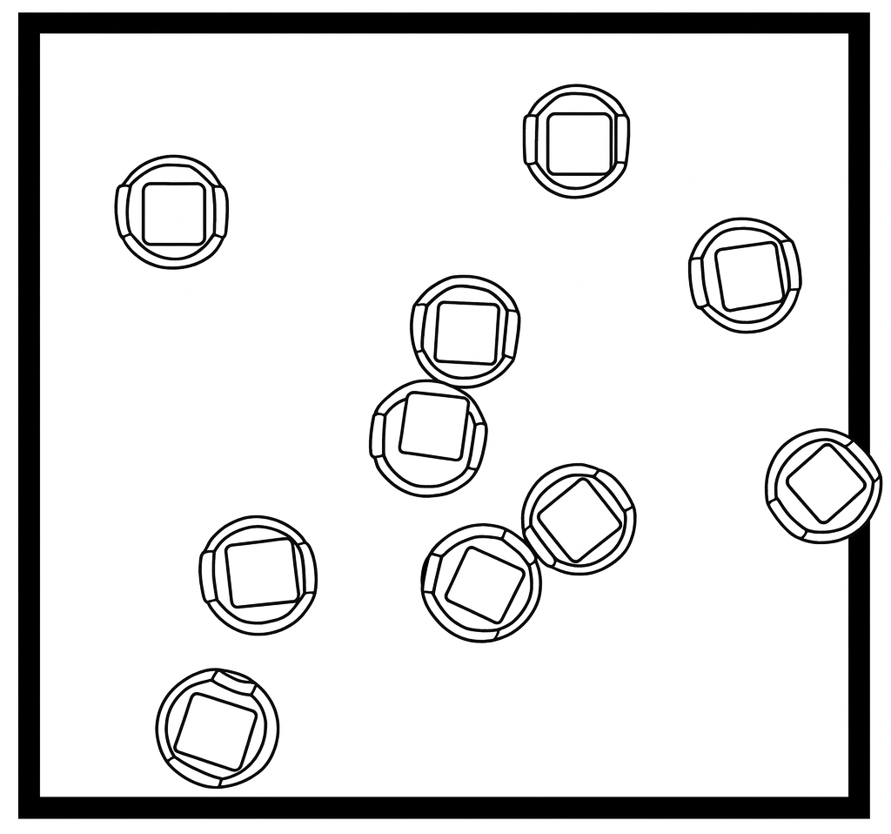
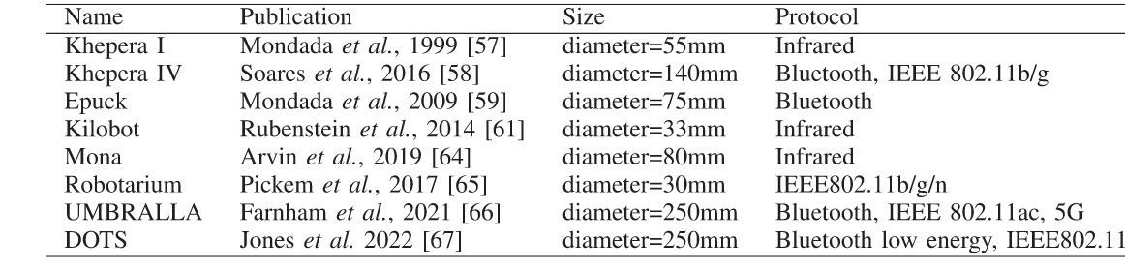
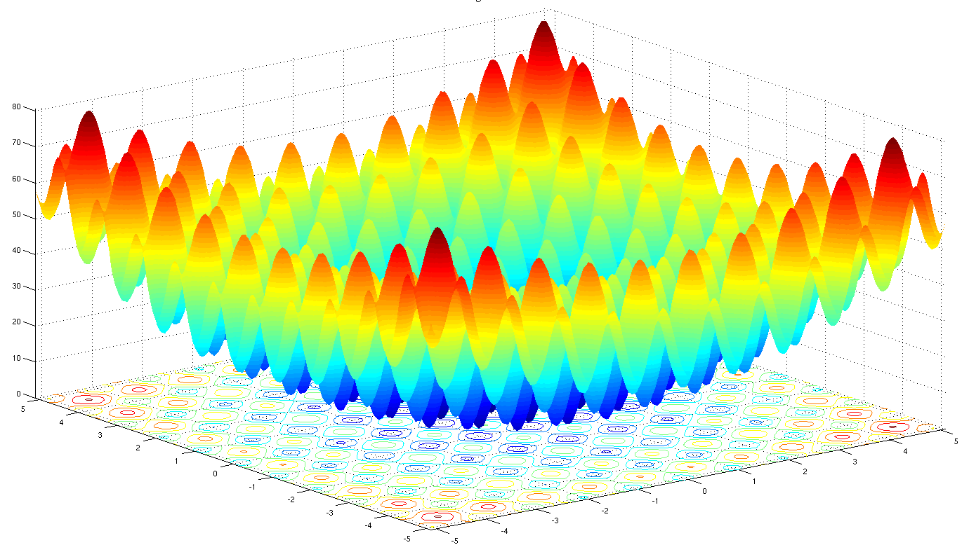
Why this research?
Situation of research
Communication is fundamental for swarm behavior emergence
Swarm studies recent focus on co-ordination and task allocation
ESP32 data link (ESP-NOW) has not been explored in swarm literature
Internal genetic Algorithm
(Local Fitness )
Periodic
Migration
Global
Convergence
Controllers
"evolve"
Promotes
genetic
diversity
Xing A, Celimuge W, Yangfei L, Min L. Multi-Robot Systems and Cooperative Object Transport: Communications, Platforms, and Challenges. 2023. 2644-1268
Rastrigin Function (WIkipedia). 2025.

Slide 3
What do we address?
Contributions to the field
1.
Aim
Quantify the impact of communication policies in a robotic swarm's embedded evolution
Independent Variable | Implementation
Swarm Density | 3, 8, 13 swarm cohorts
Locomotion | Static vs Brownian motion
Topology Inference | Stochastic peer ordering vs Comm-aware biased peer ordering
Message Limits | Unlimited vs Limited message caps during experiments
Transmission Frequency | Random micro-delays bounded by peer latency to spread out transmission bursts
2.
Objectives
  Develop a hardware-in-the-loop testbed that permits reliable real-time data capture
  Design set of experiments to systematically test ESP-NOW communication under different independent variables
  Write firmware for the island-model embedded evolution and ESP-NOW
  Evaluate large volumes of data relevant to communication and convergence key performance indicators
3.
Research Question
Given the various independent variables profiled, can we identify pragmatic swarm design rules for this type of swarm?

Slide 4
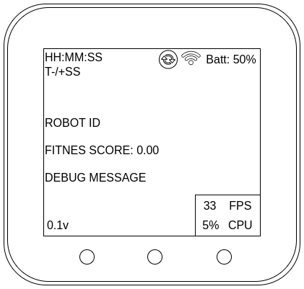
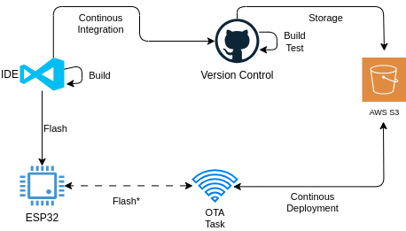
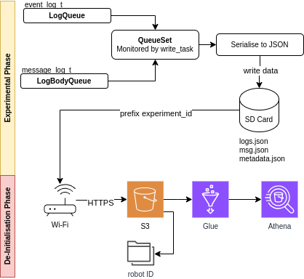
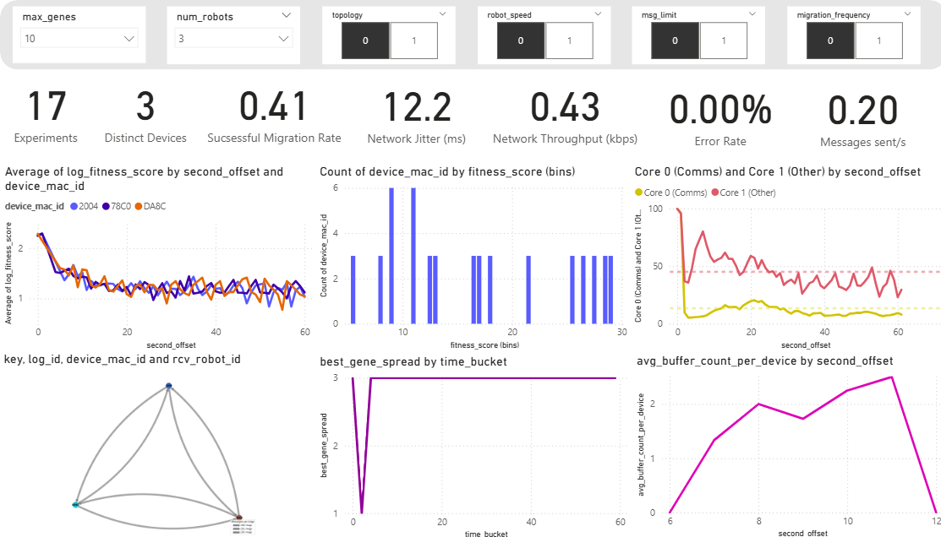
Technical Contributions
Hardware-in-the-loop framework
A​
E​
D
Time (t)
B​
C

Slide 5
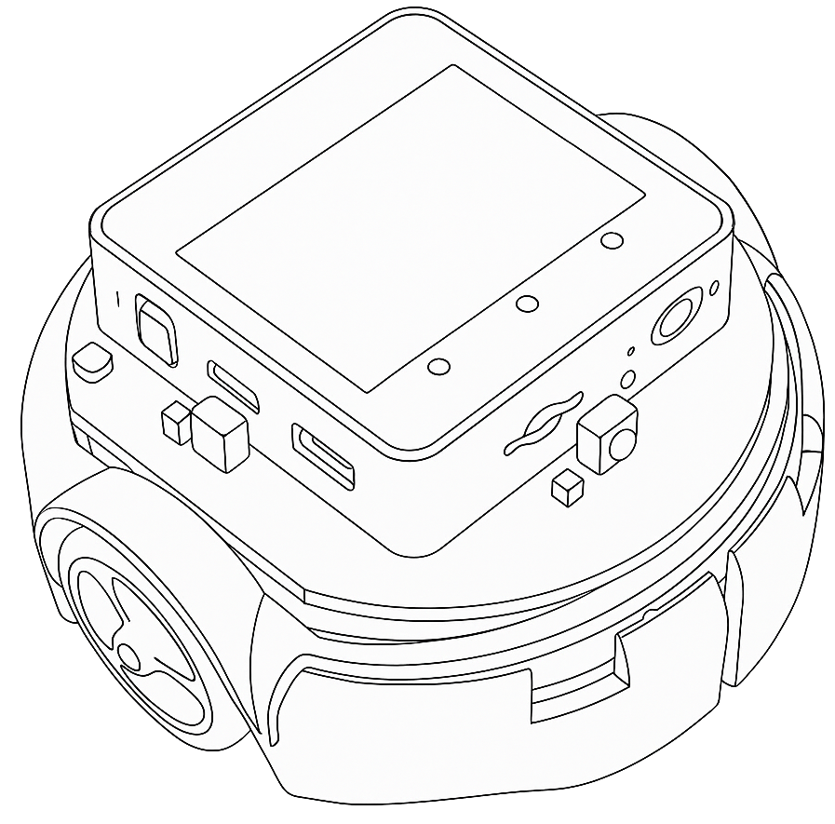


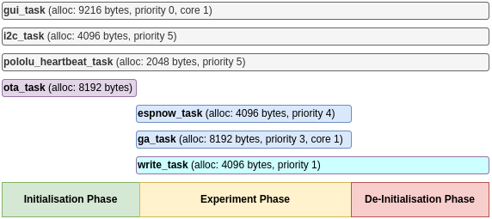
Technical Contributions
FreeRTOS GA/ESP-NOW Implementation
Due to the nature of the communication, we had to handle the execution of the Genetic Algorithm and sending/receiving of messages.
Event push-driven unicast communication
Use of queues and buffers for in-coming messages.​
Asynchronous
Handle multiple FreeRTOS tasks concurrently and in parallel:
Handle event logging for data analysis
Keep evolving solutions locally
Keep sending and receiving ESP-NOW messages

Slide 6
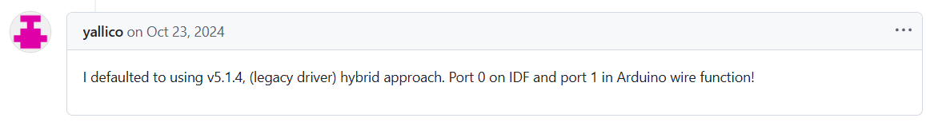
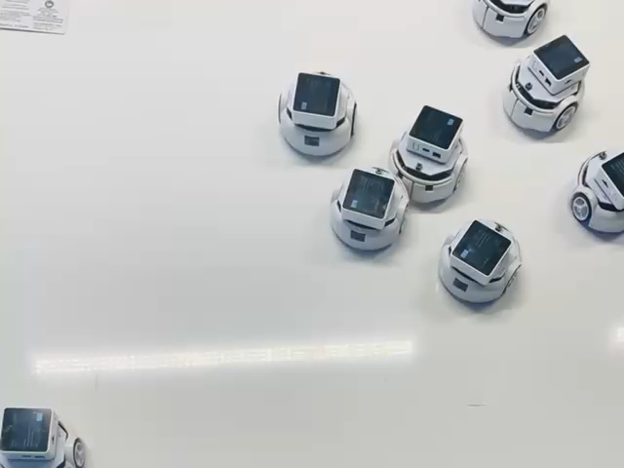
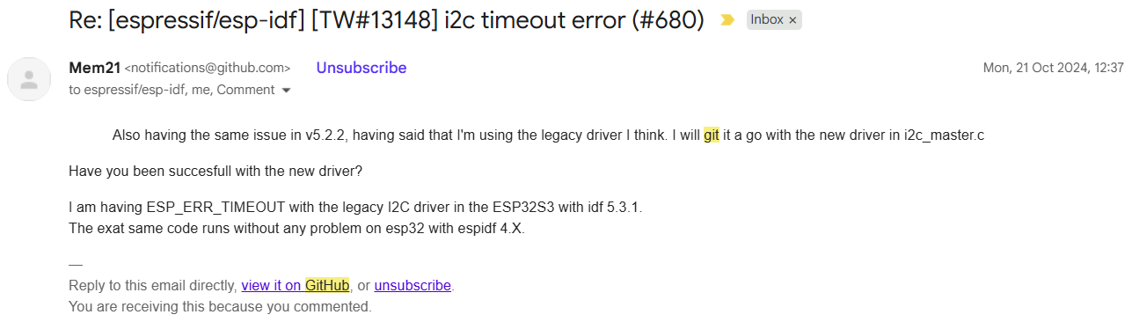
Technical Contributions
I²C Hardware Abstraction Layer (HAL) bug fixing for ESP32
Successfully modified ESP-IDF HAL source code to implement I²C and became an open-source contributor.
https://github.com/espressif/esp-idf/issues/680#issuecomment-2426425417

Slide 7
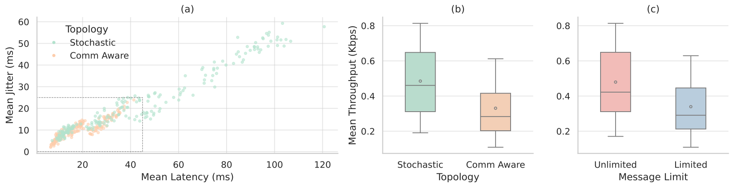
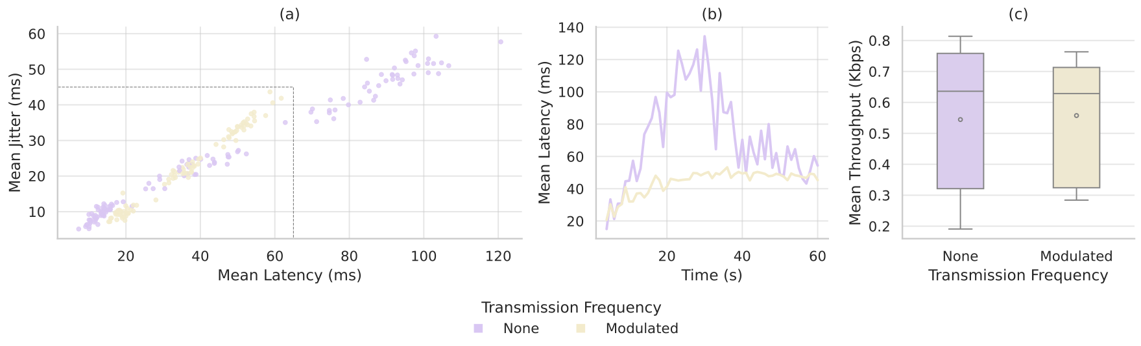
Knowledge Contributions
Link formation and transmission timing, drive QoS and adaptation on this platform
Topology Inference
Transmission Frequency

Slide 8
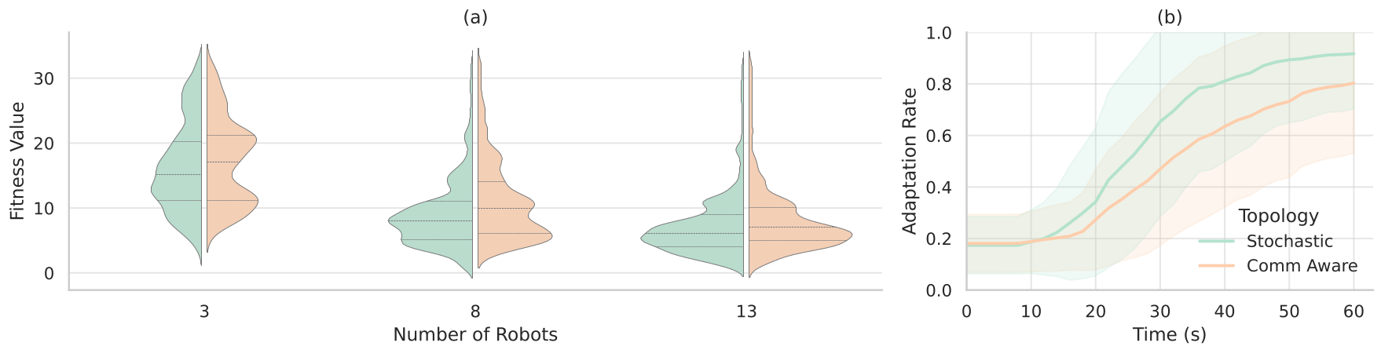
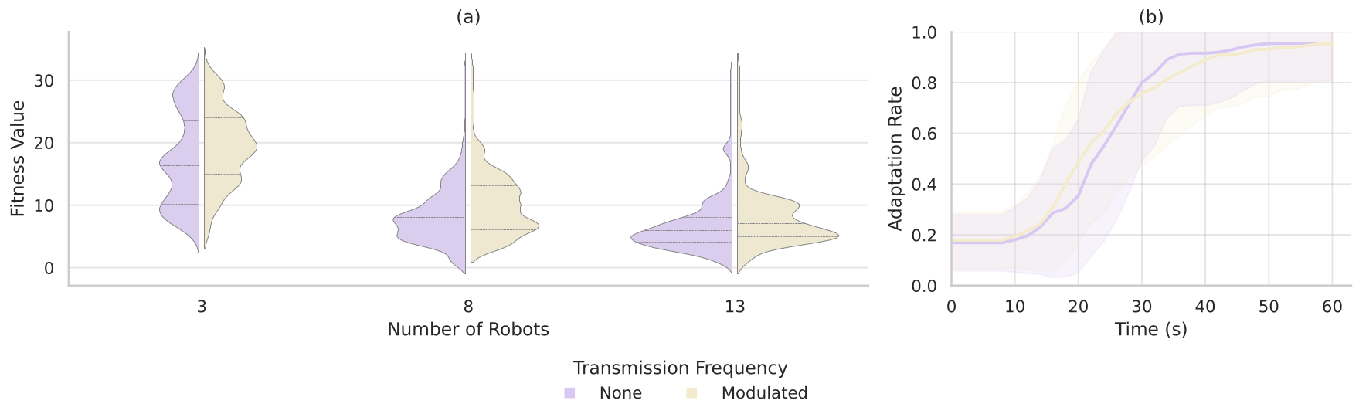
Knowledge Contributions
Link formation and transmission timing, drive QoS and adaptation on this platform
Topology Inference
Transmission Frequency

Slide 9
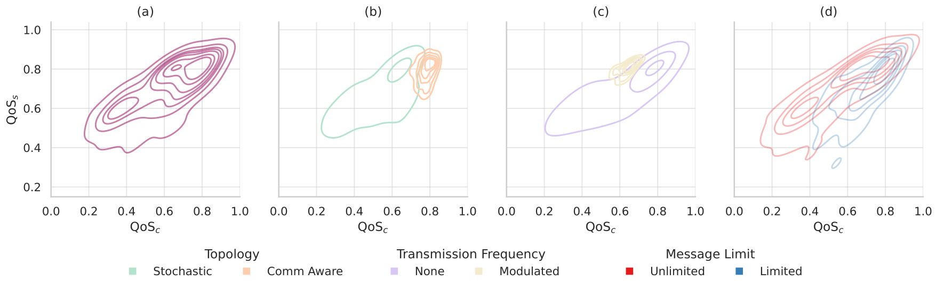
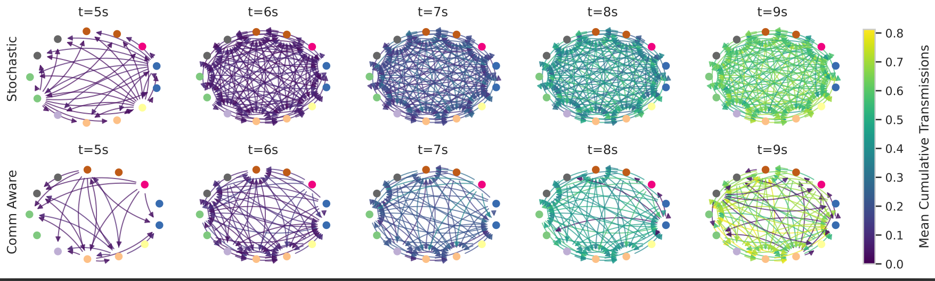
Knowledge Contributions
13-agent deep dive

Slide 10
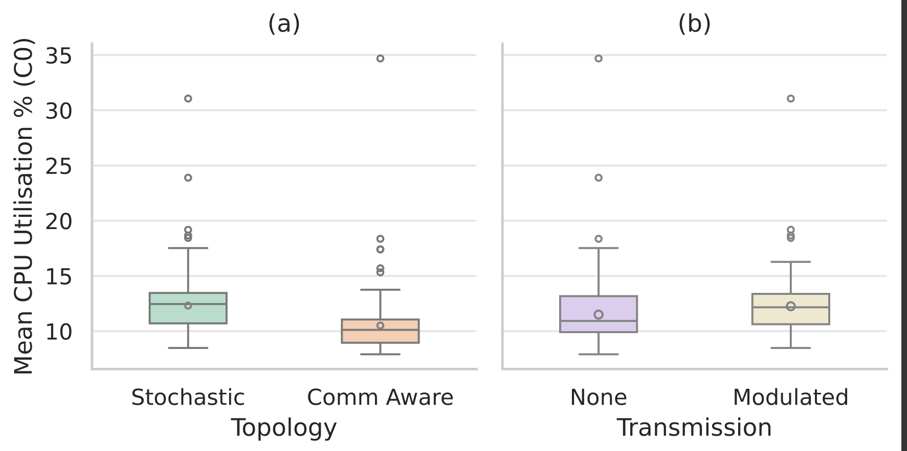
Knowledge Contributions
Conclusions and Future Studies
Design Rules
Rapid diffusion / high throughput → stochastic + micro-delays.
Low latency/jitter / robustness → comm-aware (limit effective links).
Research Question
Given the various independent variables profiled, can we identify pragmatic swarm design rules for this type of swarm?
Future Work
Stress-test larger and dynamic payloads to probe the limits of our conclusions.
Determine optimal communication policies for energy efficient deploymens

