Slide 1
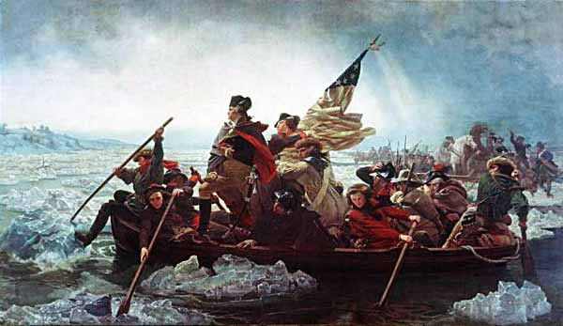
Struggles in the Middle States

Slide 2
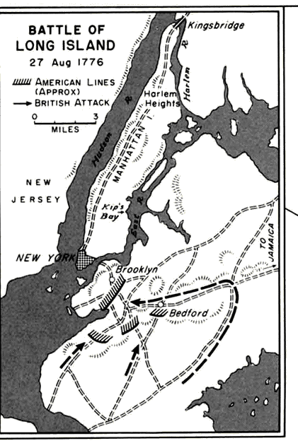
In June 1776, British ships moved into New York harbor.
The ships carried thousands of British troops and signaled a shift in fighting from New England into the Middle States.
In August 1776, the Battle of Long Island signaled the beginning of bleak times for the Continental Army.

Slide 3
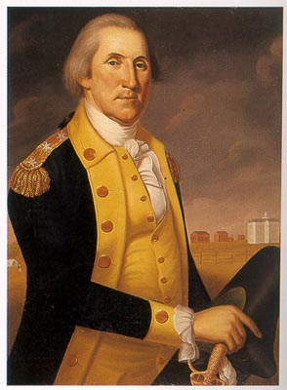
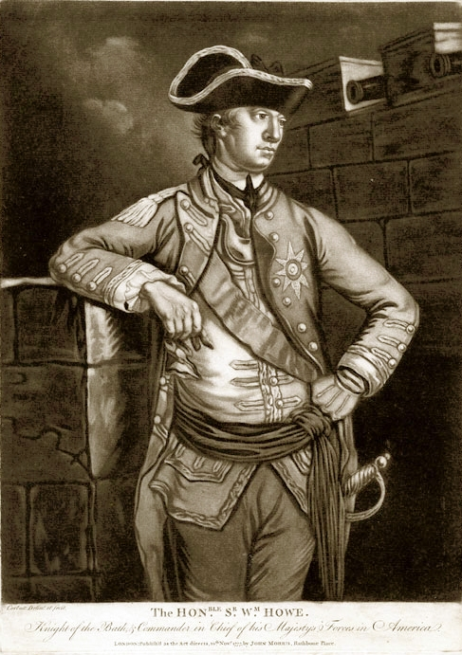
The commanders of the opposing armies were:
General
George Washington
Colonists
General
William Howe
England

Slide 4
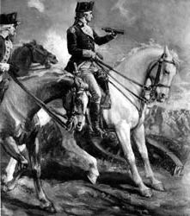
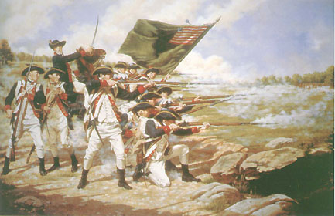
Washington had fewer than 20,000 poorly trained troops and no navy.
Howe had 34,000 troops and 10,000 sailors.
What do you think was the result of these battles for New York City?

Slide 5
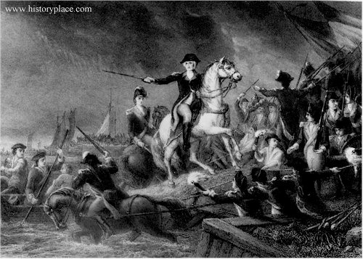
When the fighting on Long Island ended, 1,400 Americans (colonists) were killed, wounded, or captured.
Washington was forced to retreat north in order to avoid being captured by the British.

Slide 6
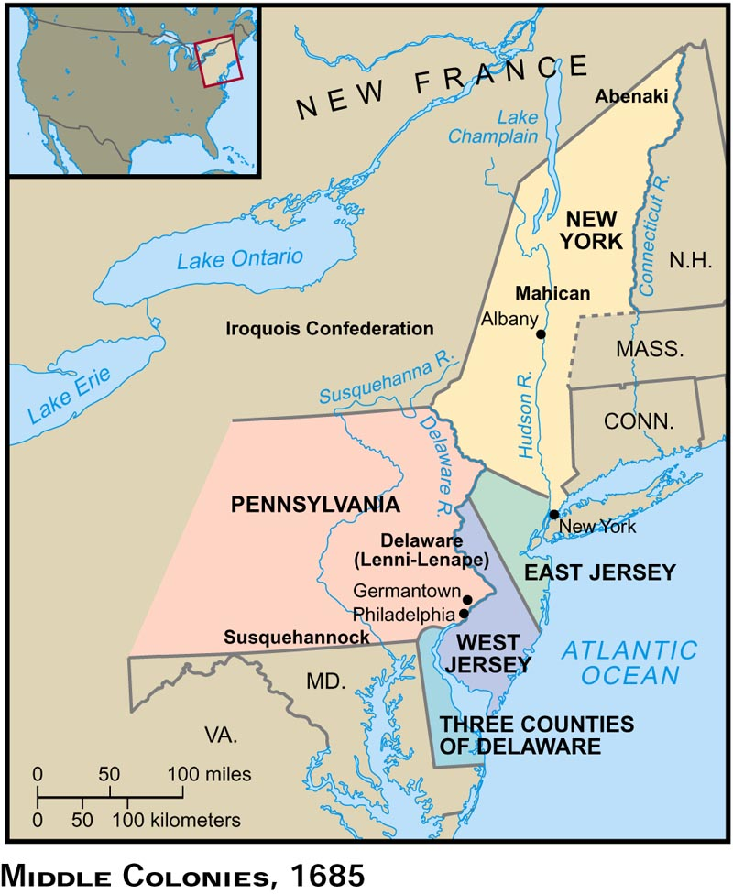
Throughout the fall, Washington’s retreating forces fought a series of skirmishes with Howe’s advancing army.
In November 1776, Washington crossed the Hudson River into New Jersey.
Finally, they crossed the Delaware River into Pennsylvania to stay ahead of the British pursuit.

Slide 7
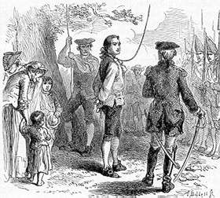
Washington needed information about the British forces in New York, so a young officer named Nathan Hale volunteered to go behind British lines…
What would be his job description? (Use one adjective)
COURAGEOUS
Unfortunately, secret notes about British troop movements were found in the soles of his shoes. He was ordered hanged the next morning.
While being walked to the gallows, he is reported to have said:
“I regret that I have but one life to lose for my country.”

Slide 8
Think/Pair/Share…
“I regret that I have but one life to lose for my country.”
Please write down your thoughts about this phrase, then turn to a partner to quietly share your comments. You have one minute to complete this task…
*

Slide 9
Please describe what is going on in the painting above.
Be descriptive (using adjectives) with your predictions.
Again, you have one minute to complete this task...

Slide 11
On Christmas night 1776, Gen. Washington and his troops crossed the frozen Delaware River, braving freezing temperatures and a lack of proper clothing, to make a daring surprise attack at Trenton, NJ.
Why? He was tired of running away from his enemy.

Slide 12
Actual Facts:
Who?
Gen. Washington & his troops
What?
Surprise attack
Where?
Delaware River at Trenton, NJ
When?
Christmas night 1776
Why?
He was tired of running away

Slide 13
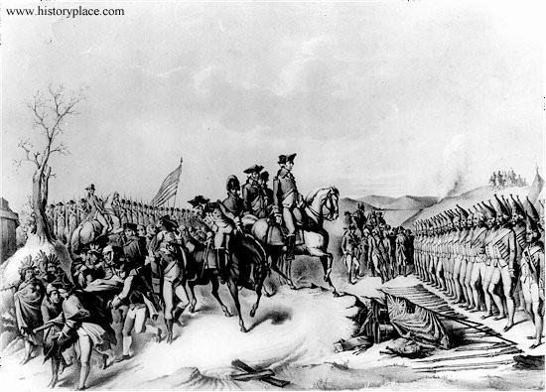
With this daring raid, the exhausted Continental Army managed to capture most of the German Hessian army that was staying across the river in Trenton.
An American soldier summed up the Battle of Trenton this way: “Hessian population of Trenton at 8:00 A.M. --1,408 men and 39 officers; Hessian population at 9 A.M.--0.” (Washington’s thoughts at 10 A.M.--priceless!!)

Slide 14
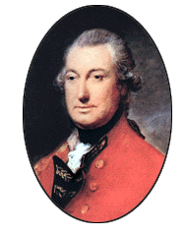
To recover from the Trenton embarrassment, General Charles Cornwallis set out to retake Trenton and capture Washington and his troops.
Late on 2 January 1777, Cornwallis and his men spotted the burning campfires of the Continental Army camp in Trenton and planned to attack in the morning…
General Cornwallis
Little did they know that they had been fooled!! Washington left the fires to burn while his forces slipped behind British lines to attack a British force that was headed toward Princeton, New Jersey.

Slide 15
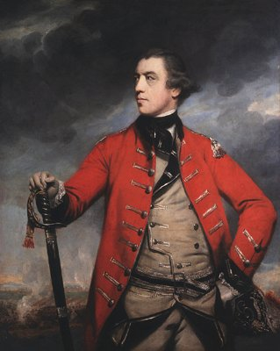
The Americans had been victorious at Trenton and Princeton, much to the dismay of British officials back home…
Meanwhile, back in England, General John Burgoyne came up with a new plan to end the war quickly…
His plan was to march three armies to Albany, New York, to take control of the Hudson River and cut off New England from the other colonies.
General
“Gentleman John” Burgoyne

Slide 16
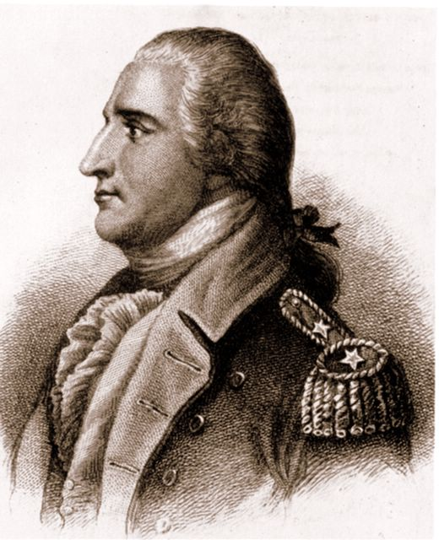
Burgoyne wanted Howe to march directly to Albany, but he was ordered by King George III to capture Philadelphia, PA. Howe achieved this in July 1777. But instead of moving north, Howe decided to stay in Philadelphia in relative comfort for the winter.
This left Burgoyne on his own to face a tough American army, led by Benedict Arnold, in northern New York.
Burgoyne would eventually take back Fort Ticonderoga but his success ended there.
General
Benedict Arnold

Slide 17
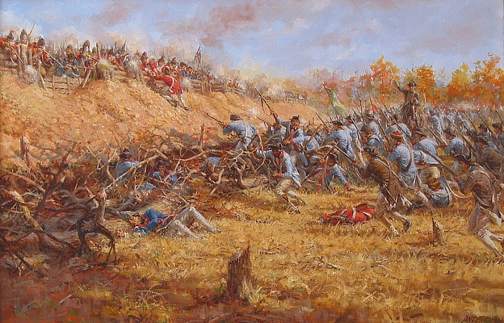
Unfortunately, Burgoyne’s army would be surrounded at the Battle of Saratoga by Arnold’s troops with the help of the Green Mountain Boys. They tried to break free, but were pushed back. Burgoyne realized he was trapped…

Slide 18
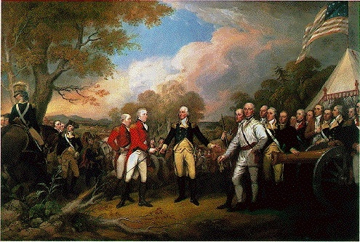
…and surrendered his entire army to the Americans on 17 October 1777. This was
(1) a major turning point in the
war,
(2) ended the British threat to New England,
and
(3) convinced France to become our ally.

Slide 19
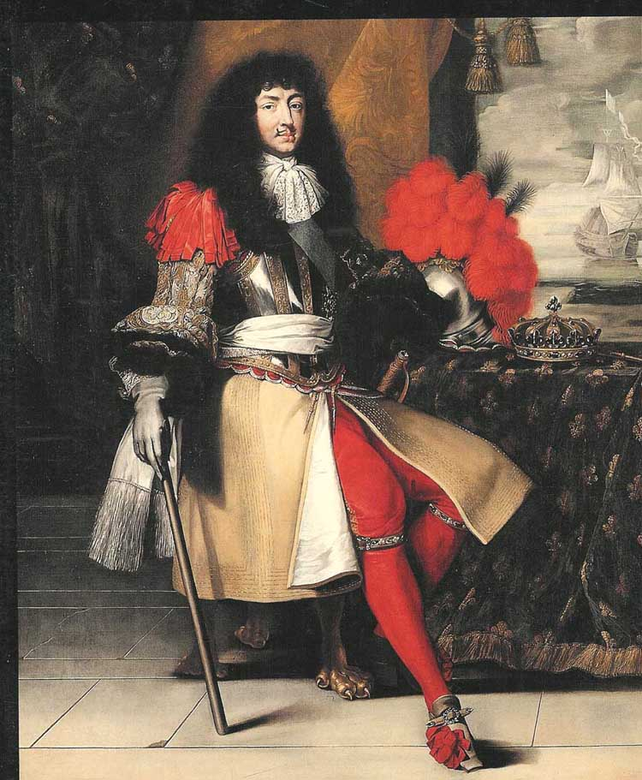
The Americans had been hoping for French aid since early 1776, when the Continental Congress sent Benjamin Franklin to Paris asking for money, weapons, and supplies. Also, Congress wanted France to declare war on Britain.
The French were eager to get revenge for their defeat in the French and Indian War, but they were also cautious.
The victory at Saratoga
convinced France that the
United States could stand up
to Britain and proved to be the
HIGH POINT of the war in 1777.
Louis XVI
King of France

Slide 20
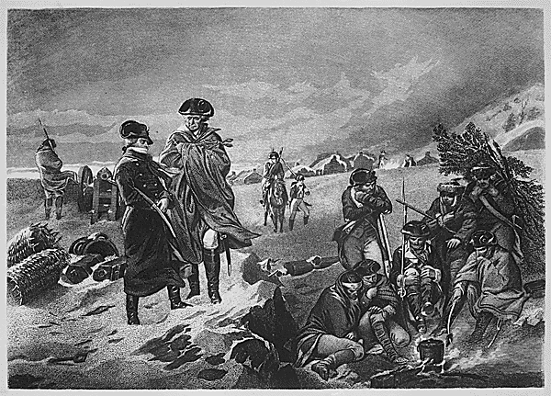
Despite improved morale from their recent victories, the Continental Army still faced hardships at Valley Forge, Pennsylvania during the long, cold winter of 1777-1778.
Soldiers experienced terrible suffering from frostbite
and diseases in the extreme winter conditions.

Slide 21
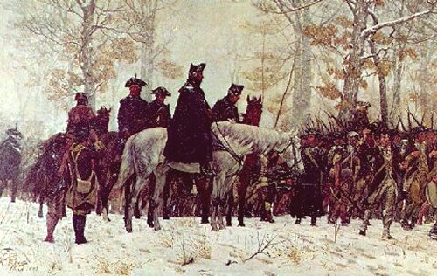
Food and supplies would eventually come from the citizens around the nation as they heard about the suffering. Some would even go to Valley Forge to help out.
Valley Forge would be the LOW POINT
of the war in 1777 for the Continental Army.

Slide 22
Any
Questions,
Comments,
or Concerns?

