Slide 1
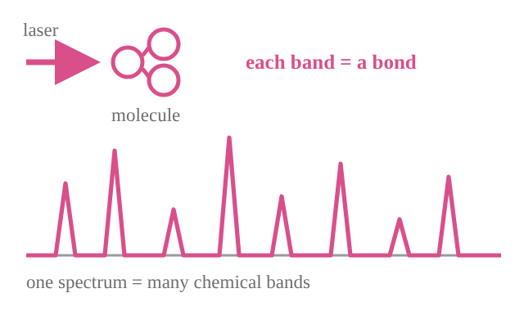
How do we capture odor differences?
Machines copy the nose — so they inherit its blind spot.
Human nose
Machines today
Raman — this work
Cell 1999 figure here
odorants × receptors matrix
(crop to ~5 rows)
Adv. Mater. 2024 figure here
panel b only: sensor array
→ pattern recognition
pattern only — which molecule?
Malnic et al., Cell 96, 713 (1999)
Adv. Mater. 36, 2402287 (2024)
One odorant hits many receptors.
Identity is the pattern.
Arrays rebuild the same pattern,
with less chemical detail.
Hundreds of narrow bands at once.
Pattern and chemistry together.
✓ pattern
✗ chemistry
✓ pattern
✗ chemistry
✓ pattern
✓ chemistry
GC–MS has the chemistry but not the pattern; the nose and the e-nose have the pattern but not the chemistry.
→ Read the Raman spectrum as a fingerprint map.
μTAS 2026
03

