Slide 1
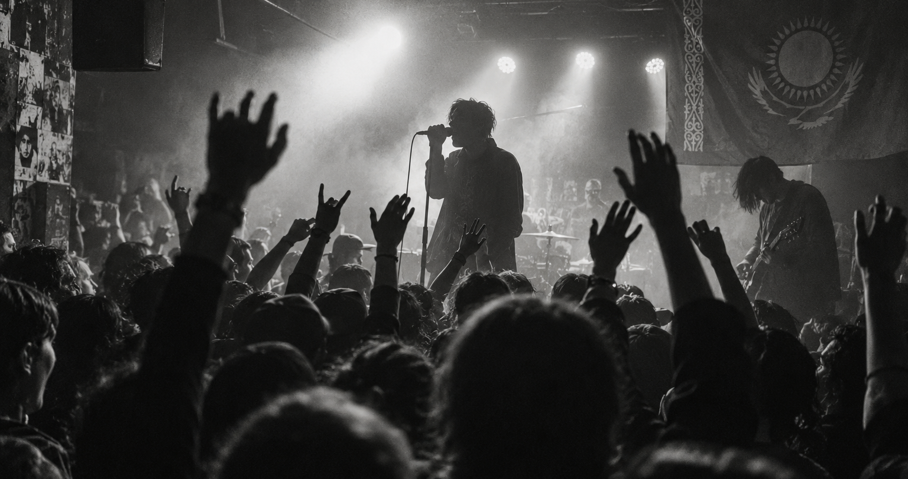
T/S®
01 / 10
TICKET
SOL
Tickets with
verifiable ownership
Buy and resell event tickets
with rules enforced on Solana.
HACKATHON MVP / KAZAKHSTAN
Notes:
Ticketsol project presentation. Source: founder brief and project README. Concert image: AI-generated illustrative artwork created for Ticketsol, not a photograph of an actual event.

Slide 2
T/S®
02 / 10
The risk of buying a ticket from a stranger
“Will this ticket
get me in?”
A buyer cannot easily verify who owns
a ticket or whether a copy is still valid.
Unofficial resale can also push prices
far above the original ticket price.
Demand hypothesis: complaints observed on Threads. Customer interviews and demand validation are still pending.
Notes:
Source: founder observations in the conversation. No market size, incidence rate, customer interviews or traction figures have been established.

Slide 3
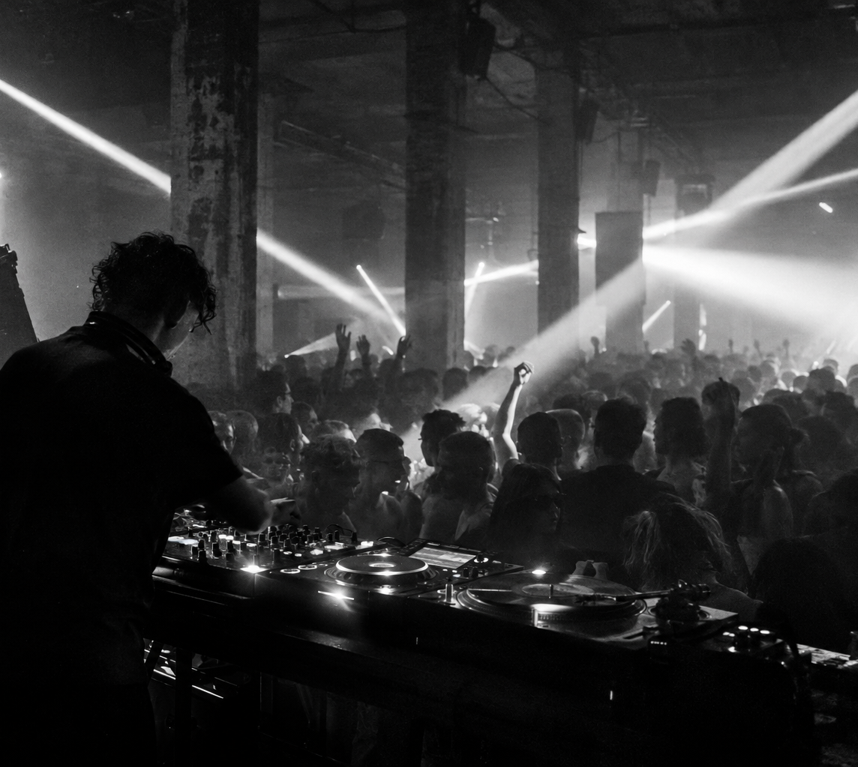
T/S®
03 / 10
Our first audience
Fans who want to verify
a resale ticket before paying.
Almaty
Astana
Shymkent
Start with trusted organizers
and their own ticket inventory.
Notes:
Source: founder-defined launch geography and audience. These are target cities, not active markets or confirmed partnerships. Image: generated Ticketsol electronic-event artwork.

Slide 4
T/S®
04 / 10
The Ticketsol solution
01
Verifiable ownership
The ticket record identifies its current owner and admission status.
02
Controlled resale
The program transfers payment and ownership together.
The MVP caps resale at the original price.
Notes:
Source: site/program/Ticketsol.sol and README. The current cap equals face value. Custom organizer-configurable policies remain a product direction, not a current feature.

Slide 5
T/S®
05 / 10
The buyer journey
01
02
03
04
Discover
Buy
Resell
Enter
Search by event,
city or genre.
Connect Phantom
and confirm the
purchase.
List at or below
the original price.
Open the QR
verification page
at the venue.
Notes:
Source: application components and README. The end-to-end transaction journey requires Devnet deployment and initialized event state. The interface currently disables purchases until that state is ready.

Slide 6
T/S®
06 / 10
How Solana enforces the ticket rules
TICKET
STATE
Owner wallet
Resale price
Ownership version
Admission status
Each sale changes the owner and ticket version.
Only the authorized organizer can mark a ticket as used.
Custom program-owned assets
Notes:
Source: site/program/Ticketsol.sol, lib/chain.ts and README. Solang compiles the program to native Solana SBF. Tickets use custom program state rather than SPL NFTs. The prototype uses one canonical event account and supports up to 64 tickets.

Slide 7
T/S®
07 / 10
QR verification at the door
OLD QR
CURRENT QR
After resale, the previous owner’s
signed proof no longer matches
the current ticket state.
A phone camera opens the page.
The organizer confirms admission
with an authorized wallet.
A copied current QR can still be presented first. Rotating QR and identity checks are outside this MVP.
Notes:
Source: components/verify-ticket.tsx and README. Verification checks a wallet signature against current Solana state. A publicly accessible site is necessary for arbitrary phones. The site currently remains private. The program rejects repeat admission, but possession of a copied current proof remains a risk.

Slide 8
T/S®
08 / 10
A fee on each resale
93%
5%
2%
Seller
Organizer
Ticketsol
Example at 0.1 SOL
0.093 SOL to the seller, 0.005 SOL to the organizer,
and 0.002 SOL to the platform. Network fees are separate.
Notes:
Source: project program and local-validator test results. These are implemented prototype parameters, not demonstrated revenue or validated pricing. Integer rounding remainder goes to the seller. The primary purchase price is 0.1 SOL.

Slide 9
T/S®
09 / 10
MVP status
BUILT
NEXT
English site with five demo events
Search and responsive poster layout
Purchase, resale and QR interfaces
Compiled Solana program
Fund and deploy to Devnet
Run the full two-wallet demo
Enable public verification access
Pilot with one trusted organizer
17 local integration checks passed. Four extra events show Coming soon. Live purchases await Devnet deployment.
Notes:
Sources: README and program/test-results.json dated 1 October 2026. Latest verified implementation state in this workspace: 17 checks passed on a local validator; frontend type check, production build and browser search checks passed. No mainnet deployment or security audit. Additional four events are catalog previews. Site uses private access.

Slide 10
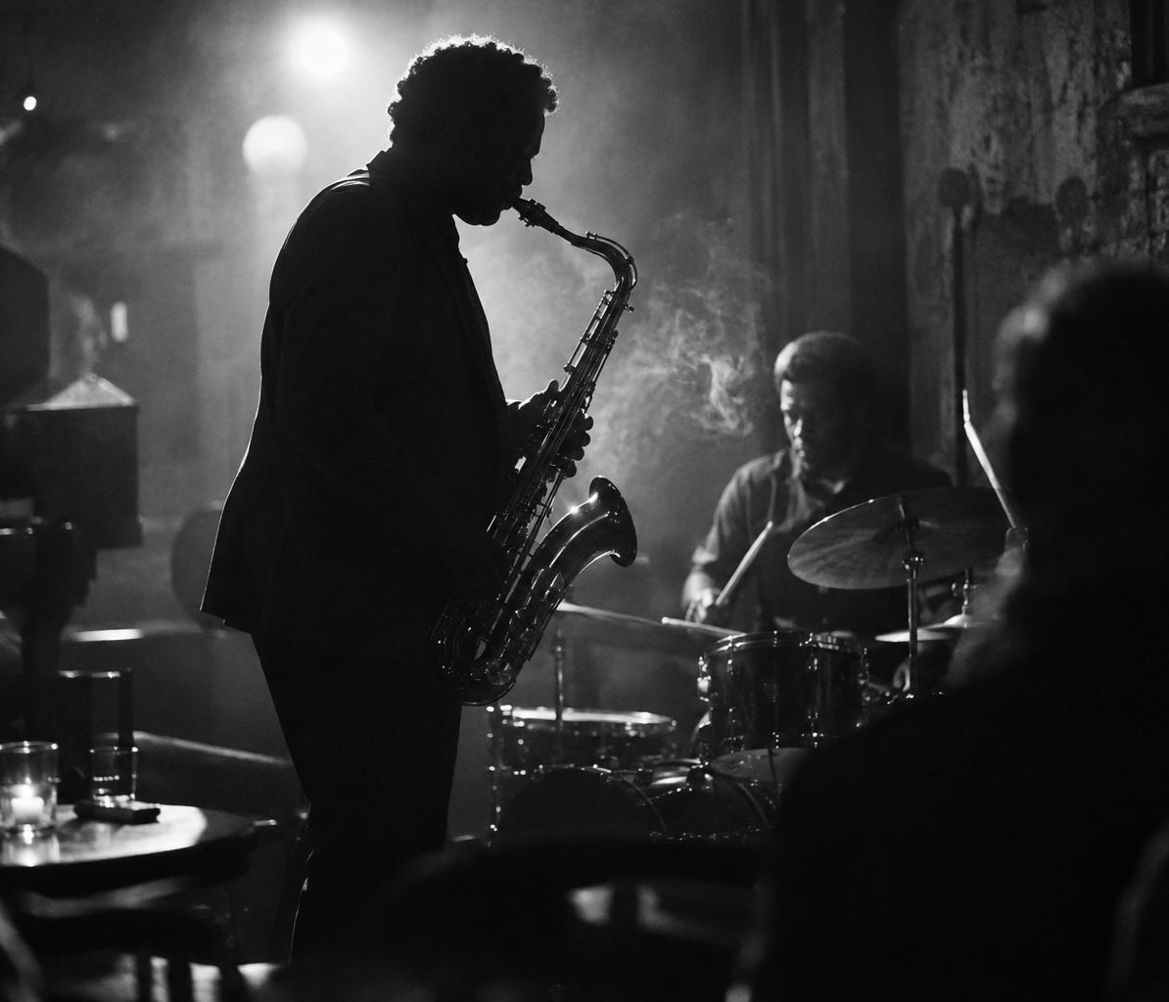
T/S®
10 / 10
The first pilot
One trusted organizer.
One event.
A complete ticket journey.
Measure purchase completion, resale use
and admission errors before expanding.
ticketsol-live.nrnbekov557178.chatgpt.site
Notes:
Proposed next step, not a confirmed pilot. Source: founder brief and project scope. Before a commercial launch: multiple event accounts, refunds, easier payments, stronger QR protection and independent security review. Generated jazz image is illustrative artwork. Site: https://ticketsol-live.nrnbekov557178.chatgpt.site (currently private).

