Slide 1

Master Thesis – Initial Meeting
Yalvaç Top
Technische Universität München
Informatics
Chair for IT Security
Munich, 13 July 2021

Slide 2
Agenda
1
What is the topic?
2
Motivation
3
Related Work
4
What will I do?
5
Roadmap

Slide 3
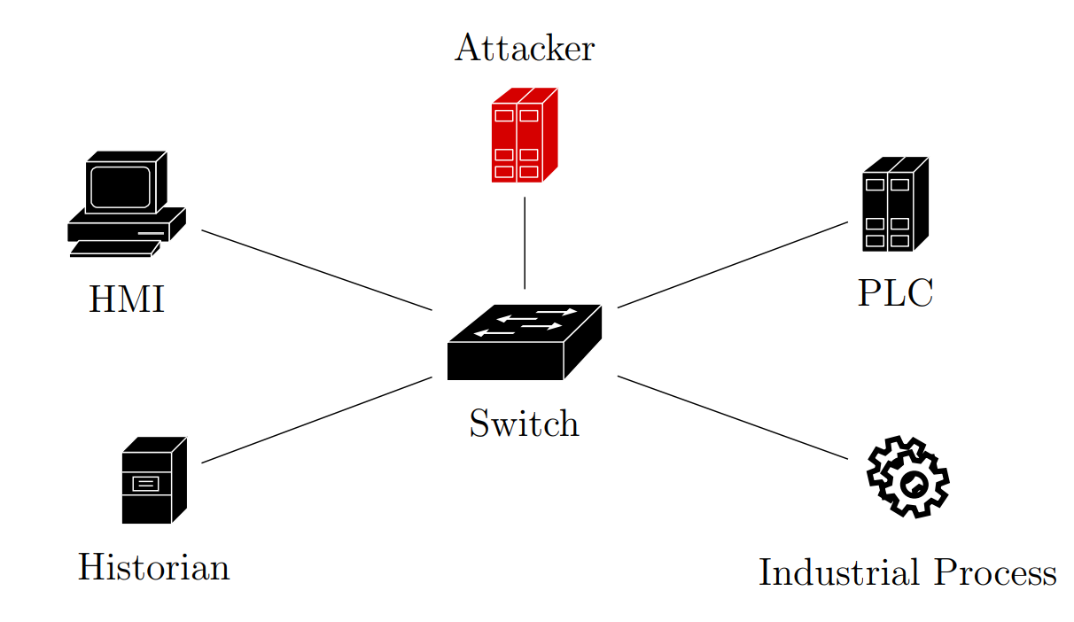
What is the topic?
Industrial Control Systems (ICS):
Sensors
PLCs
SCADA
Closed Network -> Stuxnet -> Security for ICS

Slide 4
What is the topic?
Features of ICS:
Time-critical, high availability
More periodic communication
Different protocols than IT networks
Anomaly Detection in ICS:
Anomaly based vs Signature based
Neural Networks vs Machine Learning vs Clustering
Network based vs Host based

Slide 5
Motivation
About me:
Siemens -> Yunex, ITS, interurban, working student, 2 years, security, DevOps
Previous security related task (IDP): Access Control of a SCADA system through SSO using Active Directory and Oracle Identity and Access Management
We deliver a SCADA system called WinCC OA
Motivation:
In every project, the devices and the topology are different.
It is not enough to comply with the standards to secure a system.
Especially in time critical systems with high availability, non-intrusive detection and prevention systems gain importance.
Based on a simple logic yet very complex when you dive in
Time Series Data -> Neural Network learns the normal behavior -> alerts in case of abnormal behavior
I want to integrate the product of my thesis into a real project as part of the solution.

Slide 6
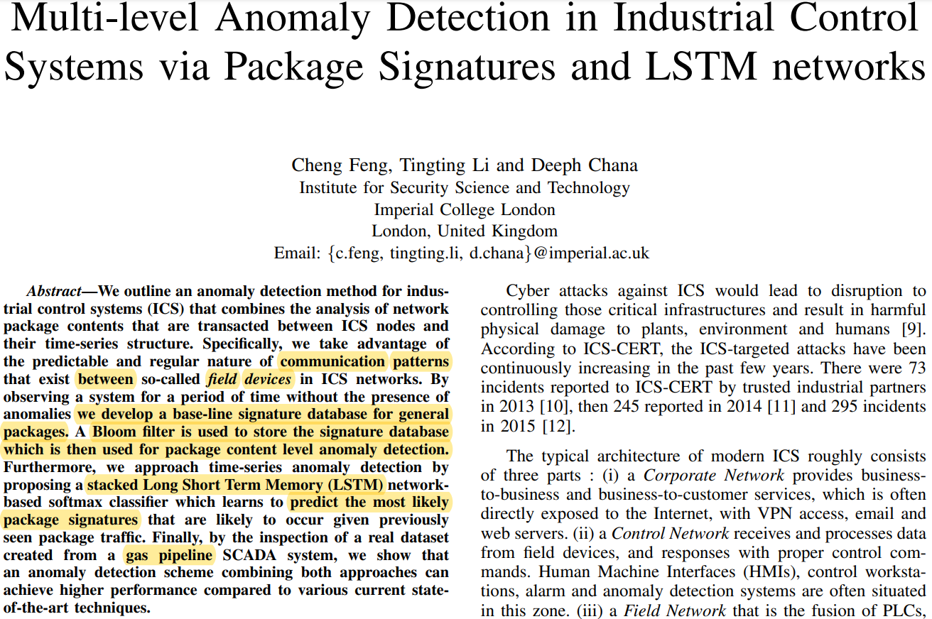
Related Work
Gets advantage of periodic and predicatable communication
Signature DB using Bloom filter (hash)
Packages are compared against DB
if not found: packages are compared against most probable „k“ packages that LSTM predicts

Slide 7
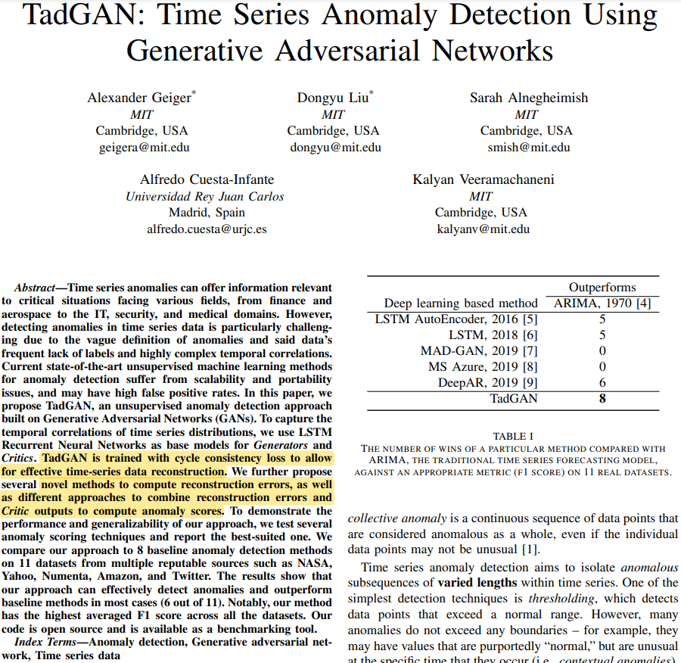
Related Work
GAN generates time series data to compare it against real data
No apriori knowledge is required about anomalies
NN encodes and then decodes the data
During encoding, information about anomalies are lost so they are not decoded for reconstruction
Anomaly score is calculated based on generator and discriminator loss

Slide 8
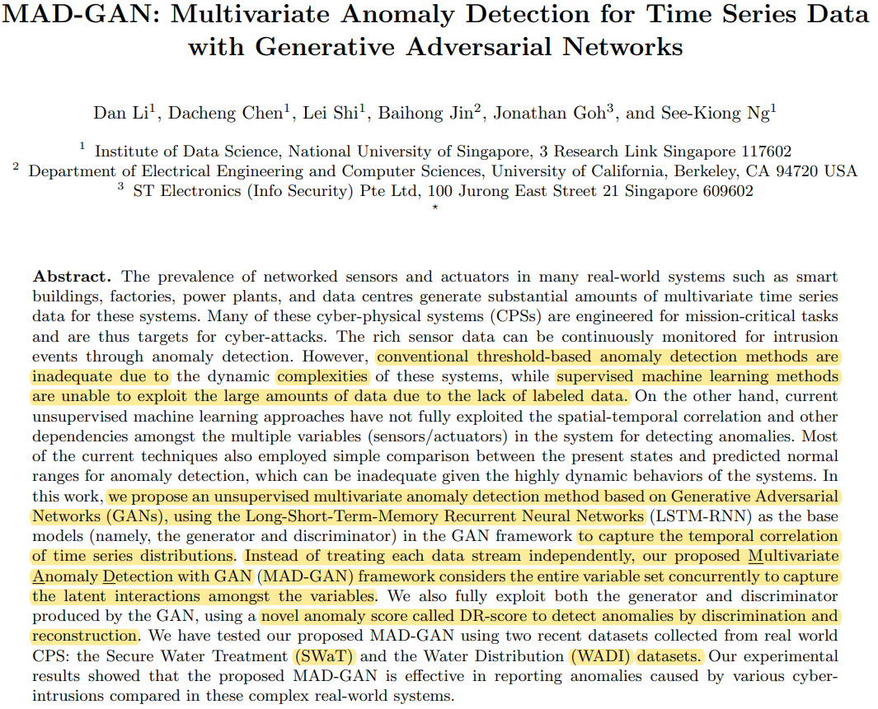
Related Work
2 LSTM-RNNs are used as data generator and discriminator
Before discrimination, the multivariate time series data (both generated and real) is divided into subsequences via a sliding window
PCA is used for dimension reduction to prevent computation overload for LSTM

Slide 9
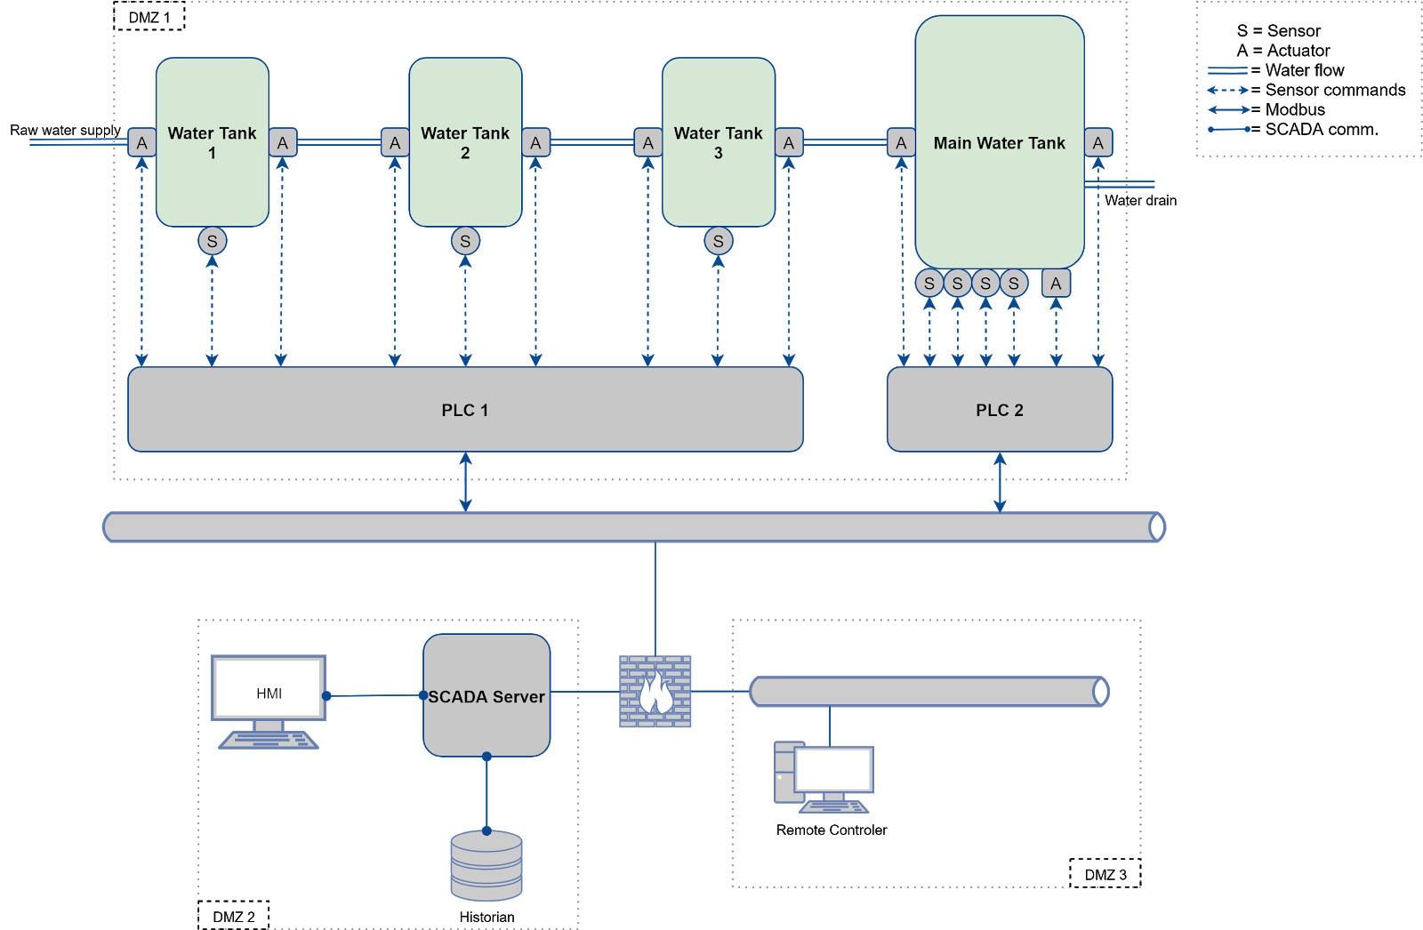
What will I do?
Topic: Improving GAN based Anomaly Detection and Evaluating on SWaT testbed (baseline), Viktor testbed (challenging) and Siemens road6 datasets (challenging)
Contributions:
Study the GAN based anomaly detectors
Improve state-of-the-art GAN based anomaly detector:
Study feature selection (FS) techniques and explore the FS methods to observe their effects on different datasets/testbeds
Study the window size to find a way to set it in an optimum way
Study and Implement multi-stage attacks on ICS sensor levels.
Evaluate our GAN based anomaly detector on SWaT testbed (as baseline), Viktor testbed (with our various attacks implementations), and Siemens road6 datasets

Slide 10
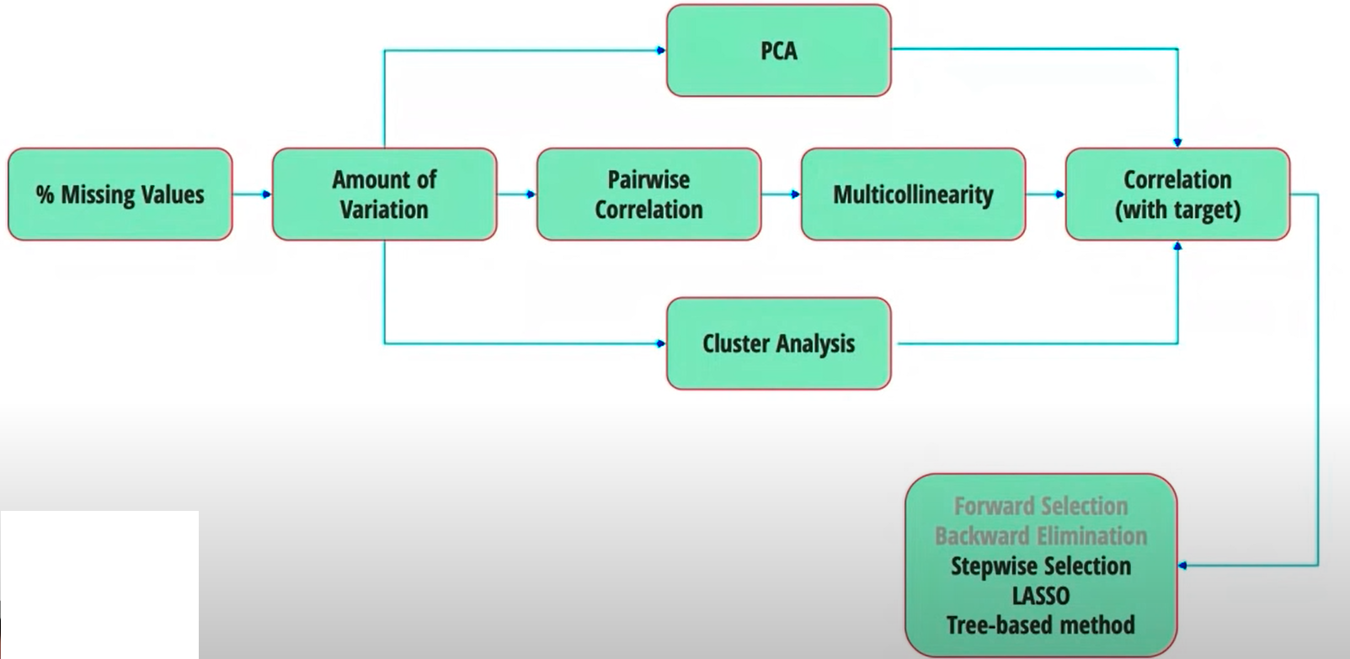
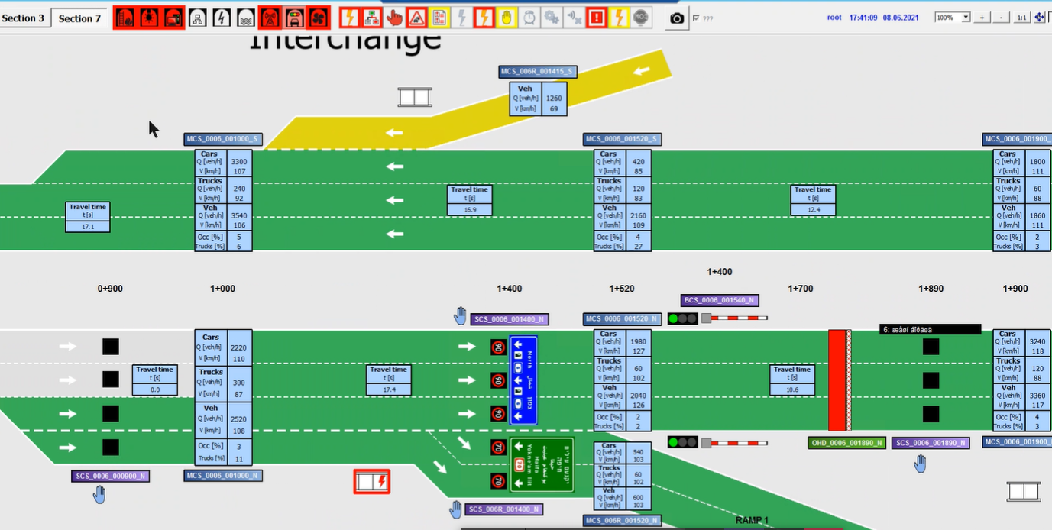
What will I do?
Some feature selection techniques to be studied:
NADICS
ExtraTreesClassifier
Pearson/Chi-squared
RFE (recursive, considers smaller set of features)
Lasso
Forward/backward selection
Challenges:
Viktor testbed: single and multi-stage attacks need to be studied and implemented
Finding the adaptive window size
Siemens Road6: implement chosen 1-2 attacks
Heterogeneous environments (datasets are very different from each other)
Reconstruction can be overfit in case of Viktor testbed due to scarcity of dimensions

Slide 11
Roadmap
15.07.21
Study and implementation of the anomaly detector
01.10.21
Study feature selection techniques in case of GAN
01.12.211
Study on how to set window size parameter ideally
15.01.21
Submission and Presentation
1
3
5
7
2
4
6
01.09.21
Implementation of the chosen attacks on Viktor Testbed and Siemens dataset
01.11.21
Implementation of chosen feature selection techniques
01.01.22
Documentation

