Slide 1
Deploying Splunk
The Splunk data pipeline
Deployment models with Splunk’s Validated Architecture
Storing data on disk
Licensing
Configuration files
Apps and add-ons

Slide 2
The Splunk Data Pipeline
Notes:
The Splunk documentation is a great resource for Splunk approved, validated architectures. It can get pretty technical when you get into distributed environments. In this class, I want to show you how three of the validated architectures work, then point you in the right direction to read about more advanced architectures.

Slide 3
The Splunk Data Pipeline
Input
  Forwarded data, uploaded data, network data, scripts
Parsing
  Examines the data, adds metadata
Indexing
  Data divided into events. Writes the data to the disk in "buckets"
Searching
  User interaction with the data
Notes:
No matter the type of deployment, the Splunk data pipeline is the same: Input, Parsing, Indexing, and Searching (IPIS)
To scale your system, you can split this functionality across multiple specialized instances of Splunk Enterprise. That’s right, no matter how large you scale, you are installing one of two types of Splunk instances: a forwarder, or a Splunk enterprise installation.
Input
Consumption of data from sources
Splunk does not look at the data contents here
Parsing – happens on the indexer or heavy forwarder
Examines, analyzes, and transforms the data
Identifying timestamps
Annotating data with metadata
Indexing
Takes the parsed data and writes it to indexes on disk, in the form of flat files stored on the indexer
Searching
Manages all the aspects of how the user interacts with the data.

Slide 4
Deployment Models
Notes:
The Splunk documentation is a great resource for Splunk approved, validated architectures. It can get pretty technical when you get into distributed environments. In this class, I want to show you how three of the validated architectures work, then point you in the right direction to read about more advanced architectures.

Slide 5
The Splunk Platform
Splunk Cloud Platform
Splunk Enterprise
Notes:
While Splunk has several products, In this course, we will focus on the core, which the Splunk Platform. The Splunk Platform includes the core products of Splunk Enterprise and Splunk Cloud Platform. The primary difference between these two products are that one is “Splunk as a Service” where Splunk handles the infrastructure. The other, Splunk Enterprise, is the traditional model of building our your own Splunk environment.
Let’s talk about Splunk Enterprise deployment models first.

Slide 6


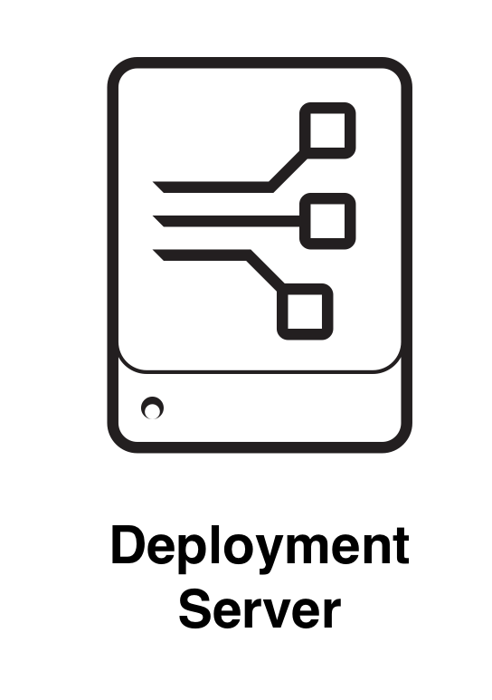
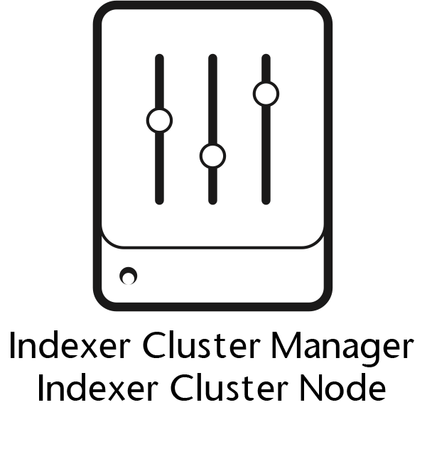


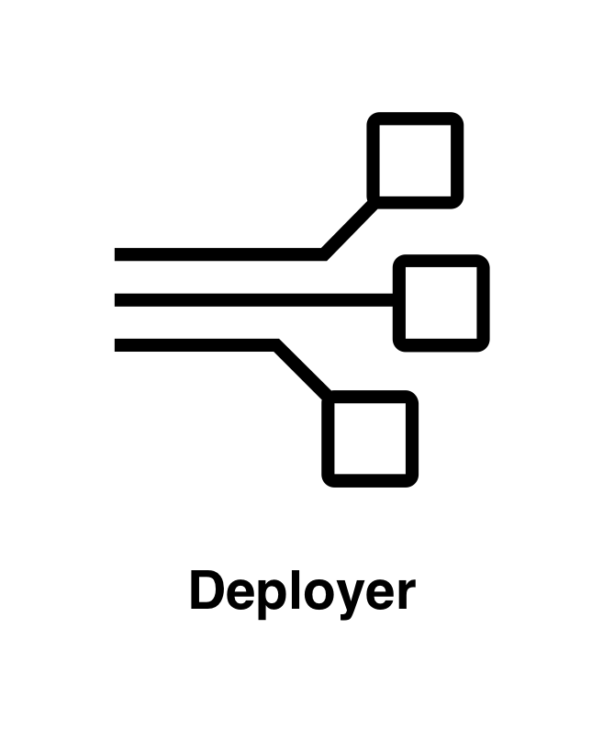
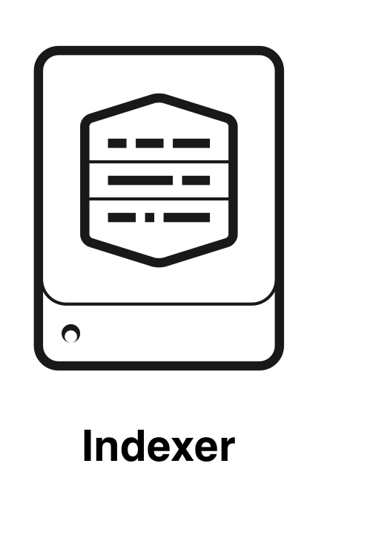
Splunk Enterprise Components
Processing
Management
License Manager
Notes:
Remember from our last discussion that The Architecture of Splunk Enterprise is built on Splunk Components. Components are simply instances of Splunk Enterprise (except Universal Forwarders) that are configured for a specific job. In this first discussion, I am going to talk about them at a high level, but we will dive more deeply into them throughout the course.
There are two broad categories of Splunk Enterprise components: Processing components handle the data, and Management components support the processing components and allow you and Splunk to manage the distributed system.
There are 3 processing components:
The Search Head handles all things search related, and in a small deployment, it will also host the web server that you log in to to use Splunk.
Forwarders simply move data from a source to an indexer or indexer cluster. There are universal forwards, which are lightweight agents that simply move the data, and heavy forwarders which are full installations of Splunk Enterprise, and they can do some data manipulations before forwarding the data to the indexers.
Indexers and indexer clusters receive the data from forwarders and transform it into Splunk events, then places those events in an index, which is a storage bucket in Splunk.
There are 5 management components to a Splunk Enterprise deployment.
The indexer cluster manager and indexer cluster node are components of indexer clusters, the manager manages the cluster and the node is one of the indexers in the cluster.
The monitoring console is a set of dashboards and health checks that are included in Splunk Enterprise. It provides insights into your deployment.
I’m going to skip down to the license manager, which is pretty self-explanatory. In a distributed deployment, one of the components will be a license manager, which every other component registers with to consume its license.
Please do not get the deployment server and the deployer mixed up. The deployment server remotely configures and manages all of your distributed Splunk components, which are called deployment clients.
Finally, the deployer manages search head clusters.

Slide 7
Splunk Enterprise S1 Architecture
Search and Indexing tier
Management
Collection tier
Notes:
In the Splunk documentation are validated architectures. Of course, it’s outside of the scope of this course to talk about all of the different architectures of Splunk, but I will go through the basic ones, and you can study others on the Splunk Docs. The first one is called “single server deployment” or S1.
In the previous slide, we saw the Splunk components that would go in each of these areas (except management). Do you know what they are?
Having the management tier allows you to manage more than one of these S1 deployments.
Which components do you think might go into each of these categories? Pause the video and think about it before moving on to the next slide…
https://docs.splunk.com/Documentation/SVA/current/Architectures/S1

Slide 8
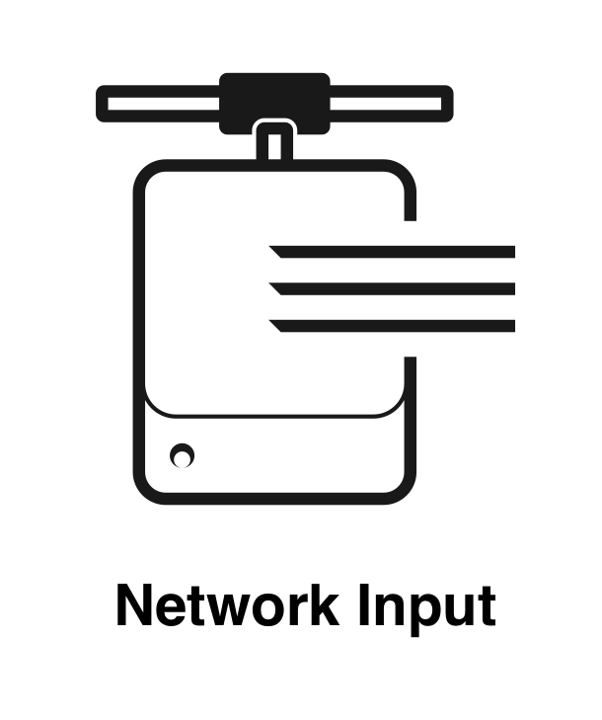
Splunk Enterprise
S1 (Single Server)
Search Head and Indexer are the same
Splunk component
Daily data ingest 500GB
Small number of users
Splunk recommends S1 for non-
critical data
© Adam Frisbee, adamfrisbee.com
Notes:
Let’s take a look at a few representative deployment types
The first one is a small or departmental deployment. In this scenario, you install Splunk Enterprise on a Windows or Linux machine.
It serves as the combined search head and indexer.
Then we set up various types of collection. Usually these are forwarders, network inputs, or file inputs.
We often don’t need a management tier in this type of small deployment, but it’s always nice to have a Deployment Server handy.
https://docs.splunk.com/Documentation/SVA/current/Architectures/S1

Slide 9
Splunk Enterprise C1 Architecture
Search tier
Management
Indexing tier
Collection tier
Notes:
In the C1, or Distributed Clustered Environment for a Single Site, we separate the search and indexing tier, so that we can deploy indexer clusters to get more Splunk advantages like high availability. We’re building modular composable, and scalable architecture as we get into larger Splunk deployments.

Slide 10
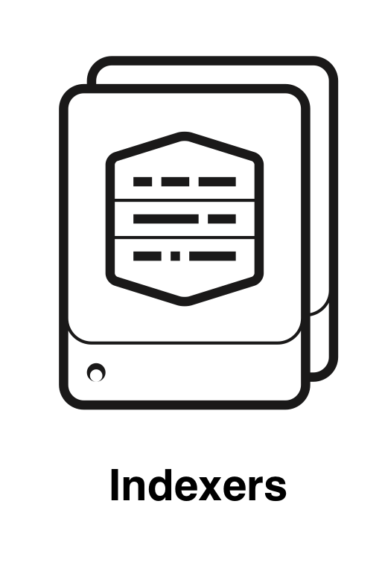


Splunk Enterprise
C1/C11 (Distributed Clustered Deployment – Single Site)
One or more stand-alone
search heads
An indexer cluster with data replication
Multiple, load balanced
collection inputs
License Manager
© Adam Frisbee, adamfrisbee.com
Notes:
The second scenario Splunk calls a C1 or C11 Distributed Clustered Deployment for a Single Site
In this deployment we decouple the search head from the indexer
Two to three load balanced indexers forming an indexer cluster. The superpower of an indexer cluster is that the data is replaced among all peers in the cluster, so you never lose any data! It’s also, of course, good for disaster recovery and search speed. This is importantly where we absolutely need the management tier. To have a working indexer cluster you need a cluster manager that manages all the data and tells the search head(s) where to find the data.
We need a deployment server to manage our deployments and updates for all of the Splunk components we now have in our environment.
We need a license manager so that all of the licensed components can verify their licenses and receive new/updated ones.
And in this scenario it’s extremely helpful to have the monitoring console that can give us an overview of the health of our environment.

Slide 11
Splunk Enterprise C3 Architecture
Search tier
Management
Indexing tier
Collection tier
Notes:
In the C3 / C13 architecture is called Distributed Clustered Environment with Search Head Clustering for a Single Site. It’s the same basic architecture as the C1 / C11, but this time, we are also creating Search Head clusters in addition to Indexer clusters!

Slide 12

Splunk Enterprise C3 Architecture
C3/C13 (Distributed Clustered Deployment with SHC – Single Site)
Search head cluster
  Deployer
Indexer cluster
  Cluster Manager
License Manager
© Adam Frisbee, adamfrisbee.com
Notes:
In this configuration we build a search head cluster, governed by a deployer (not to be confused with a deployment server!). The deployer governs the members of the search head cluster. It distributes apps, files, configuration updates to all of the members through what is called a configuration bundle. A search head cluster is a group of search heads that serves as a central resource for searching. You can run the same searches, view the same dashboards, and access the same search results from any search head in the cluster. One of the members is assigned to be the search head cluster captain, and schedules jobs and replication activities among the cluster.

Slide 13
Splunk Cloud Platform
Search tier
Management
Indexing tier
Collection tier
Notes:
Splunk Cloud Platform is delivered and maintained by Splunk. It is delivered as a cloud based service where Splunk manages the infrastructure, and you get most of the same benefits of building our your own Splunk Enterprise deployment with a few key differences that I will discuss in a moment. Splunk Cloud Platform is available on both AWS and Microsoft Azure (GCP coming soon)

Slide 14

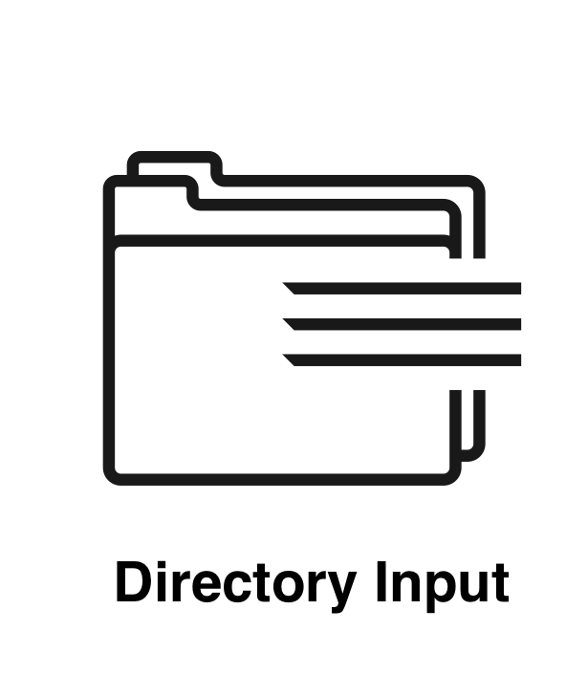

Splunk Cloud Platform Architecture
Notes:
Splunk Cloud Platform can accept and process almost all of the same types of data as Splunk Enterprise, plus it has some unique input options.
You’ll get most data into Splunk Cloud by using Forwarders.

Slide 15




Splunk Cloud Platform Architecture
AWS Data Firehose
Notes:
Other data can be ingested using AWS data firehose, which streams your AWS data directly into Splunk Cloud
The Splunk Edge Processor and Ingest processor solutions can be used for advanced data processing and routing.

Slide 16

Subscription Types
Splunk Cloud is subscription based
Workload-based
  Amount of compute and storage resources being used
Data ingest-based
  Amount of data ingested into Splunk per day
Notes:
Like most cloud offerings, Splunk is subscription based, and the cost can either be based on workload (compute and storage usage), or data ingestion based (based on how many gigabytes of data Splunk consumes per day)

Slide 17

Apps in Splunk Cloud
Only vetted and compatible apps
Some apps can be self installed through the app browser; others require a support ticket to be submitted
Private apps are supported, but are vetted by Splunk
Notes:
There are a few other noteworthy differences, and you should take a look at the Splunk Cloud docs to read about them all
No access to the CLI or underlying infrastructure. That means you won’t be able to edit .conf files or do any CLI functions without submitting a support ticket to Splunk.
No direct data ingestion (like TCP or syslog). This data can be ingested, you just have to use a forwarder.

Slide 18
How Splunk Stores Data

Slide 19

How Splunk Stores Data
A repository for Splunk data
Splunk transforms incoming data into events,
and stores it in indexes
An event is a single row of data
host | source | sourcetype | ip_address
web1.company.com | /var/log/ | cisco_syslog | 10.250.117.14
web2.company.com | udp:514 | syslog | 10.250.117.17
© Adam Frisbee, adamfrisbee.com
Notes:
Index
When Splunk processes raw data, it adds that data to indexes. Indexes map to places on the disk, which Splunk calls “buckets”
Splunk comes with several indexes, and you can create your own indexes as well.
The default index is called “main”, Splunk also has an “_internal” index that stores internal logs and a few other indexes come with Splunk.

Slide 20

How Splunk Stores Data
A single row of data, made up of fields
Fields are key=value pairs
Splunk adds default fields to all events
  _time
  index
  host
  source
  sourcetype
[Fri Sep 09 10:42:29.902025 2011] [core:error]
[pid 35708:tid 4328636416] [client 72.15.99.187]
File does not exist: /usr/local/apache2/htdocs/favicon.ico
© Adam Frisbee, adamfrisbee.com
Notes:
Event
An event is a single row of data
Events have fields, which are key=value pairs. Splunk automatically looks for clear “key=value” entries in the data and creates fields. Splunk also looks for common key/value pairings that don’t necessarily have an equal sign.
Splunk also adds default fields to all events. They are
Timestamp: Splunk assigns a timestamp value to events in UNIX time, regardless of how time is stored in your data it is converted to UNIX time and stored in the _time field. If the data does not have timestamps, the time at which the data is indexed is used as the timestamp for the events.
Host: the hostname or IP address of the source system
Source: name of the file, stream, or other input from which the event originates
Sourcetype: the format of the data. For example, Apache log files have a specific format, shown here in green

Slide 21
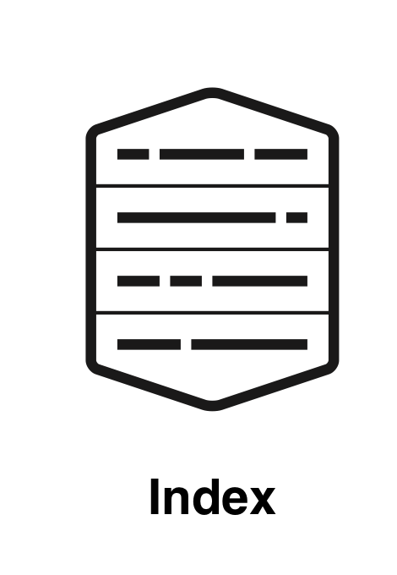






How Splunk Stores Data
HOT
WARM
COLD
FROZEN
THAWED
© Adam Frisbee, adamfrisbee.com
Notes:
In Splunk, an index contains compressed raw data and associated index files.
These index files are spread out into different directories depending on their age.
Splunk calls these directories buckets
There are five buckets, which again are simply directories that the indexer uses to store data based on age
Hot: Newly indexed data. Actively written to. An index has one or more hot buckets.
Warm: Data rolled from the hot bucket with no active writing. An index has many warm buckets.
Cold: Buckets rolled from warm and moved to a different location. An index has many cold buckets.
Frozen: Rolled from cold. The indexer deletes frozen buckets by default, but you can chose to archive them first.
Thawed: Buckets restored from an archive.
You can set the index bucket ages by modifying a configuration file index.conf

Slide 22
How Splunk Stores Data
$SPLUNK_HOME/var/lib/splunk/defaultdb/db/*
$SPLUNK_HOME/var/lib/splunk/defaultdb/db/*
$SPLUNK_HOME/var/lib/splunk/defaultdb/colddb/*
(Location that you specify for archival purposes)
$SPLUNK_HOME/var/lib/splunk/defaultdb/thaweddb/*
© Adam Frisbee, adamfrisbee.com
Notes:
Most buckets are a subdirectory of the index directory. In this case “defaultdb” is the directory for the index called “main”. For example, in the hotPath, after the db/ we can have multiple hot buckets. Buckets have specific naming conventions (subdirectories) that we won’t go into here.

Slide 23

SmartStore
Allows you to use remote object stores like AWS S3
Most data resides on remote storage while the indexer maintains a local cache (hot buckets)
Notes:
As a deployment's data volume increases, demand for storage typically outpaces demand for compute resources. SmartStore allows you to manage your indexer storage and compute resources in a cost-effective manner by scaling those resources separately.
SmartStore is an indexer capability that provides a way to use remote object stores, such as Amazon S3, Google GCS, or Microsoft Azure Blob storage, to store indexed data.

Slide 24
Splunk Enterprise Licensing

Slide 25
Two Types of Enterprise Licensing
Volume-based
Infrastructure
Notes:
Each Splunk software instance requires a license. Splunk software licenses specify the features you have access to and how much data can be indexed.
There are two license types for Splunk Enterprise

Slide 26

Volume-based Licensing
Based on data indexed per day, not data stored
Daily indexing volume is measured from midnight to midnight by the clock on the license manager
© Adam Frisbee, adamfrisbee.com
Notes:
With volume based licensing, you get access to all Splunk features
Your license is measured by data indexed per day on a 24 hour clock
Other things that do not count against your license
Splunk internal log data
Duplicate data
Metadata
License manager can be your search head, or a separate license server

Slide 27

Infrastructure Licensing
Based on virtual CPUs (vCPU)
  Physical or logical core, virtual core, etc.
  Splunk uses the CPUs reported by the OS
All search heads and indexers count towards vCPU capacity
© Adam Frisbee, adamfrisbee.com
Notes:
A newer type of license based on vCPUs (resources)
As organizations moved more data to Splunk and their usage patterns evolved (e.g., lots of data ingested but less frequently searched, or very high search activity on smaller data sets), the ingest-based model sometimes felt misaligned with the value customers derived. It also incentivized data filtering at the source, potentially losing valuable context.
Other things that do not count against your license
Splunk internal log data
Duplicate data
Metadata
License manager can be your search head, or a separate license server

Slide 28
Splunk Volume-based Licensing
No penalty (+100GB/day)
Warning
Violation
Search disabled (<100GB/day)
© Adam Frisbee, adamfrisbee.com
Notes:
Licenses volume of 100GB per day or higher
If you exceed your licensed daily volume on any one calendar day, you get a warning, but search is not disabled
Licenses volume of less than 100GB per day
If you generate 45 license warnings in a 60 day period, you are in violation, and that license stack will not be searchable. You need to contact Splunk to reset that license.

Slide 29
Which components need a license?
License Manager
© Adam Frisbee, adamfrisbee.com
Notes:
Any Splunk component that indexes data requires a license.
In a small (C1) deployment, you will probably have a Search Head/Indexer combination component, which would require a license.
In a distributed (S1 / S11) or higher environment, you might have multiple indexers using license pools managed by a license manager
In a distributed environment, most Splunk Enterprise instances need access to an enterprise license (anything that indexes data)
Heavy forwarders only need a license if they are doing things other than forwarding, like parsing or indexing
A collection of licenses whose individual licensing volume amounts aggregate to serve as a single unified amount of indexing volume is called a stack

Slide 30
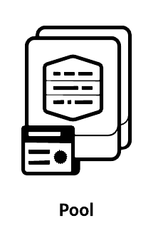
License Pooling
License pools are created from license stacks
Pools are sized for specific purposes
Managed by the license manager
Indexers and other Splunk Enterprise components are assigned to a pool
© Adam Frisbee, adamfrisbee.com
Notes:
LICENSE POOLS are created from license stacks
Specific quantities of licensing volume can be allocated for specific purposes
The license manager manages license pools
Indexers and other Splunk Enterprise components that need a license are assigned to a pool
Splunk recommends not assigning forwarders to a license pool, since they have unique license types

Slide 31
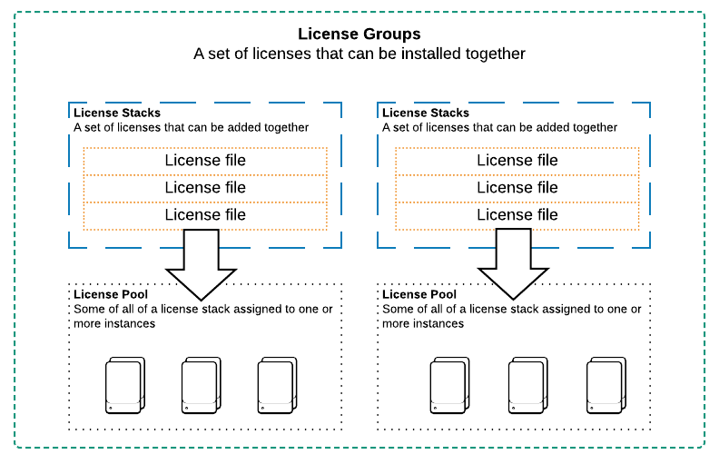
Splunk Licensing
© Adam Frisbee, adamfrisbee.com
Notes:
LICENSE GROUPS are sets of license stacks. A stack can only be a member of one group, and only one group can be “active” at any given time.
The groups are:
Enterprise/Sales Trial: Allows stacking of purchased enterprise licenses
Enterprise Trial: Default group. Cannot stack licenses
Free: No stacking
Forwarders: No stacking

Slide 32
Configuration Files and Apps

Slide 33
A Note on Configuration Files
Everything Splunk does is governed by configuration files
Configuration files are stored in /etc, and they have the .conf extension
Configuration files are layered
  You can have .conf files that have the same name in different directories
  Splunk determines which one to use based on the current app
The /etc/<app>/default directory contains preconfigured versions of .conf files
The /etc/<app>/local directory is where custom configurations are stored
Notes:
We will have more to say on configuration files later in the course, but it’s important to understand what they are and what they do at this point in the course

Slide 34
Configuration File Structure
[Stanza]
Attribute = Value
[Stanza]
Attribute = Value

Slide 35
Splunk Apps
Apps
Add-ons
Visualization
Data enrichment
Analysis
Tags
Reports & dashboards
Data models
User interface
Datasets
© Adam Frisbee, adamfrisbee.com
Notes:
Apps extend Splunk’s functionality
They enhance the user experience with built in dashboards, reports, alerts, saved searches, etc.
Add-ons primarily support apps
They enrich the incoming data with tags, data models, datasets, etc.
Apps and add-ons can be created by individuals, third party companies, or Splunk
Apps and add-ons that are built by Splunk carry the ”Splunk Built” logo
Apps and add-ons that are certified by Splunk carry the “Splunk Certified” logo

Slide 36

Splunk Apps
foo.conf
bar.conf
baz.conf
© Adam Frisbee, adamfrisbee.com, Images from Open Clipart
Notes:
An app is a collection of Splunk configuration files, views, knowledge objects, and sometimes add-ons

Slide 37
Splunk Apps
© Adam Frisbee, adamfrisbee.com, Images from Open Clipart
Notes:
An add-on is a subset of an app
Add-ons specify data collection, but do not have GUIs because they are part of the larger app

Slide 38
Index data
  Look at the indexes-”buckets”-on disk
Explore a license
Add the homework data set
Install an app
  Download and install an app
  Look at the .conf files

Slide 39
Splunk deployment topologies and when to use them
Indexes and storing data
Licensing
Extending Splunk with apps and add-ons

