Slide 1
Installing Splunk
Create a lab with me!
  Download and install a hypervisor (Virtual Box)
  Download a Linux image (Ubuntu Server)
  Install and configure Ubuntu on the virtual machine
  Download and install Putty (for Windows users)
  Clone the virtual machine
  Download a Microsoft Windows image
  Create a Windows virtual machine
Download and install Splunk on the virtual machines
  The first Linux machine will act as the Search Head / Indexer combination
  The second Linux (cloned) machine will act as a Heavy Forwarder
  The third machine (Windows) will serve various purposes
  We will also install Splunk on a Mac
Heavy forwarders
Universal forwarders

Slide 2
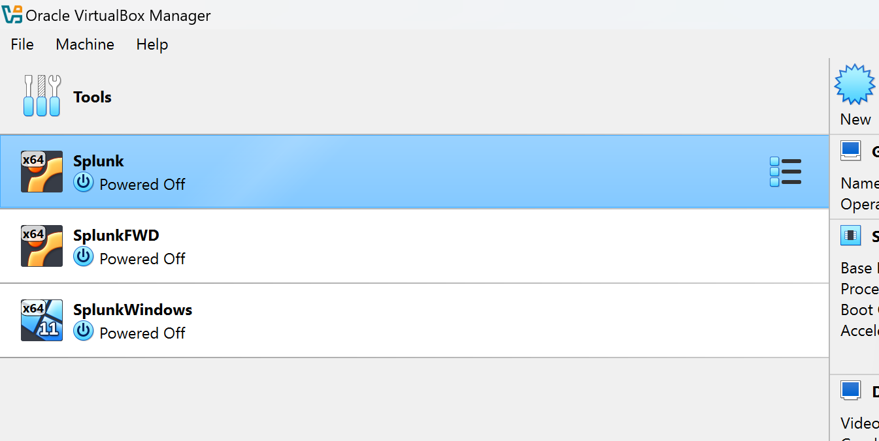
My Lab
Notes:
My lab is local to my machine and is built using Oracle’s Virtual Box, which is a free virtualization platform. As you can see, I have 5 virtual machines that are turned on or off depending on the demo I am recording. I have two Linux (Ubuntu) virtual machines that act as a Splunk search head and forwarder, as well as two Windows virtual machines that act as a Splunk search head and forwarder. I have a third Windows machine that acts as my Splunk Cloud forwarder. It is not required to build a lab in this class for you to be successful; you can be successful with a Splunk cloud platform search head.
Virtual box is free and you can download it at virtualbox.org
Almost all Linux distributions are free, and you can download them at their respective sites. I selected Ubuntu server for my distribution and you can download the ISO at Ubuntu.com

Slide 3
Installing Splunk in Linux

Slide 4

Linux Search Head
Splunk offers a few Linux install options
We will be using the .tgz file and wget
  Extract the .tgz into /opt
  Start Splunk

Slide 5
Splunk Linux Search Head Details
Visit Splunk.com and click on “Trials and Downloads.” Log in with your account or create a new one
Under “Splunk Enterprise” select “Get My Free Trial”
Select the Linux tab
Select “copy wget link” for the .tgz file
Paste the wget string into your Linux command line, adding sudo before it
  sudo wget –O …
Check whether the file was successfully downloaded using the ls command
The default Splunk home directory is /opt/splunk, so let’s untar the file into the opt directory. We can do this with one command
  sudo tar xvzf <splunk_package_name.tgz> -C /opt
Go to the Splunk home directory:
  cd /opt/splunk/bin
Start Splunk for the first time
  Sudo ./splunk start --accept-license
Create a username and password as prompted
Wait for the web server to be online, get the IP address of this machine, and visit your Splunk search head web interface at https://<ip-address>:8000
Relevant Splunk Doc
https://docs.splunk.com/Documentation/Splunk/latest/Installation/InstallonLinux

Slide 6
Installing Splunk in Windows

Slide 7

Windows Search Head
Download the Splunk installer for Windows
Use the Wizard to install and configure the search head
Use a Local account unless you’re in a Microsoft Domain and using AD or Entra
Open ports 9997 and 8089 on the Windows Firewall

Slide 8
Installing Splunk in MacOS

Slide 9

Mac
Download the Splunk installer for Mac
Use the Mac installer to install and configure the search head
A bit more involved than Windows
Like Linux + Windows install

Slide 10
Splunk Mac Search Head Details
Visit Splunk.com and click on “Trials and Downloads.” Log in with your account or create a new one
Under “Splunk Enterprise” select “Get My Free Trial”
Select the Mac tab
Select the DMG install file (advanced users can use the .tgz)
Double-click the DMG file, a Finder window that contains the splunk.pkg opens
Double-click the Install Splunk icon to start the installer.
In the Installation Type panel, click Install. This installs Splunk Enterprise in the default directory /Applications/Splunk
When the installation finishes, a popup informs you that an initialization must be performed.
A terminal window appears and you are prompted to specify a userid and password to use with Splunk Enterprise.
A popup appears asking what you would like to do. Click Start and Show Splunk. The login page for Splunk Enterprise opens in your browser window.
Relevant Splunk Doc
https://docs.splunk.com/Documentation/Splunk/latest/Installation/InstallonMacOS

Slide 11
Installing Heavy Forwarders

Slide 12

Heavy Forwarders
Same process as installing Splunk Enterprise
Configure receiving on the Search Head or Indexer
Configure as a forwarder in settings
Point the forwarder to the IP or DNS name of the Search Head or Indexer
Port 9997

Slide 13
Installing Universal Forwarders

Slide 14

Universal Forwarders - Linux
Enable receiving on the Search Head/Indexer
Download the Splunk Universal Forwarder for Linux, create a dedicated user (splunkfwd), and extract the .tgz into /opt
Set up user permissions, start Splunk, create credentials, and configure the receiving port (9997).
Enable boot-start, add the indexer as a target, and begin monitoring data from specified locations

Slide 15
Splunk Linux Universal Forwarder Details
Visit Splunk.com and click on “Trials and Downloads.” Log in with your account or create a new one
Click “Trials and Downloads”
Under “Splunk Universal Forwarder” select “Get my free download”
Select the Linux tab
Select “copy wget link” for the .tgz file for the correct version of Linux
Create the least privileged user and group, both named splunkfwd
  sudo useradd –m splunkfwd
Paste the wget string into your Linux command line, adding sudo before it
  sudo wget –O …
Check whether the file was successfully downloaded using the ls command
Untar the .tgz file
  sudo tar xvzf <splunk_package_name.tgz> -C /opt
Go to the Splunk forwarder home directory:
  cd /opt/splunkforwarder
Give the least privileged user and group access to the Splunk home directory
  sudo chown –R splunkfwd:splunkfwd /opt/splunkforwarder
Start Splunk for the first time
  Move to the /bin directory (cd /bin)
  Sudo ./splunk start --accept-license
Create a username and password as prompted
Configure receiving on the search head
  Settings / Forwarding and receiving / New receiving port
  Enter the default port of 9997
Restart the search head
  Settings / Server Controls / Restart Splunk
Stop the forwarder
  Sudo ./splunk stop
Run the boot-start script
  Sudo ./splunk enable boot-start
Add the indexer/search head as the target
  Sudo ./splunk add forward-server <ip address>:<port>
Add a data monitor to forward
  Sudo ./splunk add monitor /var/log
Relevant Splunk Doc
https://docs.splunk.com/Documentation/Forwarder/latest/Forwarder/Installanixuniversalforwarder

Slide 16
Universal Forwarders - Windows
Configure Indexer & Firewall: Set up the Search Head to receive data and open port 9997 on the Windows firewall for incoming traffic.
Download the Splunk Universal Forwarder .msi installer on the Windows machine intended for data forwarding.
Run the installer, select the "Local System,“ user, choose desired Event Logs, create credentials, and connect to the Search Head/Indexer.

Slide 17
Splunk Windows Universal Forwarder Details
Set up receiving on the search head/indexer
  Settings / Forwarding and receiving / Configure receiving / New receiving port / 9997
Open port 9997 for incoming traffic on the Windows firewall
  Search “firewall” and click on Windows Defender Firewall
  Select Advanced settings
  Select Inbound Rules
  Select New Rule
    Select Port / Next
    Select TCP / Specific local ports: 9997 / Next
    Select Allow the connection / Next
    Select all: Domain, Private, Public / Next
    Name the firewall rule / Finish
Restart the Splunk search head/indexer
  Settings / Server controls / Restart Splunk
On the Windows machine from which you intend to forward data, go to Splunk.com and log in
Click Free Trials and Downloads
Scroll down to Universal Forwarder
Select Get My Free Download
  On the Windows tab, select Download Now for your version of Windows (I will not be using wget for Windows)
Run the .msi installer
In the installation wizard, check the box to accept the license agreement, select “An on-premises Splunk Enterprise instance” and click “Customize Options”
Skip the default directory and SSL certificate screens
Select Local System (the default is “Virtual Account,” but for this class we will run it as Local System) / Next
Check at least one box under Windows Event Logs (I checked them all) / Next
Create a username and password
Skip the Deployment Server screen / Next
Type in the IP address and port of the search head/indexer
Click Install, then Finish
Relevant Splunk Doc
https://docs.splunk.com/Documentation/Forwarder/latest/Forwarder/InstallaWindowsuniversalforwarderfromaninstaller

Slide 18
Universal Forwarders - MacOS
Obtain the Splunk Universal Forwarder for macOS (DMG or tar.gz) and run the installer or extract the .tgz
Complete the initial setup, creating a local administrator username and password for the forwarder
Configure the forwarder to connect to your Splunk Search Head/Indexer and define data inputs

Slide 19
Windows Universal Forwarder to Splunk Cloud Platform Details
On the Splunk Cloud Platform search head, click on Universal Forwarder to download the UF credentials package
Copy the UF credentials package file (.spl) to the machine from which you intend to forward data
On the same machine, go to Splunk.com and download the universal forwarder and run the installer package (.msi)
On the Wizard set up screen, accept the license agreement and select “A Splunk Cloud instance”
Click “Customize Options” and make sure you run the UF as a Local System account
On the Credentials screen, uncheck “Generate random password.” Manually put in an administration username and password. The Splunk credentials package will need this information
Skip the Deployment server screen and select “Install” on the final screen
  This will install the Splunk universal forwarder in
  c:\Program Files\Splunkuniversalforwarder\
Open an elevated command prompt by typing cmd into the search bar, right click on “Command Prompt” and select “Run as administrator”
Go to the Splunk home directory, in this case you will type:
  cd\Program Files\Splunkuniversalforwarder\bin
Install the Splunk UF credentials package
  Splunk.exe install app c:\users\<user name>\downloads\splunkclouduf.spl
Restart the Splunk forwarder
  Splunk.exe restart
Relevant Splunk Doc
https://docs.splunk.com/Documentation/Forwarder/9.2.1/Forwarder/ConfigSCUFCredentials

Slide 20
Built a lab
Installed a search head/indexer combination in Linux, Windows, and Mac
Installed and configured both universal and heavy forwarders in Linux, Windows, Mac, and Splunk Cloud Platform

