Slide 1
Searching in Splunk
What is Search Processing Language (SPL)?
The Anatomy of a Search
Time
Basic Search Processing Language (SPL)
Fields and Field Extractions
Notes:
One of the most important activities we do in Splunk is search.
But Searching in Splunk is not just Googling data—it’s a powerful way to interact with the data

Slide 2
What is Search Processing Language?

Slide 3
SPL encompasses all the search commands and their functions, arguments, and clauses. Its syntax was originally based on the Unix pipeline and SQL. The scope of SPL includes data searching, filtering, modification, manipulation, insertion, and deletion. – The Splexicon

Slide 4

What Does it Mean to Search in Splunk?
It’s the primary way users interact with data in Splunk.
  Query
  Calculate
  Transform
  Organize
  Visualize
  Manipulate

Slide 5

Search and Reporting App
Default app
  Comes built-in to Splunk
Primary way to search and analyze data in Splunk
  Index data
  Build reports and visualizations
  Configure alerts
  Create dashboards

Slide 6
The Anatomy of a Search

Slide 7
Big glob of events
Intermediate glob of events
The events we want in the
format we want
Notes:
A Splunk search is all about reducing complexity in unstructured or semi structured data so that it provides value to data analysts and users. A basic search pipeline looks like this:
Step 1: We input a big glob of events. This data can come from forwarders, network inputs, scripted inputs, uploads, anywhere. Then we perform broad searches on it so that we filter out some of the data that we don’t want.
In step two, we have a slightly better data set to work with. Now, we can perform further searches, commands, and transformations until we get the data we want into the format we want.
In step 3, we have the data we want in the format we want, and now we have to decide what to do with it. In this step, we create reports, dashboards, and alerts.
(animation) And in between each step is the Unix pipe.

Slide 8

Pipe: Take the previous data, do something to it, then output it to the next step
Index
Raw event search
Commands
Commands
Results
Notes:
The pipe opeators tell Splunk to take the output of the previous commands, do something with it, then output it to the next step.
We continue to do this until we have the data we want in the format we want

Slide 9
Time
Notes:
How Splunk handles time is important. Data analytics rely on timestamps in the data. It doesn’t make sense to know, for example, how many failed login attempts there were if we don’t have a time window in which we are interested.

Slide 10

Timestamps
Timestamps are converted to UNIX time and stored in the _time field
Splunk assumes that any data indexed is in the time zone of the Splunk instance
Notes:
UNIX time is the number of seconds that have elapsed since January 1, 1970, also known as epoch time.

Slide 11

The _time Field
A default, and essential, field
Values in the _time field are stored in UNIX time
In Splunk web, the _time field appears in human-readable format
Use search commands to manipulate the time format
Notes:
We can format time in any way we want using Pythonst stripf and stringf time and stringp time (we’ll talk about these later).

Slide 12
Looks for timestamps in the event data
Source name or file name
File modification time
Current system time
Notes:
Splunk is good at dealing with unstructured data. Unstructured data often has timestamps that are not in traditional formats, or sometimes none at all.
How Splunk determines timestamps
Looks for the timestamp in the event itself
It looks for a time or date in the event
If an event has a time and date, but not a year, Splunk software determines the year, as described in How Splunk software determines timestamps with no year, and builds the timestamp from that.
Looks at the source name or file name
If no events in a source have a date, Splunk software tries to find a date in the source name or file name
For file sources: File modification time
For file sources, if no date can be identified in the file name, Splunk software uses the file modification time.
Last resort
As a last resort, Splunk software sets the timestamp to the current system time when indexing each event.
https://docs.splunk.com/Documentation/Splunk/8.0.0/Data/HowSplunkextractstimestamps

Slide 13
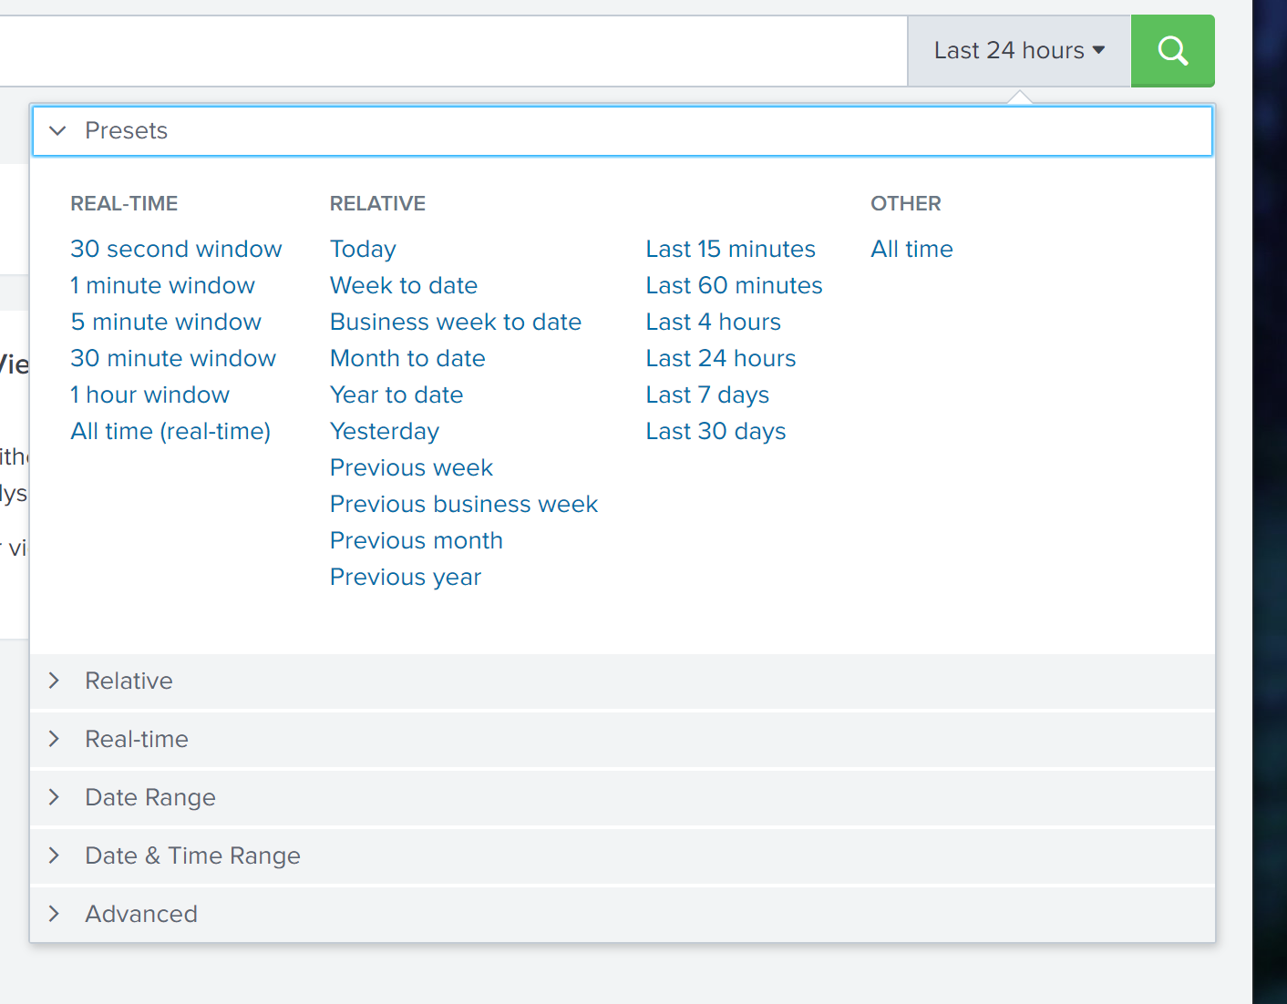
The Time Range Picker
Splunk uses time stamps for the time range picker
The defaults for the time range picker are Real-Time, Relative, and Other
We can also do some more granular things with time selection

Slide 14
Specify Absolute Time Ranges Using SPL
Specify time ranges directly in your search
For absolute ranges:
earliest=<%m/%d/%Y:%H:%M:%S> latest=<%m/%d/%Y:%H:%M:%S>
earliest=01/14/2021:16:32:00 latest=07/14/2021:21:00:00

Slide 15
Specify Absolute Time Ranges Using SPL
Specify time ranges directly in your search
For relative ranges:
  + or – to indicate the offset
  Number
  Time unit (years y, quarters q, months mon, weeks w, days d, hours h, minutes m, seconds s)
-30m | 30 minutes ago
-7d | 7 days ago
+1d | 1 day from now

Slide 16
Time Variables
Format time using time variables
Useful when evaluating time and specifying time in SPL
Variable | Description
%c | Date and time in the format of the server
%H | Hour (24-hour clock)
%I | Hour (12-hour clock)
%M | Minutes (00 – 59)
%p | AM or PM
%S | Seconds (00 – 59)

Slide 17
Time Variables
Format dates using variables
Variable | Description
%F | Date in ISO 8601 format (yyyy-mm-dd)
%A | Full weekday name (Monday)
%d | Day of month (01 – 31)
%j | Day of year
%B | Full month name (January)
%m | Month (01 – 12)
%y | Year as a two-digit number (00 – 99)
%Y | Year as a four-digit number (yyyy)

Slide 18
Converting Time Using strftime
We can convert time into the format we want during search time using and eval expression, strftime, and time variables on the _time field
| eval <new field> = strftime(<time field>, “<format>”)
| eval New_Time = strftime(_time, “%I:%M, %p”)
_time
160617990
New_Time
1:05, PM

Slide 19
POP QUIZ!
It is currently Monday, January 1st, 1900 at 5:00 PM. How will the following string format this time and date?
String | Answer
%A, %B %d, %Y - %I:%M %p | Monday, January 01, 1900 – 5:00 PM

Slide 20
Basic Searching

Slide 21
Basic Searching
Broad search terms - metadata
Index
  index = main, index = default
Host
  host = server.com, host = 192.168.1.1
Source , sourcetype
  source = /var/lib, sourcetype = csv
© Adam Frisbee, adamfrisbee.com

Slide 22
Basic Searching
Broad search terms
Keywords
  failed, error
Phrases
  “failed login”
Fields
  Key value pairs
  user=user1.domain.com
Wildcards
  *ailed, fail*, user=*
Booleans
  AND, OR, NOT
© Adam Frisbee, adamfrisbee.com

Slide 23
Basic Searching
Basic search commands
stats
  Statistics
eval
  Calculates an expression
dedup
  Removes duplicates
Table
  Builds a table with specified fields
chart / timechart
  Returns results in tabular output for charting
rename
  Renames a specific field
sort
  Sorts results by specified fields
© Adam Frisbee, adamfrisbee.com

Slide 24
Basic Searching
Constructing a basic search
Search Terms
Commands
host=myhost.lcl source=hstlogs user=* (message=fail* OR message=lock*)
| table _time user message
| sort -_time
© Adam Frisbee, adamfrisbee.com
Notes:
To construct a basic search, we begin with broad search terms. If we know any of the metadata, it is wise to start filtering based on that. For example, in this search, we have specified the host and the source. That takes a potentially huge burden off of the system because now there is a bunch of data that Splunk doesn’t need to worry about.
We are also specifying a specific field, user, and an asterisk. That means that we want Splunk to search the user field for any value (we assume this contains usernames).
Next, we are specifying two additional fields using a Boolean OR. This is saying ”search the message field for anything that starts with “fail” (so that could be fail, failure, failed, etc.) OR anything in the message field that starts with lock (so it could be locked, locking, lokheed, etc.).
After our broad search is complete, it’s time to do some commands to manipulate the results to get them into the format we want. In this search, I began with the pipe delimiter. You can put the pipe delimiters on separate lines for a nice, clean look. They can all go on the same line as well.
I’ve done two commands here. The first one is to build a basic table with three fields. The _time field is a Splunk default metadata field that is a timestamp (more on that next), the next field is user—we searched the user field and so this will display all data with that field and any value. The next field is the message field, and it will display message fields with fail* OR lock* and nothing else.
Then we do another command that sorts descending by the _time field.

Slide 25
Basic Searching
_time | user | message
2021-03-28-7:10:07 | user1.domain.com | failed log on
2021-03-28-7:17:00 | user1.domain.com | failed log on
2021-03-28-7:17:00 | user1.domain.com | locked
© Adam Frisbee, adamfrisbee.com

Slide 26
Fields

Slide 27

Fields
Searchable key – value pairs
Key = value
  user = user1
  ip_addr = 192.168.1.1
  message = error
  host = websvr.com
Notes:
Fields are searchable key-value pairs. When Splunk processes event data, it looks for potential fields in the data

Slide 28

Field Discovery
Splunk automatically discovers fields
  Default fields
    host, source, sourcetype, _time, etc.
  Obvious key-value pairs
  Field extractions
Notes:
Splunk has a power field discovery engine. Here’s how it works:
First, it discovers default fields in the data. When we added data to Splunk we saw this in action. Default fields include host, source, sourcetype, _time, and more.
Next, it looks for obvious key-value pairs in the first 100 events in the data.
Then, it builds fields using custom field extractions built by users and apps

Slide 29



Fast
Smart
Verbose
© Adam Frisbee, adamfrisbee.com
Notes:
Splunk has three search modes. Selection of these search modes have a significant impact on the performance of your Splunk environment. There are use-cases for each mode. The default mode is Smart mode, in which, as we’ve discussed, Splunk attempts to determine what results you are looking for and return them as quickly as possible, based on the structure of your search. By default, Smart mode attempts to discover fields in the data by looking for key=value pairs. If your search contains transforming commands, like stats chart and timechart, then Smart mode acts mode like fast mode assuming you don’t need any more automatic field discovery.
Fast mode is great when you know all of the fields you want to search, and you specify them in the search. Your search can run super fast because Splunk doesn’t have to use processing power to discover fields. Fast mode disables field discovery.
Verbose mode should be used when you don’t know much about the data and need Splunk to expend its full resources auto discovering fields. Verbose mode returns all event and field data it can possibly find, at the cost of a slower search.

Slide 30

Field Extractions
Custom field extractions can be built using the Splunk field extractor
Uses regular expressions (regex) to extract fields based on patterns

Slide 31
Tour of the Search and Reporting app
Broad search
Basic commands
Manipulating time
Extracting fields

Slide 32
What SPL is
The anatomy of a search
Timestamps and dealing with time
Fields

