Slide 1
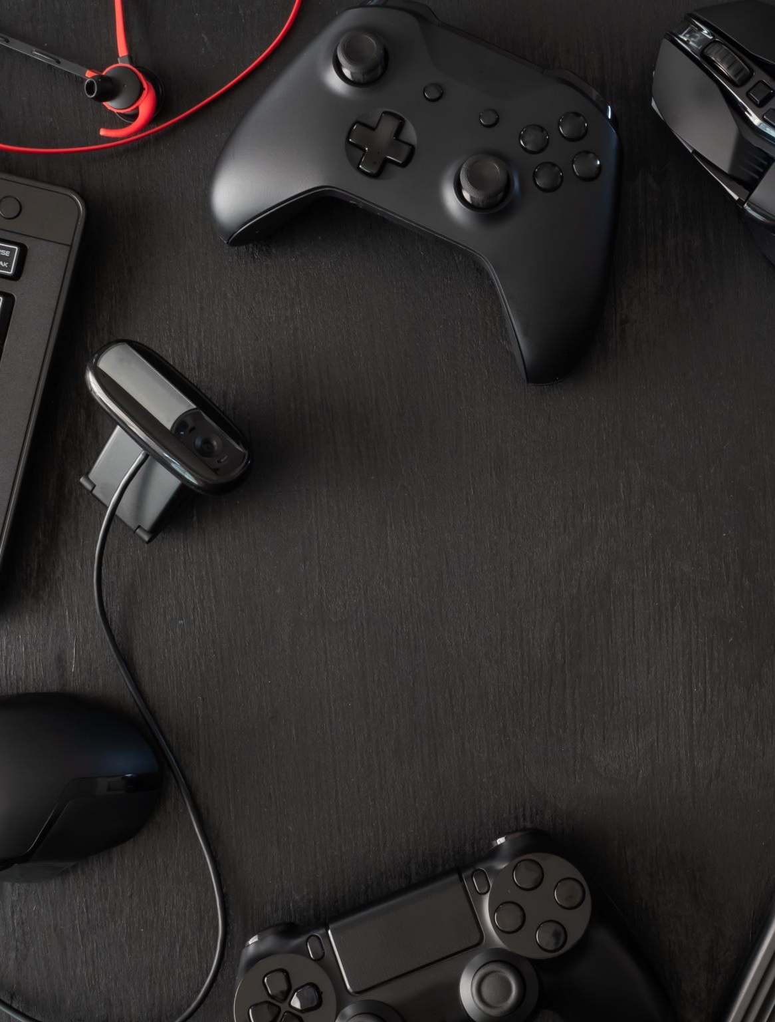
Comparison of Controller-Based vs. Touch-Based Input on Large Displays
Bachelor Thesis Final Talk
27.03.2025
Nasim Khatib
Supervisor: Dr. Simon Völker
Notes:
I will be presenting the final talk of my Bachelor Thesis Comparison of Controller-Based vs. Touch-Based Input on Large Displays

Slide 2
Introduction
Motivation
Increase in large displays utilization
Increase and widening the scope of controllers usage
Goals
Comparing compatabilities between the 2 input methods on large displays
Finding efficient input methods to utilize with large displays
Notes:
Why did we decide to do the thesis?

Slide 3
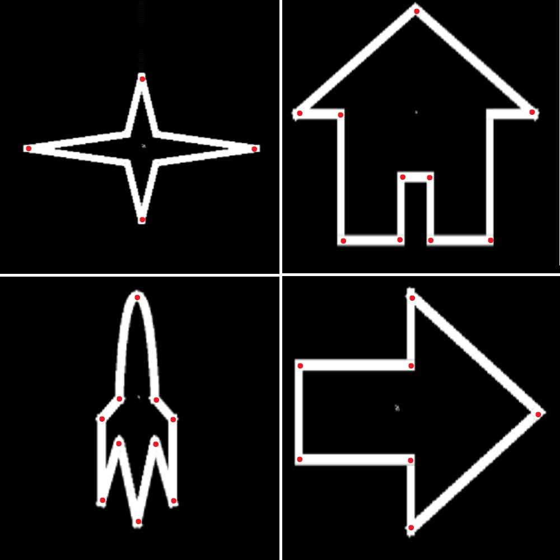
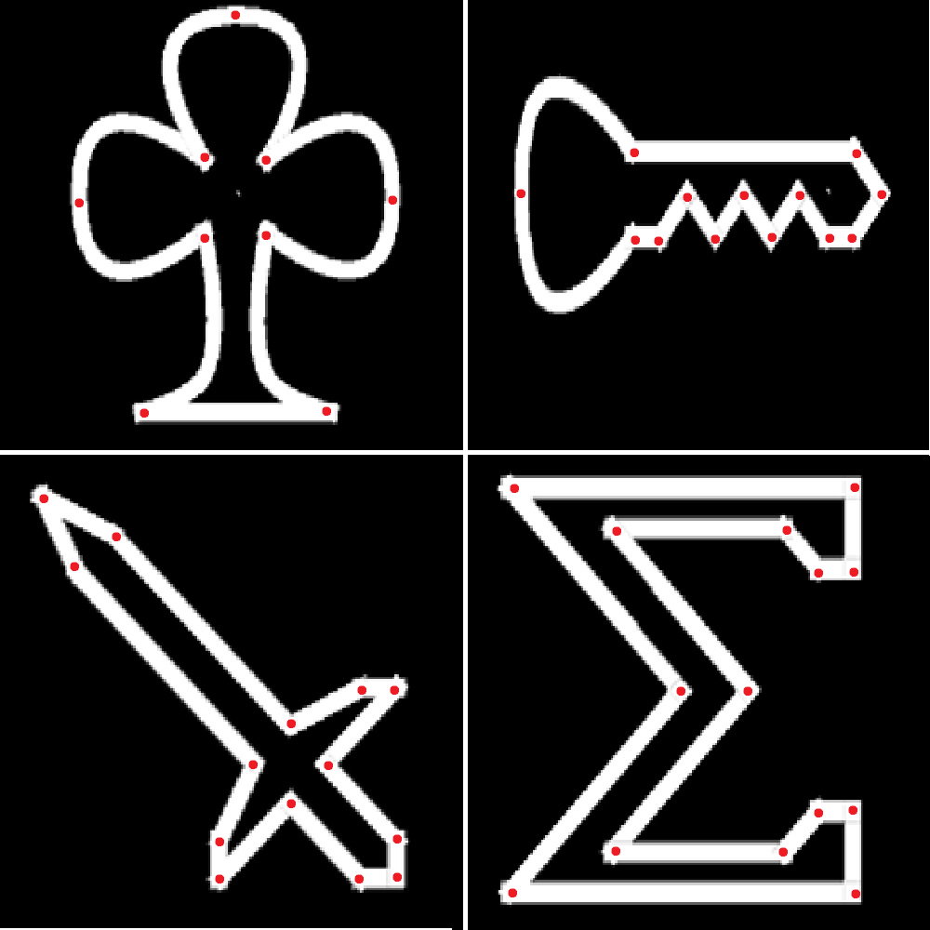
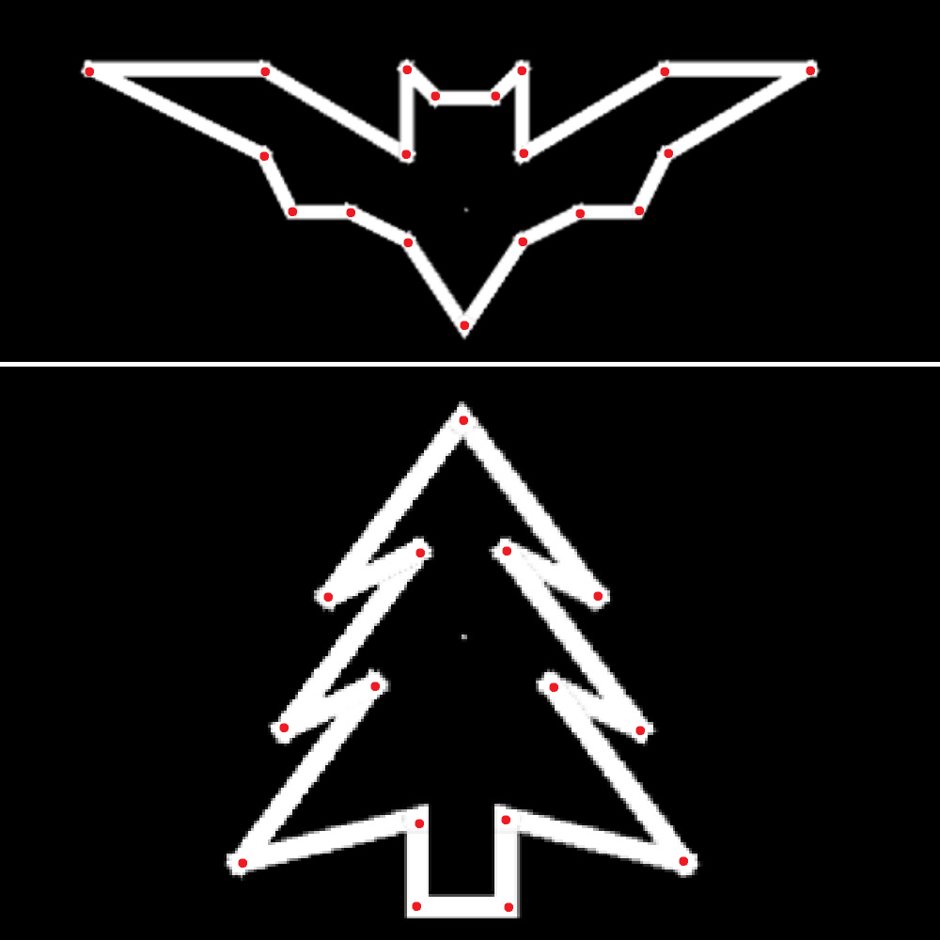
Game Design
Level Categories
Easy Levels (1 – 4)
Medium Levels (5 – 8)
Hard Levels (9 – 10)
Notes:
We have developed a Game with 10 levels
3 different difficulities
Easy is more intuitive, medium needs some coordination between thoughts and fast solving, Hard focuses more on

Slide 4
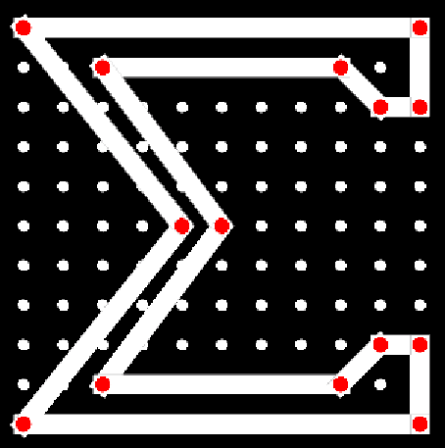
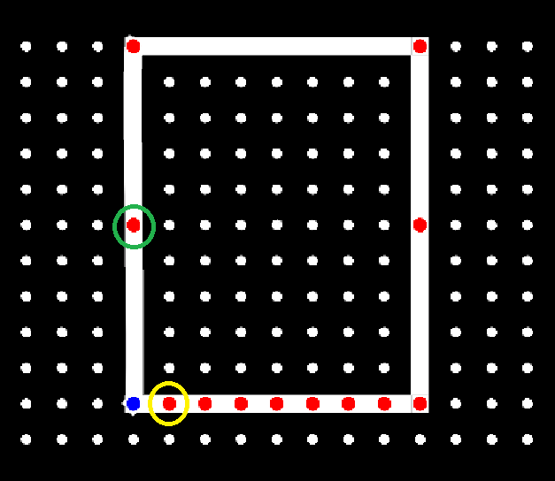
Game Design
Progress of the Game
Notes:
Players have to move the nodes around so that they match it to the designated shape

Slide 5
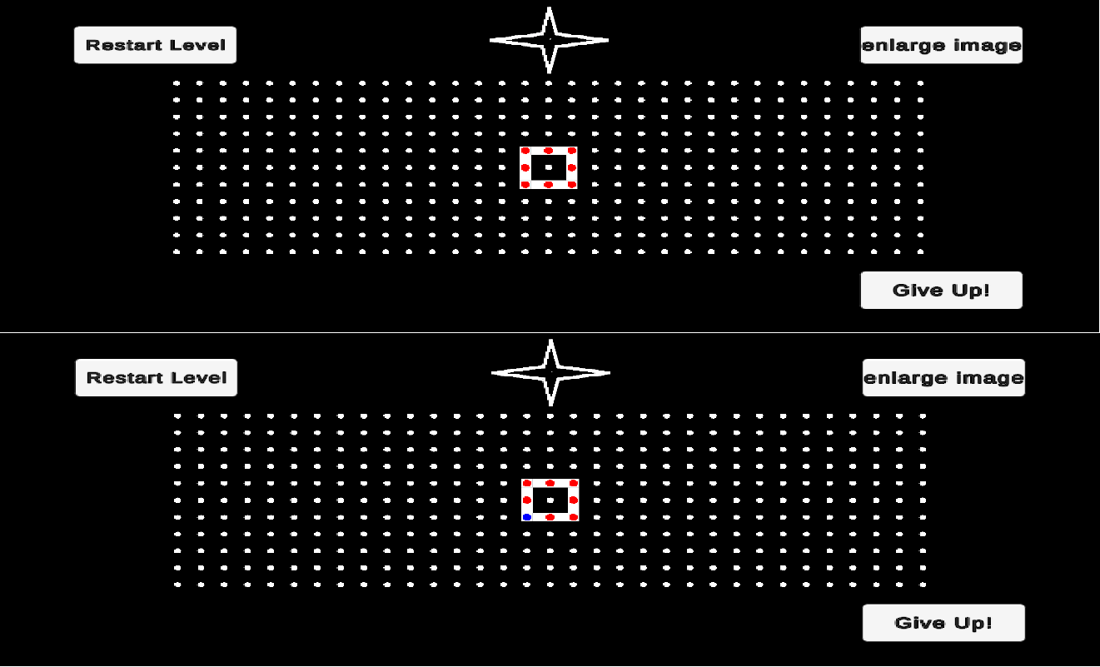
Game Design
Process
5 Levels with controller input
5 Levels with touch input
Randomized order in each group (unbiased)
Pull nodes to match the shape
Auto snap radius
Layout
Notes:
Participants had to complete 5 levels with one input method, and then another 5 with the other
The starting input method was assigned to them by us to avoid bias
Levels were randomized to avoid bias too
Participants could start with level3 and others with level 1
In order of 2 easy levels 2 medium and 1 hard
Layout shows how a level would look in controller mode and in touch mode

Slide 6
Game Design
Controller
Continuous movement
Clockwise/counter clockwise navigation between nodes
Select and unselect mechanism
Touch
Drag and Drop input
No navigation between nodes
No select and unselect mechanism
Notes:
Some of the attributes of the 2 input methods throughout the gameplay

Slide 7
Study Setup
11 participants
Laptop
27″ display with touch-input compatability
Sony PlayStation 5 DualSense Wireless Controller
Notes:
The Study included
1
2
3
4

Slide 8
Study Approach
Within-subject-study
paired t-test
Notes:
The approach was based on the study being a within-subject-study, since we have 1 group that are going to go through an activity with 2 diffirent conditions we saw fit to use Paired-t-test

Slide 9
Results
Data collection
UserID
LevelID
Input method
Number of attempts
Steps/Move counter
Time
Completion category
Notes:
These are the data that we collected including…

Slide 10
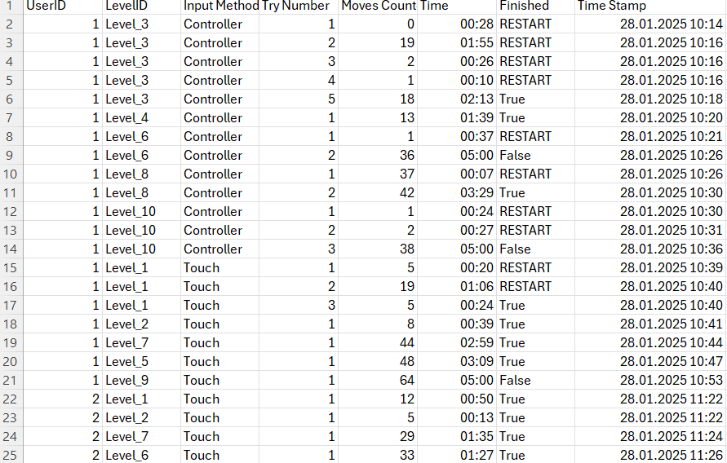
Collected Data Sample
Sample from the first participant:

Slide 11
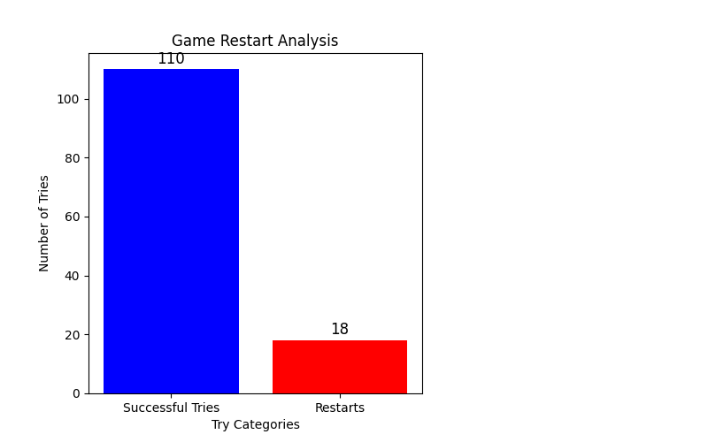
Restarts
Number of restarts in relation to all attempts
Notes:
We obsereved a very interesting finding

Slide 12
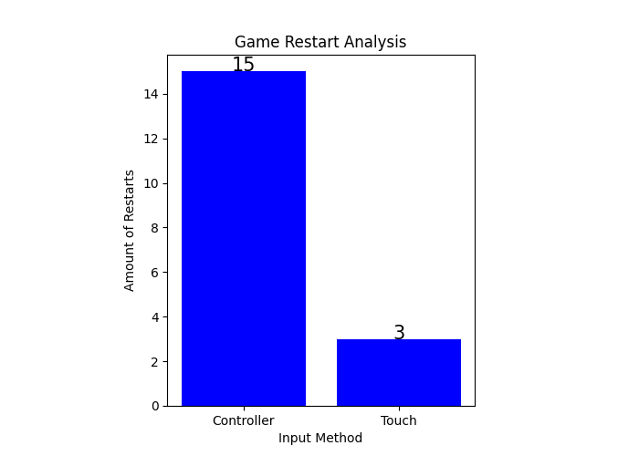
Restarts
Number of restarts in each condition
Notes:
What is more interesting is that 15 out of 18 were in controller

Slide 13
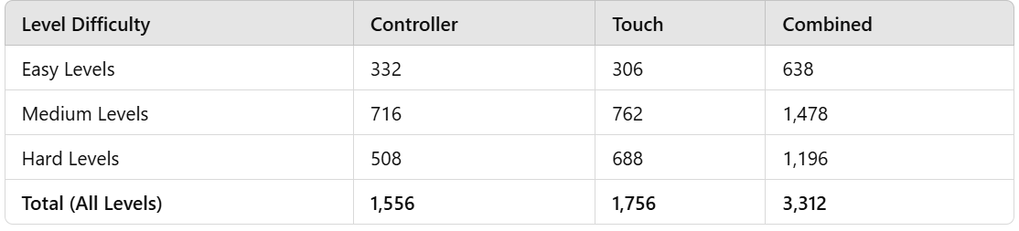
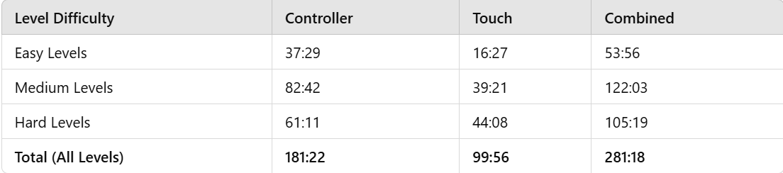
Time and Step Count

Slide 14
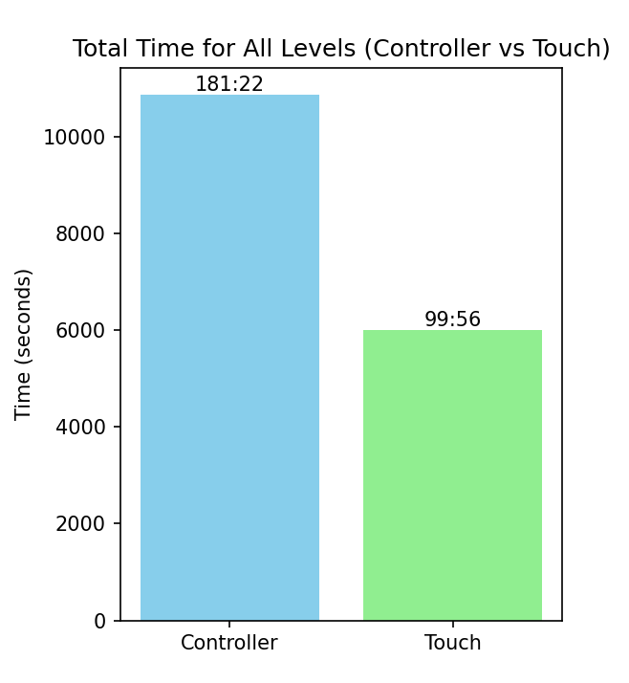
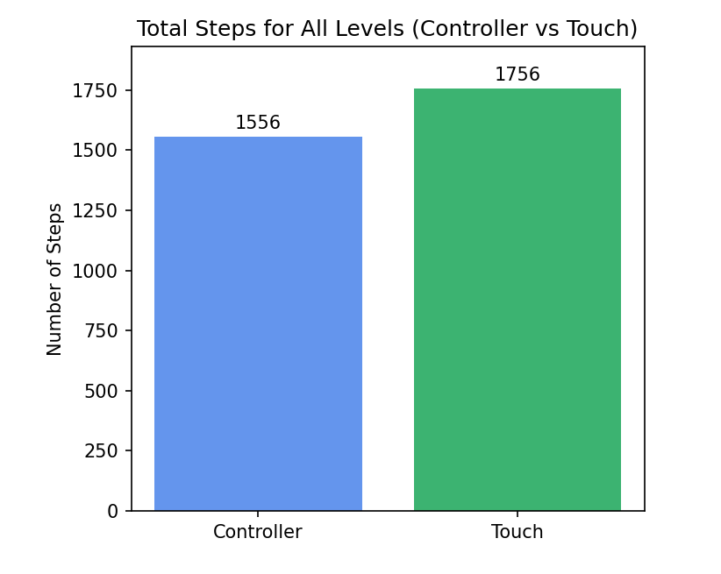
Time and Step Count
Notes:
Looking at the combined data of all levels, we can see a clear difference
Although in touch-.based input players used more move, it had significantly less time than controller, indicating that touch-based input is faster than controller.

Slide 15
Time and Step Count
Step Count
Time
Move_counter_p-value = 0.4
No significant difference between conditions
Time_p-value = 0.00006
Significant difference between conditions
Notes:
Through the Paired-t-test we confirm those clear differences

Slide 16
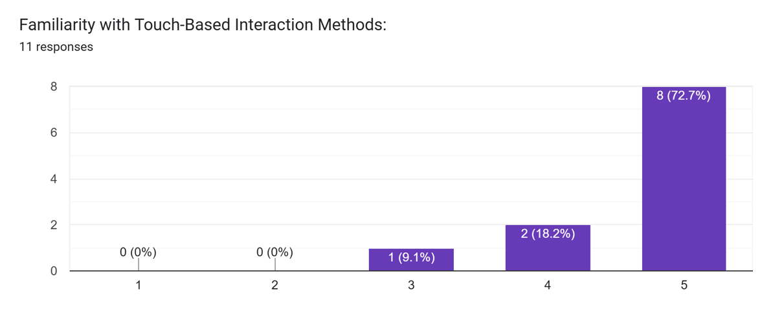
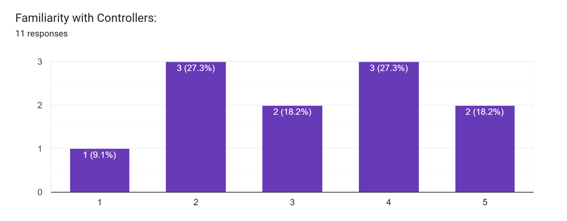
User Evaluation
Familiarity with both input methods
Controller not commonly used
Notes:
When we asked the participants through the quistionnaire

Slide 17
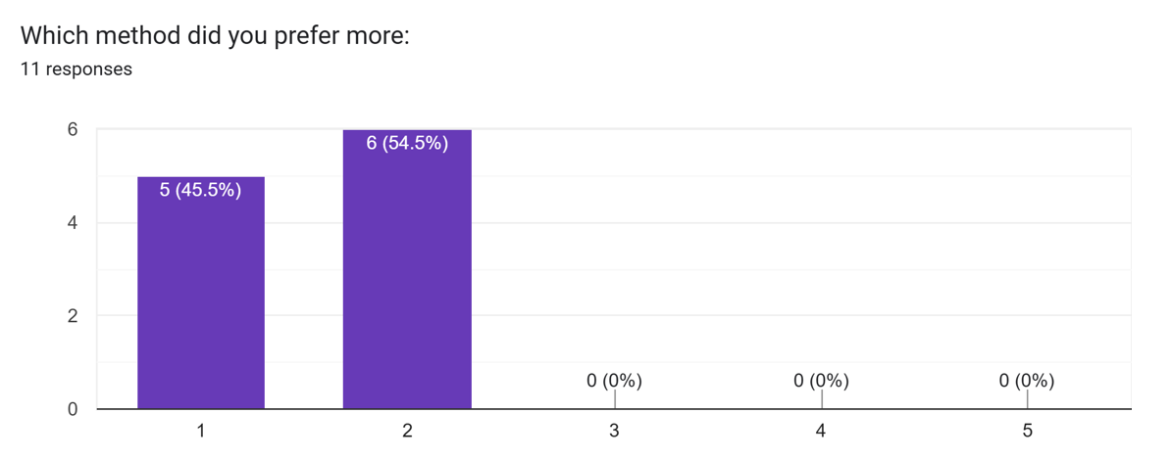
User Evaluation
Clear and total preference towards touch input
Notes:
1 Is Touch and 5 Is Controller
All participants preferd Touch

Slide 18
User Evaluation
Text Feedback
Image scaling problem
No clear indication of input method switch between levels
Participants preferred having a controller customization to adapt to their preference
Participants reported preference towards grid-based movement in controller-based input
Participants suggested lots of improvements that could have helped the likelihood of controller

Slide 19
Limitations
Study focuses mainly on 1 touch input method (drag-and-drop)
Study focuses on complex activities with cognitive thinking expectency
No focus on other Input methods
All participants were familiar with touch-based input, while almost half of them are not with controllers.

Slide 20
Summary
Touch-based input:
More intuitive
Most preferred among users
Controller-based input:
Less intuitive
Not commonly used
Needs lots of improvement
Notes:
Touch-based input more intuitive than controller-based input
touch is prefered amongst large displays, when compared with controller

Slide 21
APPENDIX

Slide 22
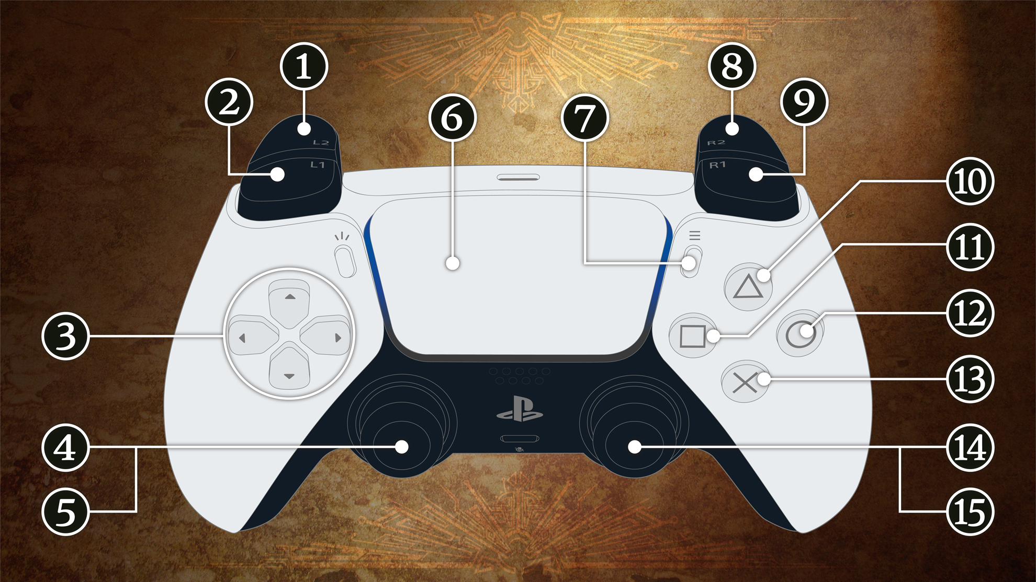
Controller Layout

Slide 23
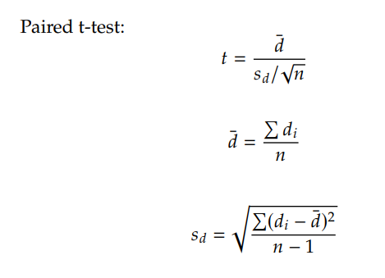
Paired t-test Function
Notes:
t stands for: T-statistic, which tells us how significant the difference is. • ¯𝑑: the mean of the differences between the paired values. • and 𝑠𝑑: Standard deviation of the differences.

Slide 24
Collective Data

Slide 25
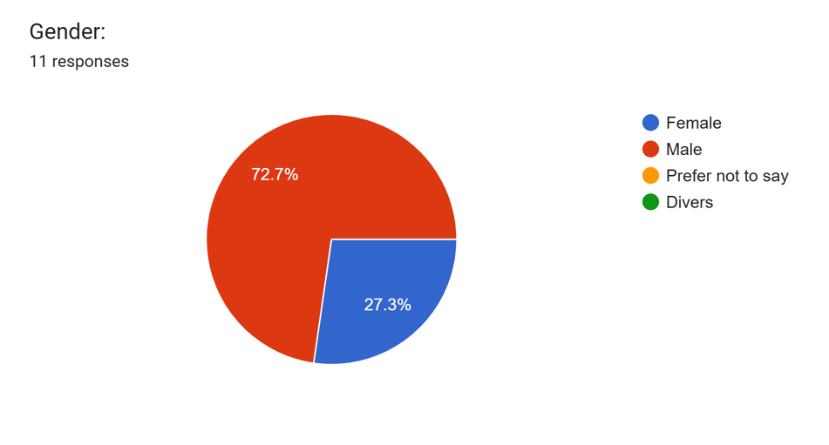
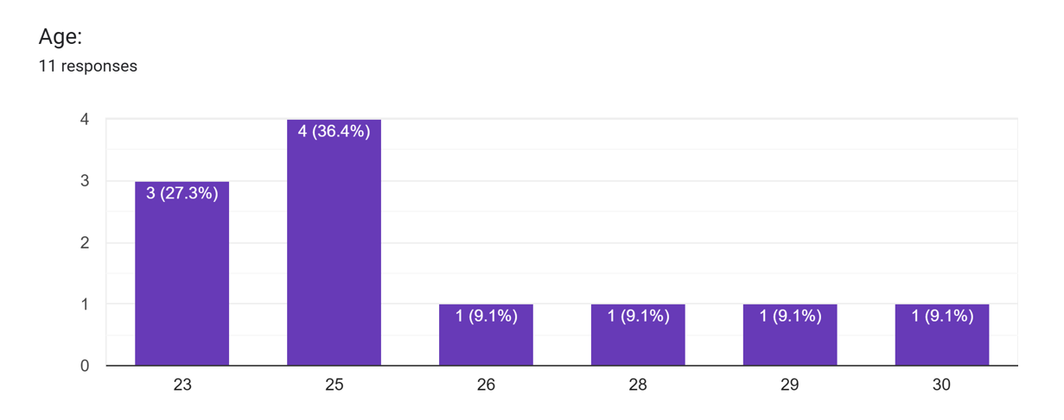
Age and Gender

