Slide 1
Home Credit Default Risk
Group 8
Team – Divya manoj, isha ghaisas, Tejasvi kartHik KumAR, Siddharth gosawi

Slide 2
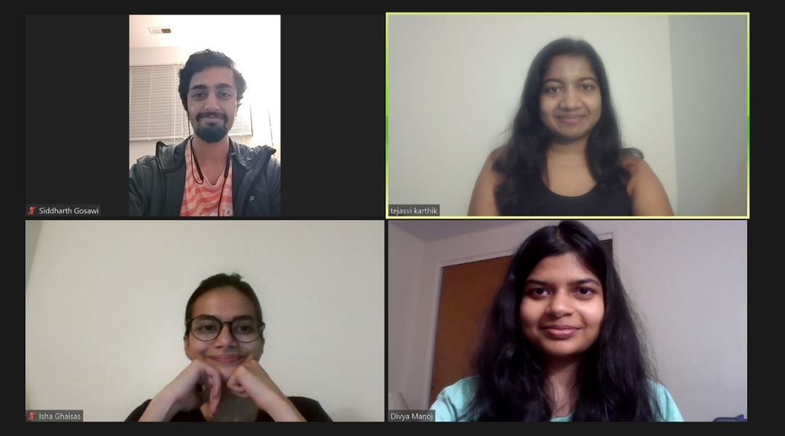
Team Photo:

Slide 3
Content:
Introduction
Visual EDA
Feature Engineering and Top Features
Overview of pipelines
Discussion of Results
Conclusion
Next Steps

Slide 4
Introduction:
This project involves providing information and assistance related to Home Credit Default Risk. The main goal is to predict whether loan applicants will successfully repay the loan or not.
Many people struggle to get loans due to insufficient or non-existent credit histories.
This population is often taken advantage by untrustworthy lenders. Home credit tries to include the unbanked population to support their economic needs.
We can provide guidance on credit risk assessment, factors influencing default risk, and strategies to mitigate such risks.

Slide 5
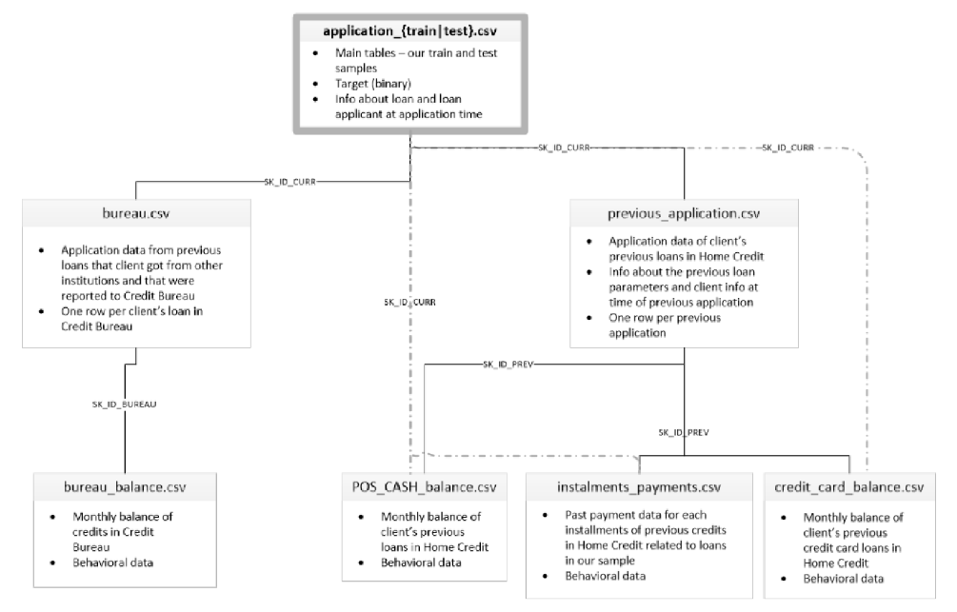
Collecting dataset:
There are 7 different sources of data:
application_train/application_test (307k rows, and 48k rows):
bureau (1.7 Million rows):
bureau_balance (27 Million rows):
previous_application (1.6 Million rows):
POS_CASH_BALANCE (10 Million rows):
credit_card_balance: installments_payment (13.6 Million rows):

Slide 6
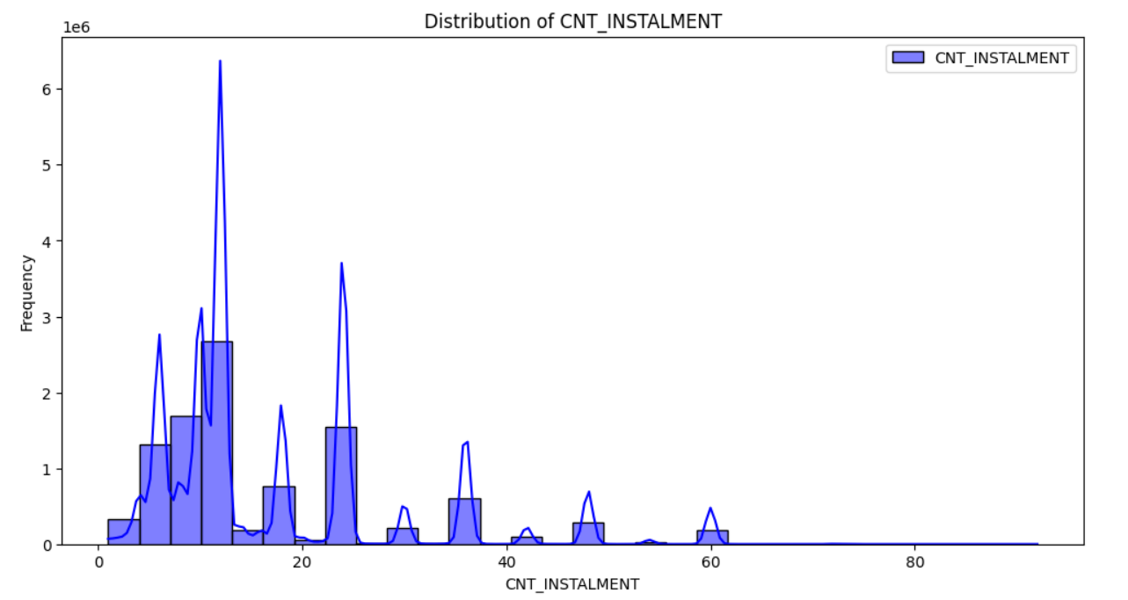
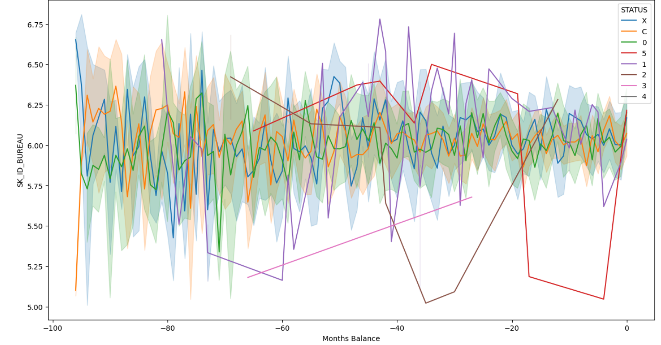
VISUAL EDA:
Distribution of key columns:
Plot of monthly balance changes for each credit :

Slide 7
Feature Engineering and Top Features
We added new features such as approved_credit_ratio, AMT_ANNUITY_credit_ratio, LTV_ratio, Approved, DAYS_INSTALMENT_DIFF, AMT_PAYMENT_PCT, AMT_DRAWINGS_PCT, AMT_DRAWINGS_ATM_PCT, AMT_DRAWINGS_OTHER_PCT, AMT_DRAWINGS_POS_PCT, AMT_PRINCIPAL_RECEIVABLE_PCT, range_AMT_Application
We combined these features with our original features. Then we plotted correlation matrix of all features with respect to target variable. From more than 100 features, we found top 20 features that had major impact on target variable - 'CNT_DRAWINGS_ATM_CURRENT_mean','AMT_DRAWINGS_PCT_mean','AMT_BALANCE_mean','LTV_ratio_mean', 'AMT_PRINCIPAL_RECEIVABLE_PCT_mean','DAYS_LAST_PHONE_CHANGE’, 'DAYS_ID_PUBLISH','EXT_SOURCE_3','EXT_SOURCE_2','EXT_SOURCE_1', 'DAYS_EMPLOYED','approved_credit_ratio_mean','AMT_ANNUITY_mean', 'CODE_GENDER','FLAG_OWN_REALTY','FLAG_OWN_CAR','NAME_CONTRACT_TYPE', 'NAME_EDUCATION_TYPE','OCCUPATION_TYPE','NAME_INCOME_TYPE', 'SK_ID_CURR'

Slide 8
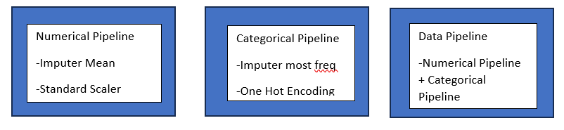
Processing Pipeline
Various Classification algorithms were used to compare with the best model. Following metrics were used to find the best model
Cross fold Train Accuracy
Test Accuracy
p-value
Train AUC_Score
Test AUC_Score
Train Time
Test Time
Confusion matrix
We implemented the Logistic regression model as the baseline model, which didn’t require high computation power and was easy to implement, in addition we implemented KNN and tuned logistic models with balanced dataset to improve our model predictiveness. Our objective in current phase s to explore various classification models which would improve our prediction. Our primary focus is on boosting algorithms which are said to be highly efficient and moderately quicker. We primarily experimented with Gradient Boosting, XGBoost, RandomForest and SVM.

Slide 9
Hyperparameter Tuning and Best Parameters
Best Parameters for Logistic Regression
predictor__C: 10 predictor__penalty: l2 predictor__tol: 0.0001
Best Parameters for K Nearest Neighbors
predictor__n_neighbors: 13 predictor__p: 2
Best Parameters for Decision Tree
max_depth: 5 min_samples_leaf: 1, min_samples_split: 2
Best Parameters for Random Forest
Bootstrap: False, min_samples_leaf: 1, min_samples_split: 2, max_depth: 10, n_estimators: 100

Slide 10
Multi Layer Perceptron

Slide 11
Results
Model | Train Acc | Test Acc | Train AUC | Test AUC | Train log loss | Test log loss | Train time | Test time
Logistic Regression | 68 | 68.77 | 0.7418 | 0.743 | 11.388 | 11.255 | 78.870 | 0.2796
KNN | 65.3 | 65.73 | 0.7760 | 0.6969 | 10.470 | 12.351 | 78.870 | 0.2796
Decision Tree | 66 | 66.44 | 0.7156 | 0.71 | 11.961 | 12.094 | 78.870 | 0.2796
Random Forest | 68.3 | 68.66 | 0.8354 | 0.7446 | 8.7162 | 11.292 | 78.870 | 0.2796

Slide 12
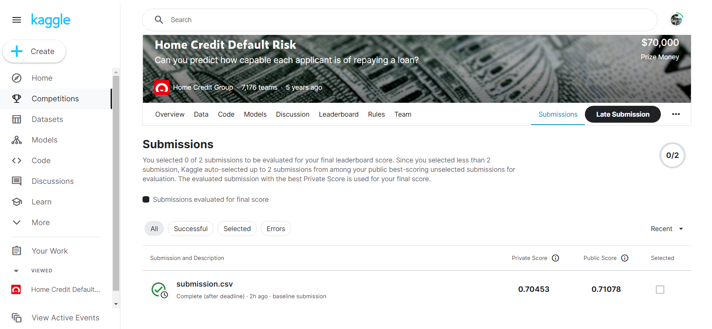
Kaggle Submission

Slide 13
Conclusion:
In conclusion, in this phase we mainly focused on Feature Engineering and Hyperparameter Tuning
We obtained a solid understanding of the features and selected best parameters for each of the ML models.
A combination or selection of Logistic Regression, Random Forest, and Decision Trees, as well as the employment of L1 and L2 loss functions measured against accuracy and AUC scores will best prepare a model for the prediction of repayment.
After feature engineering and traning the models on the smaller data set, the Random Forest Classifier algorithm has shown the most promise with AUC score of 0.718.
Finally, Multi Layer Perceptron model gave a more better accuracy (69%) than other models.

Slide 14
Future Scope
Long short term memory networks could be used to incorporate time series data.
Advanced techniques like SMOTE could be deployed to handle the class imbalance problems.
Recursive feature selection can be used to reduce the features.

