Slide 1
Javascript Basics & Examples
05/15/2015 Yiqi Gao

Slide 2
3 languages
HTML to define the content of web pages
CSS to specify the layout of web pages
JavaScript to program the behavior of web pages

Slide 3
Quick Example
<button type="button“ onclick="document.getElementById('demo').innerHTML = Date()">Click me to display Date and Time.</button>
<p id="demo"></p>

Slide 4
JavaScript Introduction
JavaScript Can Change HTML Content
JavaScript Can Change HTML Attributes
JavaScript Can Change HTML Styles (CSS)
JavaScript Can Validate Data

Slide 5
JavaScript Can Change HTML Content
<p id="demo">JavaScript can change HTML content.</p>
<button type="button" onclick="document.getElementById('demo').innerHTML = 'Hello JavaScript!'">Click Me!</button>

Slide 6
JavaScript Can Change HTML Attributes
<img id="myImage" onclick="changeImage()" src="pic_bulboff.gif" width="100" height="180">
<p>Click the light bulb to turn on/off the light.</p>
<script>
function changeImage() {
var image = document.getElementById('myImage');
if (image.src.match("bulbon")) {
image.src = "pic_bulboff.gif";
} else {
image.src = "pic_bulbon.gif";
}
}
</script>

Slide 7
JavaScript Can Change HTML Styles (CSS)
<p id="demo">JavaScript can change the style of an HTML element.</p>
<script>
function myFunction() {
var x = document.getElementById("demo");
x.style.fontSize = "25px";
x.style.color = "red";
}
</script>
<button type="button" onclick="myFunction()">Click Me!</button>

Slide 8
JavaScript Can Validate Data
<p>Please input a number between 1 and 10:</p>
<input id="numb" type="number">
<button type="button" onclick="myFunction()">Submit</button>
<p id="demo"></p>
<script>
function myFunction() {
var x, text;
// Get the value of the input field with id="numb"
x = document.getElementById("numb").value;
// If x is Not a Number or less than one or greater than 10
if (isNaN(x) || x < 1 || x > 10) {
text = "Input not valid";
} else {
text = "Input OK";
}
document.getElementById("demo").innerHTML = text;
}
</script>

Slide 9
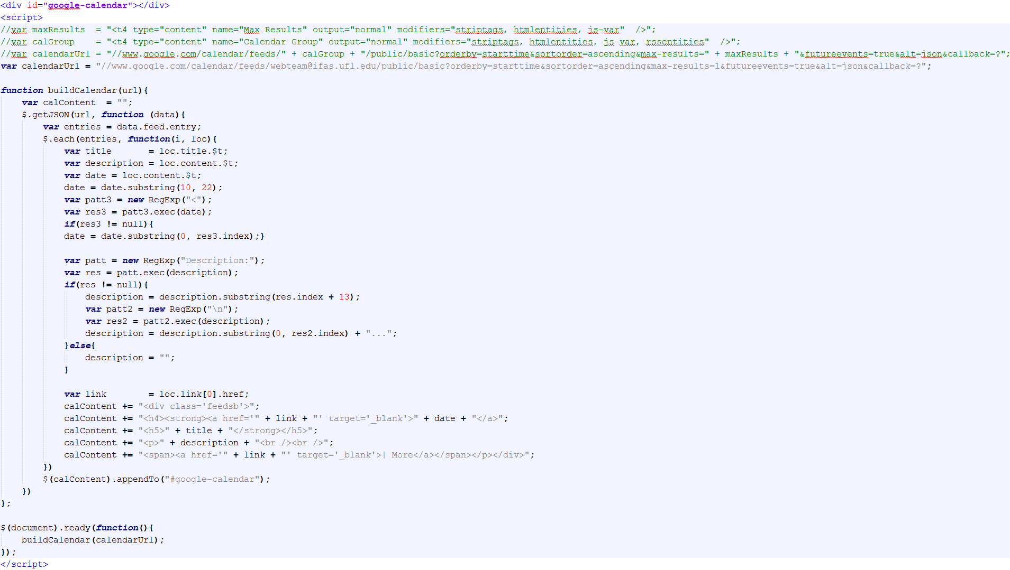
Google Calendar

Slide 10
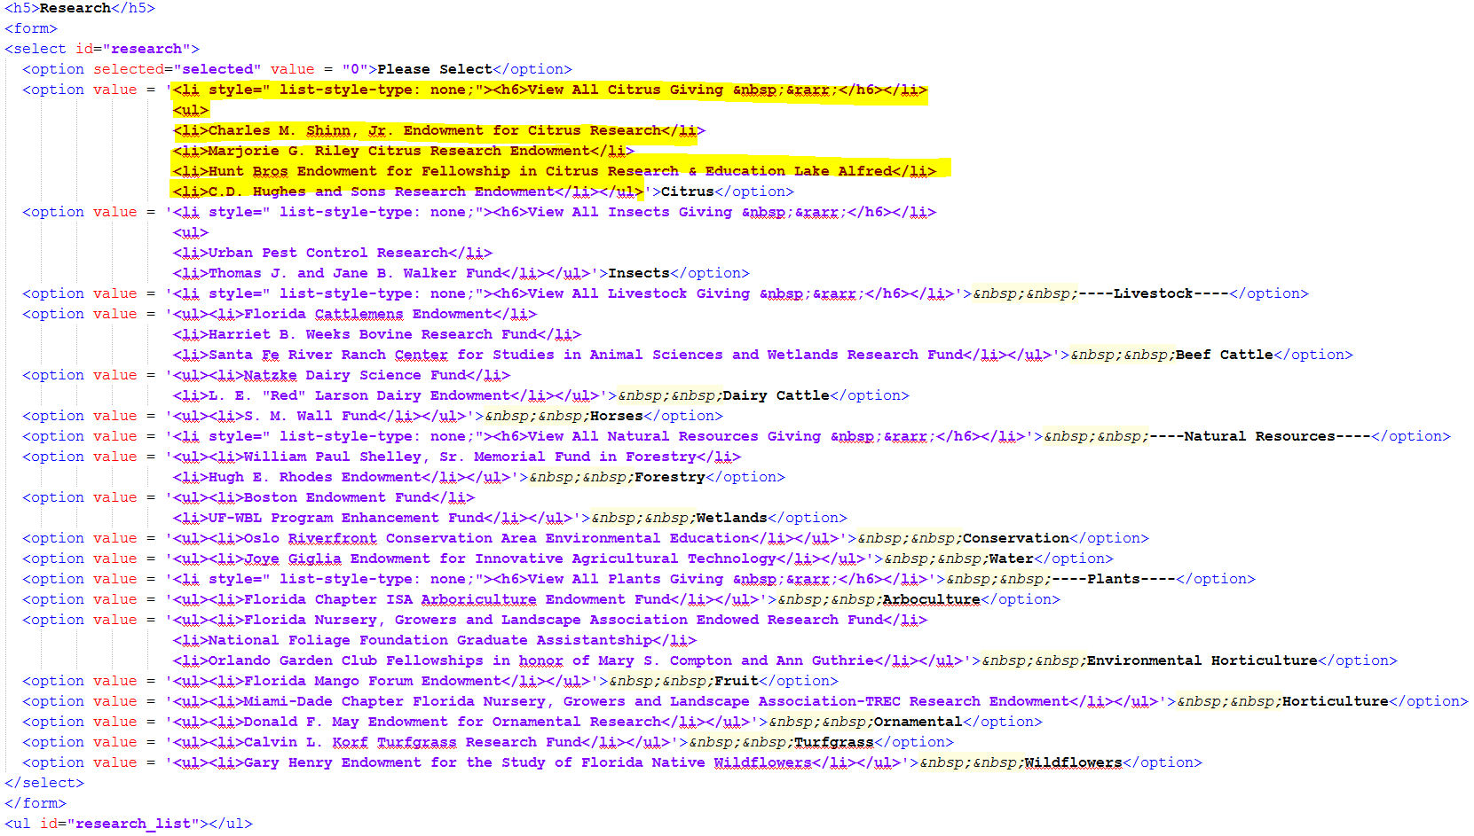
Give Now (Dropdown)
HTML:

Slide 11
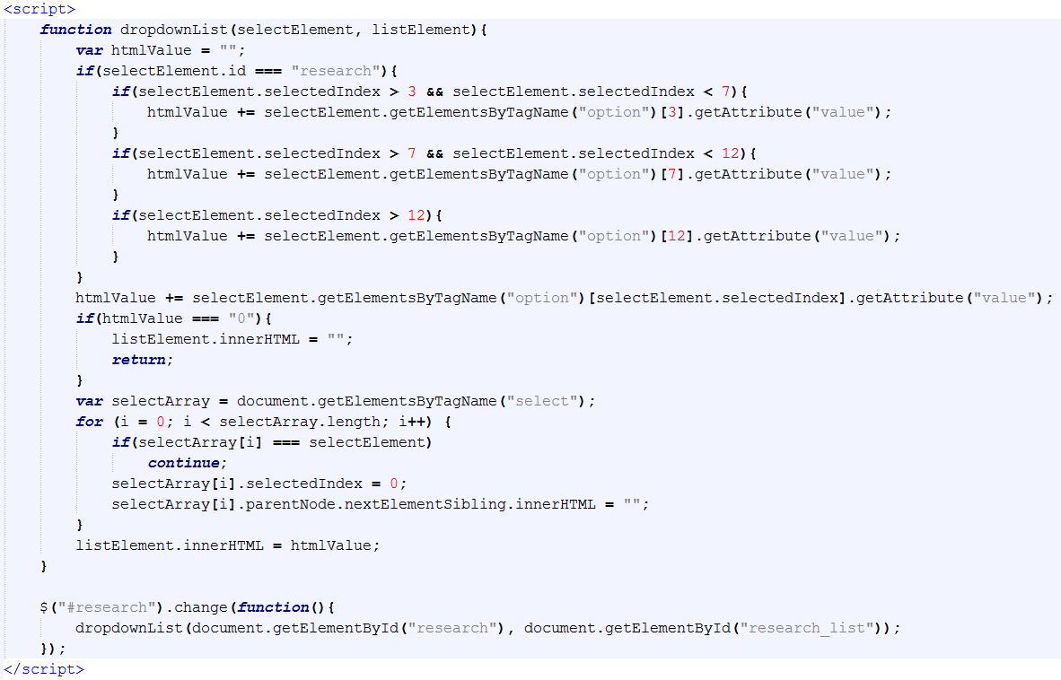
Give Now (Dropdown)
Javascript:

Slide 12
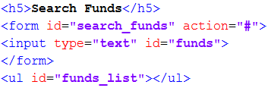
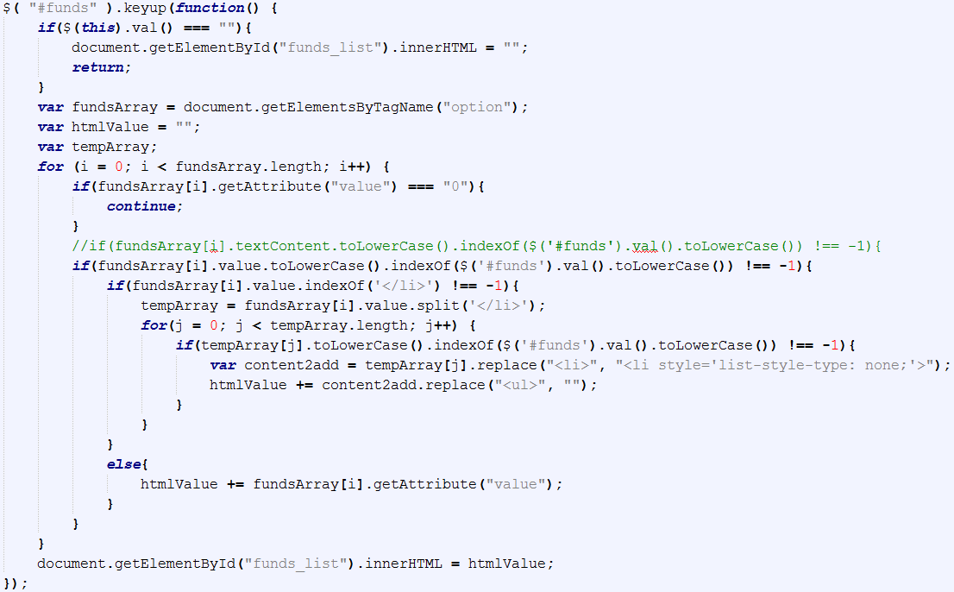
Give Now (Search)
HTML & Javascript:

