Slide 1
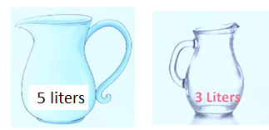
A Water Jug Problem:1
You are given two jugs, a 5-gallon one and a 3-gallon one, a pump which has unlimited water which you can use to fill the jug, and the ground on which water may be poured. Neither jug has any measuring markings on it.
Our task is to get 4 gallon of water in the 5 gallon jug

Slide 2
State Space Representation:
we will represent a state of the problem as a tuple (x, y)
where x represents the amount of water in the 5-gallon jug and
y represents the amount of water in the 3-gallon jug.
Note that 0 ≤ x ≤ 5, and 0 ≤ y ≤ 3.
Here ,
The initial state is (0, 0).
The goal state is (4, y) for any value of y

Slide 3
The possible operations that can be used in the problem are listed as follows:
Fill 5-g jug from the tap and empty the 5-g jug by throwing water down the drain.
Fill 3-g jug from the tap and empty the 3-g jug by throwing water down the drain.
Pour some or 3-g water from 5-g jug into 3-g jug to make it full.
Pour some or full 3-g jug water into 5-g jug.

Slide 4
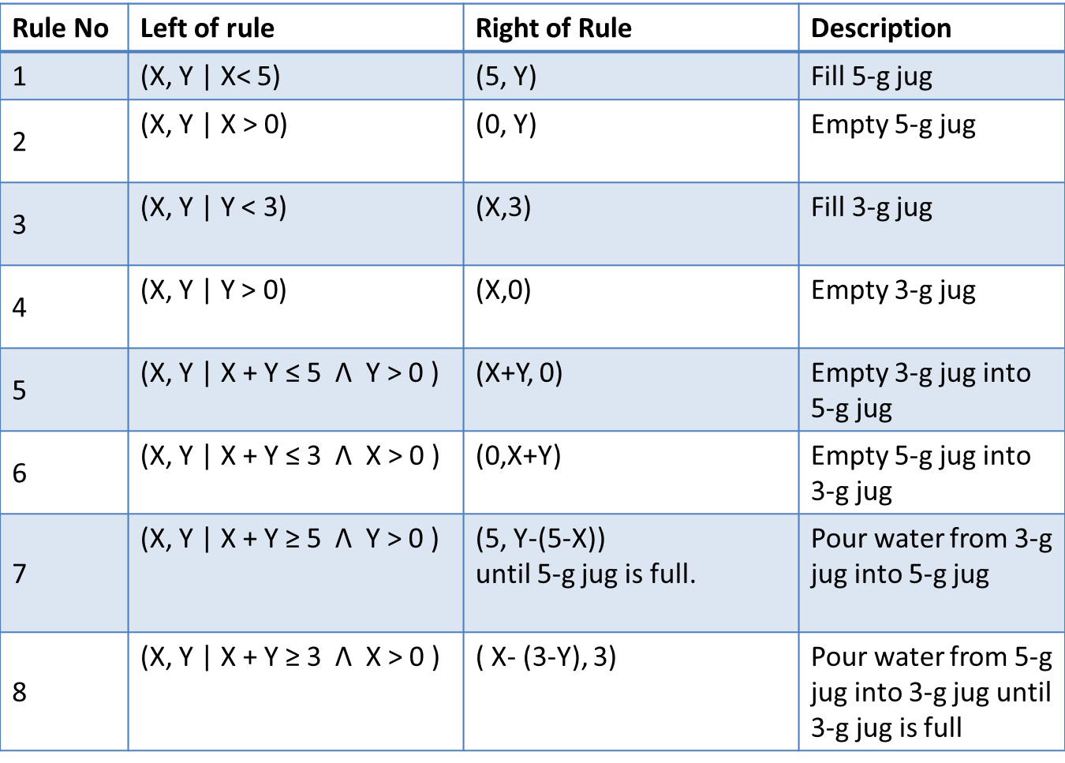
The above operations can be formally given as production rules as follows:

Slide 5
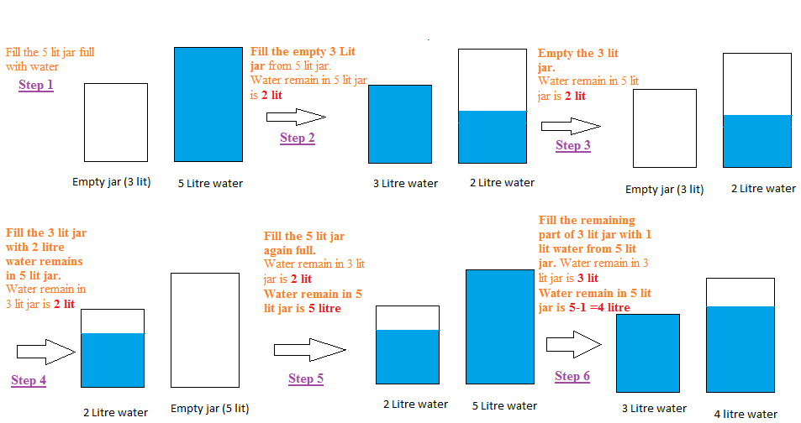
One of the possible solution :

Slide 6
Two possible solutions are given as follows: Solution-1 Solution-2
Rule applied | 5-g jug | 3-g jug | Step No
Start state | 0 | 0
1 | 5 | 0 | 1
8 | 2 | 3 | 2
4 | 2 | 0 | 3
6 | 0 | 2 | 4
1 | 5 | 2 | 5
8 | 4 | 3 | 6
Goal state | 4 | -
Rule applied | 5-g jug | 3-g jug | Step No
Start state | 0 | 0
3 | 0 | 3 | 1
5 | 3 | 0 | 2
3 | 3 | 3 | 3
7 | 5 | 1 | 4
2 | 0 | 1 | 5
5 | 1 | 0 | 6
3 | 1 | 3 | 7
5 | 4 | 0 | 8
Goal state | 4 | -

Slide 7
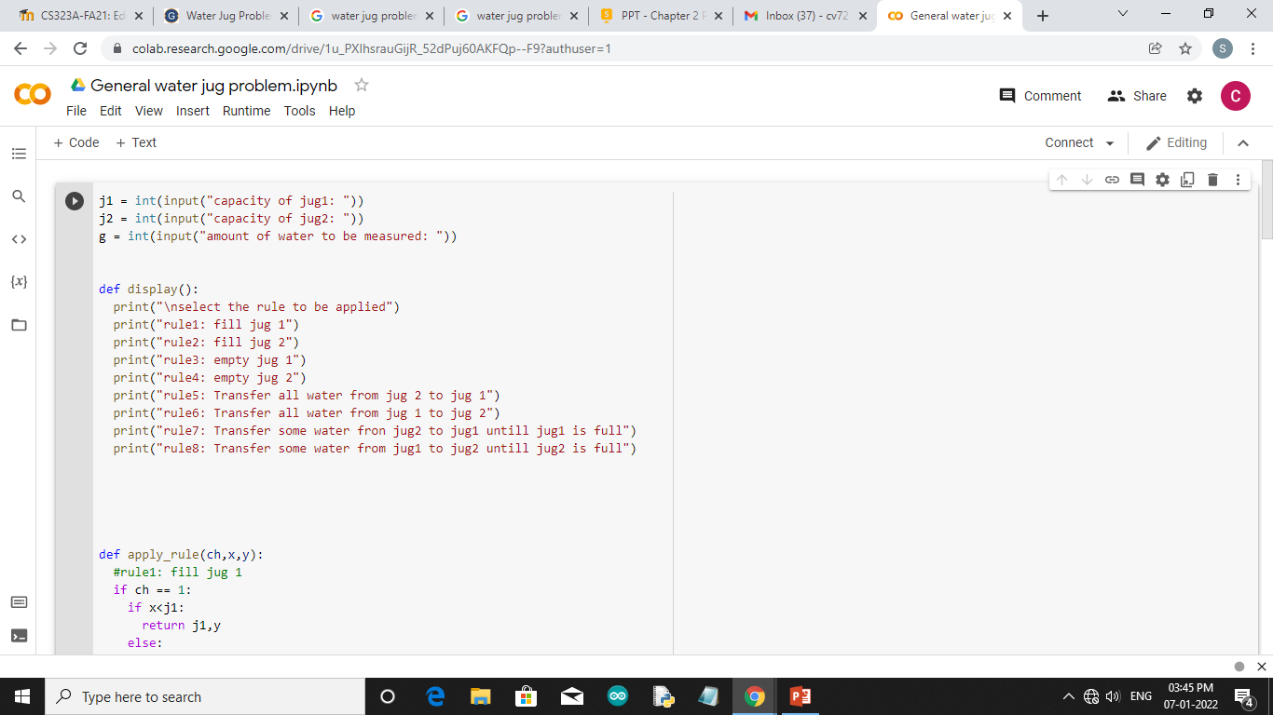

Slide 8
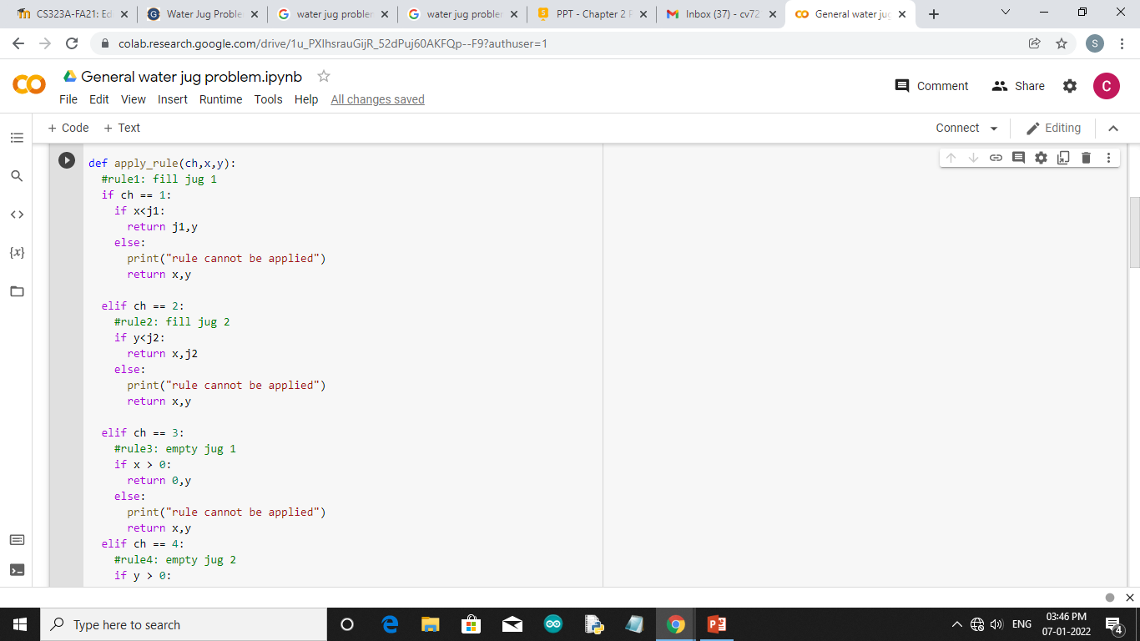

Slide 9
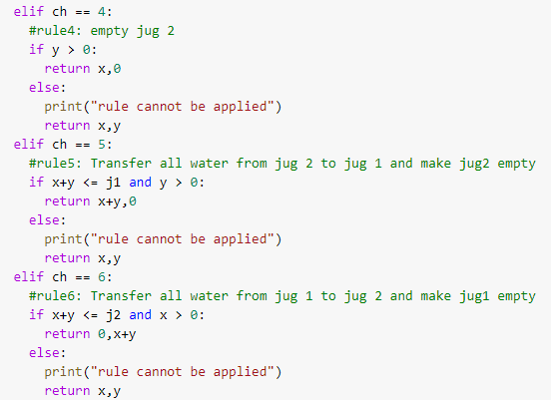

Slide 10
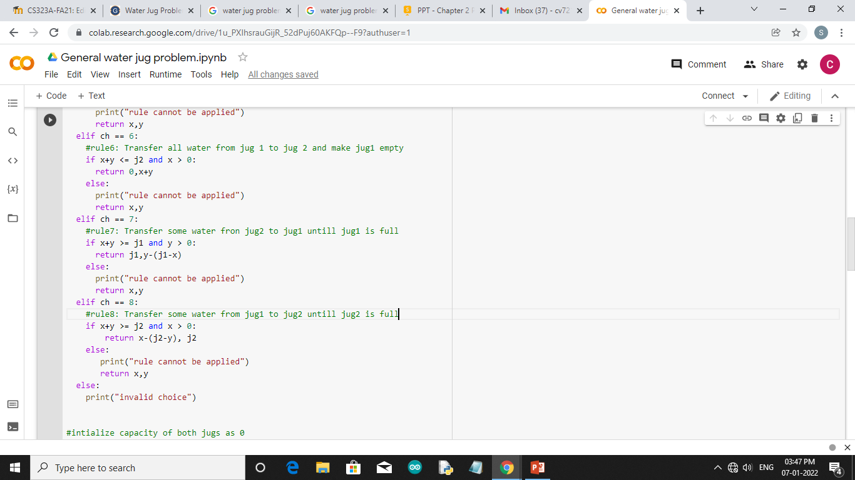

Slide 11
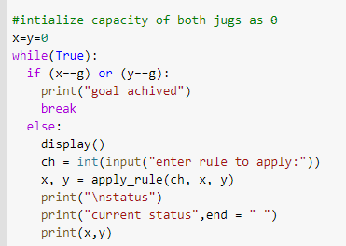

Slide 12
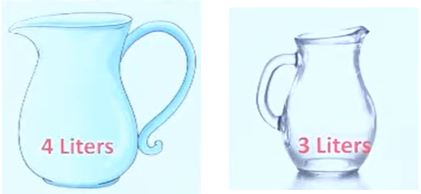
A Water Jug Problem:2
You are given two jugs, a 4-gallon one and a 3-gallon one, a pump which has unlimited water which you can use to fill the jug, and the ground on which water may be poured. Neither jug has any measuring markings on it.
How can you get exactly 2 gallons of water into the 4-gallon jug.

Slide 13
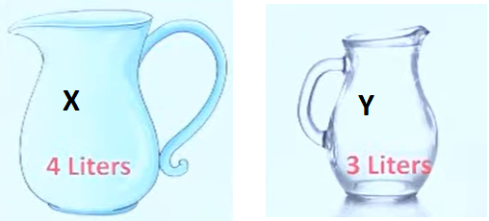
State Space Representation:
we will represent a state of the problem as a tuple (x, y)
where x represents the amount of water in the 4-gallon jug and
y represents the amount of water in the 3-gallon jug.
Note that 0 ≤ x ≤ 4, and 0 ≤ y ≤ 3.
Here ,
The initial state is (0, 0).
The goal state is (2, y) for any value of y

Slide 14
Production rules for Water Jug Problem

Slide 16
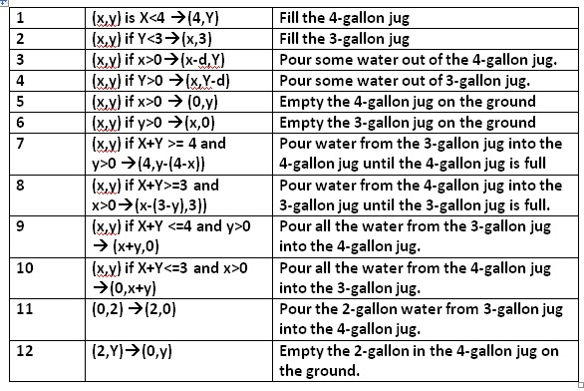
The operators that are used to solve the problem are represented as rules whose left side are matched against the current state and whose right sides describe the new state that results from applying the rule.

Slide 17
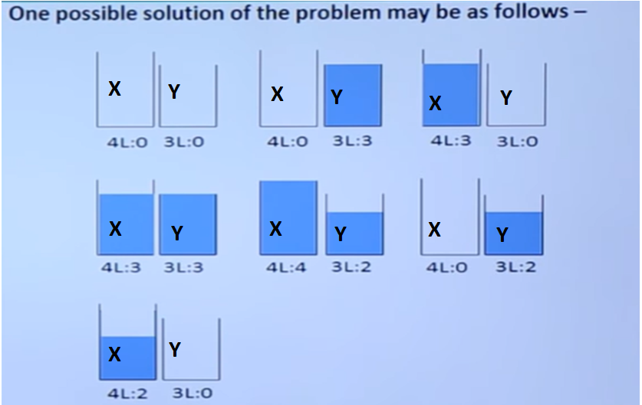
There are several sequences of operations that will solve the problem
One of the possible solutions is given as:

Slide 18
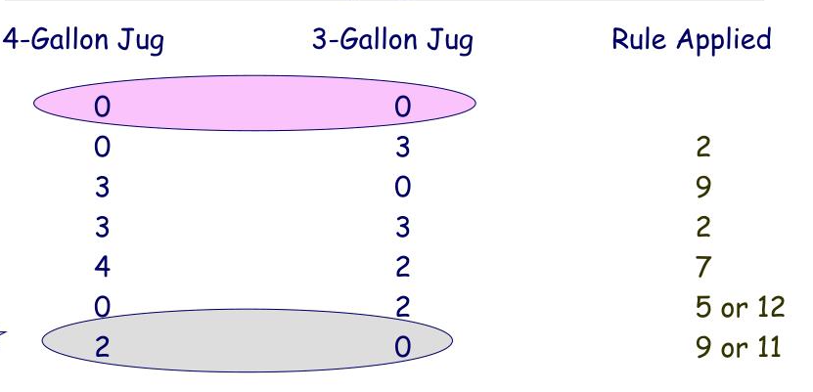

Slide 19
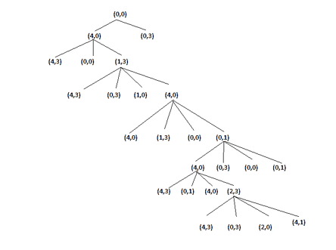

Slide 20
