Slide 1
Case Study: Agate’s Information System

Slide 2
A1:
AGATE Ltd Case Study:
Introduction

Slide 3
Requirements
To record details of Agate’s clients and advertising campaigns for those clients.
  To record names, address, contact details for each client.
  To record details of each campaign for each client (title of campaign, planned start & finish dates, estimated costs, budgets, actual costs & dates, current state of completion).
  To provide information that can be used in separate accounts system for invoicing clients for campaigns.
  To record payments for campaigns that are also recorded in separate accounts system.
  To record which staff are working on which campaigns, including campaign manager for each campaign.
  To record which staff are assigned as staff contacts to clients.
  To check on status of campaigns and whether they are within budget.

Slide 4
Requirements (cont’)
To provide creative staff with recording details of adverts and products of creative process that leads to development of concepts for campaigns and adverts.
  To allow creative staff to record notes of ideas for campaigns and adverts.
  To provide other staff with access to those concept notes.
  To record details of adverts, including progress on their production.
  To schedule dates when adverts will be run.
To record details of all staff in company.
  To maintain staff records for creative and administrative staff.
  To maintain details of staff grades and the pay for those grades.
  To record which staff are on which grade.
  To calculate annual bonus for all staff.

Slide 5
Requirements (cont’)
Non-functional requirements.
  To enable data about clients, campaigns, adverts, staff to be shared between offices.
  To allow system to be modified to work in different languages.

Slide 6
A2:
AGATE Ltd Case Study:
Requirements Model

Slide 7
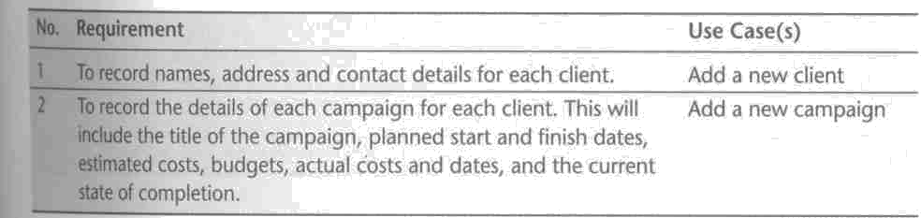
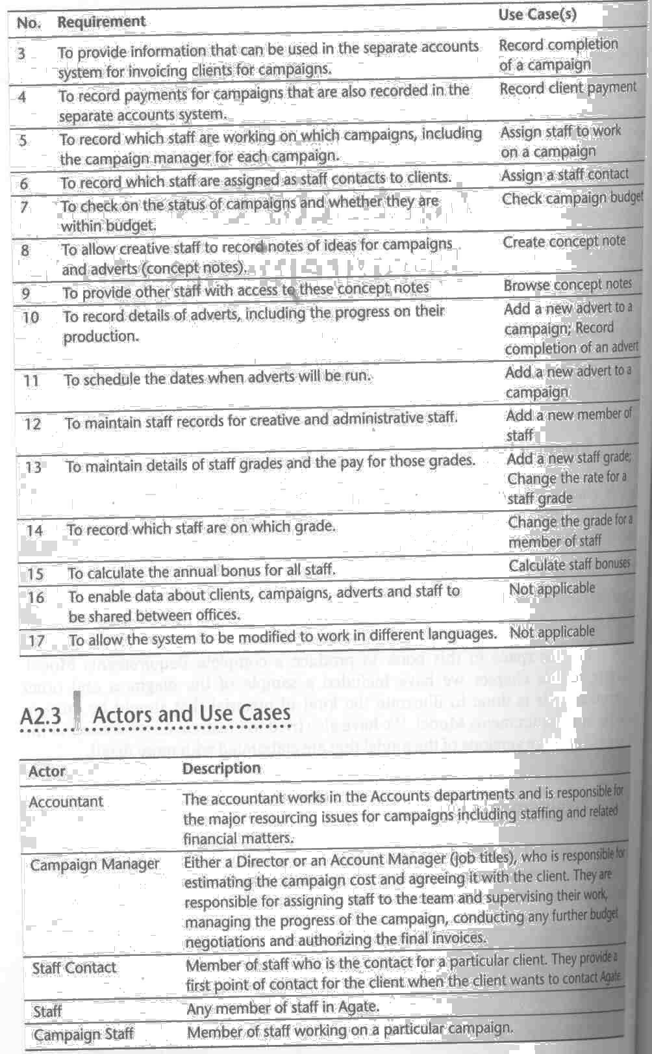
Require-ment list

Slide 8
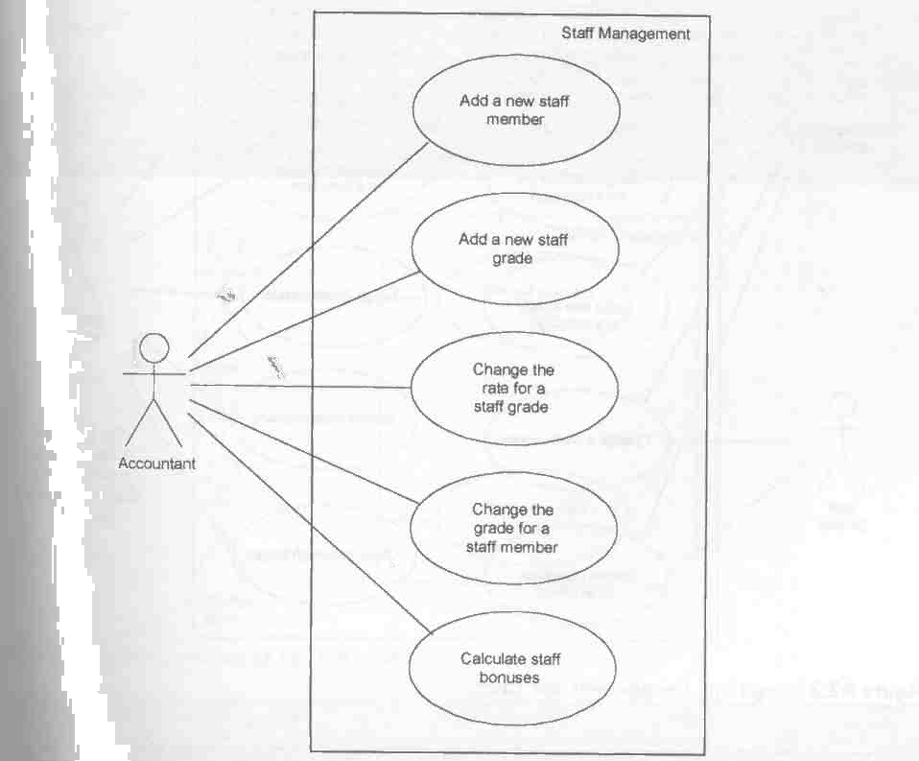
Use case for Staff Management

Slide 9
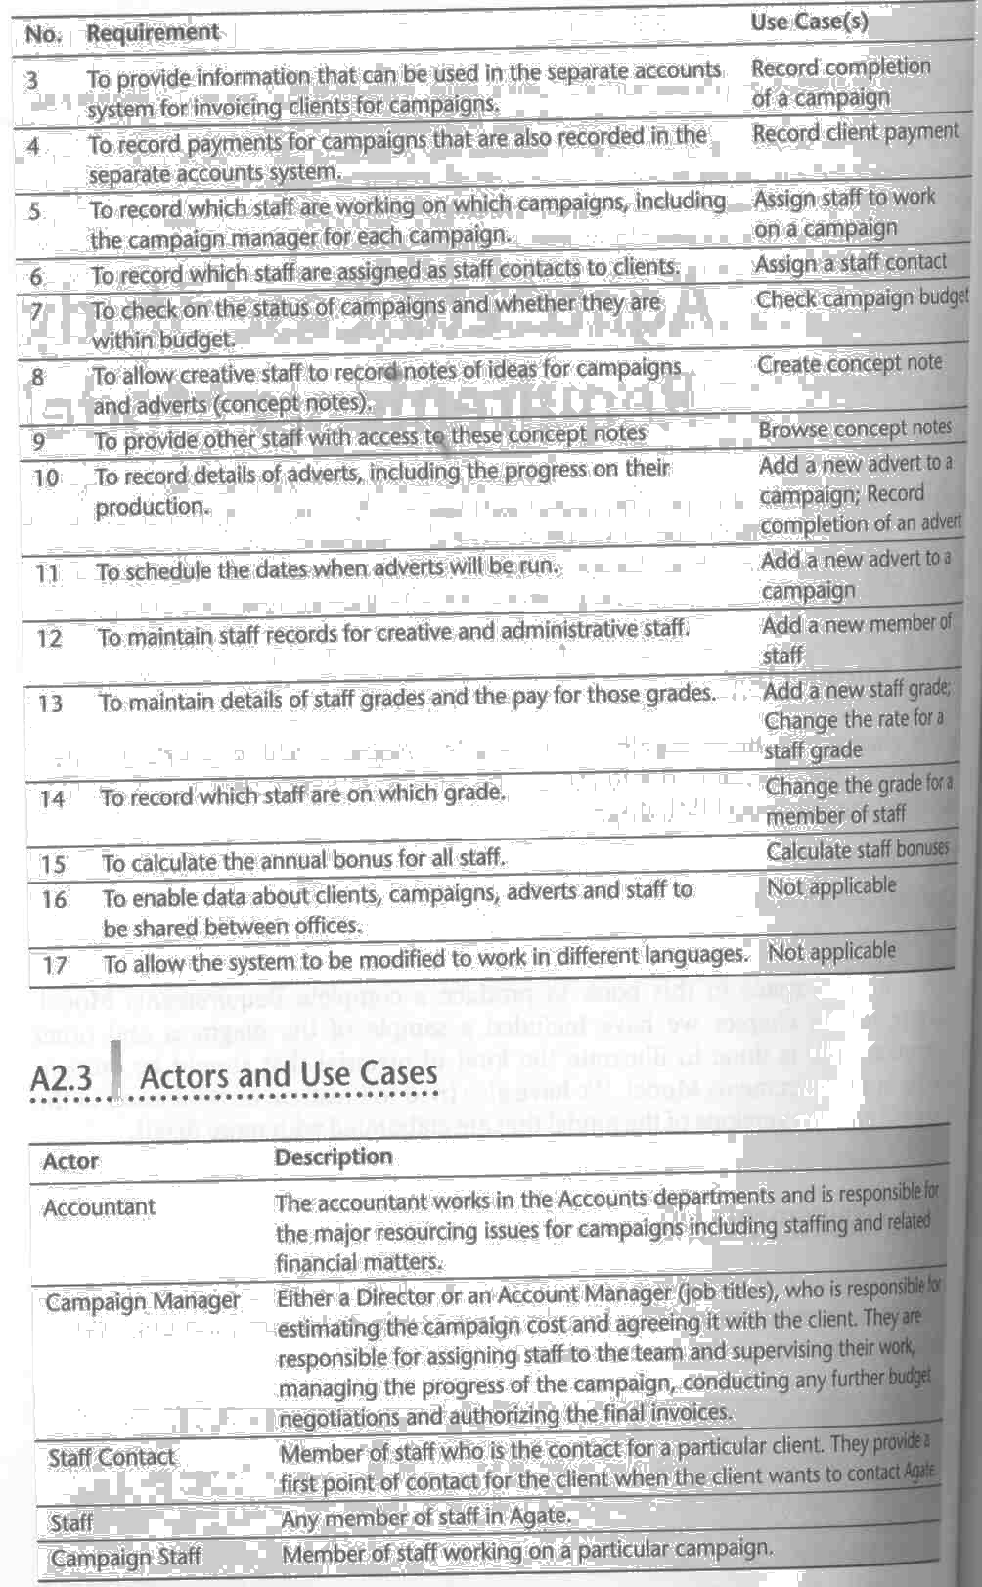
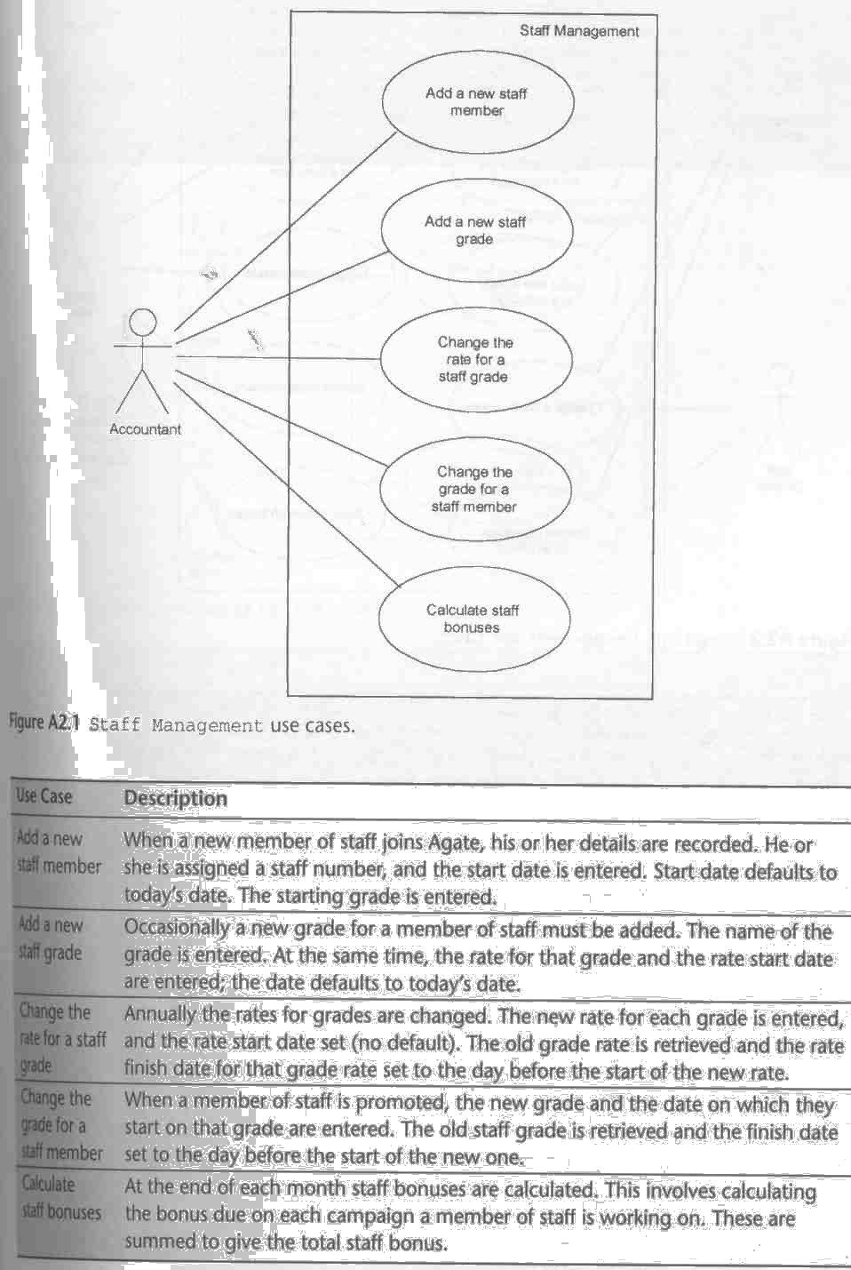
Use case for Staff Manage-ment (cont’)

Slide 10
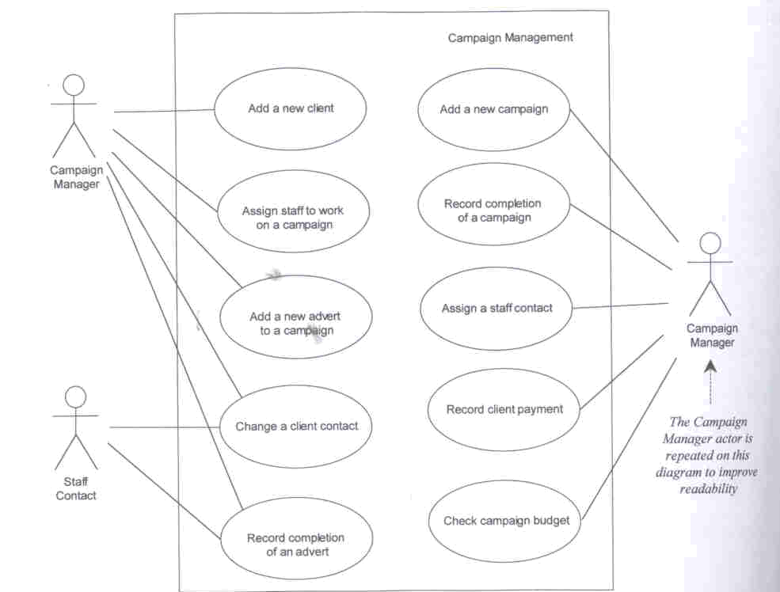
Use case for Campaign Management

Slide 11
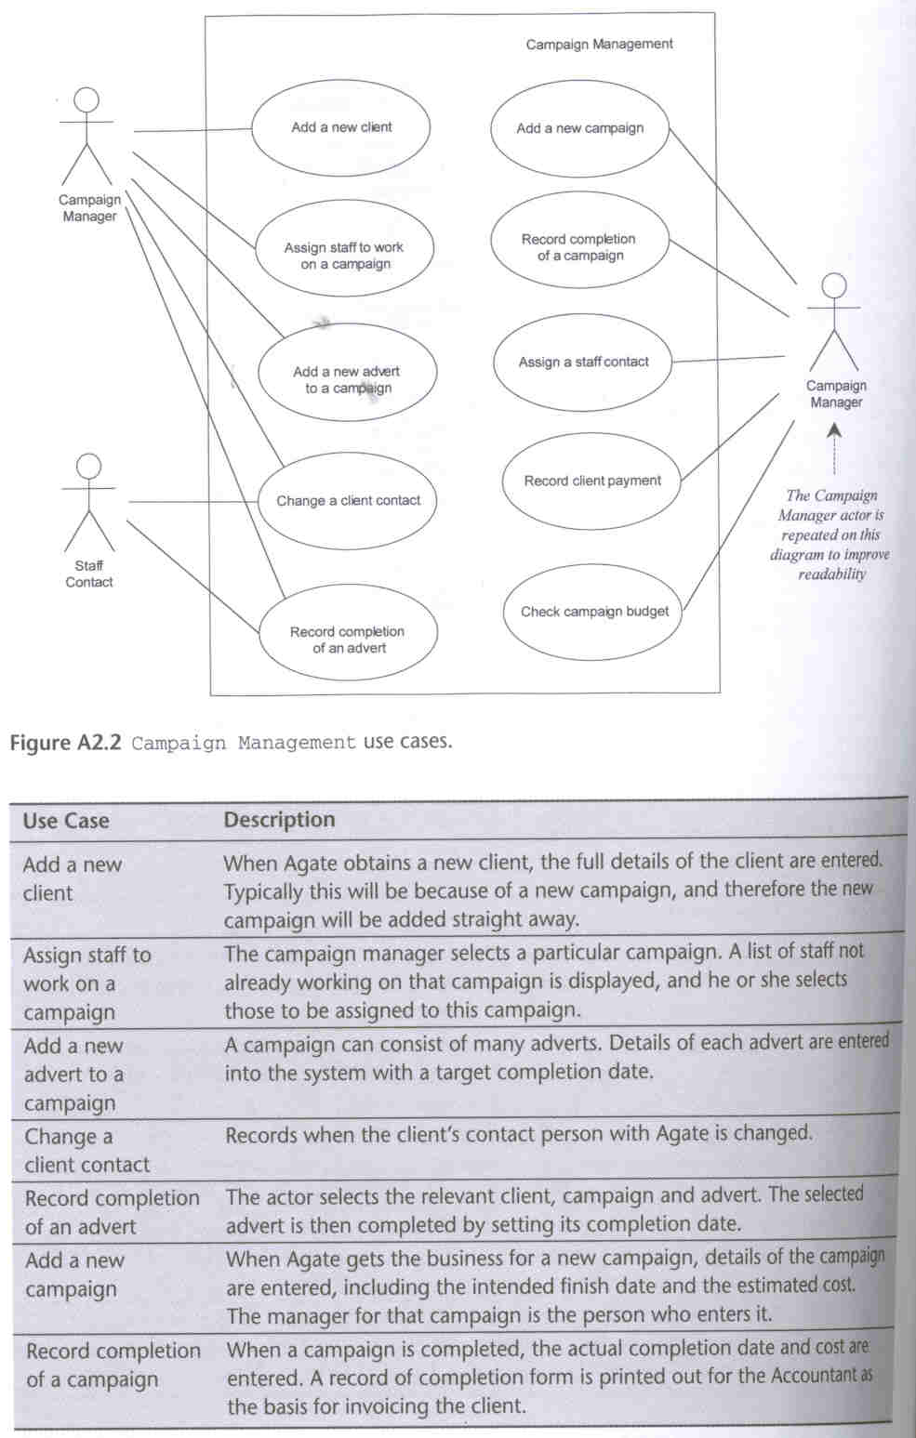
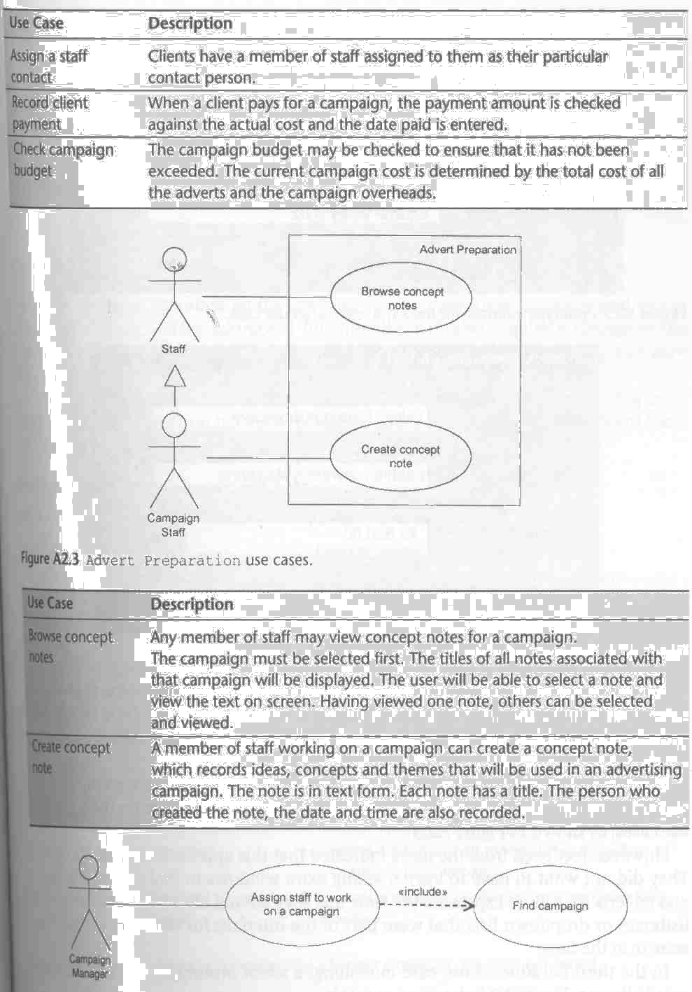
Use case for Campaign Manage-ment (cont’)

Slide 12
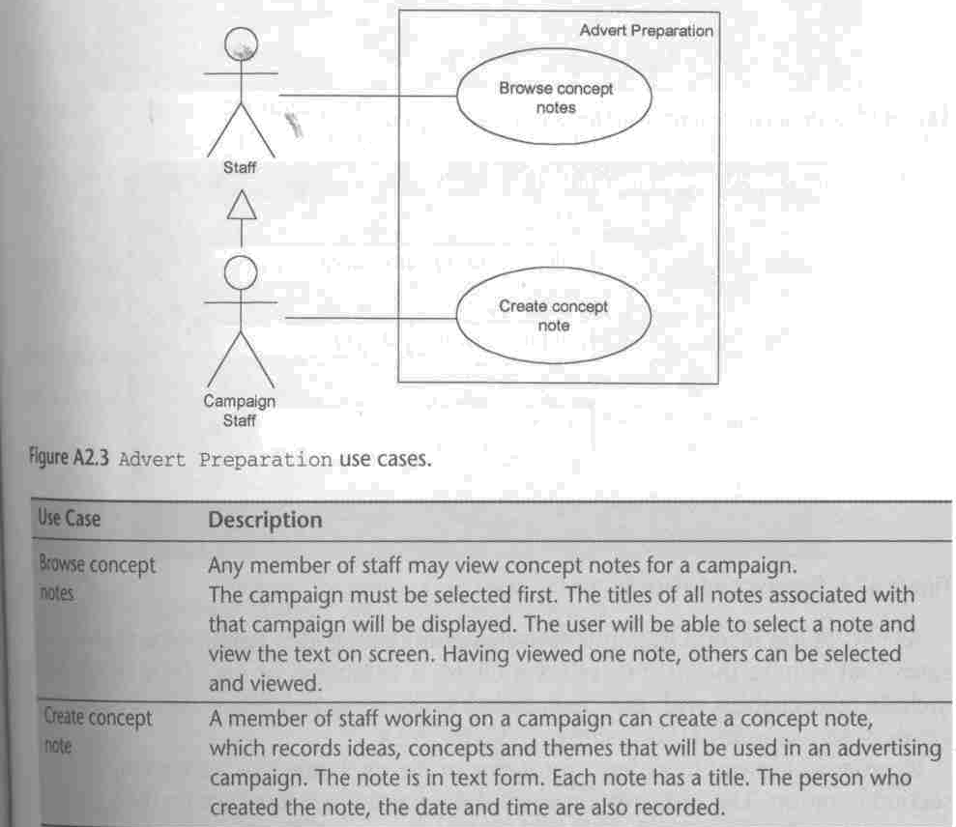
Use case for Advert Preparation

Slide 13
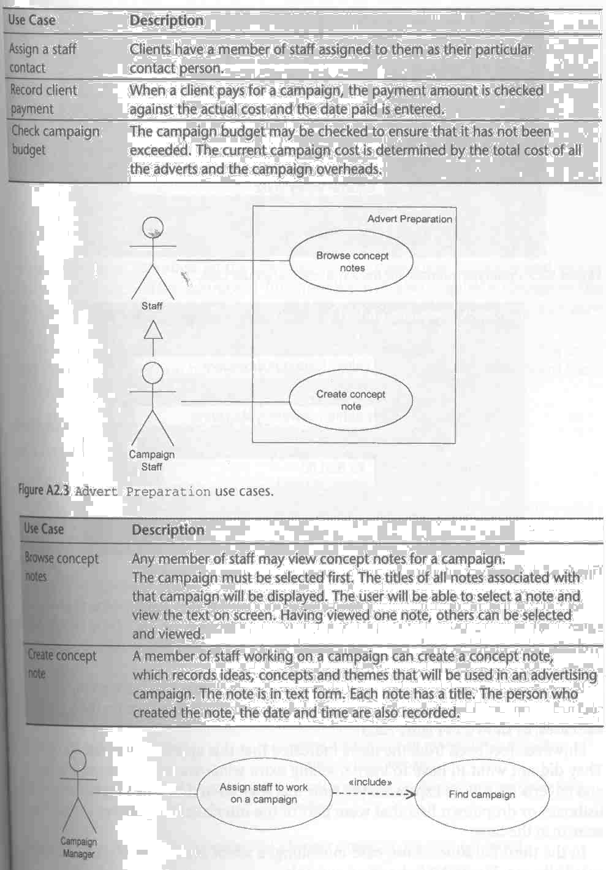
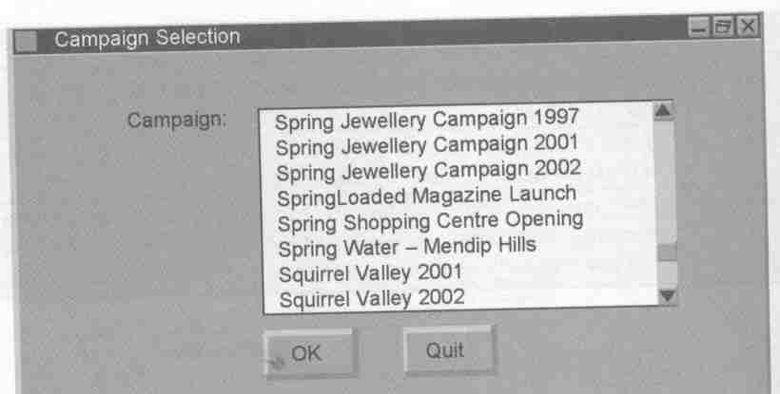
Incursion & Prototype interface for Find campaign use case

Slide 14
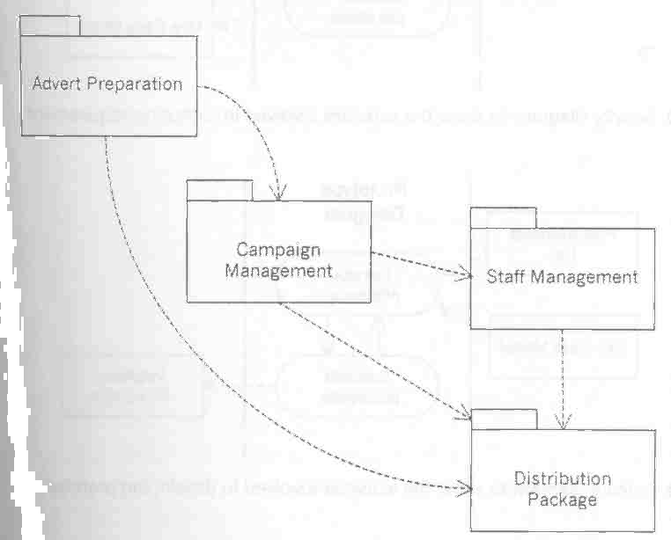
Initial Package Architecture

Slide 15
Initial Package Architecture (cont’)
Use cases have been grouped into 3 sub-system packages: Campaign Management, Staff Management, and Advert Preparation.
Distribution Package is necessary to meet Requirement # 16

Slide 16
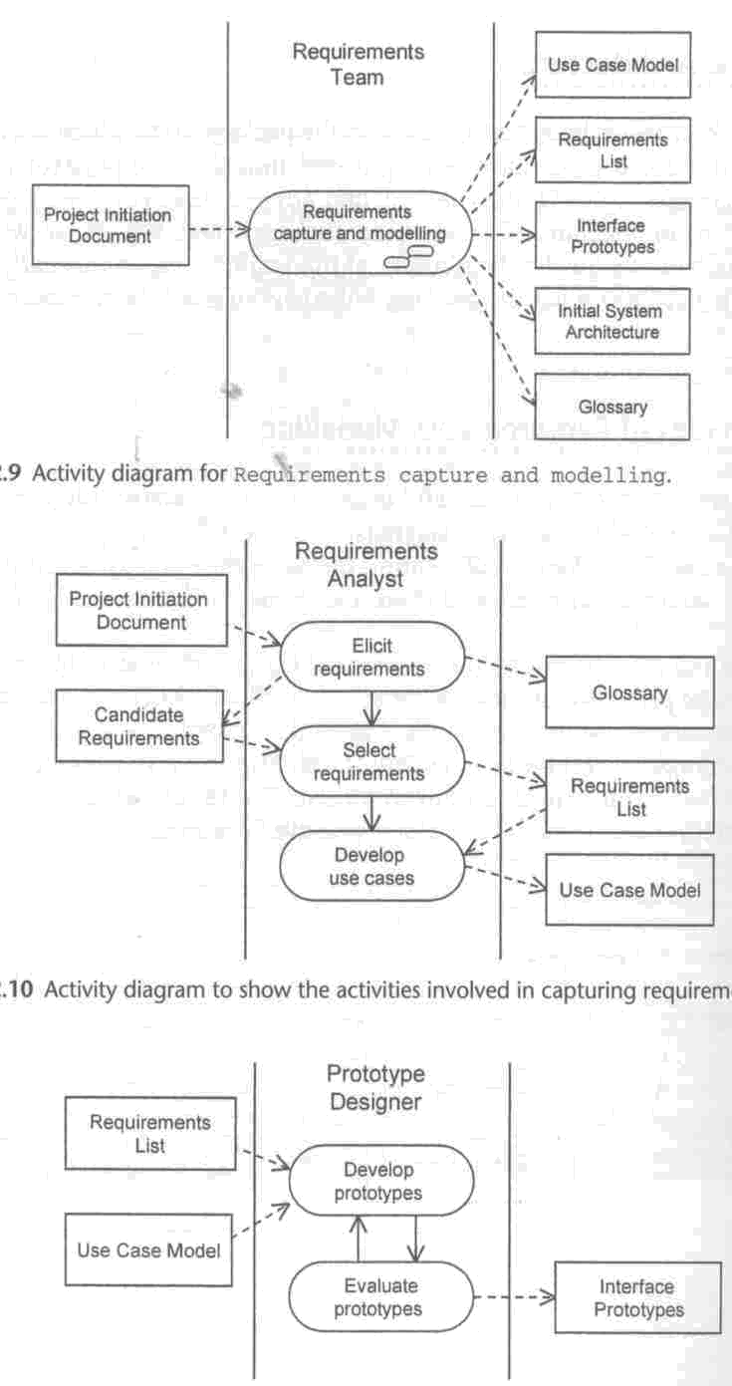
Activity diagram for Requirements capture and modeling

Slide 17
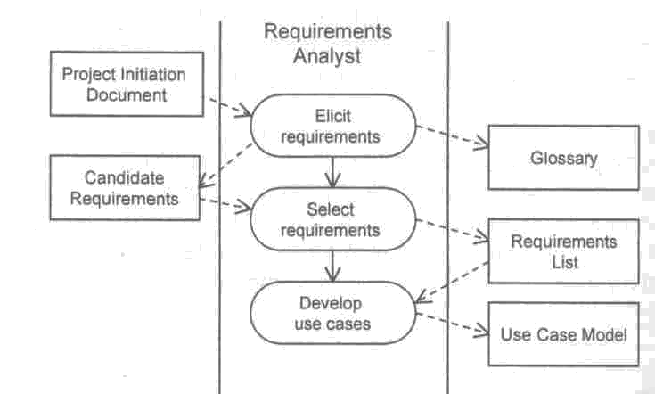
Activity diagram for Capturing requirements

Slide 18
Activity diagram for
Developing prototype

Slide 19
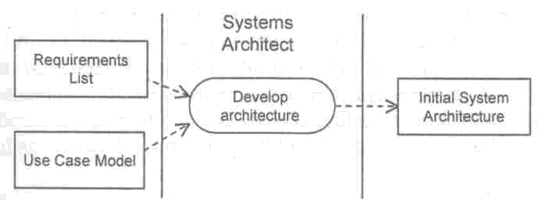
Activity diagram for Developing
an initial architecture

Slide 20
A3:
AGATE Ltd Case Study:
Requirements Analysis

Slide 21
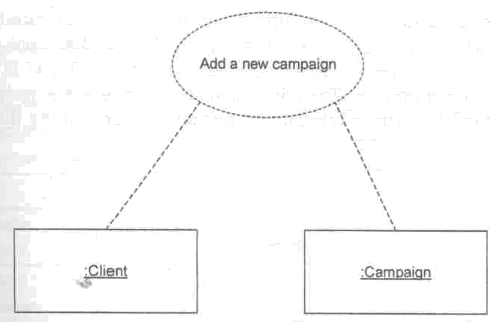
Use case collaboration:
Add a new campaign

Slide 22
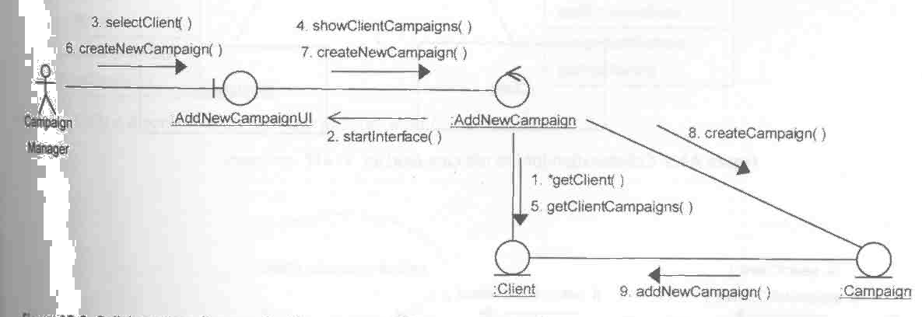
Collaboration diagram for
Add a new campaign

Slide 23
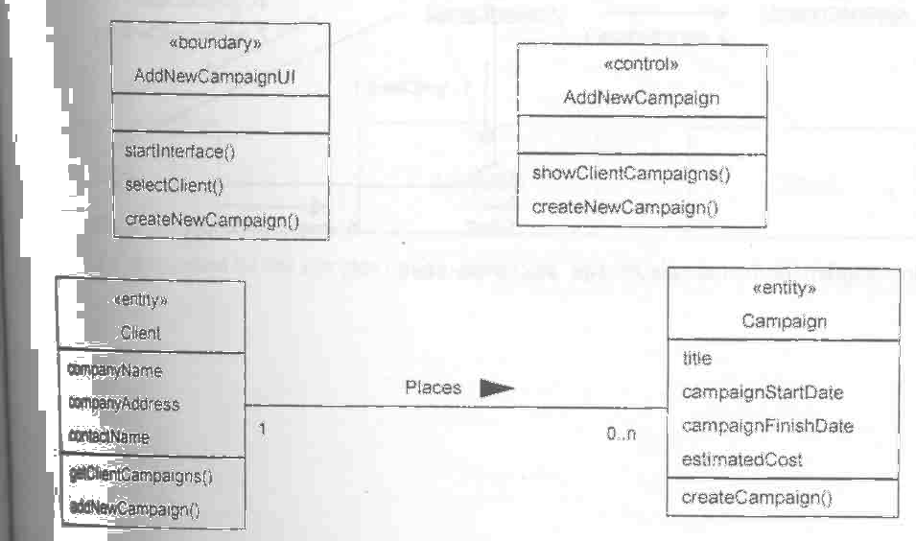
Class diagram for
Add a new campaign

Slide 24
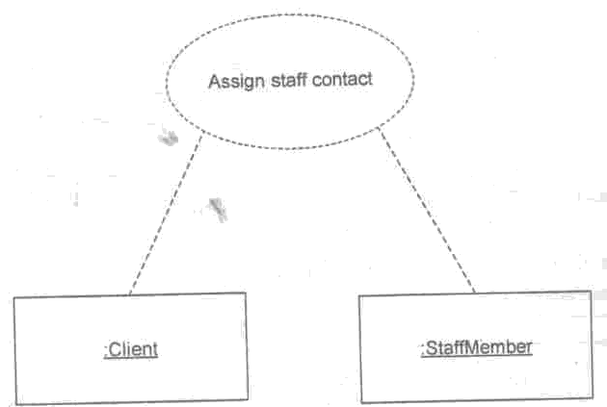
Use case collaboration:
Assign staff contact

Slide 25
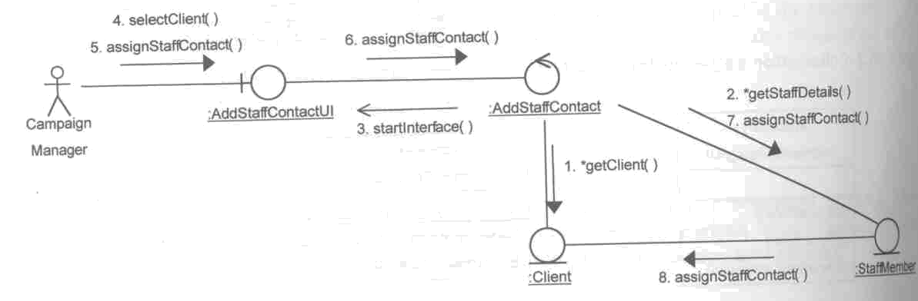
Collaboration diagram for
Assign staff contact

Slide 26
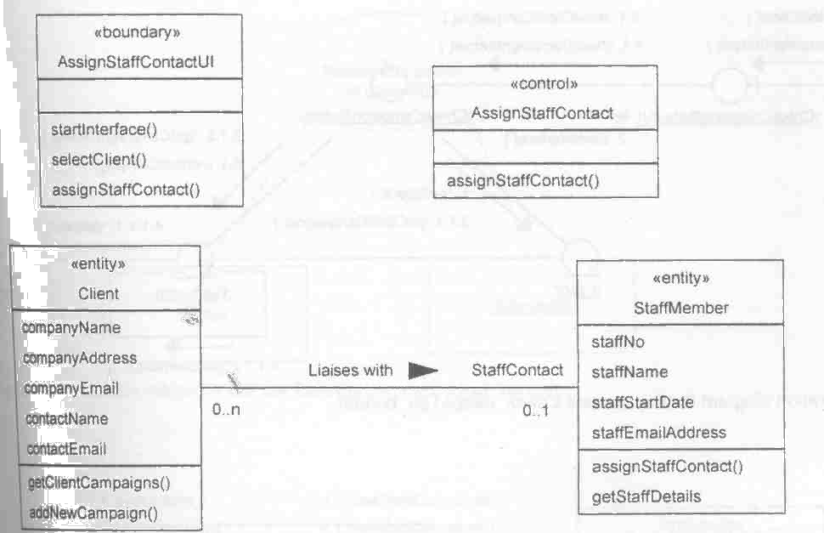
Class diagram for
Assign staff contact

Slide 27

Use case collaboration:
Check campaign budget

Slide 28
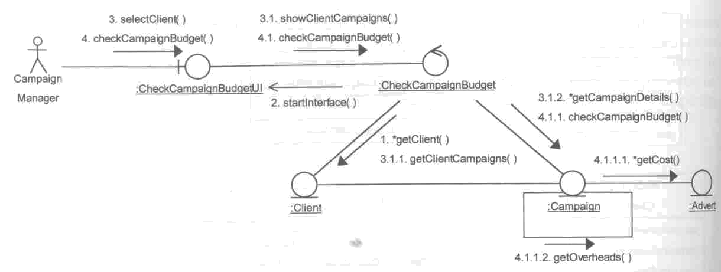
Collaboration diagram for
Check campaign budget

Slide 29
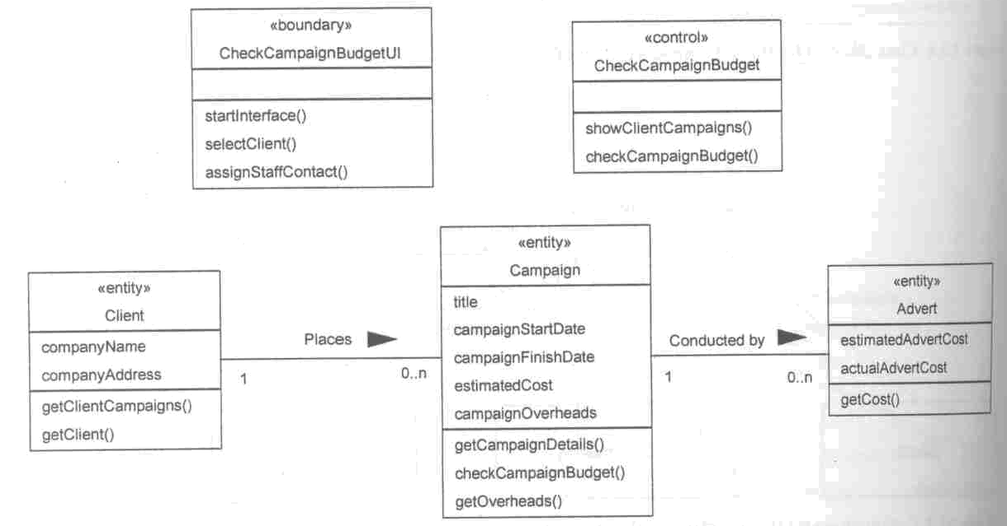
Class diagram for
Check campaign budget

Slide 30
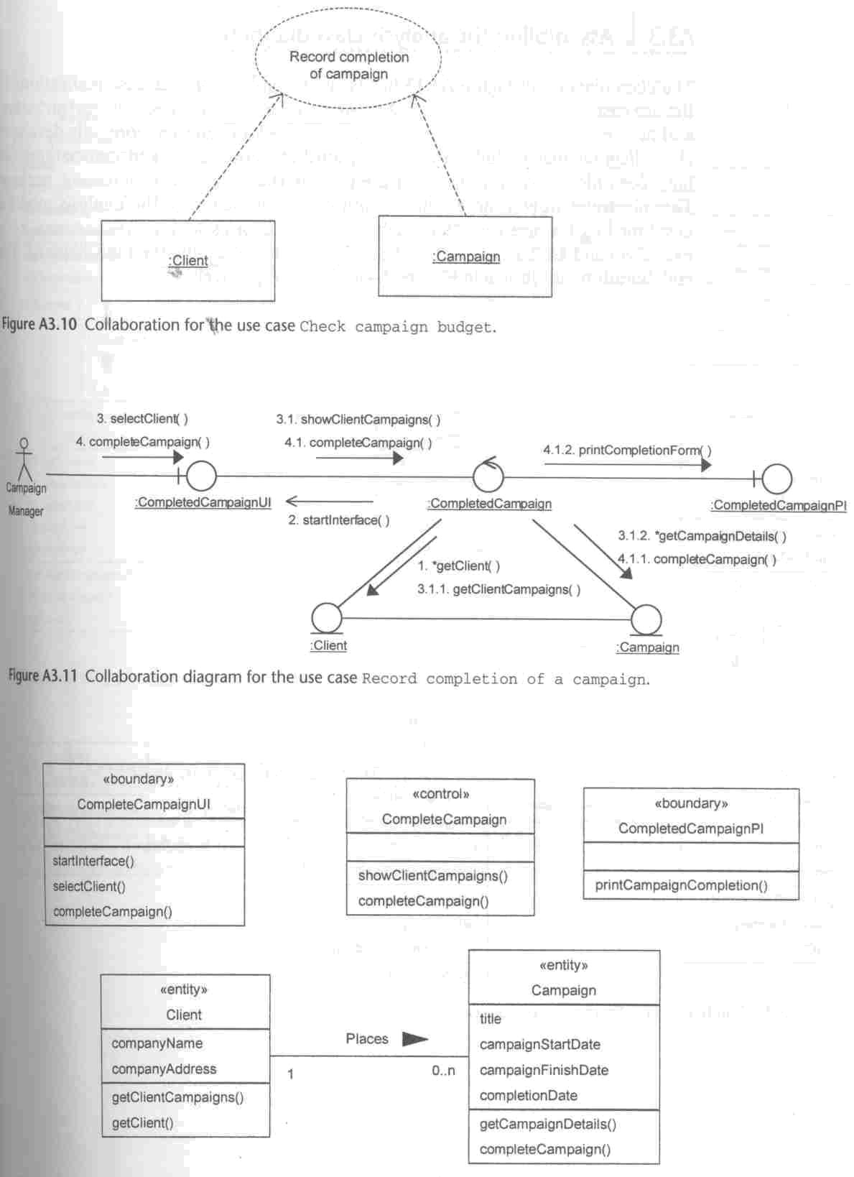
Use case collaboration:
Record completion of campaign

Slide 31
Collaboration diagram for
Record completion of campaign

Slide 32
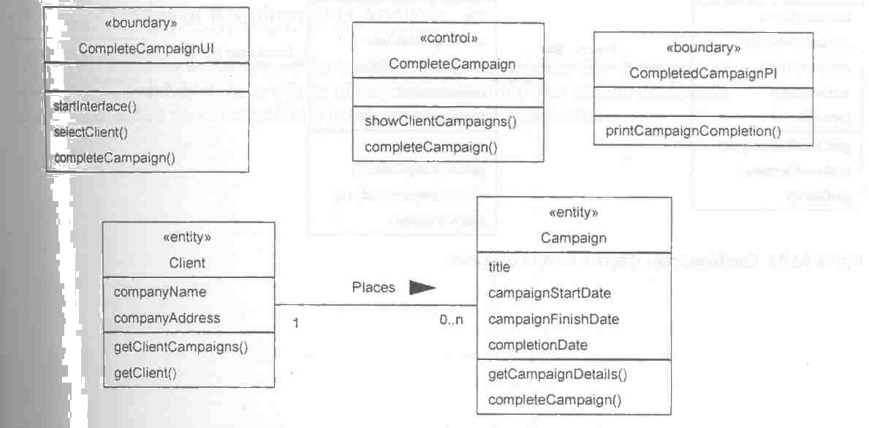
Class diagram for
Record completion of campaign

Slide 33
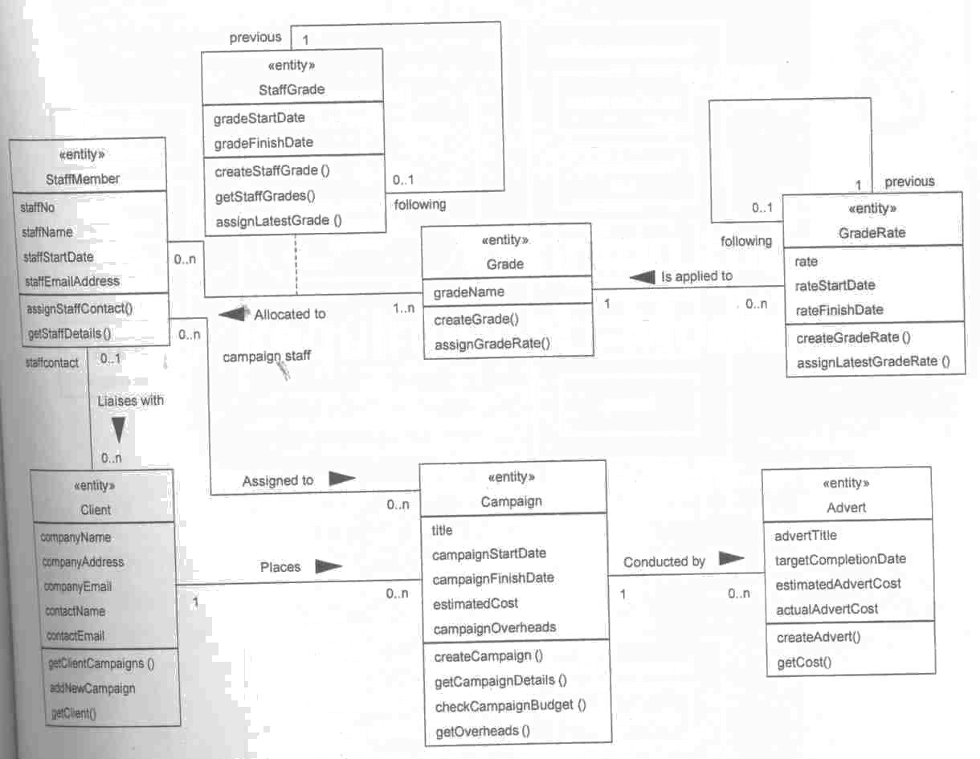
Class diagram after further requirement analysis

Slide 34
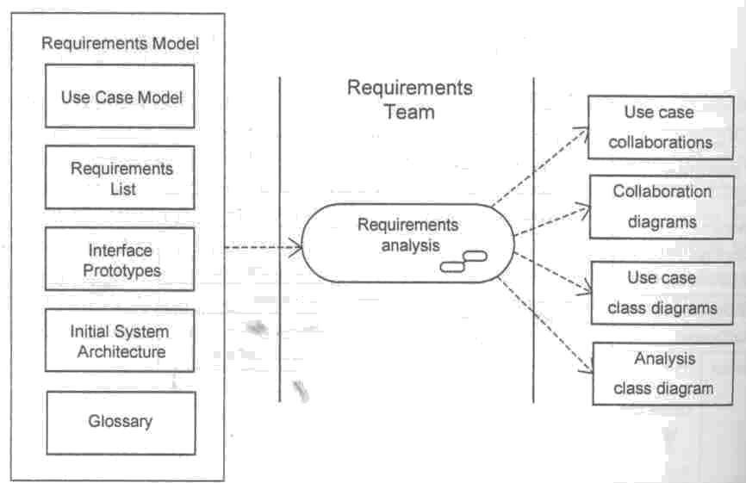
Activity diagram for
Requirement analysis

Slide 35
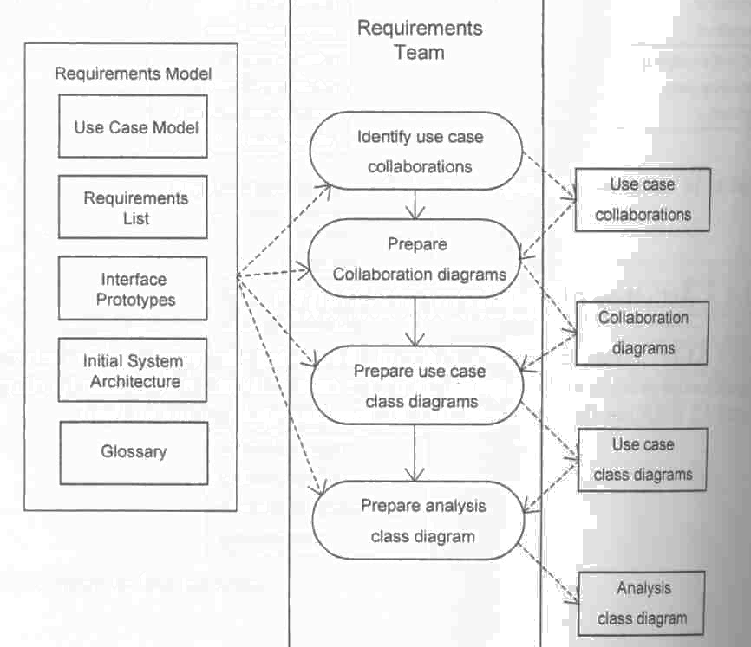
Activity diagram for
Analysis use case realization

Slide 36
A4:
AGATE Ltd Case Study:
Requirements Model (Cont.)

Slide 37
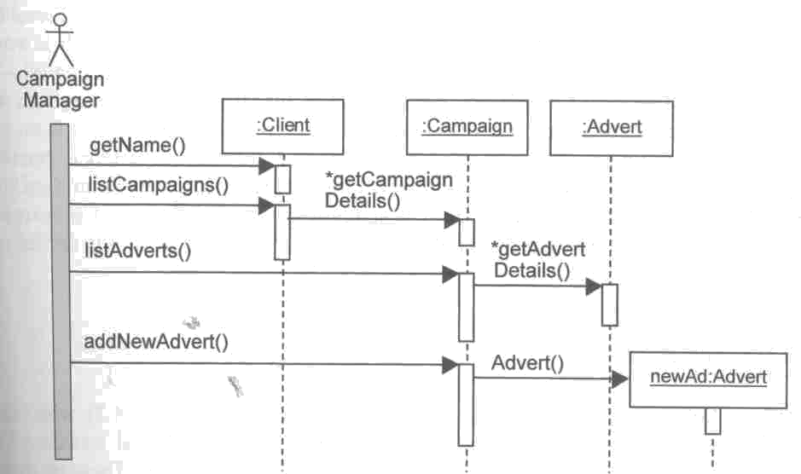
Sequence diagram for
Add a new advert to a campaign

Slide 38
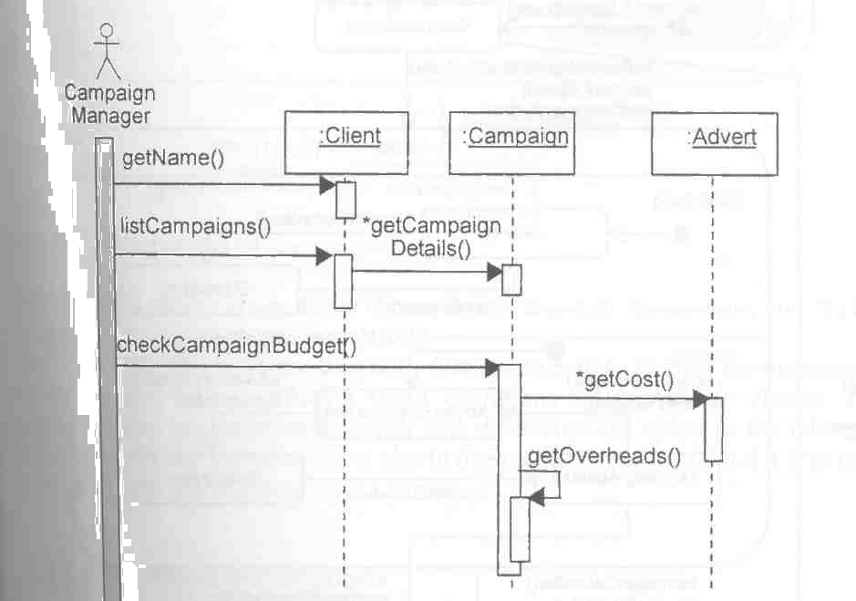
Sequence diagram for
Check campaign budget

Slide 39
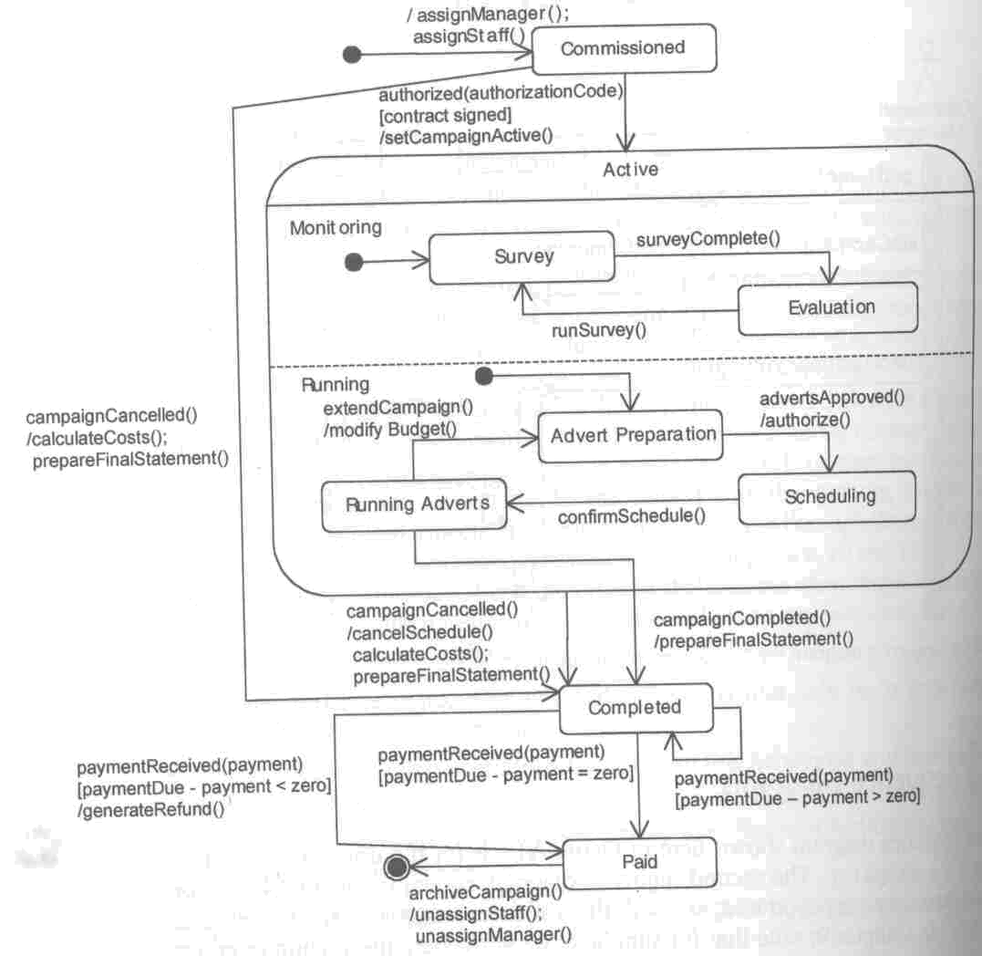
State-chart for Cam-paign

Slide 40
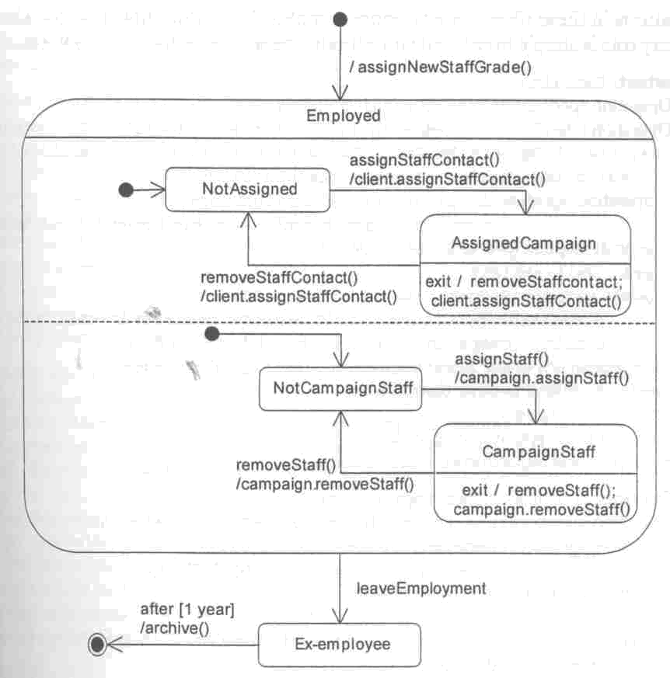
State-chart for Staff
Member

Slide 41
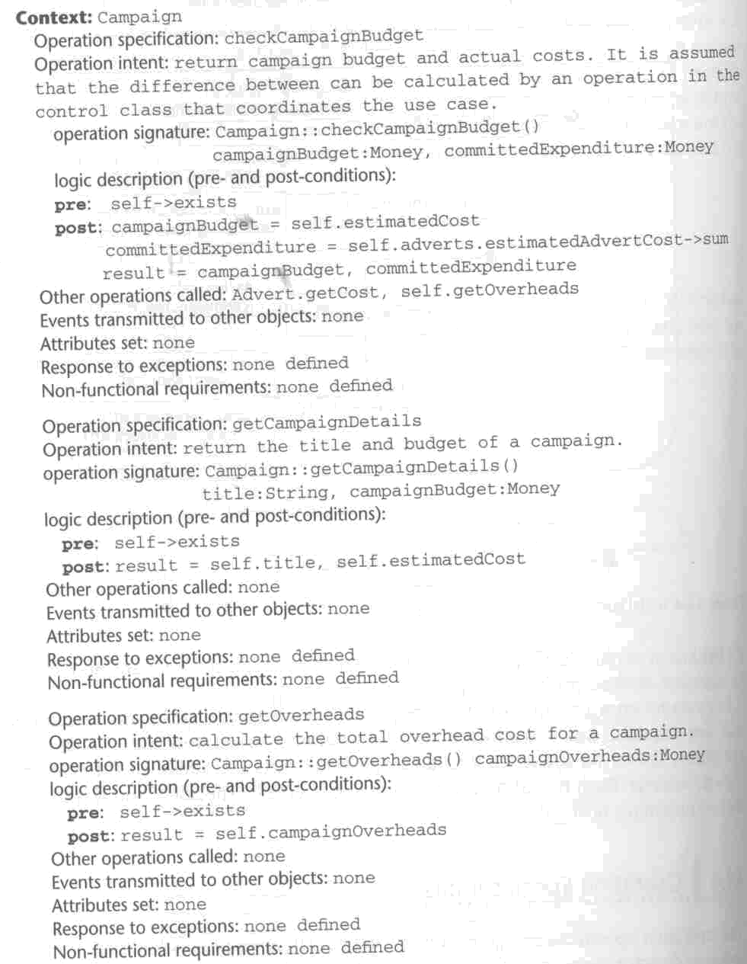
Operational specification for Campaign

Slide 42

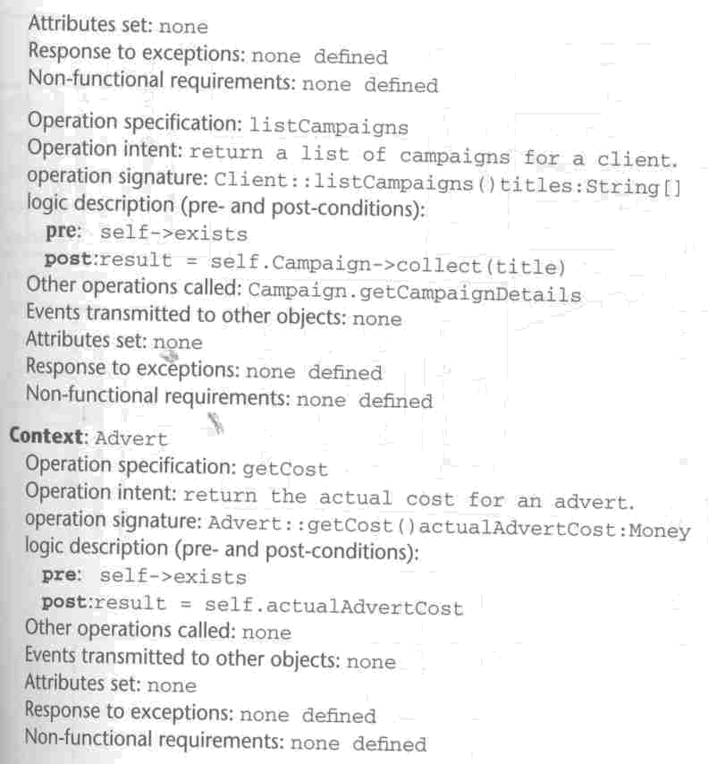
Operational specification for Client & Advert

Slide 43
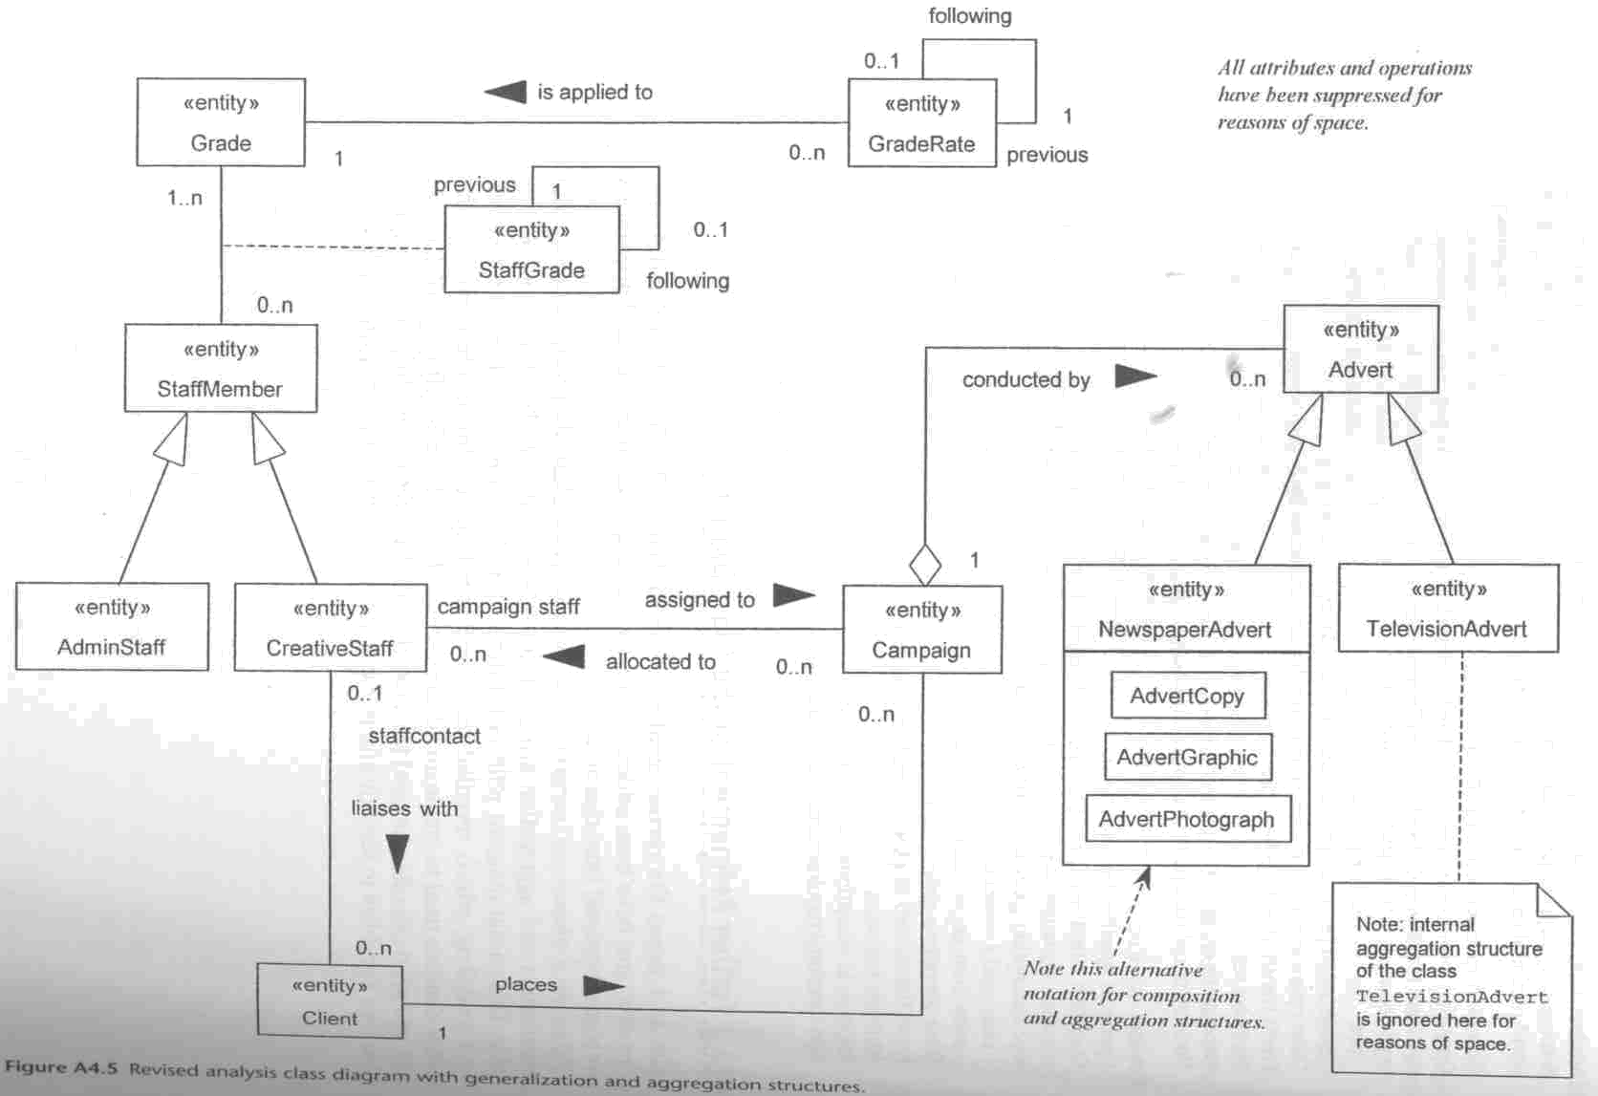
Revised analysis class diagram with generalization and aggregation

Slide 44
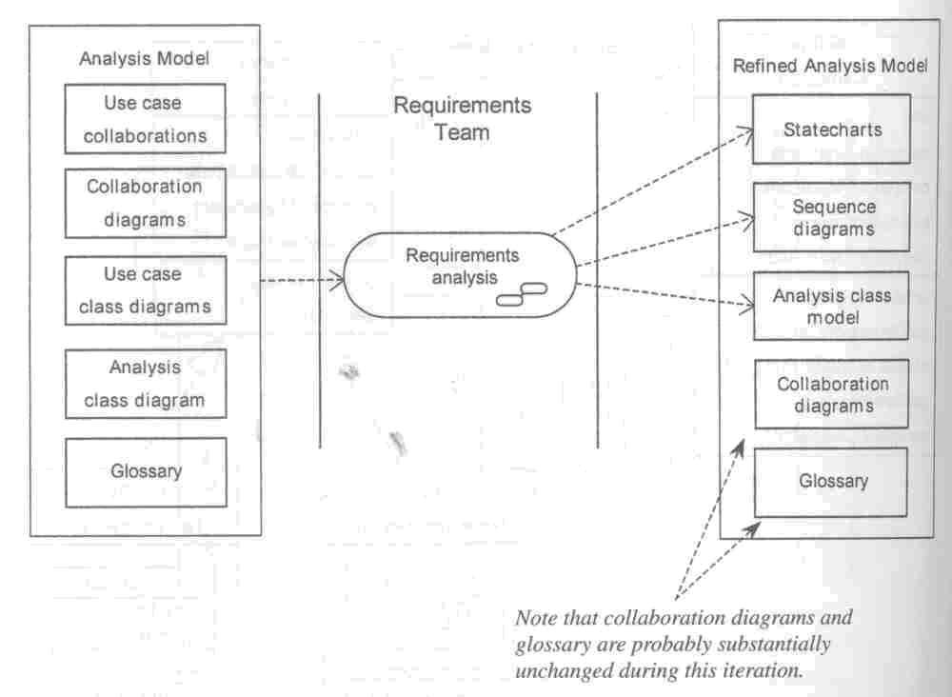
Activity diagram for
Iteration analysis

Slide 45
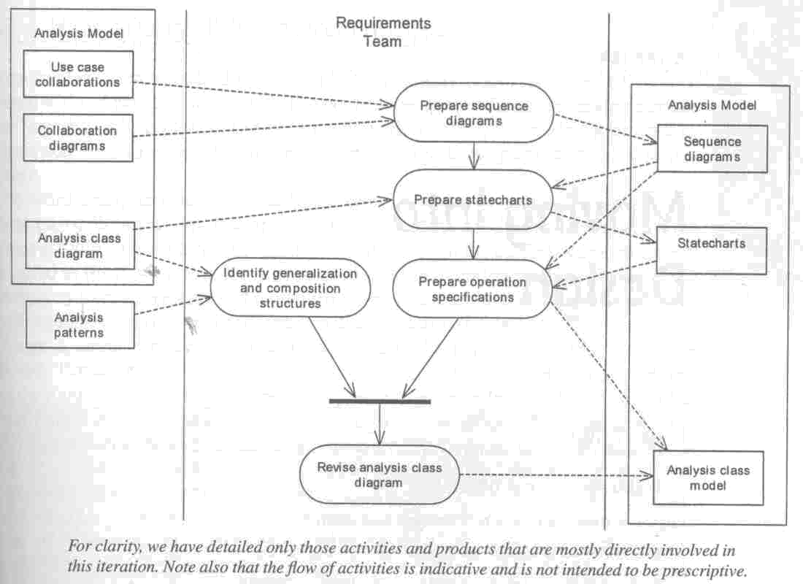
Activity diagram for
Iteration analysis (cont’)

Slide 46
A5:
AGATE Ltd Case Study:
Design

Slide 47
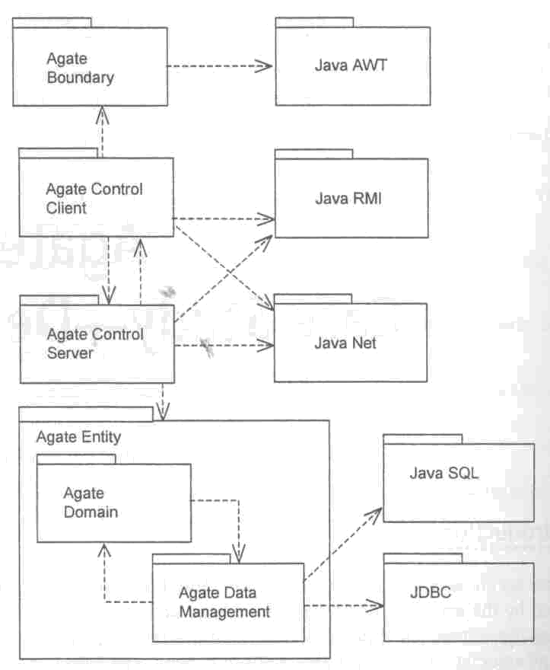
Package diagram for
Software architecture

Slide 48
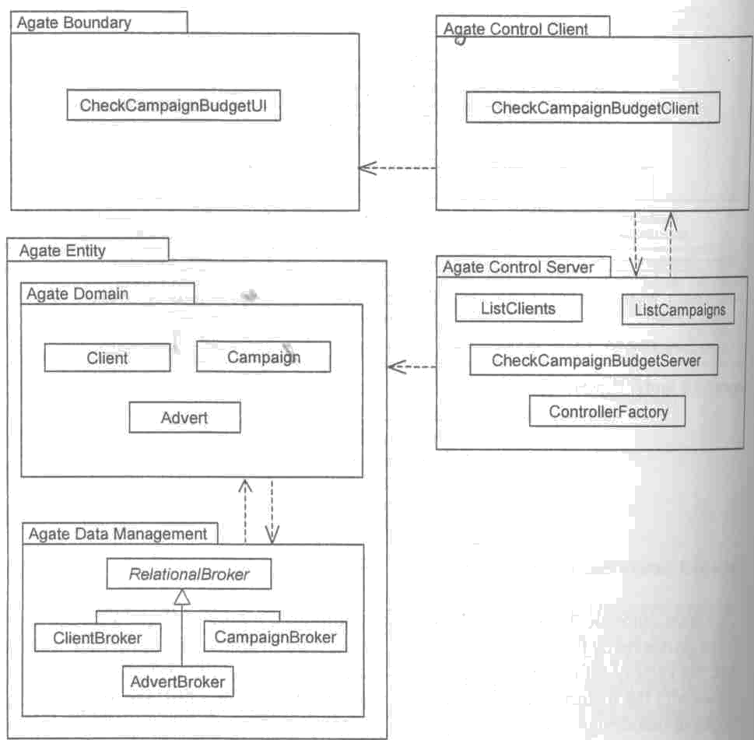
Package diagram showing classes

Slide 49
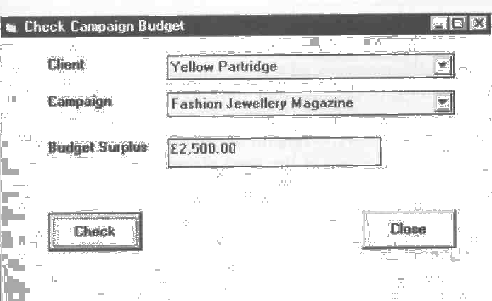
Prototype UI for
Check campaign budget

Slide 50
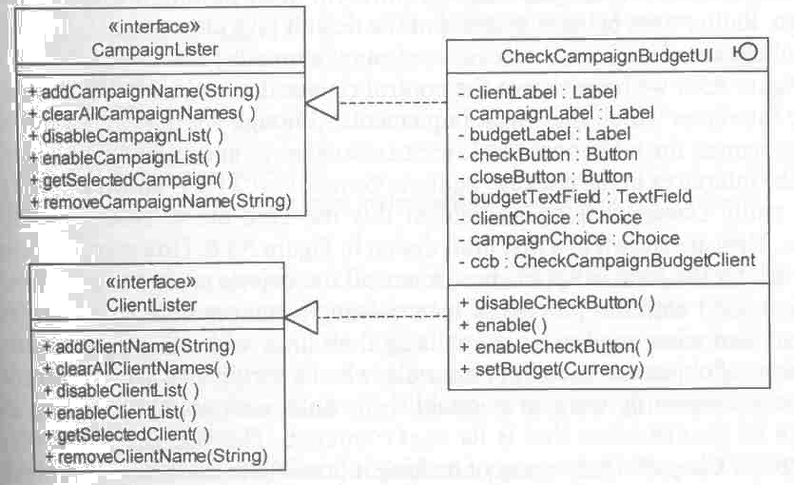
Classes in package
Agate::Boundary

Slide 51
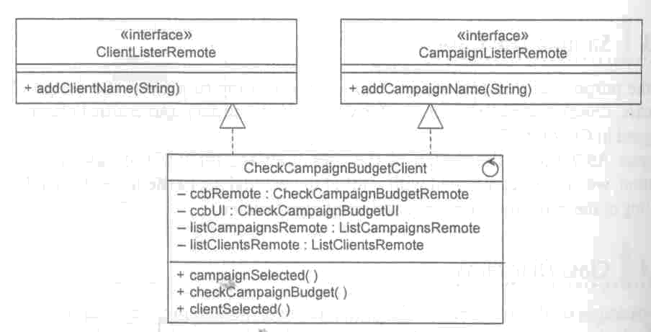
Classes in package
Agate::Control::Client::CheckCampaignBudget

Slide 52
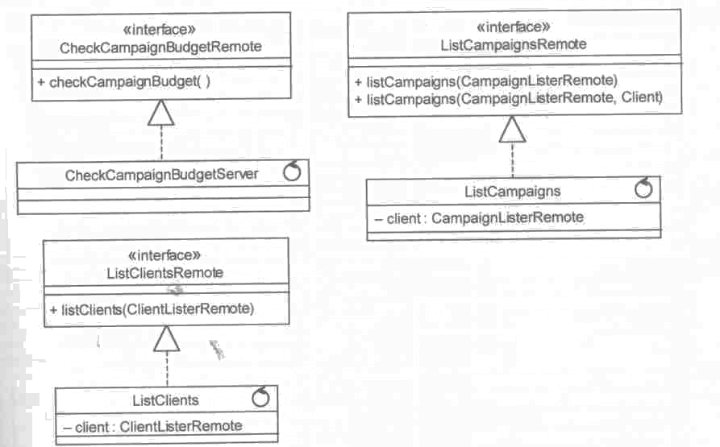
Classes in package
Agate::Control::Server

Slide 53
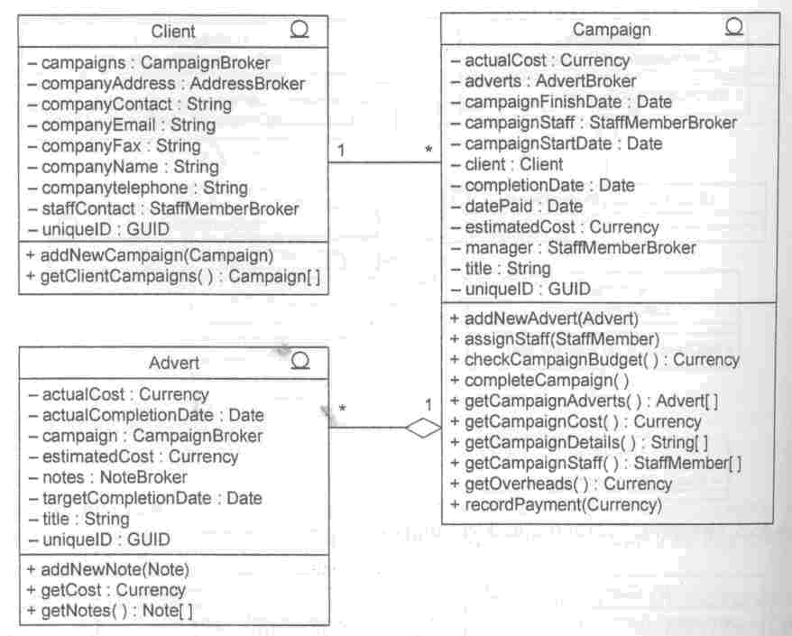
Classes in package
Agate::Entity::Domain

Slide 54
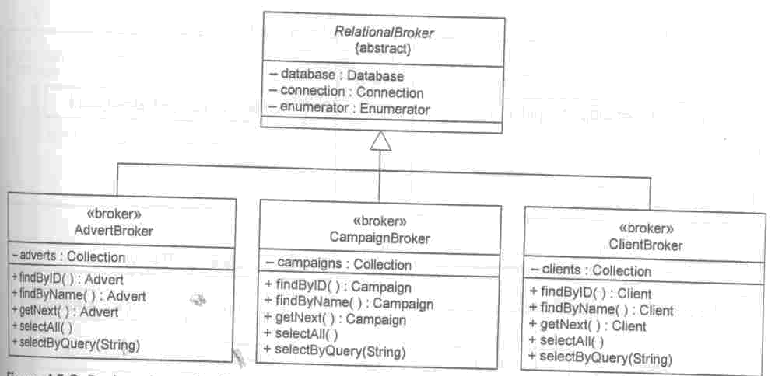
Broker classes in package
Agate::Entity::DataManagement

Slide 55
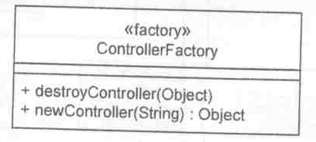
Factory class in package
Agate::Control::Server

Slide 56
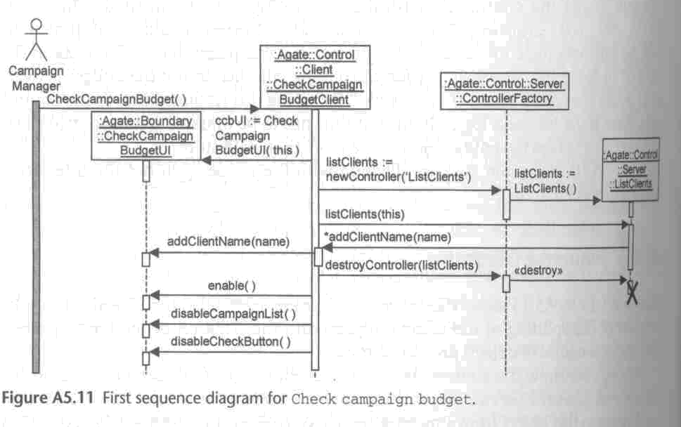
Sequence diagram for
Check campaign budget

Slide 57
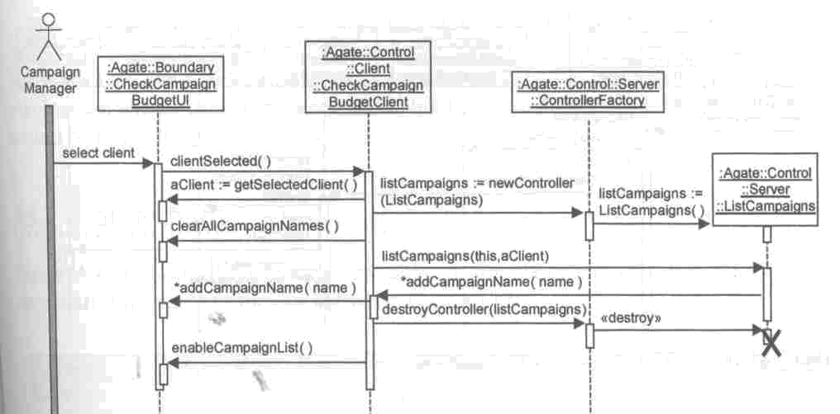
Sequence diagram for
Check campaign budget (cont’)

Slide 58
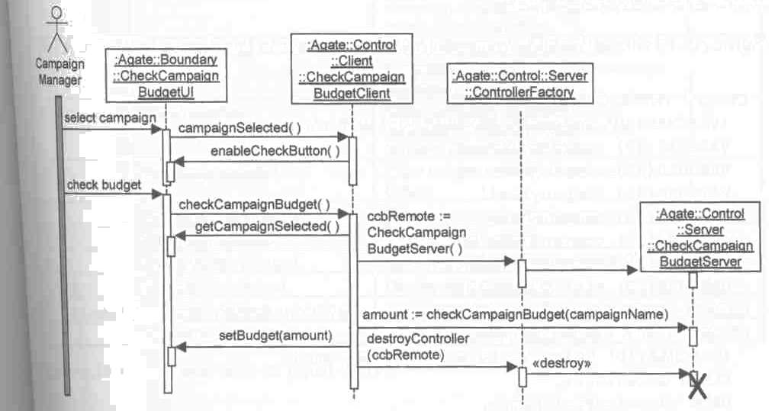
Sequence diagram for
Check campaign budget (cont’)

Slide 59
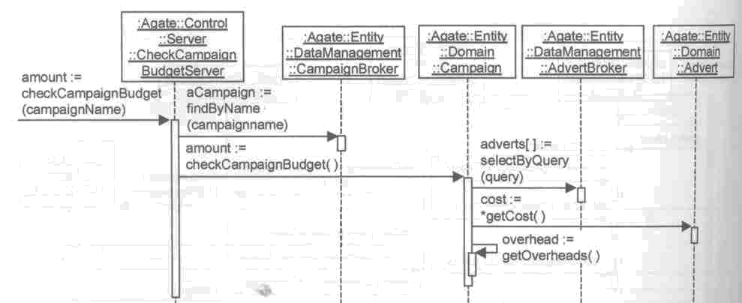
Sequence diagram for
Check campaign budget (cont’)

Slide 60

Statechart for control of UI in Check campaign budget

Slide 61

Event-action for Statechart for control of UI in Check campaign budget

Slide 62

Activity diagram for
Design workflow

Slide 63

Activity diagram for
Design workflow (cont’)

