Slide 1


CENTRE OF
EXCELLENCE (COE) JAVA PLATFORM
Dr.Y.Madhulika, Assoc. Professor
CONFIDENTIAL 1

Slide 2

AGENDA
1
2
3
4
5
Understanding the execution of java program
What is JVM?
What is JRE?
What is JDK?
Difference between JDK, JRE and JVM

Slide 3
Understanding the execution of java program
We write the Java source code in Simple.Java file using an editor or IDE (integrated development environment) e.g. Eclipse or IntelliJ Idea.
Program has to be compiled into byte code. Java compiler (javac) compiles the source code to Simple.class file.
This class file can be executed in any platform/OS by JVM (Java virtual machine).
JVM translates byte code into native machine code which machines can execute.

Slide 4
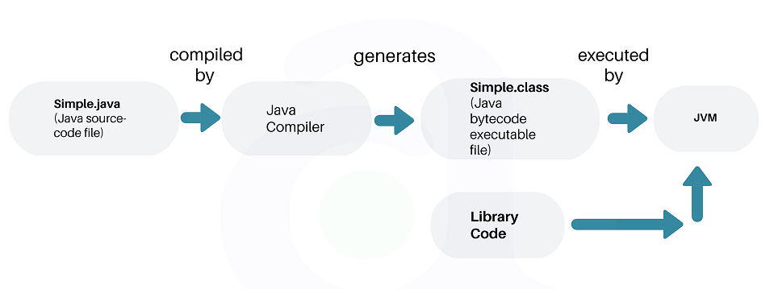
Java Execution

Slide 5
What is JVM?
Java Virtual machine (JVM) is the virtual machine that runs the Java byte codes. You get this byte code by compiling the .java files into .class files. .class files contain the byte codes understood by the JVM.
In the real world, JVM is a specification that provides a runtime environment in which Java byte code can be executed.

Slide 6
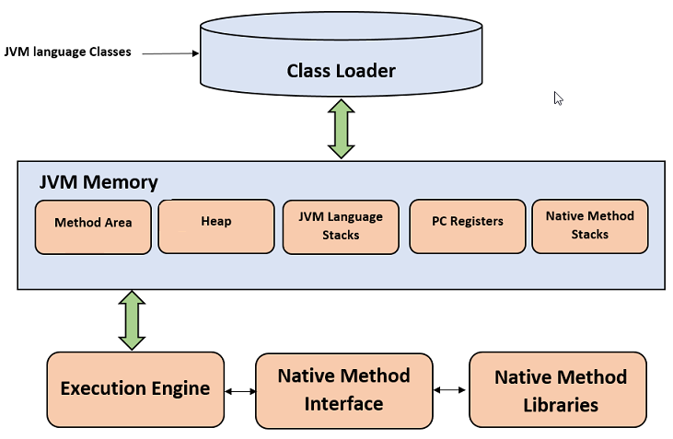
JVM Architecture

Slide 7
JVM Architecture Continued…
Class Loader
The class loader is a subsystem used for loading class files. It performs three primary functions, i.e. class loading, linking, and initialization.
Loading
To load classes, JVM has 3 kind of class loaders. Bootstrap, extension and application class loader.
When loading a class file, JVM finds out a dependency for some arbitrary class XYZ.class.
First bootstrap class loader tries to find the class. It scans the rt.jar file in JRE lib folder.
If class is not found then extension class loader searches the class file in inside jre\lib\ext folder.
Again if class is not found then application classloader searches all the Jar files and classes in CLASSPATH environment variable of system.
If class is found by any loader then class is loaded by class loader; else ClassNotFoundException is thrown.

Slide 8
JVM Architecture Continued…
Linking
After class is loaded by the classloader, linking is performed. A bytecode verifier will verify whether the generated bytecode is proper or not. If verification fails we will get a verification error. It also performs the memory allocation to static variables and methods found in the class.
Initialization
This is the final phase of class loading, here all static variable will be assigned with the original values, and the static blocks will be executed.

Slide 9
JVM Architecture Continued…
JVM Memory Areas
The memory area inside JVM is divided into multiple parts to store specific pieces of application data.
Method Area stores class structures like metadata, the constant runtime pool, and the code for methods.
Heap stores all objects that are created during application execution.
Stacks store local variables, and intermediate results. All such variables are local to the thread by which they are created. Each thread has its own JVM stack, created simultaneously as the thread is created. So all such local variable are called thread-local variables.
PC register store the physical memory address of the statements which is currently executing. In Java, each thread has its separate PC register.
Java supports and uses native code as well. Many low level code is written in languages like C and C++. Native method stacks hold the instruction of native code.

Slide 10
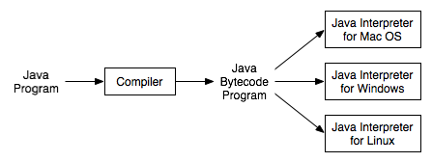
JVM Execution Engine
All code assigned to JVM is executed by an execution engine. The execution engine reads the byte code and executes one by one. It uses two inbuilt interpreter and JIT compiler to convert the bytecode to machine code and execute it.

Slide 11
Interpreter
A JVM interpreter pretty much converts each byte-code instruction to corresponding native instruction by looking up a predefined JVM-instruction to machine instruction mapping. It directly executes the byte code and does not perform any optimization.
JIT Compiler
To improve performance, JIT compilers interact with the JVM at runtime and compile appropriate byteco de sequences into native machine code. Typically, the JIT compiler takes a block of code (not one statement at a time as interpreter), optimizes the code, and then translates it to optimized machine code.
The JIT compiler is enabled by default. You can disable the JIT compiler, in which case the entire Java program will be interpreted. Disabling the JIT compiler is not recommended except to diagnose or workaround JIT compilation problems.

Slide 12
What is JRE?
The Java Runtime Environment (JRE) is a software package which bundles the libraries (jars) and the Java Virtual Machine, and other components to run applications written in the Java. JVM is just a part of JRE distributions.
To execute any Java application, you need JRE installed in the machine. It’s the minimum requirement to run Java applications on any computer.
JRE bundles the following components –
DLL files used by the Java HotSpot Client Virtual Machine.
DLL files used by the Java HotSpot Server Virtual Machine.
Code libraries, property settings, and resource files used by the Java runtime environment. e.g. rt.jar and charsets.jar.
Java extension files such as localedata.jar.
Contains files used for security management. These include the security policy (java.policy) and security properties (java.security) files.
Jar files containing support classes for applets.
Contains TrueType font files for use by the platform.

Slide 13
What is JDK?
JDK is a superset of JRE. JDK contains everything that JRE has along with development tools for developing, debugging, and monitoring Java applications. You need JDK when you need to develop Java applications.
Few important components shipped with JDKs are as follows:
appletviewer – this tool can be used to run and debug Java applets without a web browser
apt – the annotation-processing tool
extcheck – a utility that detects JAR file conflicts
javadoc – the documentation generator, which automatically generates documentation from source code comments
jar – the archiver, which packages related class libraries into a single JAR file. This tool also helps manage JAR files
jarsigner – the jar signing and verification tool
javap – the class file disassembler

Slide 14
javaws – the Java Web Start launcher for JNLP applications
JConsole – Java Monitoring and Management Console
jhat – Java Heap Analysis Tool
jrunscript – Java command-line script shell
jstack – utility that prints Java stack traces of Java threads
keytool – tool for manipulating the keystore
policytool – the policy creation and management tool
xjc – Part of the Java API for XML Binding (JAXB) API. It accepts an XML schema and generates Java classes

Slide 15
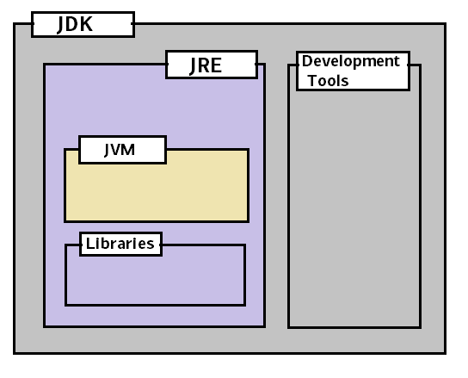
Difference between JDK, JRE and JVM
JRE = JVM + libraries to run Java application.
JDK = JRE + tools to develop Java Application.

