Slide 1

Cyclistic Bike-Share Analysis
Presented by: NAWFEL BOUTABIA

Slide 2

Introduction
Overview of Cyclistic and the business problem:
Cyclistic is a bike-share program that aims to increase the number of annual members. The goal of this analysis is to understand how casual riders and annual members use Cyclistic bikes differently to inform strategies for converting casual riders into annual members.

Slide 3

Data Preparation
Data sources:
Cyclitic historical trip data
Data cleaning and preparation process:
Removed duplicates
Handled missing values
Standardized date formats
Created new columns for ride length and day of the week

Slide 4
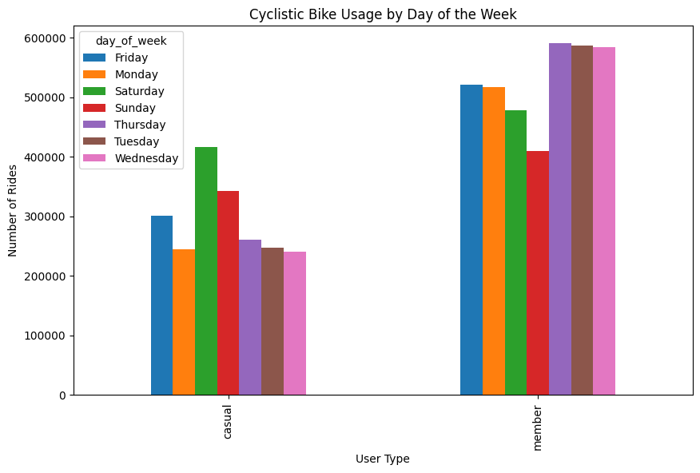
Usage Patterns by Day of the Week

Slide 5
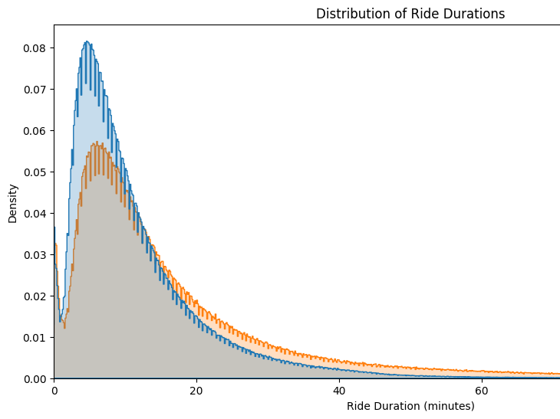
Distribution of Ride Durations

Slide 6
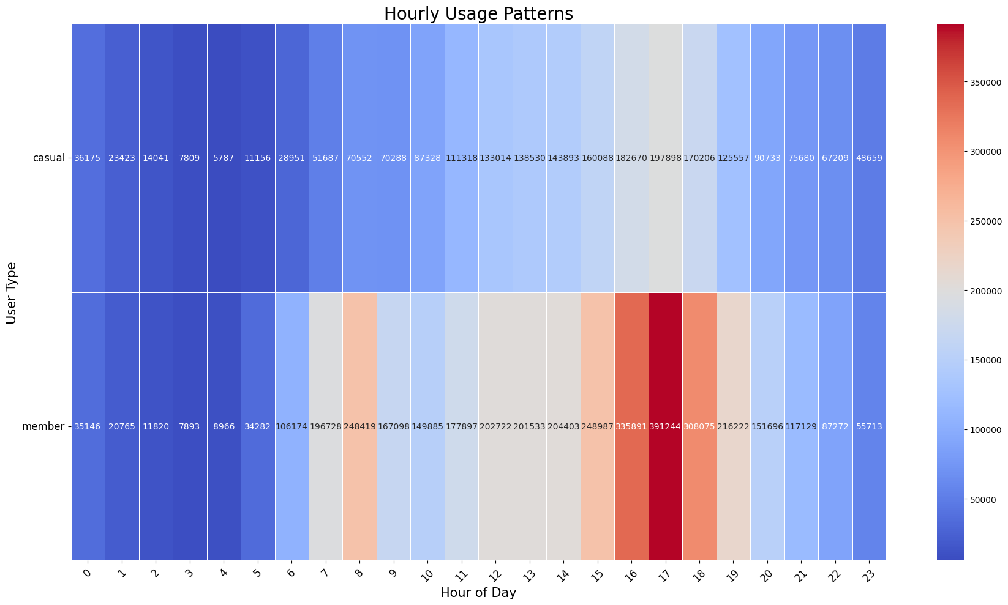
Hourly Usage Patterns

Slide 7
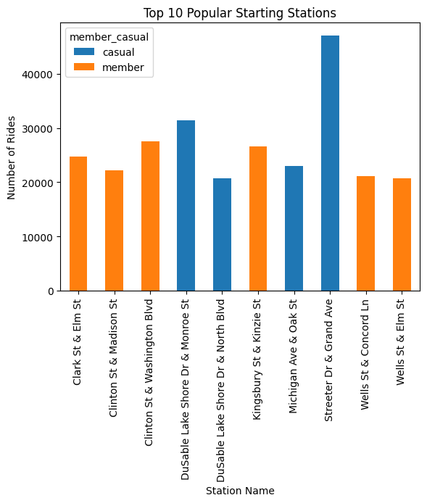
Popular Starting Stations

Slide 8
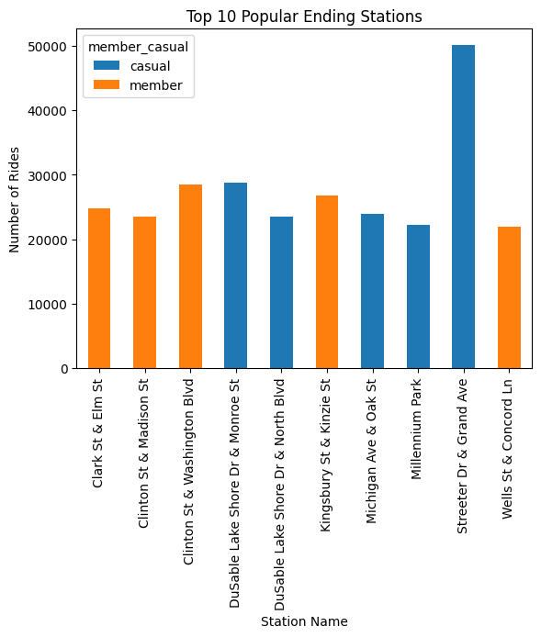
Popular Ending Stations

Slide 9
Recommendations
Based on the analysis, here are the top three recommendations:
1. Targeted Marketing Campaigns: Focus on casual riders who frequently ride on weekends and during peak hours.
2. Weekend Promotions: Introduce special promotions and discounts for annual memberships during weekends.
3. Highlight Membership Benefits: Emphasize the convenience and cost savings of annual memberships for regular users.

Slide 10
Conclusion
Summary of key findings:
- Casual riders use bikes more on weekends, while members have consistent usage throughout the week.
- Casual riders have longer ride durations compared to members.
- Members show peak usage during commute hours (morning and evening).
Next steps:
- Implement targeted marketing campaigns and promotions.
- Monitor and evaluate the effectiveness of the strategies.

Slide 11
Thank You
Thanks to all stakeholders and everyone who took the time to watch this presentation. Your support and feedback are greatly appreciated.

