Slide 1
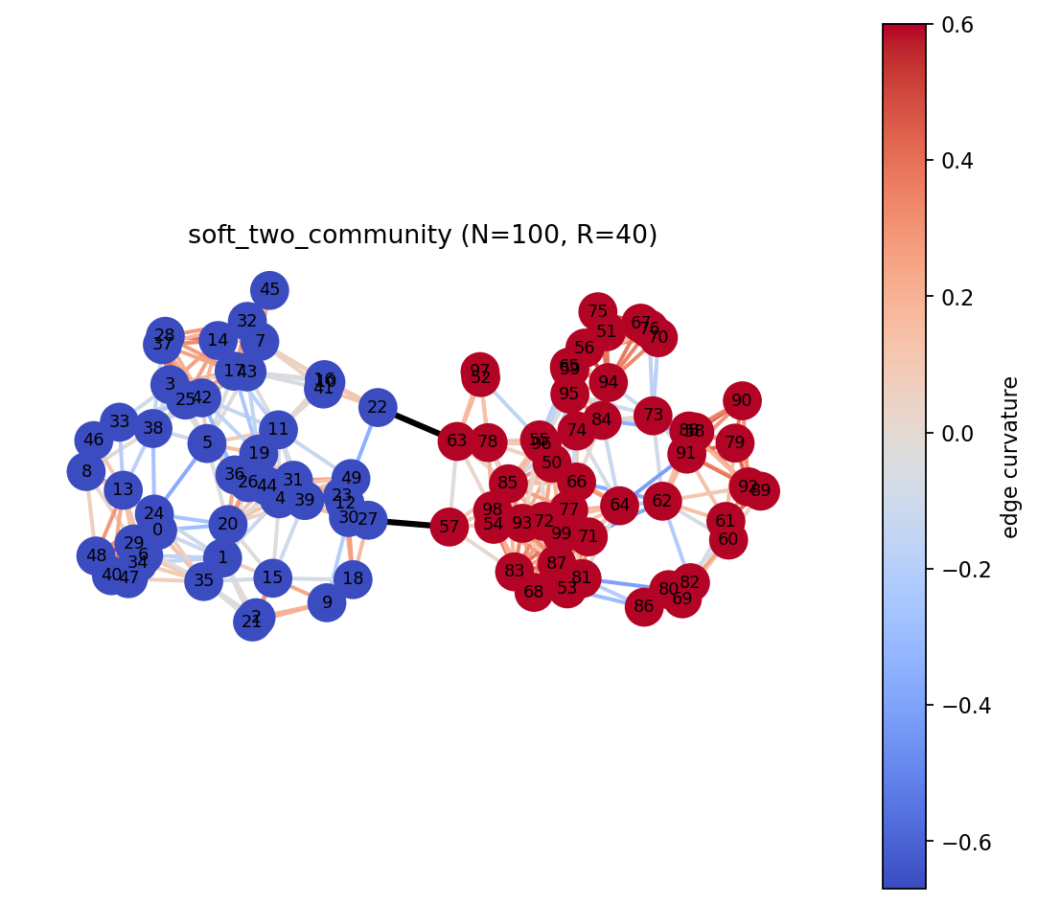
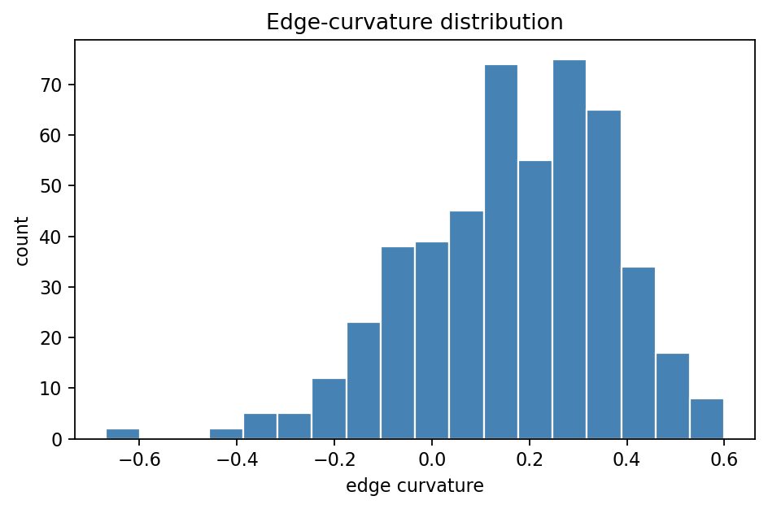
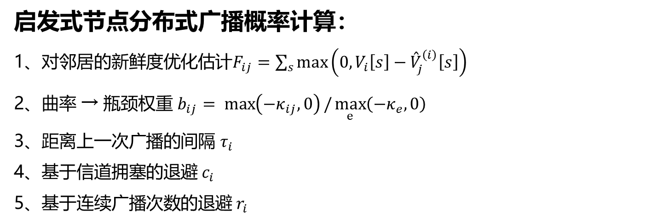
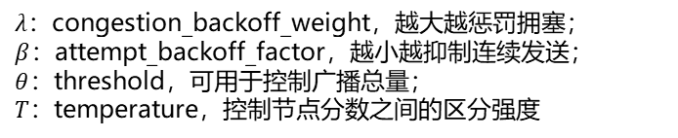

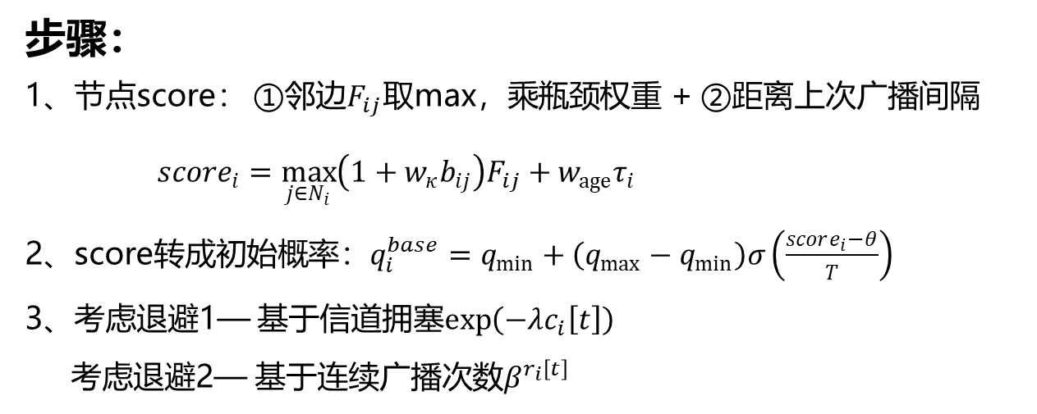
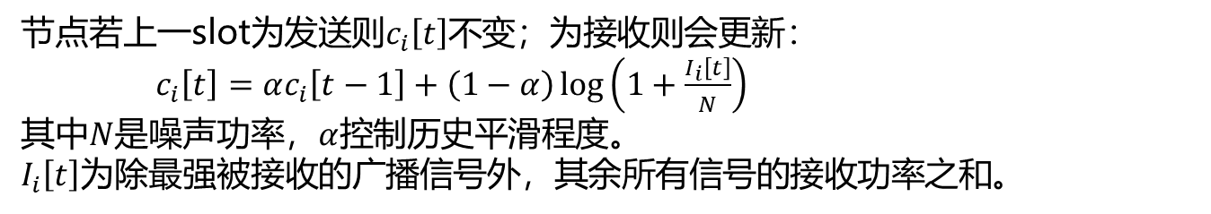
启发式节点分布式广播概率计算：
1、对邻居的新鲜度优化估计$F_{ij}=\sum_{s}{\max\left(0,V_{i}\left[s\right]−{\overset{ˆ}{V}}_{j}^{\left(i\right)}\left[s\right]\right)}$
2、曲率 → 瓶颈权重 $b_{ij}= \max\left(−κ_{ij},0\right)/\max_{e}\left(−κ_{e},0\right)$
3、距离上一次广播的间隔 $τ_{i}$
4、基于信道拥塞的退避 $c_{i}$
5、基于连续广播次数的退避 $r_{i}$
${\overset{ˆ}{V}}_{j}^{\left(i\right)}$为i节点处缓存的j节点最新版本信息
步骤：
1、节点score： ①邻边$F_{ij}$取max，乘瓶颈权重 + ②距离上次广播间隔
$score_{i}=\max_{j∈N_{i}}\left(1+w_{κ}b_{ij}\right)F_{ij}+w_{age}τ_{i}$
2、score转成初始概率：$q_{i}^{base}=q_{min}+\left(q_{max}−q_{min}\right)σ\left(\frac{score_{i}−θ}{T}\right)$
3、考虑退避1— 基于信道拥塞$\exp\left(−λc_{i}\left[t\right]\right)$
考虑退避2— 基于连续广播次数$β^{r_{i}\left[t\right]}$
$λ$：congestion_backoff_weight，越大越惩罚拥塞；
$β$：attempt_backoff_factor，越小越抑制连续发送；
$θ$：threshold，可用于控制广播总量；
$T$：temperature，控制节点分数之间的区分强度
$$q_{i}=\operatorname{clip}\left(q_{i}^{base}\exp\left(−λc_{i}\left[t\right]\right)β^{r_{i}\left[t\right]},q_{min},q_{max}\right)$$
节点若上一slot为发送则$c_{i}\left[t\right]$不变；为接收则会更新：
$c_{i}\left[t\right]=αc_{i}\left[t−1\right]+\left(1−α\right)\log\left(1+\frac{I_{i}\left[t\right]}{N}\right)$
其中$N$是噪声功率，$α$控制历史平滑程度。
$I_{i}\left[t\right]$为除最强被接收的广播信号外，其余所有信号的接收功率之和。

Slide 2
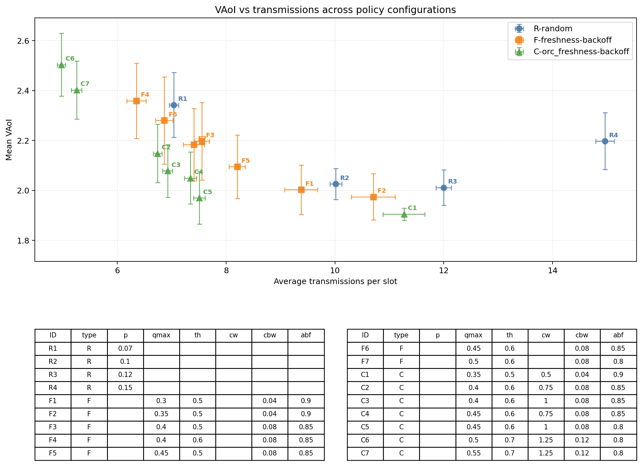
N=100；P_u=0.05
在相近的广播次数下，
orc性能最好
Notes:
curvature-gossip\scripts\plot_multi_vaoi_vs_transmissions.py

Slide 3
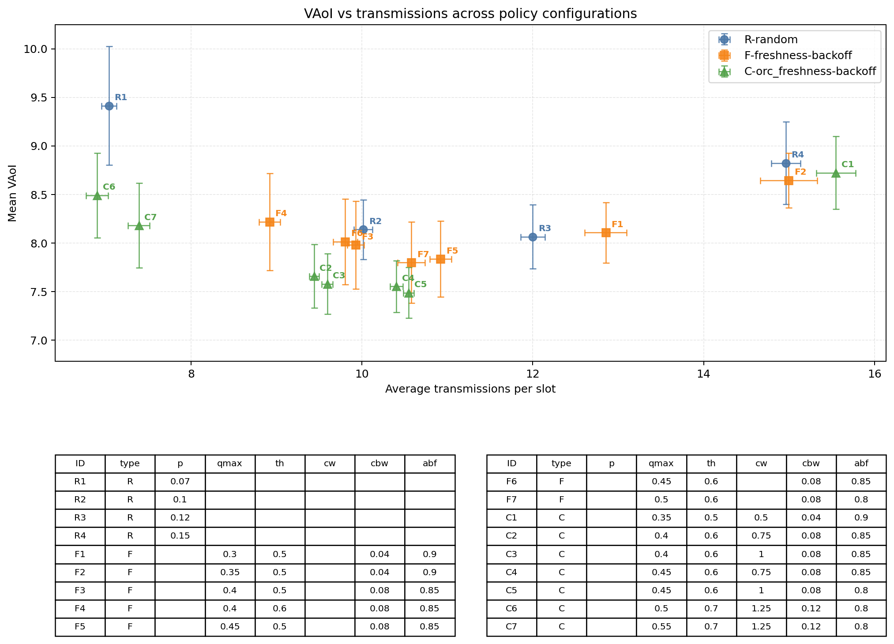
N=100；P_u=0.20

Slide 4
N | update P | q_min-max | age_ weight | threshold | temperature | congestion_ backoff_weight | attempt_ backoff_factor | curvature_weight
100 | 0.2 | 0.01- 0.45 | 0.003 | 0.6 | 0.20 | 0.08 | 0.90 | 0.75
policy | mean_VAoI | mean_max_VAoI | p95_max_VAoI | avg_tx_per_slot | successful_decodes_per_tx
freshness_backoff | 8.29842 | 29.5625 | 38.3333 | 9.76912 | 5.39075
orc_freshness_backoff | 7.73416 | 27.6758 | 35.3333 | 10.4337 | 5.20958
random | 11.0612 | 37.007 | 53.5167 | 17.953 | 3.25112
N | update P | q_min-max | age_ weight | threshold | temperature | congestion_ backoff_weight | attempt_ backoff_factor | curvature_weight
100 | 0.2 | 0.01- 0.45 | 0.003 | 0.6 | 0.20 | 0.08 | 1 | 0.75
freshness_backoff | 8.33242 | 29.4744 | 38 | 9.87018 | 5.35892
orc_freshness_backoff | 7.75543 | 27.6011 | 34.6667 | 10.534 | 5.1756
random | 11.0612 | 37.007 | 53.5167 | 17.953 | 3.25112
N | update P | q_min-max | age_ weight | threshold | temperature | congestion_ backoff_weight | attempt_ backoff_factor | curvature_weight
100 | 0.1 | 0.01- 0.45 | 0.003 | 0.6 | 0.20 | 0.08 | 0.9 | 0.75
freshness_backoff | 4.34595 | 17.4923 | 23 | 8.21088 | 5.94705
orc_freshness_backoff | 3.8942 | 15.9239 | 21.6667 | 8.87193 | 5.75245
random | 5.50023 | 20.8347 | 30.1833 | 17.953 | 3.25112

Slide 5
N | update P | q_min-max | age_ weight | threshold | temperature | congestion_ backoff_weight | attempt_ backoff_factor | curvature_weight
100 | 0.1 | 0.01- 0.45 | 0.003 | 0.6 | 0.20 | 0.08 | 0.9 | 0.75
freshness_backoff | 4.34595 | 17.4923 | 23 | 8.21088 | 5.94705
orc_freshness_backoff | 3.8942 | 15.9239 | 21.6667 | 8.87193 | 5.75245
random | 5.50023 | 20.8347 | 30.1833 | 17.953 | 3.25112
N | update P | q_min-max | age_ weight | threshold | temperature | congestion_ backoff_weight | attempt_ backoff_factor | curvature_weight
100 | 0.1 | 0.01- 0.45 | 0.003 | 0.6 | 0.20 | 0.08 | 0.9 | 1
freshness_backoff | 4.34595 | 17.4923 | 23 | 8.21088 | 5.94705
orc_freshness_backoff | 3.85496 | 15.786 | 21.5167 | 9.12702 | 5.66069
random | 5.50023 | 20.8347 | 30.1833 | 17.953 | 3.25112
N | update P | q_min-max | age_ weight | threshold | temperature | congestion_ backoff_weight | attempt_ backoff_factor | curvature_weight
100 | 0.1 | 0.01- 0.45 | 0.003 | 0.6 | 0.20 | 0.08 | 0.8 | 1
freshness_backoff | 4.20464 | 16.6379 | 21 | 8.77368 | 5.74849
orc_freshness_backoff | 3.82309 | 15.6568 | 21 | 9.02807 | 5.69959
random | 5.50023 | 20.8347 | 30.1833 | 17.953 | 3.25112

Slide 6
N | update P | q_min-max | age_ weight | threshold | temperature | congestion_ backoff_weight | attempt_ backoff_factor | curvature_weight
100 | 0.05 | 0.01- 0.45 | 0.003 | 0.6 | 0.20 | 0.08 | 0.9 | 0.75
freshness_backoff | 2.26661 | 10.7867 | 14.3333 | 7.30632 | 6.29216
orc_freshness_backoff | 2.04306 | 9.53263 | 12.3333 | 7.49018 | 6.2608
random | 2.06997 | 9.85158 | 13 | 10.0119 | 5.32788
orc与random性能相近，但所需广播次数更少

