Slide 1

Project Presentation
Project name
Design and implementation of a mobile application for university events management.

Slide 2
Project Presentation
Problem Statement
Notwithstanding high diversity and significance of the events organized in universities, their management still can be quite manual, distributed, and inefficient. The result of this situation is a lack of information, poor student participation, and a problem for organizers in planning and monitoring their activities. .How could we design an intuitive and interactive mobile app that would enable the organization, promotional and involvement in university events and with the promised user experience?

Slide 3
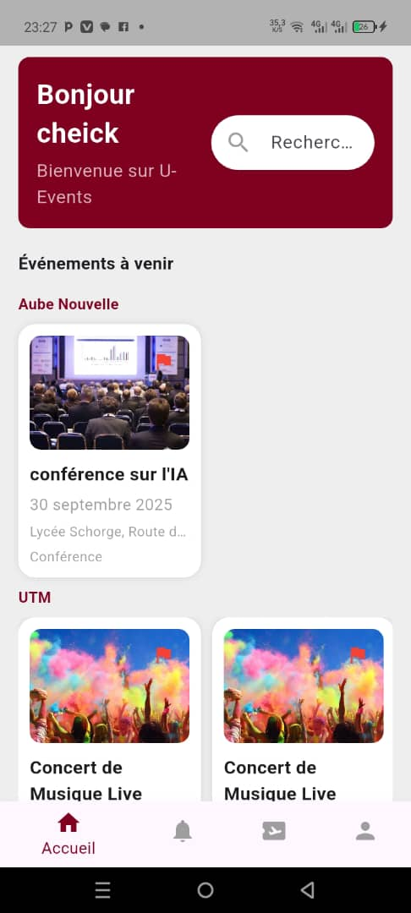
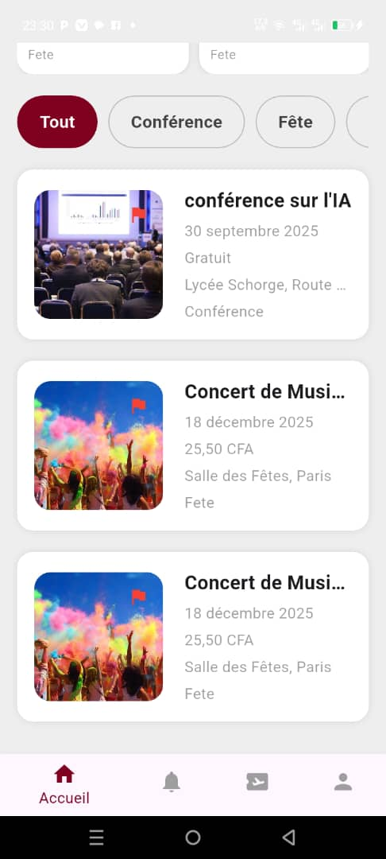
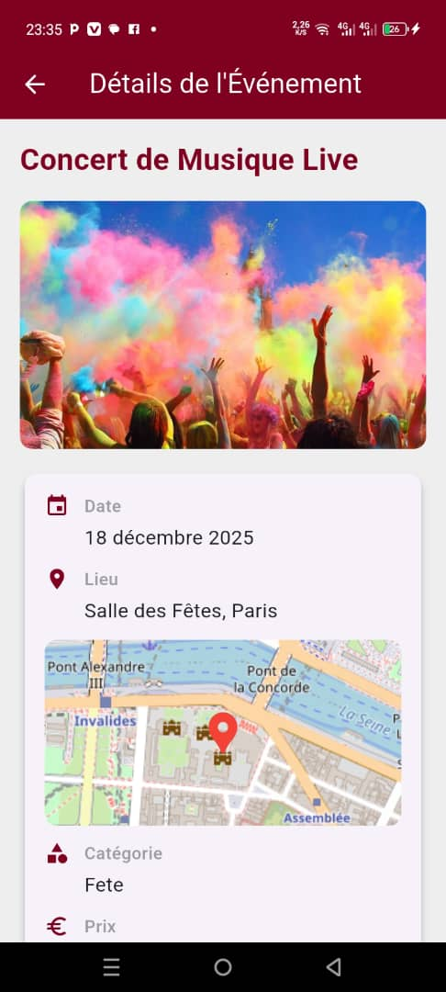
Project Presentation
Innovative Solution
The university event management application is a platform designed to help universities to organize, promote, and efficiently manage their academic, cultural, and sports events. It centralizes event information and provides students and staff with quick access to event details. With this solution, students can browse upcoming events, register for those they are interested in, and receive real-time notifications. Organizers can easily plan events, manage registrations, and interact with participants. The application also facilitates inter-university connectivity, allowing students to access events hosted by other institutions.

Slide 4
Project Presentation
Expected Outcome
Intelligent event creation assistance, Offline access, Integration with university. databases;

