Slide 1
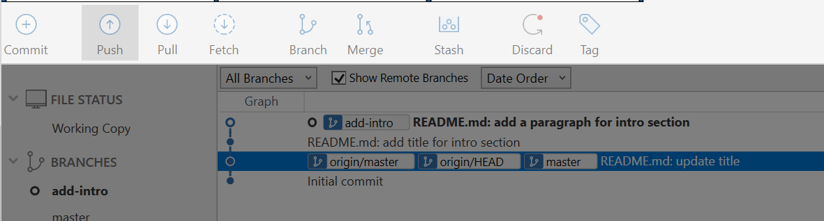
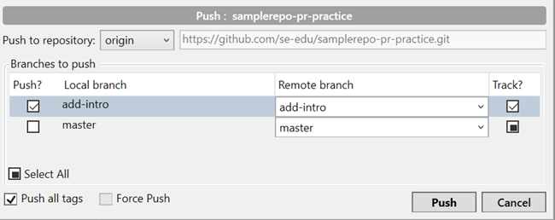
1
Your GitHub username
2
https://github.com/john/samplerepo-pr-practice.git
3
4

