Slide 1
Integration Strategies Late & one-time vs Early & Frequent
[click on the slide to advance animation]

Slide 2



Late and one-time Integration
UI
UI
UI
UI
Logic
Search
Logic
Search
Logic
Search
Logic
Search
Cache
Storage
Cache
Storage
Cache
Storage
Cache
Storage
In this approach, each developer starts developing their own components.
They continue to develop their own components…
… until they are complete.
Then, they get together, …
… and integrate the components.
Notes:
In this approach, each developer starts developing their own components.
[afterclick] They continue to develop their own components…
[afterclick] … until they are complete.
[afterclick] Then, they get together, …
[afterclick] … and integrate the components.

Slide 3
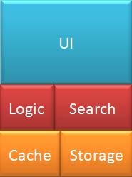
Early and frequent Integration
UI
UI
UI
Logic
Search
Logic
Search
Logic
Search
Cache
Storage
Cache
Storage
Cache
Storage
In this approach, each developer develops an initial/basic version of their own components, …
… and integrate those versions.
Then, they develop their components a bit more, ...
… and integrate again.
Then, they develop their components some more, ...
… and integrate again. And so on.
Notes:
In this approach, each developer develops an initial/basic version of their own components, …
[afterclick] … and integrate those versions.
[afterclick] Then, they develop their components a bit more, ...
[afterclick] … and integrate again.
[afterclick] Then, they develop their components some more, ...
[afterclick] … and integrate again. And so on.

