Slide 1
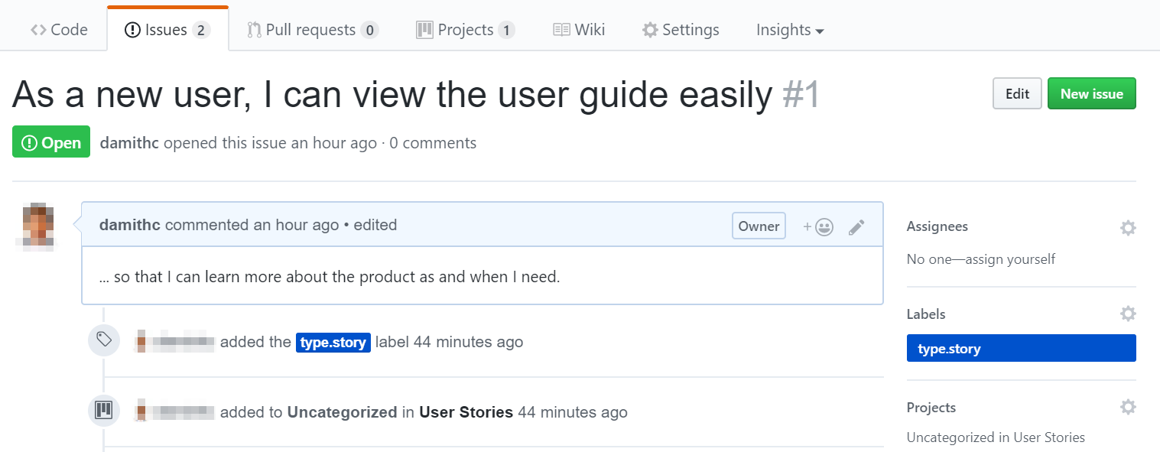
The ‘benefit’ part of the use case can be given here

