Slide 1
Indian Institute of Technology Guwahati
Department of Energy Engineering
B.TECH PROJECT · FINAL PRESENTATION
Optimal Cost Sizing of a PV–Battery Microgrid for IIT Guwahati
Lifecycle economics, reliability and robustness analysis
PRESENTED BY
UNDER THE GUIDANCE OF
Amit Raj
Kuldeep Kumar
Roll No. [add before presenting]
[Presentation date]
Notes:
Introduce yourself, your supervisor and the project in one sentence: we size a solar plus battery system for two IIT Guwahati departments at the lowest 15-year cost while keeping unmet demand at or below 1 %, and then test how robust that answer is to weather, demand growth, grid access, a supercapacitor and uncertain inputs. Fill in the roll number and date before presenting, and place the IITG logo in the grey slot.

Slide 2
ROADMAP
Outline of the talk
01
Slides 3–6
02
Slides 7–11
03
Slides 12–18
Introduction
Literature and gap
Modelling and optimisation
Microgrids, IITG demand, solar resource, objectives
Landscape, reference study, comparison, contribution
Architecture, data, component and cost models, PSO
04
Slides 19–22
05
Slides 23–26
06
Slides 27–34
Optimal design
Robustness
Scenarios and conclusions
Sizing, design space, dispatch, battery ageing
Weather years, sensitivity, reliability target, Monte Carlo
Load growth, grid access, supercapacitor, CERC check
Demand + weather data
Hourly simulator
PSO optimiser
Optimal design
Stress tests
Engineering decisions
The logic of the project: every result in Parts IV–V comes from the same verified simulator.
Amit Raj · Optimal Cost Sizing of a PV–Battery Microgrid · B.Tech Project, IIT Guwahati
2 / 34
Notes:
Walk through the structure. Part I sets up the problem, Part II positions it in the literature, Part III explains the model and optimiser, Part IV gives the optimal design and stress-tests it, and Part V covers the scenario studies and conclusions. The flow strip at the bottom is the logic of the whole project: data feed a verified simulator, an optimiser searches it, and the optimum is then tested against weather, uncertainty and alternative scenarios.

Slide 3
INTRODUCTION
What is a microgrid?
A microgrid is a local group of generators, storage and loads controlled as one unit — connected to the main grid or running on its own (islanded).
Utility grid
PCC switch
Generation sits close to the load
Storage covers the gap between supply and demand
A controller dispatches every unit, hour by hour
Islanded operation: every kWh must come from local sources
Common bus (AC or DC)
Solar PV
arrays, inverter
Storage
battery, supercap.
Generators
diesel, biogas
Loads
labs, workshops
Energy management system: monitors and dispatches every unit
AC-coupled · this project
DC-coupled
PV inverter and battery converter each feed an AC bus. Same topology as Kumar et al. (2018).
PV and batteries share a DC bus: fewer conversion stages, natural for storage and supercapacitors.
Lasseter (2002); Hatziargyriou et al. (2007); Dragičević et al. (2016).
Amit Raj · Optimal Cost Sizing of a PV–Battery Microgrid · B.Tech Project, IIT Guwahati
3 / 34
Notes:
A microgrid is a local group of generators, storage and loads that can be controlled as one unit and can either connect to the main grid or run islanded (Lasseter 2002; Hatziargyriou et al. 2007). Point out the common bus and the controller. Then the coupling choice: in an AC-coupled system each source has its own converter onto an AC bus; in a DC microgrid PV and batteries share a DC bus, which saves conversion stages (Dragičević et al. 2016). Be explicit that this project models an AC-coupled system, the same topology as the reference study: the PV inverter is inside the CERC all-in PV cost and the battery connects through a bidirectional converter. The off-grid case means islanded operation with no utility connection.

Slide 4
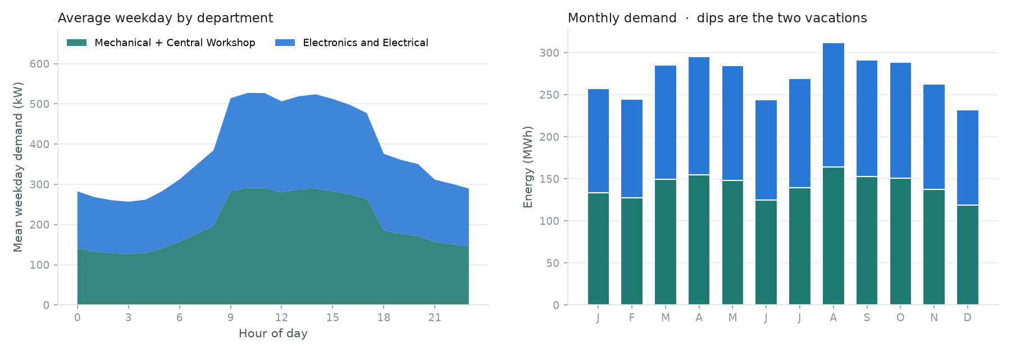
INTRODUCTION
IIT Guwahati departmental electricity demand
3,267 MWh
annual demand
644 kW
peak demand
0.58
load factor (mean / peak)
Average weekday by department, and monthly energy (dips = vacations). Source: prepare_data.py.
How the hourly load was built · assumption, not metered data
Equipment inventory per department → rated kW × duty × operating hours → weekday and two-vacation calendar → hourly profile, calibrated against campus statistics (Kumar et al. 2018).
Mechanical + Workshop 1,702 MWh (52 %) · Electronics + Electrical 1,565 MWh (48 %). Power ratings are engineering estimates.
Amit Raj · Optimal Cost Sizing of a PV–Battery Microgrid · B.Tech Project, IIT Guwahati
4 / 34
Notes:
The study supplies two departments: Mechanical Engineering with the Central Workshop, and Electronics and Electrical Engineering. Annual demand is 3,267 MWh with a 644 kW peak; the load factor (mean over peak) is 0.58. Mechanical plus Workshop is slightly larger. The load is not metered: it is built bottom-up from equipment inventories (rated kW, duty, operating hours), the weekday calendar and two vacation periods, then checked against the campus statistics in Kumar et al. Stress that this is the project's largest assumption and that demand turns out to be the strongest cost driver.

Slide 5
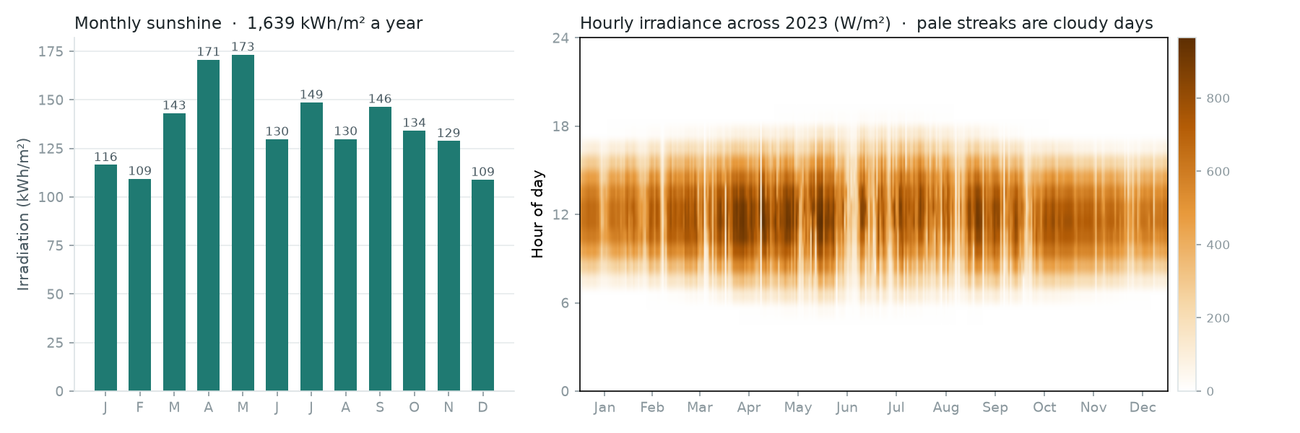
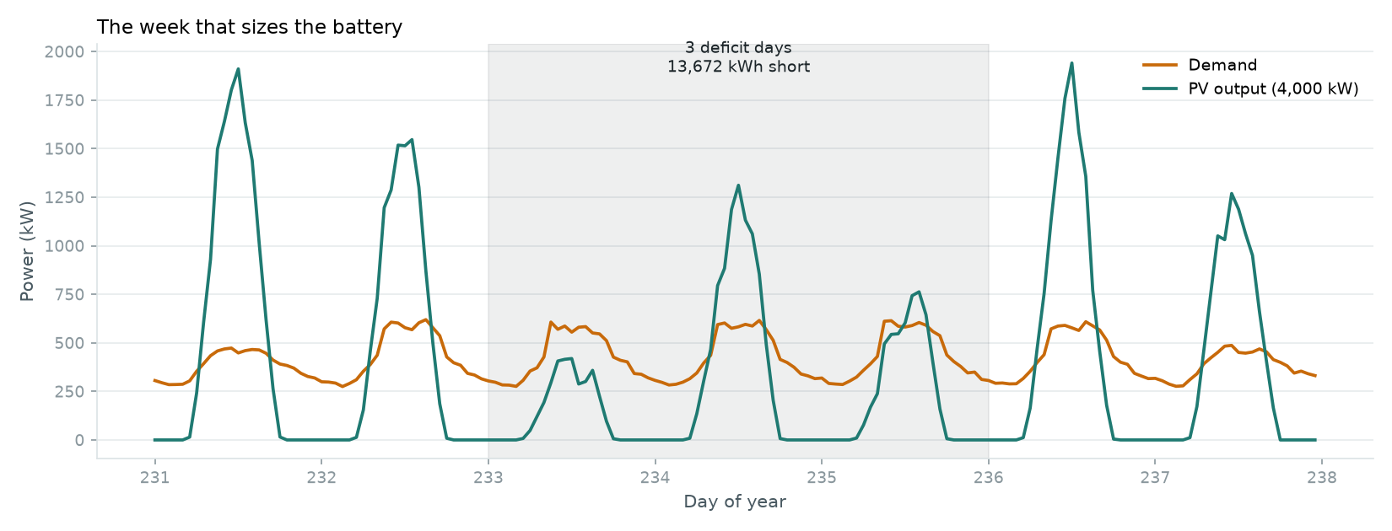
INTRODUCTION
Solar resource and why storage is needed
NASA POWER, 26.16 °N 91.77 °E, 2023.
Worst week: PV (teal) against demand (amber).
1,639 kWh/m²
12 / 12
3 days
global horizontal irradiation, 2023
months in which PV energy exceeds demand
dull spell, ≈13.7 MWh short: this sizes the battery
Takeaway Storage is needed for nights and multi-day cloudy spells, not for seasons.
Amit Raj · Optimal Cost Sizing of a PV–Battery Microgrid · B.Tech Project, IIT Guwahati
5 / 34
Notes:
NASA POWER hourly data for the campus point give 1,639 kWh/m² in 2023. Left: monthly sunshine; pre-monsoon months are sunniest and the monsoon brings dull spells. Right: the worst week. Every month has more PV energy than demand, so the shortfall is not seasonal: it comes from runs of consecutive dull days. In this week three deficit days add up to about 13.7 MWh short, which is what sizes the battery. Demand peaks in working hours while PV peaks at noon, and the evening and night load must come from storage.

Slide 6
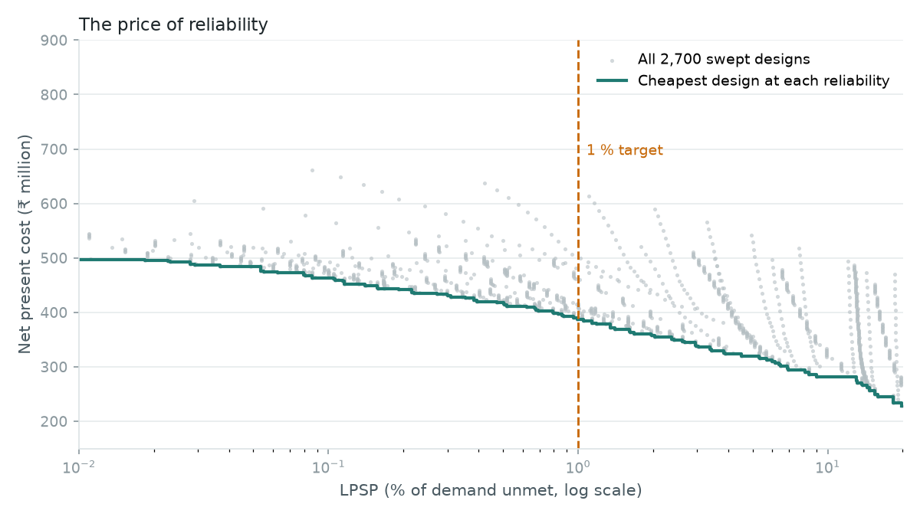
INTRODUCTION
Research motivation and objectives
Cost
PV is cheap per kWh but only produces in daylight; batteries and replacements dominate later costs.
Reliability
Each step towards zero unmet demand needs more storage and PV, at a rising price.
Lifetime
Batteries wear out within the 15-year horizon, so ageing has to be modelled, not assumed.
Cheapest design at each reliability level (grid sweep).
Objective
Find the least-cost PV–battery configuration that supplies both departments with unmet demand ≤ 1 %, over a 15-year lifecycle — then test that answer against weather, demand growth, grid access, a supercapacitor and uncertain inputs.
Amit Raj · Optimal Cost Sizing of a PV–Battery Microgrid · B.Tech Project, IIT Guwahati
6 / 34
Notes:
The core tension: PV energy is cheap but intermittent; storage removes unmet demand but is expensive and wears out. The Pareto curve on the right, from the 2,700-design sweep, shows the price of reliability: each step towards zero unmet demand costs more. We fix the reliability target at LPSP ≤ 1 % of annual demand and minimise the 15-year net present cost, which includes replacements and salvage, not just capital. Decision variables are PV size, battery strings, converter rating, and supercapacitor strings.

Slide 7
LITERATURE REVIEW
Research landscape
1995
2002
2008
2018
Particle swarm optimisation
The microgrid concept
GA + LPSP; multi-objective design
Degradation from counted cycles
Kennedy & Eberhart
Lasseter
Yang et al.; Dufo-López & Bernal-Agustín
Xu et al.
1996
2006
2016
2018
LPSP-based PV–battery sizing
HOMER hourly techno-economics
DC microgrid control review
HOMER study of the IITG campus
Borowy & Salameh
Lambert, Gilman, Lilienthal
Dragičević et al.
Kumar et al.
Sizing for reliability
Lifecycle economics
Battery ageing
Weather and uncertainty
Metaheuristic search
Themes this project combines. Full references on the last slide.
Amit Raj · Optimal Cost Sizing of a PV–Battery Microgrid · B.Tech Project, IIT Guwahati
7 / 34
Notes:
A qualitative timeline of the work this project builds on, not a publication count. Borowy and Salameh (1996) sized PV and battery for a target loss-of-power-supply probability at minimum cost. Kennedy and Eberhart (1995) introduced particle swarm optimisation. Lasseter (2002) framed the microgrid concept. HOMER (Lambert et al. 2006) made hourly techno-economic simulation standard. Yang et al. (2008) combined LPSP with a genetic algorithm; Dufo-López and Bernal-Agustín (2008) went multi-objective. Dragičević et al. (2016) reviewed DC microgrids. Xu et al. (2018) modelled battery degradation from counted stress cycles. Kumar et al. (2018) applied HOMER to the IITG campus.

Slide 8
LITERATURE REVIEW
Reference study: Kumar et al. (2018), IEEE Access
What they did
What this project takes
What this project changes
HOMER Pro, multi-year module
Whole IITG campus: peak 3,075 kW, ≈60,379 kWh/day
12 scenarios: PV, biogas, diesel, lead-acid, grid
10 % yearly load growth, 15-year project
Component costs (Table 2) and economics
Discover 12VRE-3000TF-L lead-acid battery
PV model (eq. 3) and AC-coupled topology
Benchmarks for comparison
Two departments, built bottom-up
Own Python simulator with 35 checks
Rainflow ageing; PSO + grid search
12 weather years; Monte Carlo
₹5,835 M
₹11.96–18.47
₹0.18–1.39
best off-grid NPC, whole campus (scenario 8)
off-grid LCOE range, per kWh
grid-connected LCOE range, per kWh
All values from Kumar et al. (2018), checked against the paper's text. Whole-campus figures, so they are benchmarks for unit cost, not for absolute NPC.
Amit Raj · Optimal Cost Sizing of a PV–Battery Microgrid · B.Tech Project, IIT Guwahati
8 / 34
Notes:
Kumar et al. used HOMER Pro with its multi-year module for the whole IITG campus (peak 3,075 kW, about 60,379 kWh a day), with 10 % yearly load growth over 15 years, comparing 12 off-grid and grid-connected scenarios with PV, food-waste biogas, diesel and lead-acid batteries. Their best off-grid case (scenario 8, load following) had NPC ₹5,835 M and LCOE ₹11.96/kWh; grid-connected LCOE was ₹0.18–1.39/kWh. We take their costs, economics and battery choice; we change the scope (two departments), the tool (our own verified Python model), the battery ageing model, the optimiser and the robustness tests.

Slide 9
LITERATURE REVIEW
Critical literature comparison
Study | System | Method | Objective / reliability | What it contributes
Borowy & Salameh (1996) | Stand-alone wind–PV–battery | Iterative sizing of PV and battery | Minimum cost at a target LPSP | 30 years of hourly data; house load
Yang et al. (2008) | Stand-alone PV–wind–battery | Genetic algorithm | Minimum annualised cost at a target LPSP | Telecom relay station case
Dufo-López & Bernal-Agustín (2008) | PV–wind–diesel–H₂–battery | Multi-objective evolutionary + GA | NPC, CO₂ and unmet load together | Pareto set of designs
Xu et al. (2018) | Li-ion battery storage | Semi-empirical model with cycle counting | Cell life loss from operating profile | Degradation from irregular cycles
Kumar et al. (2018) | IITG campus: PV, biogas, diesel, battery, grid | HOMER Pro multi-year | NPC and LCOE, 12 scenarios | Site data, costs, benchmark
This work | Two IITG departments: PV–battery (+ SC option) | Own simulator; grid search + PSO | Min. 15-year NPC, LPSP ≤ 1 % | Rainflow ageing, 12 weather years, Monte Carlo
LPSP: loss of power supply probability. SC: supercapacitor. Details confirmed from publisher or index records (DOIs in References).
Amit Raj · Optimal Cost Sizing of a PV–Battery Microgrid · B.Tech Project, IIT Guwahati
9 / 34
Notes:
Read across the rows. Each study covers part of the problem. Borowy and Salameh introduced LPSP-constrained least-cost sizing; Yang et al. solved it with a genetic algorithm; Dufo-López and Bernal-Agustín added emissions and unmet load as objectives; Xu et al. showed how to estimate battery life from counted stress cycles; Kumar et al. gave the site, costs and benchmark for IITG. This project combines LPSP-constrained NPC minimisation with cycle-counted ageing, multiple weather years and uncertainty analysis in one reproducible model. Only facts confirmed from the papers' records are in the table.

Slide 10
RESEARCH GAP
Research gap and contribution
Gaps in the reference approach
What this project adds
Battery life as constant throughput
Cycle-counted ageing
Weather robustness
HOMER's default model ignores depth of discharge.
Rainflow + Miner's rule on the datasheet curve, plus temperature float life.
Same design on 12 NASA years; a design optimised for all of them.
One weather year
A design can look reliable only because the year was sunny.
Bottom-up demand
Verified, open model
Two departments from equipment inventories; tested ±20 %.
35 automated checks; PSO cross-checked by grid search.
Campus aggregate load
Department-level demand and its uncertainty are not studied.
Scenario studies
Source audit
Unchecked inputs
Staged growth, grid access, supercapacitor economics.
CERC order checked: paper's PV cost and discount rate corrected.
Reference costs are reused without going back to the source.
Amit Raj · Optimal Cost Sizing of a PV–Battery Microgrid · B.Tech Project, IIT Guwahati
10 / 34
Notes:
Be careful with the claim. None of these techniques is new on its own. The gap is in combining them for this site, and in checking the assumptions a black-box tool hides. HOMER's default battery model treats lifetime throughput as constant regardless of depth of discharge; a single weather year can flatter a design; and the reference paper's inputs were never re-checked against their source. This project addresses each of these in an open, verified Python model.

Slide 11
METHODOLOGY
Research questions, methods and answers
# | Research question | Method (script) | Short answer | Slide
1 | Does PSO reproduce the grid-search optimum? | Grid sweep + PSO, 5 seeds (pso.py) | Yes: 5/5 runs within 0.41 %, below the grid best | 18–19
2 | How does battery ageing affect lifecycle cost? | Rainflow + Miner (simulator.py) | Life 7.7 y; replacements ₹54.6 M | 22
3 | Is the design reliable in other weather years? | 12 NASA years (performance.py) | No: misses 1 % in 8 of 12 years | 23
4 | Does staged expansion save cost under growth? | 15-year growth model (multiyear.py) | Yes: 33 % cheaper at 10 %/yr | 27
5 | How does grid access change the design? | Grid scenarios (grid_connected.py) | Grid + 2,400 kW PV, no battery: ₹142 M | 28
6 | Is a supercapacitor economically justified? | 1-s load + filter (sc_study.py) | At best break-even (τ ≈ 1–2 s) | 29–30
7 | Which inputs drive cost and reliability? | Tornado, spider (sensitivity.py) | Demand, then PV and battery prices | 24–25
8 | How uncertain are the results? | Monte Carlo, 1,000 runs | NPC ₹343 M–₹436 M; target missed 60 % | 26
9 | Do corrected CERC inputs change the design? | Re-run with CERC values | NPC +2.3 %, design unchanged | 31
Amit Raj · Optimal Cost Sizing of a PV–Battery Microgrid · B.Tech Project, IIT Guwahati
11 / 34
Notes:
This map is the spine of the talk. Each question has a method, a script, an answer and the slide where the evidence is shown. Use it to signpost: every result later on answers one of these rows.

Slide 12
MODELLING
Proposed system architecture
PV array
4,368 kW
AC bus
Hourly dispatch rules
PV inverter
1
PV serves the load directly.
Curtailed PV
Department loads
Mech + Workshop, Electrical
2
Surplus charges the battery, limited by charge current, converter rating and room in the battery.
Battery bank
177 strings × 20 × 3 kWh
Bidirectional
converter
3
Whatever cannot be stored is curtailed.
Unmet demand
4
A deficit is drawn from the battery, down to 20 % state of charge.
Supercapacitor (option)
4 strings × 24 modules
DC–DC stage
5
Demand the battery cannot cover is unmet: it counts towards LPSP.
Studied separately with 1-second load data (slides 29–30); not part of the hourly balance.
Amit Raj · Optimal Cost Sizing of a PV–Battery Microgrid · B.Tech Project, IIT Guwahati
12 / 34
Notes:
The modelled system, AC-coupled as in Kumar et al. The PV array feeds the AC bus through its own inverter, whose cost is inside CERC's all-in PV price. The battery bank is 177 strings of 20 × 3 kWh batteries behind a bidirectional converter (efficiency 0.95). Each hour the dispatch is load following: PV serves the load first; surplus charges the battery within its current, converter and state-of-charge limits, and the rest is curtailed; a deficit is drawn from the battery and whatever it cannot supply is unmet demand. The supercapacitor (dashed) is an optional add-on studied separately; it does not take part in the hourly energy balance.

Slide 13
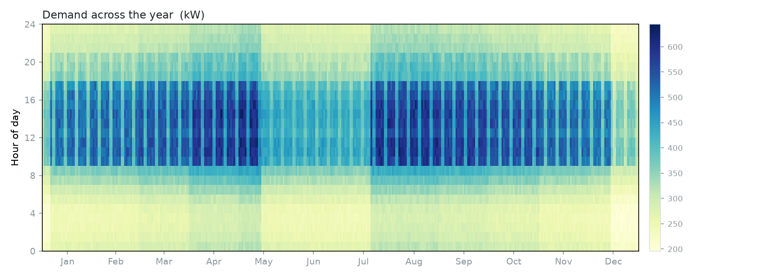
MODELLING
Demand and weather data pipeline
Equipment inventory
per department
Rated kW × duty
× operating hours
Weekday and
vacation calendar
Hourly department
profiles
data/inputs.csv
8,760 hours:
load, GHI, T
NASA POWER 2023
GHI + temperature
Gap filling and
clean-up
Worst-case transient → transient_spec.csv
4 machines together: 93 kW for 5 s (465 kJ)
NASA POWER 2013–2024
weather years for robustness and Monte Carlo
Assumptions to state
Ratings are estimates; load is not metered
Same 2023 load shape in every weather year
Every hour of the year: working hours, weekends and vacations show clearly.
Amit Raj · Optimal Cost Sizing of a PV–Battery Microgrid · B.Tech Project, IIT Guwahati
13 / 34
Notes:
prepare_data.py builds the hourly demand: each department's equipment list gives rated kW, a duty factor and operating hours; a calendar applies weekdays and the two vacation periods (equipment runs at 45 % in vacation); the result is calibrated against the campus statistics and written to data/inputs.csv. NASA POWER supplies hourly irradiance (CERES SYN1deg) and temperature (MERRA-2). The same script writes the worst-case transient (four machines switching together: 93 kW for 5 s) for the supercapacitor study. The 2013–2024 weather years feed the robustness and Monte Carlo studies.

Slide 14
MODELLING
PV, battery and converter models
PV array
Battery bank
Bidirectional converter
P_PV(t) = P_r · f_d · G(t)/G_STC · [1 + α (T_c(t) − 25)]
E(t+1) = E(t) + η_b · P_ch(t)
P_ch = min(surplus·η_c, P_conv·η_c, P_ch,max, room/η_b)
T_c(t) = T_a(t) + (NOCT − 20)/800 · G(t)
E(t+1) = E(t) − P_dis(t) / η_b
P_dis = min(deficit/η_c, P_conv/η_c, P_dis,max, avail)
f_d = 0.85 derating
α = −0.40 %/°C
NOCT = 45 °C, G_STC = 1,000 W/m²
Inverter inside CERC all-in cost
0.2 E_max ≤ E(t) ≤ E_max
η_c = 0.95 each way
Optimised rating: 998 kW
AC side never exceeds the rating (checked)
η_b = √0.85 each way
3 kWh per battery, strings of 20
P_ch ≤ 0.684 kW, P_dis ≤ 1.607 kW per battery
(57 A and 133.9 A at 12 V)
Amit Raj · Optimal Cost Sizing of a PV–Battery Microgrid · B.Tech Project, IIT Guwahati
14 / 34
Notes:
The PV model is equation 3 of Kumar et al.: rated capacity times a derating factor of 0.85 times irradiance over 1,000 W/m², corrected for cell temperature with a coefficient of −0.40 %/°C; cell temperature comes from ambient temperature and irradiance through the NOCT model with NOCT 45 °C. The battery is an energy bucket between 20 % and 100 % state of charge, with the 85 % round-trip efficiency split equally between charge and discharge. Charge and discharge are limited by the datasheet currents (57 A and 133.9 A at 12 V). The converter limits both directions to its rating and costs 5 % each way.

Slide 15
MODELLING
Reliability and lifecycle cost formulation
Reliability and economics
Battery ageing
LPSP = Σ E_unmet(t) / Σ E_load(t) ≤ 1 %
1
Rainflow-count the hourly state of charge → cycles of depth Dᵢ
NPC = C_cap + Σ C_rep,k/(1+r)^t_k + Σ C_O&M/(1+r)^t − C_salv/(1+r)^15
2
Cycle life N(D) from the datasheet: 5,000 at 20 %, 2,500 at 50 %, 1,500 at 80 % DoD
r = (1 + i_nom)/(1 + f) − 1 = 1.1070/1.0571 − 1 = 4.72 %
3
Miner's rule: damage per year = Σ nᵢ / N(Dᵢ); wear life = 1 / damage
CRF = r(1+r)^N / ((1+r)^N − 1) = 0.0945, LCOE = NPC · CRF / E_served
4
Float life from service life vs temperature: 12.1 years at this site
Salvage: last unit bought × fraction of life left at year 15 (linear, as HOMER)
15-year horizon; costs in constant 2016–17 rupees (Kumar et al., CERC)
LPSP counts energy not served, not the number of shortage hours
5
Battery life = min(wear life, float life) → replacements and salvage
Amit Raj · Optimal Cost Sizing of a PV–Battery Microgrid · B.Tech Project, IIT Guwahati
15 / 34
Notes:
Reliability is LPSP: unmet energy over demand for the year, which must be at most 1 %. It is an energy measure, not a count of shortage hours. Economics follow HOMER's conventions. The real discount rate is (1.1070/1.0571) − 1 = 4.72 %. NPC adds capital, discounted replacements and O&M, and subtracts the discounted salvage value of life left at year 15. LCOE is NPC times the capital recovery factor (0.0945) divided by energy served. Battery life is the shorter of the wear life and the float life. Wear life comes from rainflow-counting the hourly state of charge and Miner's rule on the datasheet cycle-life curve; float life comes from the datasheet's service-life versus temperature curve averaged over the site's hourly temperatures: 12.1 years.

Slide 16
OPTIMISATION
Mathematical optimisation formulation
Decision vector
x = [ P_PV (kW), N_str (integer), P_conv (kW), N_SC (integer) ]
Minimise
NPC(x) over 15 years
Subject to
LPSP(x) ≤ 0.01
N_SC ≥ N_SC,req = 4 (465 kJ transient)
x within the bounds in the table
Variable | Lower | Upper | Unit
PV capacity | 1,000 | 8,000 | kW
Battery strings | 0 | 500 | × 60 kWh
Converter | 300 | 3,000 | kW
SC strings | 4 | 4 | fixed at need
Bounds are wider than the grid sweep, so PSO is not boxed in.
Feasibility-first score
Every feasible design beats every infeasible one
Among infeasible designs, the smaller violation wins
Avoids NPC + k·violation, where a cheap unreliable design can win
score = NPC if feasible
score = 10¹⁰ · (1 + violation) otherwise
violation = max(0, LPSP − 0.01) + max(0, N_SC,req − N_SC)
Amit Raj · Optimal Cost Sizing of a PV–Battery Microgrid · B.Tech Project, IIT Guwahati
16 / 34
Notes:
Four decision variables: PV capacity, number of battery strings, converter rating and supercapacitor strings. Minimise NPC subject to LPSP ≤ 1 % and enough supercapacitor strings to absorb the 465 kJ transient (4 strings). Strings are integers. Constraints are folded into a feasibility-first score: a feasible design scores its NPC; an infeasible one scores 10¹⁰ × (1 + violation), so any feasible design beats any infeasible one and smaller violations rank better. A plain penalty NPC + k × violation can let a slightly unreliable but cheap design win. The supercapacitor count is fixed at the requirement in the final runs, because extra strings only add cost.

Slide 17
MODELLING
Python simulator and its verification
Inputs: load, GHI, temperature (8,760 h)
Verification: 35 checks, all passing
PASS
Simulator · 20
PV output for every hour
Energy balances close; SoC, converter and current limits hold; LCOE, salvage, cycle and float life match hand calculations; penalties rank correctly
Hour loop: PV → load; surplus → battery → curtail; deficit → battery → unmet
PASS
Multi-year model · 7
Annual totals: served, unmet, curtailed, throughput
With no growth the 15-year model equals the single-year one for three designs; yearly costs add up to NPC
Rainflow + Miner → battery life → replacements
PASS
Grid model · 8
NPC, LCOE, salvage
Grid-only cost matches the hand calculation; energy balances close; exports never exceed the cap
Score = NPC, or penalty if LPSP > 1 %
Verification, not validation: the code is checked against itself and hand calculations, not against a measured microgrid.
Amit Raj · Optimal Cost Sizing of a PV–Battery Microgrid · B.Tech Project, IIT Guwahati
17 / 34
Notes:
One function, simulate(), evaluates a design: it computes PV output for the year, steps through the 8,760 hours of dispatch, then computes battery life and the lifecycle cost and folds the constraints into the score. It runs in about 9 ms, which makes the 2,700-design sweep and PSO cheap. Verification means the code does what it is meant to: 35 automated checks pass. These cover physical limits, energy balances that close exactly, monotonic behaviour, hand calculations of LCOE, salvage, cycle life and float life, the penalty logic, and agreement of the 15-year model with the single-year model when there is no growth. Verification is not external validation: there is no measured microgrid to compare against, which is a stated limitation.

Slide 18
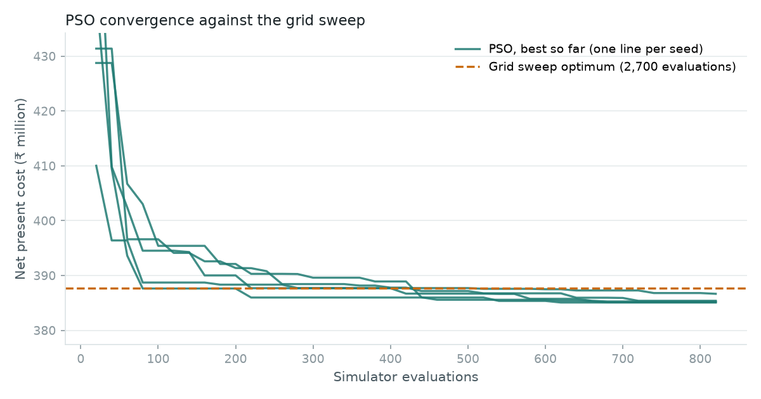
OPTIMISATION
Grid search and particle swarm optimisation
Initialise 20 particles at random within bounds
Round to whole kW / strings; simulate (cached)
Update personal and global best scores
loop
v ← w·v + c₁r₁(p_best − x) + c₂r₂(g_best − x)
Clip |v| ≤ 20 % of range; walls absorb
Best NPC so far for each of 5 seeds, against the grid-sweep optimum.
Repeat 40 iterations → best design
2,700
5 / 5
≈820
w = 0.7298, c₁ = c₂ = 1.49618 (Clerc & Kennedy 2002).
grid designs; best ₹387.7 M
PSO seeds within 0.41 %
simulations per PSO run
Amit Raj · Optimal Cost Sizing of a PV–Battery Microgrid · B.Tech Project, IIT Guwahati
18 / 34
Notes:
The grid sweep tests 2,700 designs: 12 PV sizes from 1,500 to 7,000 kW, 25 battery sizes from 20 to 500 strings and 9 converter ratings from 600 to 2,200 kW. Its best feasible design costs ₹387.7 M. PSO uses 20 particles for 40 iterations with the Clerc–Kennedy constriction coefficients (w = 0.7298, c1 = c2 = 1.49618), velocity capped at 20 % of the range, absorbing walls, and positions rounded to whole kW and strings with a cache. Five independent seeds all finish within 0.41 % of each other and below the grid best, after about 820 simulations each. A fine local grid of 3,179 designs around the PSO answer finds nothing better. That is strong evidence of a good optimum, not a proof of global optimality.

Slide 19
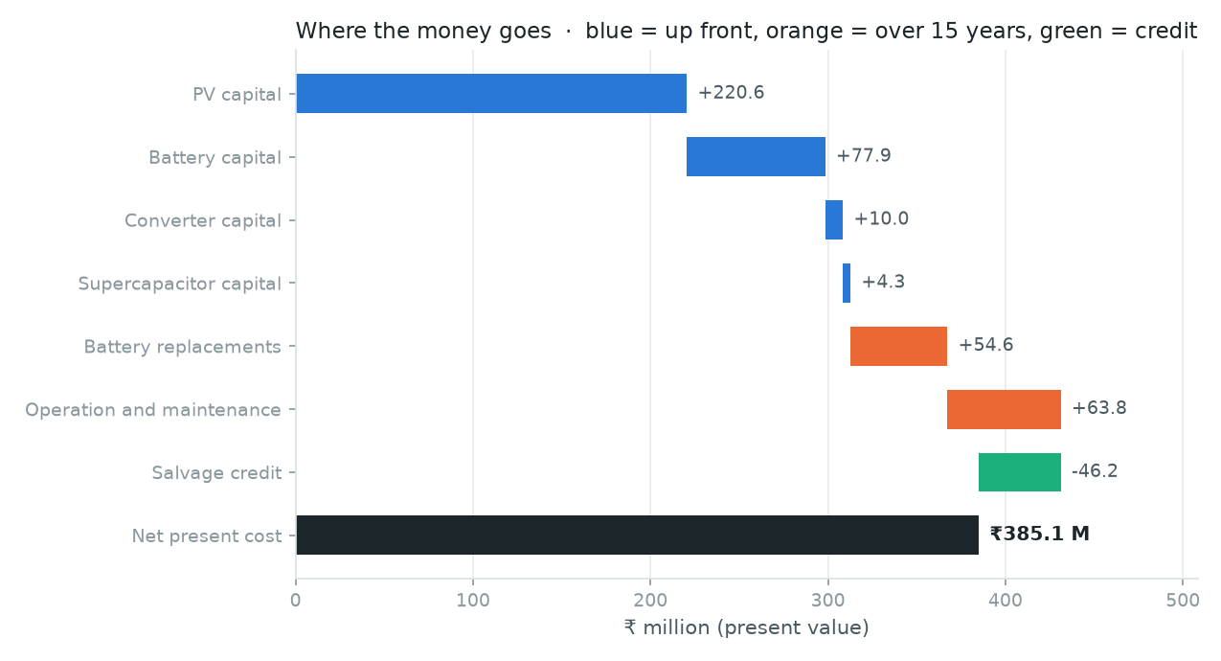
RESULTS
Optimal off-grid sizing
4,368 kW
10.6 MWh
PV array
battery (177 strings)
998 kW
4 strings
converter
supercapacitor (required)
₹385.1 M
₹11.25/kWh
15-year NPC
LCOE
Where the NPC goes: capital (blue), 15-year costs (orange), salvage credit (green).
1.00 %
7.7 years
LPSP (limit 1 %)
battery life
Takeaway PSO ₹385.1 M vs grid sweep ₹387.7 M: the same valley found two independent ways — strong evidence, not a proof of global optimality.
Amit Raj · Optimal Cost Sizing of a PV–Battery Microgrid · B.Tech Project, IIT Guwahati
19 / 34
Notes:
The optimum is 4,368 kW of PV, 10.6 MWh of battery (177 strings), a 998 kW converter and the 4 required supercapacitor strings. NPC is ₹385.1 M, LCOE ₹11.25/kWh, LPSP exactly at the 1 % limit, and battery life 7.7 years, so the bank is replaced once within 15 years. PV capital is the largest item; battery capital plus its replacement is next. The balance: more PV is cheaper than more battery for covering most shortfalls, but PV alone cannot carry the night, and a bigger bank cycles less and lasts longer. The grid sweep's best was ₹387.7 M; PSO is 2.6 M cheaper because it searches between grid points.

Slide 20
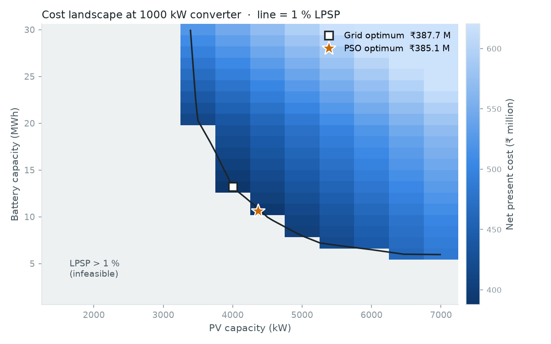
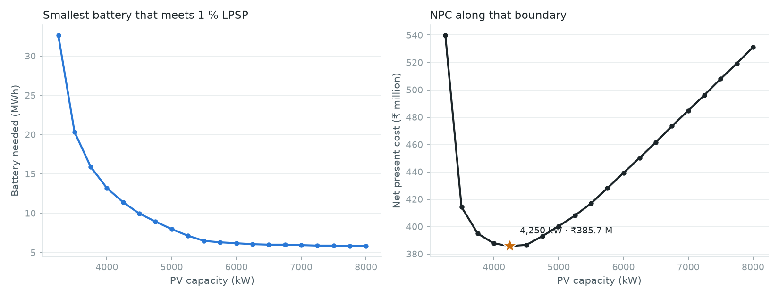
RESULTS
Design space: a flat valley along the reliability boundary
Battery needed and NPC along the 1 % boundary.
NPC landscape at 1,000 kW converter; line = 1 % LPSP.
6
1.6 %
On the boundary
feasible grid designs within 2 % of the cheapest
cost spread of the five cheapest
every optimum sits exactly at LPSP = 1 %
Amit Raj · Optimal Cost Sizing of a PV–Battery Microgrid · B.Tech Project, IIT Guwahati
20 / 34
Notes:
Left: NPC over PV and battery size at a 1,000 kW converter; grey is infeasible (LPSP above 1 %), the black line is the 1 % boundary, and both optima sit on it. Right: along that boundary, more PV means less battery is needed, and NPC is flat over a wide range. 6 feasible grid designs lie within 2 % of the cheapest, and the five cheapest are within 1.6 %. Practically, that gives freedom to choose PV and battery sizes to suit roof area, procurement or phasing, at almost no cost penalty.

Slide 21
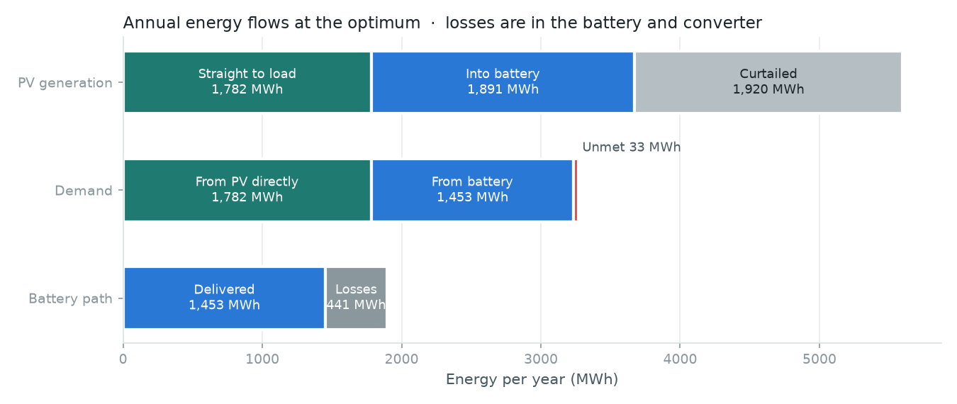
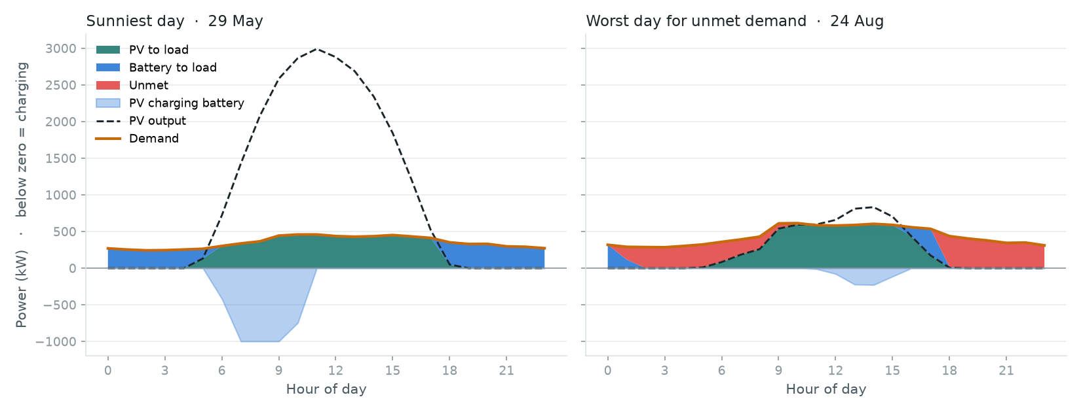
RESULTS
Energy flows and hourly dispatch
Hourly dispatch: sunniest day and worst day.
Annual energy flows at the optimum (MWh).
5,593 MWh
34 %
441 MWh
33 MWh
PV generated per year
of PV curtailed (battery full)
lost in battery and converter
unmet = 1 % of demand
Takeaway An islanded system must oversize PV and throw energy away to stay reliable through dull spells.
Amit Raj · Optimal Cost Sizing of a PV–Battery Microgrid · B.Tech Project, IIT Guwahati
21 / 34
Notes:
Left: a year at the optimum. PV generates about 5,593 MWh. About a third goes straight to the load, a third into the battery, and 1,920 MWh (34 %) is curtailed because the battery is full. Battery and converter losses are about 441 MWh. Unmet demand is 33 MWh, 1 % of demand. Right: the sunniest day, when the battery fills by mid-morning and PV is curtailed, and the worst day, when the battery is empty and demand goes unmet in the evening and night. High curtailment is the price of reliability in an islanded system.

Slide 22
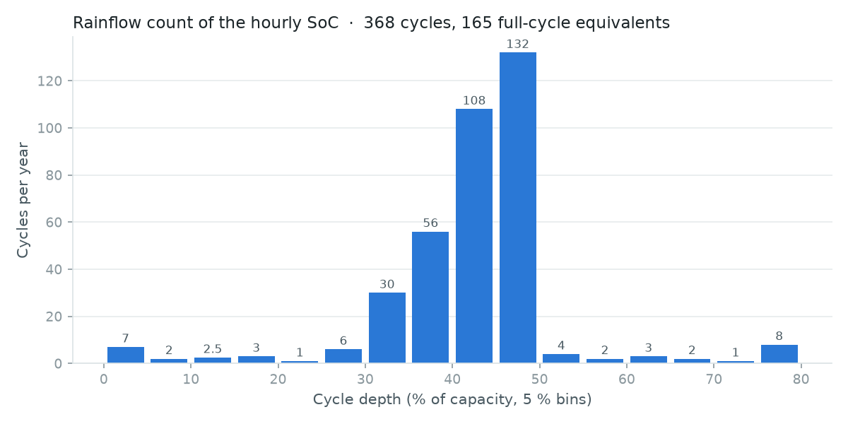
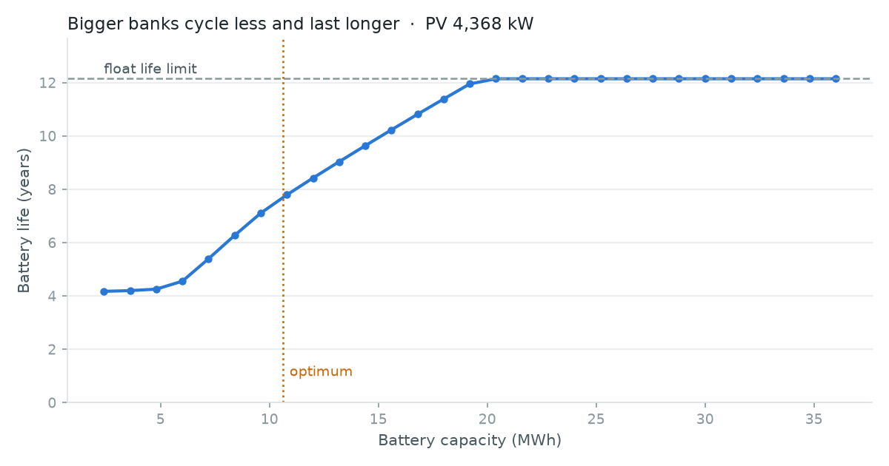
RESULTS
Battery operation and ageing
Rainflow cycle depths of the hourly SoC (one year).
Battery life against bank size at the optimum PV.
7.7 y
12.1 y
year 7.7
₹54.6 M
wear life: cycling-limited
float life at site temperatures
one replacement in 15 years
replacements (present value)
Takeaway Ageing links sizing to cost: a larger bank cycles less, lasts longer and needs fewer replacements.
Amit Raj · Optimal Cost Sizing of a PV–Battery Microgrid · B.Tech Project, IIT Guwahati
22 / 34
Notes:
Left: rainflow count of the hourly state of charge. Most cycles are 30–50 % deep, the daily charge and discharge. Feeding these depths through the datasheet cycle-life curve and Miner's rule gives a wear life of 7.7 years, shorter than the 12.1-year float life, so this bank is limited by cycling and is replaced once, in year 7.7. Right: bigger banks cycle shallower and last longer, until about 20 MWh where they hit the float-life ceiling. That is why lifecycle cost, not capital cost, decides the bank size: a cheaper small bank needs more replacements. Replacements cost ₹54.6 M in present value.

Slide 23
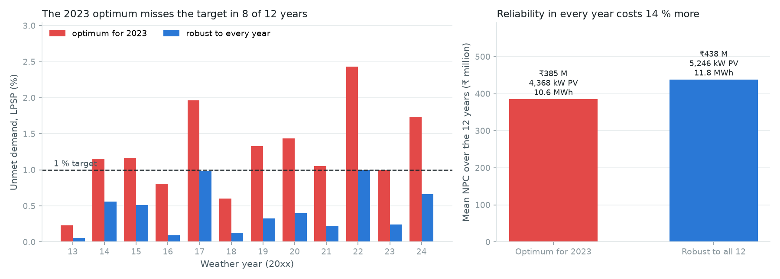
ROBUSTNESS
Multi-year weather robustness
Left: LPSP of each design in each weather year. Right: mean NPC over the 12 years.
8 of 12
2.43 %
+14 %
133 h
years the 2023 design misses 1 %
worst year (2022)
cost of meeting 1 % in all 12 years
shortage hours in 2023 (17 events)
Amit Raj · Optimal Cost Sizing of a PV–Battery Microgrid · B.Tech Project, IIT Guwahati
23 / 34
Notes:
The 2023-optimised design was run unchanged on 12 years of NASA weather, 2013–2024, with the 2023 load. It misses the 1 % target in 8 of 12 years; the worst is 2022 at 2.43 %. 2023 was the second-sunniest year in the record, which flatters the design. The robust design was explicitly optimised, not picked by trial: PSO (20 particles, 30 iterations, started from the 2023 optimum) minimised the mean NPC over the 12 years subject to LPSP ≤ 1 % in every year. It needs 5,246 kW PV and 11.8 MWh battery and costs ₹438 M on average, 14 % more. In 2023 itself the nominal design has 17 shortage events totalling 133 hours; the longest lasts 14 hours.

Slide 24
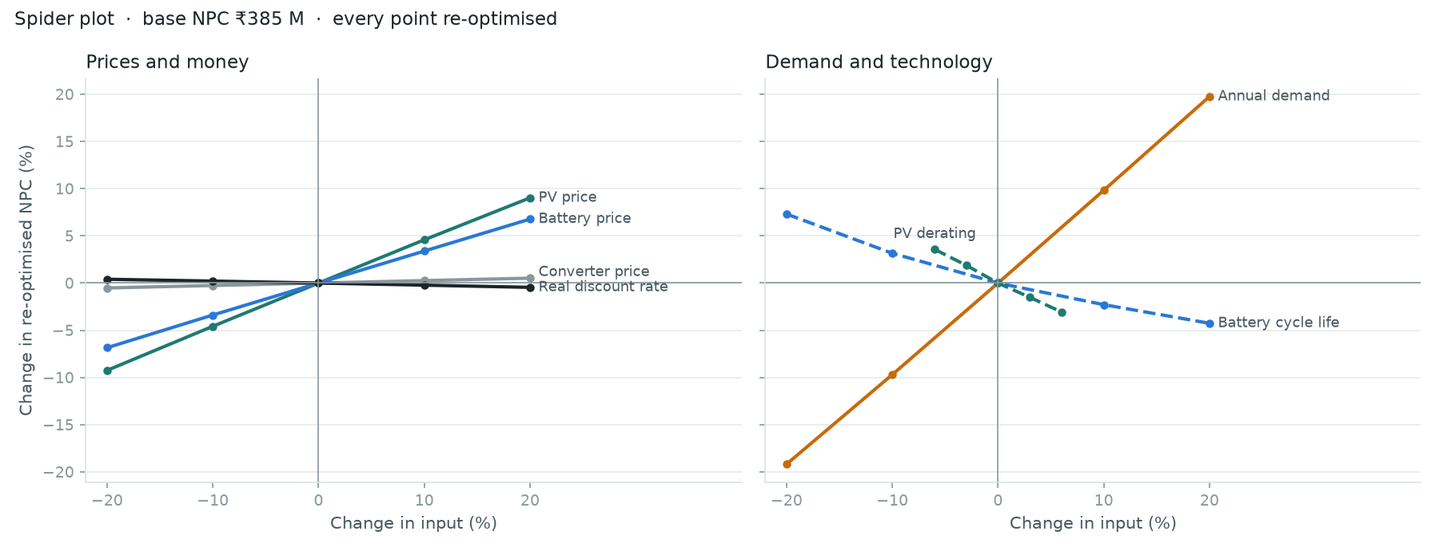
SENSITIVITY
One-at-a-time sensitivity of the re-optimised cost
Spider plot: % change of re-optimised NPC (base ₹385 M) for each input changed alone.
-19 / +20 %
-9 / +9 %
-7 / +7 %
+7 / -4 %
demand −20 / +20 %
PV price −20 / +20 %
battery price −20 / +20 %
cycle life −20 / +20 %
Amit Raj · Optimal Cost Sizing of a PV–Battery Microgrid · B.Tech Project, IIT Guwahati
24 / 34
Notes:
Each input is changed on its own, PSO re-optimises the design, and the plot shows the percentage change in the re-optimised NPC from the base. That is the cost of the best design under the new conditions, not of today's design. Demand dominates: ±20 % demand moves cost by about ±20 %, almost proportionally, because every component scales with it. PV price is next, then battery price and battery cycle life. The discount rate and converter price hardly matter. PV derating is limited to ±6 % so it stays physical.

Slide 25
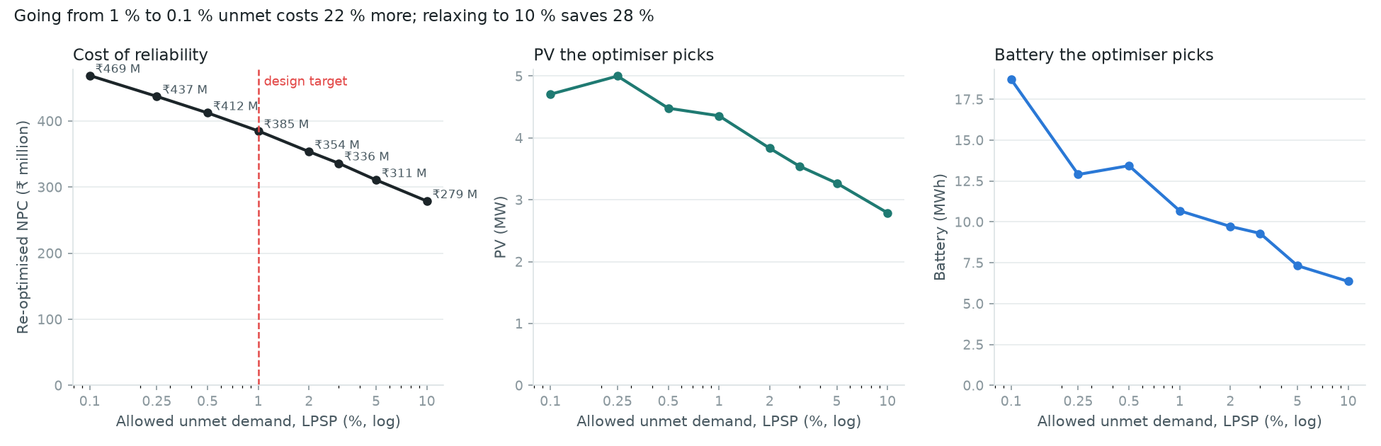
SENSITIVITY
The reliability target: what each step costs
Re-optimised NPC, PV and battery against the allowed unmet demand (log scale).
+22 %
₹385.1 M
-28 %
1 % → 0.1 % unmet (₹469 M)
design target: 1 % unmet
1 % → 10 % unmet (₹279 M)
Amit Raj · Optimal Cost Sizing of a PV–Battery Microgrid · B.Tech Project, IIT Guwahati
25 / 34
Notes:
Here the constraint itself is varied and the design re-optimised for each target. Going from 1 % to 0.1 % unmet demand raises NPC by 22 %; relaxing to 10 % cuts it by 28 %. The design changes too: tighter targets need much more battery, while PV changes less. The tornado chart in plot_results.py gives the same ranking as the spider plot. The practical point: the 1 % target is a choice with a price, and should be agreed with the institute, for example by exempting loads that can be shed.

Slide 26
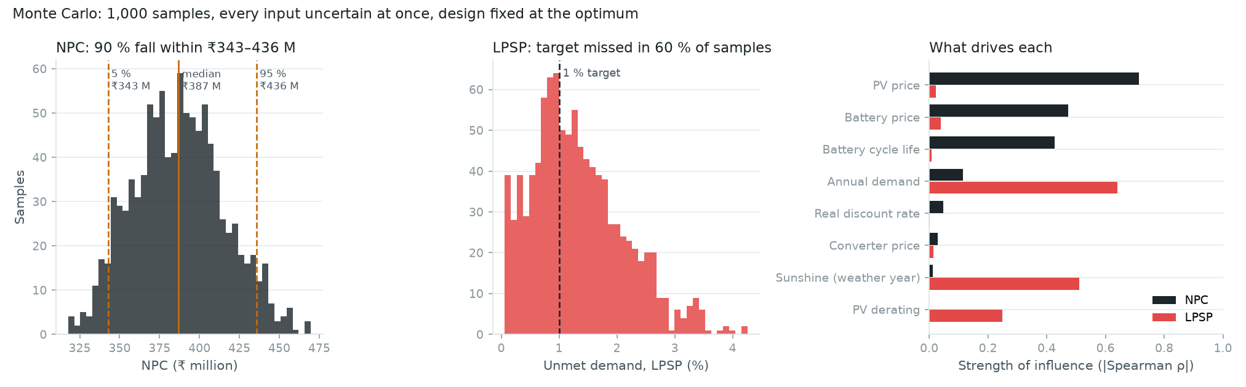
UNCERTAINTY
Monte Carlo uncertainty analysis
Distributions of NPC and LPSP, and the influence of each input (|Spearman ρ|).
Sampled input | Distribution
PV, battery, converter prices | uniform ±20 %
Real discount rate, cycle life | uniform ±20 %
PV derating · demand | ±6 % · ±10 %
Weather year | uniform, 2013–2024
₹343 M–436 M
60 %
5th–95th percentile of NPC
of samples miss the 1 % target
Amit Raj · Optimal Cost Sizing of a PV–Battery Microgrid · B.Tech Project, IIT Guwahati
26 / 34
Notes:
Sensitivity moves one input at a time; this moves all of them at once. 1,000 samples, design fixed at the optimum. Prices of PV, battery and converter, the real discount rate and battery cycle life are uniform within ±20 %; PV derating within ±6 %; demand within ±10 %; and the weather year is drawn uniformly from 2013–2024. 90 % of sampled NPCs fall between ₹343 M and ₹436 M: this is the 5th to 95th percentile of the sampled outcomes, not a statistical confidence interval. The design misses the 1 % target in 60 % of samples. The right panel shows that prices and cycle life drive cost, while demand and weather drive reliability.

Slide 27
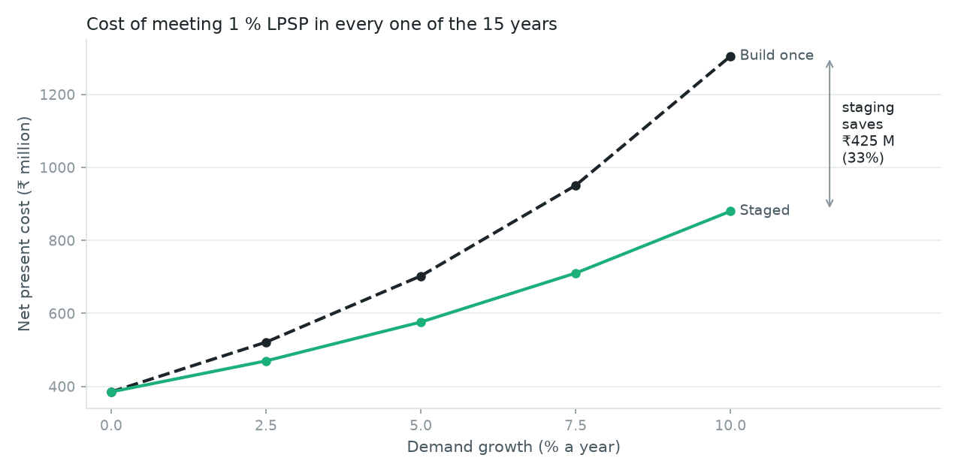
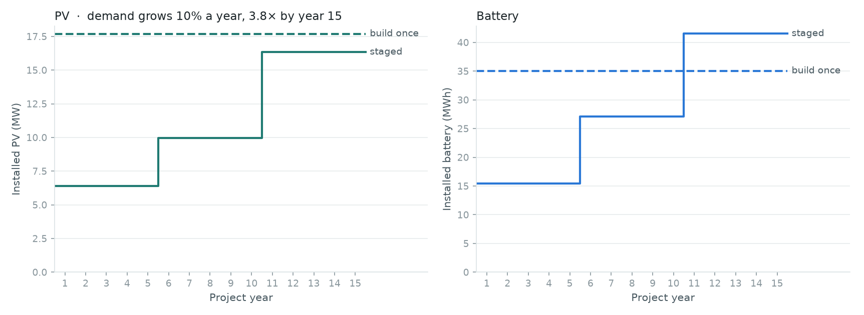
SCENARIOS
Load growth and staged expansion
Installed PV and battery, year by year (10 %/yr).
NPC against growth rate.
₹1,305 M
₹880 M
−33 %
₹13.08/kWh
build once for year 15
staged: years 1, 6, 11
lifecycle cost saved
staged LCOE (paper: 11.96–18.47)
Takeaway Under growth, build in stages: later spending is discounted and capacity is not idle for years.
Amit Raj · Optimal Cost Sizing of a PV–Battery Microgrid · B.Tech Project, IIT Guwahati
27 / 34
Notes:
With demand growing 10 % a year (Kumar et al.), year-15 demand is 3.8 times year 1, and today's optimum fails from year 2. Two strategies, both meeting 1 % in every year: build everything for year 15 at the start, or add capacity at the start of years 1, 6 and 11. Each is optimised with PSO plus a local search and two seeds, which agree within 0.12 %. Staging costs ₹880 M against ₹1,305 M, 33 % less. Two effects: money spent later is discounted, and the early oversized battery in the build-once plan cycles shallowly for years and still ages. The staged LCOE of ₹13.08/kWh lies inside the paper's off-grid range of ₹11.96–18.47/kWh.

Slide 28
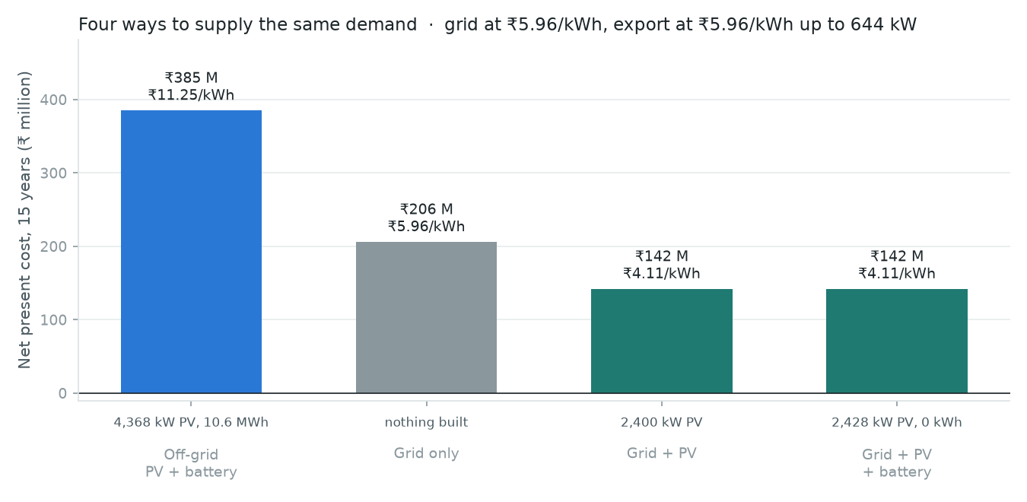
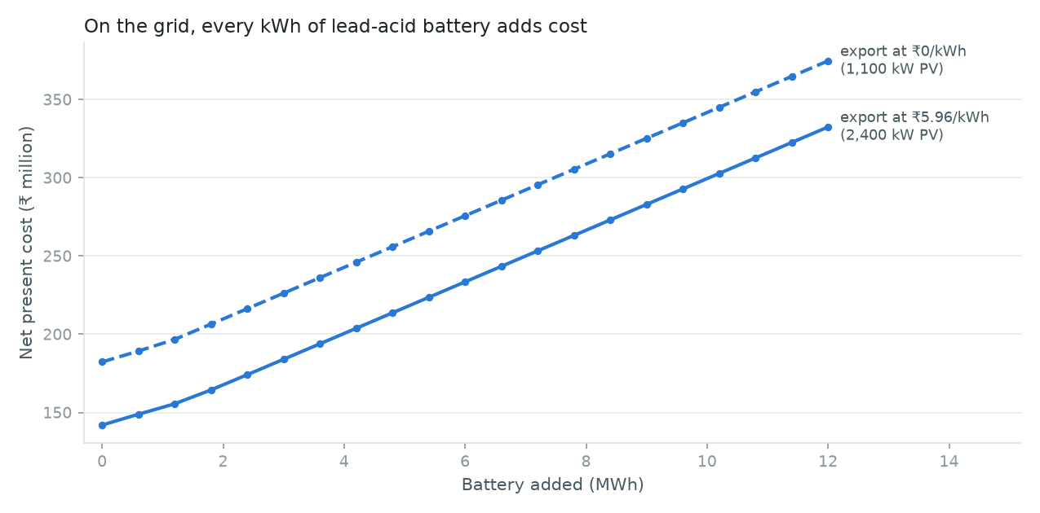
SCENARIOS
Grid-connected alternatives
Four ways to supply the same demand.
NPC as battery is added on the grid.
Assumptions
₹142 M
0 kWh
Buy ₹5.96/kWh; export ₹5.96/kWh up to 644 kW
Grid always available: no outages modelled
grid + 2,400 kW PV (₹4.11/kWh)
battery chosen at every export price
Takeaway With a reliable grid, storage is not worth it: the grid is the cheapest battery.
Amit Raj · Optimal Cost Sizing of a PV–Battery Microgrid · B.Tech Project, IIT Guwahati
28 / 34
Notes:
With a grid at the Assam commercial tariff of ₹5.96/kWh, buying everything costs ₹206 M. Adding 2,400 kW of PV cuts this to ₹142 M (₹4.11/kWh), the cheapest option overall, because PV's lifetime cost is about ₹4.3/kWh, below the tariff. Exports are paid at the tariff, as the paper assumes, but capped at the 644 kW peak load: without a cap more PV would always look profitable. The battery never pays: every MWh adds cost, even with no export payment, because storing a kWh in lead-acid costs more than buying one. Important: the grid is assumed always available, so this is not the same reliability boundary as off-grid; outages are not modelled.

Slide 29
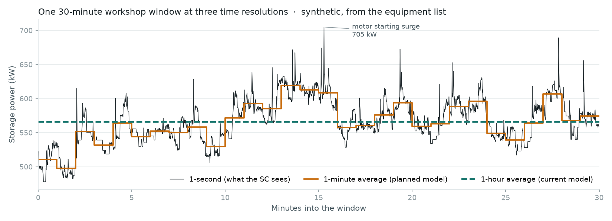
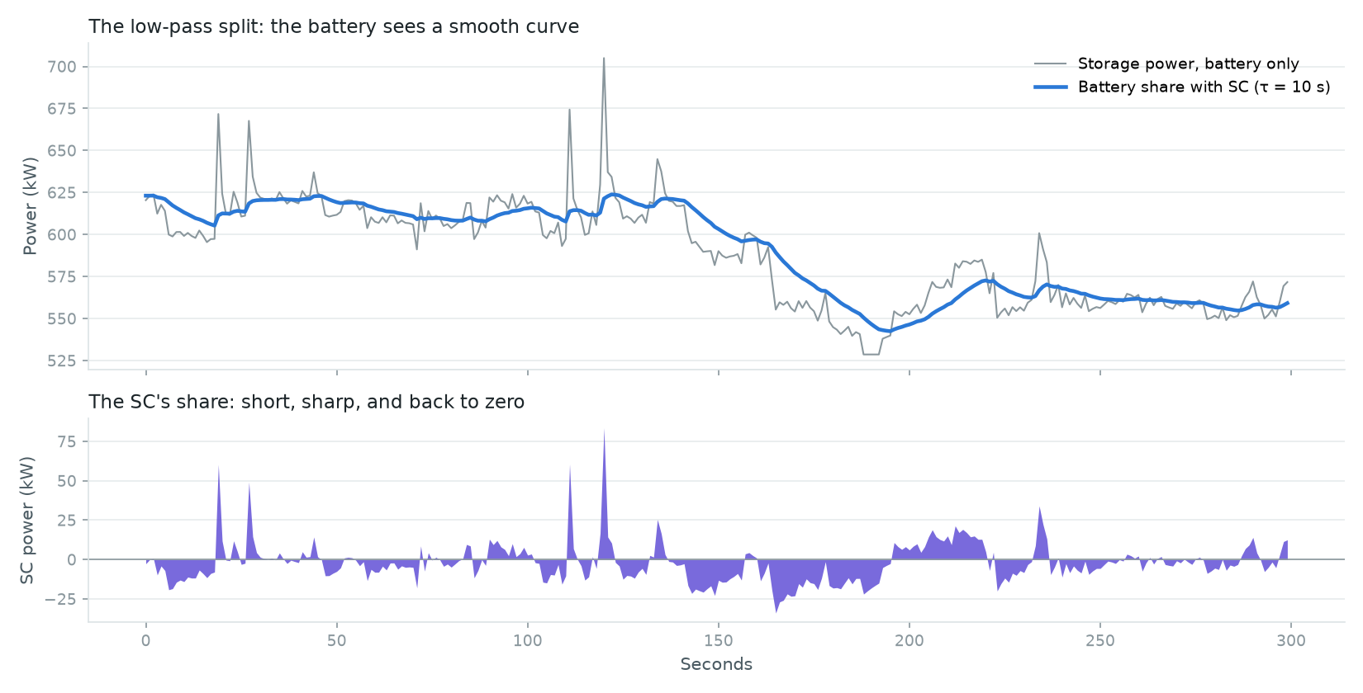
SUPERCAPACITOR
Supercapacitor: what it would see
Synthetic 1-s workshop load (from the equipment list).
Low-pass split: battery share (blue) and SC share (purple), τ = 10 s.
93 kW
0.0088 C
34 %
4 × 24
coincident step, 5 s (465 kJ)
step relative to the 10.6 MWh bank
battery ramp left with τ = 2 s
strings × 16 V / 58 F modules
Takeaway Technically the SC smooths the battery's fastest ramps; the question is whether that pays.
Amit Raj · Optimal Cost Sizing of a PV–Battery Microgrid · B.Tech Project, IIT Guwahati
29 / 34
Notes:
The hourly model cannot see a supercapacitor. sc_study.py builds a synthetic 1-second load for a working hour from the equipment list: machines switch on and off as Markov chains, direct-on-line motors draw a starting surge, and welders flicker. Left: one 30-minute window at 1 s, 1 min and 1 h. Right: a first-order low-pass filter with time constant τ sends the slow part of the storage power to the battery and the fast part to the supercapacitor. The design transient is 93 kW for 5 s, 465 kJ, needing 4 strings of 24 modules (16 V, 58 F). For this 10.6 MWh bank that step is only 0.0088 C, far below the C/10 rate the battery is rated at.

Slide 30
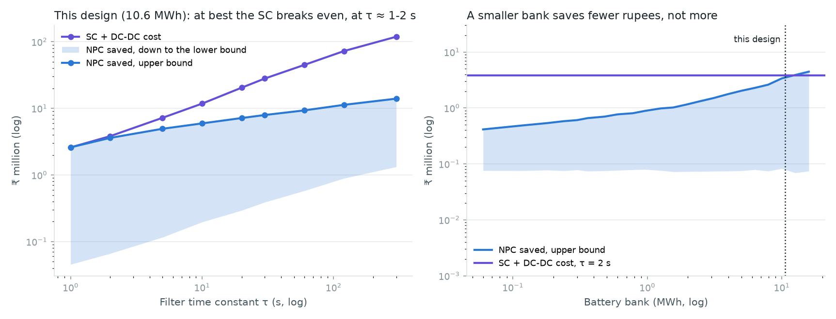
SUPERCAPACITOR
Is a supercapacitor economically justified?
Filter τ | SC + DC–DC cost | NPC saved (lower–upper)
1 s | ₹2.59 M | ₹0.05–2.60 M
2 s | ₹3.82 M | ₹0.07–3.60 M
10 s | ₹11.77 M | ₹0.20–5.94 M
Unresolved assumptions
Module price ₹45,000 (placeholder)
Motor starting surge 5× rated
Machine on-times and power ratings
SC + DC–DC cost against battery NPC saved, by filter τ and by bank size.
Break-even at best
0.0088 C
only with the upper bound, τ ≈ 1–2 s
the step is no stress for this bank
Takeaway Not justified on cost for this design. Revisit with real prices, or for small banks whose current limit the surge exceeds.
Amit Raj · Optimal Cost Sizing of a PV–Battery Microgrid · B.Tech Project, IIT Guwahati
30 / 34
Notes:
Its only economic value here is longer battery life. sc_study.py rainflow-counts the battery's second-scale cycles with and without the supercapacitor, adds them to the hourly cycles, and converts the life gain into NPC saved. Those cycles are far shallower than the datasheet's lowest point (20 % DoD), so two bounds are used: extending the datasheet's log-log slope (upper) or constant wear per kWh (lower). At τ = 1 s the SC and its DC–DC stage cost ₹2.59 M and save ₹0.05–2.60 M; at τ = 2 s ₹3.82 M against ₹0.07–3.60 M. At best it breaks even; longer filters cost more than they save. A smaller bank saves fewer rupees, not more, because it is cheaper to replace. Technical benefit is not economic benefit, and several inputs are placeholders.

Slide 31
SOURCE VALIDATION
Checking the reference paper against CERC
Input | Kumar et al. (2018) | CERC order (primary) | Used in this project
PV capital cost | ₹50,502 / kW | ₹53,002 / kW (₹530.02 lakh/MW) | Paper value (base)
Discount factor | 10.70 % | 10.64 % | Paper value (base)
+2.3 %
₹393.9 M
Unchanged
NPC with CERC values
vs base ₹385.1 M
re-optimised design: same sizes
Sources
CERC, Petition SM/03/2016, order 29 Apr 2016, para 9 (discount factor) and para 27 (PV cost); CERC, Petition 17/SM/2015, order 23 Mar 2016 (PV cost breakdown). Both PDFs are in resources/.
Amit Raj · Optimal Cost Sizing of a PV–Battery Microgrid · B.Tech Project, IIT Guwahati
31 / 34
Notes:
Kumar et al. cite the CERC FY 2016-17 tariff order (Petition SM/03/2016, 29 April 2016) for the PV cost and discount rate. The order says ₹530.02 lakh/MW, which is ₹53,002/kW, and a discount factor of 10.64 % (12.76 % × 0.70 × (1 − 34.61 %) + 16 % × 0.30). The paper uses ₹50,502/kW and 10.70 %. 10.70 % is the earlier figure that the order replaces; 50,502 does not appear in the order. We do not speculate about why. Re-running with the CERC values raises NPC by 2.3 % to ₹393.9 M, and re-optimising returns the same design. We keep the paper's values as the base case for comparability and report the corrected case. The lesson for reproducibility: check inputs against the primary source, not the citing paper.

Slide 32
DISCUSSION
Integrated engineering discussion
Cost
Reliability
Robustness
Demand ±20 % → ±20 % NPC; then PV price, battery price, cycle life.
Nominal optimum sits on the 1 % edge; misses it in 8 of 12 years.
+14 % buys 1 % in every weather year; Monte Carlo misses 60 %.
Demand growth
Grid access
Supercapacitor
Staged expansion saves 33 % at 10 %/yr.
Grid + PV is 63 % cheaper than off-grid; no battery.
Technical benefit is real; economic benefit is at best break-even.
Optimal microgrid sizing is a trade-off between lifecycle cost, reliability and robustness to changing operating conditions.
Amit Raj · Optimal Cost Sizing of a PV–Battery Microgrid · B.Tech Project, IIT Guwahati
32 / 34
Notes:
Pull the threads together. Cost is set mostly by demand and the PV and battery prices. Reliability is set by weather and demand, and a single-year optimum sits exactly on the 1 % boundary, so any worse year breaks it. Robustness costs about 14 % for weather alone. Growth favours staging. Grid access changes the answer completely. The supercapacitor's case is conditional. The central message: optimal sizing is a trade-off between lifecycle cost, reliability and robustness, and the cheapest nominal design is the least robust one.

Slide 33
CONCLUSIONS
Conclusions, limitations and future work
Conclusions
Limitations
Future work
Optimum: 4,368 kW PV, 10.6 MWh, 998 kW; ₹385.1 M, ₹11.25/kWh
PSO matches and improves on grid search (5/5 seeds)
Robust to 12 weather years: +14 % cost
Staging saves 33 % under 10 % growth
Grid + PV: ₹142 M, no battery
Supercapacitor: at best break-even
Synthetic load, not metered
Verified (35 checks), not externally validated
SC price, surge, on-times are placeholders
Costs from 2016–17; lead-acid only
Grid case ignores outages
Hourly model; one load shape for all years
Calibrate with department meter data
Adopt the multi-year design as the main result
Compare LFP batteries at today's prices
Add diesel backup, as in Kumar et al.
CO₂ savings and cost–emission trade-off
Supplier quotes for SC and DC–DC stage
Amit Raj · Optimal Cost Sizing of a PV–Battery Microgrid · B.Tech Project, IIT Guwahati
33 / 34
Notes:
Conclusions are the verified numbers. Limitations are stated plainly: the load is synthetic, the model is verified but not validated against a measured system, the supercapacitor inputs are placeholders, the battery costs date from 2016, and the grid case ignores outages. Future work follows directly from the limitations: meter data, a multi-year design as the headline result, LFP batteries, diesel backup as in the reference study, CO₂ accounting and real supercapacitor quotes.

Slide 34
REFERENCES
References and acknowledgements
[1] A. Kumar, A. R. Singh, Y. Deng, X. He, P. Kumar, R. C. Bansal, “Multiyear load growth based techno-financial evaluation of a microgrid for an academic institution,” IEEE Access, vol. 6, pp. 37533–37555, 2018. doi:10.1109/ACCESS.2018.2849411
[2] CERC, Determination of levellised generic tariff for FY 2016-17, Petition No. SM/03/2016, order 29 Apr 2016. cercind.gov.in/2016/orders/SORE.pdf
[3] CERC, Benchmark capital cost norm for solar PV and solar thermal projects, FY 2016-17, Petition No. 17/SM/2015, order 23 Mar 2016.
[4] NASA POWER Project, hourly all-sky irradiance (CERES SYN1deg) and 2 m temperature (MERRA-2), 26.162 N 91.7668 E, 2013–2024. power.larc.nasa.gov
[5] Discover Energy Corp., 12VRE-3000TF-L Tubular Flooded RE Series datasheet, 12 Nov 2013.
[6] B. S. Borowy, Z. M. Salameh, “Methodology for optimally sizing the combination of a battery bank and PV array in a wind/PV hybrid system,” IEEE Trans. Energy Convers., vol. 11, no. 2, pp. 367–375, 1996. doi:10.1109/60.507648
[7] H. Yang, W. Zhou, L. Lu, Z. Fang, “Optimal sizing method for stand-alone hybrid solar–wind system with LPSP technology by using genetic algorithm,” Solar Energy, vol. 82, no. 4, pp. 354–367, 2008. doi:10.1016/j.solener.2007.08.005
[8] R. Dufo-López, J. L. Bernal-Agustín, “Multi-objective design of PV–wind–diesel–hydrogen–battery systems,” Renewable Energy, vol. 33, no. 12, pp. 2559–2572, 2008. doi:10.1016/j.renene.2008.02.027
[9] B. Xu, A. Oudalov, A. Ulbig, G. Andersson, D. S. Kirschen, “Modeling of lithium-ion battery degradation for cell life assessment,” IEEE Trans. Smart Grid, vol. 9, no. 2, pp. 1131–1140, 2018. doi:10.1109/TSG.2016.2578950
[10] J. Kennedy, R. Eberhart, “Particle swarm optimization,” Proc. ICNN’95, vol. 4, pp. 1942–1948, 1995. doi:10.1109/ICNN.1995.488968
[11] M. Clerc, J. Kennedy, “The particle swarm — explosion, stability, and convergence in a multidimensional complex space,” IEEE Trans. Evol. Comput., vol. 6, no. 1, pp. 58–73, 2002. doi:10.1109/4235.985692
[12] R. H. Lasseter, “MicroGrids,” IEEE PES Winter Meeting, vol. 1, pp. 305–308, 2002. doi:10.1109/PESW.2002.985003
[13] N. Hatziargyriou, H. Asano, R. Iravani, C. Marnay, “Microgrids,” IEEE Power Energy Mag., vol. 5, no. 4, pp. 78–94, 2007. doi:10.1109/MPAE.2007.376583
[14] T. Dragičević, X. Lu, J. C. Vasquez, J. M. Guerrero, “DC microgrids—Part I: A review of control strategies and stabilization techniques,” IEEE Trans. Power Electron., vol. 31, no. 7, pp. 4876–4891, 2016. doi:10.1109/TPEL.2015.2478859
[15] T. Lambert, P. Gilman, P. Lilienthal, “Micropower system modeling with HOMER,” in Integration of Alternative Sources of Energy, Wiley, 2006, ch. 15. doi:10.1002/0471755621.ch15
[16] M. A. Miner, “Cumulative damage in fatigue,” J. Appl. Mech., vol. 12, pp. A159–A164, 1945. · ASTM E1049-85, Standard practices for cycle counting in fatigue analysis.
Acknowledgements Supervisor Kuldeep Kumar · Department of Energy Engineering, IIT Guwahati · NASA POWER open data. Thank you — questions welcome.
Amit Raj · Optimal Cost Sizing of a PV–Battery Microgrid · B.Tech Project, IIT Guwahati
34 / 34
Notes:
Point to the full list in References.md and resources/SOURCES.md. Thank your supervisor, Kuldeep Kumar, the Department of Energy Engineering, and the providers of open data (NASA POWER) and the reference study. Then invite questions.

