Slide 1
Sign Language Recognition using Deep Learning

Slide 2
Table of contents
01
04
02
05
03
06
Abstract
Expected Outcomes
Merits and Demerits
Hardware & Software Requirements
Methodology
Conclusion

Slide 3
Abstract
Sign language recognition systems are essential for facilitating communication and accessibility for the deaf and hard of hearing community. However, ensuring user privacy while deploying such systems remains a significant concern. In this study, we propose a novel framework for privacy-preserving sign language recognition leveraging deep learning techniques. Our approach employs federated learning and differential privacy to train a deep neural network on decentralized data sources, ensuring that sensitive user information remains localized and protected.

Slide 4
Hardware and Software Requirements
Requirements
Software
• GPU
• 16 GB RAM
• Tensor flow • imutils
• numpy • opencv2
• time • jupyter notebook

Slide 5
Methodology
Sign language recognition systems are essential for facilitating communication and accessibility for the deaf and hard of hearing community. However, ensuring user privacy while deploying such systems remains a significant concern.
1. Collect images for deep learning using your webcam and OpenCV
2. Label images for sign language detection using Labellmg
3. Setup Tensorflow Object Detection pipeline configuration
4. Use transfer learning to train a deep learning model
5. Detect sign language in real time using OpenCV

Slide 6
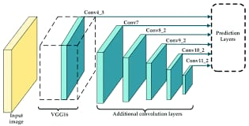
Cntd..
Deep Learning
Sign language recognition systems are essential for facilitating communication and accessibility for the deaf and hard of hearing community. However, ensuring user privacy while deploying such systems remains a significant concern.
1. Collect images for deep learning using your webcam and OpenCV
2. Label images for sign language detection using Labellmg
3. Setup Tensorflow Object Detection pipeline configuration
4. Use transfer learning to train a deep learning model
5. Detect sign language in real time using OpenCV

Slide 7
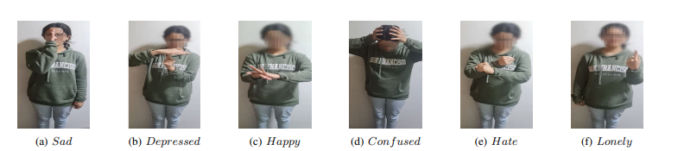
Expected Outcomes

Slide 8
Merits
Demerits
Privacy protection
Real-time communication
Limited Precision
Enivronmental Factors
Learning Curve
Dependency on Camera Quality

Slide 9
Conclusion
Privacy-preserving BSL recognition system is proposed using a state-of-the-art XeThru X4M03 UWBRADAR sensor and deep learning algorithms. For BSL, six most common emotions were considered in this pilot study, namely, sad, depressed, happy, confused, hate, and lonely. For each class, micro-Doppler unique features were stored in the form of spectrograms. These were used to train three deep
learning models, namely InceptionV3, VGG16, and VGG19
models. The classification accuracy for most of the classes wasclose to 100% with the VGG16 model outperforming others,giving an overall accuracy of 93.33% on all six classes.

Slide 10
References
Hira Hameed, Muhammad Usman, Muhammad Zakir Khan
Privacy-Preserving British Sign Language Recognition Using Deep Learning, 2022 44th Annual International Conference of the IEEE Engineering in Medicine & Biology Society (EMBC) Scottish Event Campus, Glasgow, UK, July 11-15, 2022

Slide 11
Thank you!

