Slide 1
Identifying Significant Factors Affecting Business Demand
Yamini Pratyusha PULIPATI
IT 5113 - Programming for Data Science
B00119094
Jabir rahman
04/27/2025

Slide 2
Objective:
Identify key factors influencing business demand using statistical methods.

Slide 3
Importance:
Helps businesses adjust strategies based on real data.
Optimizes service offerings and marketing targeting.

Slide 4
Data Overview
Dataset Features:
Provider ID
Location (Urban/Rural)
Service Type (Cleaning, Plumbing, Painting, etc.)
Rating (scale of 1–5)
Number of Customers
Discount Availability (Yes/No)
Average Price

Slide 5
Data Preprocessing
Key Steps:
Handled missing values where necessary.
Encoded categorical features:
Location: Urban (1), Rural (0)
Discount: Yes (1), No (0)
Selected only numeric columns for correlation analysis.

Slide 6
Model Selection
Models Used:
T-test:
Compared customer numbers for providers offering discounts vs not offering.
Linear Regression:
Modeled the relationship between Rating, Discount, Price, Location and No_of_Customer

Slide 7
Model Evaluation
T-test Results:
Providers offering discounts had significantly higher customer numbers (p < 0.05).
Regression Results:
Positive correlation between Rating, Discount availability, and No_of_Customers.
Moderate influence from Average Price and Location.
Visualization:
Heatmaps and scatterplots confirmed key patterns.

Slide 8

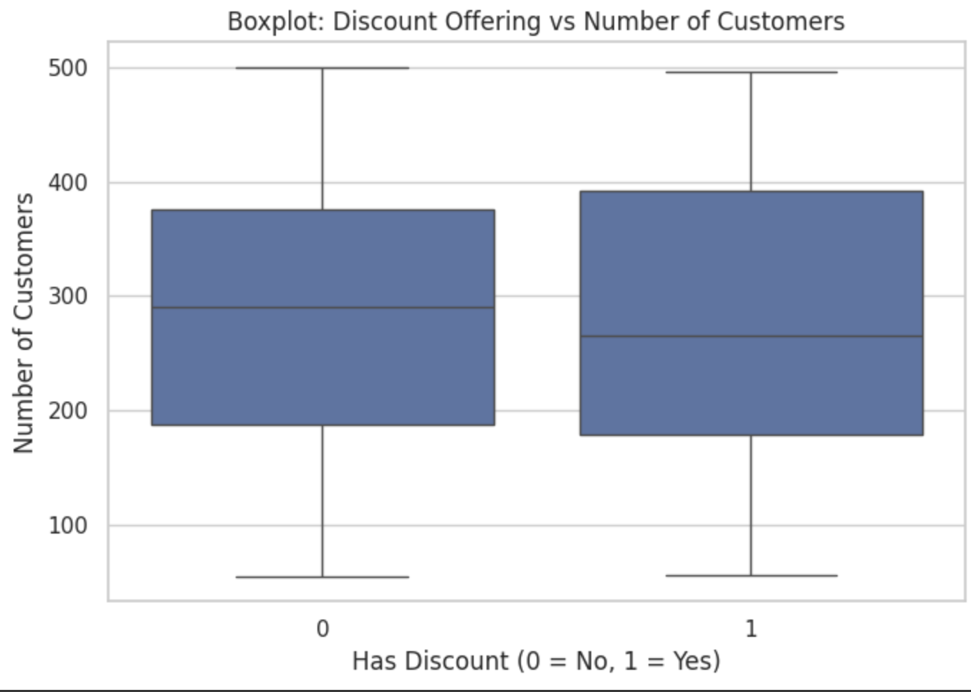
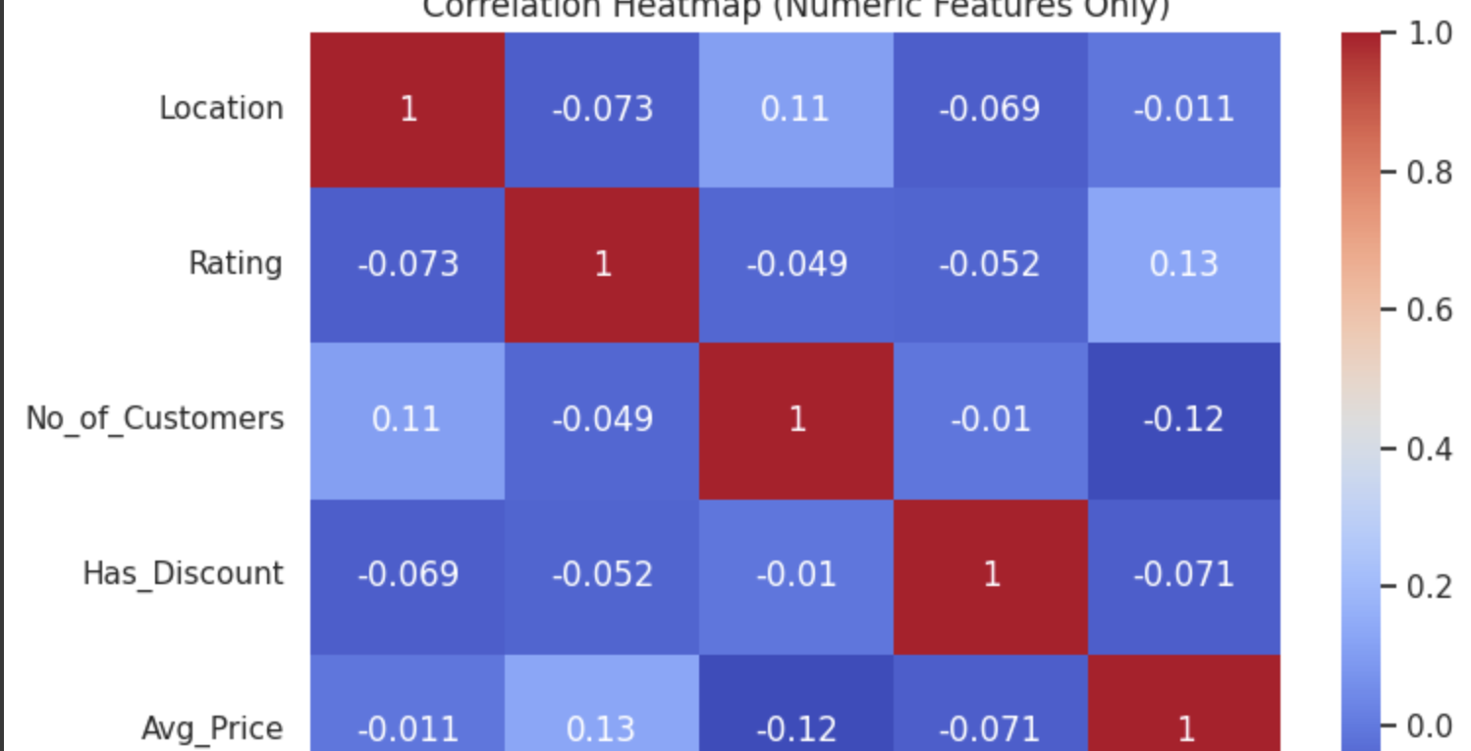

Slide 9
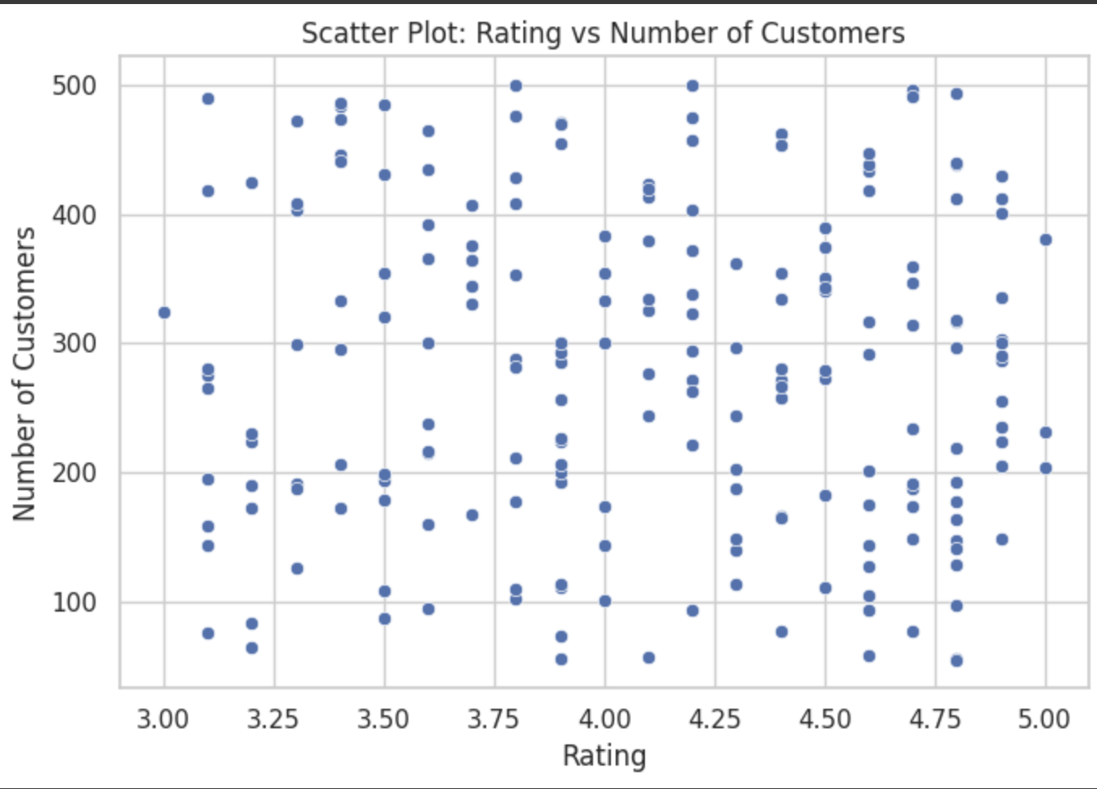

Slide 10
Key Insights & Challenges
Insights:
Discounts and higher ratings drive greater business demand.
Average price and location also affect customer numbers.
Challenges:
Encoding mixed data types (categorical + numerical).
Avoiding overfitting in small sample subsets.
Managing feature correlations.

Slide 11
Conclusion and Future Work
Conclusion:
Discount offerings and maintaining high ratings are crucial for improving customer acquisition.
Future Work:
Expand dataset with more features (customer satisfaction, service experience).
Apply advanced modeling techniques like Random Forest Regression and XGBoost.

Slide 12
THANK YOU 🤝🏻

