Slide 1

Predicting Metal Dysregulation in ALS Bridging gene expression and metal homeostasis
Yamini Chitikela, Roshith Jonnalagadda
cs.odu.edu/~cs_ychit001/
Date: March 31, 2026
1

Slide 2
Prob lem
Why predict metal dysregulation?
Amyotrophic lateral sclerosis (ALS) is a fatal neurodegenerative disease that destroys motor neurons. Median survival is only 3–5 years, and current treatments offer minimal benefit. Studies reveal dysregulated metal homeostasis in ALS - high ferritin, low transferrin and misfolded metal-binding proteins. Measuring metals directly requires expensive instruments (synchrotron XRF, LA-ICP-MS) and limited access.
[1] [2] [3]
2

Slide 3
Observations & Hypothesis
Observations
• High ferritin & low transferrin indicate iron overload
• Mutations in Cu/Zn-SOD1 and DJ-1 disrupt metal binding
• Manganese transporters (SLC30A10, SLC39A14) and ATP13A2 regulate Mn efflux/uptake
Hypothesis
Expression of metal-binding genes reflects the intracellular metal environment.
By aggregating anchor gene expression, we can infer relative metal load from RNA-seq alone.
[4] [5] [6] [7] [8] [9] [10]
3

Slide 4




Dataset & Preprocessing
We leverage the NYGC ALS Consortium dataset (GSE153960) comprising 462 samples from ALS patients and controls. Samples span motor cortex, cervical, thoracic and lumbar spinal cord. Preprocessing steps include: (1) mapping Ensembl IDs to gene symbols; (2) normalization and quality control; (3) selecting highly variable genes; (4) constructing spatial graphs using k-nearest neighbours (k=6).
Mapping IDs
Normalization
High-var genes
Graph build
[11]
4

Slide 5
Anchor Genes & Target Construction
Rationale
• Ferritin (FTH1/FTL) stores iron in cells.
• TFR1 is up-regulated when iron is low, while hepcidin down-regulates ferroportin.
• Zn transporters (ZnT3) import zinc into synaptic vesicles; metallothioneins bind heavy metals.
• ATP7A/ATP7B transport copper and deliver Cu to SOD1; DJ-1 protects against metal toxicity.
• Mn efflux via SLC30A10 & ATP13A2; Mn uptake via SLC39A14.
We selected anchor genes for each metal based on their roles in metal transport or storage. Targets are computed as the mean expression of anchor genes and standardized per metal.
Metal | Anchor Genes (examples)
Iron (Fe) | FTH1, FTL, TFR1, HAMP, SLC40A1
Zinc (Zn) | SLC30A3 (ZnT3), metallothioneins
Copper (Cu) | ATP7A, ATP7B, ATOX1, CCS, ceruloplasmin
Manganese (Mn) | SLC30A10, SLC39A14, ATP13A2
[12] [13] [14] [15] [16] [17] [18] [19] [20] [21] [22] [23]
5

Slide 6
Graph Neural Network Approach
Spatial transcriptomics creates a graph where each spot is a node and edges connect neighbouring spots (k=6). Graph neural networks (GNNs) aggregate information from neighbouring nodes to learn local metal signatures and share context across tissue. We compare linear regression, random forest and GNN models using cross-validation across anatomical regions.
Gene expression (features)
Metal prediction
[24] [25]
6

Slide 7
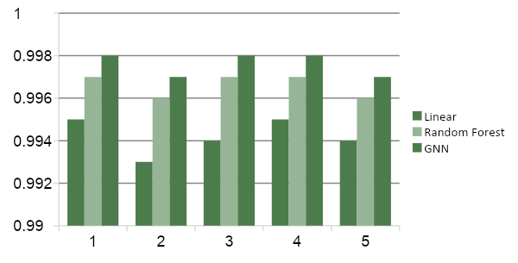
Performance & Results
Key Insights • Linear models already capture most variance due to the construction of targets. • Tree-based models (RF) slightly improve predictive performance by capturing interactions. • GNNs provide marginal gains but incorporate spatial context, which may enhance biological interpretability.
7

Slide 8
Novelty & Contributions
Novelty
• First to infer metal dysregulation from transcriptomic data in ALS.
• Anchor gene strategy links metal transport/storage proteins to gene expression.
• Integrates spatial context via GNNs, capturing neighbourhood information.
Contributions
• Curated open ALS RNA-seq dataset with spatial annotations.
• Developed a reproducible pipeline for deriving metal targets and training models.
• Open-sourced code and interactive dashboards for exploration.
[26]
8

Slide 9
Discussion & Limitations
Limitations
• Targets derived from mean expression, so linear models dominate.
• No ground-truth metal measurements to calibrate absolute concentrations.
• Anchor genes may have overlapping roles across metals.
• Dataset limited to ALS; generalisation to other disorders remains to be tested.
Discussion
• Despite simplicity, proxies capture known patterns of metal imbalance.
• Spatial context may reveal localised dysregulation (e.g., hotspots around motor neurons).
• Potential to integrate proteomics or imaging to refine models.
9

Slide 10
Conclusion & Future Work
Conclusion
• Gene expression can serve as a proxy for relative metal load in ALS tissues.
• Anchor gene sets capture biologically meaningful patterns of metal homeostasis.
• GNNs offer a principled way to incorporate spatial context.
Future Work
• Validate predictions with metal quantification (LA-ICP-MS, ICP-MS).
• Expand analysis to other neurodegenerative diseases (e.g., Parkinson’s, Alzheimer’s).
• Explore integrative models combining gene expression with proteomic and imaging modalities.
10

