Slide 1
Cybersecurity Incident Classification Using Machine Learning
Project Report
By: Yamini Devi

Slide 2
Objectives
Objective: Predict severity/category of incidents using machine learning.
Goals:
Data preprocessing for cleaning and transformation.
Training and evaluating models for insights and effectiveness.
Dataset: Attributes related to cybersecurity incidents with a classification target variable "IncidentGrade".

Slide 3
Data Preprocessing
Loading Data:
Dataset read using Pandas.
Data inspection via df.info() and df.head().
Handling Missing Values:
Columns >50% missing removed.
Numerical: Imputation (mean/median).
Categorical: Frequent category or "Unknown" tag.
Cleaning Data:
Duplicates removed.
Corrected data types.
Correlation Analysis:
Heatmaps and correlation matrix.
High-correlation features identified.

Slide 4
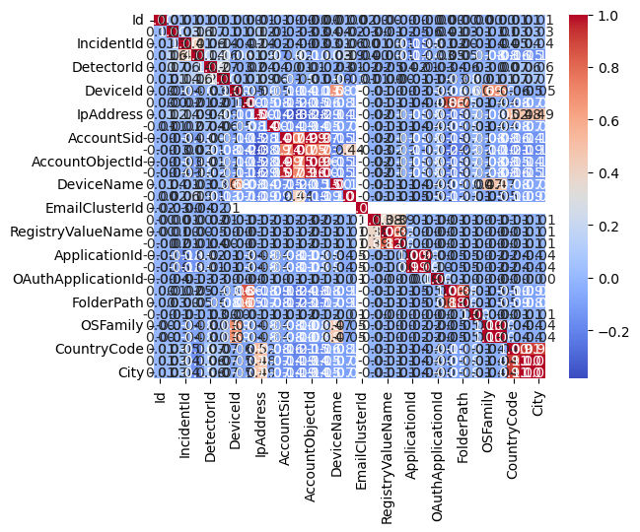
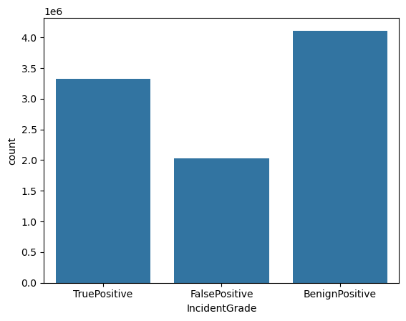
Data Preprocessing (continued)….
Indicates that the data is balanced
Correlation map of the input features

Slide 5
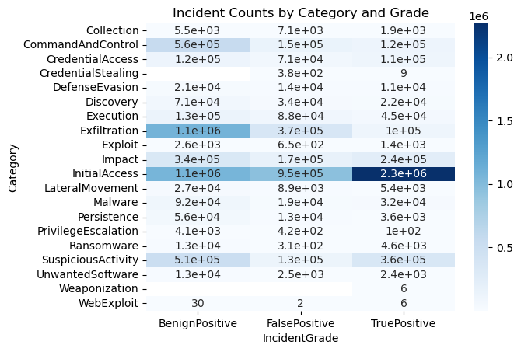
Data Preprocessing (continued)….
incident count by category and grade

Slide 6
Data Splitting & Scaling
Splitting:
Train-Test Split:
80% training, 20% validation.
Stratified on target variable.
Scaling:
MinMaxScaler: Normalizes numerical features to [0,1].
Reason: Ensures fairness in feature contributions.

Slide 7
Machine Learning Models
Logistic Regression:
Linear model for binary classification.
Evaluation Metrics: Precision, Recall, F1-score.
Decision Tree Classifier:
Non-linear model capturing feature interactions.
Strengths: Handles categorical/numerical data, no scaling needed.
Challenges: Prone to overfitting.
Other Models:
Random Forest
Fully Connected Neural Network
Gradient Boosting
Balanced Random Forest

Slide 8
NN Architecture
Fully Connected network
Dense(64, input_dim=X_train_scaled.shape[1], activation='relu'),
Dense(32, activation='relu'),
Dense(3, activation='softmax')

Slide 9
Results and Comparisons
Logistic Regression:
Strengths: Simple, interpretable.
Weaknesses: Limited to linear relationships.
Decision Tree:
Strengths: Captures complex patterns.
Weaknesses: Overfitting risk.
Metric Highlights:
Logistic Regression: High Precision.
Decision Tree: High Recall.

Slide 10
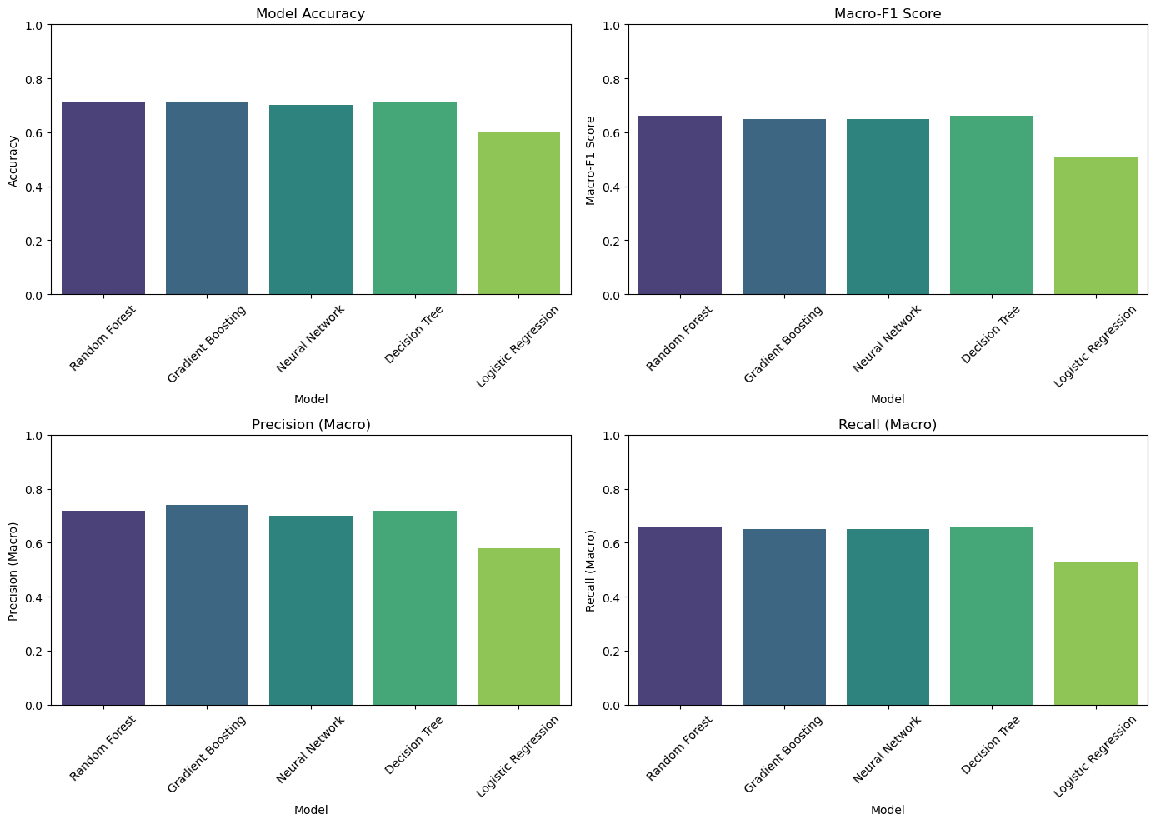
Results Visualizations

Slide 11
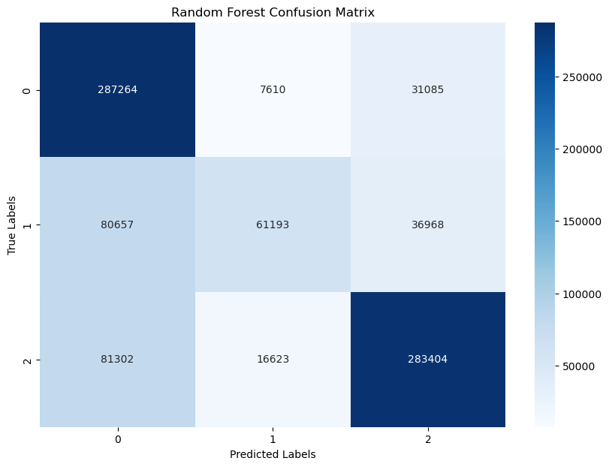
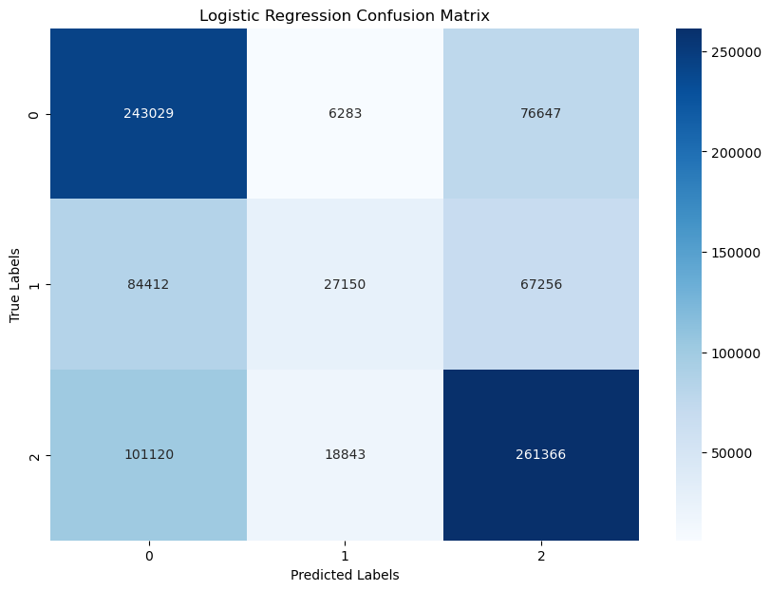
Results Visualizations (Confusion Matrix)

Slide 12
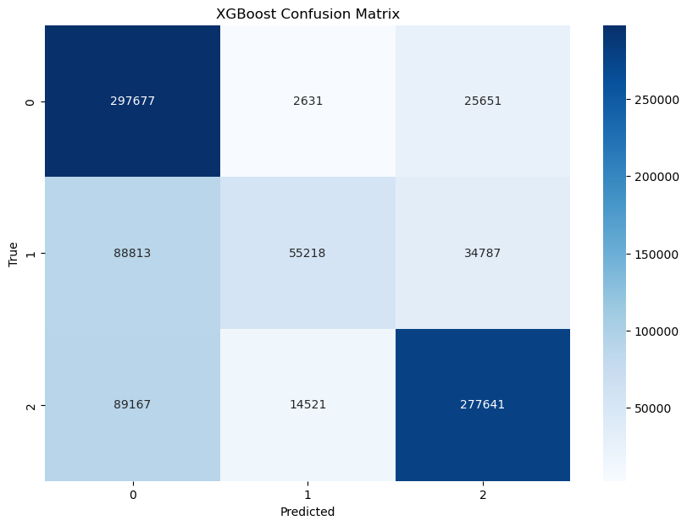

Results Visualizations (Confusion Matrix)

Slide 13
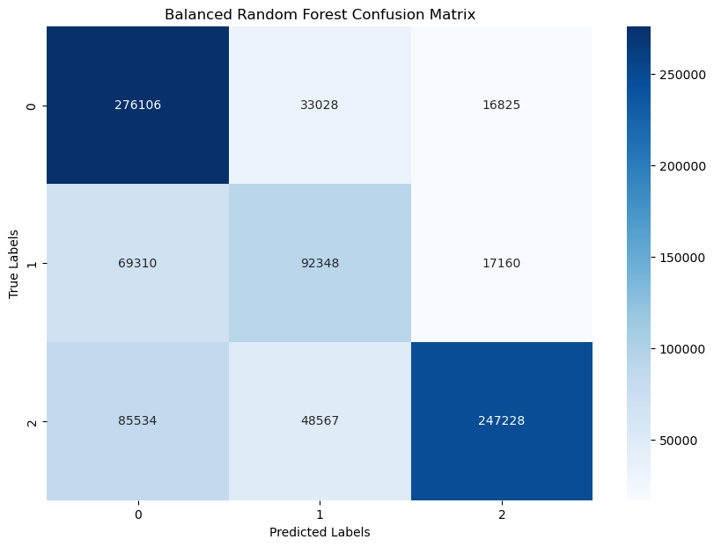

Results Visualizations (Confusion Matrix)

Slide 14
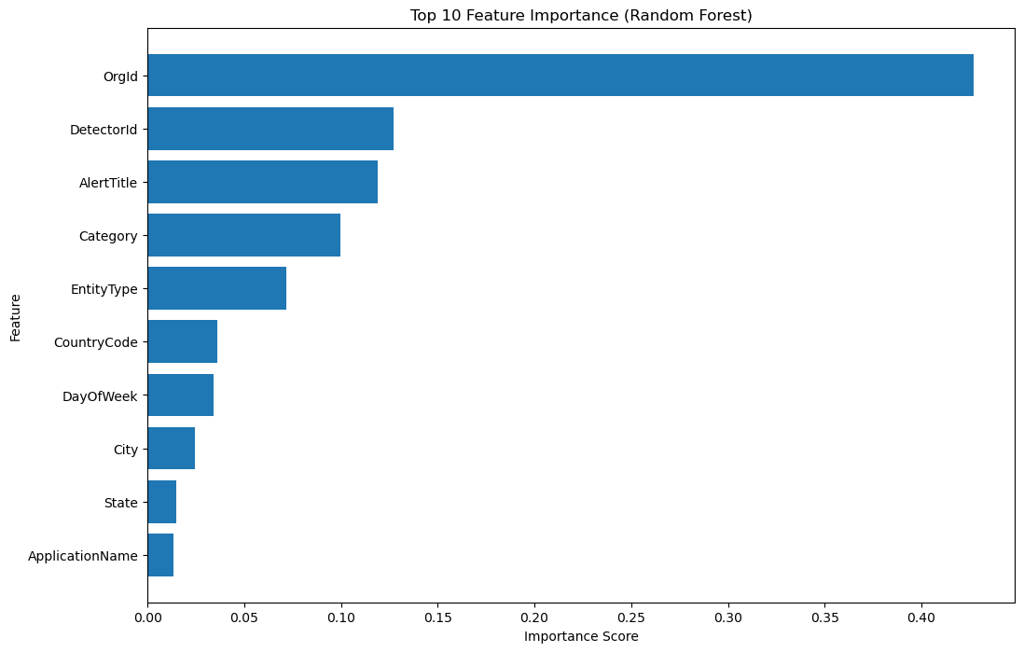
Results Visualizations (Feature importance)

Slide 15
Discussion & Conclusion
Logistic Regression proved to be a robust baseline model with fewer tuning requirements.
Summary:
Data preprocessing ensured a clean, well-structured dataset.
Both models demonstrated strengths and trade-offs, catering to different needs.

