Slide 1

DEVOPS

Slide 2
INTRODUCTION
DevOps is a software development method that stresses communication, collaboration and integration between software developers and information technology(IT) professionals there by
Enable rapid evaluation of products
Reduce risk, cost and improve quality
Increased usage of data center automation and configuration management tools

Slide 3
PRINCIPLES AND ROLES
Iterative and frequent deployments using repeatable and reliable processes
Continuously monitor and validate operational quality characteristics
ROLES:
Dev
Add or modify features
Ops
Create or enhance services

Slide 4
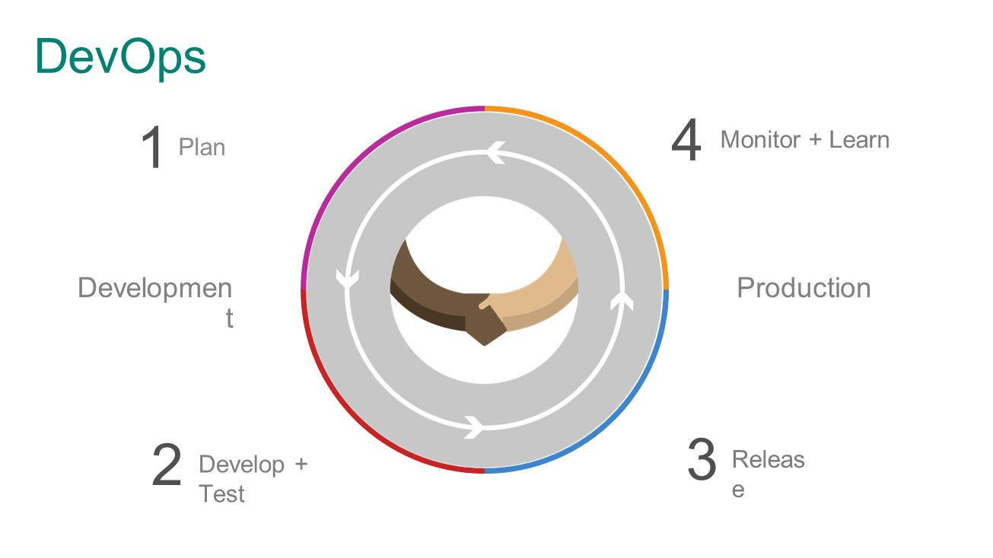
WORKING

Slide 5
CONCLUSION
DevOps is a major change in Information System
It aims to automate the software and infrastructure development, testing and delivery process by prompting the new environment.

