Slide 1
Myocardial Infarction in Females
- Presented by Yamini Joshi
Contents
Understanding Myocardial Infarction
Objective of Analysis and Data-Set Description
EDA :
  Age Distribution
  Year Wise Outcome Frequency
  Smoking Status
  MI Symptoms Box-plots
  MI Symptoms Frequency as per outcome
  Survival and Mortality Ratio Pie-Chart
Correlation between Categorical Variables
Exploratory Data Analysis Summary
Classification Model Selection
Model Selection and Evaluation (Confusion Matrix and Accuracy Score)
Model Evaluation using AUC/ROC Curve
Conclusion

Slide 2
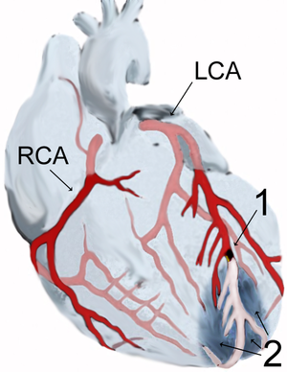
Myocardial Infarction in Females
Myocardial Infarction is medical name of a heart attack. Heart Attack is caused by regular blockage in oxygen flow to the heart.
Most heart attacks result from atherosclerosis (Narrowing and hardening of arteries due to a build-up of plaque round artery wall). Due to this build-up, the oxygen flow reduces and the arteries are damaged which result in heart attack or stroke. The risk factors for heart attack and atherosclerosis are basically the same: High BP, High Cholesterol, Diabetes, poor diet, no physical activity etc.
In early middle age, men have a greater risk of heart attack than women. However, a woman's risk increases once she begins menopause. This could be the result of a menopause-related decrease in levels of estrogen, a female sex hormone that may offer some protection against atherosclerosis.

Slide 3
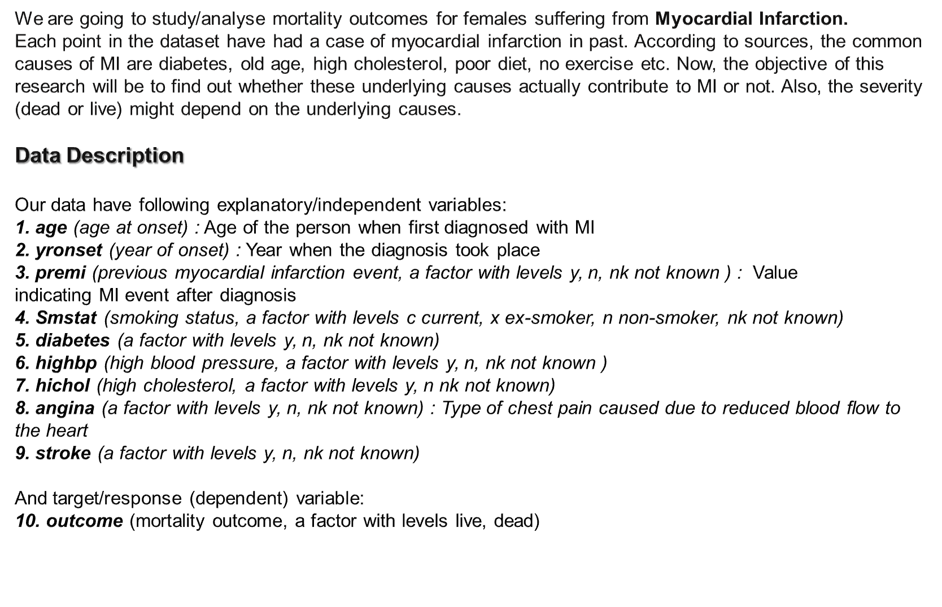
Objective

Slide 4
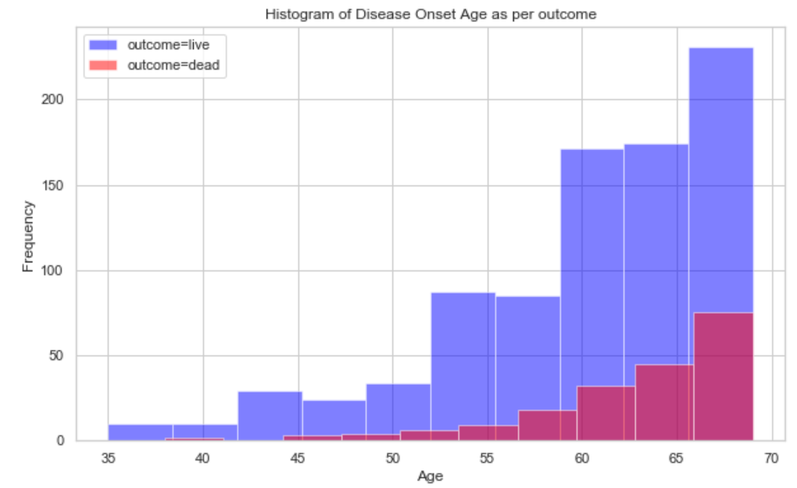
Age Distribution
Age is left-skewed, that means that most of the women with MI belongs to the age group of 55-70.
Younger females(< 50 yr age) can be considered as outliers here, because there are less cases of young people with heart problems. And we can relate to that, as people seem to ignore the irregular symptoms like chest pain or breathing problem, till they get severe with age and then it is diagnosed at a later age.
After data cleaning, we have 179 females out of 1049 records that are less than 55 year of age

Slide 5
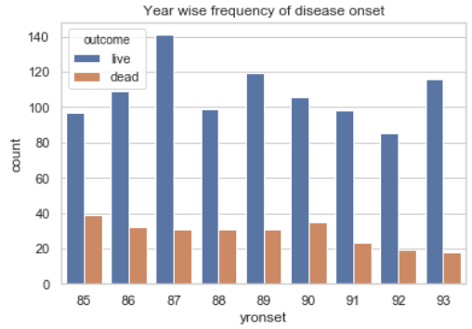
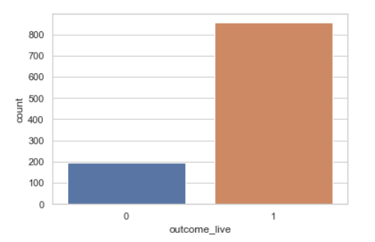
Year Wise Outcome Frequency
In the left plot, we can see the year-wise frequency of the outcome classes. And below points can be inferred from the plot:
The mortality count was constant from ‘86 to ’89, hiked a little in ‘90 and then again dropped constantly for next 3 years.
Year ‘87 had the maximum number of female diagnosed with MI and year ‘92 had the least.
From the right-plot, we can understand why the year-wise frequency had significant difference between two class counts.
The ‘dead’ class denoted with ‘0’ in the plot above, contributes 25% of the data and ‘live’ class denoted with ‘1’ contributes 75% of the data. So we have unbalanced classes here and that will reflect in other plots as well.

Slide 6
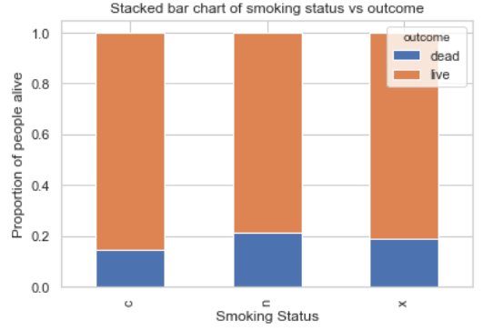
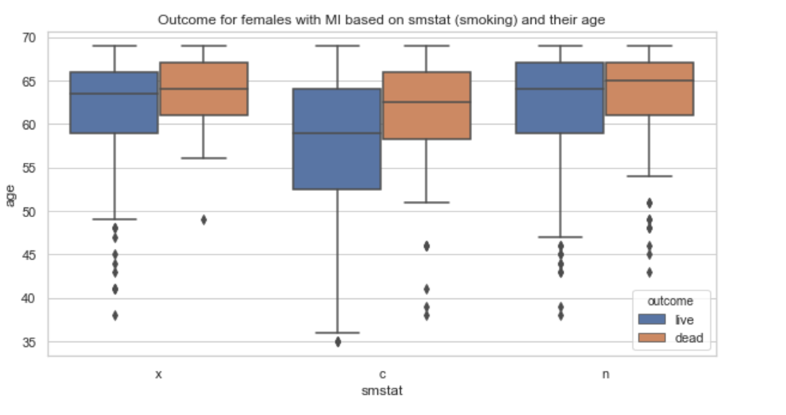
Smoking Status
From the box plot above, the area spread of ‘dead’ class in case of current smoker (‘c’) is most and also has the minimum median mortality age for class ‘dead’.
Though from our dataset no significant difference between smokers/ex-smokers or non-smokers can be deduced, other researches on the subject states that smoking has adverse effect on the MI patients.
Source: https://www.hindawi.com/journals/isrn/2011/174358/

Slide 7
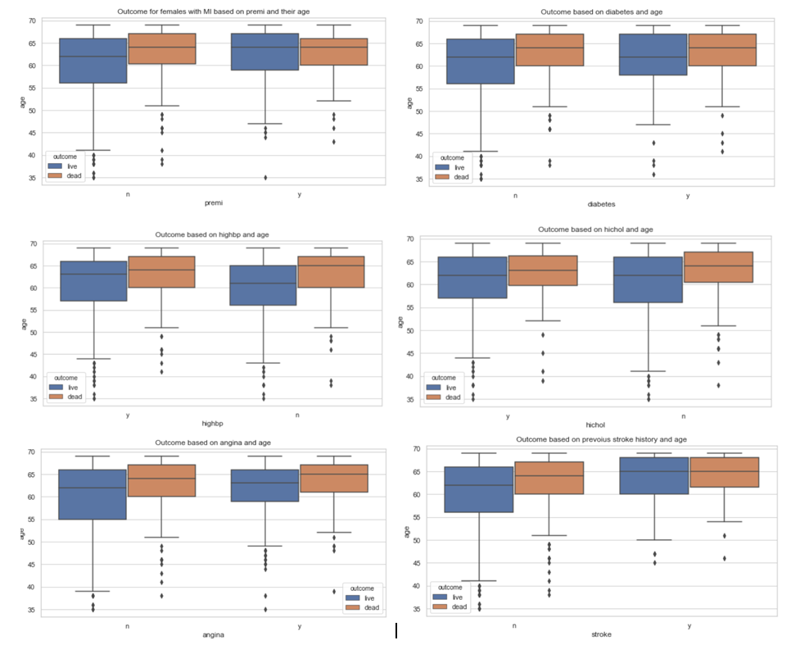
MI Symptoms Box-plots
[Pre-MI, Diabetes, high BP, high Cholesterol , Angina and Stroke]
Pre-MI
Diabetes
High Cholesterol
High BP
Angina
Stroke History

Slide 8
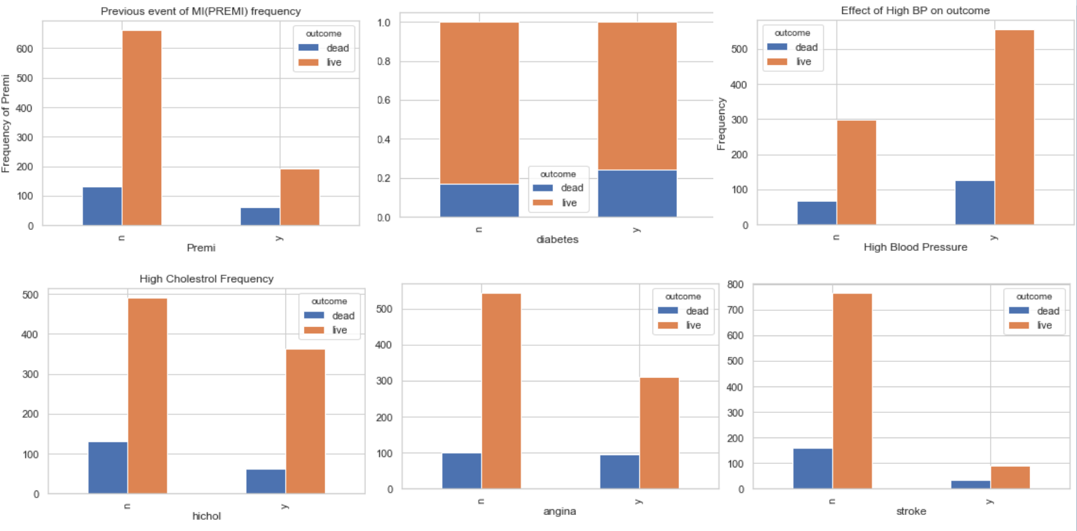
MI Symptoms Frequency as per outcome
[Pre-MI, Diabetes, high BP, high Cholesterol , Angina and Stroke]
From the box-plots we can infer that the older women (>50 yr of age) are at more risk of been severely affected by the MI. And that the majority of women who have succumbed to the disease with presence of various symptoms (plotted above) had an average age of 65.
The above frequency plots, don’t give a clear idea on how these symptoms might be contributing to the outcome. As the classes are unbalanced and death count seems to be more in absence of the factors like stroke, premi & angina. Moreover, the total records belonging to each category for different symptoms are also not equal.
For more clarity, we will be plotting the mortality and survival ratios for different causes of MI

Slide 9
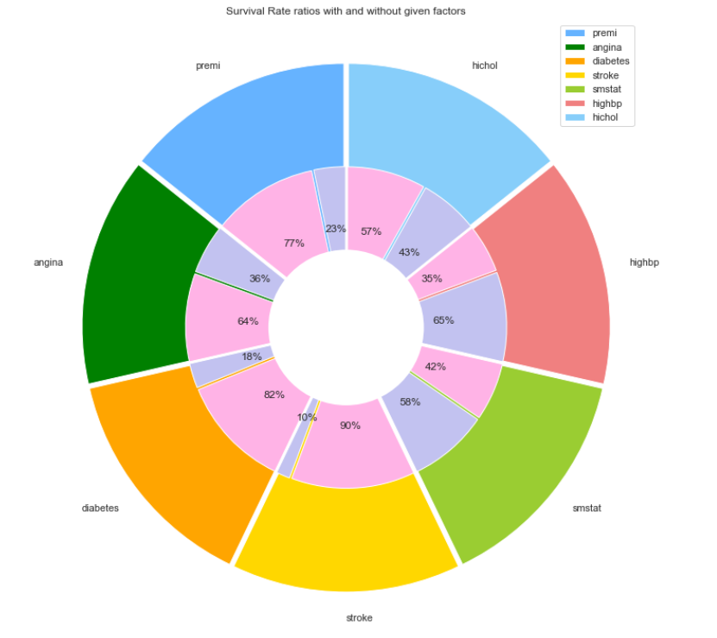
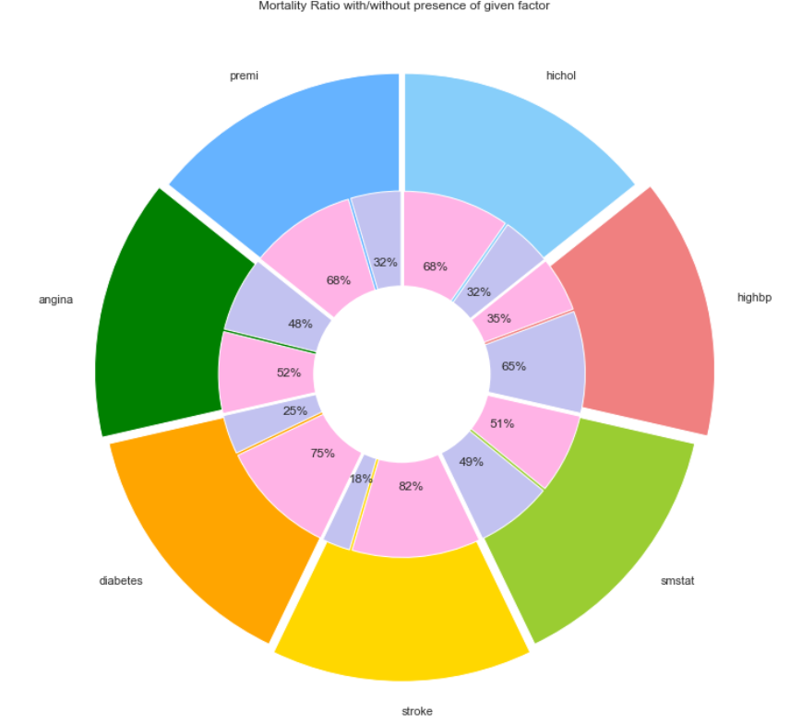
Survival and Mortality Rate Pie-chart
[Pre-MI, Diabetes, high BP, high Cholesterol , Angina and Stroke]
Survival Rate ratios with and without the symptoms
Mortality Rate ratios with and without the symptoms
Survival Rate of females with Stroke history (0.1) is less than the mortality rate of females with Stroke history (0.18).
Same goes for other factors like Diabetes [survival is 0.18 and mortality is 0.25] , Angina [survival is 0.36 and mortality is 0.48] and Pre-MI [survival is 0.23 and mortality is 0.32] .
However for high BP, the survival and mortality rates are same with or without the condition in our given data.
Though the factors like smoking and high cholesterol have more survival rate than mortality rate in the presence of these symptoms.

Slide 10
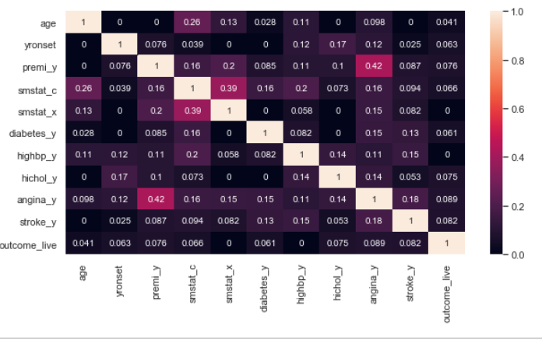
Correlation Between Categorical Variables
When any disease is diagnosed, generally first step is to observe/ask the symptoms and then confirm the findings with defined scans or tests as per the causes. Like fatigue, nausea, frequent fever, low appetite etc can be indication of Typhoid or Malaria, this can be further confirmed with proper tests.
However, this implies that certain symptoms must be related in order for a first guess of the disease. So here, we have tried to find relation between these factors. Whereas, correlation makes sense or comes into picture for continuous variables.
Since we have 8/10 categorical variables here, instead of using Pearson correlation values we have created a function using chi-square and passed this to the heat-map plot to get the correlation values which are in a range [0-1].
Above heat-map plot shows some positive relation between Angina and Pre-MI (0.42), we will ignore correlation between ex-smoker and current-smoker as they have been split from a single column.

Slide 11
Exploratory Data Analysis Summary
From the above exploratory analysis, it can be seen that 50% of female's age with 'dead' outcome lie in the range 59-69. And maximum women who are dead are above 50 year of age.
The mortality rate of females with MI had decreased from the year of onset 90 and ahead, it can be because medical science had made new discoveries and research developments during this period. Initial treatments for MI like percutaneous coronary intervention (PCI), or coronary artery bypass graft (CABG) surgery have made significant progress in the management of obstructive CAD over the past three decades. It was introduced in late 70's but it came into practice by major medical institutions around mid-80's and since then enhancements/improvements/medical researchers have been constantly made to the procedure.
Female with history of angina have survival rate of 36% and 48% mortality rate. That is also in sync with the other researches that states that people with angina may or may not develop MI at a later stage. But if they do get MI, then the chances of angina getting severe increases and if people have MI first, then there are high chances that they will develop angina later. Angina is also one of the initial symptoms for MI.
Our data also support the above point, as from the analysis mortality rate of people with only pre-MI condition (no symptom of angina) is 0.09 but women with angina and no pre-MI have mortality rate of 0.25 and women with both pre-mi and angina have 0.23. Still women suffering from neither has 0.43 mortality rate which is less than the survival rate 0.58.

Slide 12
Classification Model Selection
As our outcome/target variable here is of Nominal type, we have three classification model that can be used for predictive modelling – Logistic Regression , Decision Trees and Random Forest.
Below are the steps followed to select the best model for our scenario –
As we have unbalanced classes (75% {live} - 25% {dead}), over-sampling was done to balance the classes before modelling. Without oversampling we had achieved higher accuracy, but all the predicted values belonged to the ‘live’ class so oversampling was required.
Splitting the data into 80:20 train: test ratio.
Training the model on the split 80% data and testing on the remaining 20% data.
Checking the prediction accuracy of the model on train and test data both. To rule out the possibility of over-fitting, we have performed the prediction on train data as well. If we get significant difference between train accuracy (high) and test accuracy (low) then it means we have an over-fit model.
Model Evaluation using Confusion Matrix and K-Fold Validation and AUC/ROC Curve

Slide 13
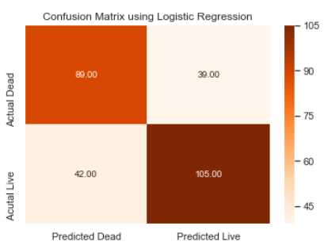
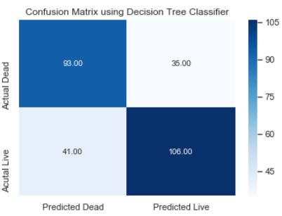
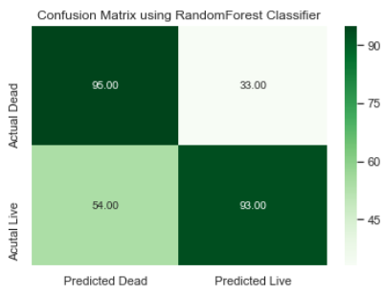
Model Selection and Evaluation
[Logistic Regression, Decision Tree and Random Forest ]
Here, we have selected three models to see which one would be good to get the best predicted outcome values.
From the above confusion matrix, it is visible that Random Forest Classifier have predicted most of the values correctly and has highest Recall and Precision values.
And if we observe the accuracy score for each model with train and test data, we can rule out over-fitting:
Accuracy score of test data using logistic is 0.71
Accuracy score of train data using logistic is 0.71
Accuracy score of test data using Decision Tree is 0.68
Accuracy score of train data using Decision Tree is 0.89
Accuracy score of test data using Random Forest is 0.72
Accuracy score of train data using Random Forest is 0.89
These scores show significant difference between train and test accuracy using Decision Tree and Random Forest model.
Whereas, Logistic Regression almost have same accuracy in both the cases and its test accuracy is almost equal to that of Decision Tree and Random Forest.

Slide 14
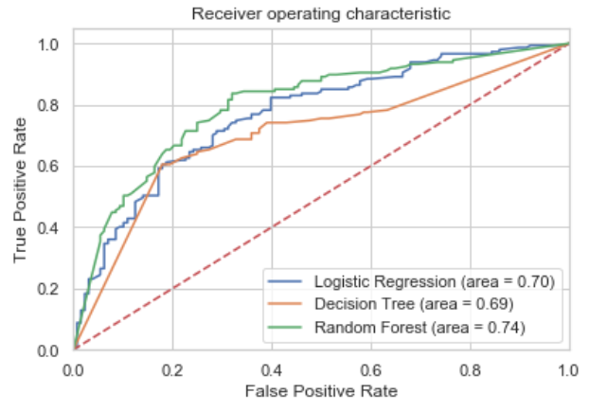
Model Evaluation – AUC/ROC Curve
[Logistic Regression, Decision Tree and Random Forest ]
Conclusion
AUC for green ROC is better than the Blue and Orange ROC. That concludes that Random Forest did a better job at classifying the values correctly.
We can see that Random Forest explains/predicts the data better from other models.

