Slide 1

EDA of 1000 IMBD Movies

Slide 2
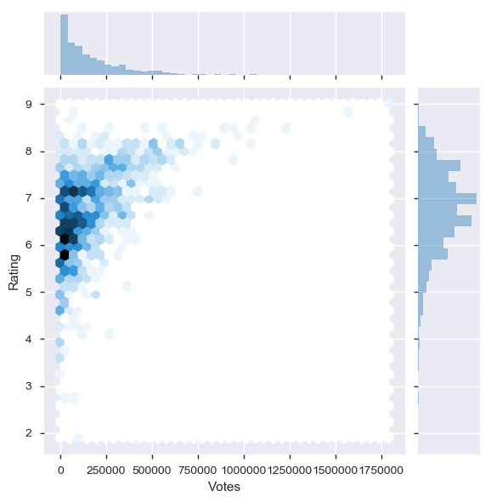
Are movies that are more voted also given good ratings?
Rating and Votes are positively related. The movies with less votes have lower rating and higher ones have higher rating

Slide 3
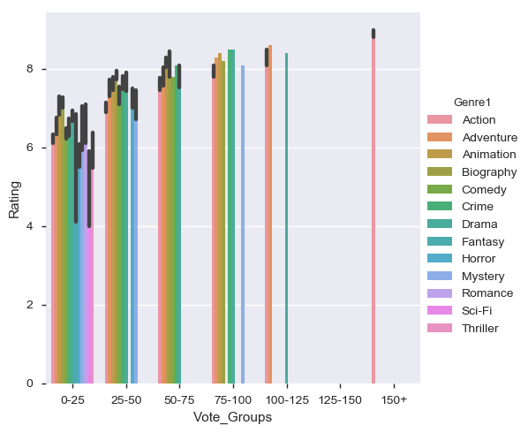
Movies that have received more rating (> 7), also belong to higher Vote Group (>100 lakh). But most of the movies belong to 0-25 (lakh) Vote group and mostly rated < 7

Slide 4
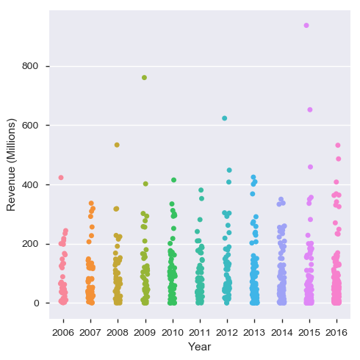
Which Year had exceptionally high revenue generating movies?
Here we can see that year 2009, 2012 and 2015 had one or two movies that had > 600 Million of revenue.

Slide 5
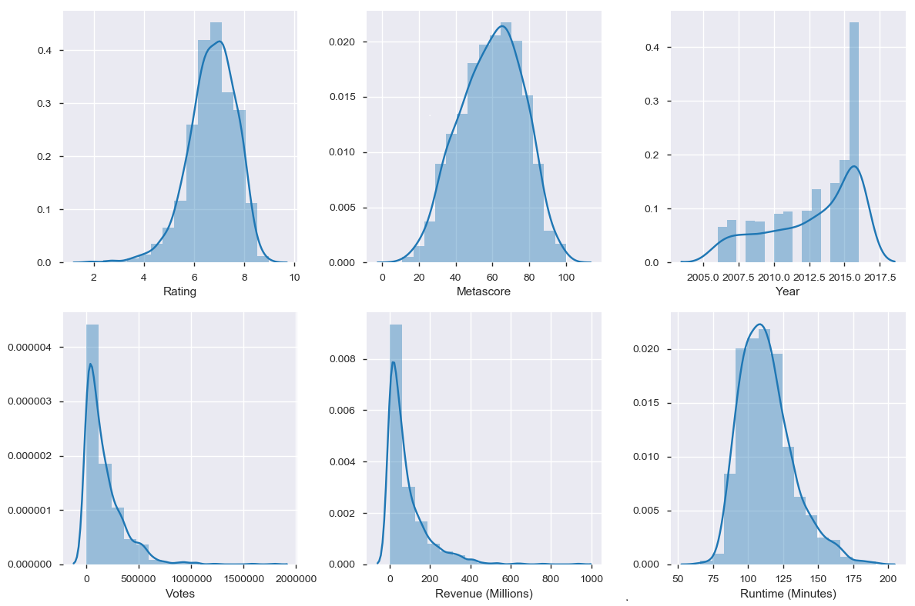
User’s Rating and Critics Rating are almost aligned with each other.
Here we can see that critics tend to rate more strictly as users have rated very few movies on lower scale (<4) whereas critics have rated comparatively more movies on lower side (<40).
In third graph, we can see that more movies belong to year 2015 and 2016 and every year more movies have released than previous years.
Most movies have received votes between 0-250000 and very few movies have been voted more than 500000.
Maximum movies revenue lie between 0-200 millions.
Movies runtime majorly lie between 90 minute to 125 minutes.

Slide 6
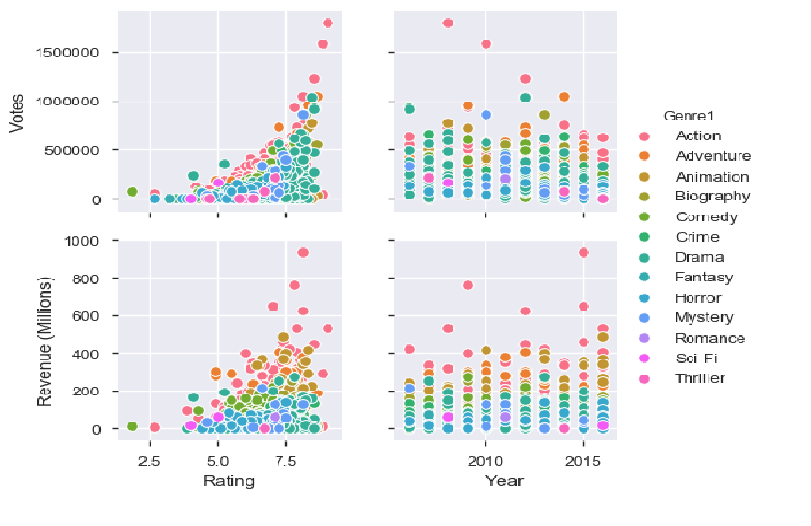
In all the 4 graphs above, we can see that highest rated, most voted and maximum revenue generating films belong to Genre ‘Action’
2. In the left 2 graphs, Rating/Revenue and Rating/Votes, both have similar trend. That is, a movie that receives more votes tend to generate more revenue and get good rating.
3. Year 2009, 2012 and 2015 released movies that generated revenue >600 millions
4. Most common Genre of the movies are Action, Adventure, Drama and Crime.

Slide 7
Some Insights from the Data
Movie "The Dark Knight" is highest rated and voted movie with Metascore of 82 (which is not highest value but a pretty good score).
Movie "Boyhood" had scored 100 in Metascore whereas Revenue is toward lower range.
The most revenue generating movie is "Star Wars: Episode VII - The Force Awakens“
3. Lowest rated movie by critic is 'Nine Lives' Genre 'Comedy' and highest rated is "Boyhood" genre 'Drama'. Lowest rated movie by user is 'Disaster' Genre 'Comedy' and highest rates by user is "The Dark Knight" genre 'Action, Crime, Drama‘
Director "Ridley Scott" has 8 movies released over the years which is maximum number of movie
by a director. Though movies by "Christopher Nolan" has highest average rating by user. And "J.J. Abrams“ movies has highest average revenue generated followed by "Christopher Nolan"

