Slide 1
Shopping Cart Abandonment Prediction Using Decision Trees and Random Forest
Machine Learning – 25SC2107E
Guided by:
Rani Mam, Assistant Professor
Yamini Katta — 2520030380
Lekhana L — 2520030364

Slide 2
Cart Abandonment in E-Commerce
Customers often add products to their cart but leave without completing the purchase.
This is known as shopping cart abandonment.
Abandoned carts mean potential revenue loss for e-commerce businesses.
Machine Learning can analyze customer behavior and predict whether a customer is likely to abandon the cart.
This allows businesses to take timely action before the customer leaves.
Customer adds products to the cart
1
Leaves without completing the purchase
2
ML predicts the risk, so a timely offer can be sent
3

Slide 3
Problem Statement
The challenge
Customers add products to their shopping carts but leave without purchasing, which leads to lost sales and revenue for e-commerce businesses.
The gap
It is hard to tell who will abandon from basic shopping activity alone. Browsing time, products viewed, cart value, previous purchases and discount usage hold useful patterns.
Our solution
A machine learning system that analyzes this behavior and classifies each customer as likely to abandon the cart or to complete the purchase.
1
2
3

Slide 4
Project Objectives
To analyze customer behavior in e-commerce shopping activities.
To identify factors that influence shopping cart abandonment.
To preprocess customer and transaction-related data for prediction.
To develop a Decision Tree classification model.
To develop a Random Forest classification model.
To evaluate and compare the performance of both models.
To predict whether a customer is likely to abandon the cart or complete the purchase.
To help e-commerce businesses take timely actions such as personalized offers and reminders.
To deploy both models in a Flask web application for live predictions.

Slide 5
Features Used
Feature | Description | Range in dataset
Browsing Time | Time spent browsing the website | 1–60 min · mean 15.04
Products Viewed | Number of products viewed | 1–22 · mean 9.04
Cart Value | Total value of products in the cart | 10–1000 · mean 93.63
Previous Purchases | Customer’s earlier purchase activity | 0–10 · mean 2.53
Discount Usage | Whether a discount was used (0 / 1) | used by 39% of customers
Target variable
Shopping Cart Abandonment
0
Purchase Completed
1
Cart Abandoned

Slide 6
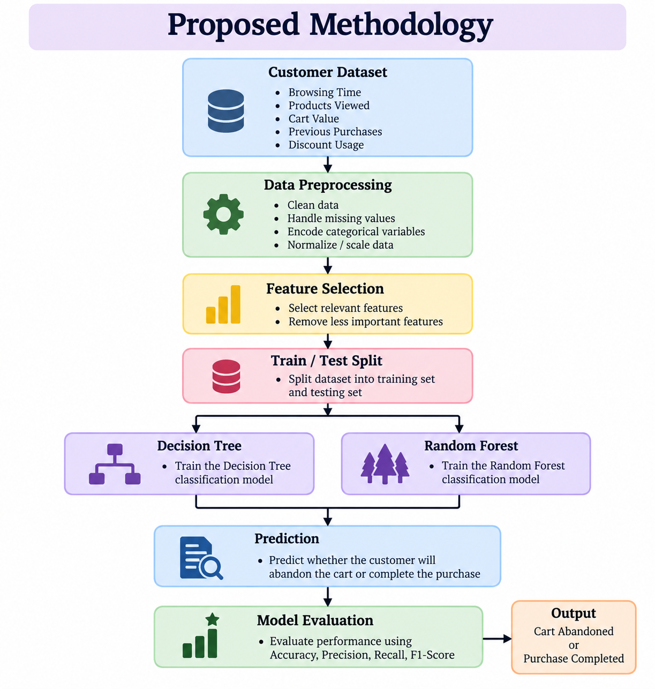

Slide 7
Dataset and Experimental Setup
3,000
customer records
80 / 20
train / test split (2,400 / 600)
45.3%
of carts abandoned
5-fold
stratified cross-validation
Model | Settings
Decision Tree | Gini criterion · max depth 5 · at least 20 samples per leaf
Random Forest | 200 trees · max depth 10 · at least 5 samples per leaf · out-of-bag scoring
The dataset is synthetic (generate_data.py), created with cart value as the strongest signal. Any real e-commerce dataset with the same six columns can be dropped in and the pipeline re-run.

Slide 8
Decision Tree Algorithm
Decision Tree Classifier
A supervised learning algorithm that classifies by splitting data into smaller groups with a sequence of decision rules.
How it works
Takes customer behavior features as input
Creates decision rules from the features
Follows branches based on customer behavior
Produces a final classification
In our project
Gini splits, max depth 5, at least 20 customers per leaf
Cart value ≤ 93.77?
Browsing time ≤ 16.55?
Browsing time ≤ 9.75?
… further splits down to depth 5
Output
Purchase Completed
Cart Abandoned
Top two levels of the trained tree

Slide 9
Random Forest Algorithm
Random Forest Classifier
A supervised classification algorithm that combines many Decision Trees to make one prediction.
How it works
Builds multiple trees from the training data
Each tree makes its own prediction
The predictions are combined
The result determines the cart status
In our project
200 trees, max depth 10; out-of-bag accuracy 75.5%
Tree 1
Tree 2
Tree 3
Tree 200
Predictions combined
Output
Purchase Completed
Cart Abandoned

Slide 10
Performance Evaluation
Metric | What it measures | Decision Tree | Random Forest
Accuracy | Overall correctness of predictions | 74.0% | 73.3%
Precision | Correctness of predicted abandoned carts | 74.6% | 75.2%
Recall | Share of actual abandoned carts identified | 64.7% | 61.4%
F1-Score | Balance between precision and recall | 69.3% | 67.6%
ROC-AUC | Ability to rank abandoners above buyers | 0.808 | 0.833
Decision Tree
Higher accuracy (74.0%), recall (64.7%) and F1 (69.3%); easy-to-read rules.
Random Forest
Higher precision (75.2%) and ROC-AUC (0.833); better at ranking customers by risk.
Evaluated on the 600 held-out test customers. Best value in each row is bold.

Slide 11
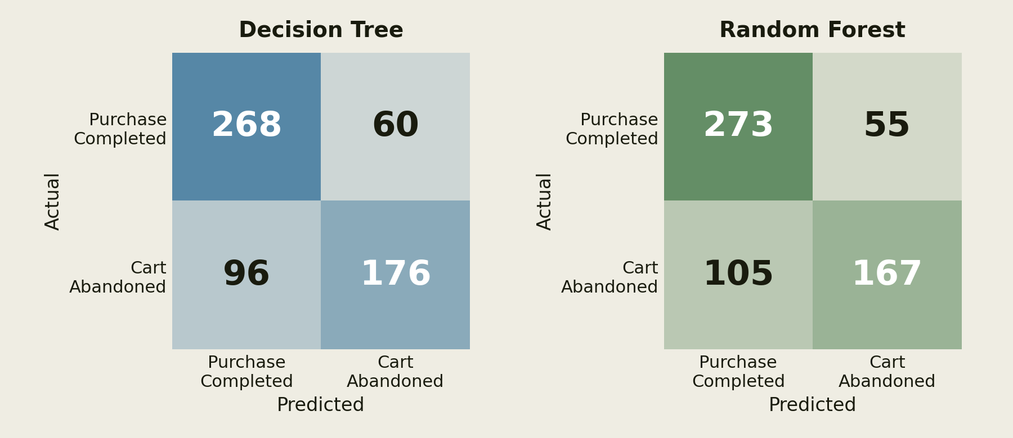
Confusion Matrix
Compares actual with predicted outcomes on the 600 test customers; the diagonal holds the correct predictions.
The Decision Tree classifies 444 of 600 correctly; the Random Forest 440.
Most errors are missed abandonments (false negatives): 96 for the Decision Tree and 105 for the Random Forest.

Slide 12
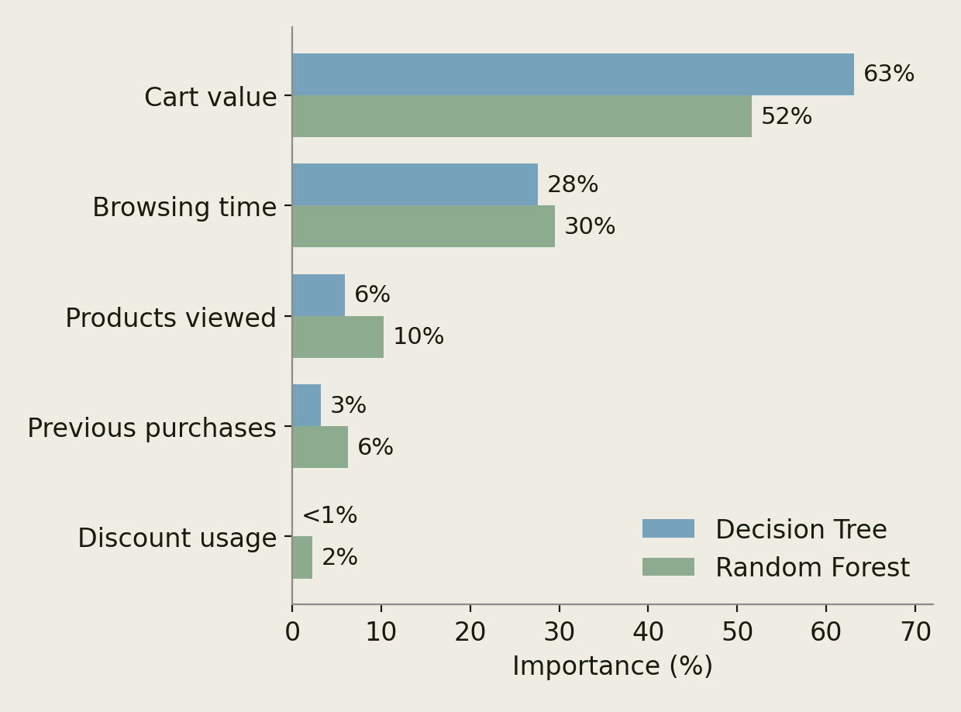
Feature Importance
Contribution of each feature to the prediction of cart abandonment
Cart Value is the strongest driver in both models (63% / 52%)
Browsing Time is next (28% / 30%)
Products Viewed also contributes (6% / 10%)
Previous Purchases contributes less (3% / 6%)
Discount Usage matters least (<1% / 2%)
Percentages: Decision Tree / Random Forest. Permutation importance on the test set also ranks Cart Value first.

Slide 13
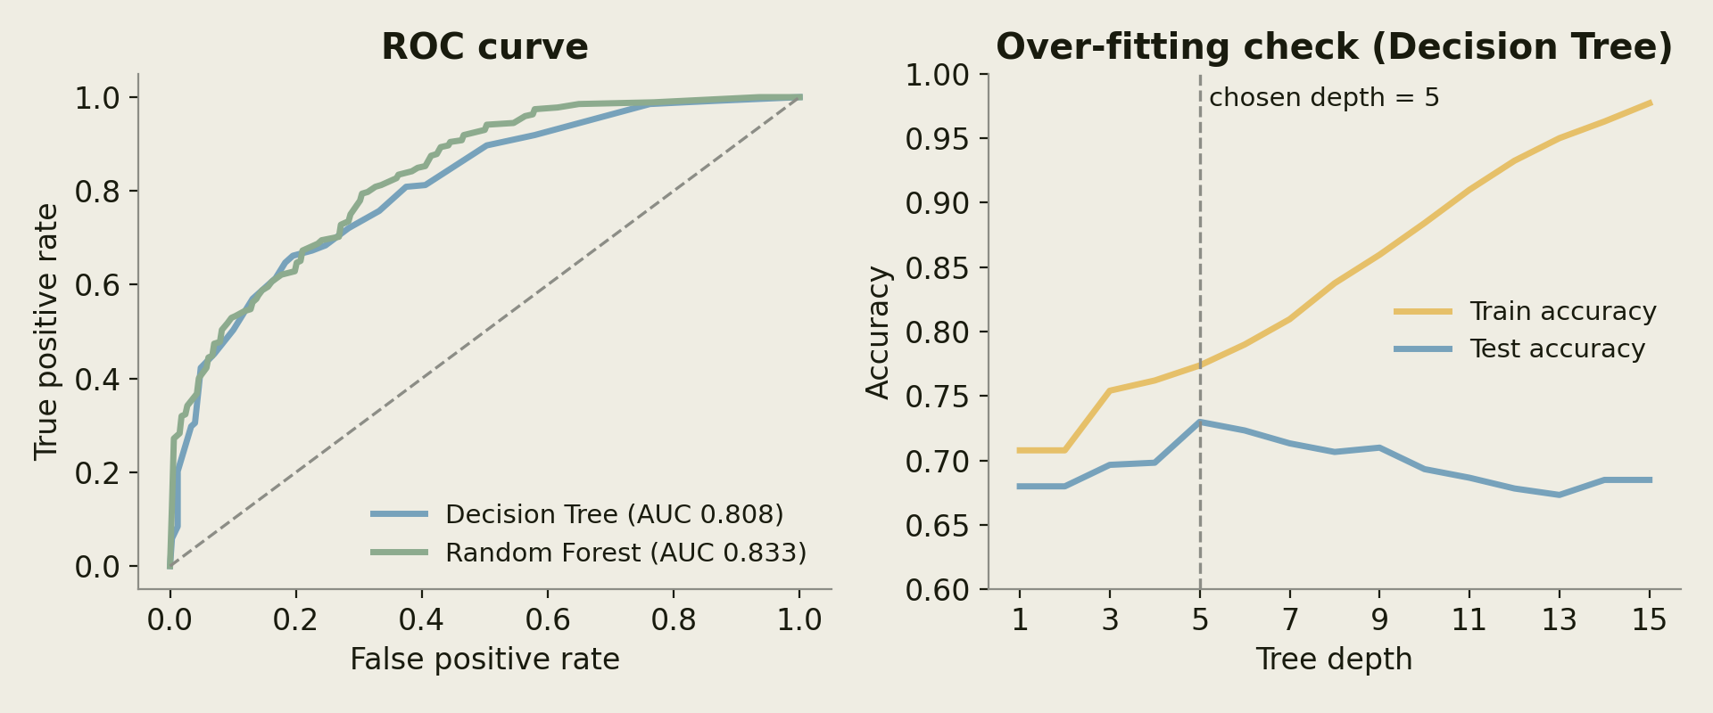
Model Validation
0.833 vs 0.808
ROC-AUC, Random Forest vs Decision Tree
75.0% vs 73.2%
5-fold CV accuracy, Random Forest vs Decision Tree
Depth 5
best test accuracy; deeper trees over-fit

Slide 14
Web Application
Input
Customer’s five features are entered on the site
Flask API
POST /api/predict validates the values
Models
Decision Tree and Random Forest each return a probability
Result
Label, probability, rule path and advice
Risk-based advice (from the Random Forest probability)
High risk · ≥ 70%
Send a reminder plus a personalised discount or free shipping now.
Medium · 40–70%
Show a cart reminder or a limited-time offer.
Low risk · < 40%
Likely to buy; no intervention needed.
The site also loads the model metrics from /api/metrics to draw its charts.

Slide 15
Conclusion and Future Scope
Conclusion
Predicts shopping cart abandonment from five customer behavior features.
Decision Tree and Random Forest perform comparably (74.0% vs 73.3% accuracy); the Random Forest ranks risk better (ROC-AUC 0.833 vs 0.808).
Cart Value is the strongest predictor; Discount Usage is the weakest.
A Flask web app turns the probabilities into retention advice.
Results use synthetic data, so they demonstrate the pipeline rather than real-world performance.
Future Scope
Use larger real-world e-commerce datasets
Include additional customer behavior features
Develop real-time cart abandonment prediction
Integrate the model with e-commerce platforms

