Slide 1
ASP.NET MVC 4.0
Module 10
Notes:
© 2010 Wipro Ltd – Internal and Restricted

Slide 2
Agenda
1
ASP.NET MVC 4.0 Overview
2
MVC Application Execution Process
3
Understanding ASP.NET MVC Controllers
4
Understanding ASP.NET MVC View

Slide 3
1. ASP.NET MVC 4.0 Overview

Slide 4
Objectives
At the end of this sub-module you should be able to
  Define and Understand What is the MVC Framework
  Understand MVC Architecture Pattern
    Define Model
    Define View
    Define Controller
  Benefits of MVC
  How to Implement in ASP. Net application
  Identify what Web Forms and MVC have in common
  New Features in MVC 4.0

Slide 5
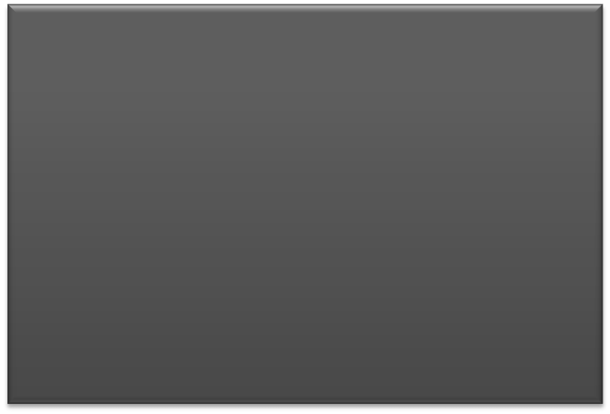
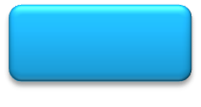
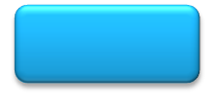
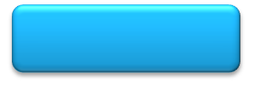
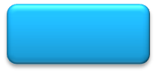
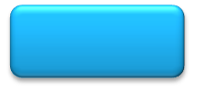
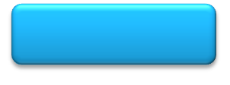
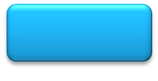
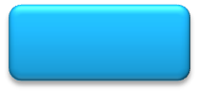
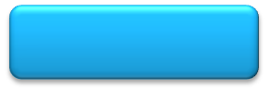

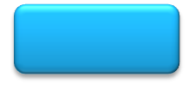
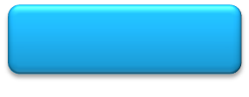
ASP.NET
ASP.NET
Caching
Modules
Globalization
Pages
Controls
Master Pages
Profile
Roles
Membership
Intrinsics
Handlers
Etc.
One web application
framework to rule them all…
Notes:
For the entire life of ASP.NET it has been seen as a single framework that included both runtime and presentational aspects. This includes core features such as roles and globalization, as well as WebForms features such as master pages and user controls.

Slide 6
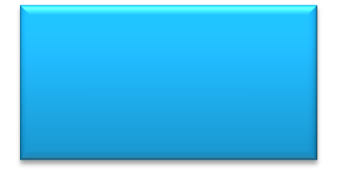
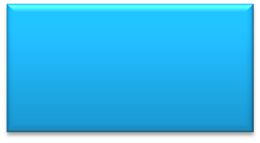
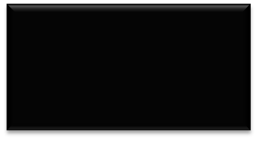
ASP.NET Now…
ASP.NET
Dynamic Data
Presentation
ASP.NET
WebForms
ASP.NET
MVC
ASP.NET
Core
Runtime
Notes:
With the release of .NET Framework 3.5 SP1, ASP.NET started being seen as more modular. ASP.NET Core now represents just the runtime aspects of ASP.NET, and ASP.NET WebForms is simply a presentation option that sits on top of that runtime. With this, it becomes possible to introduce other presentation layer implementations on top of ASP.NET, such as the new ASP.NET MVC framework.
While many who are beginning to investigate into ASP.NET MVC think that it is the replacement for WebForms, as you can see, it is simply another option for developing web applications using the ASP.NET runtime.

Slide 7
What is the MVC Framework?
MVC is a reference to a design pattern
(M)odel
(V)iew
(C)ontroller

Slide 8
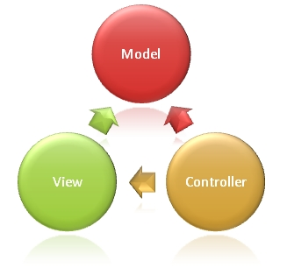
MVC Architectural Pattern
An architectural pattern used to separate an application into three main aspects
Notes:
Model. Set of classes that represent data and business rules for how data can be changed and manipulated.
View. Application’s user interface
Controller. Set of classes that handles communication from user, overall application flow, and application-specific logic.
The Model-View-Controller (MVC) architectural pattern separates an application into three main components: the model, the view, and the controller. The ASP.NET MVC framework provides an alternative to the ASP.NET Web Forms pattern for creating Web applications. The ASP.NET MVC framework is a lightweight, highly testable presentation framework that (as with Web Forms-based applications) is integrated with existing ASP.NET features, such as master pages and membership-based authentication.
© 2009 Wipro Ltd – Internal & Restricted

Slide 9
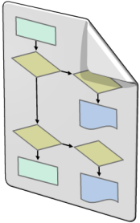

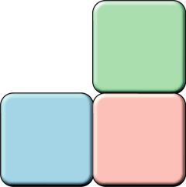
MVC Architectural Pattern
The ASP.NET MVC framework is a lightweight, highly testable presentation framework that is integrated with the existing ASP.NET features
The MVC framework includes the following components:
Models
Model objects are the parts of the application that implement the logic for the application's data domain
Views
Views are the components that display the application's user interface (UI)
Controllers
Controllers are the components that handle user interaction, work with the model, and select a view to render the UI
Notes:
© 2009 Wipro Ltd – Internal & Restricted

Slide 10
What is an MVC Controller?
The ASP.NET MVC framework is a lightweight, highly testable presentation framework that is integrated with the existing ASP.NET features
The MVC framework includes the following components:
Models
Model objects are the parts of the application that implement the logic for the application’s data domain
Views
Views are the components that display the application’s user interface (UI)
Controllers
Controllers are the components that handle user interaction, work with the model, and select a view to render the UI
Notes:
© 2009 Wipro Ltd – Internal & Restricted

Slide 11
What is an MVC View?
The ASP.NET MVC framework is a lightweight, highly testable presentation framework that is integrated with the existing ASP.NET features
The MVC framework includes the following components:
Models
Model objects are the parts of the application that implement the logic for the application’s data domain
Views
Views are the components that display the application’s user interface (UI)
Controllers
Controllers are the components that handle user interaction, work with the model, and select a view to render the UI
Notes:
© 2009 Wipro Ltd – Internal & Restricted

Slide 12
MVC Architectural Pattern
The MVC framework includes the following components:
Models. Model objects are the parts of the application that implement the logic for the application's data domain. Often, model objects retrieve and store model state in a database. For example, a Product object might retrieve information from a database, operate on it, and then write updated information back to a Products table in a SQL Server database.
Views. Views are the components that display the application's user interface (UI). An example would be an edit view of a Products table that displays text boxes, drop-down lists, and check boxes based on the current state of a Product object.
Controllers. Controllers are the components that handle user interaction, work with the model, and ultimately select a view to render that displays UI. In an MVC application, the view only displays information; the controller handles and responds to user input and interaction. For example, the controller handles query-string values, and passes these values to the model, which in turn might use these values to query the database.
Notes:
© 2009 Wipro Ltd – Internal & Restricted

Slide 13
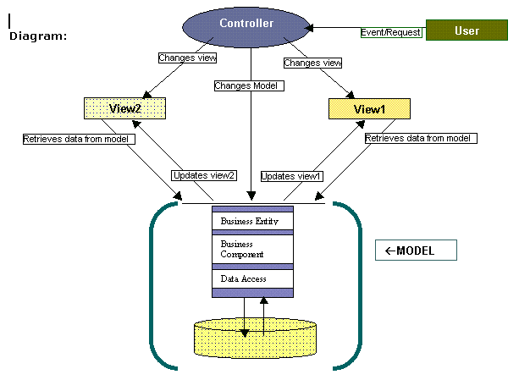
Model View Controller (MVC)
Notes:
VIEW:
View is the graphical data presentation (outputting) irrespective of the real data processing. View is the responsible for look and feel, some custom formatting, sorting etc. View is completely isolated from actual complex data operations. For example, Online product catalog view is completely separated from database connection, query, tables etc. It simply gets final row-data from the model and puts some cosmetics and formatting before displaying it in browser. View provides interface to interact with the system. The beauty of MVC approach is that it supports any kind of view, which is challenging in today’s distributed and multi-platform environment.
A MVC model can have multiple views, which are controlled by controller. View interface can be of WEB-FORMS, HTML, XML/XSLT, XTML, and WML or can be Windows forms etc.
MODEL:
Model is responsible for actual data processing, like database connection, querying database, implementing business rules etc. It feeds data to the view without worrying about the actual formatting and look and feel. Data provided by Model is display-neutral so it can be interfaced with as many views without code redundancy; this eases your code maintenance and reduces bugs and allows code -reuse at good extent. Model responds to the request made by controllers and notifies the registered views to update their display with new data.
CONTROLLER:
Controller is responsible for Notice of action. Controller responds to the mouse or keyboard input to command model and view to change. Controllers are associated with views. User interaction triggers the events to change the model, which in turn calls some methods of model to update its state to notify other registered views to refresh their display.
© 2009 Wipro Ltd – Internal & Restricted

Slide 14
Benefits of MVC
It makes it easier to manage complexity by dividing an application into the model, the view, and the controller.
It does not use view state or server-based forms. This makes the MVC framework ideal for developers who want full control over the behavior of an application.
It uses a Front Controller pattern that processes Web application requests through a single controller. This enables you to design an application that supports a rich routing infrastructure.
It provides better support for test-driven development (TDD).
It works well for Web applications that are supported by large teams of developers and for Web designers who need a high degree of control over the application behavior.
Notes:
© 2009 Wipro Ltd – Internal & Restricted

Slide 15
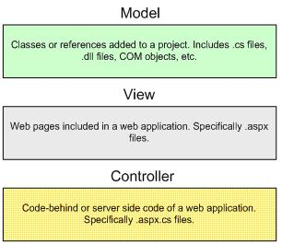
Implementing MVC in ASP.NET
Notes:
Models. Model objects are the parts of the application that implement the logic for the application's data domain
Views. Views are the components that display the application's user interface (UI).
Controllers. Controllers are the components that handle user interaction, work with the model, and ultimately select a view to render that displays UI
© 2009 Wipro Ltd – Internal & Restricted

Slide 16
Why MVC in ASP.NET
Makes your application code more
Testable
Modifiable
Reusable
Maintainable
Scalable
Notes:
It makes it easier to manage complexity by dividing an application into the model, the view, and the controller.
It does not use view state or server-based forms. This makes the MVC framework ideal for developers who want full control over the behavior of an application.
It uses a Front Controller pattern that processes Web application requests through a single controller. This enables you to design an application that supports a rich routing infrastructure.
It provides better support for test-driven development (TDD).
It works well for Web applications that are supported by large teams of developers and for Web designers who need a high degree of control over the application behavior.
© 2009 Wipro Ltd – Internal & Restricted

Slide 17
Web Forms and MVC have in common
Both run on IIS
Both use .aspx pages
Both can
  use Master pages
  though you can use a different view engine if you’d like in MVC
Both can use any data access framework
(ADO.NET, LINQ, Entity Framework, etc.)
Notes:
.cshtml extensions can also be used for Razor Engine (if C# is development language) which can be used for test driven development.
© 2009 Wipro Ltd – Internal & Restricted

Slide 18
New Features of ASP.NET MVC 4
ASP.NET Web API
Mobile Features
Display Modes
Asynchronous Controllers
OAuth and OpenID
Bundling and Minification
    Adding Controller to any project folder
    Enhancements to default project templates
    Jquery Mobile, View Switcher and Browser overriding
    Azure SDK
Support for Database Migrations using Entity Framework
Notes:
New Features of ASP.NET MVC 4
ASP.NET MVC 4 includes several new features, such as the ASP.NET Web API, mobile features, display modes, asynchronous controllers, Oauth and OpenID support, and bundling and magnification.
o ASP.NET Web API. The ASP.NET Web API makes it easy to create a set of web services that can respond to browser requests using simple HTTP verbs such as GET, POST, and DELETE. Using the Web API, you can build the back end web services that a client-centric web application can call. Building web applications using client-centric HTML pages and the Web API is an alternative to using ASP.NET MVC.
o Mobile features. As smartphones and tablets become ubiquitous, you should ensure that your website displays well on all screen sizes, resolutions, color depths, and so on. ASP.NET MVC 4.0 includes several new features to make this easier. For example, the jQuery Mobile script library renders a rich user interface for smartphone browsers, but simpler controls to older models of phones. You can use the new Mobile Project Template that uses jQuery Mobile to create sites specifically for mobile devices. Alternatively, you can add mobile-specific views to your MVC project.
o Display modes. Display modes allow you to select a view easily based on the web browser that made the request. Display modes help render HTML for mobile devices and they can be used to display content on unusual desktop browsers. When you add a display mode for a particular browser, you override the views, template views, and partial views that are used to render HTML.
o Asynchronous controllers. Usually, a Controller action renders synchronously. If the action takes a long time to run, the user has to wait because the action uses a single thread. With asynchronous actions, you can call a long-running method on a separate thread and wait for the results to be returned. This enables an action to complete and respond to the user before the results are returned.
o OAuth and OpenID standards support. Using the OAuth and OpenID standards for identifying users connected to the web application over the Internet, you can call the services of a thirdparty site to check the credentials of a user. You can trust the identity verified by the external site, and then use it to authorize access to internal resources. Using these technologies, you could, for example, enable users to access internal resources by logging on with their Windows Live account.
o Bundling and minification. When a browser requests a webpage, the server often returns the page with a CSS style sheet and one or more JavaScript files. ASP.NET MVC 4.0 can bundle these separate files into a single file to increase the efficiency of the response. It can also minify these files, by removing white space, shortening variable names, and performing other actions that save space. This saves time on downloads and both server and client-side resources, and makes your web application faster.

Slide 19
Notes:
Adding Controller to any project folder
You can now right click and select Add Controller from any folder in your MVC project. This gives you more flexibility to organize your controllers however you want, including keeping your MVC and Web API controllers in separate folders.
Enhancements to default project templates
The template that is used to create new ASP.NET MVC 4 projects has been updated to create a more modern-looking website
Jquery Mobile, View Switcher and Browser overriding
The jQuery.Mobile.MVC package includes a sample view-switcher component to switch between Desktop/Mobile views
Azure SDK
ASP.NET MVC 4 supports the 1.6 and newer releases of the Windows Azure SDK
Support for Database Migrations using Entity Framework
ASP.NET MVC 4 projects now include Entity Framework 5. One of the great features in Entity Framework 5 is support for database migrations. This feature enables you to easily evolve your database schema using a code-focused migration while preserving the data in the database
© 2009 Wipro Ltd – Internal & Restricted

Slide 20
Summary
In this sub-module we have discussed
  What is the MVC Framework
  MVC Architecture Pattern
    Define Model
    Define View
    Define Controller
  Benefits of MVC
  How to Implement in ASP. Net application
  Identify what Web Forms and MVC have in common
  New Features in MVC 4.0

Slide 21
Developing MVC Models
Notes:
© 2009 Wipro Ltd – Internal & Restricted

Slide 22
Objectives
At the end of this sub-module you should be able to
  Understand Models
  Developing Models
  Using an Entity Framework Context
  Using LINQ to Entities
  Data Type Errors Handled by MVC Models
  What Are Model Binders?
Notes:
© 2009 Wipro Ltd – Internal & Restricted

Slide 23
What is an MVC Model?
The model represents the domain of the application.
The purpose of the model is to add meaning to the raw data.
Model also adds rules to the application which orchestrate how the application should work.
Model is not responsible for accessing the persistent storage mechanism.
Notes:
MVC model is basically a C# or VB.NET class A Set of classes that represent data and business rules for how data can be changed and manipulated. The model represents the domain of the application. The purpose of the model is to add meaning to the raw data. Model also adds rules to the application which orchestrate how the application should work. Model is not responsible for accessing the persistent storage mechanism.
© 2009 Wipro Ltd – Internal & Restricted

Slide 24
Creating an MVC Model
MVC model can be created manually or by leveraging the power of an object relational mapping tool.
LINQ to SQL can be used to generate a model by automatically creating the model classes from the database schema.
Entity Framework allows the developer to generate the model classes based on the database schema using a visual designer.
Entity Framework also allows the developer to generate the database schema based on the model classes.
Notes:
LINQ to SQL can be used to generate a model by automatically creating the model classes from the database schema. Entity Framework allows the developer to generate the model classes based on the database schema using a visual designer. Entity Framework also allows the developer to generate the database schema based on the model classes.
© 2009 Wipro Ltd – Internal & Restricted

Slide 25
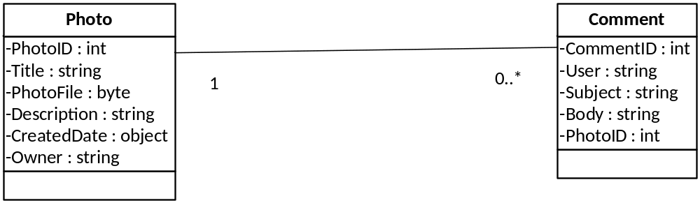
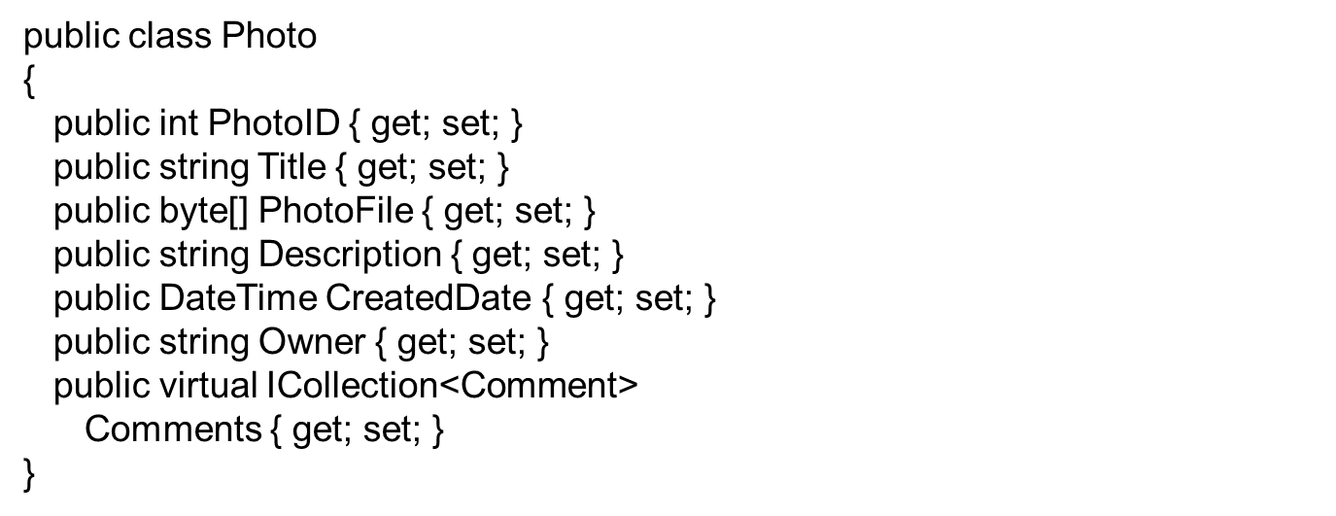
Developing Models
Notes:
The model classes usually specify three attributes for each property:
o The name of the property, for example, Title.
o The data type of the property, for example, String.
o The access levels of the property, for example, the get and set keywords to indicate read and write access.

Slide 26
Using an Entity Framework Context
Using the Entity Framework involves:
    Using the Context in Controllers
    Using Initializers to Populate Databases
Notes:
Using the Context in Controllers
After defining the Entity Framework context and model classes, you can use them in MVC controllers to pass data to views for display
Using Initializers to Populate Databases:
If you are using the code-first or model-first workflow, Entity Framework creates the database the first time you run the application and access data

Slide 27
Using LINQ to Entities
LINQ to Entities is the version of LINQ that works with Entity Framework.
Sample LINQ Query:
photos = (from p in context.Photos
orderby p.CreatedDate descending
select p).Take(number).ToList();
Notes:
LINQ to Entities provides Language-Integrated Query (LINQ) support that enables developers to write queries against the Entity Framework conceptual model using Visual Basic or Visual C#. Queries against the Entity Framework are represented by command tree queries, which execute against the object context. LINQ to Entities converts Language-Integrated Queries (LINQ) queries to command tree queries, executes the queries against the Entity Framework, and returns objects that can be used by both the Entity Framework and LINQ

Slide 28
Data Type Errors Handled by MVC Models
Data type errors refer to the problem caused by incompatibility between the data types
The MVC model created using the Entity Framework handles the data type errors automatically
Notes:
The HandleErrorAttribute attribute in ASP.NET MVC lets you specify how to handle an exception that is thrown by an action method. By default, when an action method with the HandleErrorAttribute attribute throws any exception, MVC displays the Error view that is located in the ~/Views/Shared folder.

Slide 29
What Are Model Binders?
The Default Controller Action Invoker uses model binders to determine how parameters are passed to actions
The Default Model Binder passes parameters by using the following logic:
  The binder examines the definition of the action that it must pass parameters to
  The binder searches for values in the request that can be passed as parameters
Notes:
model binder in MVC provides a simple way to map posted form values to a .NET Framework type and pass the type to an action method as a parameter. Binders also give you control over the deserialization of types that are passed to action methods. Model binders are like type converters, because they can convert HTTP requests into objects that are passed to an action method. However, they also have information about the current controller context

Slide 30
Summary
In this sub-module we have discussed
  Developing Models
  Using an Entity Framework Context
  Using LINQ to Entities
  Data Type Errors Handled by MVC Models
  What Are Model Binders?
Notes:
© 2009 Wipro Ltd – Internal & Restricted

Slide 31
3. Understanding Controllers

Slide 32
Objectives
At the end of this sub-module you should be able to learn
  What is a ASP.NET Controller
  How to create Controller
  How to add Action to the controller

Slide 33
Understanding Controllers
MVC controllers are responsible for responding to requests made against an ASP.NET MVC website. Each browser request is mapped to a particular controller.
The Controller is responsible for generating the response to the browser request.
For example, the controller might return a particular view back to the browser or the controller might redirect the user to another controller.
A controller is a class that derives from the base System.Web.Mvc.Controller class.
Notes:
© 2009 Wipro Ltd – Internal & Restricted

Slide 34
Understanding Controllers
Listing1 - Controllers\ProductController.cs
using System;
using System.Collections.Generic;
using System.Linq;
using System.Web;
using System.Web.Mvc;
using System.Web.Mvc.Ajax;
namespace MvcApplication1.Controllers
{
public class ProductController : Controller
{
public ActionResult Index()
{
// Add action logic here
return View();
} } }
Notes:
The Controller class is responsible for the following processing stages:
• Locating the appropriate action method to call, and validating that it can be called.
• Getting the values to use as the action method’s arguments.
• Handling all errors that might occur during the execution of the action method.
• Rendering the appropriate view.
© 2009 Wipro Ltd – Internal & Restricted

Slide 35
Understanding Controller Actions
A controller exposes controller actions. An action is a method on a controller that gets called when you enter a particular URL in your browser address bar.
In this case, the Index() method is called on the ProductController class. The Index() method is an example of a controller action.
A controller action cannot be a static method.
The method cannot be an extension method.
The method cannot be a constructor, getter, or setter.
The method cannot have open generic types.
The method is not a method of the controller base class.
The method cannot contain ref or out parameters.
Notes:
© 2009 Wipro Ltd – Internal & Restricted

Slide 36
Understanding IController and ControllerBase
Whenever we add a controller to our MVC project, Visual Studio, creates a class whose name is suffixed with "Controller".
Alternatively, we can also create a controller by inheriting from ControllerBase class or by implementing the IController interface.
  IController interface, sole purpose is to execute some code when a request is made to a controller
This is possible as, Controller class inherits ControllerBase class, which in turn implements the methods of IController interface
  The abstract ControllerBase class represents the base class for all MVC controllers. It implements the IController interface's, Execute() method which executes the specified request
Notes:
Studio, creates a class whose name is suffixed with "Controller".
This newly created class inherits from Controller class, which makes it to behave as a controller.
Alternatively, we can also create a controller by inheriting from ControllerBase class or by implementing the IController interface.
IController interface, sole purpose is to execute some code when a request is made to a controller
This is possible as, Controller class inherits ControllerBase class, which in turn implements the methods of IController interface
The abstract ControllerBase class represents the base class for all MVC controllers. It implements the IController interface's, Execute() method which executes the specified request
© 2009 Wipro Ltd – Internal & Restricted

Slide 37
Understanding Action Results
The ActionResult class encapsulates the result of an action method. The MVC framework supports 9 types of action results including:
ContentResult — This action result to return text to the web browser. You can return plain text, XML, a comma-separated table, or other text formats. This text can be rendered in the web browser or parsed with client-side code.
EmptyResult — Returns a null result.
FileResult — Returns a binary file.
JavaScriptResult — Returns JavaScript.
JsonResult — Returns a serialized Json object.
PartialViewResult — You can use this action to generate a section of an HTML page, but not a complete HTML page. Partial views can be reused in many views throughout a web application.
RedirectResult — Redirects to another action method by using its URL.
RedirectToRouteResult — Redirects the web browser to another action method or another route.to another action method.
ViewResult — Renders a view. This class contains properties that identify the view to render, the name of the view, the name of the master view, view data, temporary data, and a collection for view engines for the application.
Notes:
All of these action results inherit from the base ActionResult class.
© 2009 Wipro Ltd – Internal & Restricted

Slide 38
Passing Information to Views
To pass information to views that have model classes, you can use the:
  View() helper method: To pass information from a controller action to a view. To pass information to views that do not have model classes, you can use the:
  ViewBag property : To dynamically add objects of any type.
  ViewData Dictionary property: Used in MVC 3 to add extra data to views. Available in MVC 4 for backward compatibility.
Notes:
Using The ViewBag
The ViewBag is a dynamic object that is part of the base controller class. Because it is a dynamic object, you can add properties that are of any type to it, in the action method. In the view, you can use the ViewBag object to obtain the values added in the action. You can add properties to the ViewBag object in the action method as shown in the following lines of code.
ViewBag.Message = "This text is not in the model object";
ViewBag.ServerTime = DateTime.Now;
Using The ViewData Dictionary
The ViewBag object was added to MVC in version 3. In the earlier versions, you could pass extra data to
views by using the ViewData dictionary. This feature is still available in MVC 4 for backward compatibility
and for developers who prefer to use dictionary objects. In fact, ViewBag is a dynamic wrapper above the
ViewData dictionary. This means that, for example, you could save a value in a controller action using
ViewBag and read the same value back out using ViewData.

Slide 39
Summary
In this sub-module, you have learnt about:
What is a ASP.NET Controller
How to create Controller
How to add Action to the controller

Slide 40
4. Understanding ASP.NET MVC View

Slide 41
Objectives
At the end of this sub-module you should be able to learn
The advantages of using the ASP.NET MVC framework Views
How view associated with the Sample action method of the Home controller
How partial view is defined
Advantages of using strongly-typed views

Slide 42
Understanding Views
MVC views are responsible for rendering the UI for an ASP.NET MVC website.
Views should not contain any application logic or database retrieval code.
A view renders the appropriate UI by using the data that is passed to it from the controller.
The data is passed to a view from a Controller action method by using the View method.
The views associated with a particular controller are located in a subfolder of the Views folder that has the same name as the controller.
A view can be shared with more than one controller, example an error page.
Notes:
© 2009 Wipro Ltd – Internal & Restricted

Slide 43
ViewPage
A view page is an instance of the ViewPage class. It inherits from the Page class and implements the IViewDataContainer interface.
The ViewPage class defines a ViewData property that returns a ViewDataDictionary object. This property contains the data that the view displays.
<%@ Page Language="C#" MasterPageFile="~/Views/Shared/Site.Master" Inherits="System.Web.Mvc.ViewPage" %>
  ViewBag property : To dynamically add objects of any type.
Notes:
© 2009 Wipro Ltd – Internal & Restricted

Slide 44
ViewPage (Cont..)
The ViewPage class defines a TempData property that returns a TempDataDictionary object.
This property contains temporary data that persists only from one request to the next.
You can use a TempDataDictionary object to pass data in the same way that you use a ViewDataDictionary object.
The data in a TempDataDictionary object persists only from one request to the next, unless you mark one or more keys for retention by using the Keep method.
Notes:
© 2009 Wipro Ltd – Internal & Restricted

Slide 45
View engines
Different view engines are responsible for rendering views with different formats.
By default, ASP.NET MVC transports with two view engines—the RazorViewEngine and the WebFormViewEngine.
The Razor view engine is responsible for rendering views in the Razor format (either .cshtml files or .vbhtml files).
Web Form view engine is used to support the older-format Web Form views (.aspx and .ascx files).
Notes:
Why a new view engine in ASP.NET MVC 3?
Beginning with the ASP.NET 1.0 release, Web Forms allowed code and markup to live side by side in ASPX pages. However, common development practices highly discouraged placing control logic in the form of raw C# code into ASPX files. Instead, the developer strove to place all logic in the code-behind. Throughout the ASP.NET releases, advancements in ASPX files included better data-binding syntax and other items more geared towards development with controls. In various MVC frameworks, view development encourages and requires code written directly alongside markup. Because the ASPX view engine was not designed with this goal in mind, the ASP.NET team decided to build an entirely new view engine with a code-focused templating approach. The result was a more intelligent parsing engine that is able to very easily figure out where code stops and where markup begins, without the developer needing to be very explicit.
© 2009 Wipro Ltd – Internal & Restricted

Slide 46
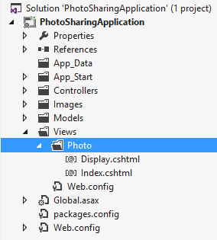
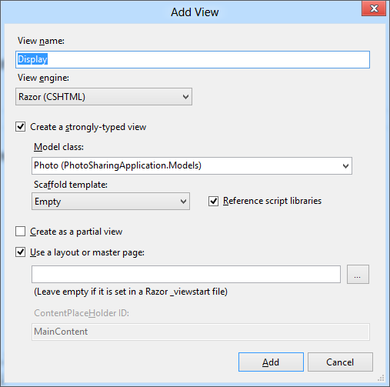
Adding Views
Notes:
you use the Razor view engine and the C# language, views are files with a .cshtml extension. If you use
the Razor view engine and the Visual Basic language, views are files with a .vbhtml extension.

Slide 47
What Are HTML Helpers?
HTML helpers are extension methods of the HtmlHelper class.
Extension methods for the HtmlHelper class are grouped in the System.Web.Mvc.Html namespace.
These extensions add helper methods for performing actions such as creating forms, rendering HTML controls, rendering partial views, and performing input validation.
HTML helpers are used to programmatically render HTML markup in a view. They return a string of type MvcHtmlHelper

Slide 48
HTML Helpers
<%: Html.TextBox("Text1") %>
Classes of HtmlHelper methods:
  MvcForm Extensions — Renders HTML forms.
  Input Extensions — Renders HTML input elements.
  Label Extensions — Renders HTML label element.
  Link Extensions — Renders HTML links.
  Select Extensions — Renders drop-down lists and lists boxes.
  TextArea Extensions — Renders an HTML TextArea.
  Validation Extensions — Renders validation controls.
Notes:
HTML helpers are simple methods that in most cases return a string. This string is a small section
of HTML that the view engine can insert into the view file to generate the completed webpage. You
can write views that render any type of HTML content without using a single helper if you prefer
not to use HTML helpers. However, HTML helpers make the task of managing HTML content easier
by rendering common HTML strings for often used scenarios.
© 2009 Wipro Ltd – Internal & Restricted

Slide 49
Creating Custom HTML Helpers
An HTML Helper is just a method that returns a string.
The string can represent any type of content that you want.
Listed below are few ASP.NET MVC framework set of standard HTML Helpers.
  Html.ActionLink()
  Html.BeginForm()
  Html.CheckBox()
  Html.DropDownList()
  Html.EndForm()
  Html.Hidden()
  Html.ListBox()
  Html.Password()
  Html.RadioButton()
  Html.TextArea()
  Html.TextBox()
Notes:
© 2009 Wipro Ltd – Internal & Restricted

Slide 50
Creating Partial Views
You can use partial views to render the same HTML content in different locations in your web application
Creating and Naming Partial Views:
  Create a partial view by using the Add View dialog
  Name partial views with an underscore prefix to keep to convention
Strongly-typed and dynamic partial views:
  Create strongly-typed partial views if you are certain that the partial view will always display the same model class.
  Create dynamic partial views if you are not sure if the partial view will always display the same model class.
Notes:
The contents of partial views, which do not render complete webpages, are contrasted with the contents of other views, which include <body> and <head> tags for a complete webpage. If you use template views, <body> and <head> tags appear in the template, and not in the view file. In such web applications the content of views and partial views can appear similar.
Creating and Naming Partial Views
In Visual Studio, you can create a partial view by using the Add View dialog, in the same manner as creating any other view. Ensure that you select the Create as a Partial View check box. Because partial views render a small section of HTML rather than a complete webpage, Visual Studio does not add <head>, <body>, and other tags to the partial view. By convention, partial views are named prefixed with an underscore character, for example, _CommentsList.cshtml. This convention is optional but is often helpful to distinguish partial views in Solution Explorer.

Slide 51
Using Partial Views
Using HTML helpers, you can use partial views within other views in a web application:
  To pass the same model object to a partial view from the parent view, use Html.Partial()
  To pass a model object to a partial view, which is different from the parent view or of a different model class, use Html.Action()
Use the ViewBag and ViewData collections to share data between the controller action, parent view, and partial view
Notes:
You can use the Html.Partial() helper to render a partial view within another view file. MVC inserts the HTML that the partial view renders into the parent view and returns the complete webpage to the browser. The first parameter is the name of the partial view file without its file extension. second optional parameter is a model object for the partial view to render. This is the same model object that the parent view uses because other model objects are not available in this context.

Slide 52
TESTING ASP.NET MVC APPLICATIONS
The ASP.NET MVC framework has been developed to be testable out of the box.
  The ASP.NET MVC Framework makes it easy and natural to unit test application functionality.
  It also enables a Test Driven Development (TDD) workflow that enables test-first based development.
Separating the Model, View, and Controller, makes it much easier to test your application
Notes:
MVC was designed to enable testability without requiring dependencies on a Web server (IIS), on a database, or on external classes Every ASP.NET MVC application should have a companion test project, so the project template for this process is super. When you create an ASP.NET MVC Web application, as soon as you click the OK button, another dialog pops up ,asking you whether you want to create a unit test project for the application
© 2009 Wipro Ltd – Internal & Restricted

Slide 53
Summary
In this sub-module, we have learnt
The advantages of using the ASP.NET MVC framework Views
How view associated with the Sample action method of the Home controller
How partial view is defined
Advantages of using strongly-typed views

Slide 54
Hands On
  Create a Books entry for books object using MVC4.0. The Web form should accept the details of the book like bookname , Type. Author, Publisher, Price and once the user clicks on submit button . Display the values entered in the next Page

Slide 55
References
References
  www.msdn/microsoft.com
Books
Professional ASP.NET MVC by Wrox publication
Step by step ASP.Net

Slide 56
Thank You

