Slide 1
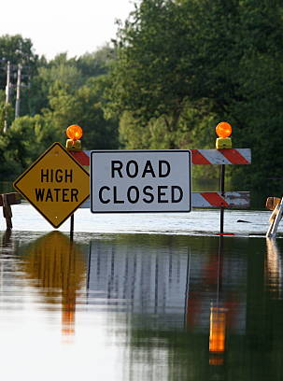
Predicting Delaware Communities with High-Risk of Flash Floods

Slide 2
Introduction & Motivation
Flash floods are sudden and rapid flooding events caused by heavy rainfall, dam failure, or rapid snowmelt. They lead to extensive damage to infrastructure and properties, as well as loss of life.
Predicting regions with high-risk of flash floods is crucial for mitigating the potential damage and loss of life. By identifying these regions, we can help emergency management agencies to take proactive measures to minimize the damage.
We develop a machine learning model to predict regions with high-risk of flash floods in Delaware based on the output of FEMA maps. We integrate the socio-demographic characteristics with predictions to identify vulnerable communities at high-risk.
Notes:
Irene

Slide 3
Methodology
Set I
ML Model
For each point, randomly generate 3 rainfall events
Interpolate features for coordinates in Set I
+
Estimate the targets
Features
Target
Land-use data (Shapefiles)
Train + Test
70% + 30%
FEMA Flood Maps
Set II
Precipitation data (NetCDF files)
Sociodemographic Data (Shapefiles)
Precipitation
Interpolate features for coordinates in Set II
Elevation data (Shapefiles)
Assess vulnerable communities
Predict Labels

Slide 4
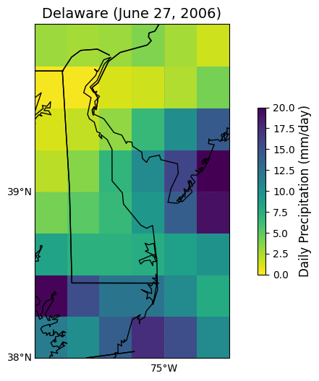
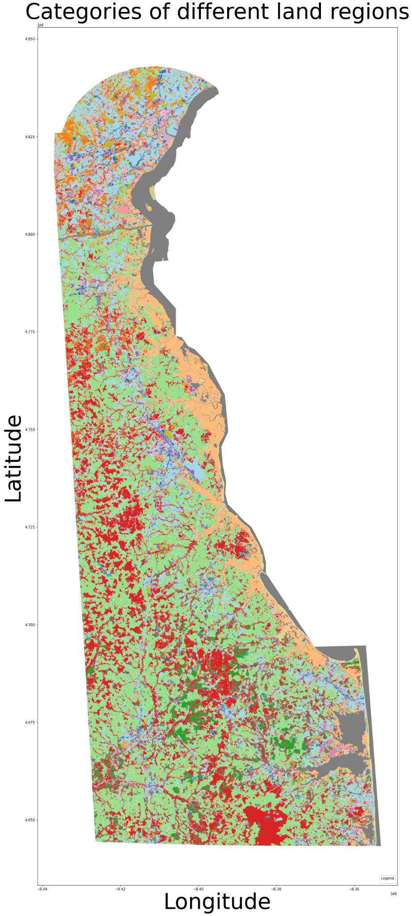
Data Description
We used the following datasets in our analysis:
Satellite Precipitation Data
Data collected from CMORPH (Climate Prediction Center's Morphing Technique) Climate Data Record.
This dataset provides high-resolution precipitation data on a global scale.
Data is measured in millimeters per day
Land-Use and Land-Cover Data
Provides information on the land-use and land-cover types in different regions of Delaware.

Slide 5
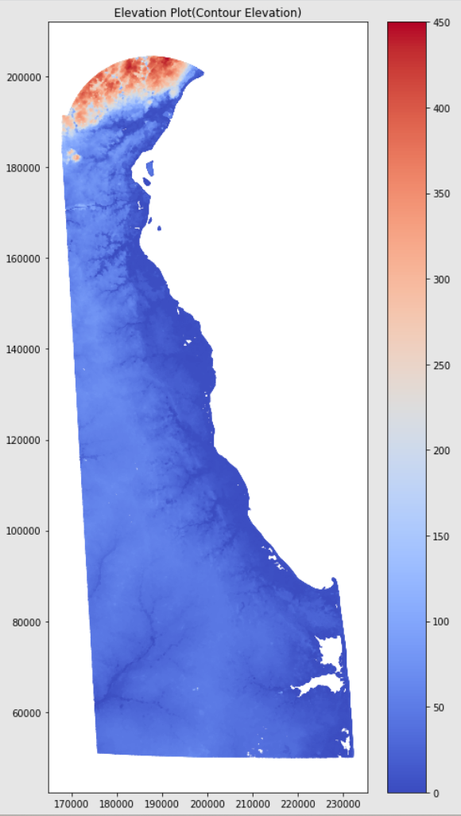
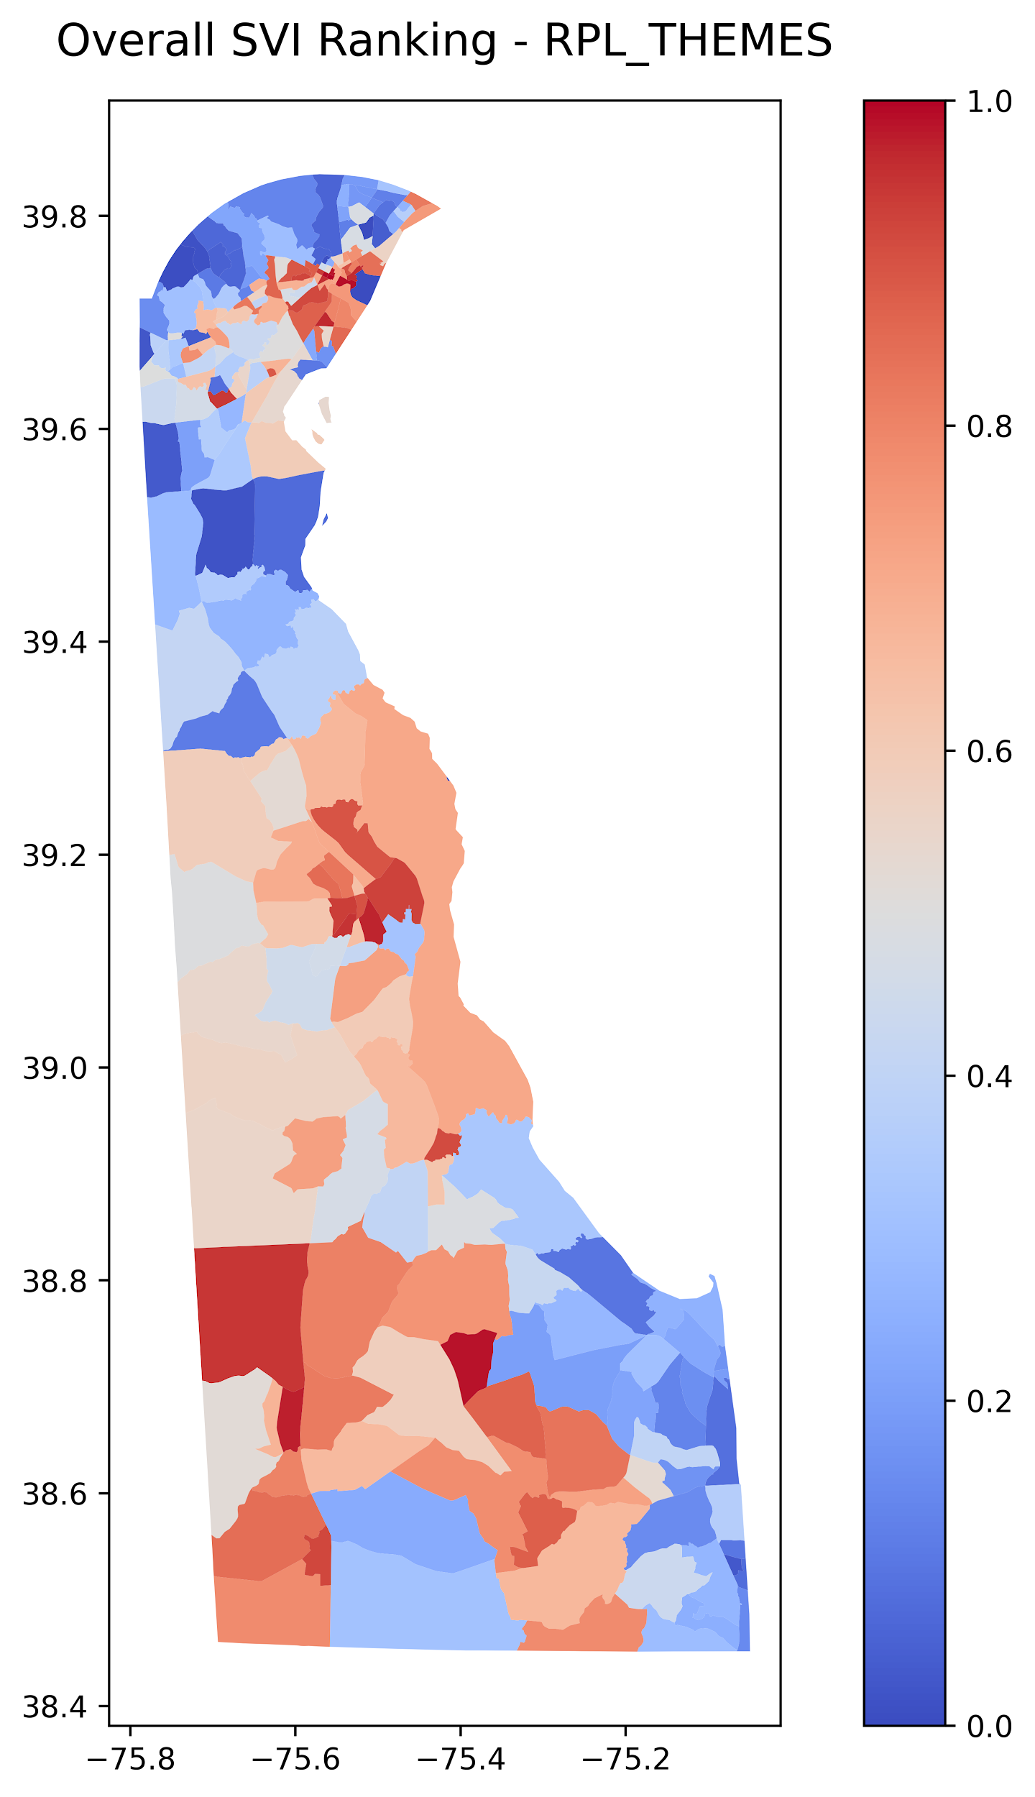
Data Description
Elevation Data
Areas with low elevation are more likely to experience flooding because water tends to accumulate in those regions.
Measurements are in meters above sea level.
Socio-Demographic Characteristics Data
Data is collected from CDC (Centers For Disease Control & Prevention) Website
Measures the Social Vulnerability Index (SVI) ratio of different census tracts.
SVI measures the level of vulnerability of a particular census tract to natural disasters.

Slide 6
What are Decision Trees?
A supervised machine learning algorithm that can be used for both classification and regression tasks.
It works by recursively partitioning the input space into smaller regions.
It splits the data based on a certain criterion, such as Entropy or Gini impurity.
Entropy: is used to measure the impurity or homogeneity of a set of data.
Gini impurity: measures the probability of misclassifying a randomly chosen data point.

Slide 7
What are Decision Trees?
We chose the decision tree model for these reasons:
Classification Analysis
Non-parametric: it does not make any assumptions about the underlying distribution of the data. This is important in our project because the relationship between the features and target variables are complex and nonlinear.
Flexibility: The decision tree model is flexible and can handle both categorical and continuous input variables.
Easily interpretable

Slide 8
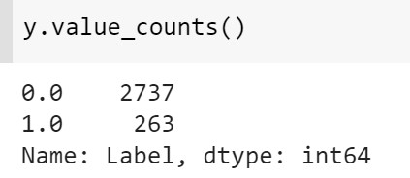
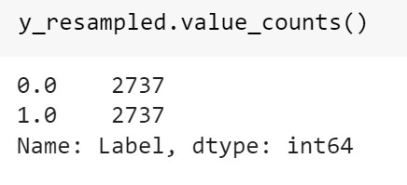
Balancing the Dataset
In the target we have 2737 of 0 class and 263 of 1 class.
After performing the sampling technique both classes have equal samples .

Slide 9
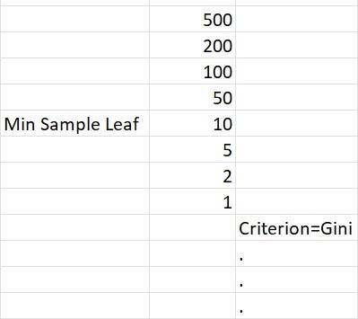
Hyperparameter Tuning using GridSearchCV
Performing the hyper parameter tuning and K fold cross validation with the help of GridSearchCV.
Hyper parameter we tuned was min sample leaf .We passed an array of random values as a dictionary.
We got best value for min sample leaf as 1.

Slide 10
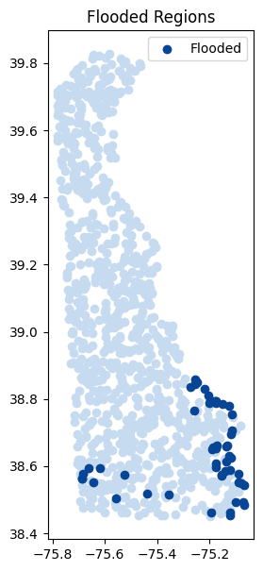
Assessing the impact on Communities
For a rainfall event these are flooded regions.
In this case most of the flooded regions are near the regions where the SVI is low.
We could do this for different rainfall events.

Slide 11
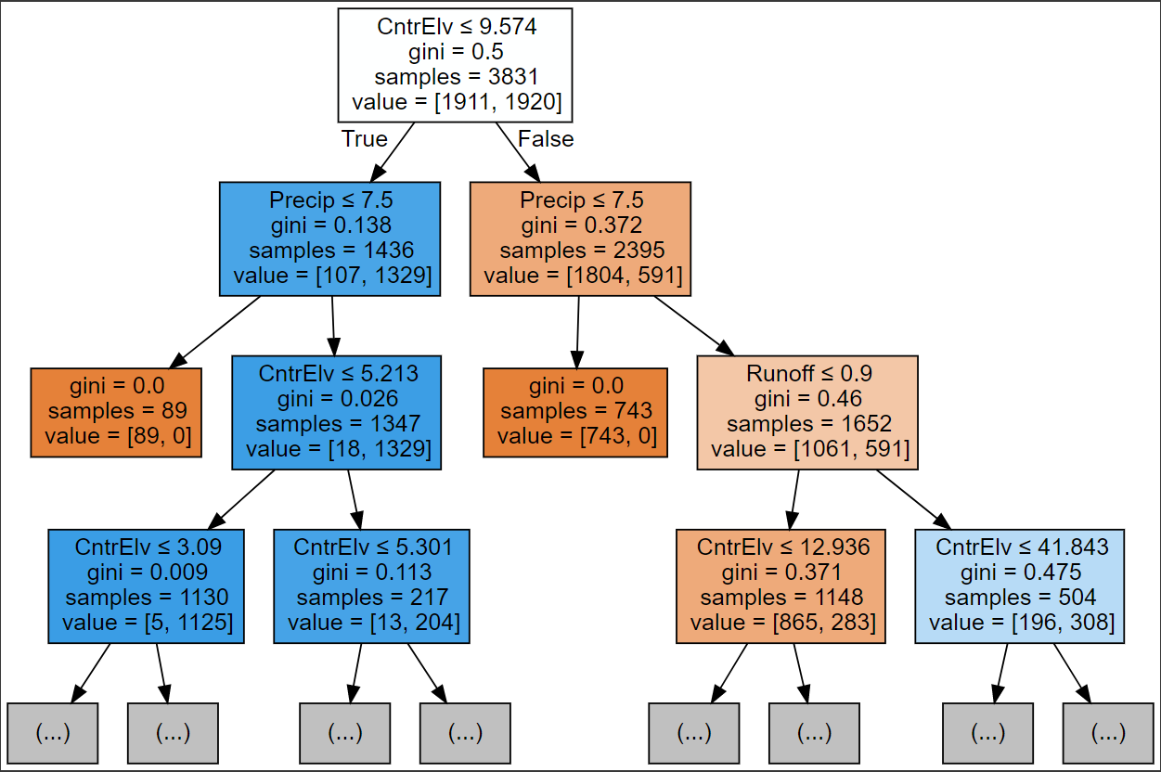
Decision Tree: Analysis Results

Slide 12
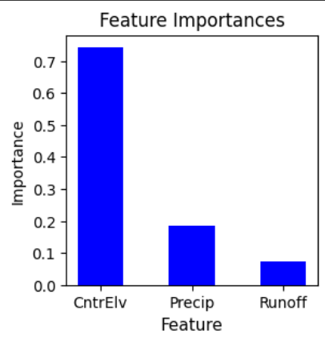
Feature Importance
Feature Importance refers to the process of determining which variables or features has the highest impact on the machine learning model.
Cntrelv has the highest importance (72%) indicates that it is a significant predictor and has large impact on the performance.
Precipitation has moderate impact on the performance with 18%.
Surface runoff has the least impact on the model’s performance with 10%
Node importance = (N_rootnode/N) [impurity_rootnode – ((N_right/N)*impurity_right) - ((N_left/N)*impurity_left)]
Feature Importance = Node Importance of that feature/Node Importance of all features

Slide 13
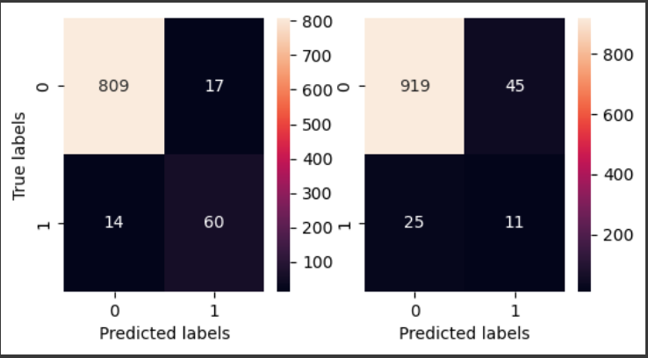
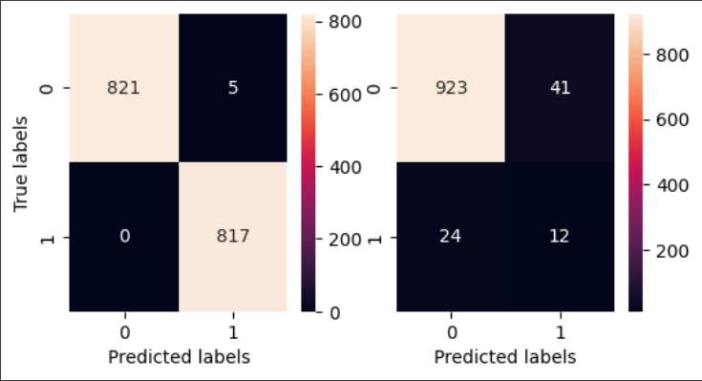
Confusion Matrix
Confusion matrix is a useful tool that helps to evaluate the performance of a classification model
Metrics: TP, TN, FP, FN
Other useful metrics:
TPR, TNR, FPR, FNR, Precision, Recall, F1 score

Slide 14
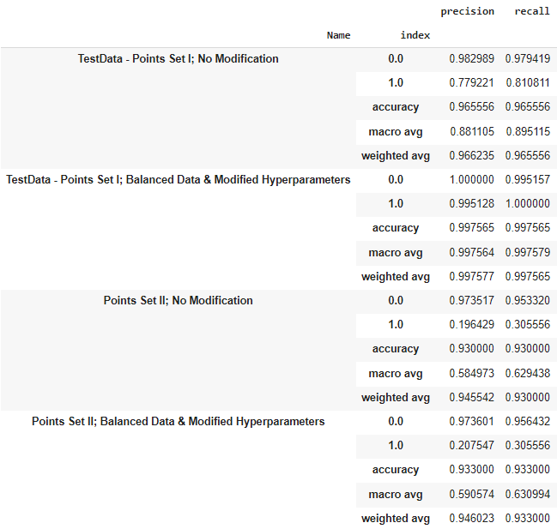
Discussion: Is the model good to use?
Case I (TestData - Points Set I; No modification): High accuracy of 0.97 as very less data points available
Case II (TestData - Points Set I; Balanced Data & Modified Hyperparameters):Increased number of samples with hyperparameter tuning
Case III (Points Set II; No modification): High accuracy but a large difference between label 0 and label 1
Case IV (Points Set II; Balanced Data & Modified Hyperparameters):The accuracy and precision increases slightly but is still very less for label 1.

Slide 15
Discussion: Is the model good to use?
Case I (TestData - Points Set I; No modification): High accuracy of 0.97 as very less data points available
Case I (TestData - Points Set I; No modification): High accuracy of 0.97 as very less data points available
Case II (TestData - Points Set I; Balanced Data & Modified Hyperparameters):Increased number of samples with hyperparameter tuning
Case II (TestData - Points Set I; Balanced Data & Modified Hyperparameters):Increased number of samples with hyperparameter tuning
Case III (Points Set II; No modification): High accuracy but a large difference between label 0 and label 1
Case III (Points Set II; No modification): High accuracy but a large difference between label 0 and label 1
Case IV (Points Set II; Balanced Data & Modified Hyperparameters):The accuracy and precision increases slightly but is still very less for label 1.
Case IV (Points Set II; Balanced Data & Modified Hyperparameters):The accuracy and precision increases slightly but is still very less for label 1.

Slide 16
Discussion: Is the model good to use?
Case I (TestData - Points Set I; No modification): High accuracy of 0.97 as very less data points available
Case II (TestData - Points Set I; Balanced Data & Modified Hyperparameters):Increased number of samples with hyperparameter tuning
Case III (Points Set II; No modification): High accuracy but a large difference between label 0 and label 1
Case IV (Points Set II; Balanced Data & Modified Hyperparameters):The accuracy and precision increases slightly but is still very less for label 1.

Slide 17
Discussion: Is the model good to use?
Case I (TestData - Points Set I; No modification): High accuracy of 0.97 as very less data points available
Case II (TestData - Points Set I; Balanced Data & Modified Hyperparameters):Increased number of samples with hyperparameter tuning
Case III (Points Set II; No modification): High accuracy but a large difference between label 0 and label 1
Case IV (Points Set II; Balanced Data & Modified Hyperparameters):The accuracy and precision increases slightly but is still very less for label 1.

Slide 18
Conclusion
The proposed model works very well if trained and tested for same set of geographic coordinates because the model learns the relationship between the complex features at these locations.
The future developments in the model need to focus on increasing the accuracy especially for prediction of label 1. At the same time, the model should have low False Negatives and False Positives. This can be done by introducing more features in the model and having more data points for training.
The results can help stakeholders identify flooded regions quickly.

